Slide 1

Action4Diabetes
Monthly Update July

Slide 2
Open Topics
Data agreement:
Set names of people Annex I to current team:
Sarah, Alexandra, Teresa, Sebastian, Dylan
A4D to send different excel formats (with cleaned data) to DC
Scoping document

Slide 3
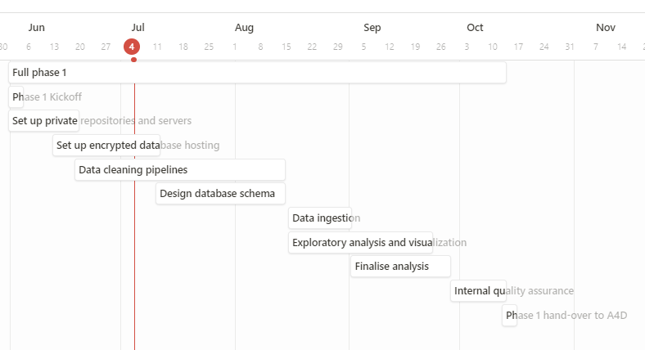
Project Overview
Done in June
Understanding worklfow logic
Start with data pipelines
Upcoming in July
Finalizing required infrastructure for development
Start database schema
Develop sanity checks in code
1. Set up private repositories and servers | 2. Set up encrypted database hosting | 3. Data cleaning pipelines | 4. Design database schema | 5. Data ingestion | 6. Exploratory analysis and visualisation | 7. Final analysis | 8. Internal quality assurance
80% | 80% | 10% | 0% | 0% | 0% | 0% | 0%

