Slide 1
Closing Session

Slide 2
What you have learned so far
What is Machine Learning: The science of programming computers so they can learn from data
Types of Machine Learning Problems: Supervised/ Unsupervised, Regression/Classification/Clustering
Ethics in Machine Learning: How to assess risk and take decisions
Introduction to Python

Slide 3
What you have learned so far (2)
Loss functions: Difference between predictions and target outputs
Overfitting, Underfitting
Data exploration

Slide 4
What you have learned so far (3)
Experiments with the models Logistic Regression, SVM and KNN
Ensemble methods: Bagging and Boosting

Slide 5
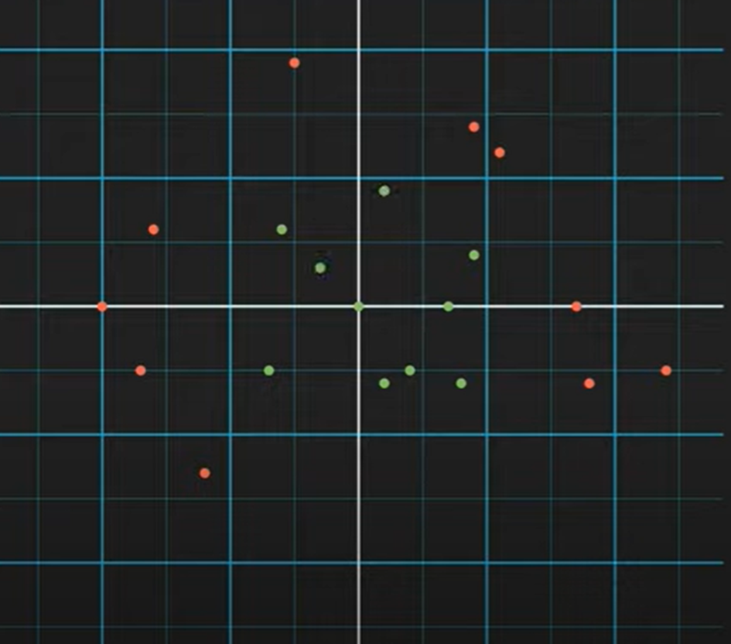
Decision Trees

Slide 6
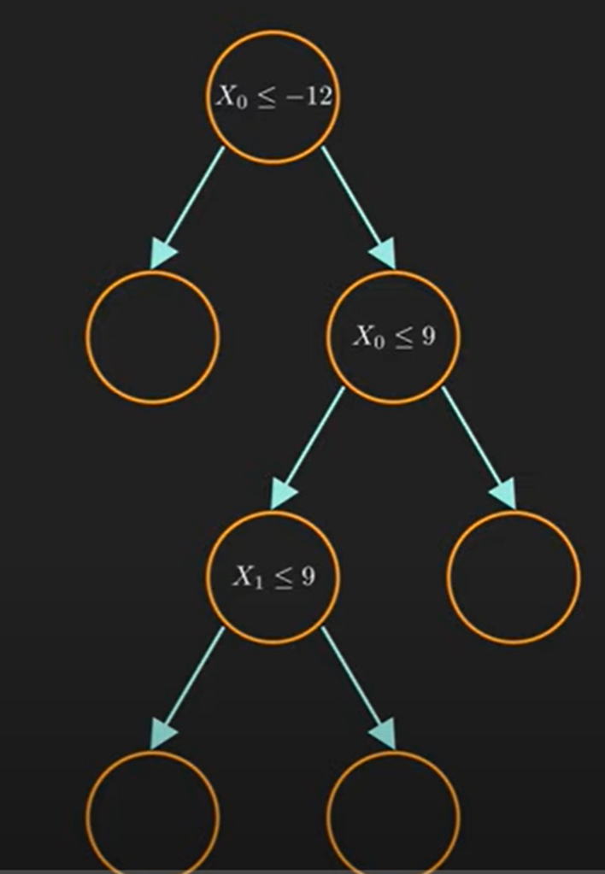
Decision Trees (2)
Example Tree

Slide 7
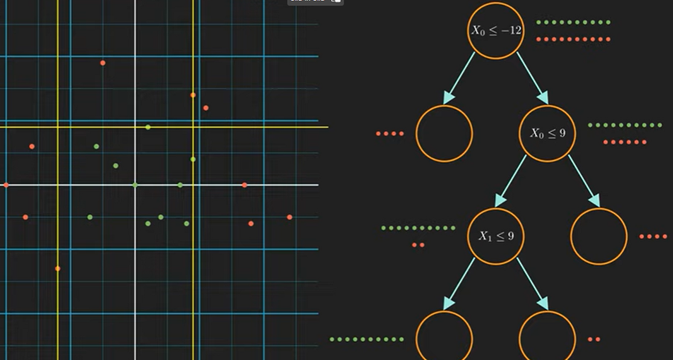
Decison Tree (3)

Slide 8
Decision Trees (4)
Which attribute to select?
The one which will result in the smallest tree
Heuristic: choose the attribute that produces the “purest” nodes

Slide 9
Random Forests
Random Forests is an ensemble method which uses bagging to combine several Decision Trees

Slide 10
What to do next - Topics
optimization techniques
further/other models:
neural networks (NN)
auto encoders
dimension reduction
learn more about the mathematical background of the models and statistics
get more hands-on experience with free datasets
more Python

Slide 11
What to do next - Resources
Literature:
K. P. Murphy, Machine Learning: A Probabilistic Perspective
C. M. Bishop, Pattern Recognition and Machine Learning
S. Shalev-Shwartz, S. Ben-David, Understanding Machine Learning
Online materials:
kaggle competitions
free data sets
Online courses
https://www.kaggle.com/learn
https://www.w3schools.com/python/default.asp
https://www.earthdatascience.org/

Slide 12
Thank you!

