Slide 1


Bitcoin price forecasting
Big Data Computing Project
A.Y. 2022 - 2023
Faculty of Ingegneria dell'informazione, informatica e statistica
Department of Informatica
Danilo Corsi
Matr. 1742375

Slide 2

Outline
Introduction
What is bitcoin?
Goal of the project

Slide 3

Outline
Introduction
What is bitcoin?
Goal of the project
Dataset and features
Data collection
Features engineering

Slide 4
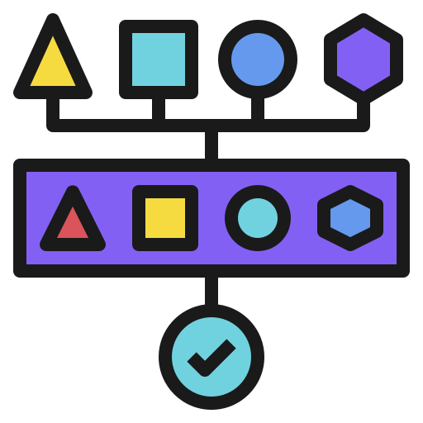
Outline
Introduction
What is bitcoin?
Goal of the project
Dataset and features
Data collection
Features engineering
Project pipeline
Data crawling / feature extraction
Models train / validation
Final scores

Slide 5

Outline
Introduction
What is bitcoin?
Goal of the project
Dataset and features
Data collection
Features engineering
Project pipeline
Data crawling / feature extraction
Models train / validation
Final scores
Conclusions

Slide 6


Introduction
What is Bitcoin?
Decentralized cryptocurrency
No central bank behind it
Relies on a network of nodes
Transactions
Strong cryptography (validity and security)
Made by anyone with a Bitcoin address
Public ledger constantly updated

Slide 7
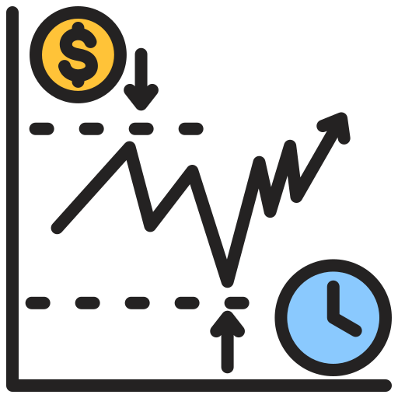
Introduction
What is Bitcoin?
Decentralized cryptocurrency
No central bank behind it
Relies on a network of nodes
Transactions
Strong cryptography (validity and security)
Made by anyone with a Bitcoin address
Public ledger constantly updated
Value determined by the market and the number of people using it
Price fluctuation can be extremely unpredictable
Prediction of Bitcoin prices can be a competitive advantage

Slide 8

Goal
Analyze machine learning techniques
Understand how accurately the price of Bitcoin can be predicted
Can provide added value to cryptocurrency investors and traders?

Slide 9

Dataset
Collecting Bitcoin data:
Blockchain.org (for blockchain data)
Binance and Kraken exchanges (for price information)
Retrieving the most relevant information from the last four years to current days

Slide 10
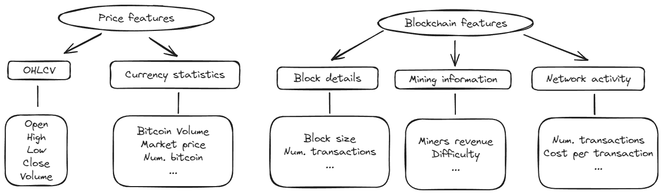
Dataset and features
Collecting Bitcoin data:
Blockchain.org (for blockchain data)
Binance and Kraken exchanges (for price information)
Retrieving the most relevant information from the last four years to current days
Categories

Slide 11




Project pipeline
Structure:
Data crawling / Feature engineering: retrieve and process data
Models’ train / validation: different models and splitting methods
Final scores: collect results and draw conclusions
Project carried out with Apache Spark (but during feature engineering I converted the Spark dataframe to a Pandas one to make some plots)

Slide 12
1 - Data crawling / Feature engineering: features
Additional features
Next market price: next-day Bitcoin price (will be the target variable)
Simple moving avg: average price over a specified number of days

Slide 13
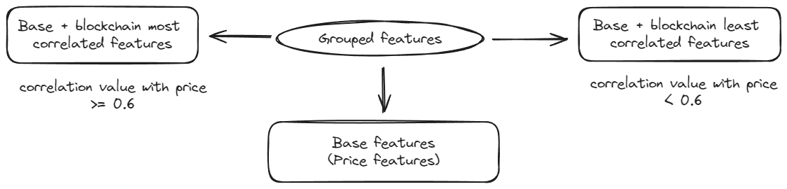
1 - Data crawling / Feature engineering: features
Additional features
Next market price: next-day Bitcoin price (will be the target variable)
Simple moving avg: average price over a specified number of days
Division of features into groups

Slide 14
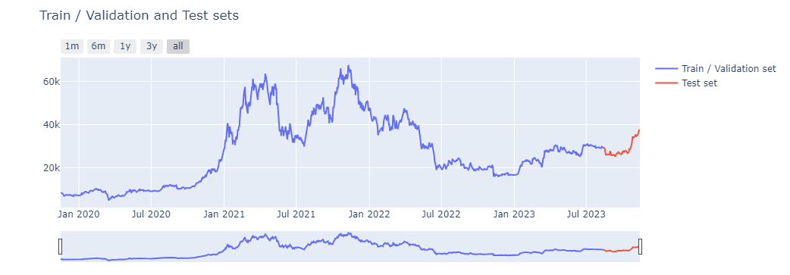
1 - Data crawling / Feature engineering: splitting
Two sets:
Train / Validation set: used to train and validate models
Test set: used to perform price prediction on never-before-seen data (last 3 months of the original dataset will be used)

Slide 15
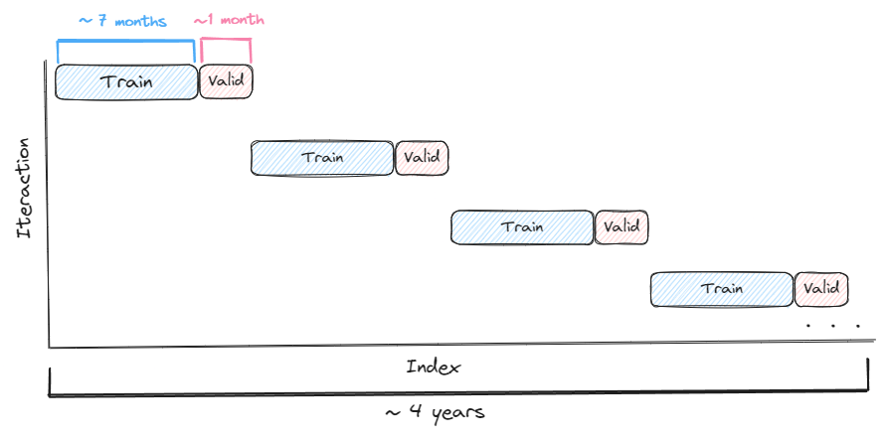
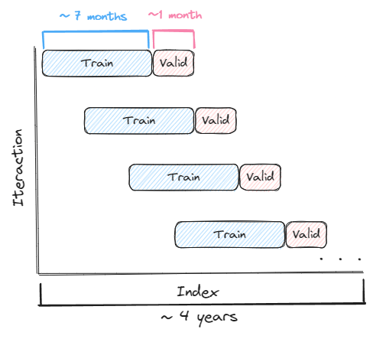
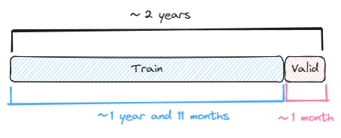
2 - Models train / validation: splitting methods
Block Splits
Walk Forward Splits
Single split
Notes:
▪ Block time series splits: involves dividing the time series into blocks of equal length, and then using each block as a separate fold for cross-validation.
▪ Walk forward time series splits: involves using a sliding window approach to create the training and validation sets for each fold. The model is trained on a fixed window of historical data, and then validated on the next observation in the time series. This process is repeated for each subsequent observation, with the window sliding forward one step at a time.
▪ Single time series split involves dividing the time series considering as validation set a narrow period of time and as train set everything that happened before this period, in such a way as to best benefit from the trend in the short term.

Slide 16


2 - Models train / validation: models and metrics
ML models:
Linear Regression
Generalized Linear Regression
Random Forest Regressor
Gradient Boosting Tree Regressor
Metrics:
RMSE (Root Mean Squared Error)
MSE (Mean Squared Error)
MAE (Mean Absolute Error)
MAPE (Mean Absolute Percentage Error)
R2 (R-squared)
Adjusted R2

Slide 17
2 - Models train / validation: accuracy
“How good the models are at predicting whether the price will go up or down?”

Slide 18
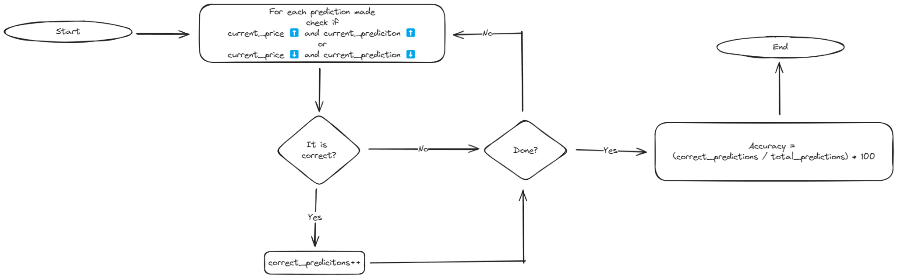
2 - Models train / validation: accuracy
“How good the models are at predicting whether the price will go up or down?”
Procedure

Slide 19
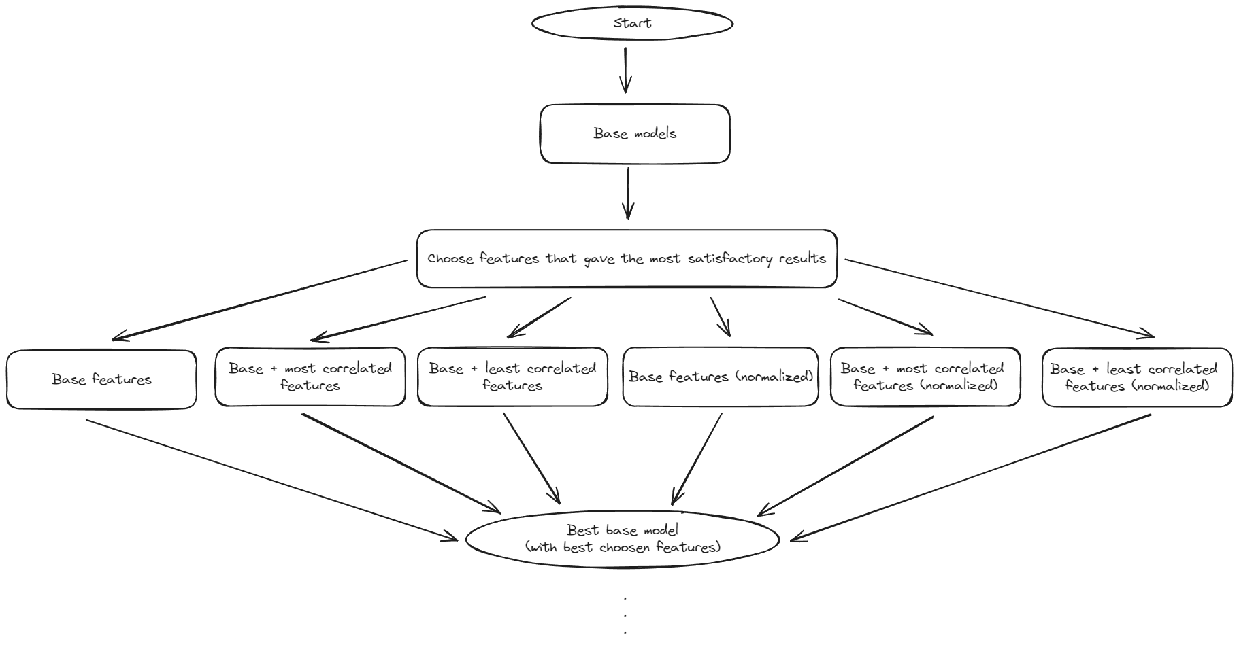

2 - Models train / validation: pipeline

Slide 20
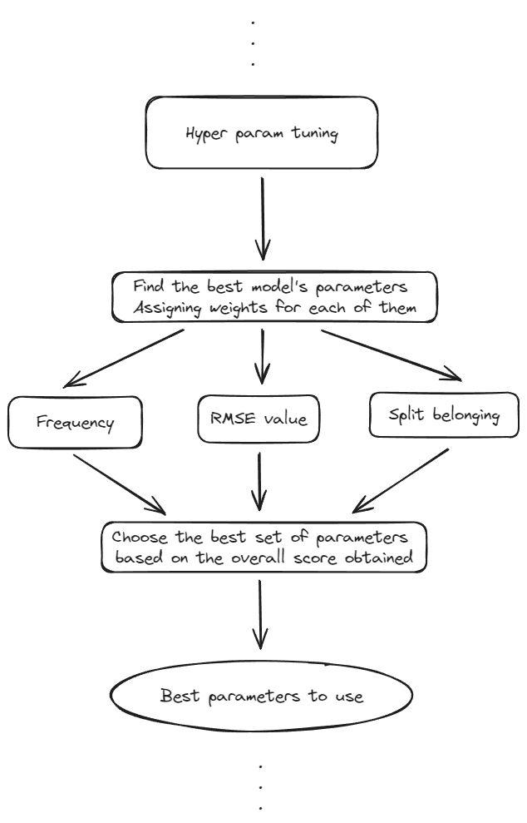



2 - Models train / validation: pipeline

Slide 21
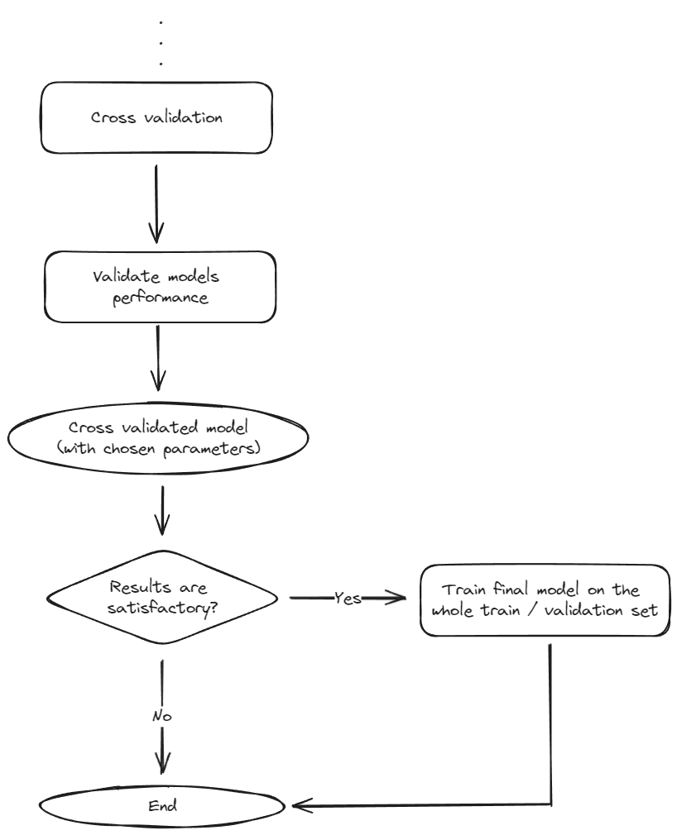

2 - Models train / validation: pipeline

Slide 22
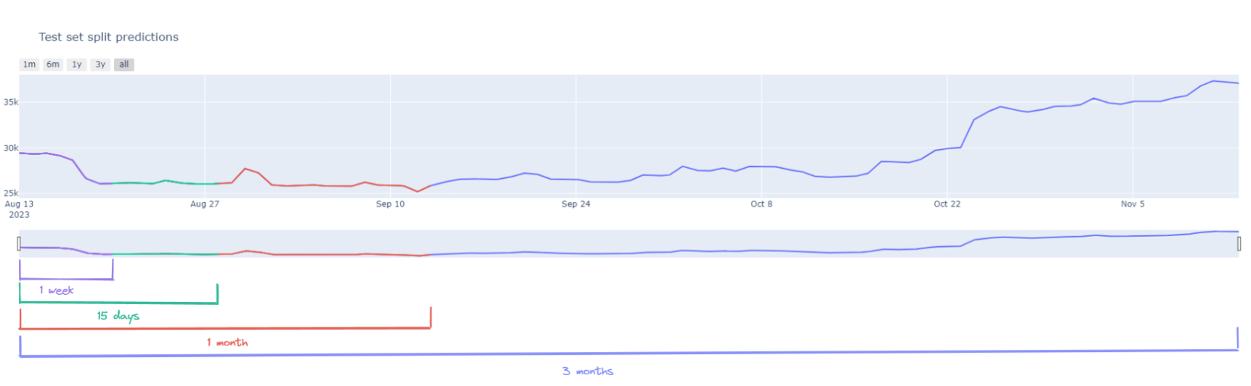
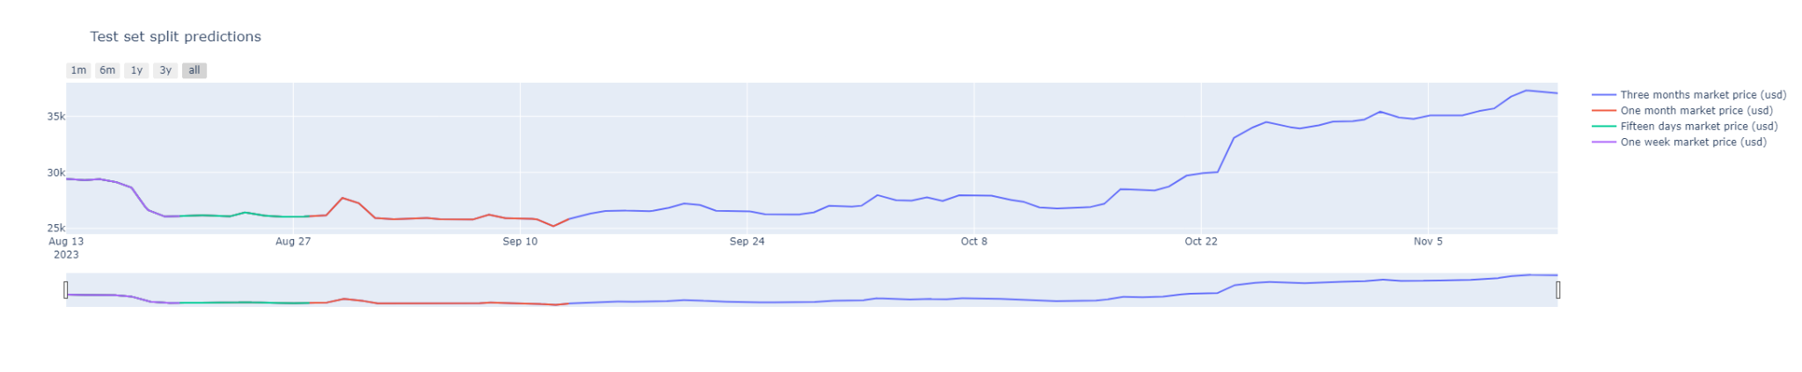
3 - Final scores
Comparison between final results
Prediction on the test set (splitted)
See how models' performance degrades as time increases

Slide 23
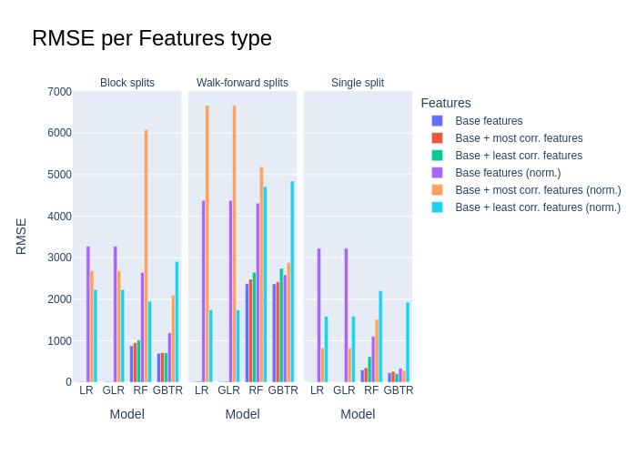
3 - Final scores: train / validation phase
Comparison between final results
Prediction on the test set (splitted)
See how models' performance degrades as time increases

Slide 24
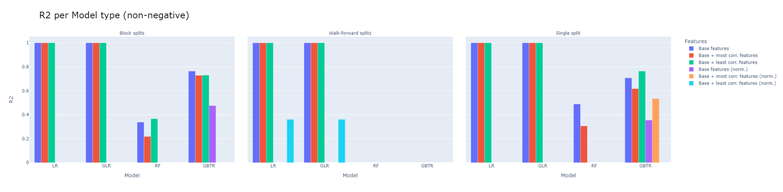
3 - Final scores: train / validation phase

Slide 25
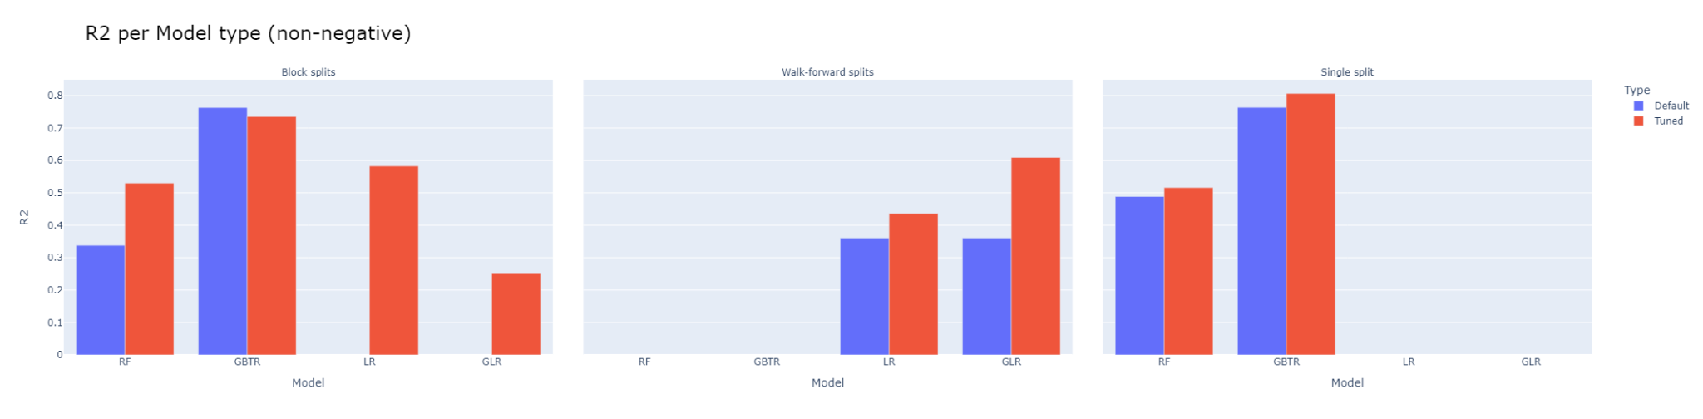
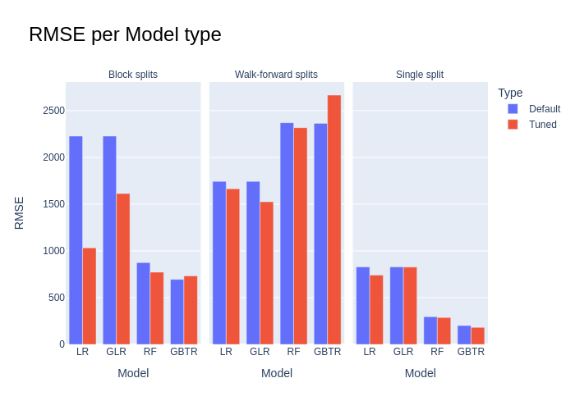
3 - Final scores: train / validation phase

Slide 26
3 - Final scores: train / validation phase

Slide 27
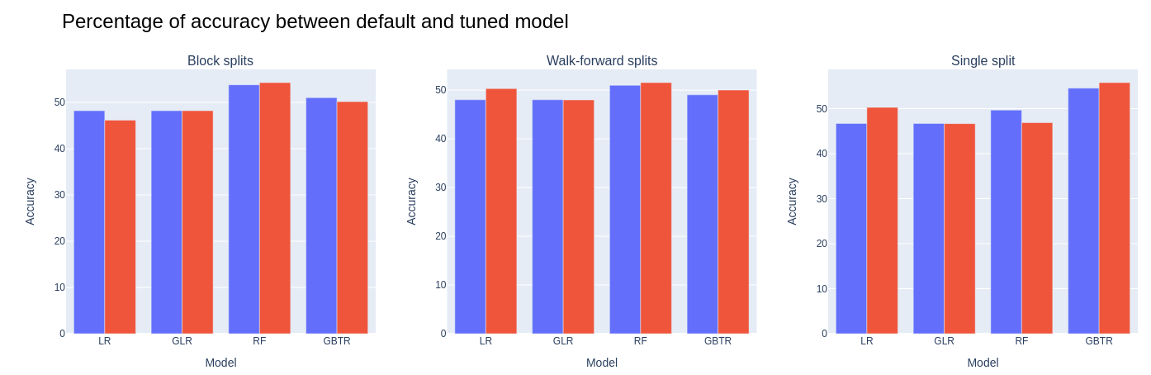
3 - Final scores: train / validation phase

Slide 28
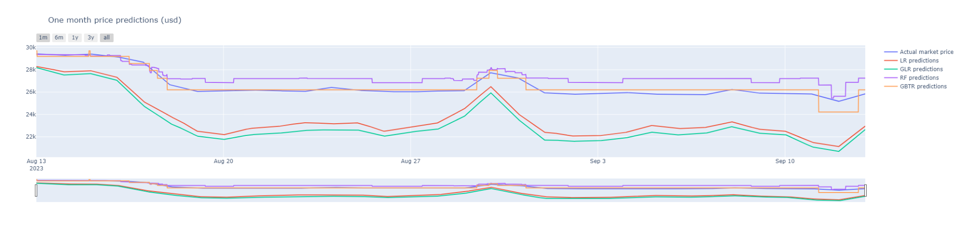
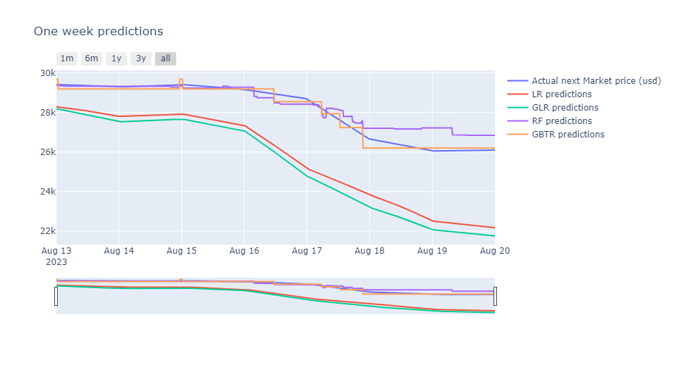
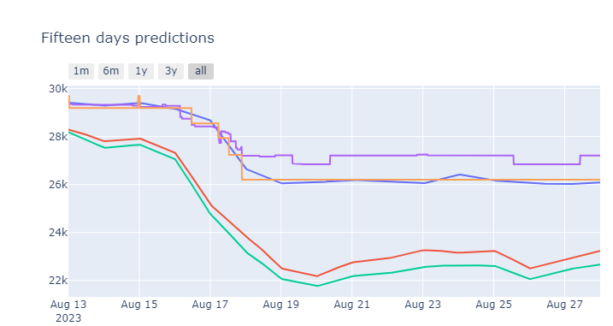
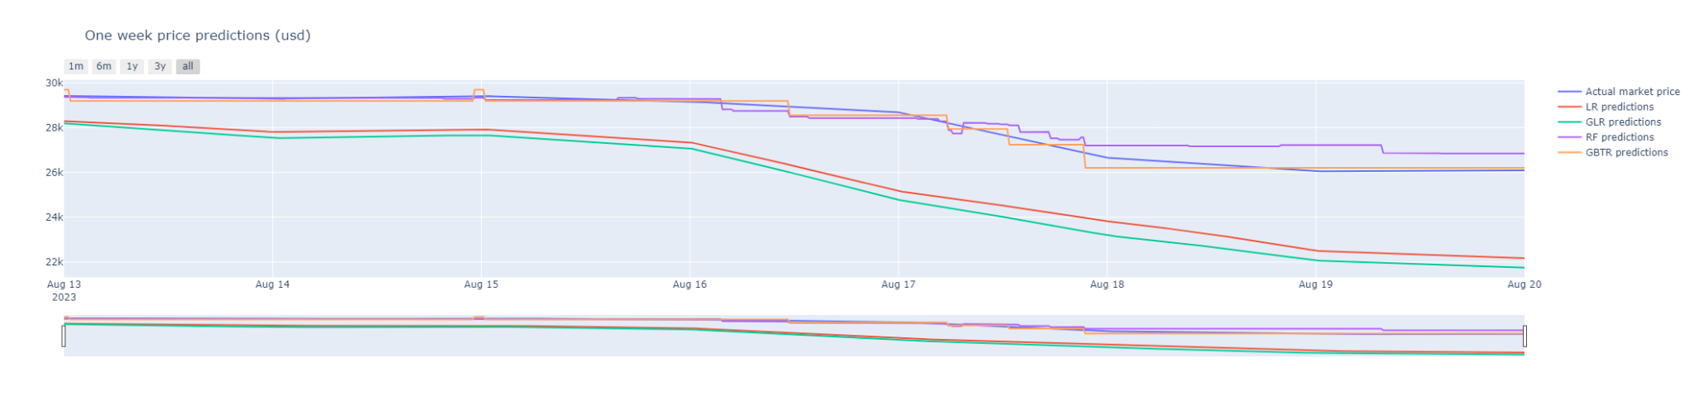
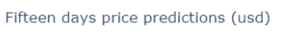

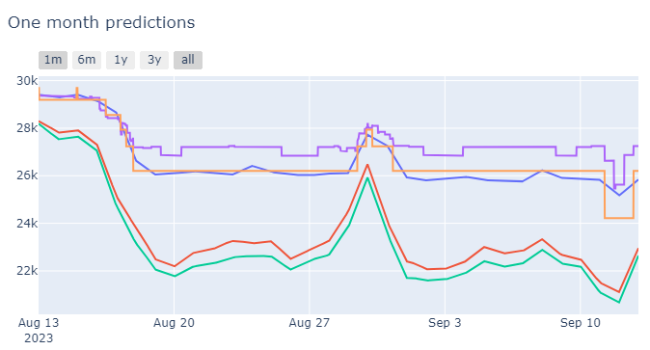
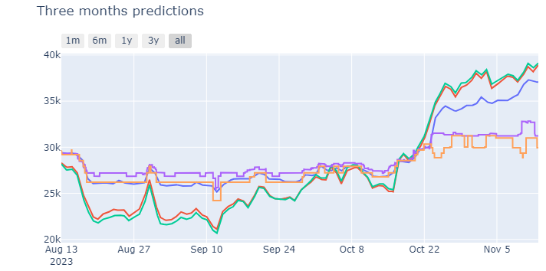
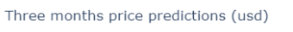
3 - Final scores: testing phase

Slide 29
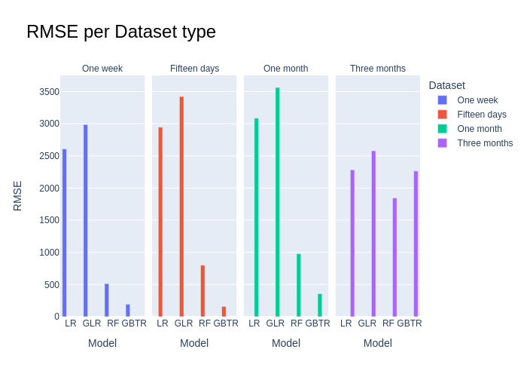
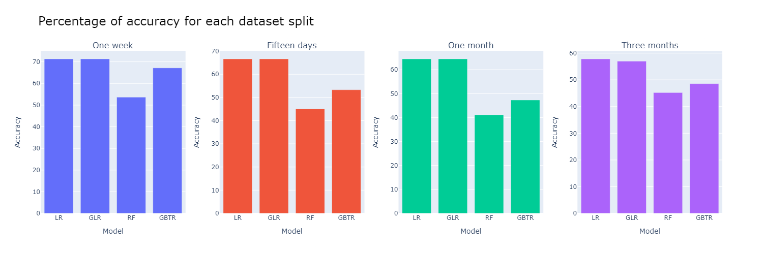
3 - Final scores: testing phase

Slide 30
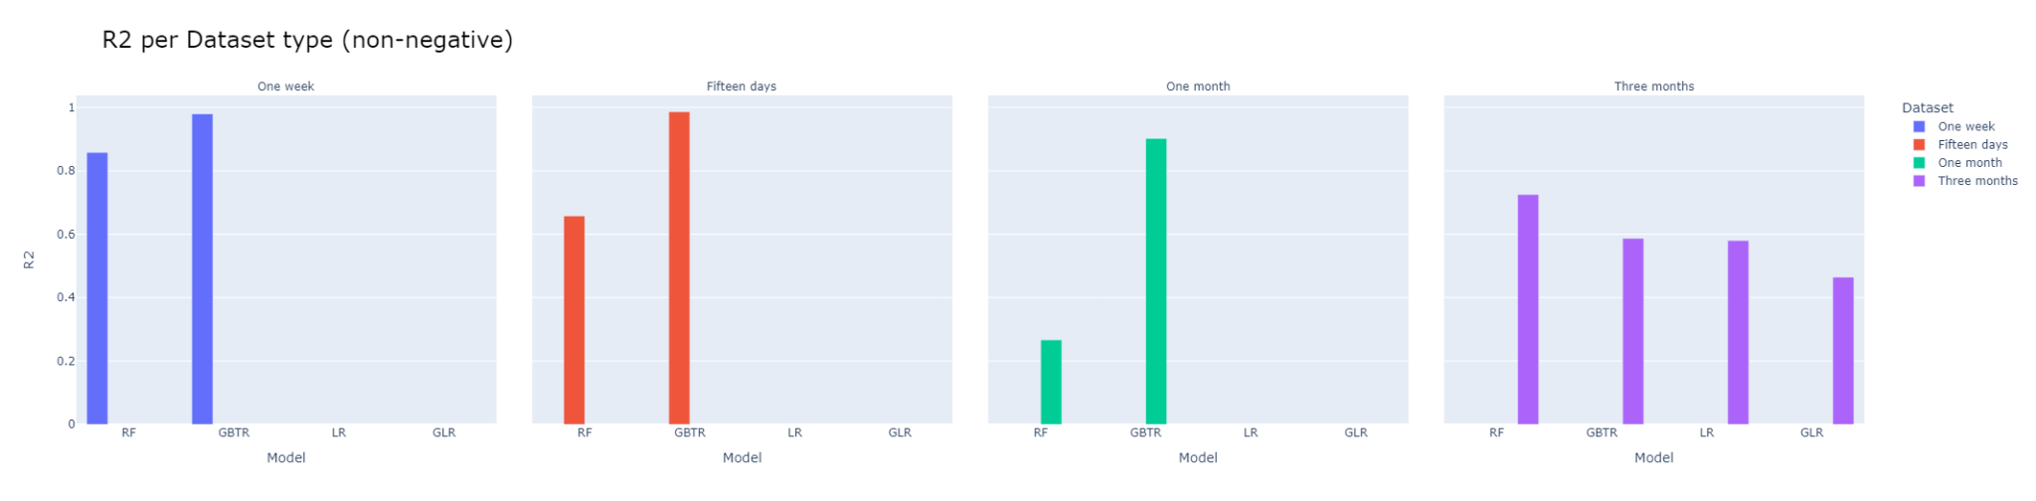
3 - Final scores: testing phase

Slide 31
3 - Final scores: testing phase

Slide 32
3 - Final scores: testing phase
Legend
Actual market price
GBTR
RF
LR
GLR

Slide 33
Conclusions
Splitting method
Better those that consider a shorter period (e.g. Single Split).
Features
Depend on the type of model
In general: blockchain-related features brought slight improvements
Models
Better in the short-medium term (especially tree-based models)
performance begins to degrade (as time period increase)
Answer to the initial question
Yes (at least as far as the trend is concerned)
If we consider a narrow forecast period
Future developments
Create a sliding window on features (additional historical data can be used)
Using deep learning approaches such as CNNs (e.g. LSTM, ARIMA...)
Implementing Transformer models that exploit self-attention

Slide 34


Thanks for the attention!
Danilo Corsi
https://github.com/CorsiDanilo

