Slide 1
Bitcoin price forecasting
Big Data Project
A.Y. 2022 - 2023
Faculty of Ingegneria dell'informazione, informatica e statistica
Department of Informatica
Danilo Corsi
Matr. 1742375

Slide 2

Introduction
Decentralized cryptocurrency, created in 2009 by an anonymous inventor (Satoshi Nakamoto)
It does not have a central bank behind it
Relies on a network of nodes that manage it in a distributed, peer-to-peer mode
Use of strong cryptography to validate and secure transactions
Can be made through the Internet to anyone with a "bitcoin address"
Its blockchain (public ledger of transactions) is constantly updated and validated by nodes in the network
Bitcoin value is determined by the market and the number of people using it
Has attracted the attention of many people in recent years
It's price fluctuation can be extremely unpredictable (difficulty on choosing the right time to buy or sell)
Prediction of Bitcoin prices can be a competitive advantage
Allowing people to know the right time to enter or exit the market

Slide 3
Goal
“Is it possible to make predictions about the price of Bitcoin using machine learning methods in combination with the price information and technical characteristics of its blockchain?”

Slide 4
Dataset
Collecting Bitcoin data using:
Blockchain.org (blockchain data)
Binance and Kraken (price information)
Retrieving the most relevant information from the last four years to the present day
Period for which there were moments of high volatility but also a lot of price lateralization)
Procedure has been made as automatic as possible
The same periods are considered each time

Slide 5
Features
Divided into several categories:
OHLCV: stands for “Open, High, Low, Close and Volume” and it's a list of the five types of data that are most common in financial analysis regarding price
Currency statistics: describes its price trend (e.g. market price, number of bitcoins in circulation...)
Block details: describes the technical characteristics of its blockchain (e.g. block size, number of transactions...)
Mining information: describes the characteristics of the consensus mode “Pow” (e.g. miners revenue, difficulty...)
Network activity: describes the actual use of Bitcoin as a method of exchange of value (e.g. number of transactions made, cost per transaction...)

Slide 6

Project pipeline
Project structure:
Data crawling / Feature engineering: Bitcoin data retrieval via APIs call and manipulation, visualization and feature extraction
Models’ train / validation: performed with hyperparameter tuning and cross validation based on different methods of splitting the dataset
Final scores: testing the final models and compare the results
Project carried out with Apache Spark (but during feature engineering I converted the Spark dataframe to a Pandas one to make some plots)

Slide 7
1 - Data crawling / Feature engineering
Obtaining the features regarding the technical data of the blockchain and the price of Bitcoin
By contacting the APIs of Blockchain.org and the two exchanges
Adding other features:
next-market-price: represents the price of Bitcoin for the next day (this will be the target variable on which to make predictions)
sma-x-days: indicators that calculate the average price over a specified number of days (5, 7, 10, 20, 50 and 100 days in our case)
Overall features divided into two distinct groups:
Base features: contains all the Currency Statistics features
Base and additional features: contains the Base features plus the additional features divided based on their correlation with the price:
If >= 0.6, then then they will be considered most correlated
If < 0.6, then then they will be considered least correlated

Slide 8
1 - Data crawling / Feature engineering
Strategy for the upcoming models train / validation phase:
Train / validate models with base features
See if by adding the additional most and least correlated features to them the performance improves
Dataset splitted into two sets:
Train / Validation set: will be used to train the models and validate the performances
Test set: will be used to perform price prediction on never-before-seen data (the last 3 months of the original dataset will be used)

Slide 9
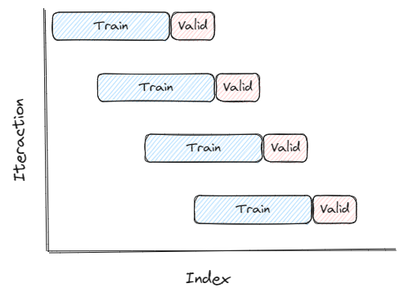
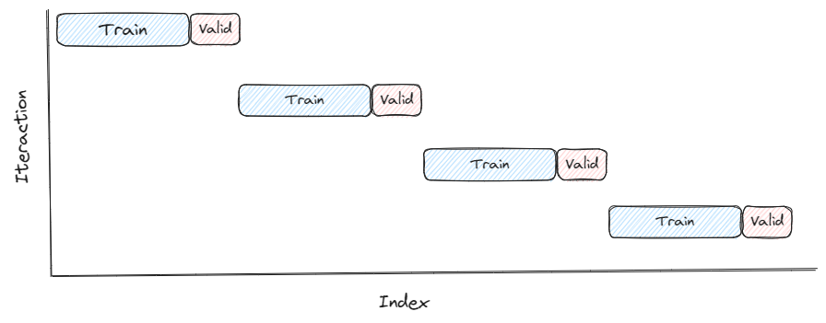

2 - Models train / validation
Dataset splitted according to different splitting method:
Notes:
▪ Block time series splits: involves dividing the time series into blocks of equal length, and then using each block as a separate fold for cross-validation.
▪ Walk forward time series splits: involves using a sliding window approach to create the training and validation sets for each fold. The model is trained on a fixed window of historical data, and then validated on the next observation in the time series. This process is repeated for each subsequent observation, with the window sliding forward one step at a time.
▪ Single time series split involves dividing the time series considering as validation set a narrow period of time and as train set everything that happened before this period, in such a way as to best benefit from the trend in the short term.

Slide 10
2 - Models train / validation
ML models:
Linear Regression
Generalized Linear Regression
Random Forest Regressor
Gradient Boosting Tree Regressor
Metrics:
RMSE (Root Mean Squared Error)
MSE (Mean Squared Error)
MAE (Mean Absolute Error)
MAPE (Mean Absolute Percentage Error)
R2 (R-squared)
Adjusted R2

Slide 11
2 - Models train / validation
ML models:
Linear Regression
Generalized Linear Regression
Random Forest Regressor
Gradient Boosting Tree Regressor
Metrics:
RMSE (Root Mean Squared Error)
MSE (Mean Squared Error)
MAE (Mean Absolute Error)
MAPE (Mean Absolute Percentage Error)
R2 (R-squared)
Adjusted R2

Slide 12
2 - Models train / validation
See how good the models are at predicting whether the price will go up or down in this way:
Consider the actual market-price, next-market-price and our predicted next-market-price
I compute whether the current prediction is correct (1) or not (0)
Count the number of correct prediction
Compute the percentage of accuracy of the model

Slide 13
2 - Models train / validation
Train / validation pipeline:
Default without normalization: make predictions using the base model
Default with normalization: like the previous one but features are normalized
Features that gave on average the most satisfactory results (for each model) are chosen and proceed with:
Hyperparameter tuning: finding the best model’s parameters to use
Block split / Walk forward split method will be used
Compute a score for each parameter chosen by each split, assigning weights based on:
Frequency
Split belonging
RMSE value
The best set of parameters is chosen based on the overall score obtained by putting weights together

Slide 14
2 - Models train / validation
Cross Validation: validate the performance of the model with the chosen parameters (using Block split / Walk forward split)
If the final results are satisfactory, the model will be trained on the whole train / validation set and saved in order to make predictions on the test set

Slide 15
3 - Final scores
Test set divided into further mini-sets:
1 week
15 days
1 month
3 months
See how models' performance degrades as time increases.
Final results are collected and compared to draw conclusions (see next)

Slide 16
3 - Final scores: train / validation phase
Features

Slide 17
3 - Final scores: train / validation phase
Splitting methods and models

Slide 18
3 - Final scores: testing phase
Dataset splitting

Slide 19
Conclusions
Concerning features
❓
Concerning splitting methods and models
❓
Concerning the dataset splitting
❓
Regarding the initial question
❓
Future developments
Create a sliding window on features so that additional historical data is used
Using deep learning approaches such as CNNs (LSTM, ARIMA...)
Implementing transformer models that exploit self-attention

Slide 20
Thanks for the attention

