Slide 1
Bitcoin price forecasting
Big Data Computing Project
A.Y. 2022 - 2023
Faculty of Ingegneria dell'informazione, informatica e statistica
Department of Informatica
Danilo Corsi
Matr. 1742375

Slide 2

Introduction
What is Bitcoin?
Decentralized cryptocurrency
It does not have a central bank behind it
Relies on a network of nodes
Use of strong cryptography to validate and secure transactions
Made by anyone with a "bitcoin address"
Has a public ledger constantly updated
Value determined by the market and the number of people using it
Price fluctuation can be extremely unpredictable
Prediction of Bitcoin prices can be a competitive advantage

Slide 3
Goal
“Analyze machine learning techniques to understand, through the processing of historical data, how accurately the price of Bitcoin can be predicted and whether this can provide added value to cryptocurrency investors and traders”

Slide 4
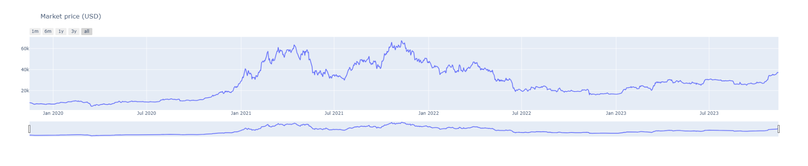
Dataset
Collecting Bitcoin data using:
Blockchain.org (for blockchain data)
Binance and Kraken exchanges (for price information)
Retrieving the most relevant information from the last four years to current days

Slide 5
Features
Divided into several categories:
OHLCV: aka. “Open, High, Low, Close and Volume”
Currency statistics: e.g. market price, number of bitcoins in circulation...
Block details: e.g. block size, number of transactions...
Mining information: e.g. miners revenue, difficulty...
Network activity: e.g. number of transactions made, cost per transaction...

Slide 6

Project pipeline
Project structure:
Data crawling / Feature engineering: data retrieval and feature extraction
Models’ train / validation: with hyperparameter tuning and cross validation (with different methods of splitting)
Final scores: comparing the results
Project carried out with Apache Spark (but during feature engineering I converted the Spark dataframe to a Pandas one to make some plots)

Slide 7
1 - Data crawling / Feature engineering
Obtaining technical and price data about Bitcoin
Adding other features:
next-market-price: next-day Bitcoin price (will be the target variable)
sma-x-days: average price (usually 5, 7, 10, 20, 50 and 100 days)
Overall features divided into two distinct groups:
Base features: currency statistics features
Base and additional features: base features + additional features
Select according to their correlation with the price:
If >= 0.6 -> most correlated
If < 0.6 -> least correlated

Slide 8
1 - Data crawling / Feature engineering
Strategy for models train / validation phase:
Train / validate models with base features
Adding additional most and least correlated features to them (see if performance improves)
Dataset splitted into two sets:
Train / Validation set: used to train and validate models
Test set: used to perform price prediction on never-before-seen data (last 3 months of the original dataset will be used)

Slide 9
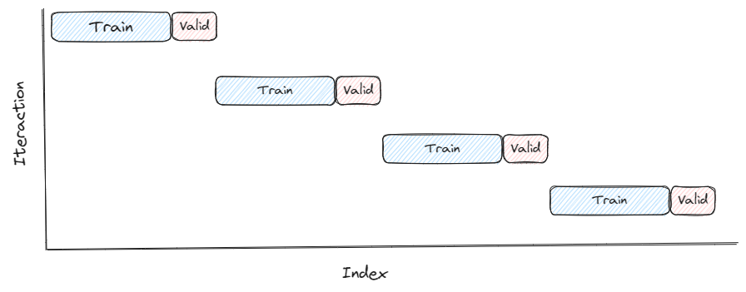
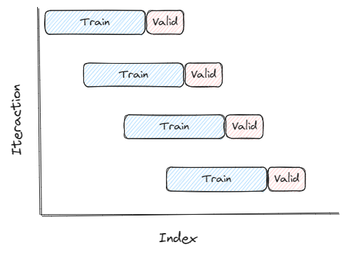

2 - Models train / validation
Dataset splitted according to different splitting method:
Block Splits
Walk Forward Splits
Single split
Notes:
▪ Block time series splits: involves dividing the time series into blocks of equal length, and then using each block as a separate fold for cross-validation.
▪ Walk forward time series splits: involves using a sliding window approach to create the training and validation sets for each fold. The model is trained on a fixed window of historical data, and then validated on the next observation in the time series. This process is repeated for each subsequent observation, with the window sliding forward one step at a time.
▪ Single time series split involves dividing the time series considering as validation set a narrow period of time and as train set everything that happened before this period, in such a way as to best benefit from the trend in the short term.

Slide 10
2 - Models train / validation
ML models used:
Linear Regression
Generalized Linear Regression
Random Forest Regressor
Gradient Boosting Tree Regressor
Metrics used:
RMSE (Root Mean Squared Error)
MSE (Mean Squared Error)
MAE (Mean Absolute Error)
MAPE (Mean Absolute Percentage Error)
R2 (R-squared)
Adjusted R2

Slide 11
2 - Models train / validation
Another metric, accuracy:
“How good the models are at predicting whether the price will go up or down”
Consider the actual market-price, next-market-price and our predicted next-market-price
Compute whether the current prediction is correct (1) or not (0)
Count the number of correct prediction
Compute the overall percentage of accuracy of the model

Slide 12
2 - Models train / validation
Default without normalization: make predictions using the base model
Default with normalization: like the previous one but features are normalized
Features that gave on average the most satisfactory results (for each model) are chosen
Hyperparameter tuning: finding the best model’s parameters to use
Block split / Walk forward split method will be used
Compute a score for each parameter chosen by each split
Assigning weights based on:
Frequency
Split belonging
RMSE value
The best set of parameters is chosen based on the overall score obtained by putting weights together

Slide 13
2 - Models train / validation
Cross Validation: validate the performance of the model with the chosen parameters (using Block split / Walk forward split)
If the final results are satisfactory, the model will be trained on the whole train / validation set and saved in order to make predictions on the test set

Slide 14
3 - Final scores
Test set divided into further mini-sets:
1 week
15 days
1 month
3 months
See how models' performance degrades as time increases
Final results are collected and compared to draw conclusions

Slide 15
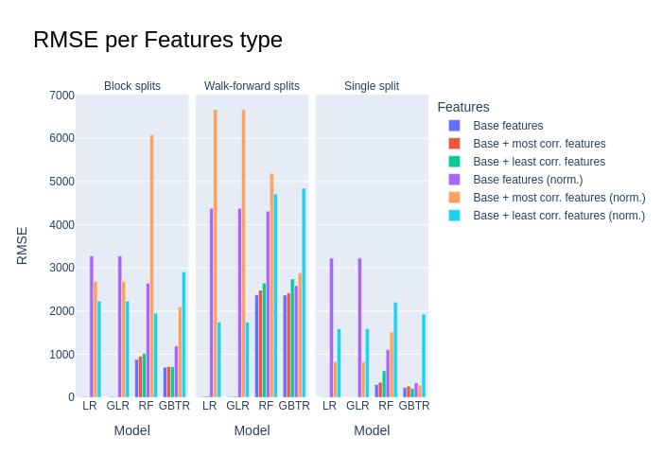
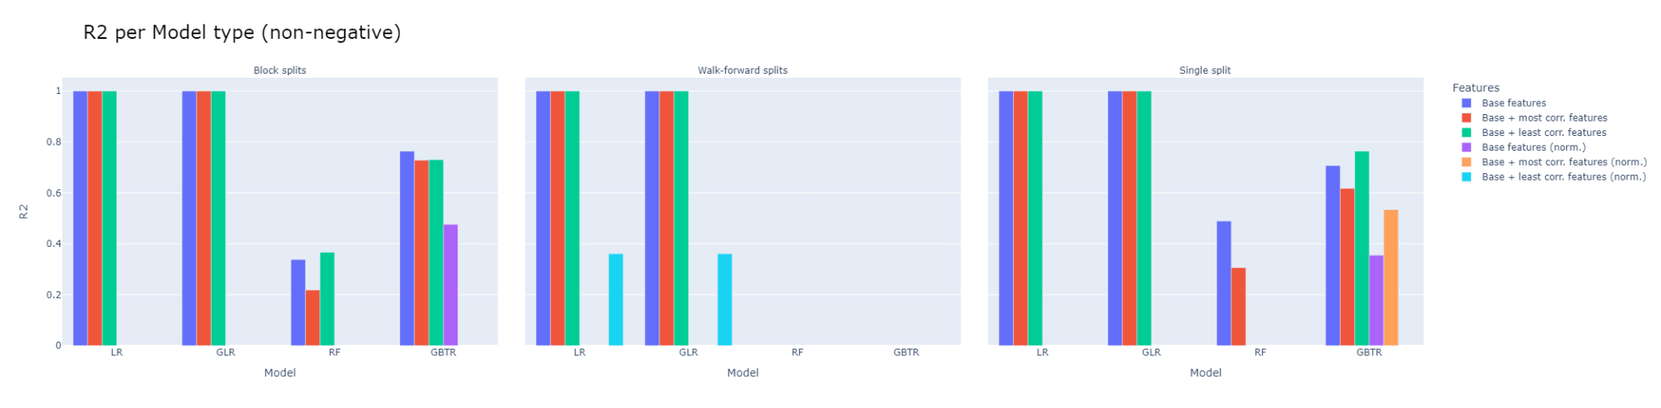
3 - Final scores: train / validation phase

Slide 16
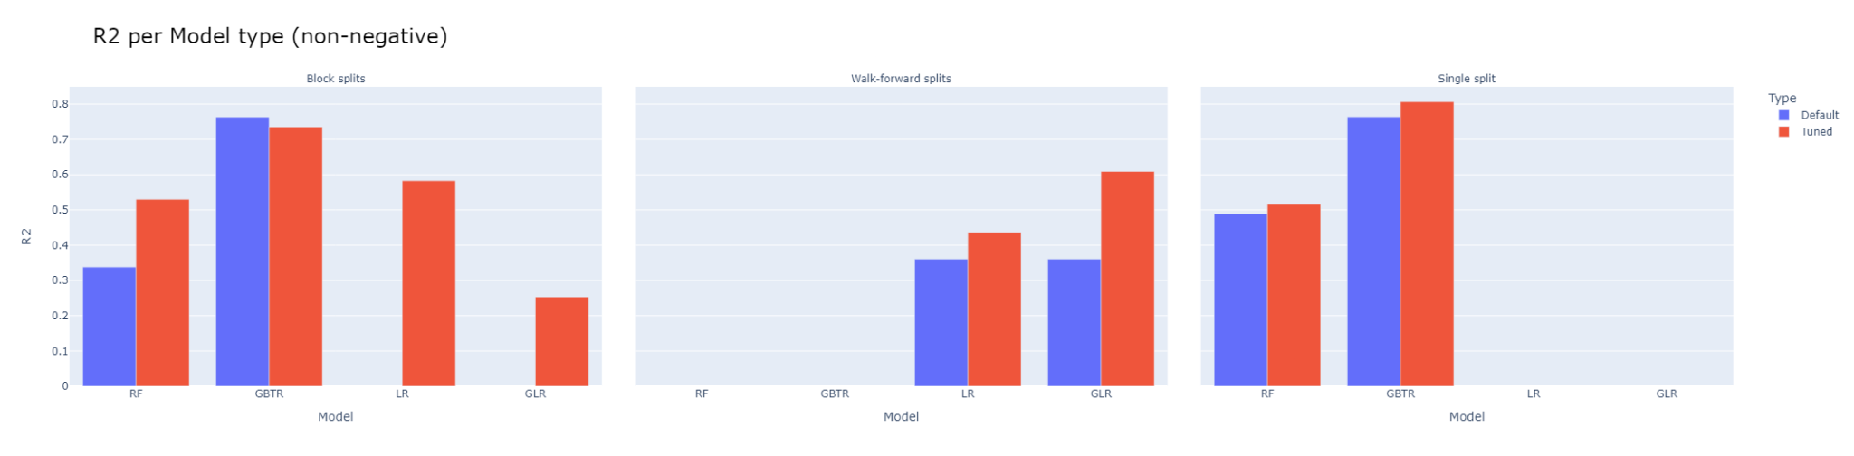
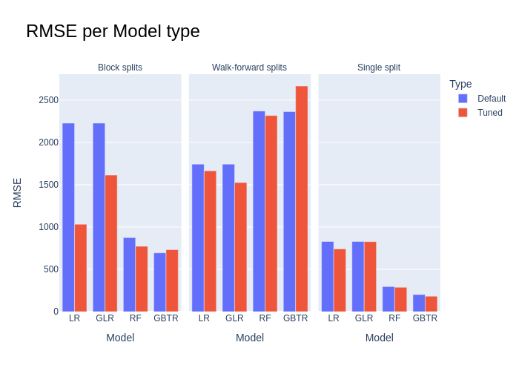
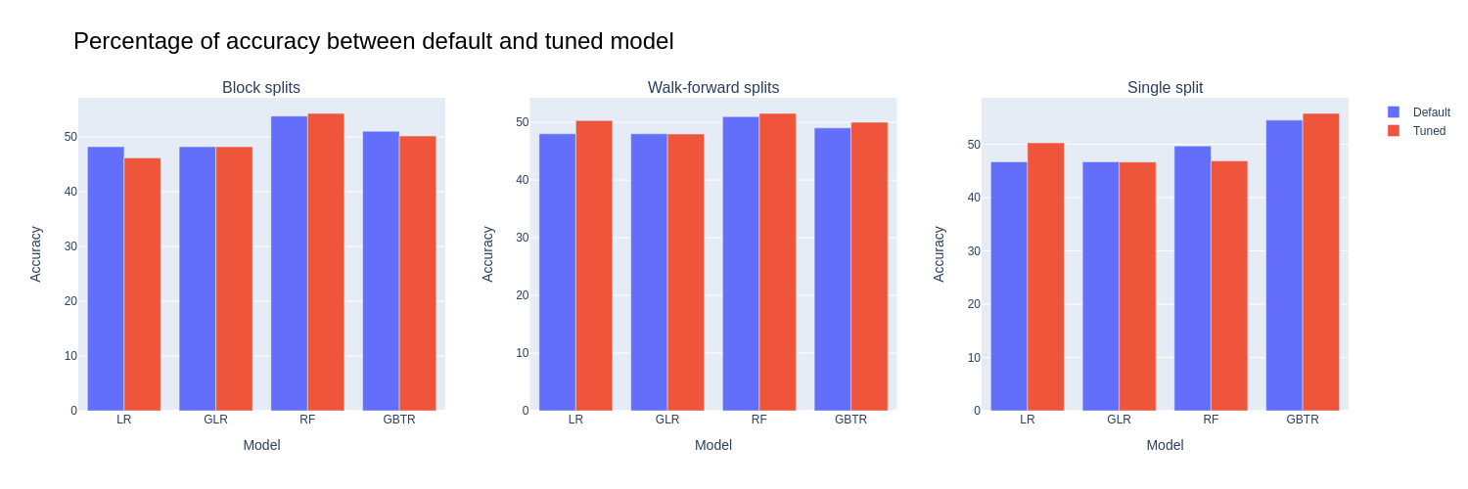
3 - Final scores: train / validation phase

Slide 17
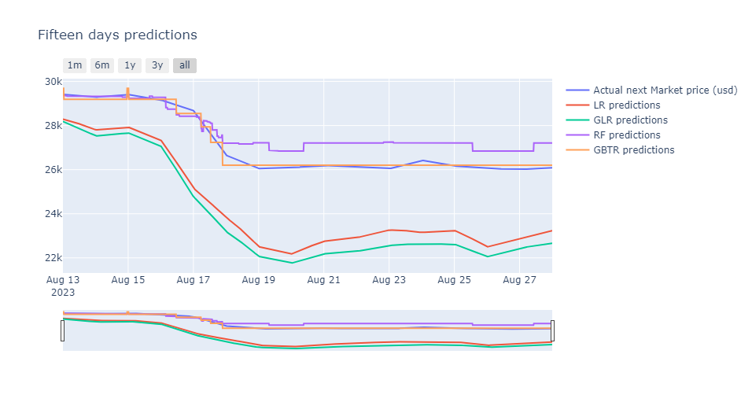
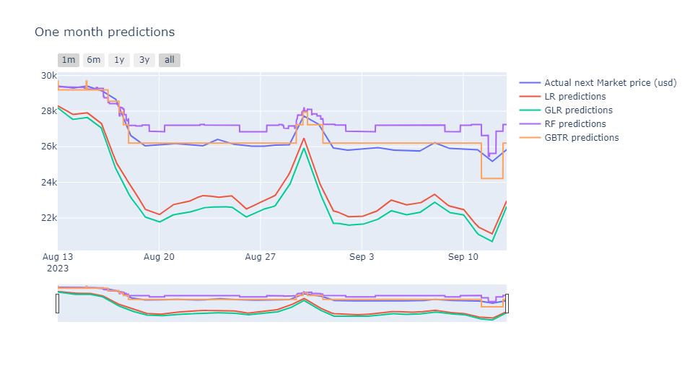
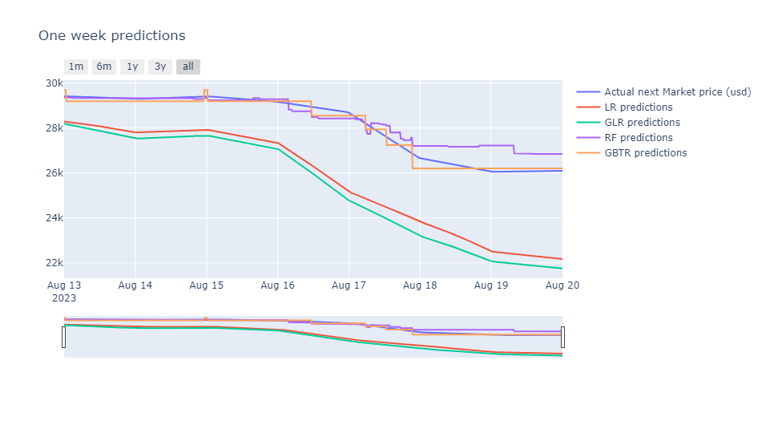
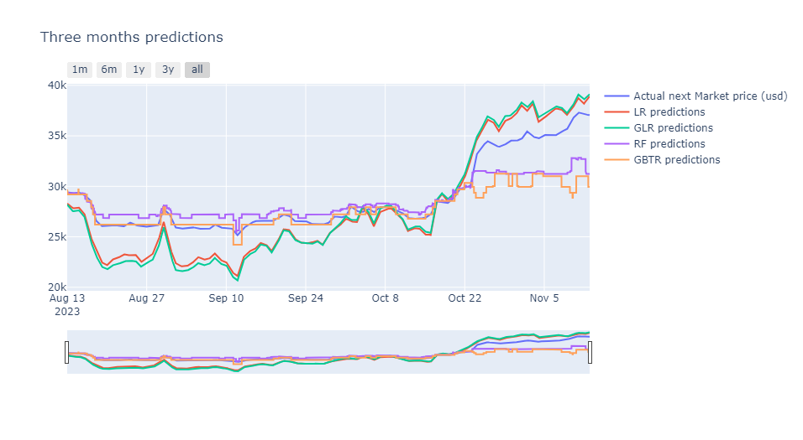
3 - Final scores: testing phase

Slide 18
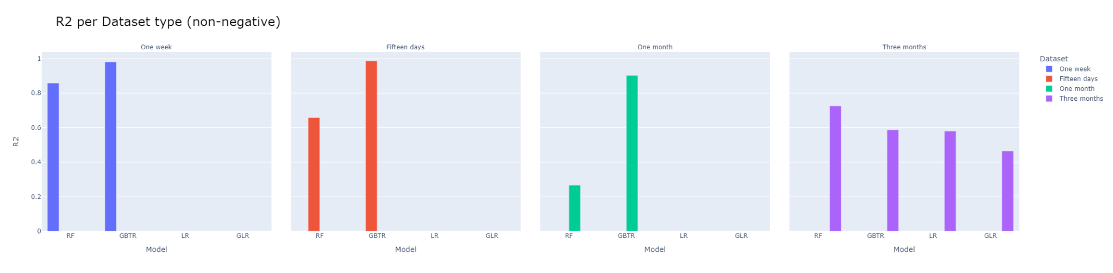
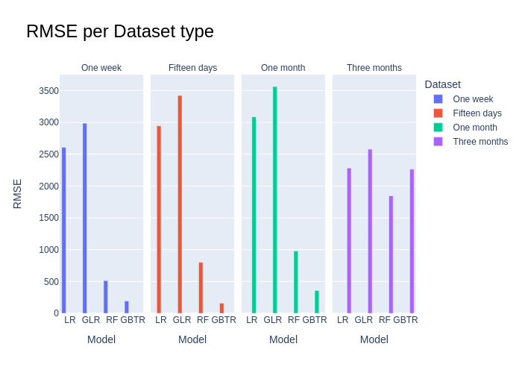
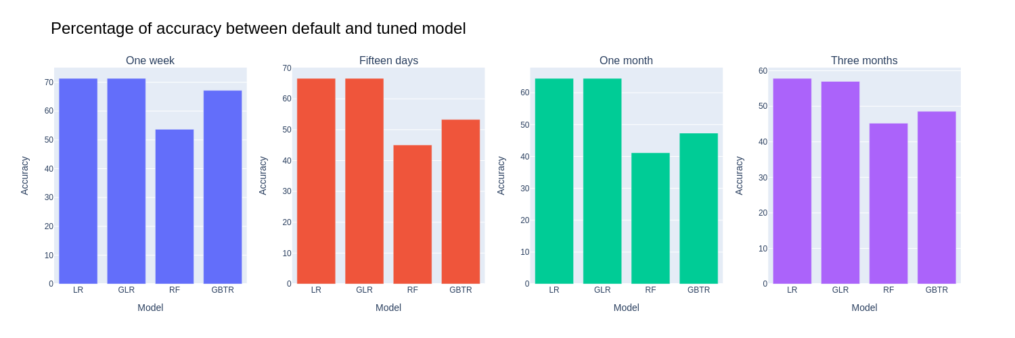
3 - Final scores: testing phase

Slide 19
Conclusions
Features
Splitting methods and models
Test dataset splitting
Answer to the initial question
Future developments:
Create a sliding window on features (additional historical data can be used)
Using deep learning approaches such as CNNs (e.g. LSTM, ARIMA...)
Implementing Transformer models that exploit self-attention

Slide 20
Thanks for the attention

