Slide 1
Bitcoin price forecasting
Big Data Computing Project
A.Y. 2022 - 2023
Faculty of Ingegneria dell'informazione, informatica e statistica
Department of Informatica
Danilo Corsi
Matr. 1742375

Slide 2
Outline
Introduction
What is bitcoin?
Goal of the project

Slide 3
Outline
Introduction
What is bitcoin?
Goal of the project
Dataset
Data collection
Features engineering

Slide 4
Outline
Introduction
What is bitcoin?
Goal of the project
Dataset
Data collection
Features engineering
Project pipeline
Data crawling / feature extraction
Models train / validation
Final scores

Slide 5
Outline
Introduction
What is bitcoin?
Goal of the project
Dataset
Data collection
Features engineering
Project pipeline
Data crawling / feature extraction
Models train / validation
Final scores
Conclusions

Slide 6

Introduction
What is Bitcoin?
Decentralized cryptocurrency
It does not have a central bank behind it
Relies on a network of nodes
Use of strong cryptography to validate and secure transactions
Made by anyone with a Bitcoin address
Has a public ledger constantly updated

Slide 7
Introduction
What is Bitcoin?
Decentralized cryptocurrency
It does not have a central bank behind it
Relies on a network of nodes
Use of strong cryptography to validate and secure transactions
Made by anyone with a Bitcoin address
Has a public ledger constantly updated
Value determined by the market and the number of people using it
Price fluctuation can be extremely unpredictable
Prediction of Bitcoin prices can be a competitive advantage

Slide 8
Goal
Analyze some machine learning techniques
Understand how accurately the price of Bitcoin can be predicted
Question: they can provide added value to cryptocurrency investors and traders?

Slide 9
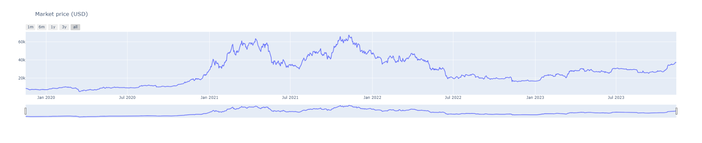
Dataset
Collecting Bitcoin data:
Blockchain.org (for blockchain data)
Binance and Kraken exchanges (for price information)
Retrieving the most relevant information from the last four years to current days

Slide 10
Features
Categories:
OHLCV: aka. “Open, High, Low, Close and Volume”
Currency statistics: e.g. market price, number of bitcoins in circulation...
Block details: e.g. block size, number of transactions...
Mining information: e.g. miners revenue, difficulty...
Network activity: e.g. number of transactions made, cost per transaction...

Slide 11

Project pipeline
Structure:
Data crawling / Feature engineering: retrieve and process data
Models’ train / validation: different models and splitting methods
Final scores: collect results and draw conclusions
Project carried out with Apache Spark (but during feature engineering I converted the Spark dataframe to a Pandas one to make some plots)

Slide 12
1 - Data crawling / Feature engineering: features
Additional features:
Next market price: next-day Bitcoin price (will be the target variable)
Simple moving avg: average price over a specified number of days
Division of features into groups:
Base features: contains currency statistics features
Base and additional features: contains base features + additional blockchain features
Divided according to their correlation value with the price:
If value >= 0.6, then most correlated
If value < 0.6, then least correlated

Slide 13
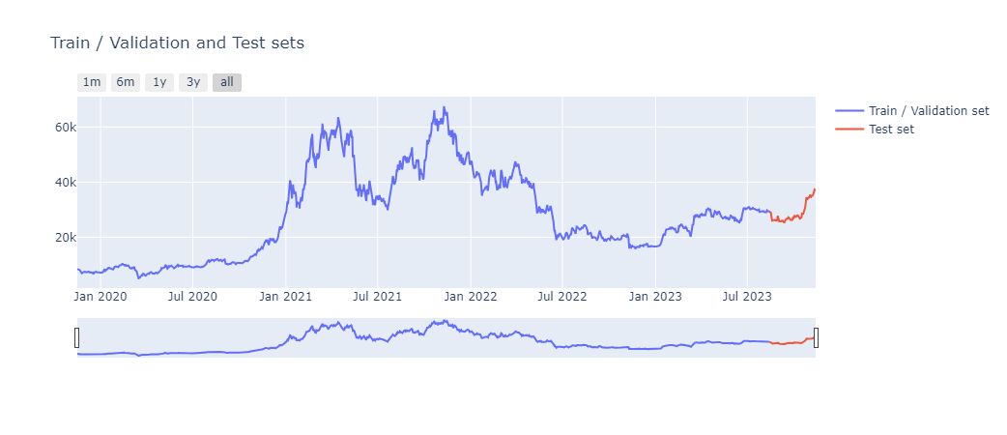
1 - Data crawling / Feature engineering: splitting
Two sets:
Train / Validation set: used to train and validate models
Test set: used to perform price prediction on never-before-seen data (last 3 months of the original dataset will be used)

Slide 14
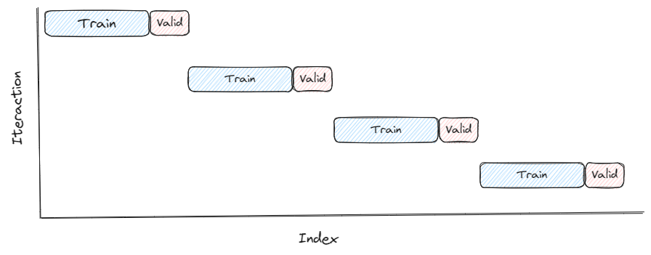
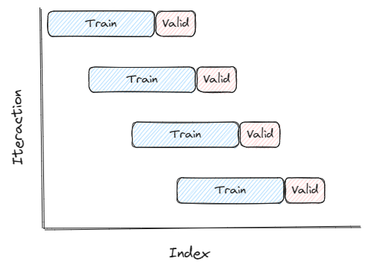

2 - Models train / validation: splitting methods
Block Splits
Walk Forward Splits
Single split
Notes:
▪ Block time series splits: involves dividing the time series into blocks of equal length, and then using each block as a separate fold for cross-validation.
▪ Walk forward time series splits: involves using a sliding window approach to create the training and validation sets for each fold. The model is trained on a fixed window of historical data, and then validated on the next observation in the time series. This process is repeated for each subsequent observation, with the window sliding forward one step at a time.
▪ Single time series split involves dividing the time series considering as validation set a narrow period of time and as train set everything that happened before this period, in such a way as to best benefit from the trend in the short term.

Slide 15
2 - Models train / validation: models and metrics
ML models:
Linear Regression
Generalized Linear Regression
Random Forest Regressor
Gradient Boosting Tree Regressor
Metrics:
RMSE (Root Mean Squared Error)
MSE (Mean Squared Error)
MAE (Mean Absolute Error)
MAPE (Mean Absolute Percentage Error)
R2 (R-squared)
Adjusted R2

Slide 16
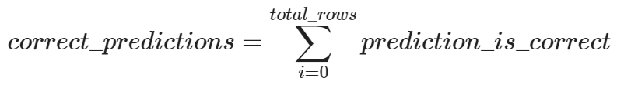
2 - Models train / validation: accuracy
“How good the models are at predicting whether the price will go up or down”
For each prediction I am going to consider it correct if the actual price goes up or down and the predicted price follows that trend, wrong if vice versa
After that I count the number of correct predictions among all of them
And finally I compute the percentage of accuracy of the model

Slide 17
2 - Models train / validation: pipeline
Base models:
With features group (base, base + most corr, base + least corr)
With and without normalization
Choose features that gave the most satisfactory results
Hyperparameter tuning
Find the best model’s parameters
Block split / Walk forward split method used
Compute a score for each parameter chosen by each split
Assigning weights based on:
Frequency
Split belonging
RMSE value
Choose the best set of parameters based on the overall score obtained

Slide 18
2 - Models train / validation: pipeline
Cross Validation
Validate performance
Block split / Walk forward split method used
Model trained on the whole train / validation set (if final results are satisfactory)

Slide 19
3 - Final scores
Comparison between final results
Prediction on the test set
Splitting:
1 week
15 days
1 month
3 months
See how models' performance degrades as time increases

Slide 20
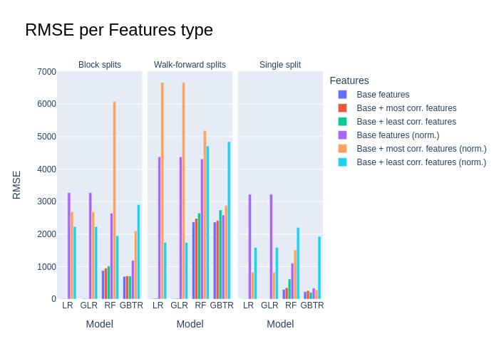
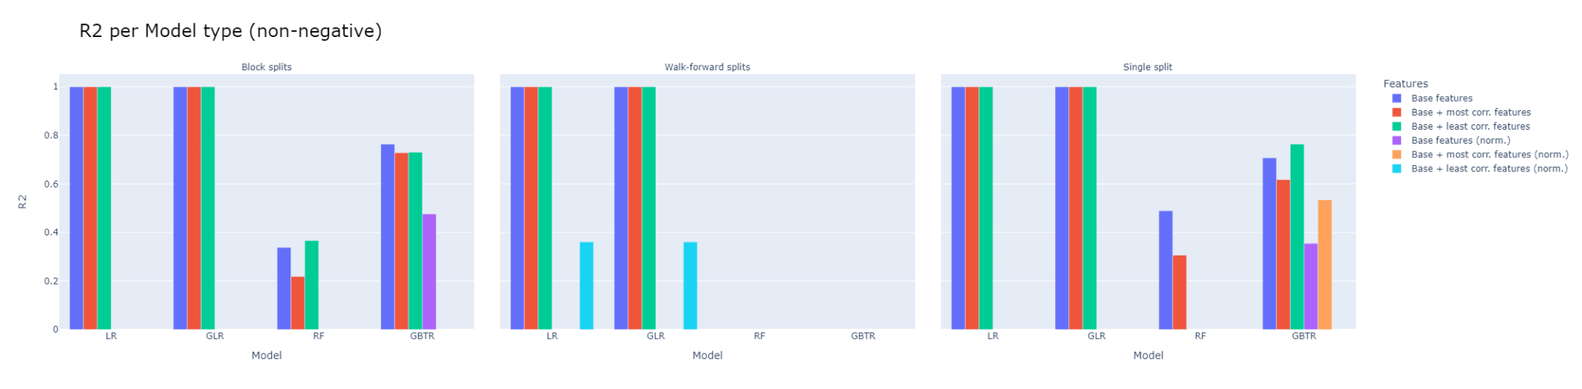
3 - Final scores: train / validation phase

Slide 21
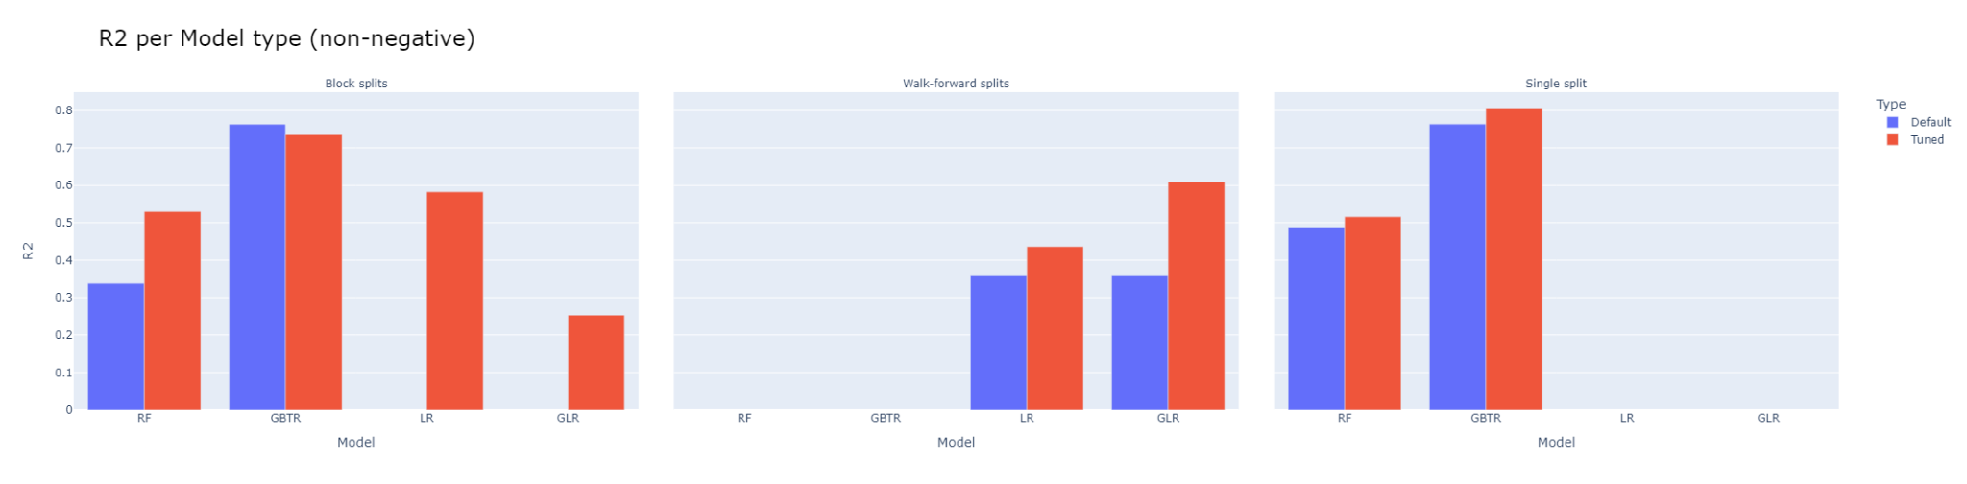
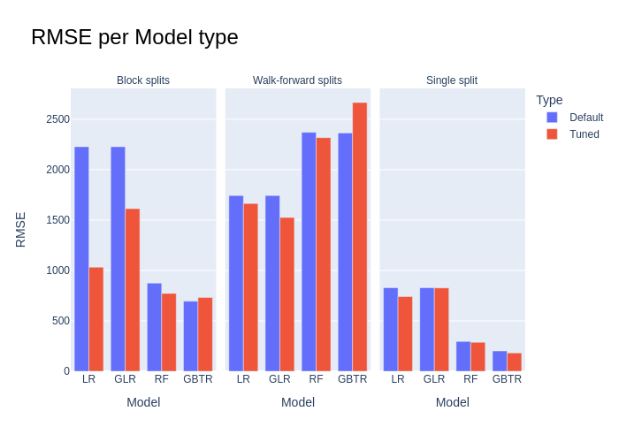
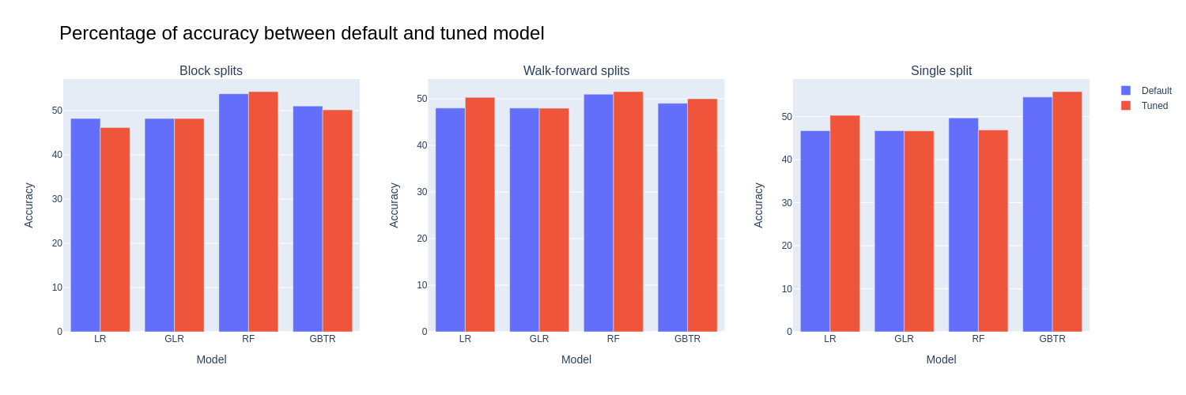
3 - Final scores: train / validation phase

Slide 22
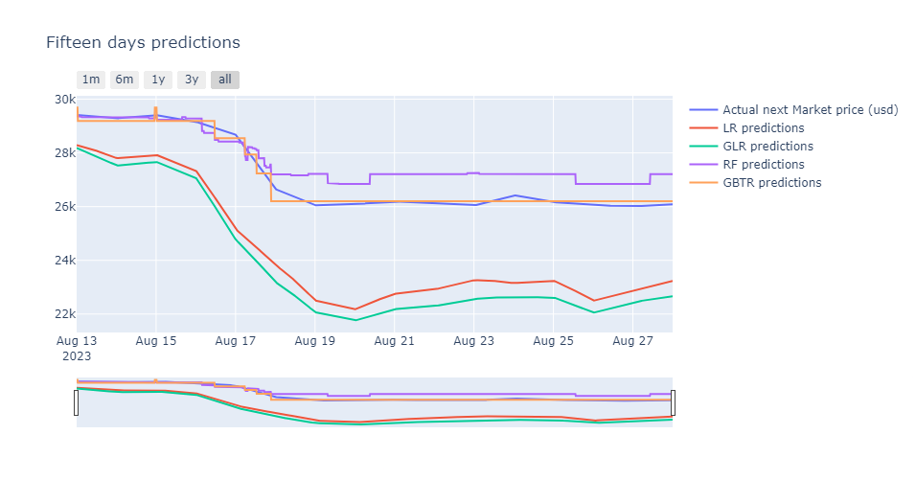
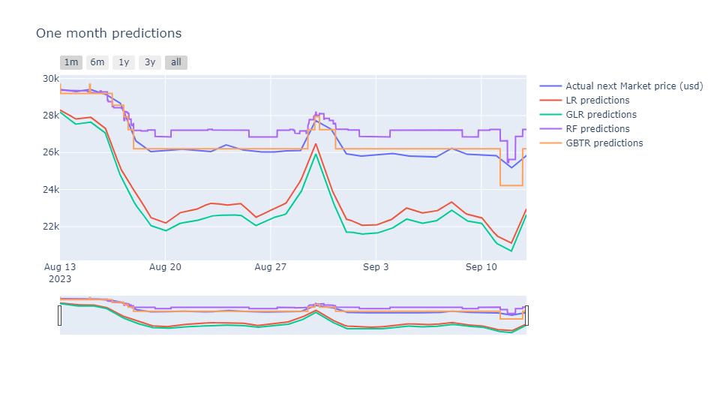
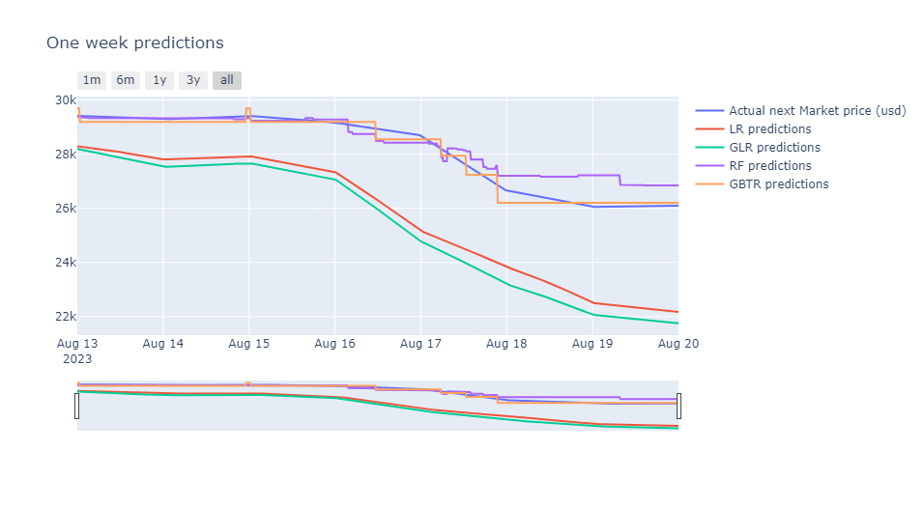
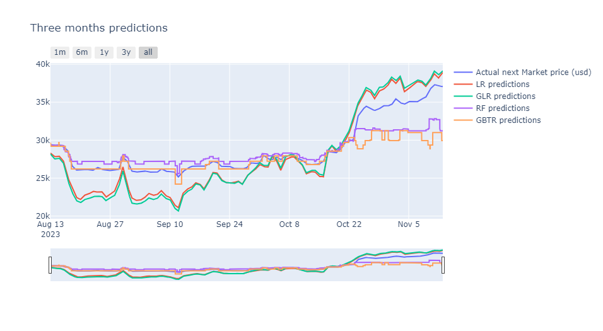
3 - Final scores: testing phase

Slide 23
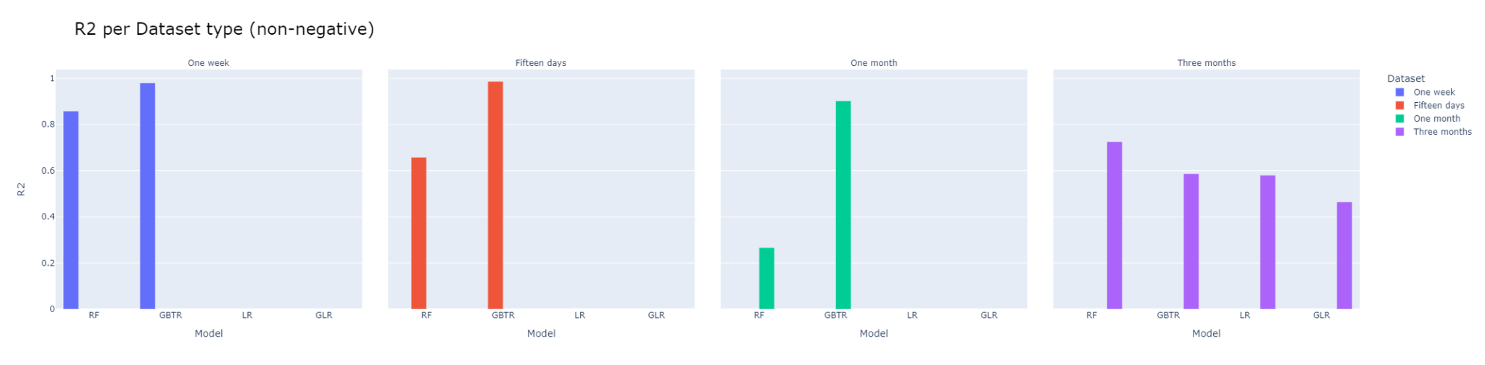
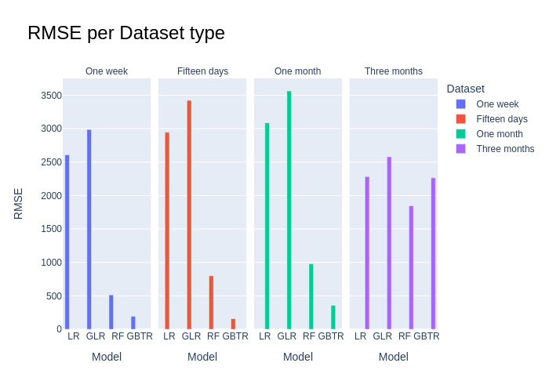
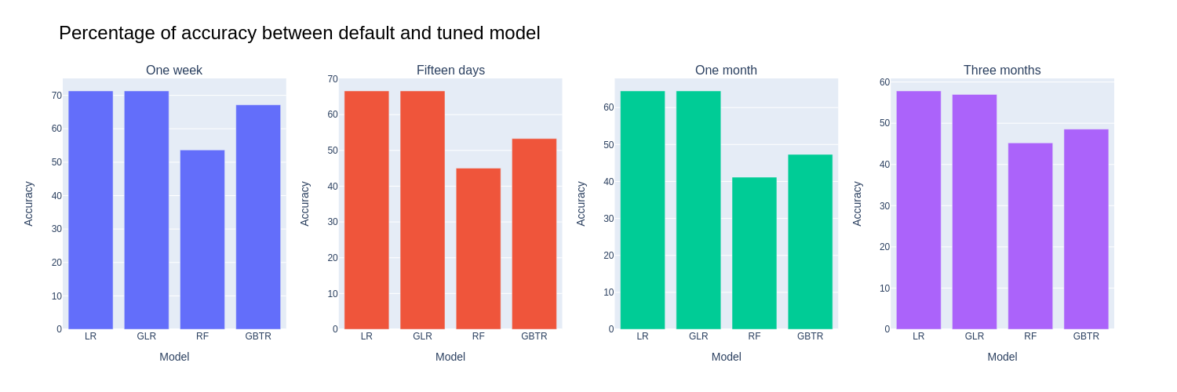
3 - Final scores: testing phase

Slide 24
Conclusions
Features
Splitting methods
Splitting models
Test dataset splitting
Answer to the initial question
Future developments:
Create a sliding window on features (additional historical data can be used)
Using deep learning approaches such as CNNs (e.g. LSTM, ARIMA...)
Implementing Transformer models that exploit self-attention

Slide 25
Thanks for the attention

