Slide 1


Esquio
.NET Core 3 Feature Flags library
https://github.com/xabaril/esquio
Apache 2.0

Slide 2
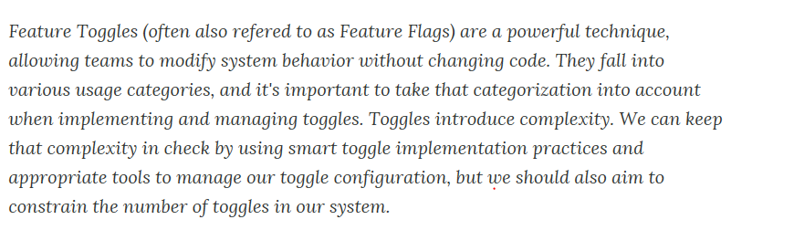

About Feature Flags?
https://www.martinfowler.com/articles/feature-toggles.html

Slide 3
About Feature Flags?
Use Cases
Canary Release:
Measure Goals from new code:
Rolling out features to a certain number of users.
Increment users whenever you want.
Release When you’re ready
Keep new features hidden and release when marketing / product are ready.
A/B testing (testing in production)
User targeting depending on user atributes
Percentage rollout
Maintenance mode
Disable some features if system is unstable.
Percentage rollout to validate new infrastructure

Slide 4
About Feature Flags?
Our vision
Is not only about development, is a deployment practice.
Will be integrated with release pipelines.
Observable and measurable
Centralized multi solution feature configuration.
..we use some this definitions
Feature is some functionality that can be deployed without release it.
Toggle is a filter used to enable or disable some feature on runtime.
Product represent a software product with one or many different Projects Web Sites, Background Services, mobile devices etc.

Slide 5
Esquio??
A “feature flags” library for .NET Core 3.X developers
ASP .NET Core 3
MVC
SPA
Background / Console apps
Xamarin
OSS, Apache 2
Learn
https://esquio.readthedocs.io/en/latest/

Slide 6
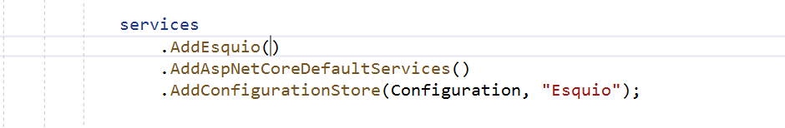
ASP.NET Core 3 + Esquio
Register and configure Esquio
Add Esquio dependencies
Add ASP.NET Core 3 dependencies
Set the configuration store to be used

Slide 7
ASP.NET Core 3 + Esquio
FeatureTagHelper
Enable or disable Razor content depending on feature(s) state.
Names, Include, Exclude properties to specify one or many features to be evaluated.
Product is optional

Slide 8
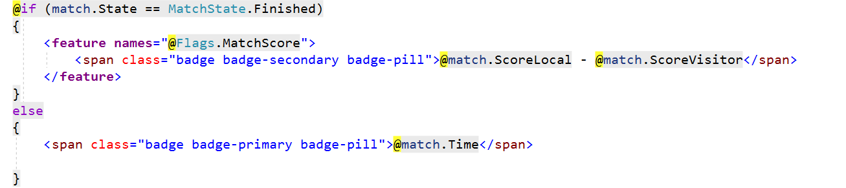
ASP.NET Core 3 + Esquio

Slide 9
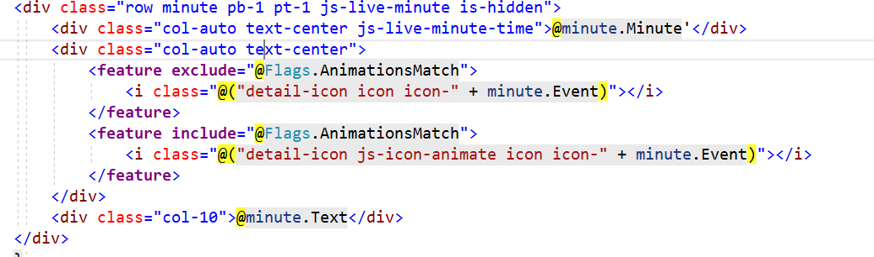
ASP.NET Core 3 + Esquio

Slide 10
ASP.NET Core 3 + Esquio
FeatureFilter
Enable or disable MVC controller(s) or MVC action(s) depending on feature(s) state.
Names to specify features to be evaluated.
Product is optional as well.
Working as route constraint / metadata

Slide 11
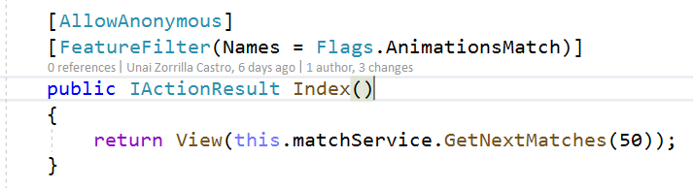
Esquio with ASP.NET Core 3

Slide 12
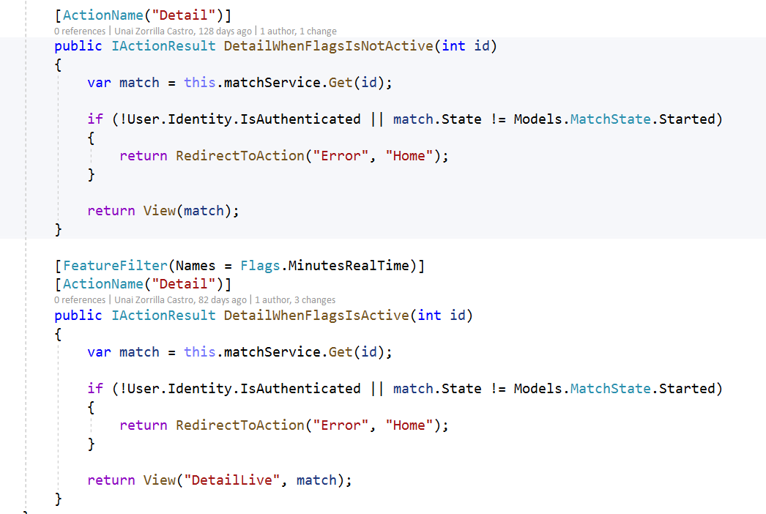
ASP.NET Core 3 + Esquio

Slide 13
ASP.NET Core 3 + Esquio
ASP.NET Core 3 Endpoint integration
RequireFeature extension method for IEndpointConventionBuilder.
Enable or disable routes using custom MatcherPolicy
Can use multiple metadata endpoint + action filter

Slide 14
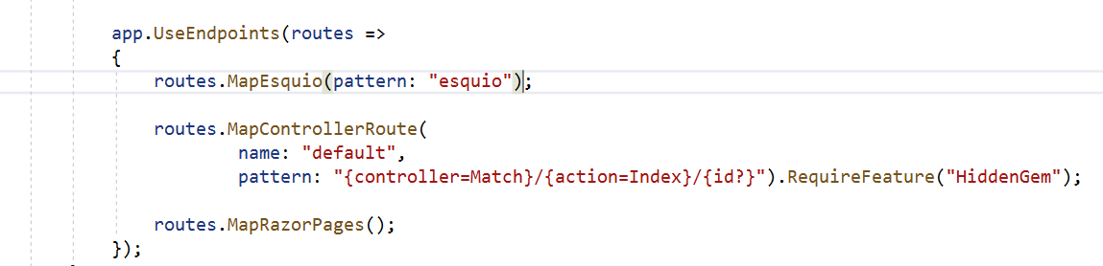
Esquio with ASP.NET Core 3

Slide 15
Esquio with ASP.NET Core 3
HTTP Endpoint for SPA’s & Non browser apps
New endpoint created with MapEsquio extension method
Configurable route path
Only for query feature(s) state

Slide 16
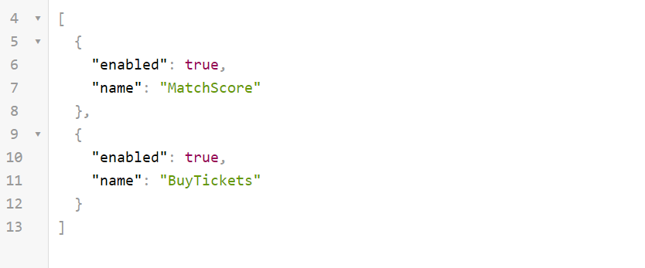
Esquio with ASP.NET Core 3
https://[yourwebproject]/[esquio]?featureName=MatchScore&featureName=BuyTickets

Slide 17
Esquio with ASP.NET Core 3
IFeatureService dependency
Used internally to evaluate features.
Custom code to evaluate feature(s).
Names to specify features to be evaluated
Product is optional as well.

Slide 18
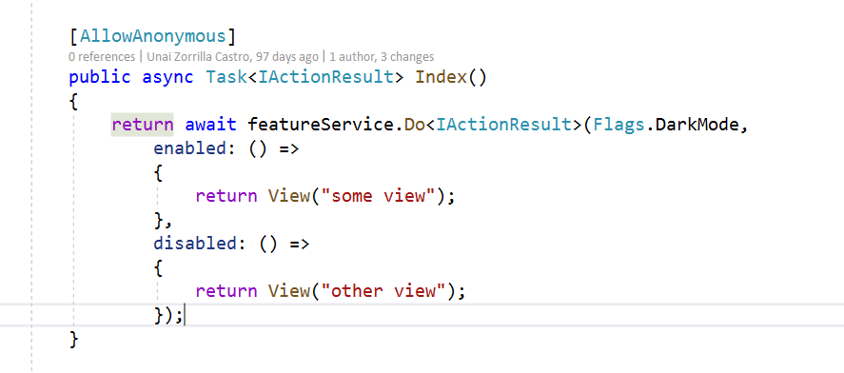
Esquio with ASP.NET Core 3

Slide 19
Esquio out of box toggles
OnToggle
OffToggle
FromToToggle
EnvironmentToggle
RoleNameToggle
UserNameToggle
GradualRolloutUserNameToggle

Slide 20
Esquio AspNetCore out of box toggles
ClaimValueToggle
GradualRolloutClaimValueToggle
GradualRolloutHeaderValueToggle
GradualRolloutSessionToggle

Slide 21
Esquio Configuration Store (Configuration)
Based on Microsoft.Extension.Configuration
Json, Environment variables etc.
Azure App Configuration Service aware.
Ideal for Simple Apps
Can’t be integrated with release pipelines easly.
Hard to maintain for multiple products / flags / toggles.

Slide 22
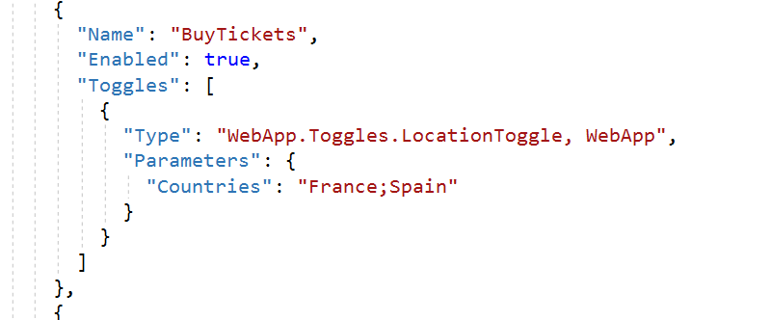
Esquio Configuration Store

Slide 23
Esquio Configuration Store (Entity Framework Core)
Centralized store for multiple products using Entity Framework Core.
Product/Feature/Toggle can be extended with new data.
Easy to integrate.

Slide 24
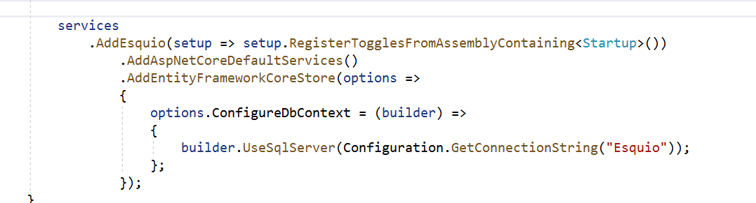
Esquio Configuration Store (Entity Framework Core)

Slide 25
Esquio UI
Web App to manage Feature / Toggle / Parameters using the Entity Framework Store.
Expose HTTP API for third party tools like Azure DevOps release tasks.
Secured with OpenIdConnect and API Key
Extend configuration store with new information
Feature tags
Change / Auditing History

Slide 26
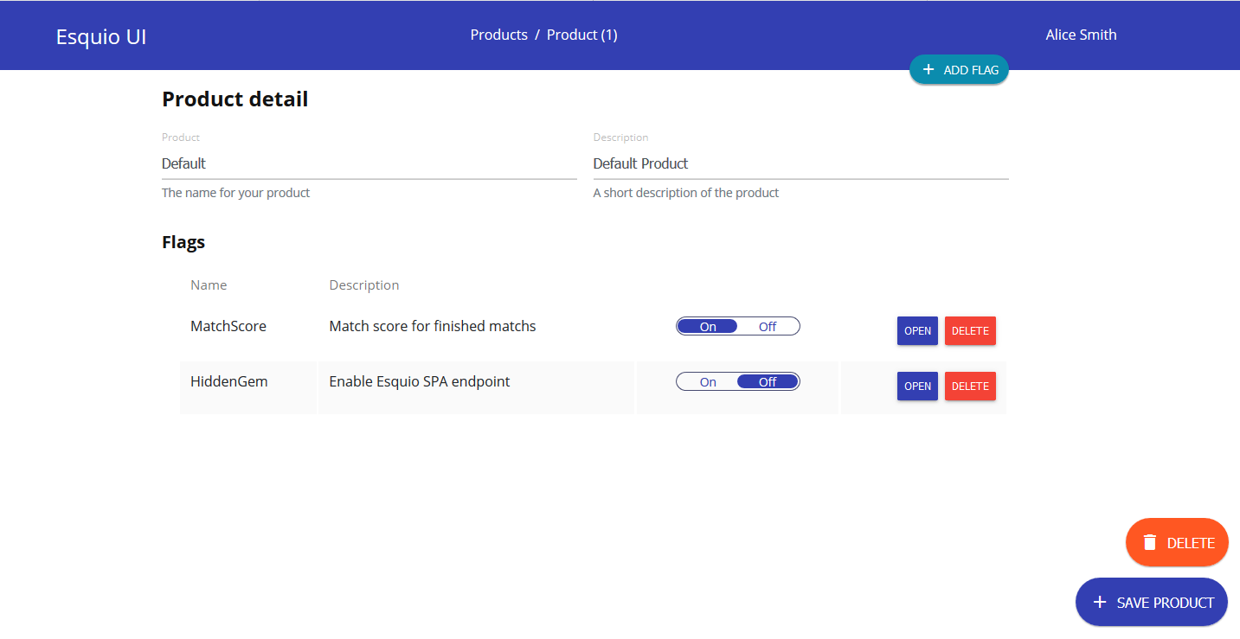

Slide 27
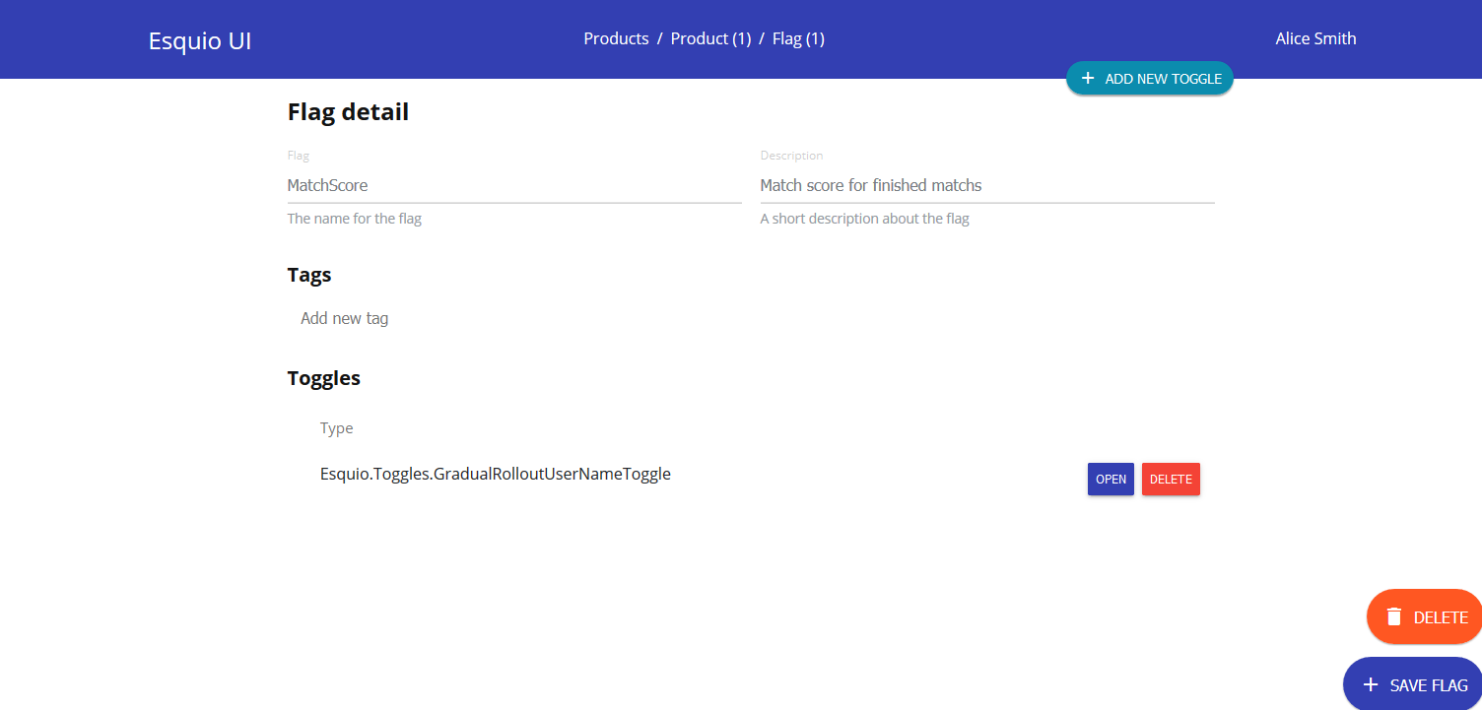

Slide 28
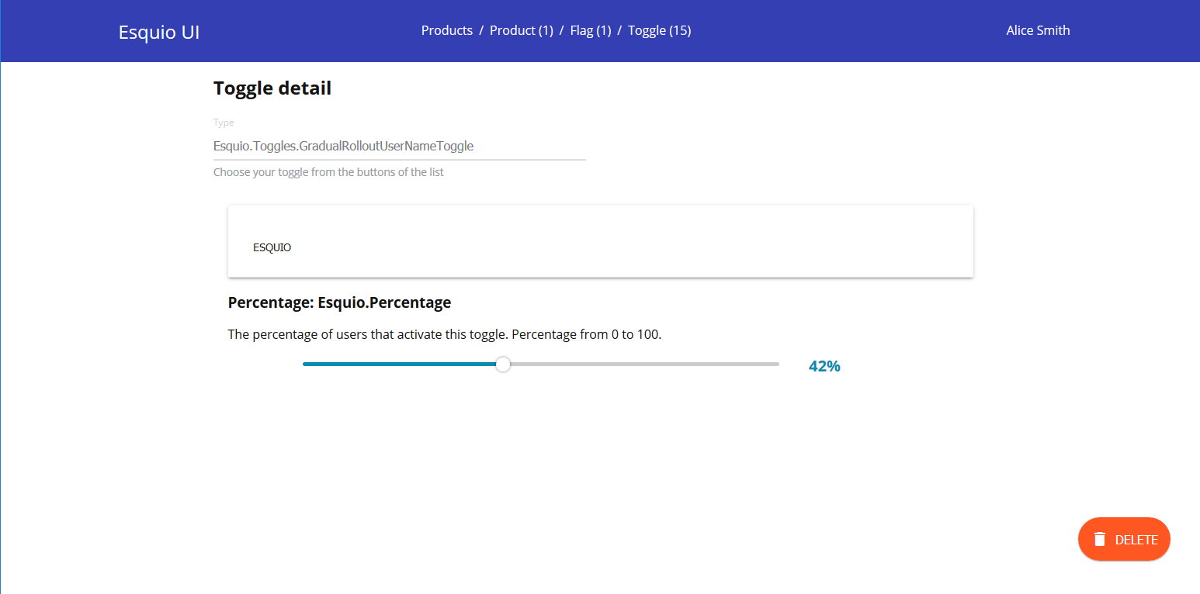

Slide 29
Esquio and Application Insights
Esquio will be integrated with application insights to include feature execution information as part of telemetry entries.
All request contains property information for each evaluated feature.
This information can be used to measure Goals and feature impact directly from Application Insights

Slide 30
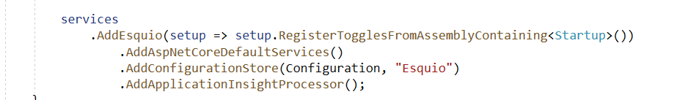
Esquio and Application Insights

