Slide 1


Esquio
.NET Core 3 Feature Flags library
https://github.com/xabaril/esquio
Apache 2.0

Slide 2
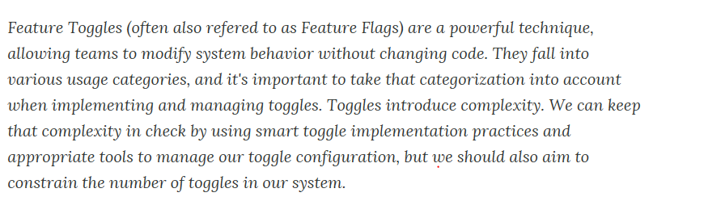

About Feature Flags
https://www.martinfowler.com/articles/feature-toggles.html

Slide 3
About Feature Flags
Use Cases
Canary Release:
Measure Goals from new code:
Rolling out features to a certain number of users.
Increment users whenever you want.
Release When you’re ready
Keep new features hidden and release when marketing / product are ready.
A/B testing (testing in production)
User targeting depending on user atributes
Percentage rollout
Maintenance mode
Disable some features if system is unstable.
Percentage rollout to validate new infrastructure

Slide 4
About Feature Flags
¿Easy?
Making a Flag|Feature Dynamic
Integrated with release pipelines
Allow toggle configurations
How do rolling out to a percentage or users / sessions etc?
How check complex criteria
Between dates
Only for certain security roles
Users from specified countries
…
De-coupling decision points from decision logic
Avoid conditionals
Allow alternative Code Paths

Slide 5
About Feature Flags
Competence ( OSS )
Spring Boot
Togglz
https://www.togglz.org/
~ 65K download per month
PHP
Qandidate
http://labs.qandidate.com/blog/2014/08/18/a-new-feature-toggling-library-for-php/

Slide 6
About Feature Flags
Competence ( Comercial )
Launch Darkly
https://launchdarkly.com/
Rollout
https://rollout.io
Unleash
https://unleash.github.io/

Slide 7
About Feature Flags
Our vision
Is not only about development, is a delivery strategy.
Will be integrated with release pipelines.
Observable and measurable
Centralized feature configuration.
Share feature configuration between micro-services
Share feature configuration between different Projects of the same solution
Azure | On-Premise | Containers
Extensible

Slide 8
Esquio
A “feature flags” library for .NET Core 3.X developers
ASP .NET Core 3
MVC
SPA
Background / Console apps
Xamarin
OSS, Apache 2
Learn
https://esquio.readthedocs.io/en/latest/

Slide 9
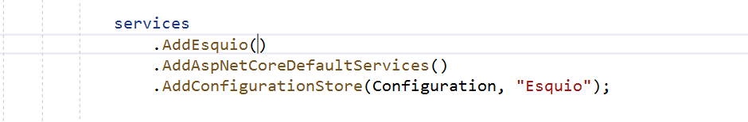
ASP.NET Core 3 + Esquio
Register and configure Esquio
Add Esquio dependencies
Add ASP.NET Core 3 dependencies
Set the configuration store to be used

Slide 10
ASP.NET Core 3 + Esquio
FeatureTagHelper
Enable or disable Razor content depending on feature(s) state.
Names, Include, Exclude properties to specify one or many features to be evaluated.
Product is optional

Slide 11
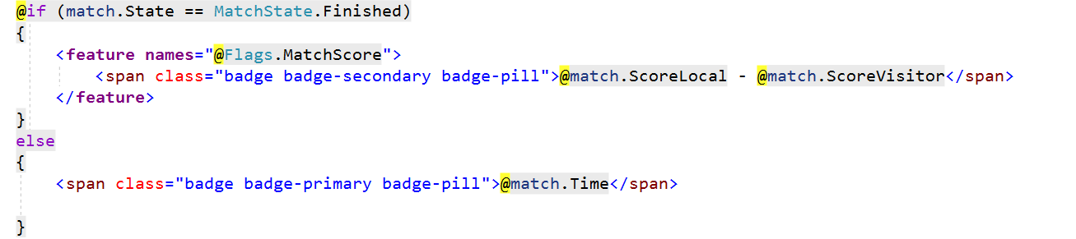
ASP.NET Core 3 + Esquio

Slide 12
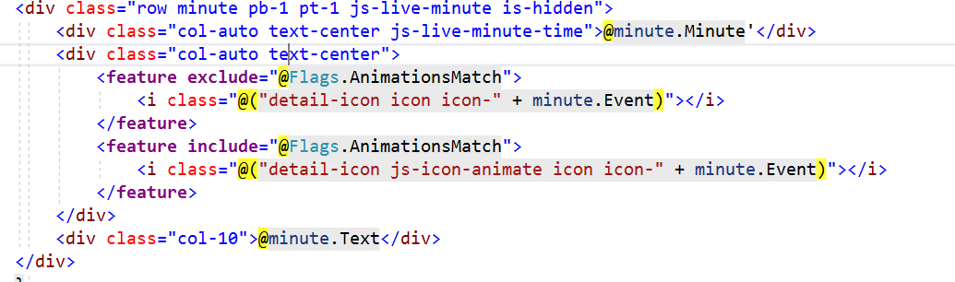
ASP.NET Core 3 + Esquio

Slide 13
ASP.NET Core 3 + Esquio
FeatureFilter
Enable or disable MVC controller(s) or MVC action(s) depending on feature(s) state.
Names to specify features to be evaluated.
Product is optional as well.
Working as route constraint / metadata

Slide 14
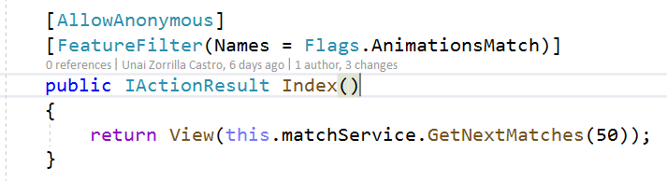
ASP.NET Core 3 + Esquio

Slide 15
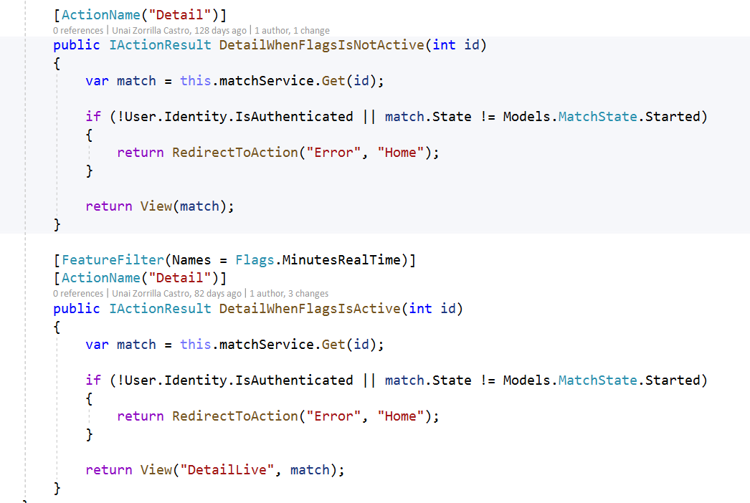
ASP.NET Core 3 + Esquio

Slide 16
ASP.NET Core 3 + Esquio
ASP.NET Core 3 Endpoint integration
RequireFeature extension method for IEndpointConventionBuilder.
Enable or disable routes using custom MatcherPolicy
Can use multiple metadata endpoint + action filter

Slide 17
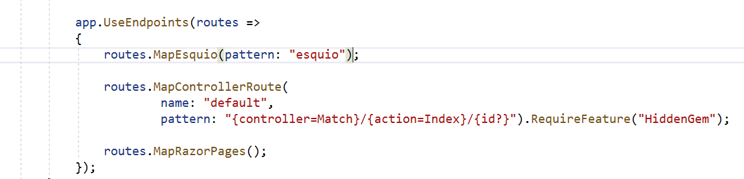
ASP.NET Core 3 + Esquio

Slide 18
ASP.NET Core 3 + Esquio
HTTP Endpoint for SPA’s & Non browser apps
New endpoint created with MapEsquio extension method
Configurable route path
Only for query feature(s) state

Slide 19
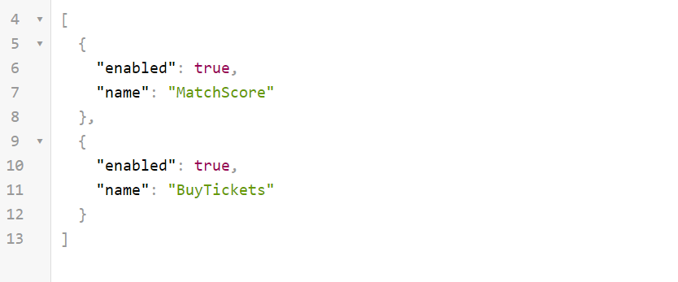
ASP.NET Core 3 + Esquio
https://[yourwebproject]/[esquio]?featureName=MatchScore&featureName=BuyTickets

Slide 20
ASP.NET Core 3 + Esquio
IFeatureService dependency
Used internally to evaluate features.
Custom code to evaluate feature(s).
Names to specify features to be evaluated
Product is optional as well.

Slide 21
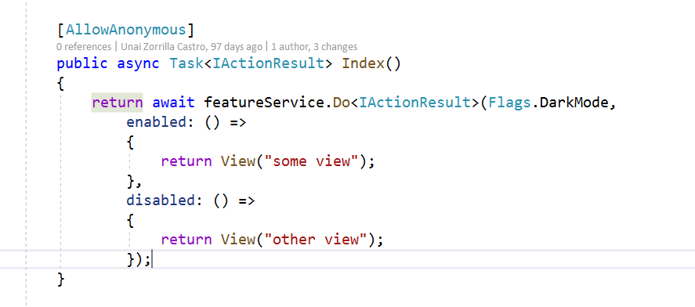
ASP.NET Core 3 + Esquio

Slide 22
Esquio out of box toggles
FromToToggle
EnvironmentToggle
RoleNameToggle
UserNameToggle
GradualRolloutUserNameToggle

Slide 23
Esquio AspNetCore out of box toggles
ClaimValueToggle
GradualRolloutClaimValueToggle
GradualRolloutHeaderValueToggle
GradualRolloutSessionToggle

Slide 24
Esquio Configuration Store (Configuration)
Based on Microsoft.Extension.Configuration
Json, Environment variables etc.
Azure App Configuration Service aware.
Ideal for Simple Apps
Can’t be integrated with release pipelines easly.
Hard to maintain for multiple products / flags / toggles.

Slide 25
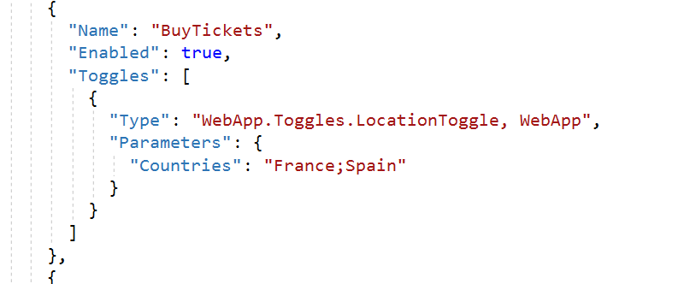
Esquio Configuration Store

Slide 26
Esquio Configuration Store (Entity Framework Core)
Centralized store for multiple products using Entity Framework Core.
Product/Feature/Toggle can be extended with new data.
Easy to integrate.

Slide 27
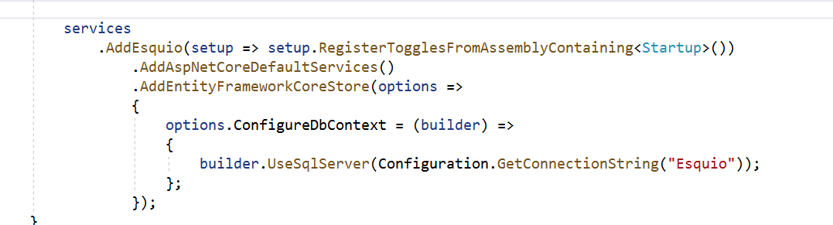
Esquio Configuration Store (Entity Framework Core)

Slide 28
Esquio UI
Web App to manage Feature / Toggle / Parameters using the Entity Framework Store.
Expose HTTP API for third party tools like Azure DevOps release tasks.
Secured with OpenIdConnect and API Key
Extend configuration store with new information
Feature tags
Change / Auditing History

Slide 29
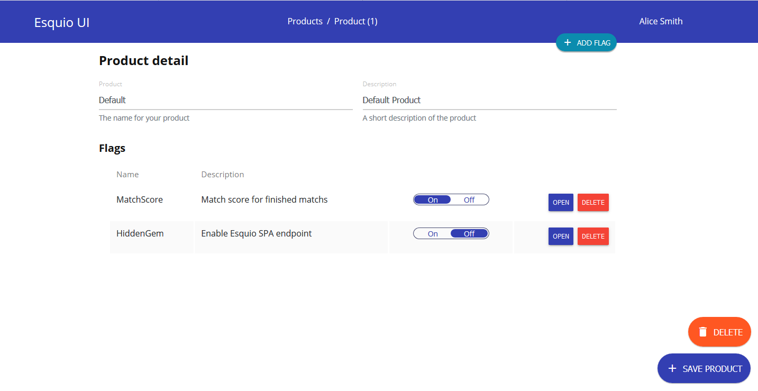

Slide 30
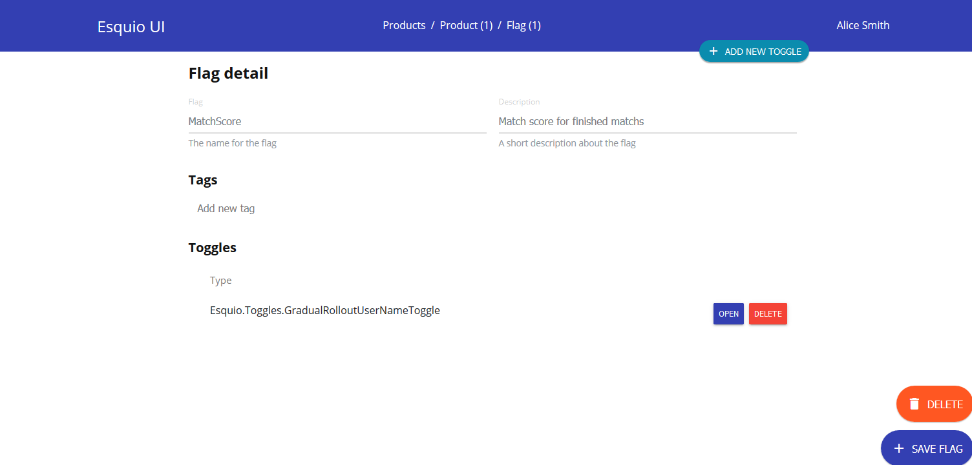

Slide 31
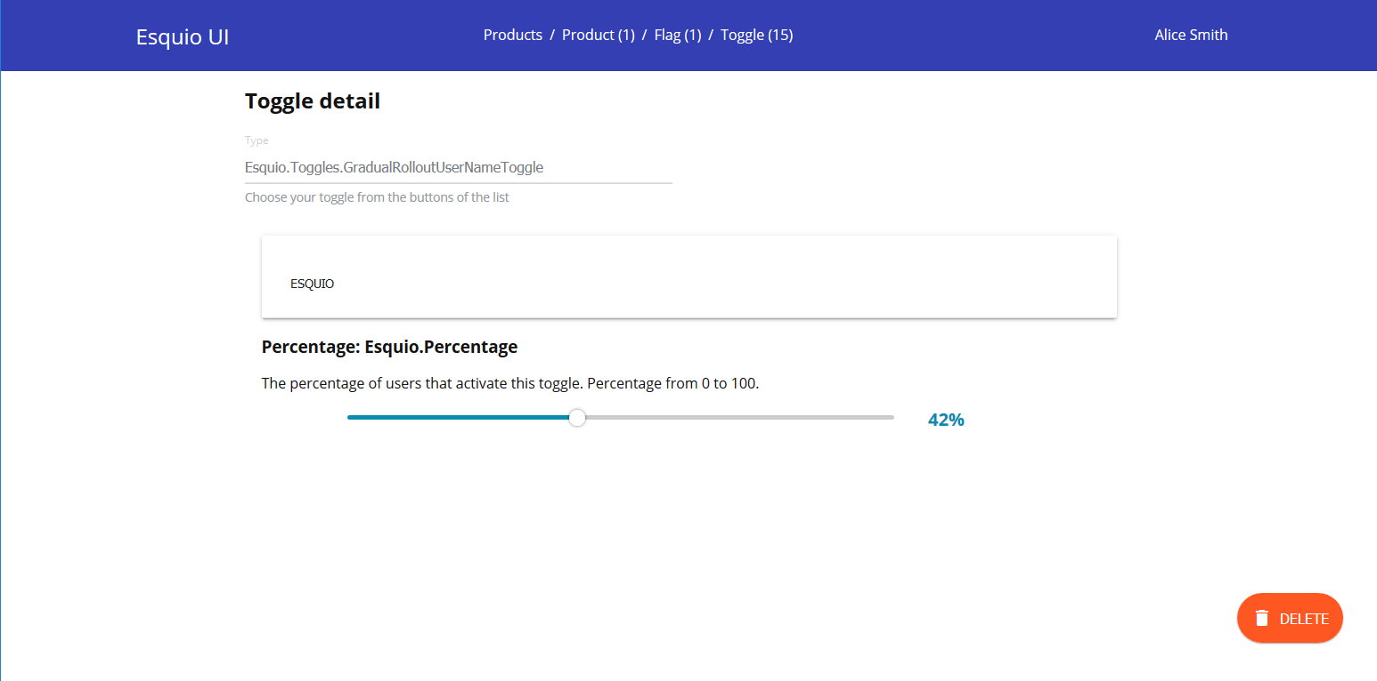

Slide 32
Esquio and Application Insights
Esquio will be integrated with application insights to include feature evaluation results as part of telemetry entries.
All request contains property information for each evaluated feature.
This information can be used to measure Goals and feature impact directly from Application Insights

Slide 33
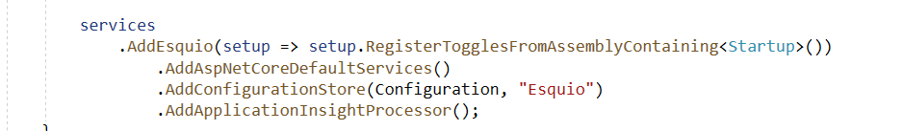
Esquio and Application Insights

Slide 34
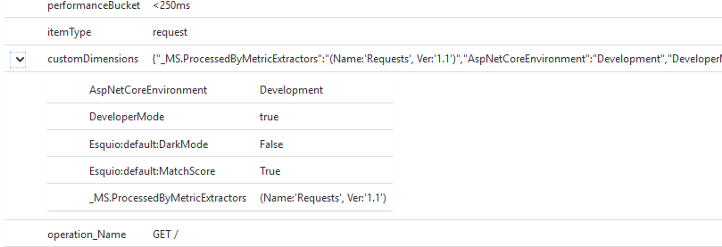
Esquio and Application Insights

Slide 35
Esquio Instrumentation
Esquio instrumentation features
Performance Counters
Feature Evaluations per second
Feature Throws per second
Feature Not Found per second
Toggle Excutions
Toggle Execution Throws
Evaluation time for each feature
Diagnostics Source
FeatureEvaluationBegin
FeatureEvaluationEnd
FeatureEvaluationNotFound
FeatureEvaluationThrows
ToggleExecutionBegin
ToggleExecutionEnd

Slide 36
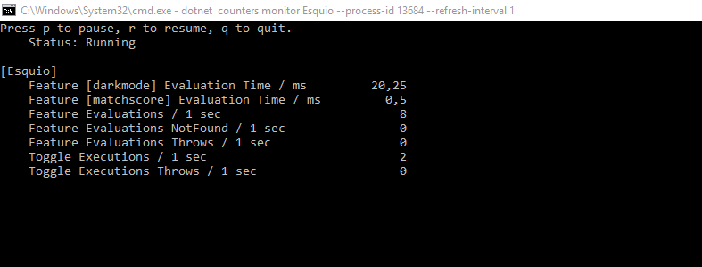
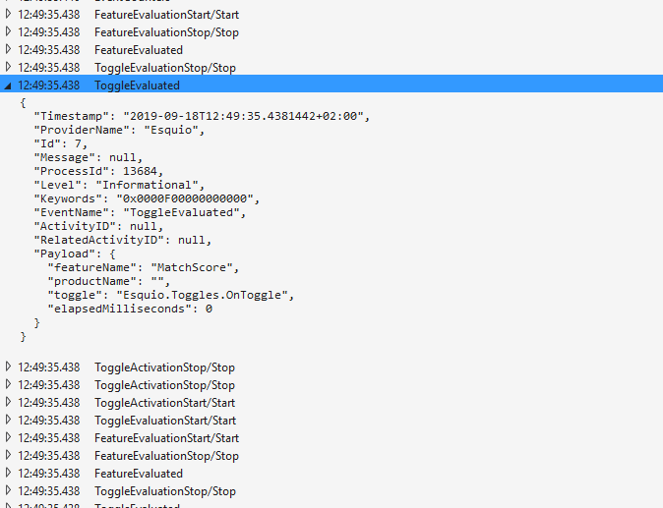
Esquio Instrumentation

Slide 37
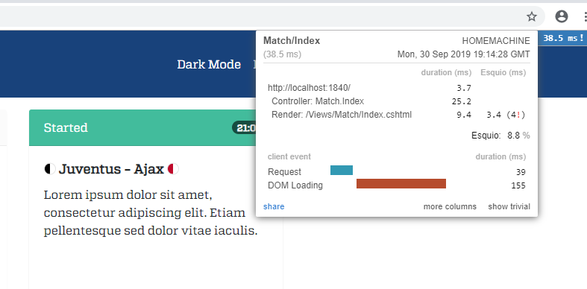
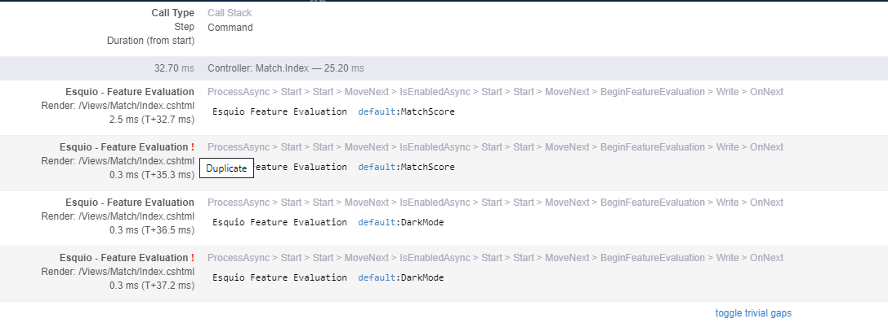
Esquio Instrumentation

Slide 38
Roadmap
Esquio 1.1 November 2019
Plugable Partitioner. [done]
New ASP.NET Core Toggles. [done]
Added typed “EventData” on DiagnosticSource events. [done]
MiniProfiler tool for Esquio features profiling. [done]
UI improvements
Authorization ( Reader, Contributor, Management ).
Improve Api Key management.

Slide 39
Roadmap
Esquio vNext
Endpoint fallback fine grain.
Redis configuration store.
Hard dependency on Store Context.
UI improvements
New Azure DevOps tasks
Feature change notifications
Feature state http context request cache

