Slide 2

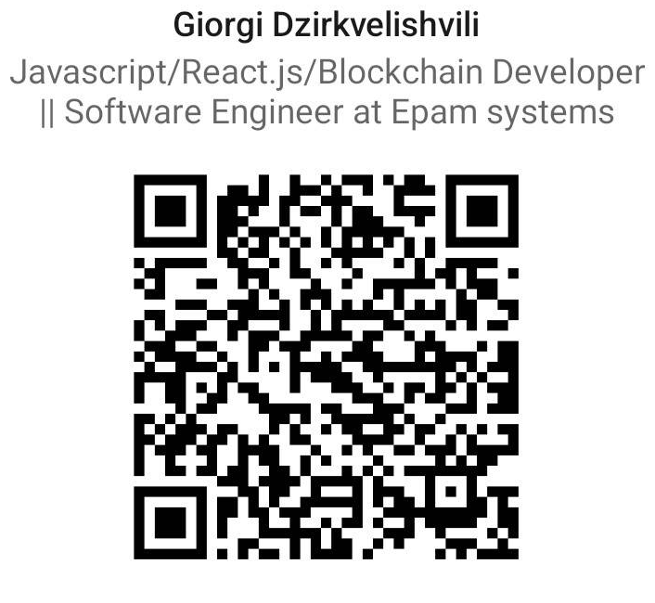
About me

Slide 3
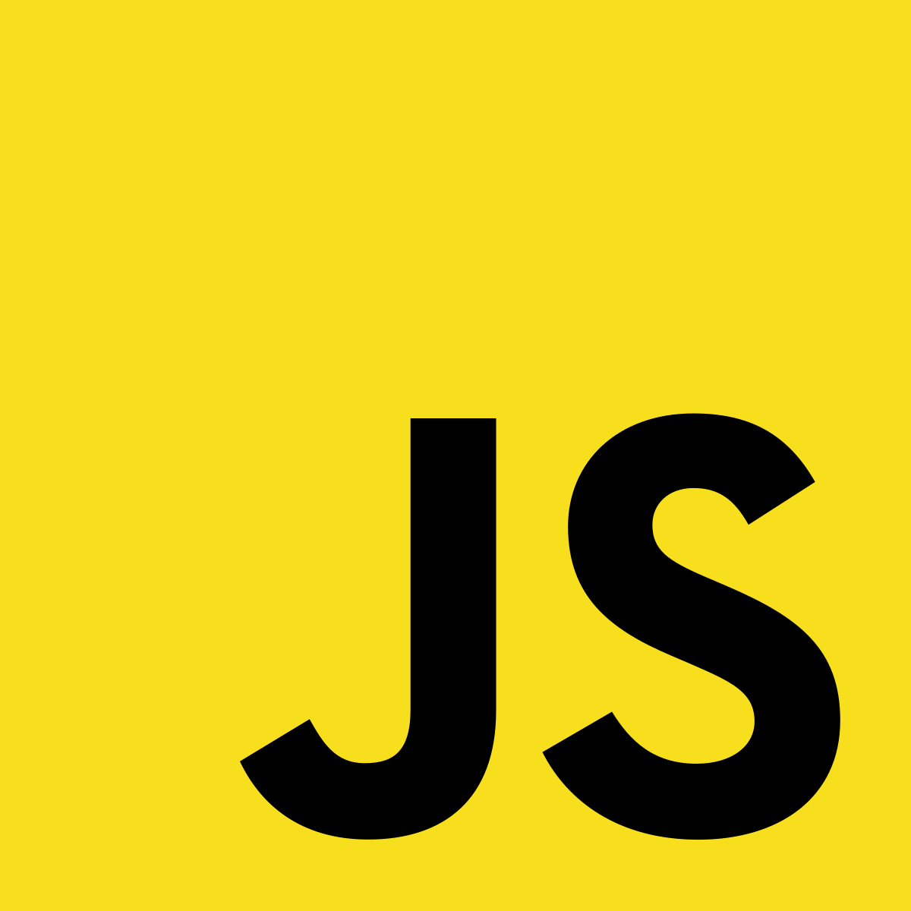
რა არის ჯავასკრიპტი
JavaScript was initially created to “make web pages alive”.
The programs in this language are called scripts. They can be written right in a web page’s HTML and run automatically as the page loads.
Scripts are provided and executed as plain text. They don’t need special preparation or compilation to run.
In this aspect, JavaScript is very different from another language called Java.

Slide 4
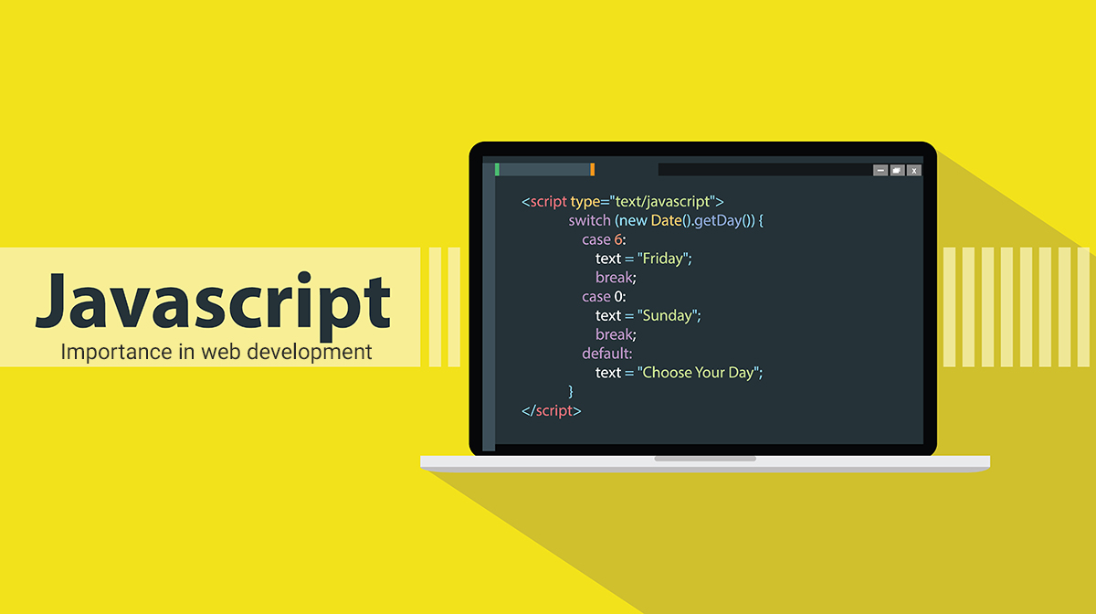
რა სუპერ ძალები აქვს ჯავასკრიპტს
Add new HTML to the page, change the existing content, modify styles.
React to user actions, run on mouse clicks, pointer movements, key presses.
Send requests over the network to remote servers, download and upload files (so-called AJAX and COMET technologies).
Get and set cookies, ask questions to the visitor, show messages.
Remember the data on the client-side (“local storage”).

Slide 5
რატომ დაერქვა ჯავასკრიპტს ჯავასკრიპტი?
When JavaScript was created, it initially had another name: “LiveScript”. But Java was very popular at that time, so it was decided that positioning a new language as a “younger brother” of Java would help.
But as it evolved, JavaScript became a fully independent language with its own specification called ECMAScript, and now it has no relation to Java at all.

Slide 6


JS Engine
Today, JavaScript can execute not only in the browser, but also on the server, or actually on any device that has a special program called the JavaScript engine.
V8 – in Chrome, Opera and Edge.
SpiderMonkey – in Firefox.
…There are other codenames like “Chakra” for IE, “JavaScriptCore”, “Nitro” and “SquirrelFish” for Safari, etc.

Slide 7

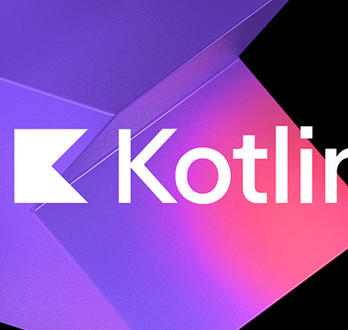
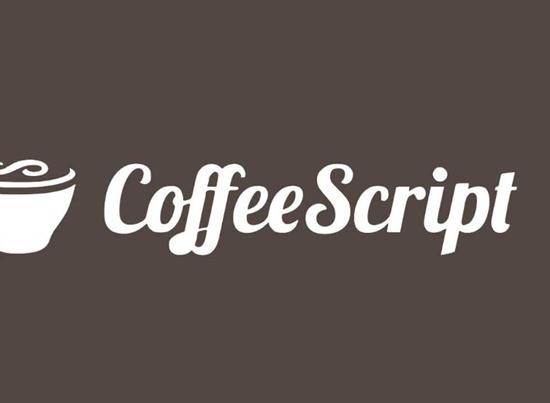
Languages over JavaScript
The syntax of JavaScript does not suit everyone’s needs. Different people want different features.
That’s to be expected, because projects and requirements are different for everyone.
So, recently a plethora of new languages appeared, which are transpiled (converted) to JavaScript before they run in the browser.
Modern tools make the transpilation very fast and transparent, actually allowing developers to code in another language and auto-converting it “under the hood”.
Examples of such languages:
CoffeeScript is “syntactic sugar” for JavaScript. It introduces shorter syntax, allowing us to write clearer and more precise code. Usually, Ruby devs like it.
TypeScript is concentrated on adding “strict data typing” to simplify the development and support of complex systems. It is developed by Microsoft.
Kotlin is a modern, concise and safe programming language that can target the browser or Node.

Slide 8
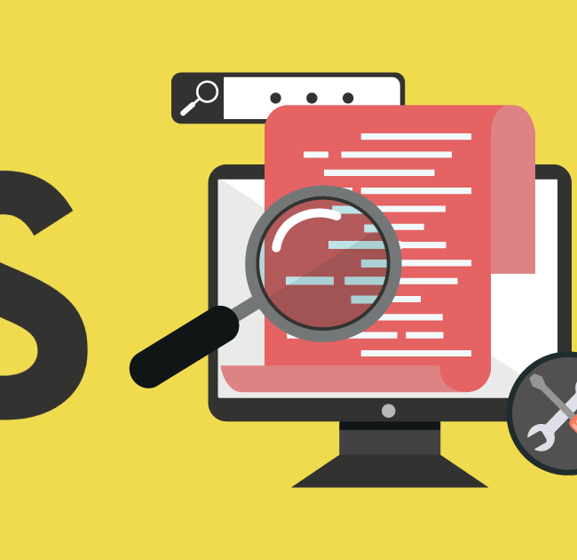
შეჯამება
JavaScript was initially created as a browser-only language, but it is now used in many other environments as well.
Today, JavaScript has a unique position as the most widely-adopted browser language, fully integrated with HTML/CSS.
There are many languages that get “transpiled” to JavaScript and provide certain features. It is recommended to take a look at them, at least briefly, after mastering JavaScript.

Slide 9
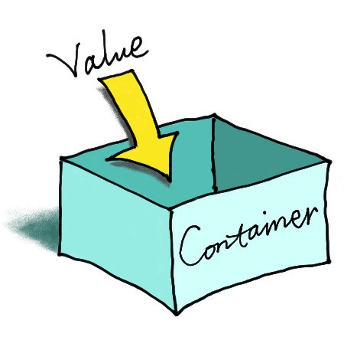
ცვლადები
უმეტესწლიად ჩვენს მიერ დაწერილ პროგრამაში შეხება გვექნება ცვლადებთან.
ცვლადები გამოიყენება ინფორმაციის შენახვისთვის.

Slide 10

ცხოვრებისეული ანალოგი
let data;
data = "Giorgi Dzirkvelishvili";
data = "Software Engineer";
data = 22;
Data

Slide 11
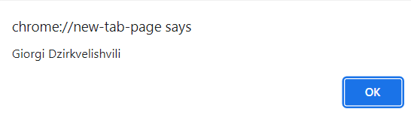
To create a variable in JavaScript, use the Var, Const, let keywords.
let data;
data = "Giorgi Dzirkvelishvili";
alert(data);
let data;
var data;
const data;

Slide 12
Constants
const pi = 3.14;
const Name;
Name = "Gio";
When a programmer is sure that a variable will never change, they can declare it with const to guarantee and clearly communicate that fact to everyone.
Variables declared using const are called “constants”. They cannot be reassigned. An attempt to do so would cause an error:
const pi = 3.14;

Slide 13
მნიშვნელოვანი ფაქტები ცვლადებზე
Case matters
Non-Latin letters are allowed, but not recommended
There is a list of reserved words, which cannot be used as variable names because they are used by the language itself. For example: let, class, return, and, function, are reserved.

Slide 14
ცვლადების სახელები
სწორად შერჩეული სახელები
let FirstName;
let TestData123;
There are two limitations on variable names in JavaScript:
The name must contain only letters, digits, or the symbols $ and _.
The first character must not be a digit.
არასწორად შერჩეული სახელები
let 123TestData;
let First-Name;

Slide 15
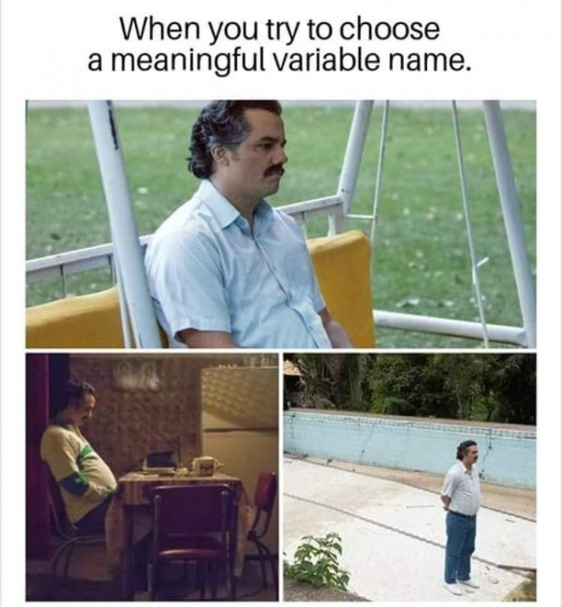
დავარქვათ ცვლადებს სახელები სწორად
Use human-readable names like userName or shoppingCart.
Stay away from abbreviations or short names like a, b, c, unless you really know what you’re doing.
Make names maximally descriptive and concise
Agree on terms within your team and in your own mind. If a site visitor is called a “user” then we should name related variables currentUser or newUser.
const pi = 3.14;

Slide 16

შეჯამება
We can declare variables to store data by using the var, let, or const keywords.
let – is a modern variable declaration.
var – is an old-school variable declaration. const – is like let, but the value of the variable can’t be changed.
Variables should be named in a way that allows us to easily understand what’s inside them.

Slide 17
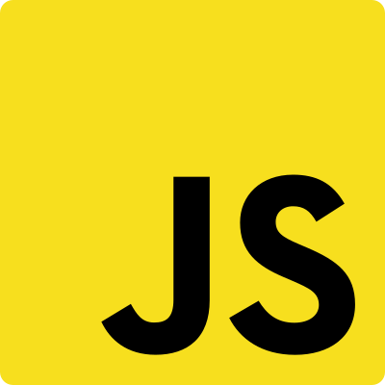
Data types in JS

Slide 18
JS ‘’dynamically typed’’
let message = "Digital Academy";
message = 2022;
We can put any type in a variable. For example, a variable can at one moment be a string and then store a number.
Programming languages that allow such things, such as JavaScript, are called “dynamically typed”, meaning that there exist data types, but variables are not bound to any of them.

Slide 19
data types
Objects {a{name:’Gio’}
Boolean true, false //
Null null //
Undefined undefined //
Number 1, 4, 7, 231, 51, 11, 9 //
BigInt 9007199254740991n //
String 'Hello''World'‘Georgia’ //
Symbol let sym1 = Symbol() //

Slide 20
Boolean (logical type)
The boolean type has only two values: true and false.
This type is commonly used to store yes/no values: true means “yes, correct”, and false means “no, incorrect”.
let isUserActive = true;
let isUserUnder18 = false;

Slide 21
Number
The number type represents both integer and floating-point numbers.
let age = 12;
let mark = 9.7;
let infinityValue = 1/0;
let negativeInfinityValue = -1/0;
let notANumber = "Giorgi" / 2;
Besides regular numbers, there are so-called “special numeric values” which also belong to this data type: Infinity,
-Infinity and NaN.

Slide 22
BigInt
alert(9007199254740991 + 1);
9007199254740992
alert(9007199254740991 + 2);
9007199254740992
In JavaScript, the “number” type cannot safely represent integer values larger than
(2⁵³-1) (that’s 9007199254740991), or less than
-(2⁵³-1) for negatives.
const bigInt = 1234567890123456789012345678901234567890n;

Slide 23
String
A string in JavaScript must be surrounded by quotes.
let name = "Gio";
let surname = "Dzirkvelishvili";
let fullName = `${name} ${surname}`;

Slide 24
null
The special null value does not belong to any of the types described above.
It forms a separate type of its own which contains only the null value. In JavaScript, null is not a “reference to a non-existing object” or a “null pointer” like in some other languages.
It’s just a special value that represents “nothing”, “empty” or “value unknown”.
let name = null;

Slide 25
The Undefined value
let name;
alert(name);
The special value undefined also stands apart. It makes a type of its own, just like null.
The meaning of undefined is “value is not assigned”.
If a variable is declared, but not assigned, then its value is undefined

Slide 26
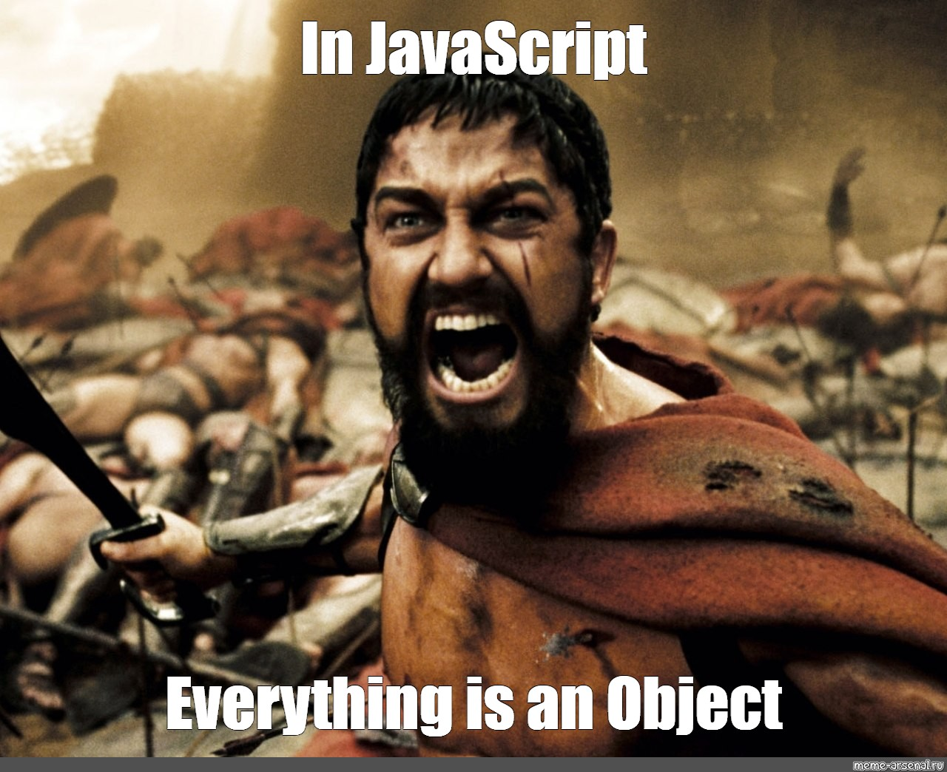
Object
The object type is special.
All other types are called “primitive” because their values can contain only a single thing (be it a string or a number or whatever). In contrast, objects are used to store collections of data and more complex entities.

Slide 27
Symbol
The symbol type is used to create unique identifiers for objects.
const sym = Symbol();

Slide 28
Typeof operator
typeof "John"
Returns "string" typeof 3.14
Returns "number" typeof true
Returns "boolean" typeof false
Returns "boolean“ typeof null
Returns “object“
Typeof ოპერატორი გამოიყენება მონაცემთა ტიპის შესამოწმებლად, Typeof ოპერატორი გვიბრუნებს სტრინგს, სადაც წერია რა მონაცემთა ტიპია ჩვენს მიერ გადაცემული პარამეტრი

Slide 29
Basic operators, maths
let sum = 1+2;
let num = 10-5;
let age = 50/10;
let mark = 3*5;
let rem = 11%2;
let name = "name";
sum++;
sum--;
Addition +,
Subtraction -,
Multiplication *,
Division /,
Remainder %,
Assignment = ,
Increment ++;
Decrement ++;

Slide 30
Summary / Q&A
There are 8 basic data types in JavaScript.
Seven primitive data types:
number for numbers of any kind: integer or floating-point, integers are limited by ±(2⁵³-1).
bigint for integer numbers of arbitrary length.
string for strings. A string may have zero or more characters, there’s no separate single-character type.
boolean for true/false.
null for unknown values – a standalone type that has a single value null.
undefined for unassigned values – a standalone type that has a single value undefined.
symbol for unique identifiers.
And one non-primitive data type:
object for more complex data structures.

Slide 31
Expressions & Statements

Slide 32
Expressions
1 → produces 1
"hello" → produces "hello"
5 * 10 → produces 50
num > 100 → produces either true or false
IsHappy ? "🙂" : "🙁" → produces an emoji
[1, 2, 3].pop() → produces the number 3
At its core, an expression is a bit of JavaScript code that produces a value.

Slide 33
Expressions can contain expressions. For example, how many expressions do you count in this chunk of JS code?
( 1 + 2 ) * 3

Slide 34
Statements
let hi = 5;
throw new Error('Something exploded!’);
if (hi > 10) {
// More statements here
}
A JavaScript program is a sequence of statements. Each statement is an instruction for the computer to do something

Slide 35
Expressions VS Statements
statements are the rigid structure that holds our program together, while expressions fill in the details.
let hi = 1;
let hi = "hello";
let hi = 5 * 10;
let hi = num > 100;
let hi = isHappy ? "🙂" : "🙁";
let hi = [1, 2, 3].pop();
Console.log() the code, If it runs, the code is an expression. If you get an error, it's a statement (or, possibly, invalid JS).

Slide 36
Summary / Q&A
A JavaScript program consists of a sequence of statements. Each statement is an instruction to do something, like create a variable, run an if/else condition, or start a loop.
Expressions produce a value, and these values are slotted into statements,
An expression is any valid unit of code that resolves to a value.
A statement is any valid unit of code that resolves to an instruction. Wherever JavaScript expects a statement, you can also write an expression. The reverse does not hold.

Slide 37
Docs
https://developer.mozilla.org/en-US/docs/Web/JavaScript/Data_structures#type_coercion
https://github.com/getify/You-Dont-Know-JS/blob/1st-ed/types%20%26%20grammar/ch1.md
https://javascript.plainenglish.io/why-does-javascript-have-0-9b6e1965a075
https://www.w3schools.com/js/js_variables.asp

Slide 38
Thank you for your Time !

