Slide 1
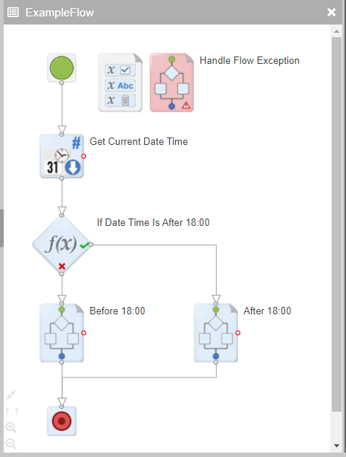
Start Flow block
Handle Flow Exception block
Flow Variable Store
Action block
Workspace
Decision block
Workspace blocks
End Flow block

Slide 2
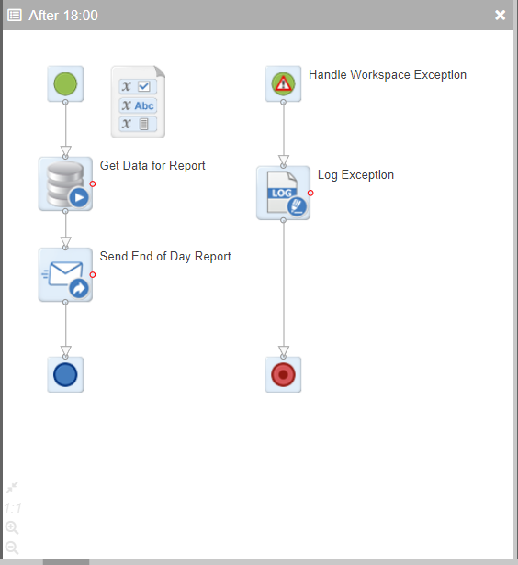
Start Workspace block
Handle Workspace Exception block
Workspace Variable Store
Action blocks
Action block
Workspace
End Workspace block
End Flow block

