Slide 1
Probabilistic online Knowledge Graph Construction from Natural Language
Clemens Damke
Department of Computer Science
Paderborn University

Slide 2
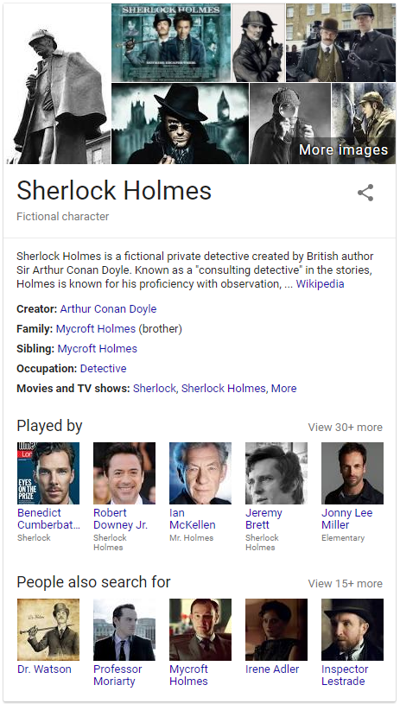
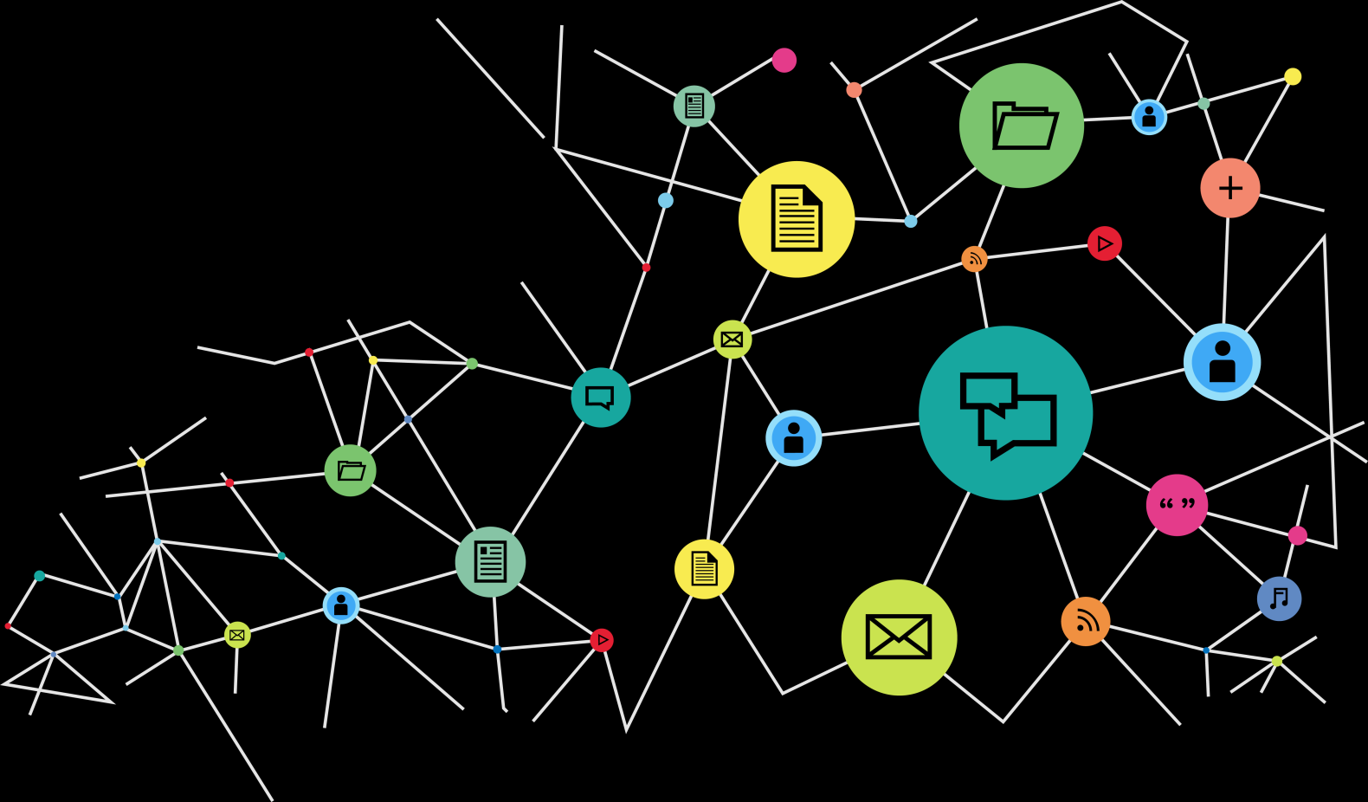
What are Knowledge Graphs?
Graphs describing arbitrary structured or unstructured information.
Used by Google since 2012 for the “knowledge panel”.

Slide 3
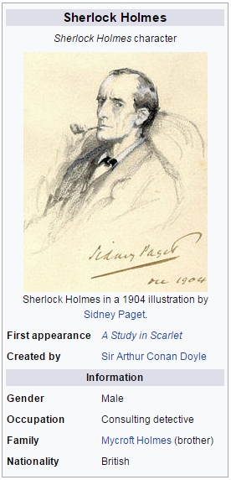
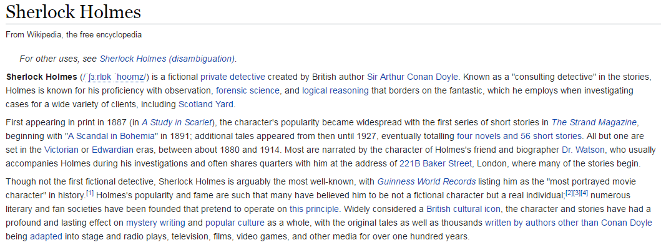
How to construct a Knowledge Graph?
From structured information
Wikipedia info boxes
CIA World Factbook
Wikidata
…
From unstructured information
Wikipedia textual description
Arbitrary websites
Chat & Mail communication
…

Slide 4
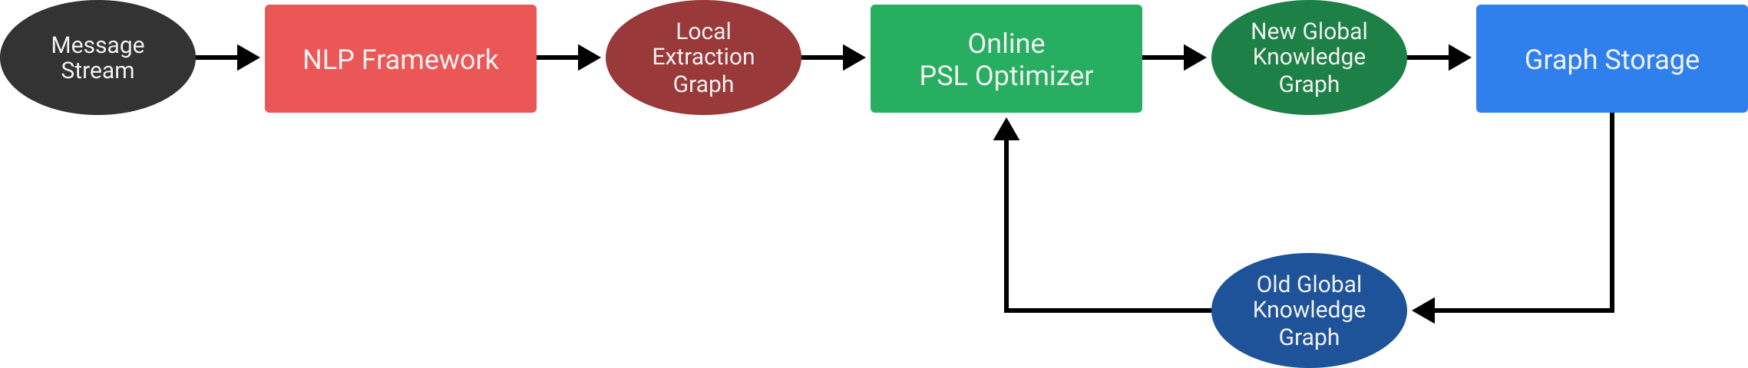
KGs from Communication Data
Infinite stream of messages
Natural language content + metadata for each message
Bob → Alice: “I saw you today.” (11.06.2017)
Alice → Bob: “I don’t think I saw you yesterday.” (12.06.2017)
…

Slide 5
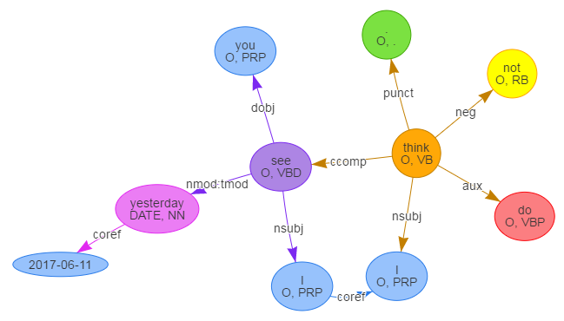
Processing a message
Create a dependency graph using an existing NLP framework.
“I don’t think I saw you yesterday.”
(12.06.2017)

Slide 6
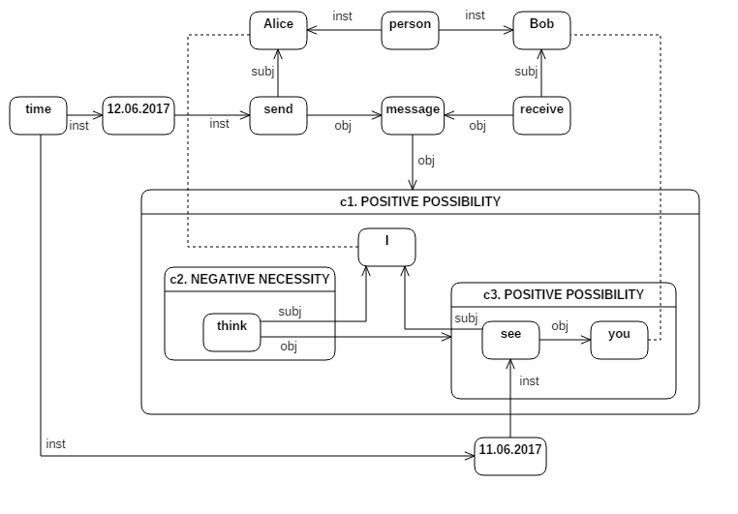
Processing a message
Construct a concept graph from the dependency graph.

Slide 7
What is a concept graph?
First described by John F. Sowa.
Based on Charles S. Peirce’s existential beta-graphs.
A logical calculus with the power of first-order predicate logic.

Slide 8


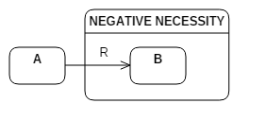
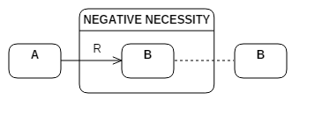



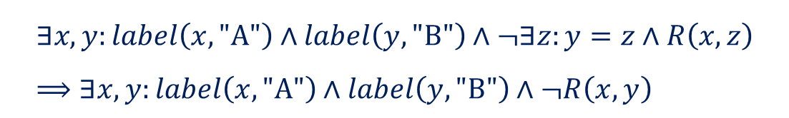
What is a concept graph?
$$∃x,y:label\left(x, \text{"}\text{A}\text{"}\right)∧label\left(y, "\text{B}\text{"}\right)$$
$$∃x,y:label\left(x, \text{"}\text{A}\text{"}\right)∧label\left(y, "\text{B}\text{"}\right)∧R\left(x, y\right)$$
$$∃x:label\left(x, \text{"}\text{A}\text{"}\right)∧¬∃y:label\left(y, "\text{B}\text{"}\right)∧R\left(x, y\right)$$
$$∃x,y:label\left(x, \text{"}\text{A}\text{"}\right)∧label\left(y, \text{"}\text{B}\text{"}\right)∧¬∃z:y=z∧R\left(x, z\right) \\ ⟹∃x,y:label\left(x, \text{"}\text{A}\text{"}\right)∧label\left(y, \text{"}\text{B}\text{"}\right)∧¬R\left(x, y\right)$$

Slide 9
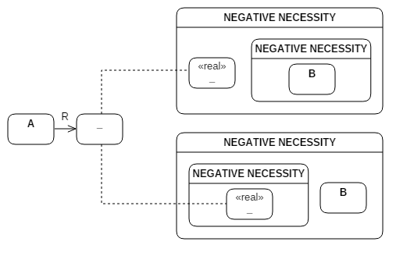
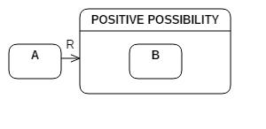

What is a concept graph?
Modal possibility added as a shorthand notation:
$$⇔$$
$$∃x,y:label(x, \text{"}\text{A}\text{")}∧R\left(x, y\right)∧(real\left(y\right)↔∃z:label\left(z, \text{"}\text{B}\text{"}\right))$$

Slide 10
What is a concept graph?
Alice → Bob:
“I don’t think I saw you yesterday.”
(12.06.2017)

Slide 11
Processing a message
How to merge this extracted concept graph with the knowledge base?

Slide 12
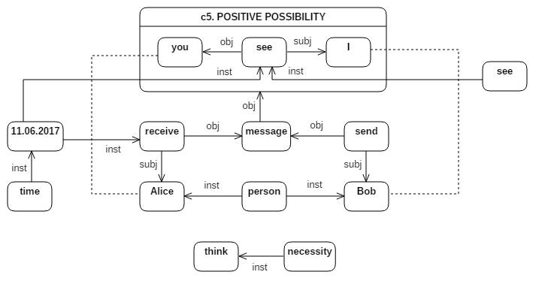
Inserting a message

Slide 13
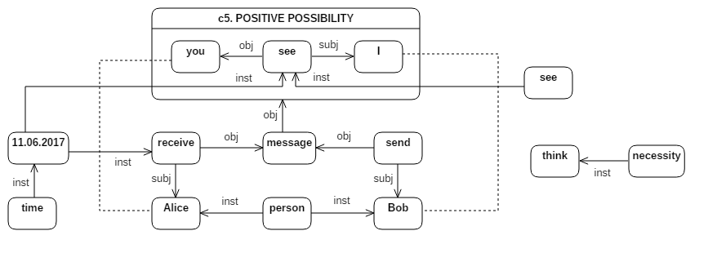
Inserting a message

Slide 14
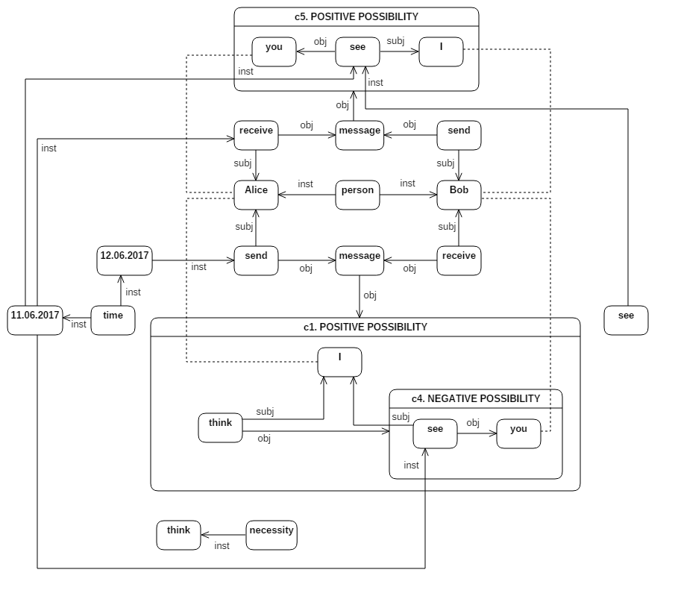
Inserting a message

Slide 15
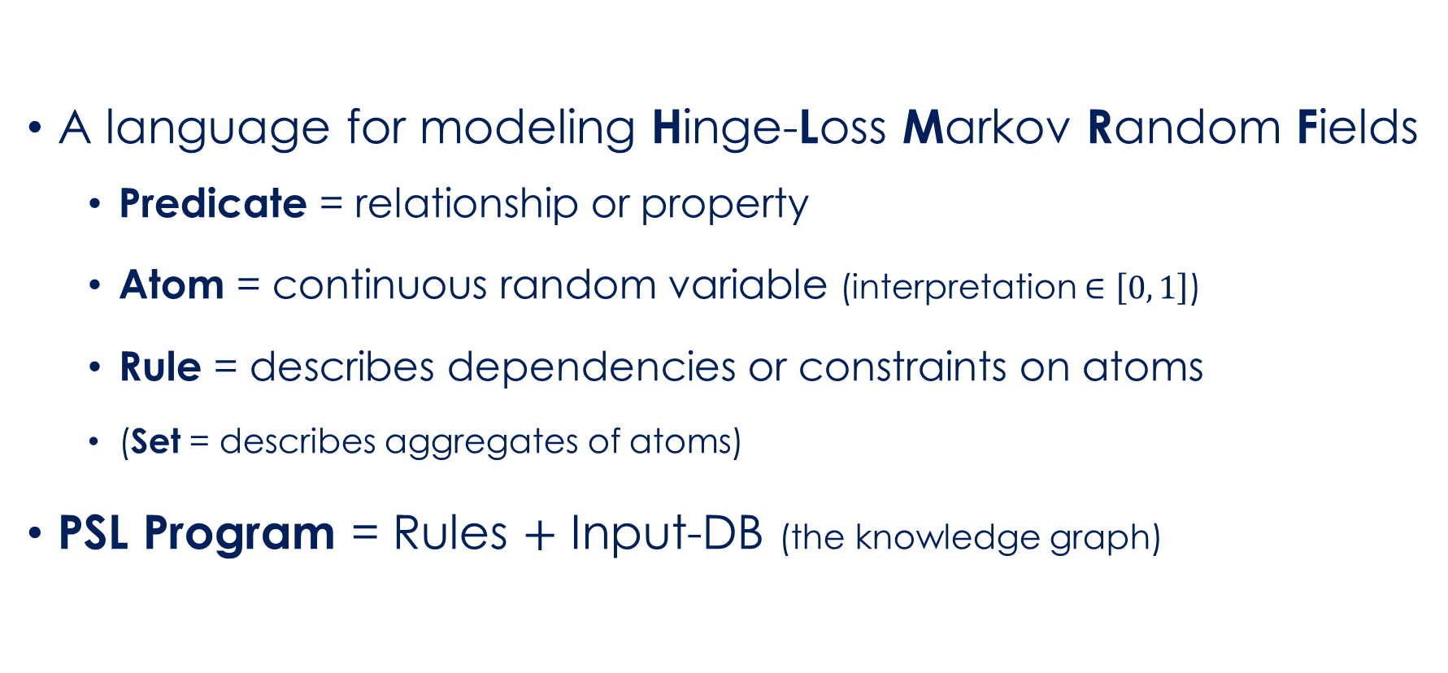
Probabilistic Soft Logic
A language for modeling Hinge-Loss Markov Random Fields
Predicate = relationship or property
Atom = continuous random variable (interpretation $∈\left[0, 1\right]$)
Rule = describes dependencies or constraints on atoms
(Set = describes aggregates of atoms)
PSL Program = Rules $+$ Input-DB (the knowledge graph)

Slide 16
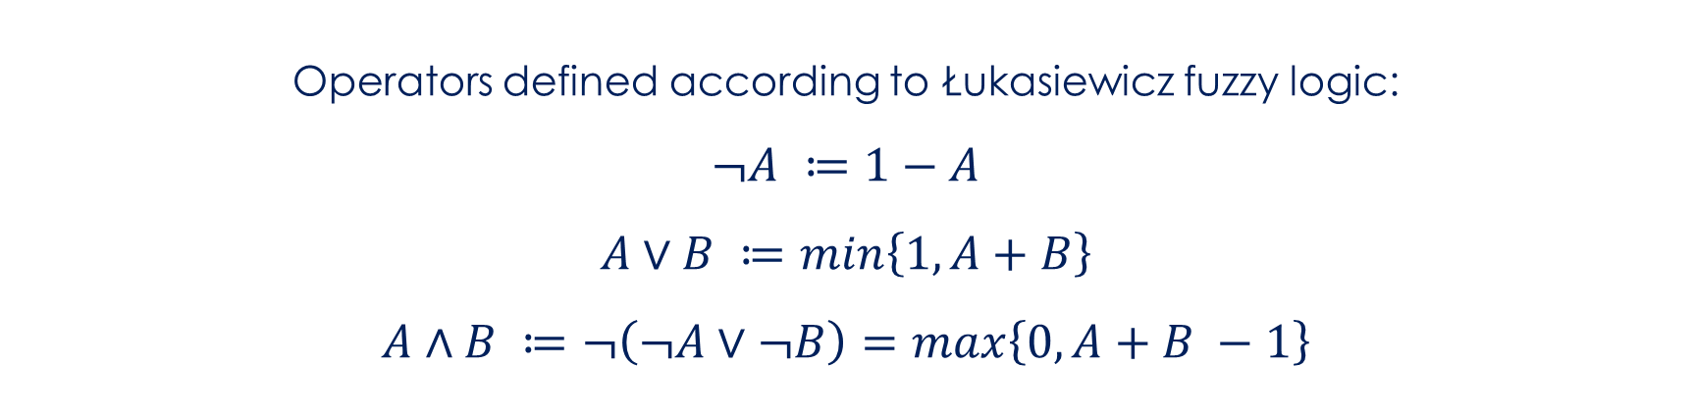

PSL Rules
atom
$${r_{1}: B}_{1}∧…∧B_{n}→H_{1}∨…∨H_{m}: w_{1}$$
body
$$≤$$
head
weight
Operators defined according to Łukasiewicz fuzzy logic:
$$¬A ≔1−A$$
$$A∨B ≔min\left\{1, A+B\right\}$$
$$A∧B ≔¬\left(¬A∨¬B\right)=max\left\{0, A+B −1\right\}$$

Slide 17
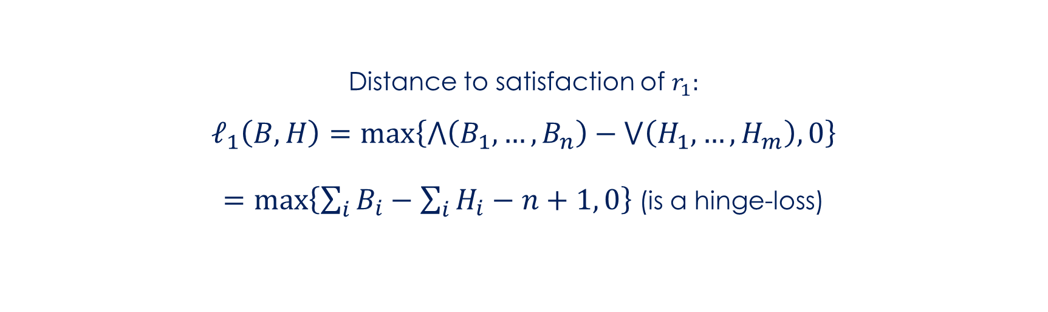
PSL Rules
atom
$${r_{1}: B}_{1}∧…∧B_{n}→H_{1}∨…∨H_{m}: w_{1}$$
body
$$≤$$
head
weight
Distance to satisfaction of $r_{1}:$
$$ℓ_{1}\left(B,H\right)=\max\left\{⋀\left(B_{1},…,B_{n}\right)−⋁\left(H_{1},…,H_{m}\right), 0\right\}$$
$=\max\left\{\sum_{i}{B_{i}}−\sum_{i}{H_{i}}−n+1, 0\right\}$(is a hinge-loss)

Slide 18
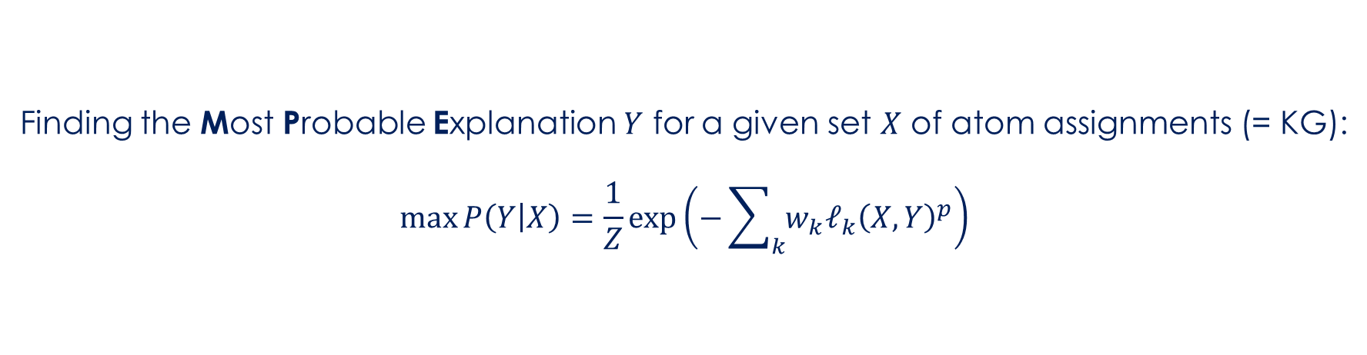
PSL Rules
atom
$${r_{1}: B}_{1}∧…∧B_{n}→H_{1}∨…∨H_{m}: w_{1}$$
body
$$≤$$
head
weight
Finding the Most Probable Explanation $Y$ for a given set $X$ of atom assignments (= KG):
$$\max{P\left(Y | X\right)=\frac{1}{Z}}\exp\left(−\sum_{k}{{{w_{k}ℓ}_{k}\left(X, Y\right)}^{p}}\right)$$

Slide 19


Using PSL for message insertion
$$r_{1}:label\left(A, X\right)∧label\left(B,Y\right)∧similar\left(X,Y\right)∧class(A)→inst(A,B)$$
$$r_{2}:inst\left(A,B\right)∧inst(B,C)→inst(A,C)$$

Slide 20
Inserting a message
Store in Graph Database

Slide 21
Thank you!

Slide 22
Further reading…
Stanford CoreNLP: https://stanfordnlp.github.io/CoreNLP/
Introduction to Concept Graphs: http://dai.fmph.uniba.sk/~sefranek/kri/handbook/handbook_of_kr.pdf (p. 213 ff.)
PSL: https://event.cwi.nl/uai2010/papers/UAI2010_0089.pdf

