Slide 1
Knowledge Graph Construction from Natural Language Streams

Slide 2
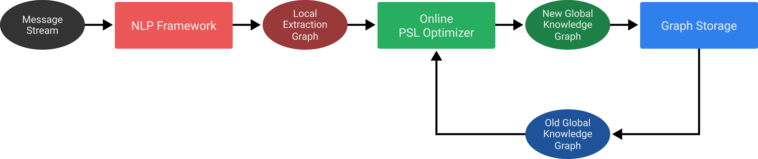
Overview

Slide 3
NLP Framework
Popular Open Source Solutions: Stanford CoreNLP, Apache OpenNLP
Commercial Alternative: ?

Slide 4
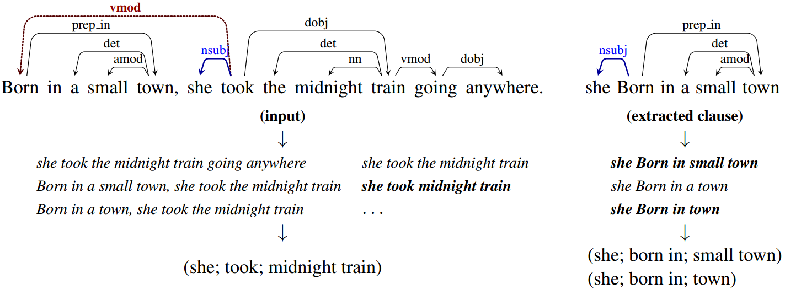
NLP Framework

Slide 5
Probabilistic Soft Logic
Fuzzy First Order Logic Calculus: Uses Łukasiewicz t-norm with (CNF → DNF)-terms
MAX-SAT can be reduced to optimization of a convex hyperplane ⇒ Solvable in O(n) via ADMM
Problem: Implementation exists only for single machine + offline inference

Slide 6
Graph Storage
Various Options: Neo4j, Titan?, Gaffer?, others?

