Slide 1
Probabilistic online Knowledge Graph Construction from Natural Language
Clemens Damke
Department of Computer Science
Paderborn University

Slide 2
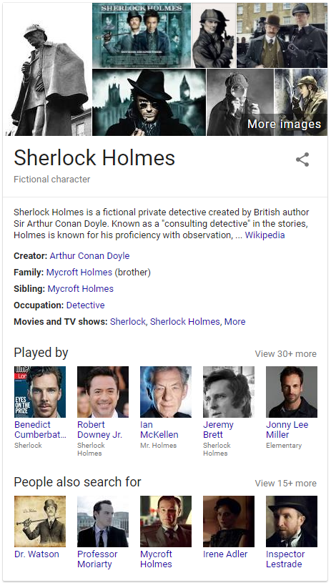
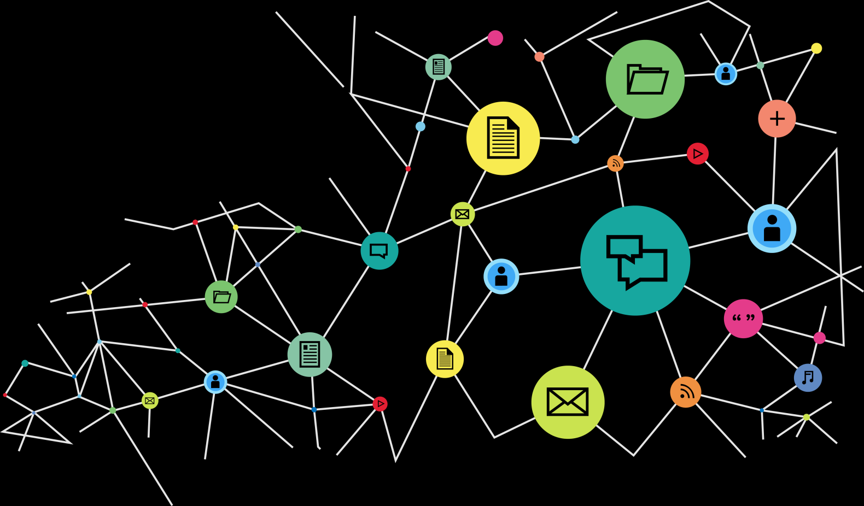
What are Knowledge Graphs?
Graphs describing arbitrary structured or unstructured information.
Used by Google since 2012 for the “knowledge panel”.

Slide 3
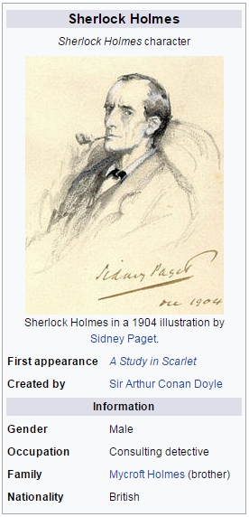
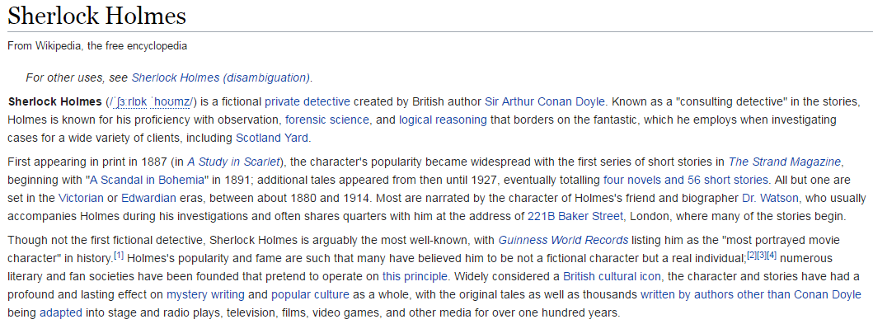
How to construct a Knowledge Graph?
From structured information
Wikipedia info boxes
CIA World Factbook
Wikidata
…
From unstructured information
Wikipedia textual description
Arbitrary websites
Chat & Mail communication
…

Slide 4
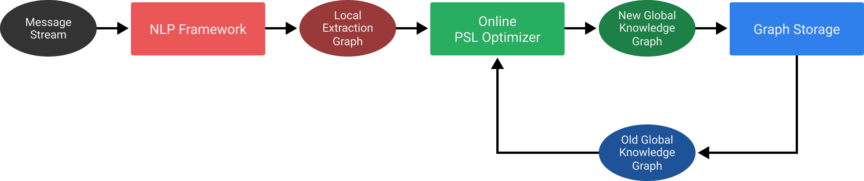
KGs from Communication Data
Infinite stream of messages
Natural language content + metadata for each message
Bob → Alice: “I saw you today.” (11.06.2017)
Alice → Bob: “I don’t think I saw you yesterday.” (12.06.2017)
…

Slide 5
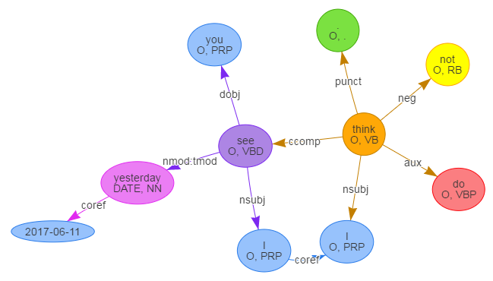
Processing a message
Create a dependency graph using an existing NLP framework.
“I don’t think I saw you yesterday.”
(12.06.2017)

Slide 6
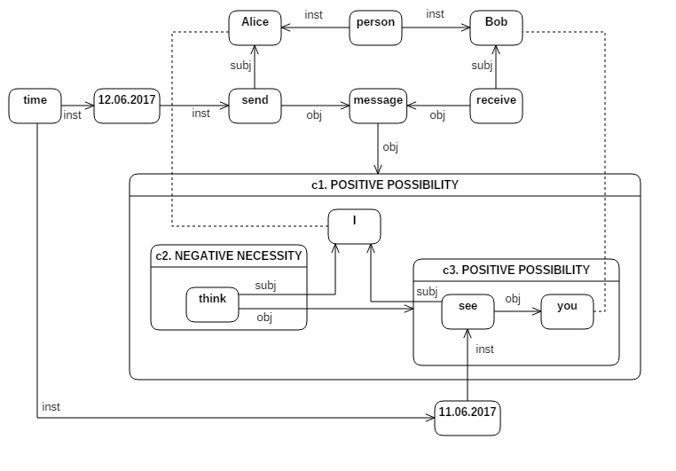
Processing a message
Construct a concept graph from the dependency graph.

Slide 7
What is a concept graph?
First described by John F. Sowa.
Based on Charles S. Peirce’s existential beta-graphs.
A logical calculus with the power of first-order predicate logic.

Slide 8


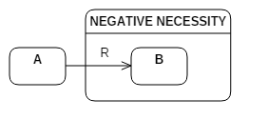
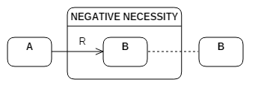
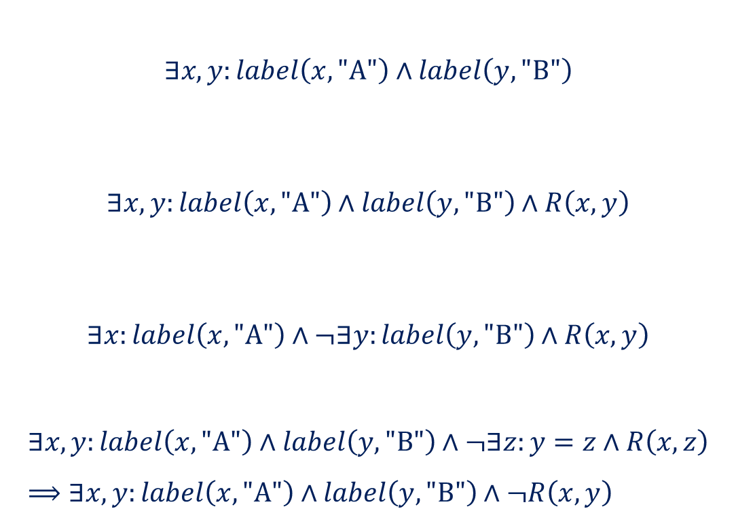
What is a concept graph?
$$∃x,y:label\left(x, \text{"}\text{A}\text{"}\right)∧label\left(y, "\text{B}\text{"}\right)$$
$$∃x,y:label\left(x, \text{"}\text{A}\text{"}\right)∧label\left(y, "\text{B}\text{"}\right)∧R\left(x, y\right)$$
$$∃x:label\left(x, \text{"}\text{A}\text{"}\right)∧¬∃y:label\left(y, "\text{B}\text{"}\right)∧R\left(x, y\right)$$
$$∃x,y:label\left(x, \text{"}\text{A}\text{"}\right)∧label\left(y, \text{"}\text{B}\text{"}\right)∧¬∃z:y=z∧R\left(x, z\right) \\ ⟹∃x,y:label\left(x, \text{"}\text{A}\text{"}\right)∧label\left(y, \text{"}\text{B}\text{"}\right)∧¬R\left(x, y\right)$$

Slide 9
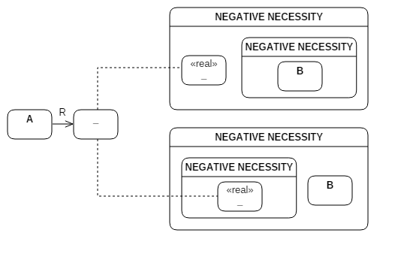
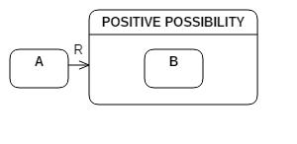

What is a concept graph?
Modal possibility added as a shorthand notation:
$$⇔$$
$$∃x,y:label(x, \text{"}\text{A}\text{")}∧R\left(x, y\right)∧(real\left(y\right)↔∃z:label\left(z, \text{"}\text{B}\text{"}\right))$$

Slide 10
What is a concept graph?
Alice → Bob:
“I don’t think I saw you yesterday.”
(12.06.2017)

Slide 11
Processing a message
How to merge this extracted concept graph with the knowledge base?

Slide 12
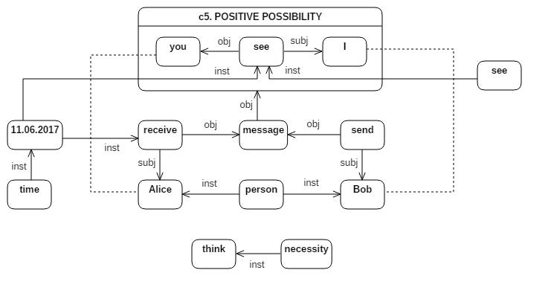
Inserting a message

Slide 13
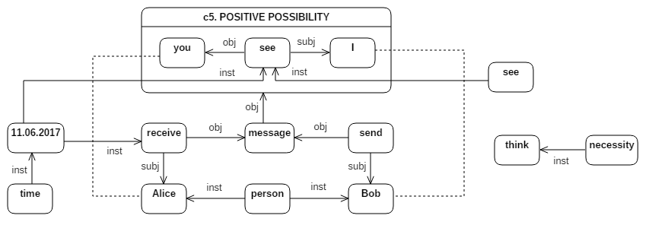
Inserting a message

Slide 14
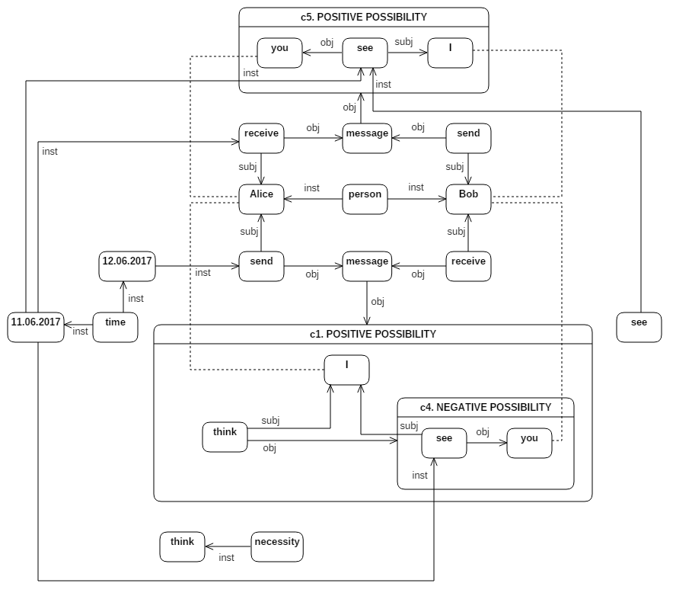
Inserting a message

Slide 15
Probabilistic Soft Logic

