Slide 1
Learning to Aggregate on Structured Data
Master Thesis Final Presentation
Clemens Damke

Slide 2
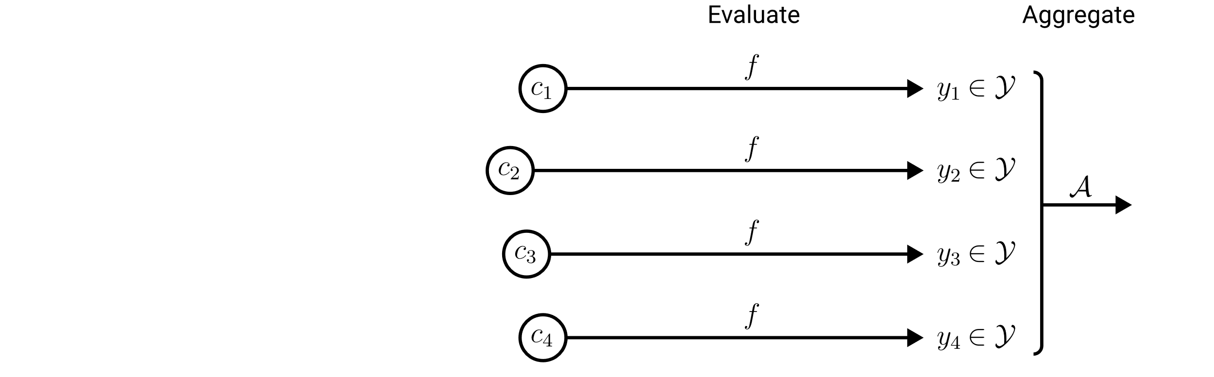
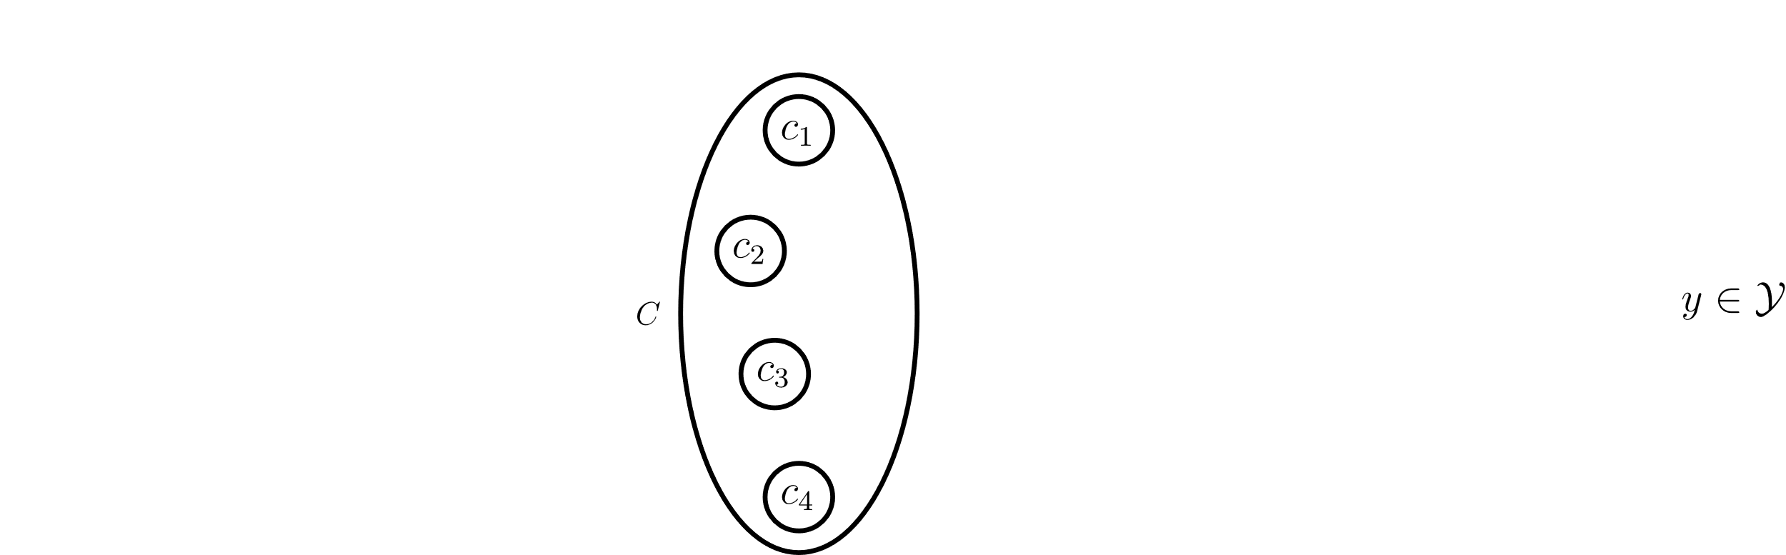
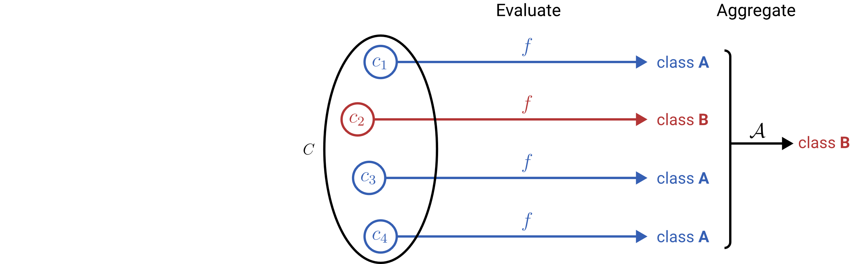
Learning to Aggregate on Unstructured Data
Permutation invariance
Variable input size
Localized explainability
composition
constituent

Slide 3
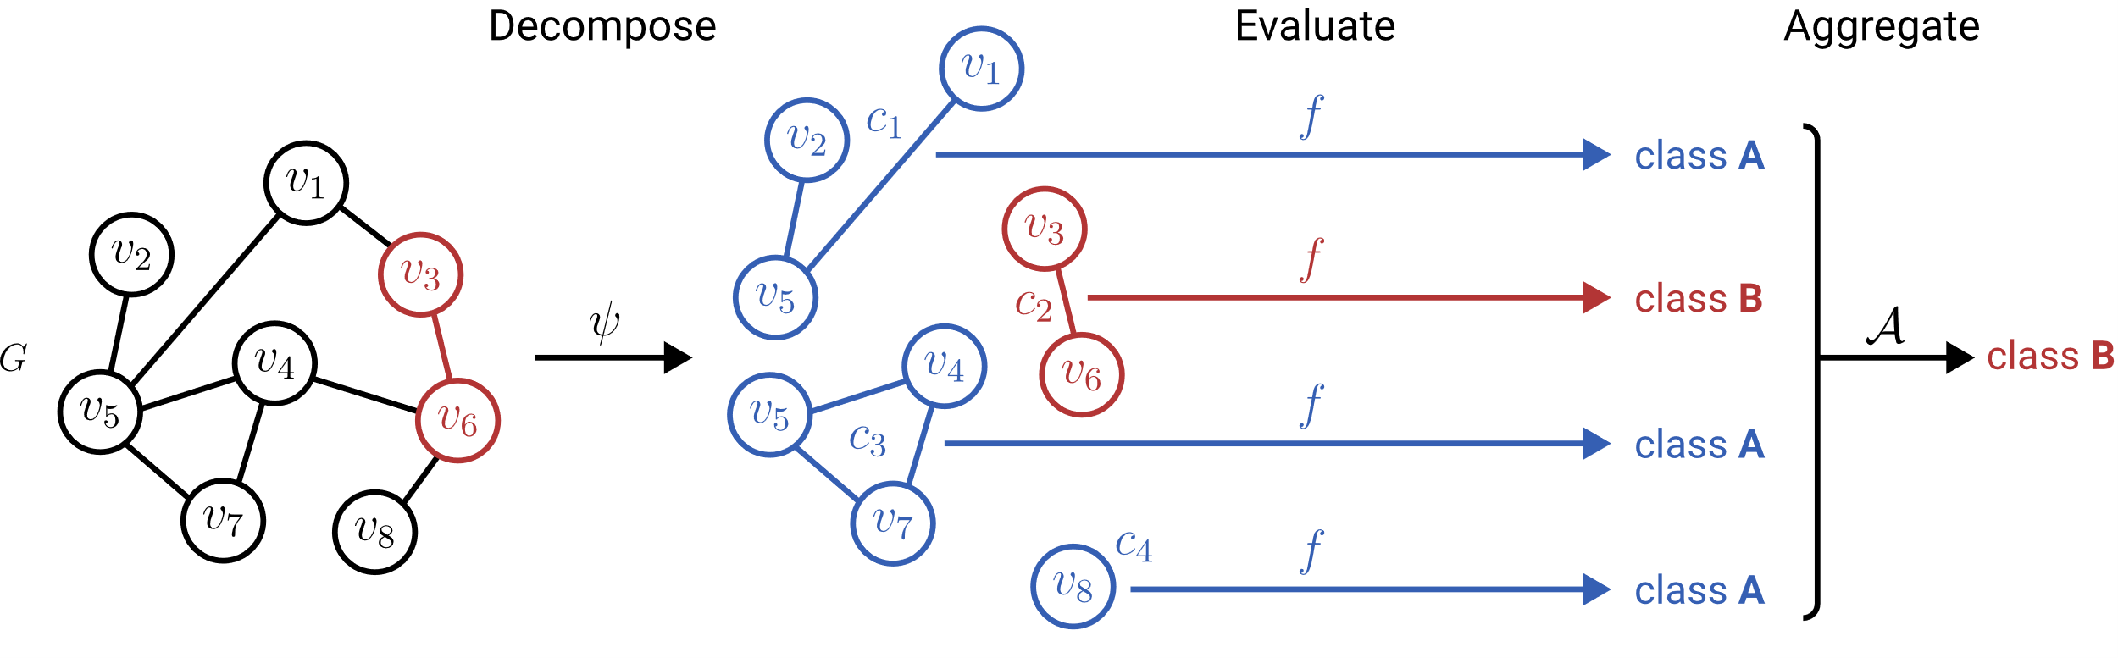
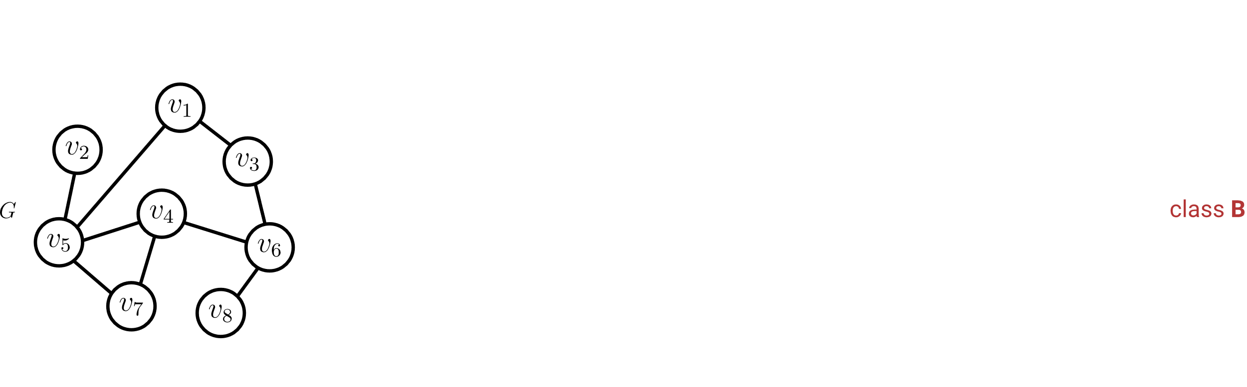
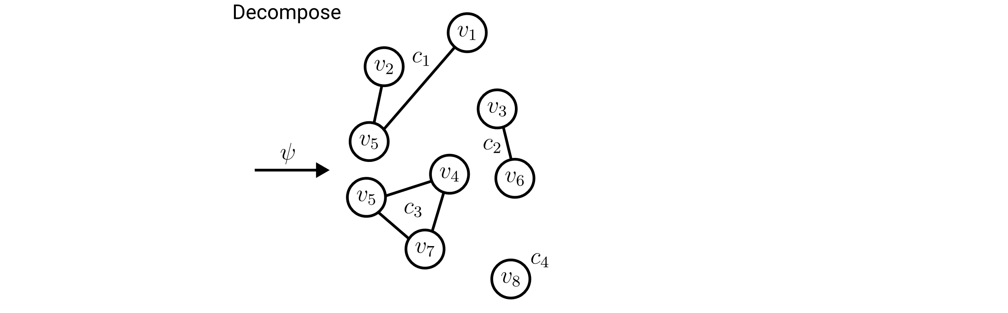
Learning to Aggregate on Structured Data
Permutation invariance
Variable input size
Localized explainability

Slide 4
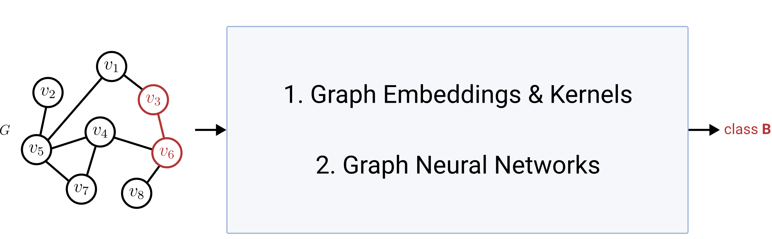
Graph Classification & Regression (GC/GR)
Permutation invariance
Variable input size
Localized explainability
ü
ü
?

Slide 5
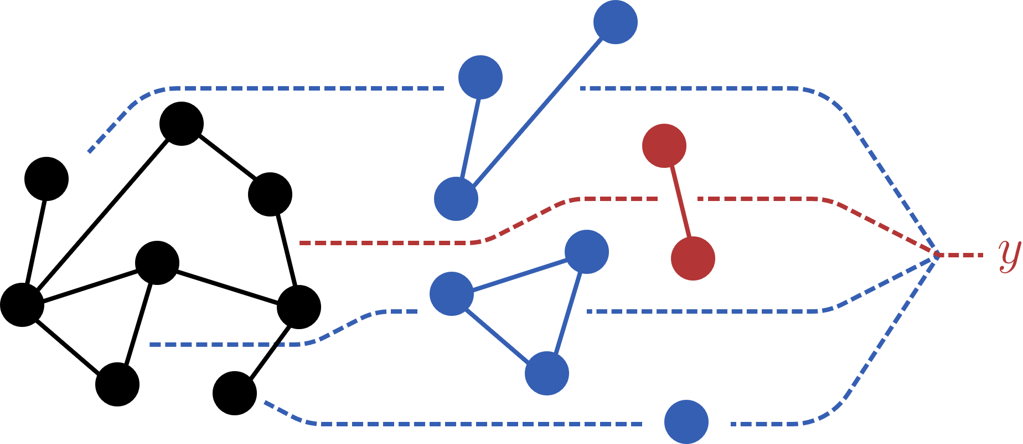
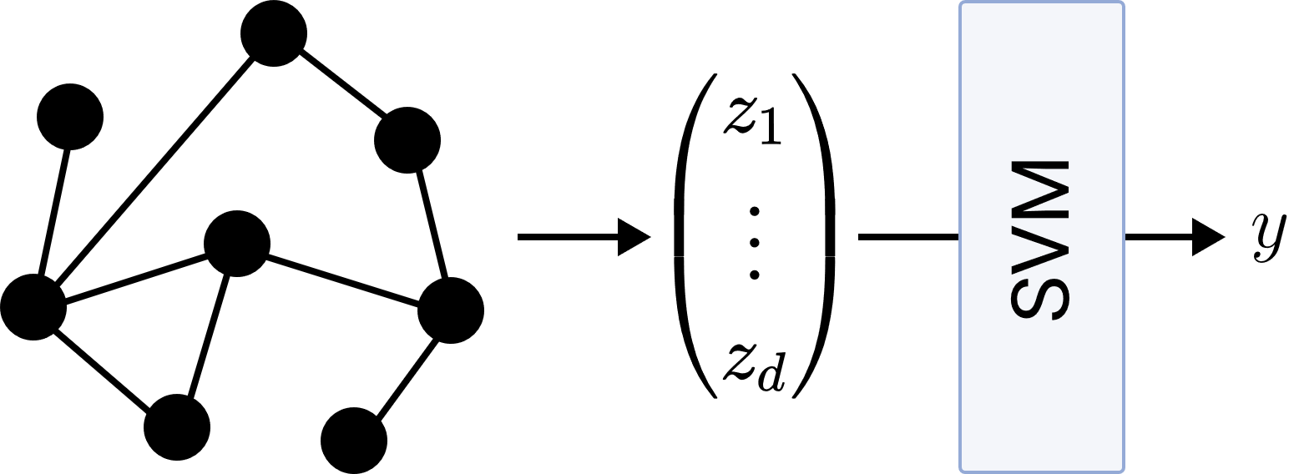
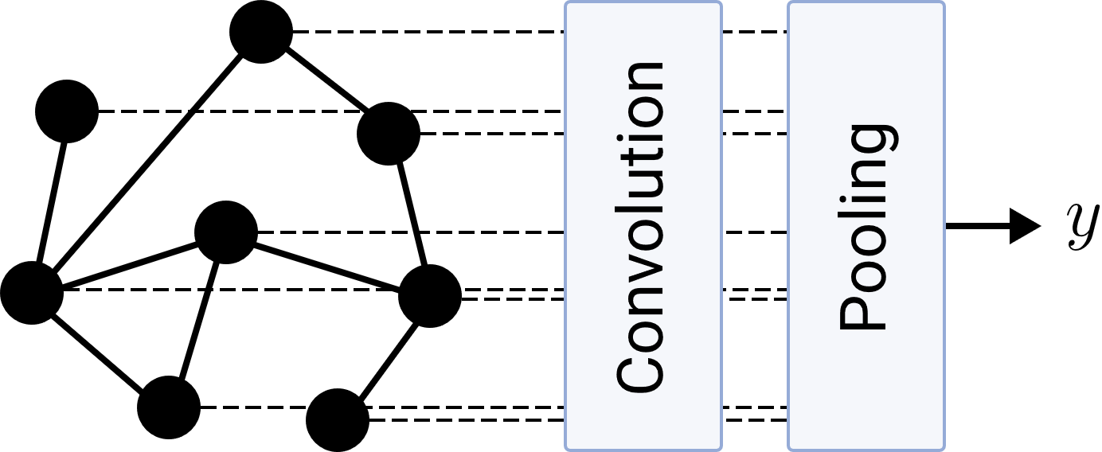
Research Questions
LTA
What is a general definition of LTA?
How does LTA relate to existing GC/GR methods?
What are shortcomings of existing GC/GR methods? How can they be fixed?
Graph Embeddings & Kernels
Graph Neural Networks

Slide 6
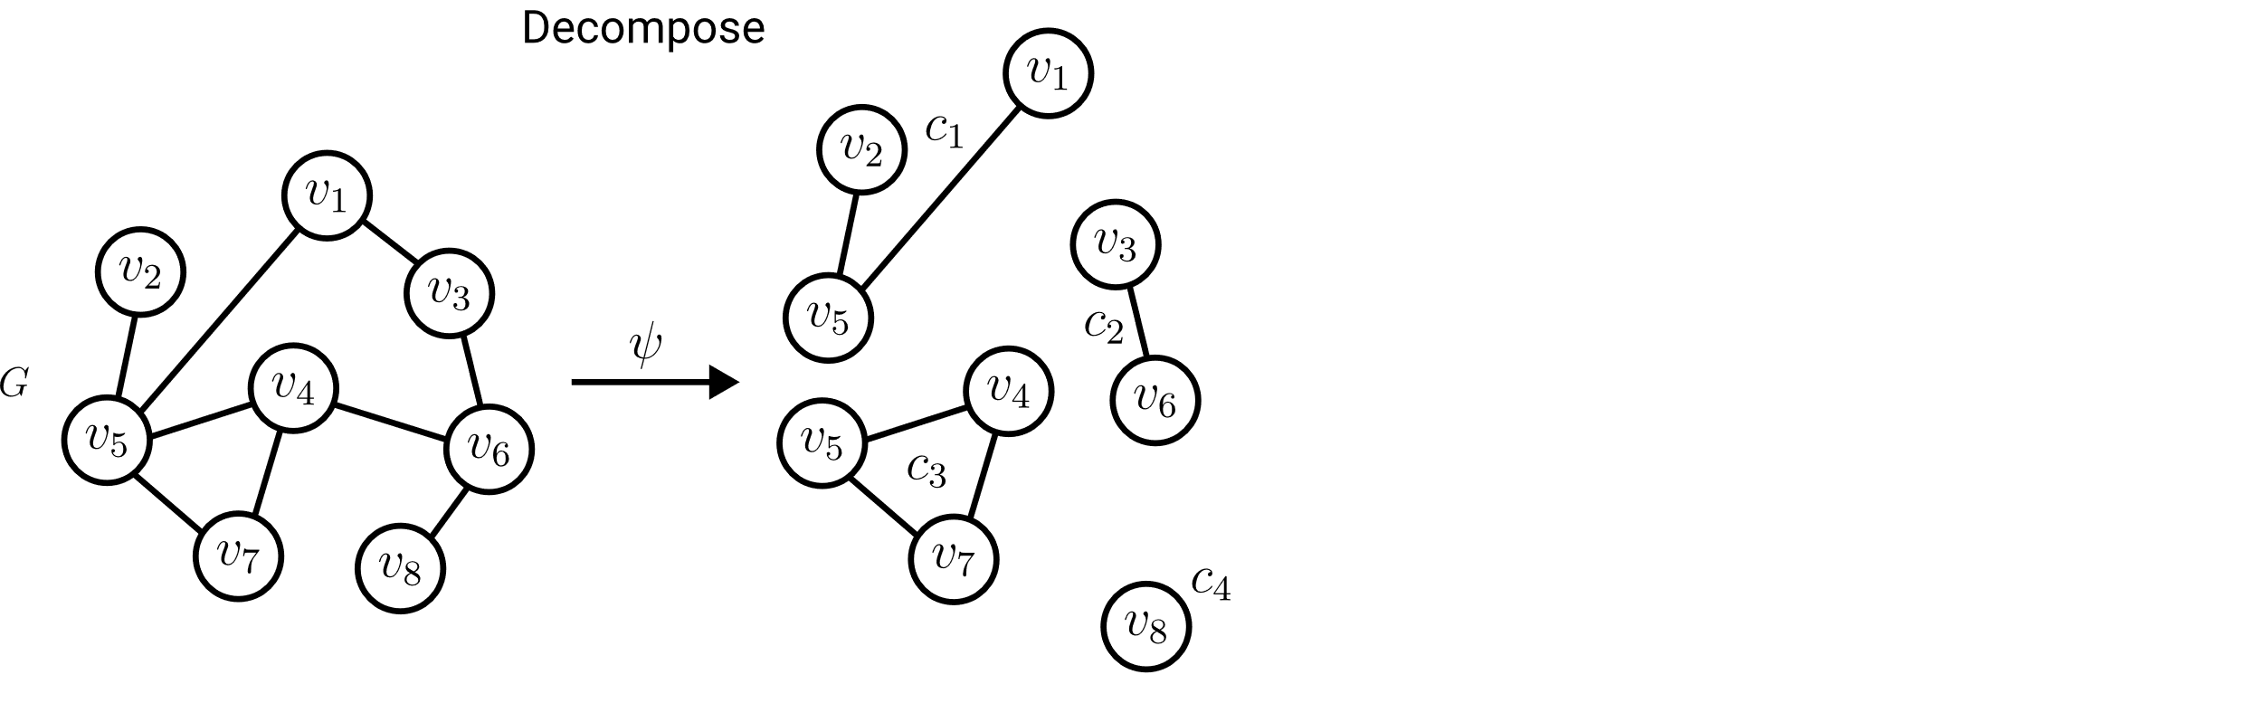

Definition of LTA: Decomposition
Ideally: Localized, interpretable subgraph constituents.
Required:
Split a graph into a subset of its subgraphs.

Slide 7
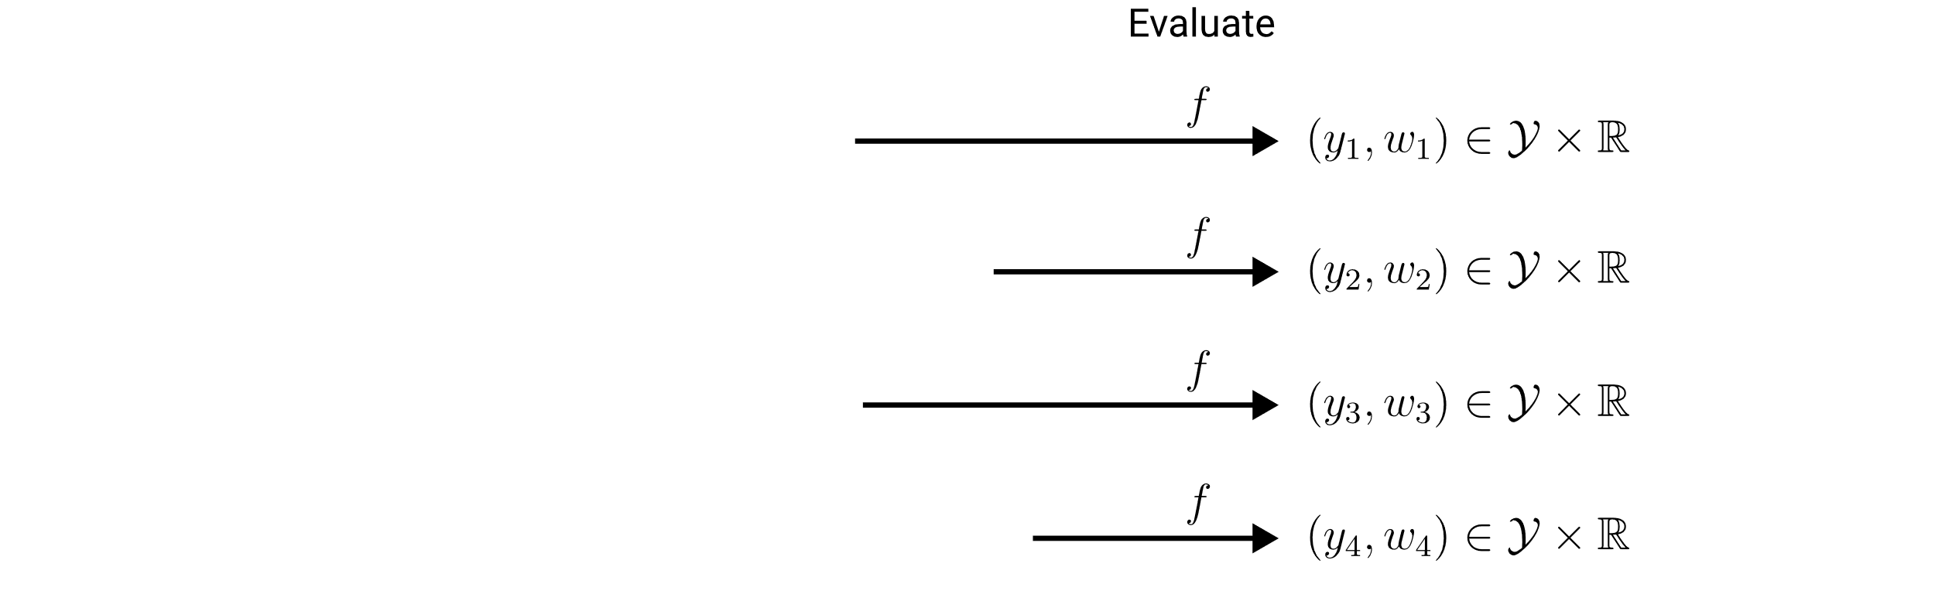

Definition of LTA: Evaluation
Importance for the composition score.
Required:
Assign a score and weight to each constituent.

Slide 8

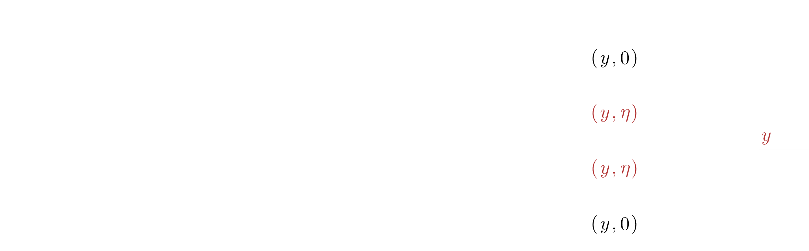
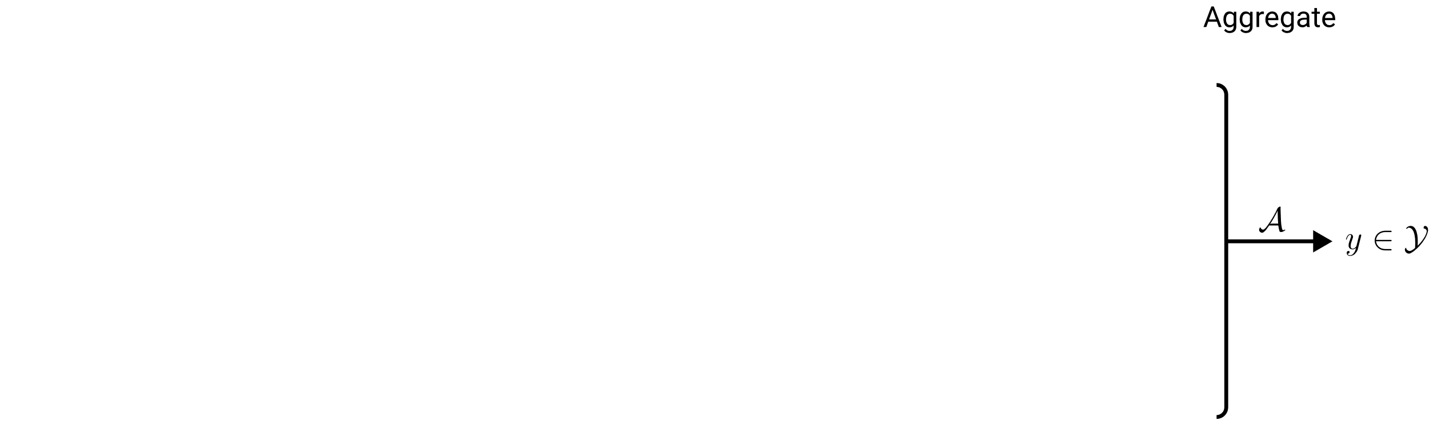
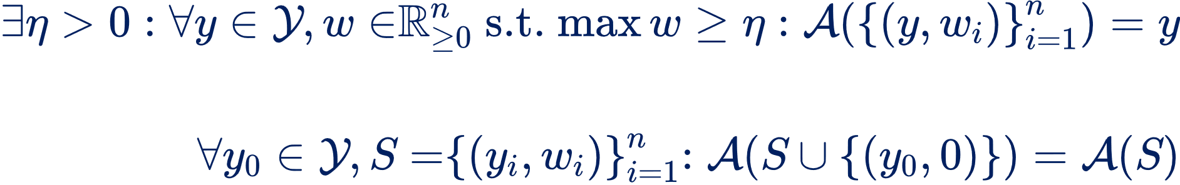
Definition of LTA: Aggregation
Idempotency:
Zero invariance:

Slide 9
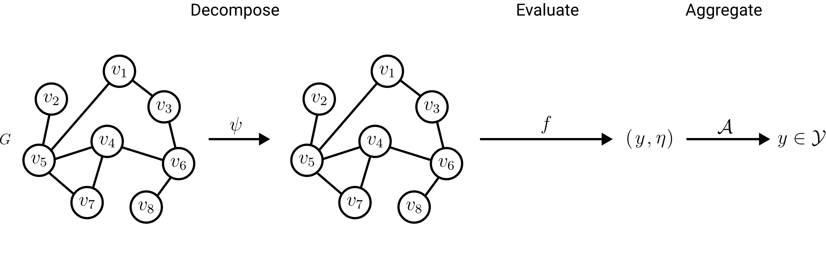
Definition of LTA: Formulations
Trivial decomposition
LTA Formulation

Slide 10
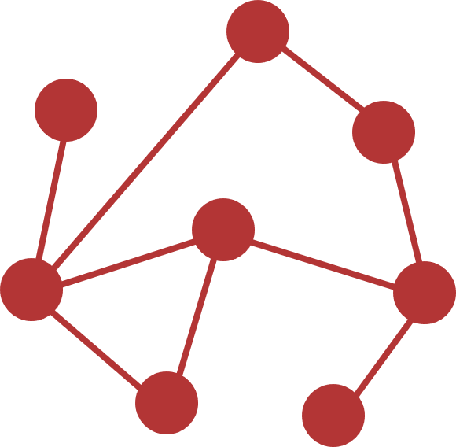
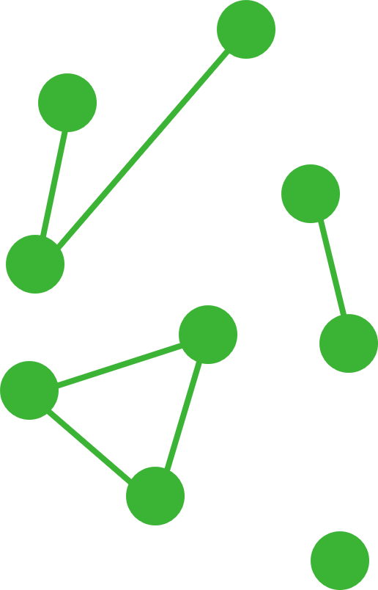
Definition of LTA: LTA vs non-LTA
non-LTA
One trivial global constituent
LTA-like
Connected component constituents
Localized Explainability
LTA-like
Localized constituents of limited size
LTA
Meaningful localized constituents

Slide 11
Research Questions
LTA
What is a general definition of LTA?
How does LTA relate to existing GC/GR methods?
What are shortcomings of existing GC/GR methods? How can they be fixed?
?
?
Graph Embeddings & Kernels
Graph Neural Networks

Slide 12
Existing GC/GR Approaches
Graph Embeddings & Kernels
Graph Neural Networks
Theoretical foundations:
Spectral graph theory
Weisfeiler-Lehmann colorings

Slide 13
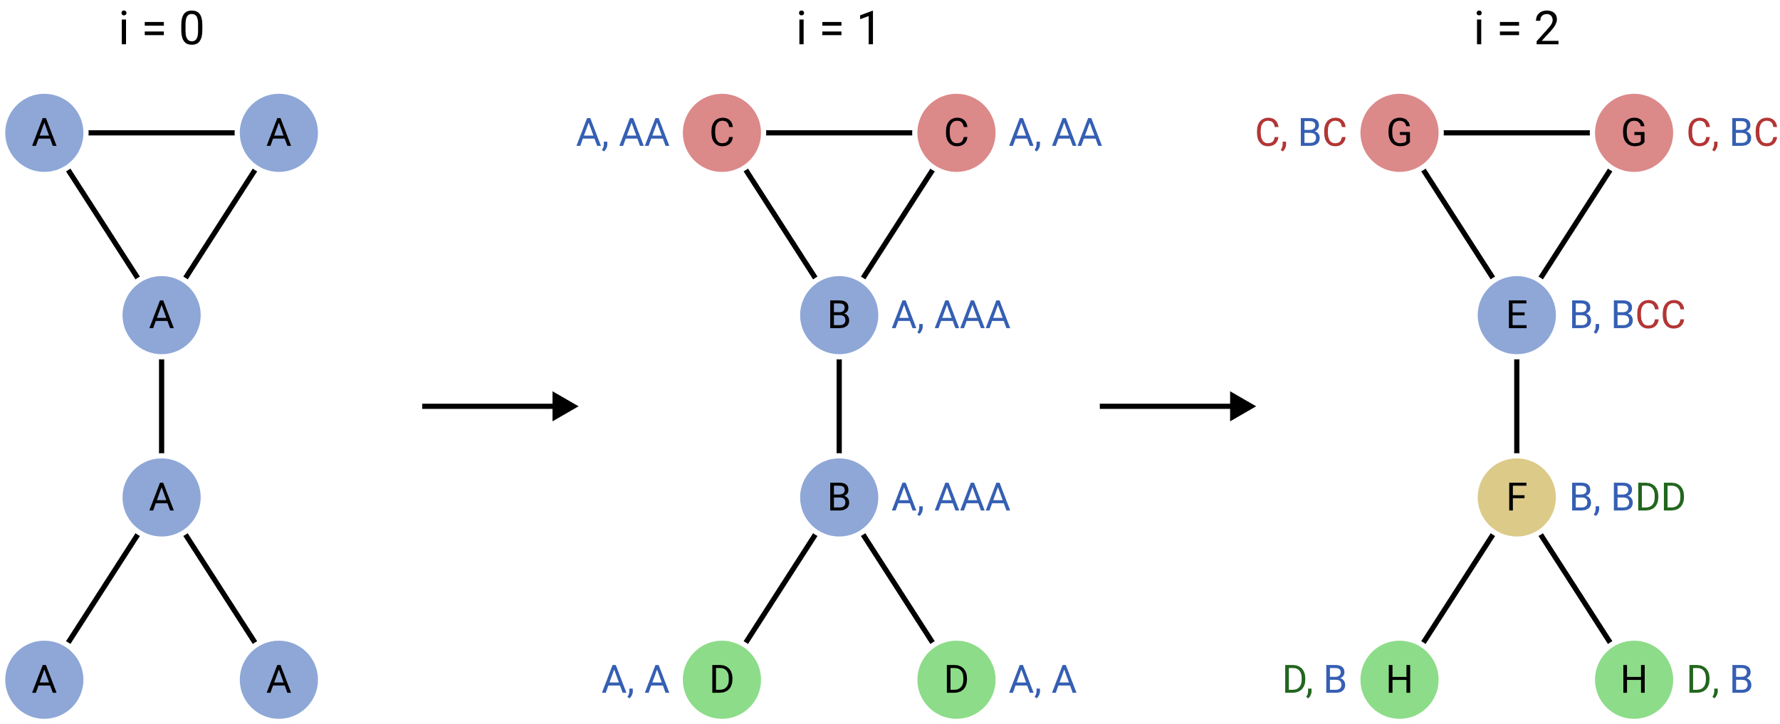
1-Dimensional Weisfeiler-Lehman Colorings
Core Idea: Characterize graphs via multisets of colors.
G
E
G
F
H
H
Refinement:

Slide 14
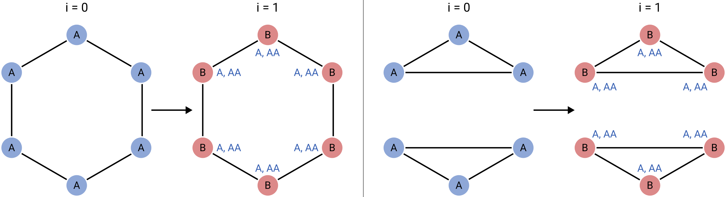
1-Dimensional Weisfeiler-Lehman Colorings
Limitations of 1-WL: Regular graphs & cycle detection.

Slide 15
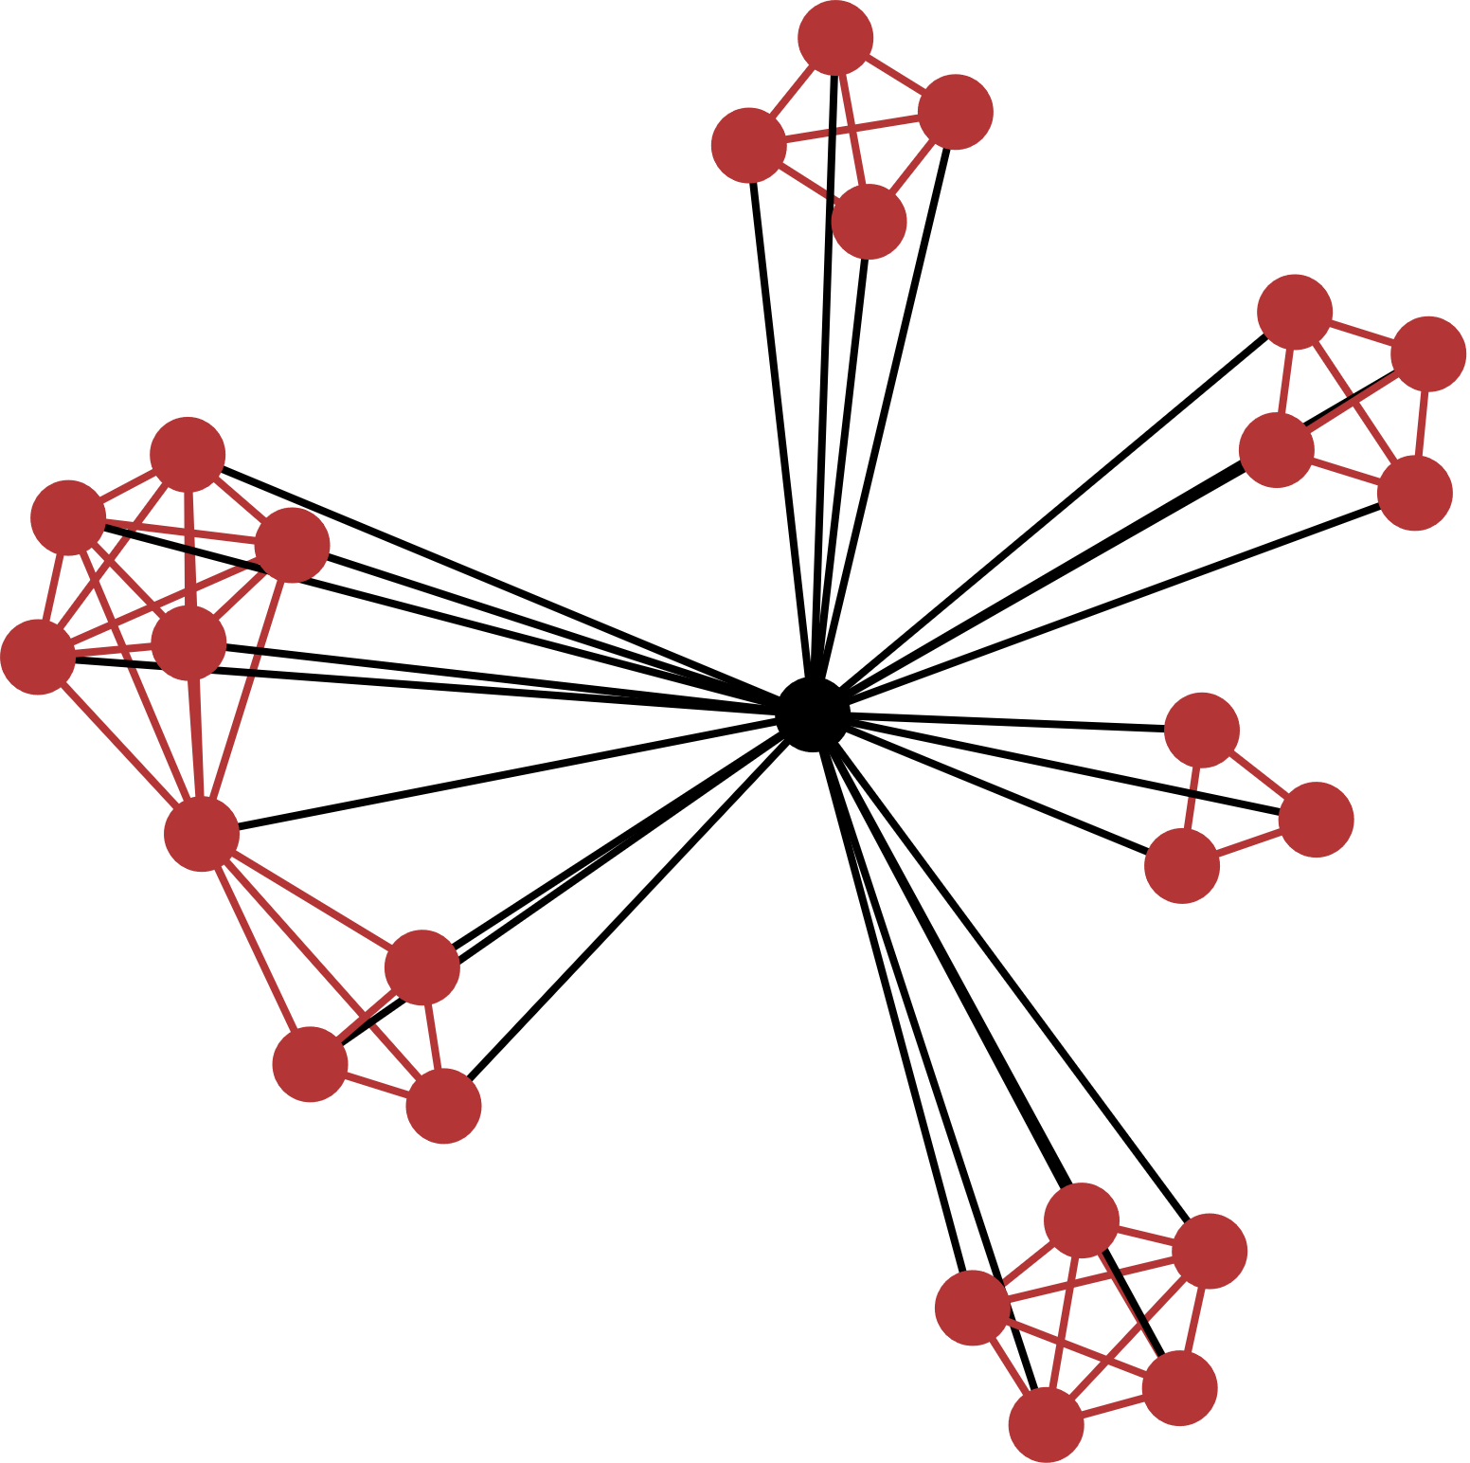
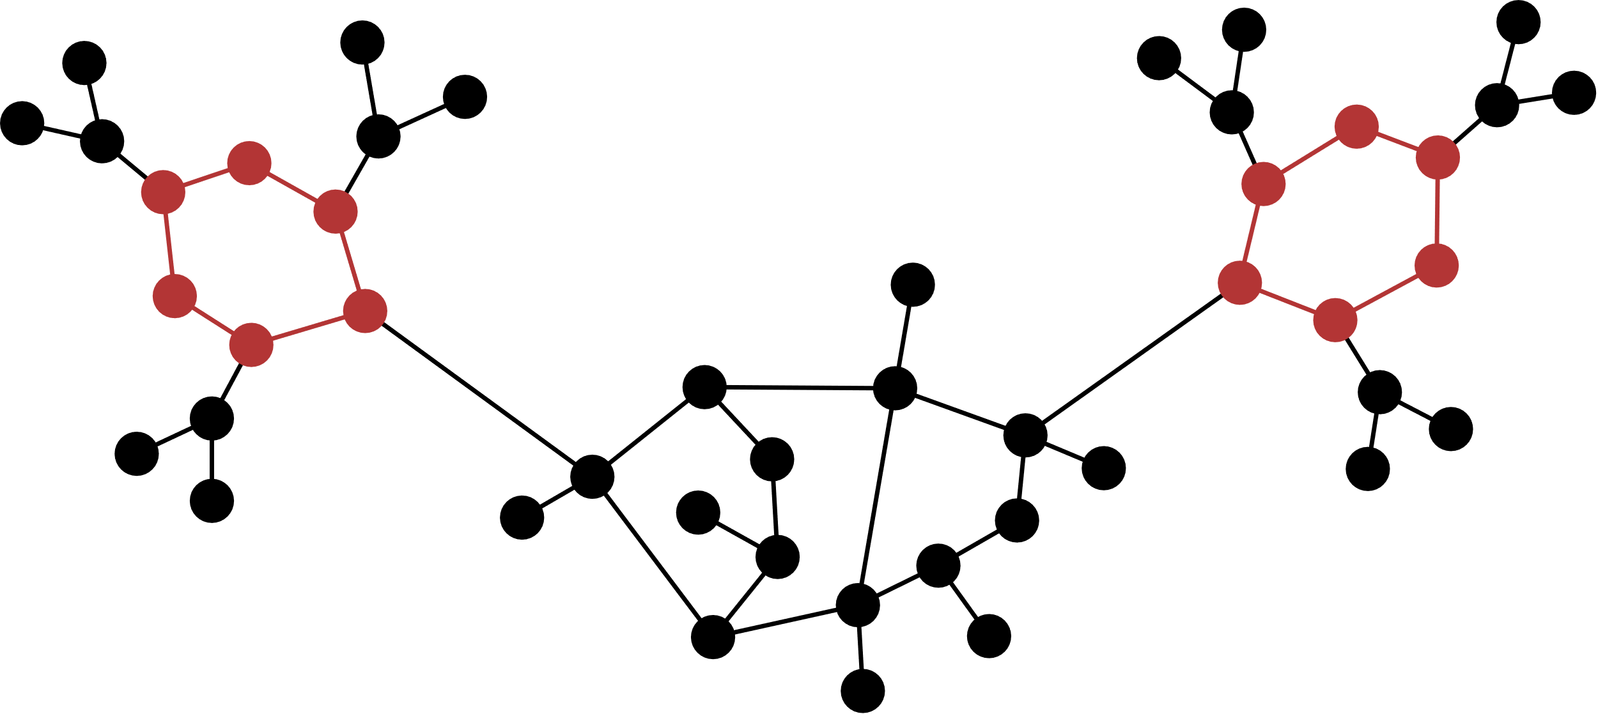

1-Dimensional Weisfeiler-Lehman Colorings
Limitations of 1-WL: Regular graphs & cycle detection.
Molecules: Carbon rings
Social networks: Clustering coefficient
$∝$ triangle count

Slide 16
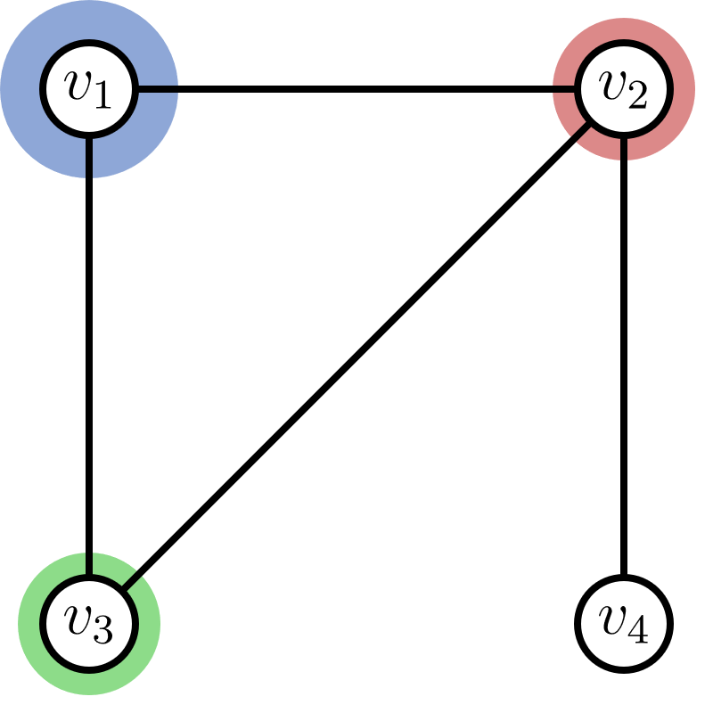
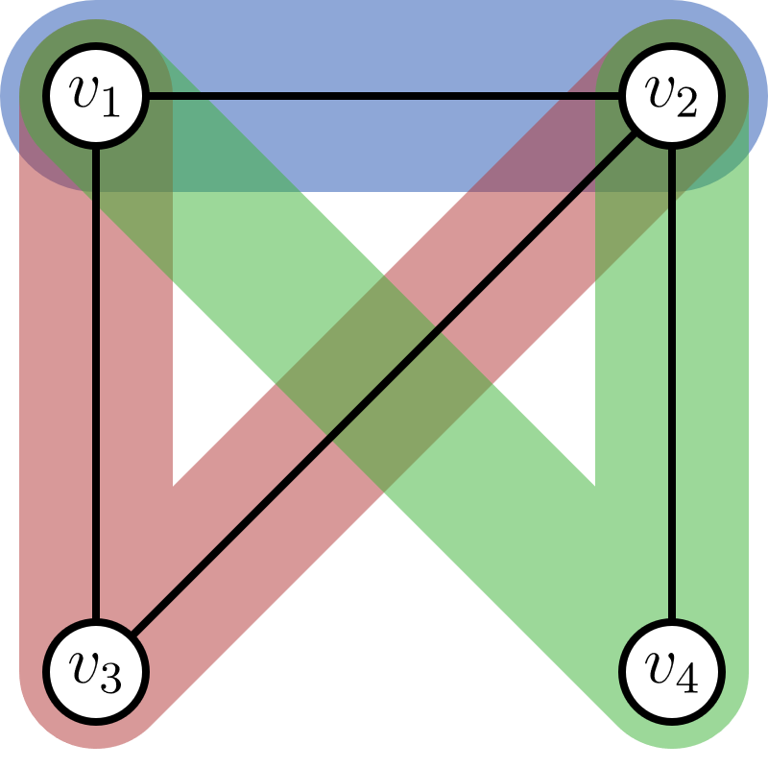
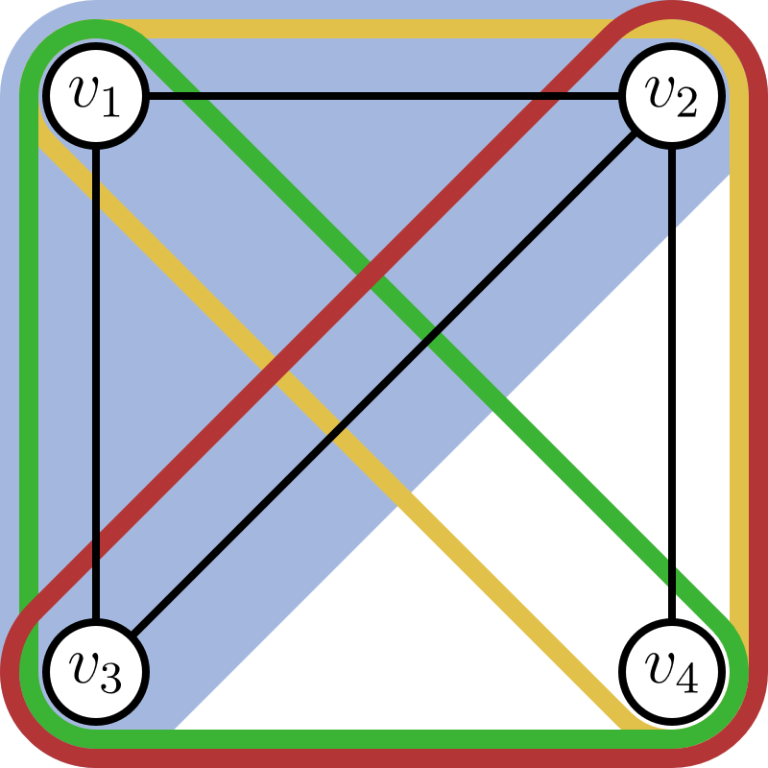
$k$-Dimensional Weisfeiler-Lehman Colorings
Discriminative power & runtime cost
1-WL
2-WL
3-WL
vertex colors
vertex pair colors
vertex triple colors
Refinement:

Slide 17
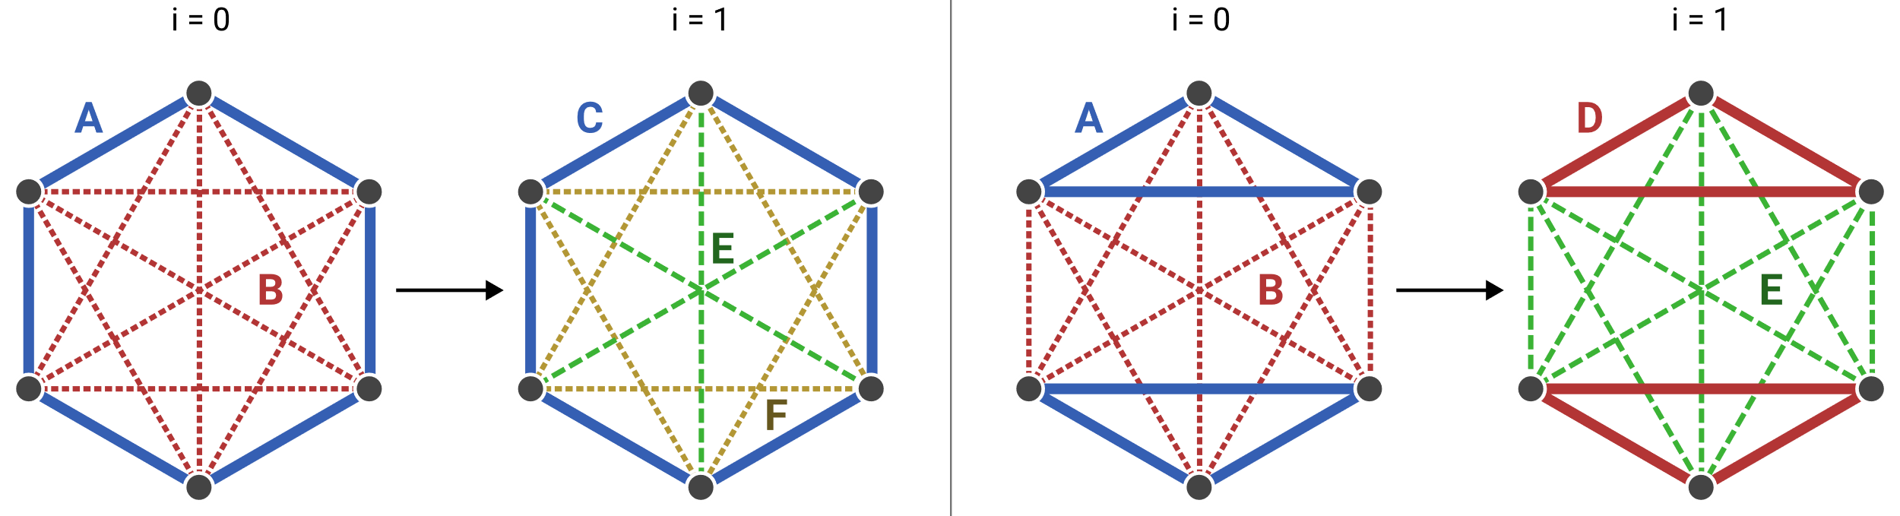
2-Dimensional Weisfeiler-Lehman Colorings
1-WL:
2-WL:

Slide 18
2-Dimensional Weisfeiler-Lehman Colorings
one 6-cycle
two 3-cycles
2-WL counts cycles of length $≤7$

Slide 19
LTA Formulation of Existing GC/GR Approaches
Graph Embeddings & Kernels
Graph Neural Networks
Theoretical foundations:
Weisfeiler-Lehmann colorings
ü

Slide 20
LTA Formulation of Graph Embeddings & Kernels
Fingerprint embeddings
WL subtree kernel
2-LWL kernel
graph2vec
WL shortest-path kernel
2-GWL kernel
…

Slide 21
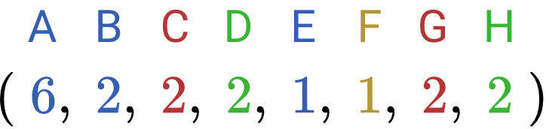
WL Subtree Kernel
1-WL color embedding:

Slide 22
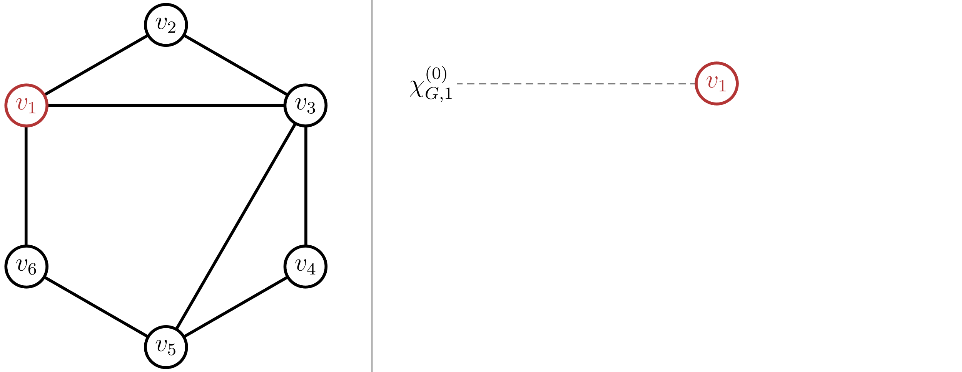
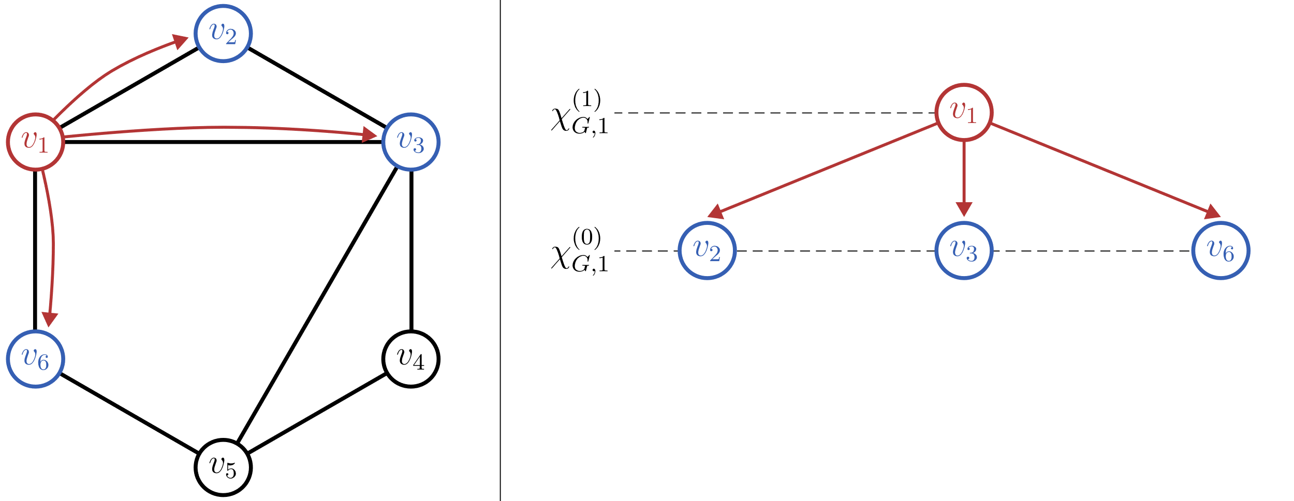
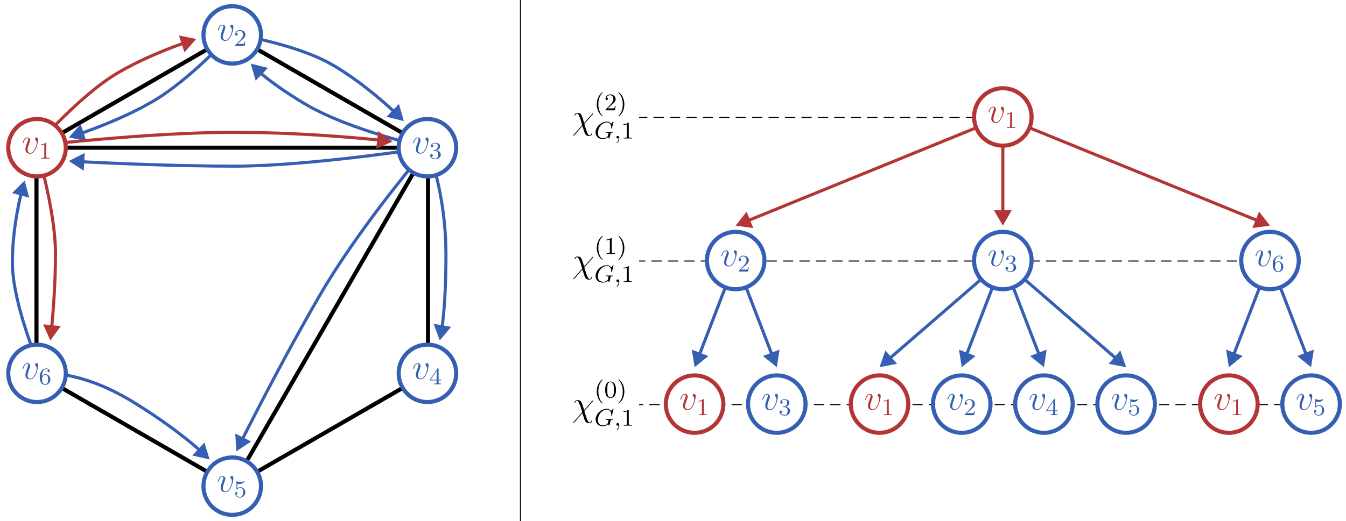
WL Subtree Kernel
Each WL color corresponds to a subtree

Slide 23
LTA Formulation of Graph Embeddings & Kernels

