Slide 1
Learning to Aggregate on Structured Data
Master Thesis Final Presentation
Clemens Damke

Slide 2
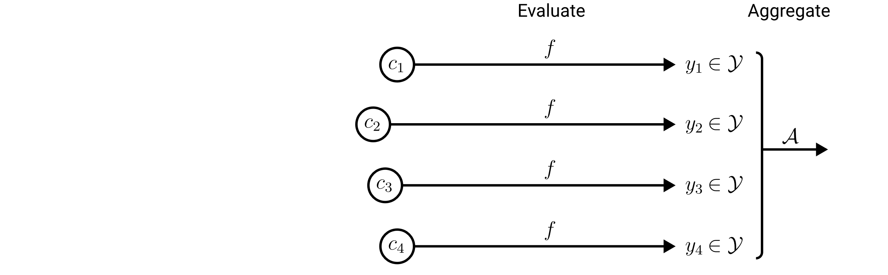
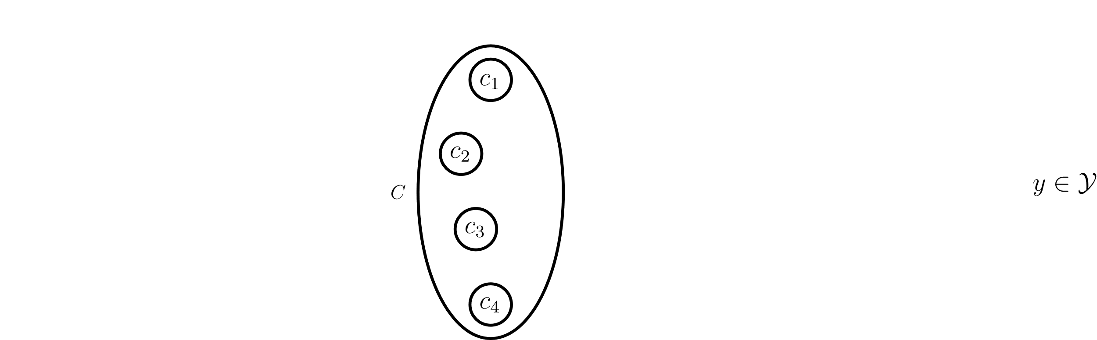
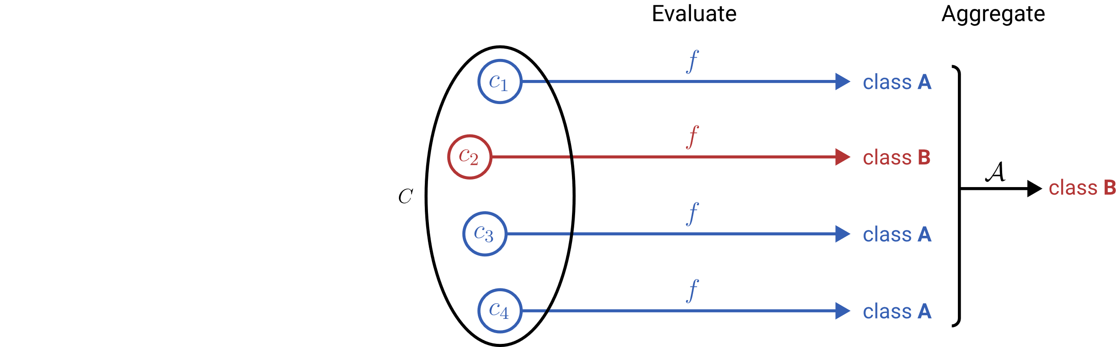
Learning to Aggregate on Unstructured Data
Permutation invariance
Variable input size
Localized explainability
composition
constituent

Slide 3
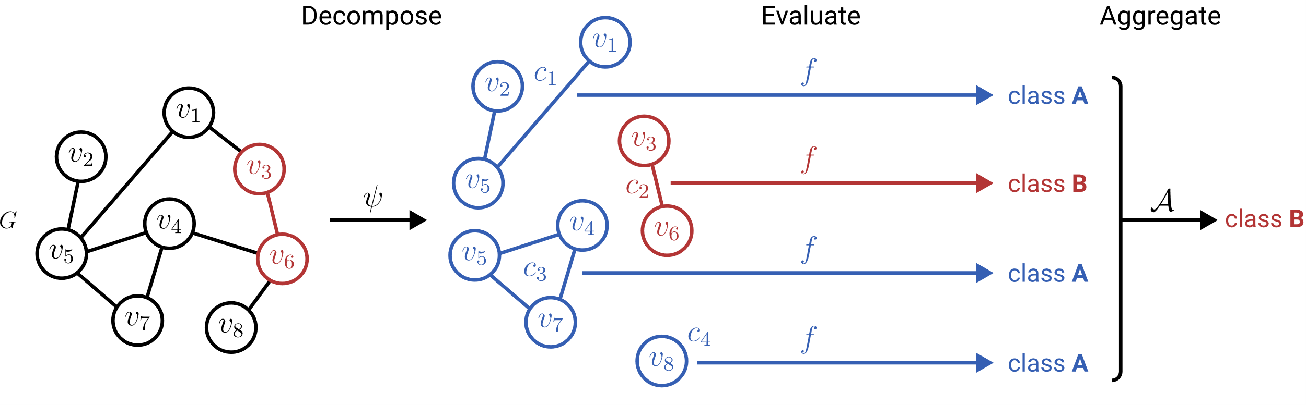
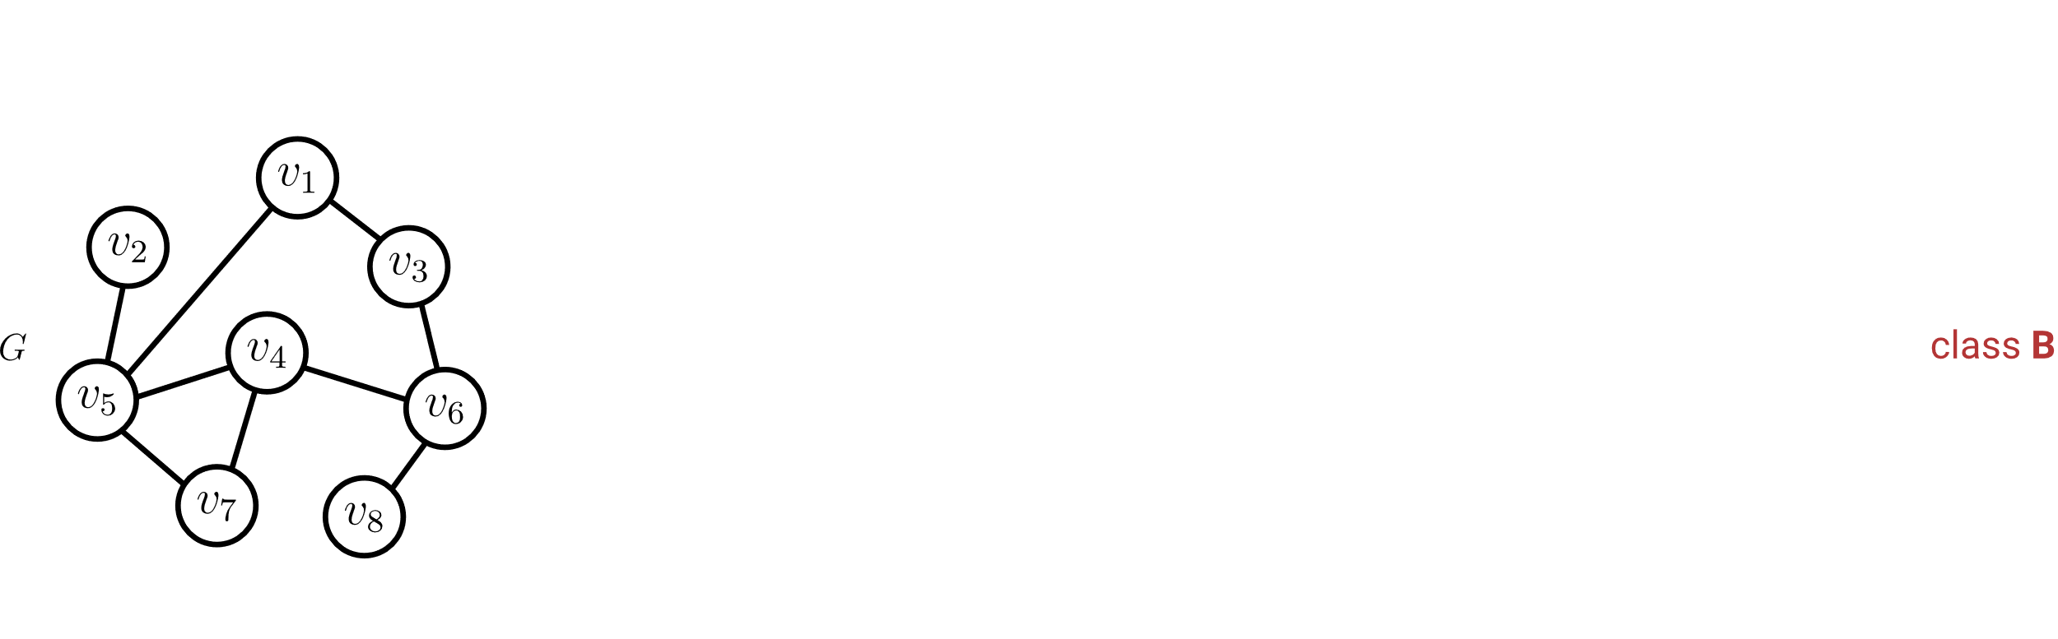
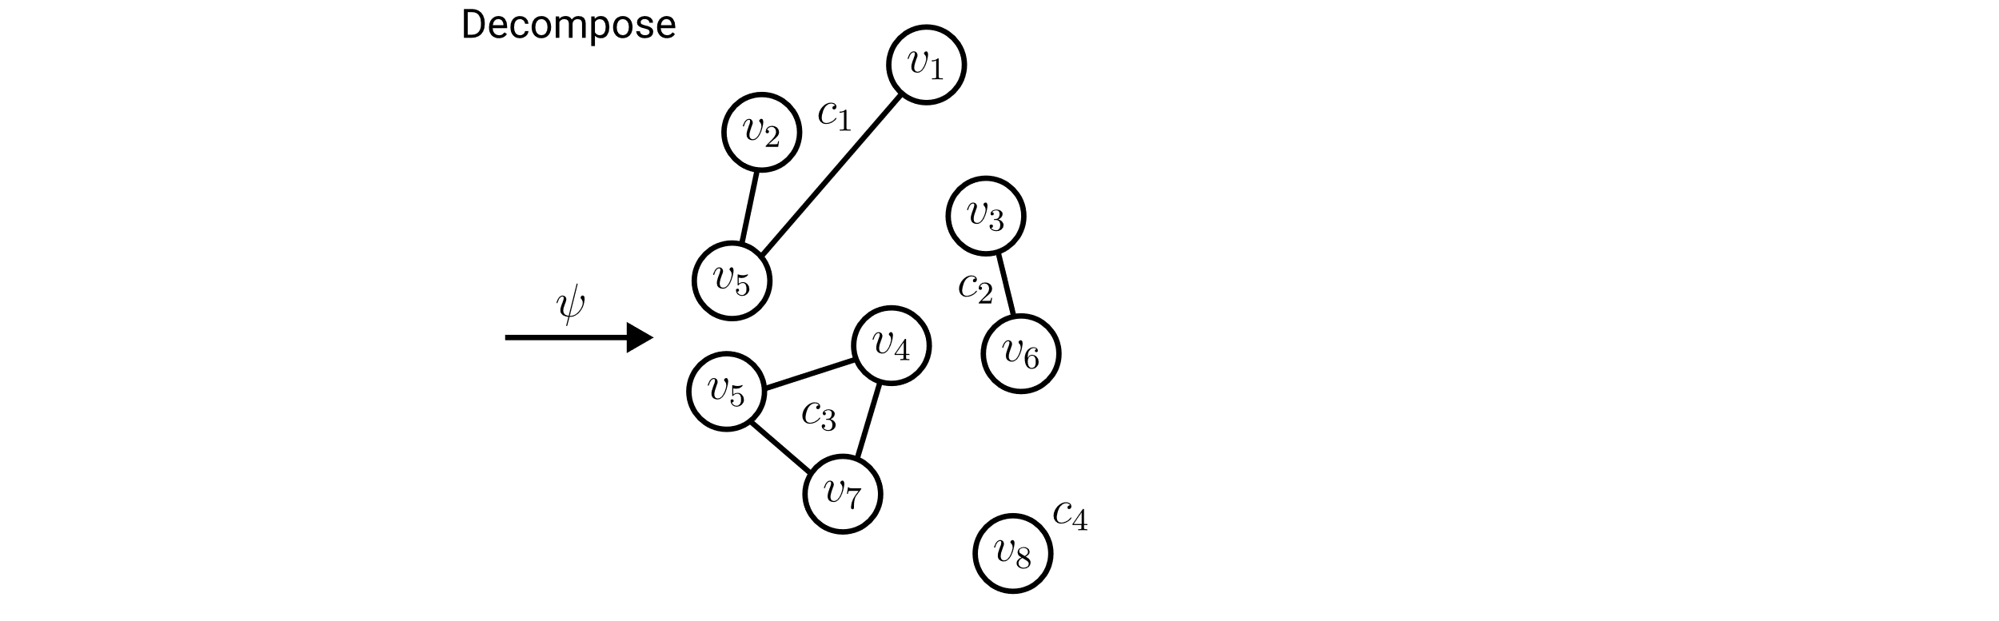
Learning to Aggregate on Structured Data
Permutation invariance
Variable input size
Localized explainability

Slide 4
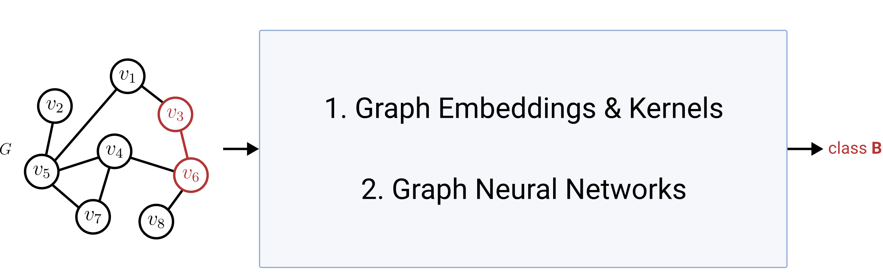
Graph Classification & Regression (GC/GR)
Permutation invariance
Variable input size
Localized explainability
ü
ü
?

Slide 5
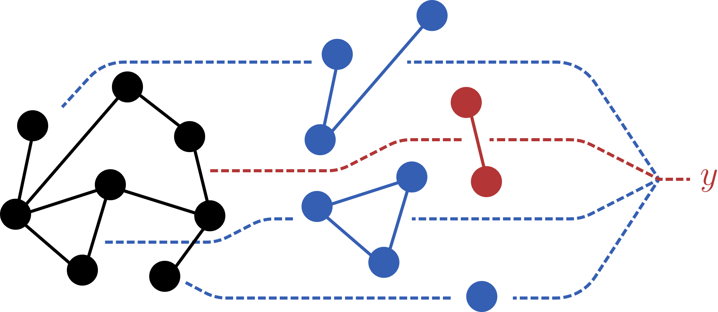
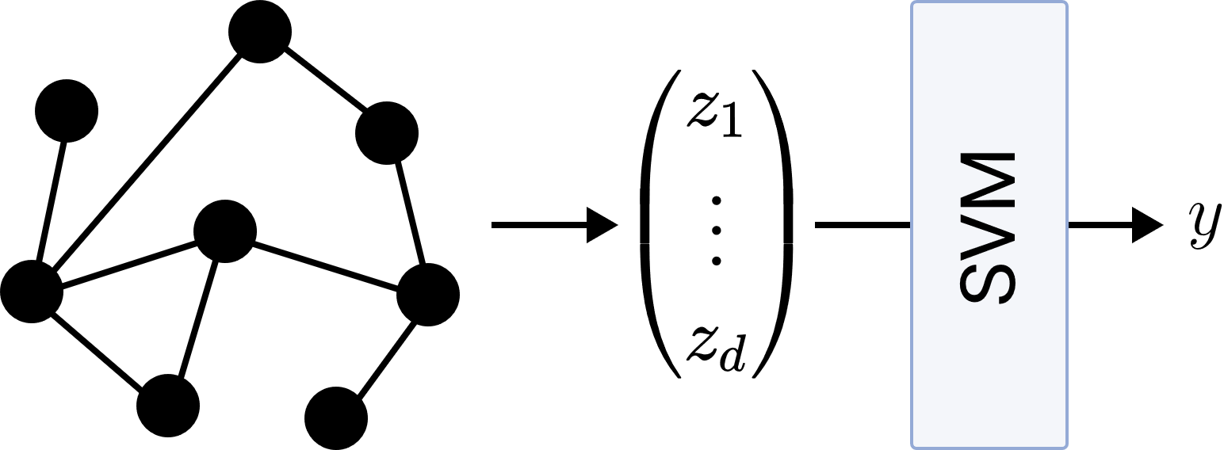
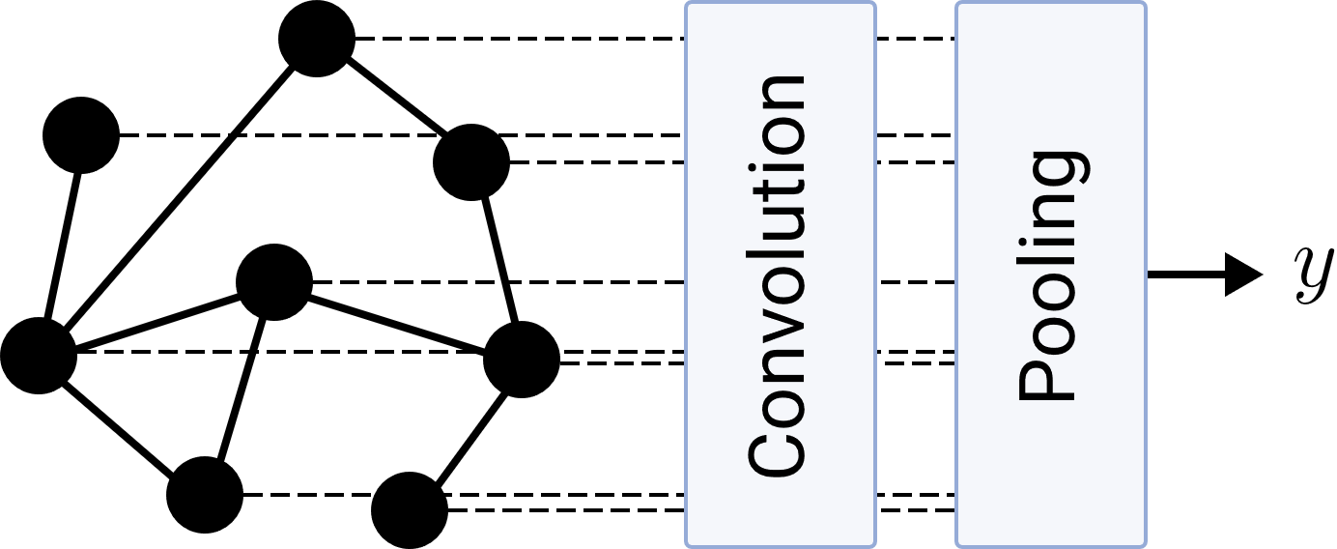
Research Questions
LTA
What is a general definition of LTA?
How does LTA relate to existing GC/GR methods?
What are shortcomings of existing GC/GR methods? How can they be fixed?
Graph Embeddings & Kernels
Graph Neural Networks

Slide 6
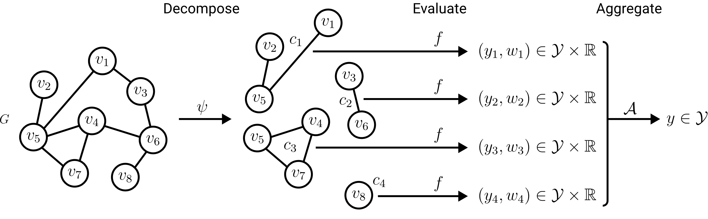
A General Definition of LTA: Decomposition

