Slide 1
Learning to Aggregate on Structured Data
Master Thesis Final Presentation
Clemens Damke

Slide 2
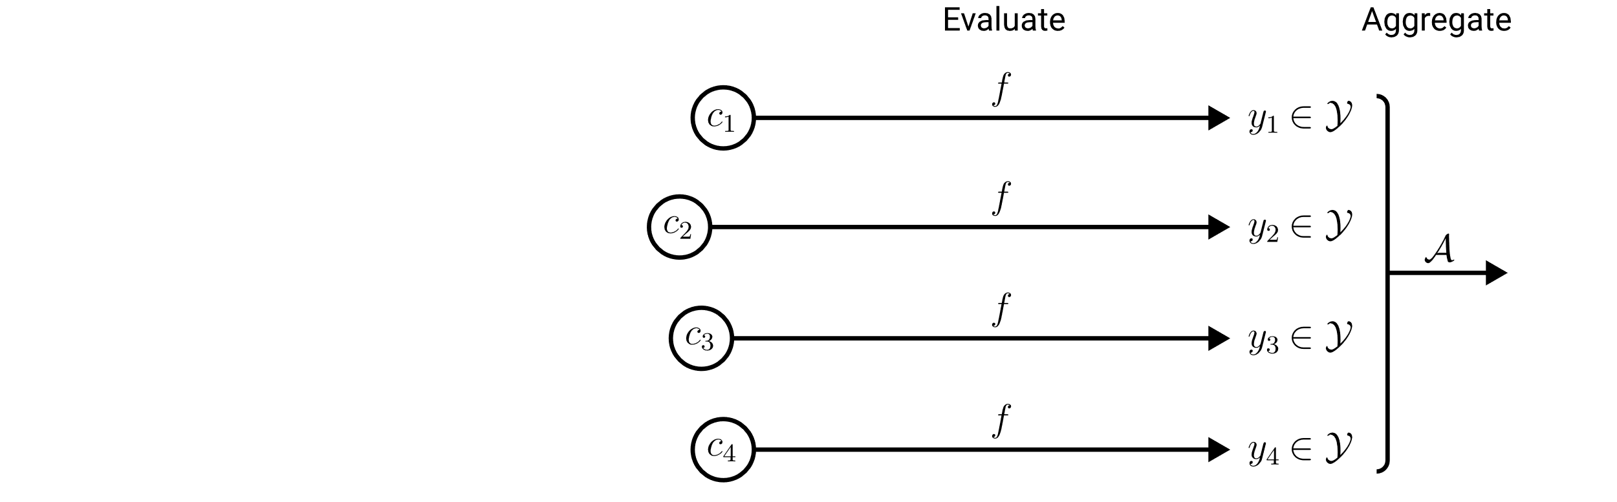
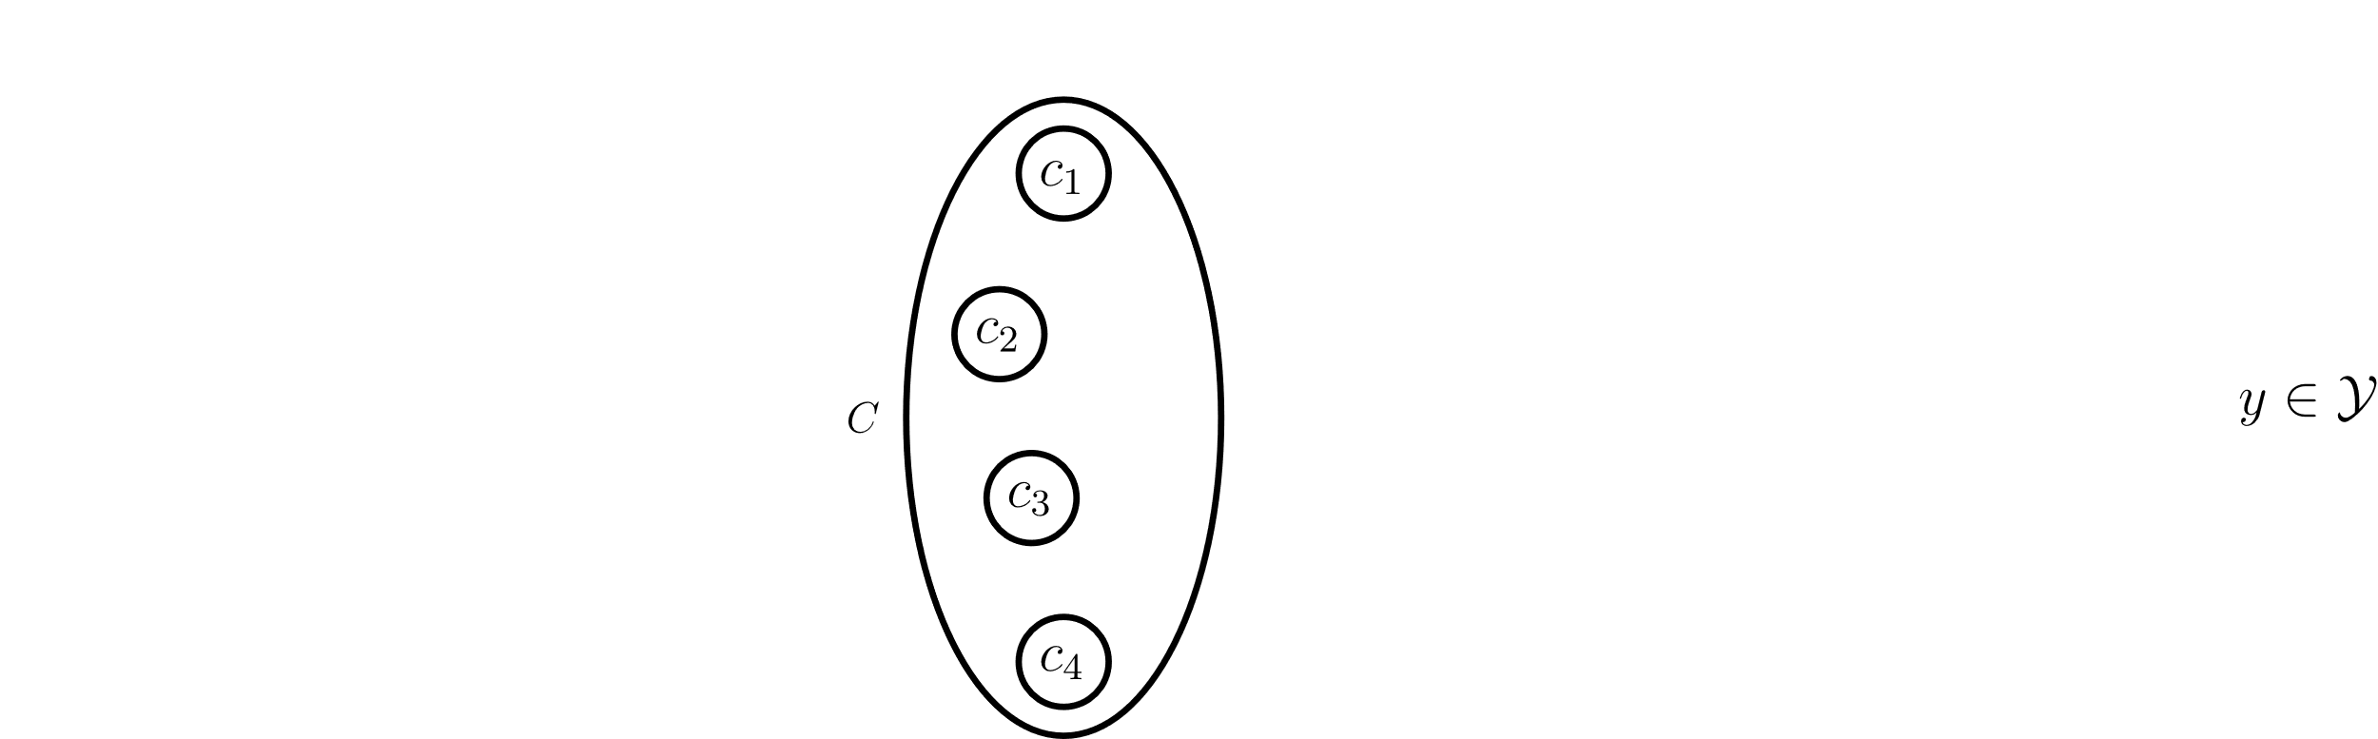
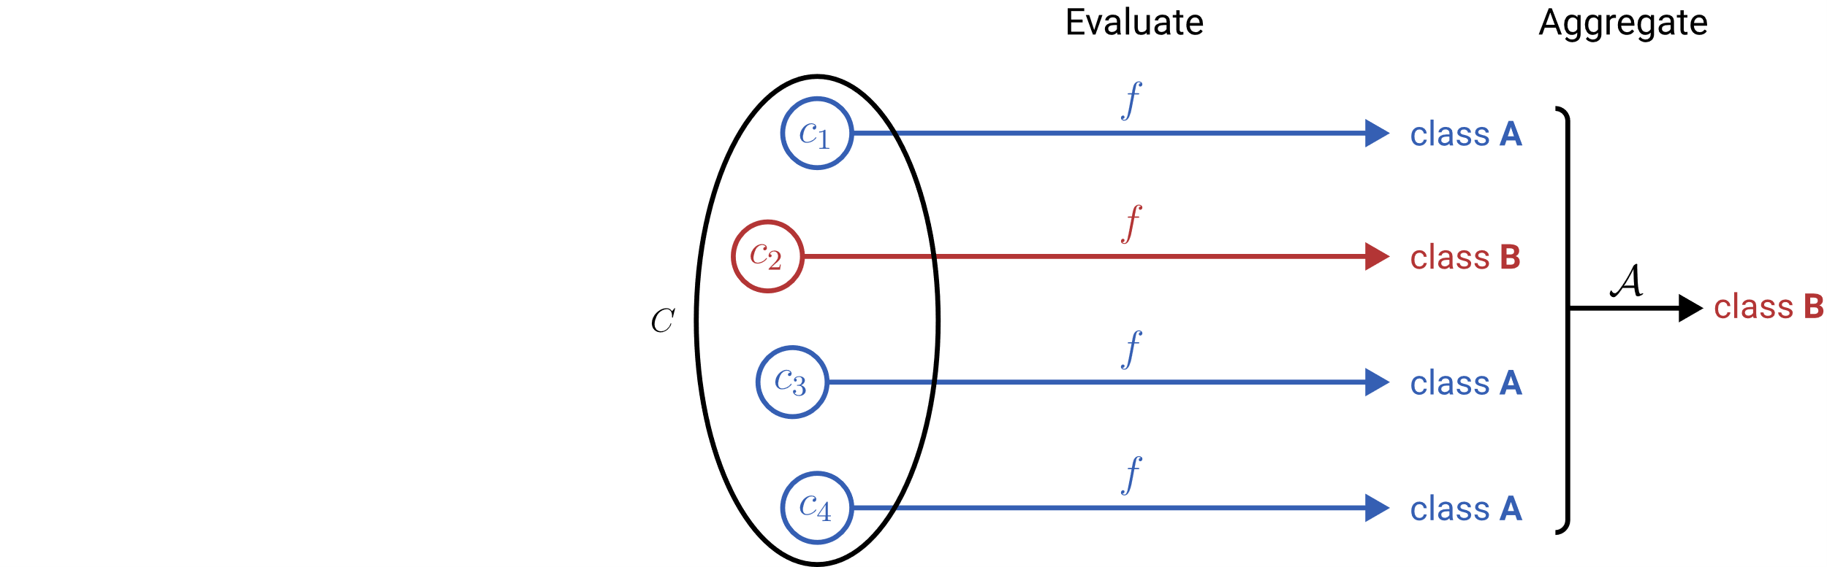
Learning to Aggregate on Unstructured Data
Permutation invariance
Variable input size
Localized explainability
composition
constituent

Slide 3
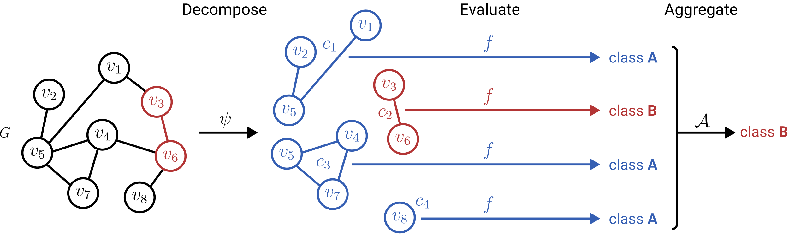
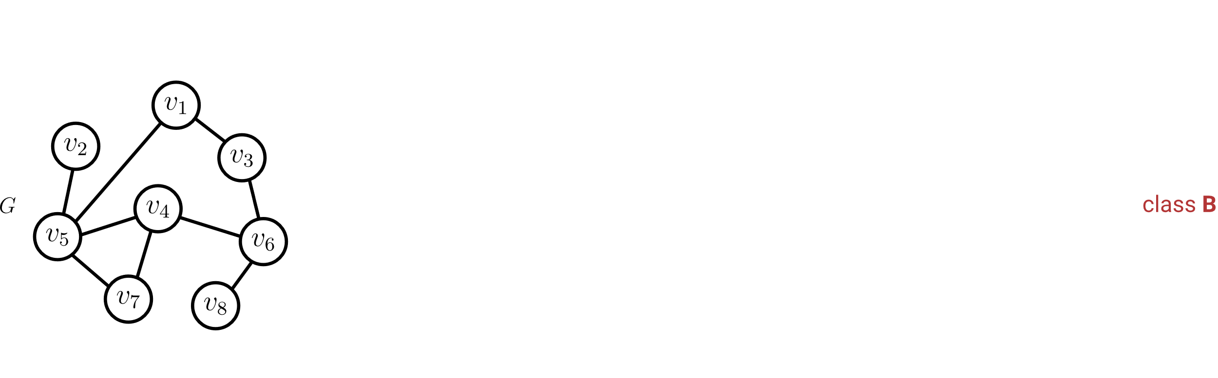
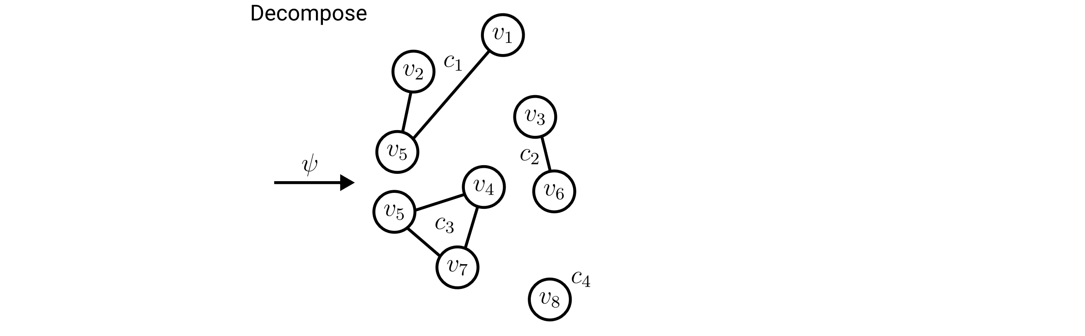
Learning to Aggregate on Structured Data
Permutation invariance
Variable input size
Localized explainability

Slide 4
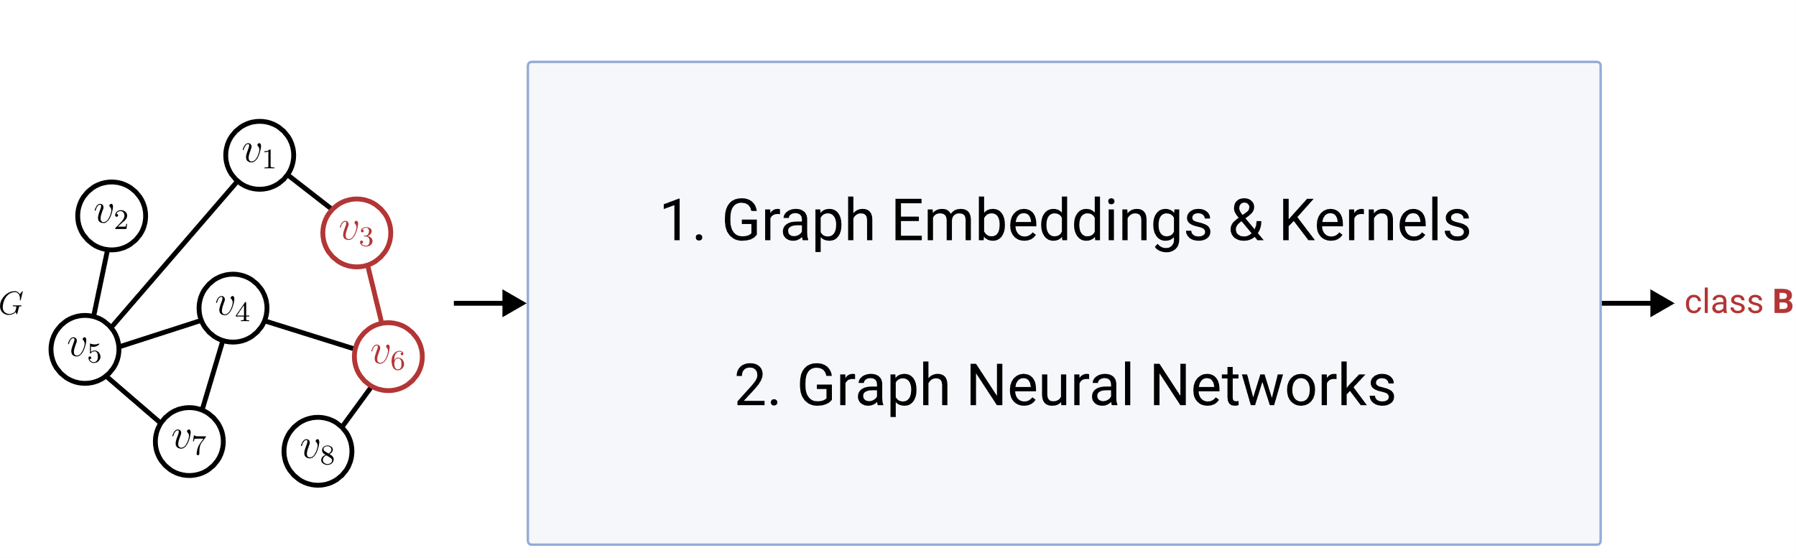
Graph Classification & Regression (GC/GR)
Permutation invariance
Variable input size
Localized explainability
ü
ü
?

Slide 5
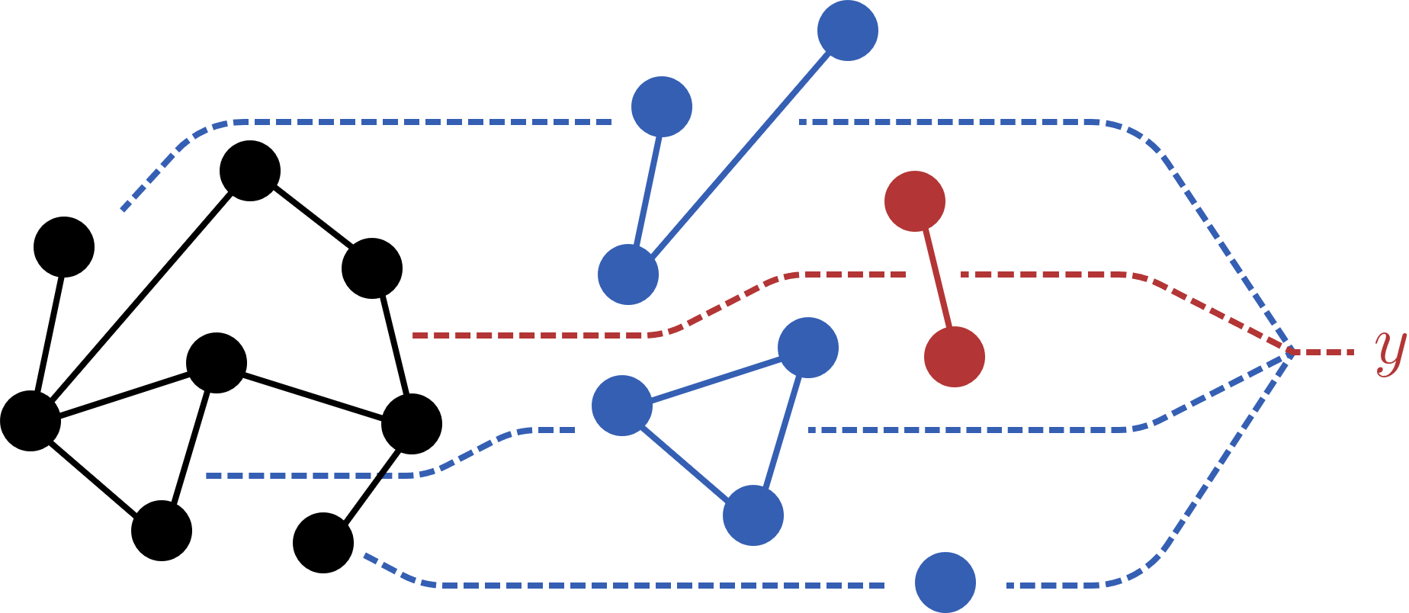
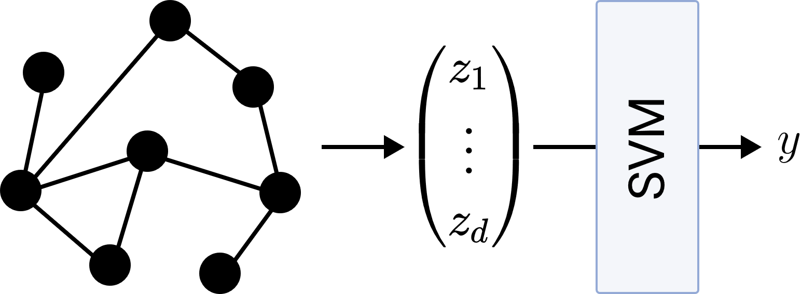
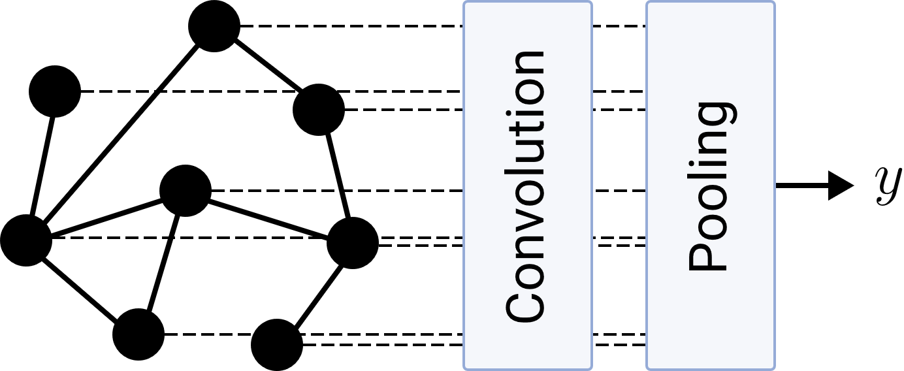
Research Questions
LTA
What is a general definition of LTA?
How does LTA relate to existing GC/GR methods?
What are shortcomings of existing GC/GR methods? How can they be fixed?
Graph Embeddings & Kernels
Graph Neural Networks

Slide 6
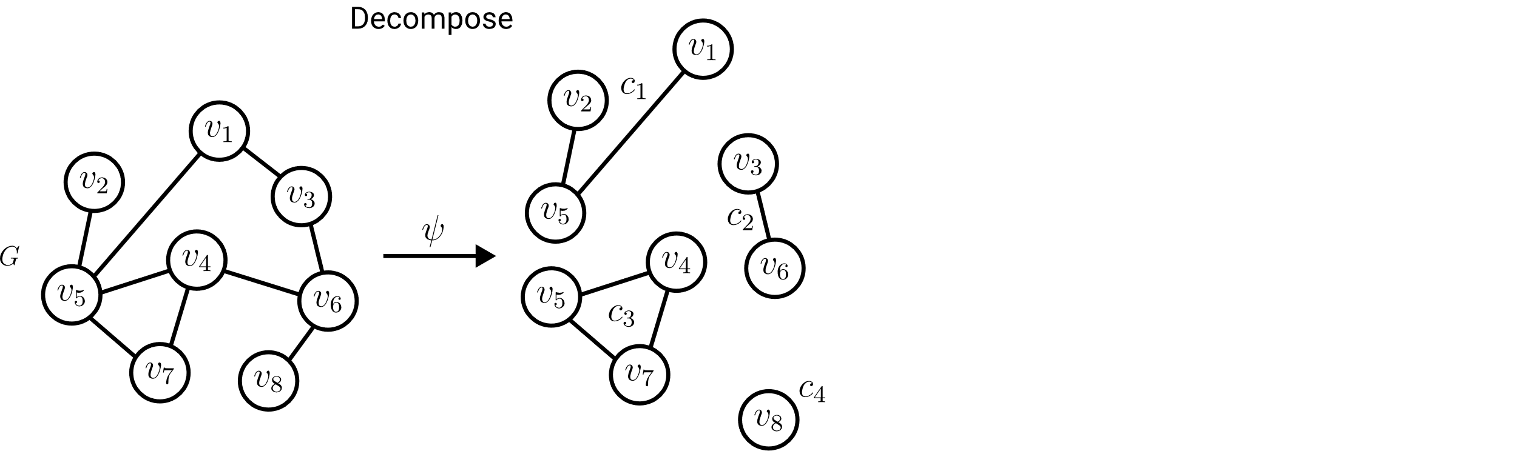

Definition of LTA: Decomposition
Ideally: Localized, interpretable subgraph constituents.
Required:
Split a graph into a subset of its subgraphs.

Slide 7
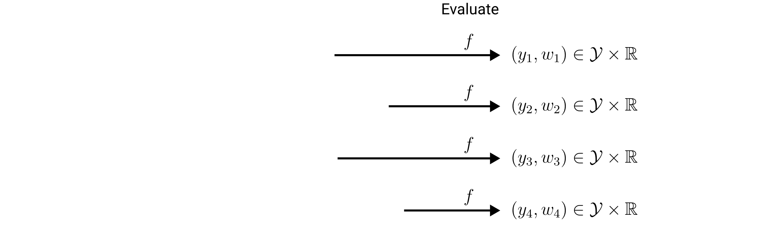

Definition of LTA: Evaluation
Importance for the composition score.
Required:
Assign a score and weight to each constituent.

Slide 8
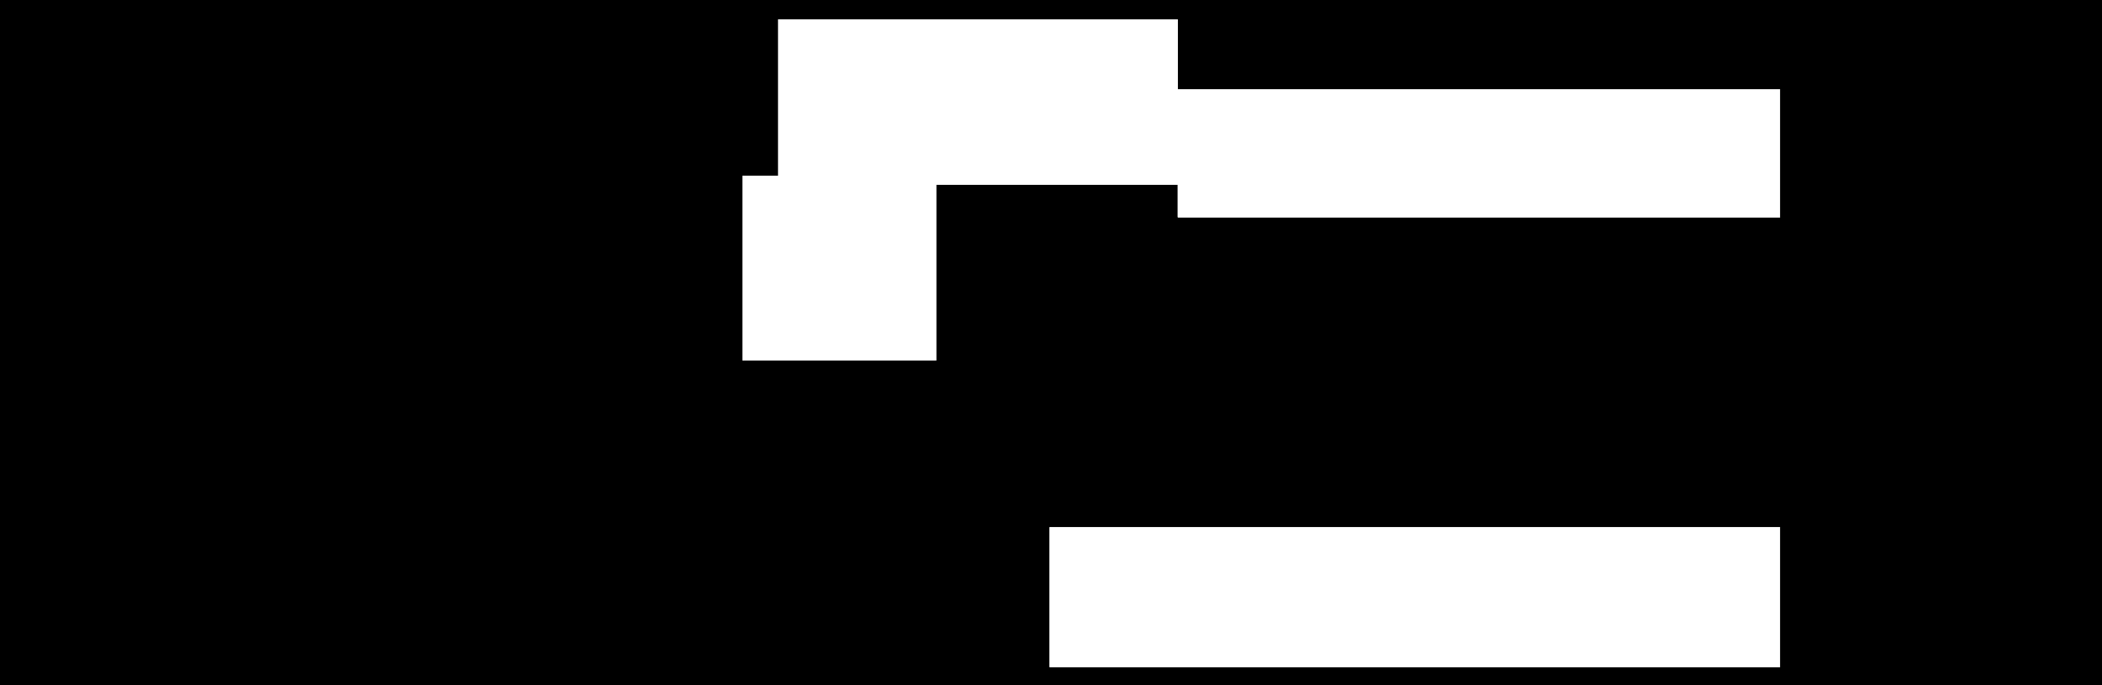
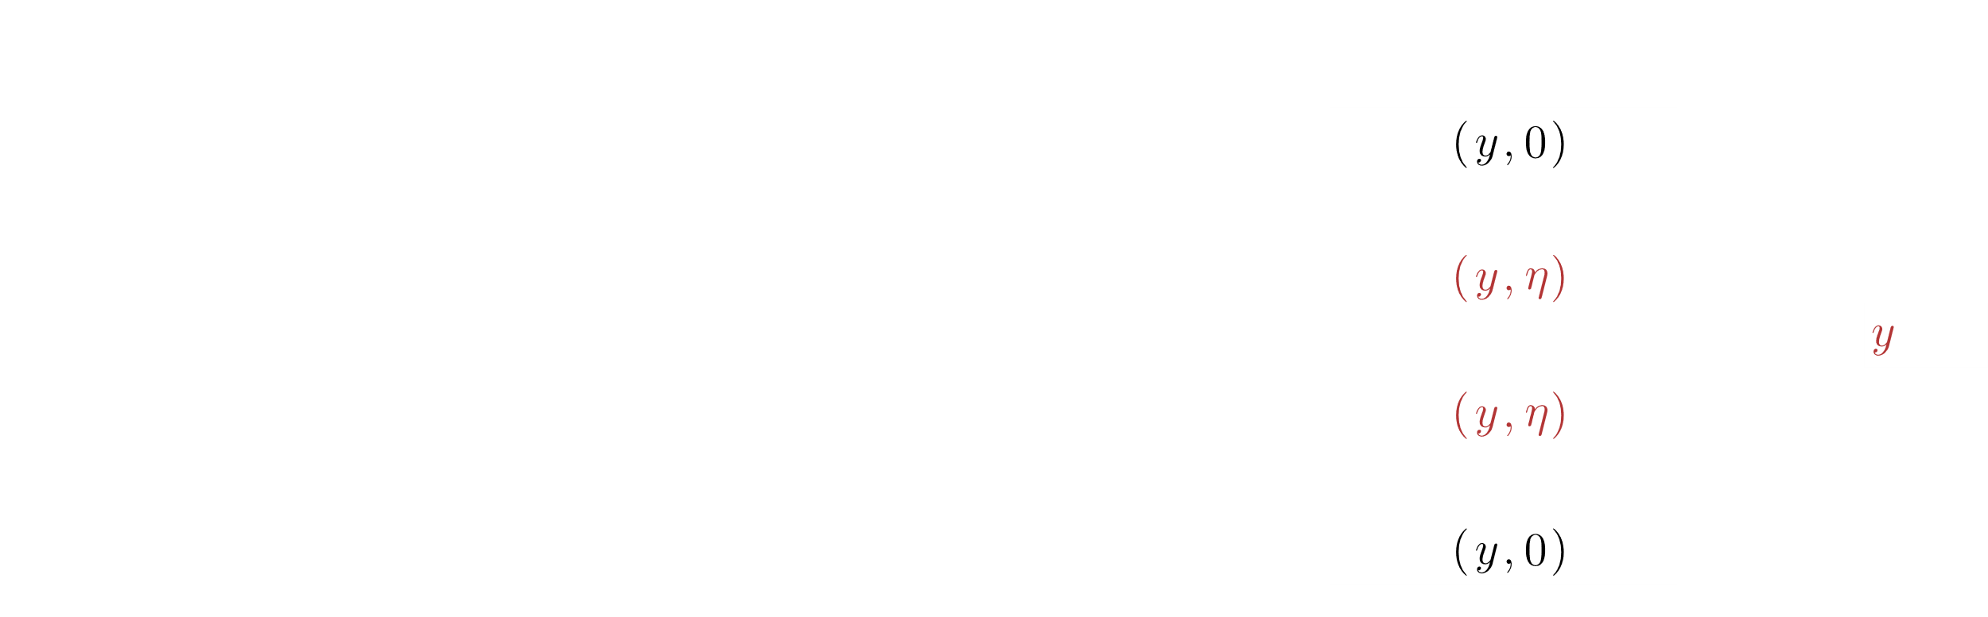
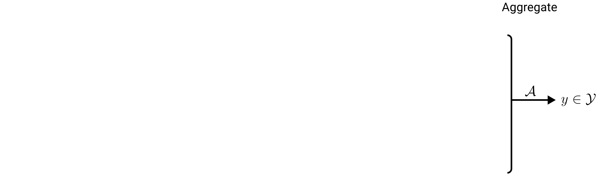
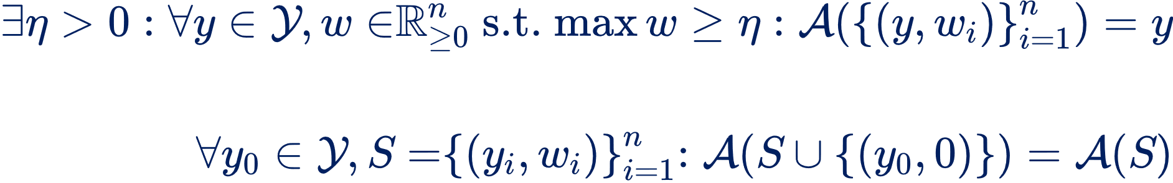
Definition of LTA: Aggregation
Idempotency:
Zero invariance:

Slide 9
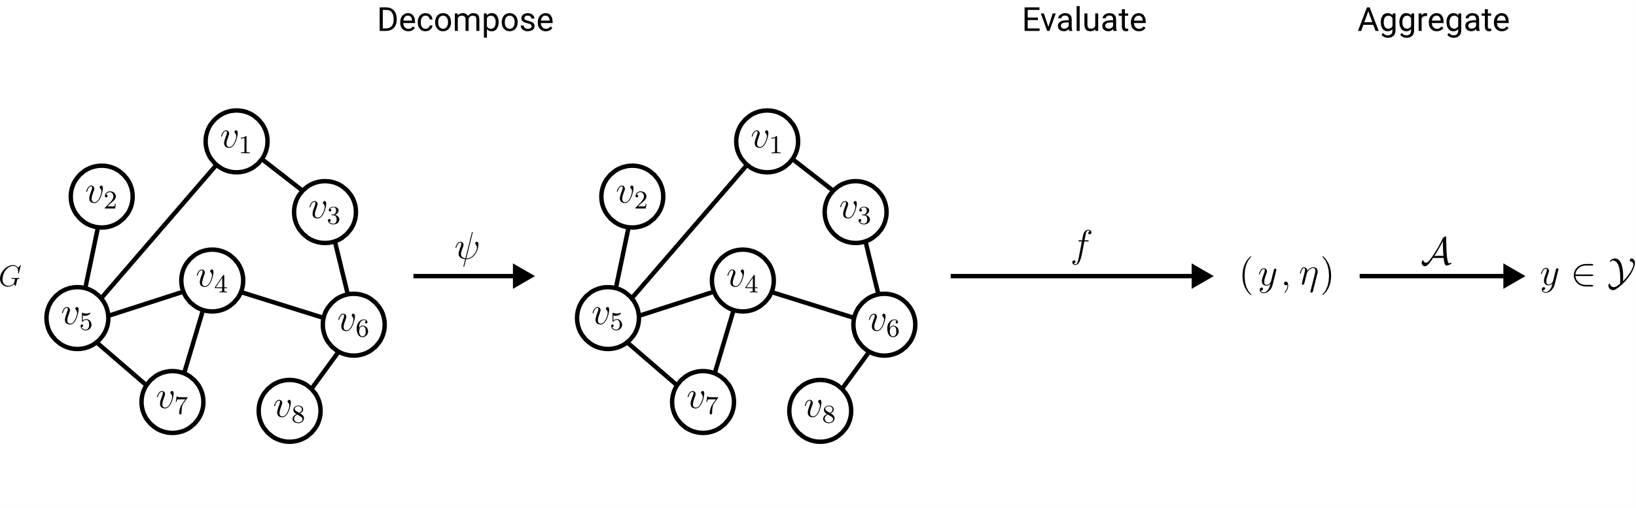
Definition of LTA: Formulations
Trivial decomposition
LTA Formulation

Slide 10
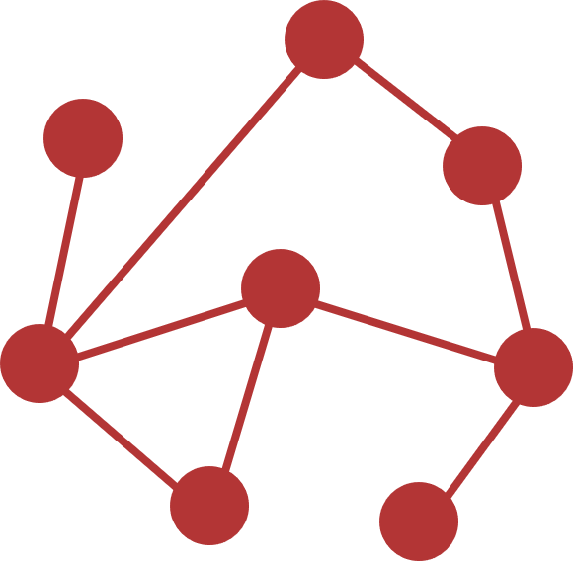
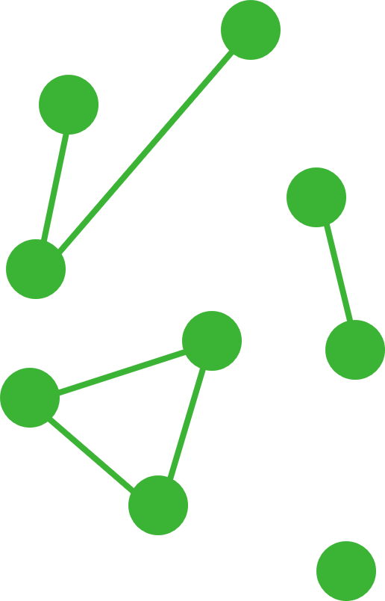
Definition of LTA: LTA vs non-LTA
non-LTA
One trivial global constituent
LTA-like
Connected component constituents
Localized Explainability
LTA-like
Localized constituents of limited size
LTA
Meaningful localized constituents

Slide 11
Research Questions
LTA
What is a general definition of LTA?
How does LTA relate to existing GC/GR methods?
What are shortcomings of existing GC/GR methods? How can they be fixed?
Graph Embeddings & Kernels
Graph Neural Networks

