Slide 1
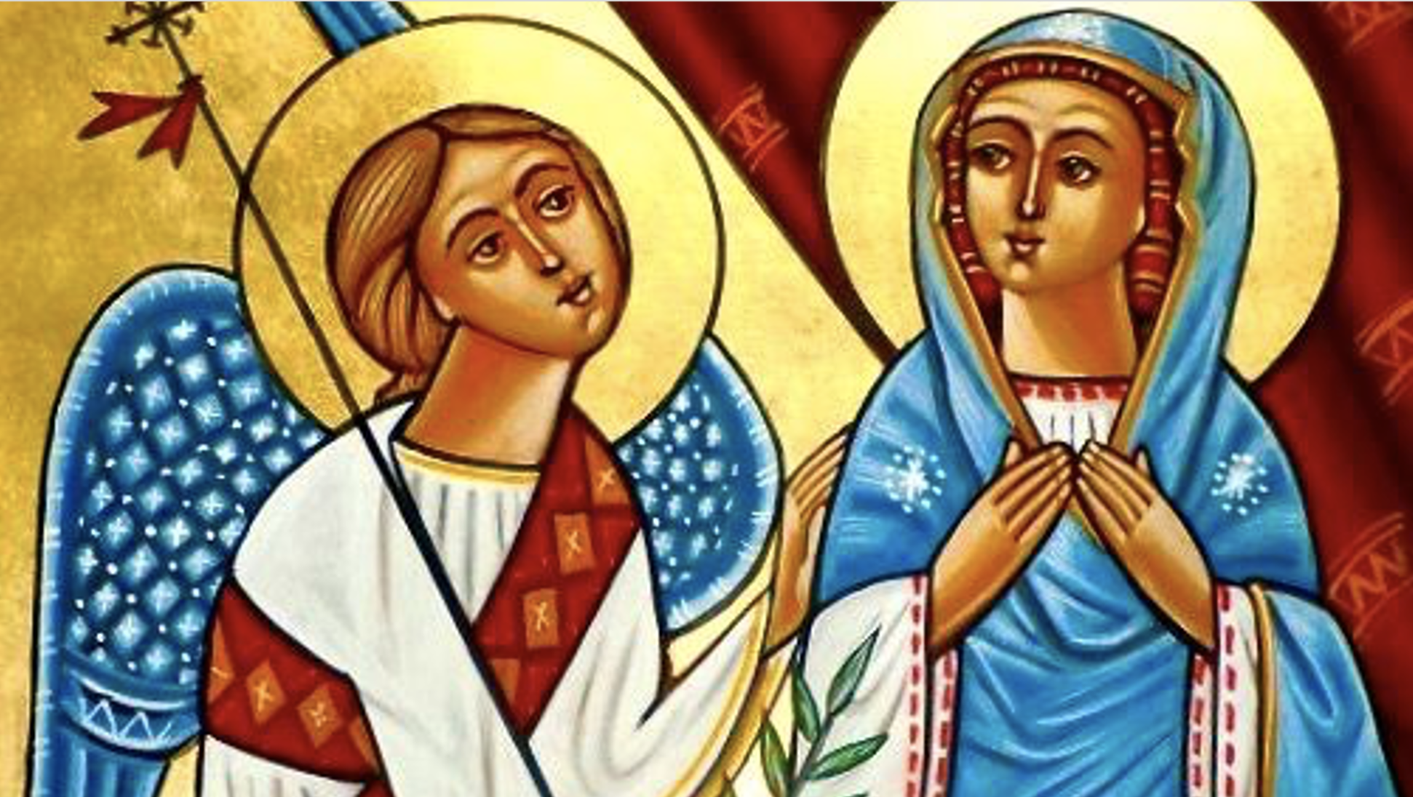
Koiahk Doxology for Archangel Gabriel
O herald of beautiful glad tidings,
you are truly great,
among the angelic ranks,
and the heavenly orders.

Slide 2
Koiahk Doxology for Archangel Gabriel
O Gabriel, the herald of the glad tidings,
the great among the angels,
and the exalted holy orders,
who carry fiery flaming swords.
Notes:
Reference from Psalm 45:9

Slide 3
Koiahk Doxology for Archangel Gabriel
For Daniel the prophet,
beheld your honor,
and you revealed to him the mystery,
of the Life-Giving Trinity.

Slide 4
Koiahk Doxology for Archangel Gabriel
To Zacharias the priest,
you announced the glad tidings,
of the birth of the forerunner,
John the Baptizer.
Notes:
Reference from Psalm 45:9

Slide 5
Koiahk Doxology for Archangel Gabriel
Likewise you announced,
glad tidings to the Virgin,
“Hail, O full grace, the Lord is with you”,
you shall bring forth the
Savior of the whole world.

Slide 6
Koiahk Doxology for Archangel Gabriel
Intercede on our behalf,
O holy archangel,
Gabriel, the herald of glad tidings,
that He may forgive us our sins.
Notes:
Reference from Psalm 45:9

