Slide 1
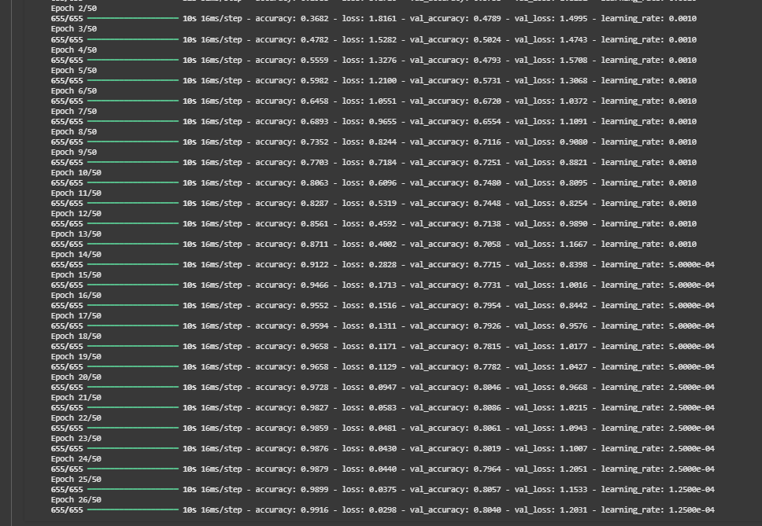
CNN model Group 2 -
Alpha
Ricardo Frias, Kristian Katt

Slide 2
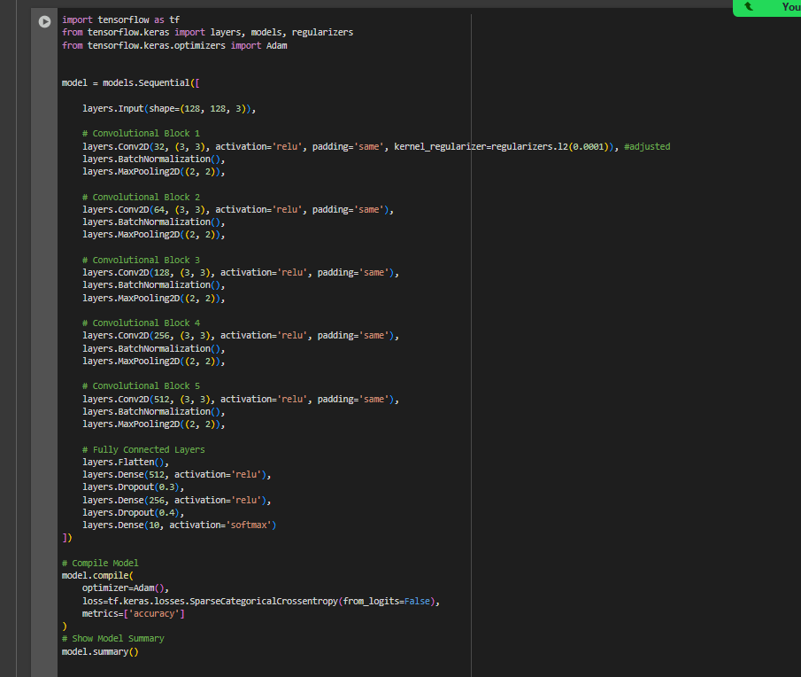
Executive summary
Our (Alpha_1) Model: Custom CNN with 5 convolutional blocks (Conv2D, BatchNorm, MaxPooling).
Regularization: L2 (first Conv layer) + Dropout (after Dense layers).
Optimizer: Adam (with learning rate scheduling).
Loss: Sparse Categorical Crossentropy
Performance:
Training Accuracy: ~99%
Validation Accuracy: 80%
Key Issue: Overfitting
Also Explored: EfficientNetB6 (higher results)
Model saved for deployment and initiated

Slide 3
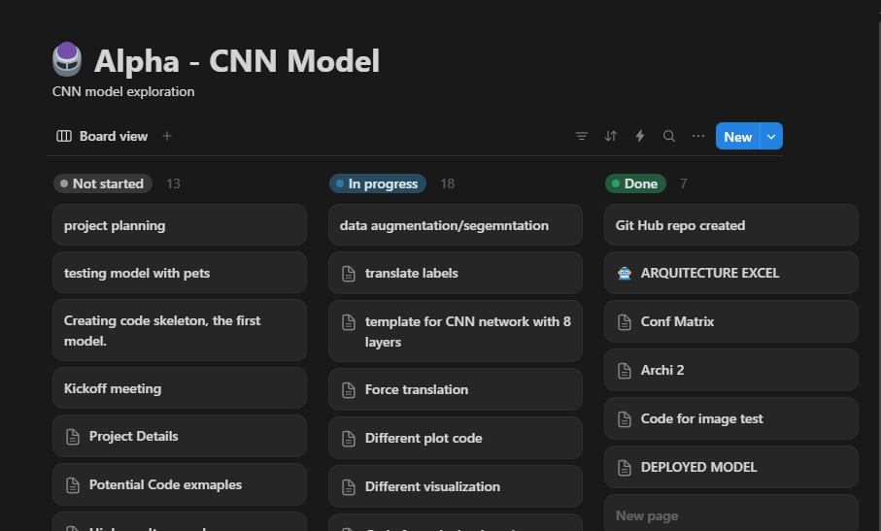
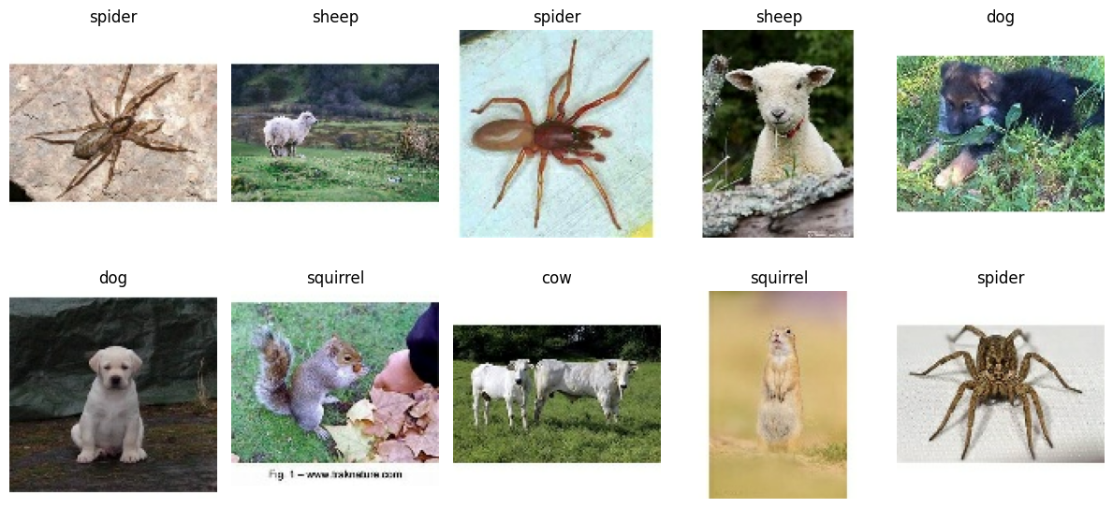
Chosen dataset: Animals 10
Already having explored the CIFAR-10 data-set, we wanted to explore a different classification task.
Chance to use our own images of pets.
Enchanced workflow using Notion as it facilitates code sharing and planning of the model.

Slide 4
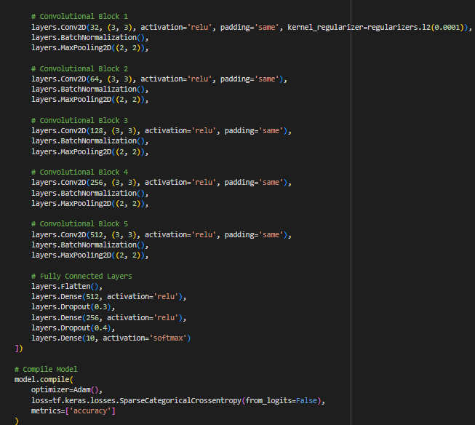
Alpha – Model
Model Architecture:
5 Convolutional Blocks: Each block consists of a Conv2D layer, BatchNormalization, and MaxPooling2D. The number of filters increases in each block (32, 64, 128, 256, 512).
L2 Regularization: Added to the first Conv2D layer to prevent overfitting.
Fully Connected Layers: Flatten, followed by two Dense layers (512 and 256 units) with ReLU activation, and a final Dense layer (10 units) with softmax activation for classification.
Dropout: Used after the dense layers (0.3 and 0.4 rates) for regularization.
Optimizer:
Adam (Adaptive Moment Estimation). The learning rate was dynamically adjusted during training using ReduceLROnPlateau. The initial learning rate was default for Adam (0.001), and it was reduced during training.
Training:
Trained for up to 50 epochs.
EarlyStopping callback: Training stopped early if validation accuracy didn't improve for 5 consecutive epochs, and the best weights were restored.
ReduceLROnPlateau callback: learning rate will be reduced if the validation accuracy plateaus.

Slide 5
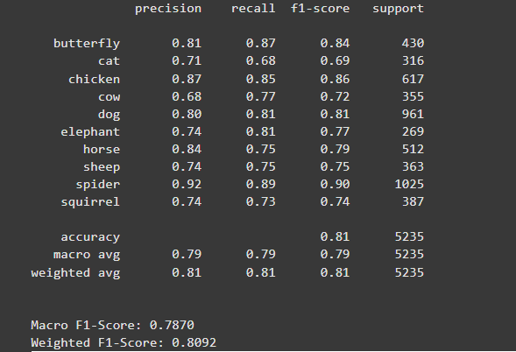
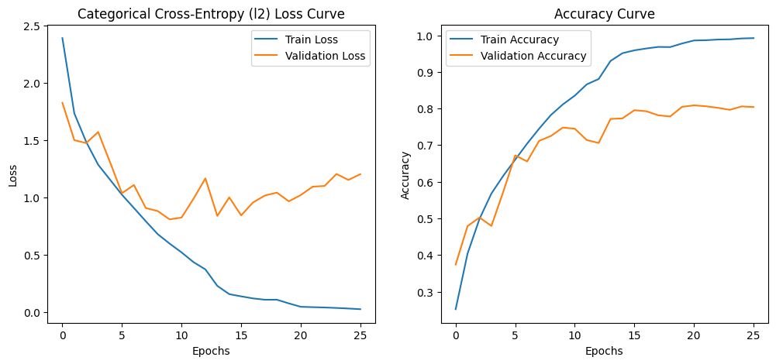
Alpha_1 - Metrics
High Training Accuracy (99.16%)
Slightly higher Validation Accuracy (80.40%)
Low Training Loss (0.0298)
High Validation Loss (1.2031):
Drop out of 0.5 in dense layers.
Possible improvements:
Further data augmentation so that it can deal with unseen data better.
Adjusting the architecture, it may need to be bigger or smaller.
Adjust the dropout and learning rate.
Conclusion: Significant overfitting, despite regularization and data augmentation

Slide 6
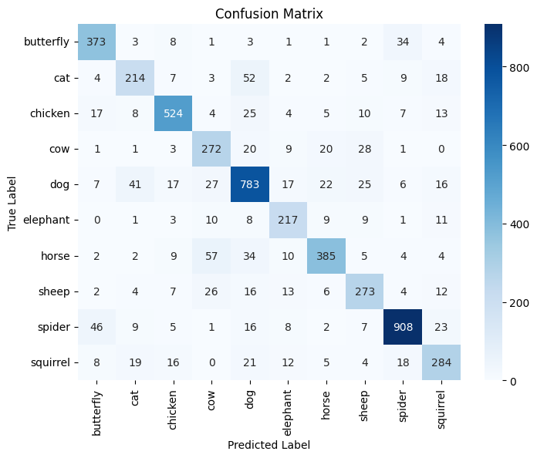
Confusion Matrix
Pros:
High overall accuracy.
Excellent performance on some classes (dog, spider).
Clear diagonal dominance in the confusion matrix.
Cons:
Confusion between visually similar classes (cow/horse, cat/dog).
Uneven performance across different classes.

Slide 7
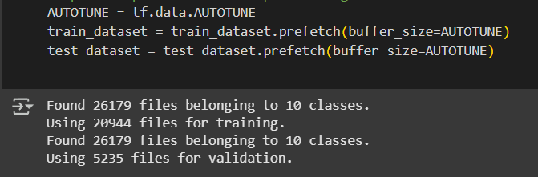
Data pre-processing
Loading: Images loaded from a directory structure (one folder per animal class) using tf.keras.utils.image_dataset_from_directory.
Resizing: All images resized to 128x128 pixels maintaining aspect ratio with padding.
Batching: Images grouped into batches of 32 for efficient training.
Splitting: Data automatically split into training (80%) and validation (20%) sets.
Optimization: prefetch with AUTOTUNE used for faster, background data loading during training.

Slide 8
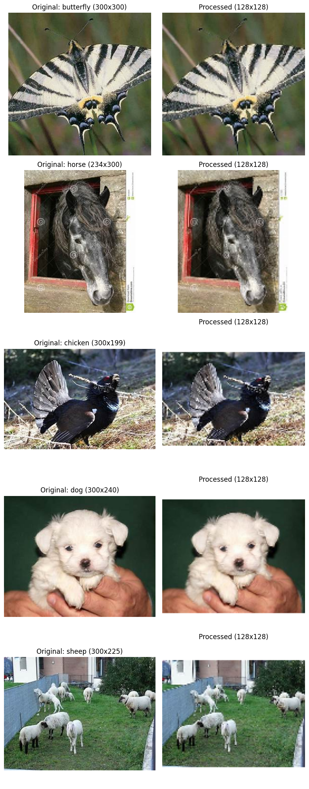
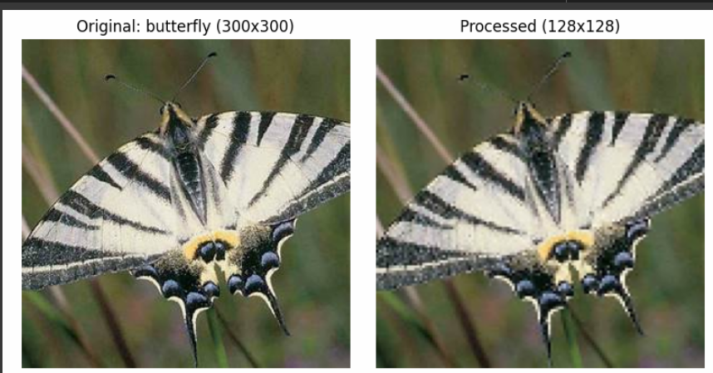
Resizing
Optimized resizing. Less loss in resizing and aspect ratio preservation.
INTER_CUBIC interpolation uses a bicubic algorithm,
which generally produces higher-quality results
To avoid distorting the images,
we used padding instead of simply squashing them. Padding adds a border
around the resized image to fill the remaining space
All images resized to 128x128 pixels for faster training and processing.

Slide 9
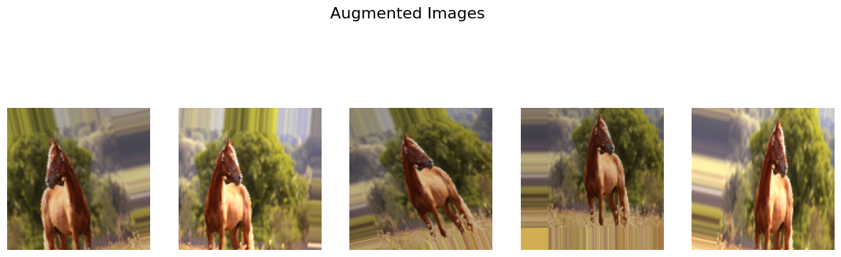
Data Augmentation
Used ImageDataGenerator from Keras to apply
various random transformations to the training images to enhance generalization.
Rotation (up to 20°)
Shifts (Horizontal & Vertical, up to 20%)
Shear (up to 20%)
Zoom (80% - 120%)
Brightness (80% - 120%)
Horizontal Flip
Nearest-neighbor fill
Rescale

Slide 10
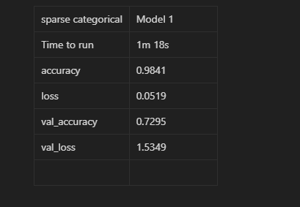
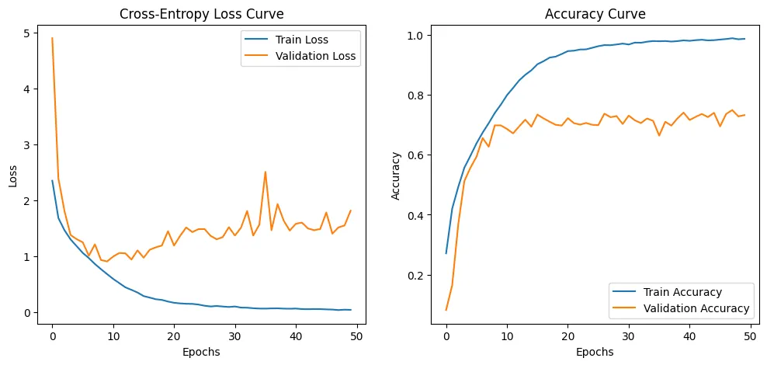
First models: Sparse Categorical Crossentropy
Our first model had a pretty high accuracy on training data, but it had difficult dealing with unseen data
Same optimization as our final model, but smaller architecture
We used 4 layers with sparse categorical crossentropy.

Slide 11
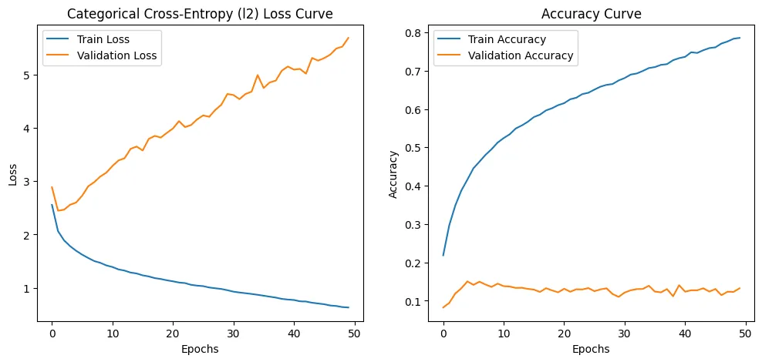
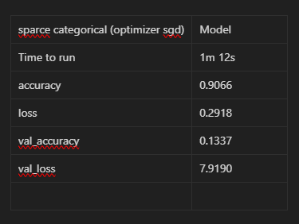
SGD
We also tried using Stochastic Gradient Descent
It failed to deliver in this architecture, low validation accuracy

Slide 12
Optimizations tried and applied
Optimizing drop out rate
Learning rate adjustments
Layer amount
Batch size
SGD, SCE, CE, Adam

Slide 13
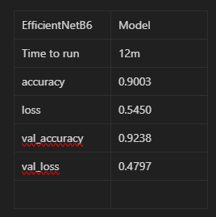
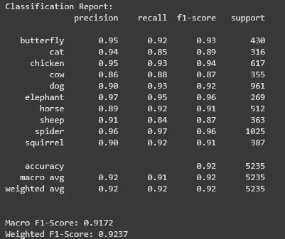
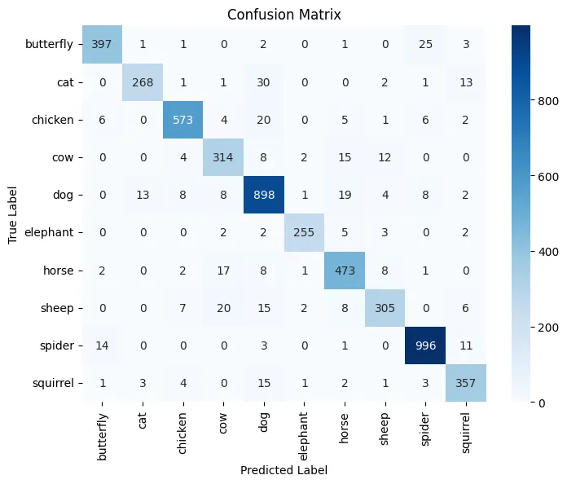
EfficentNetB6 - Transfer learning
Made by google
Compound Scaling: Intelligently scales width, depth, and resolution together.
Reached a high val-acc
Pros: High validation accuracy (92% without tuning)

Slide 14
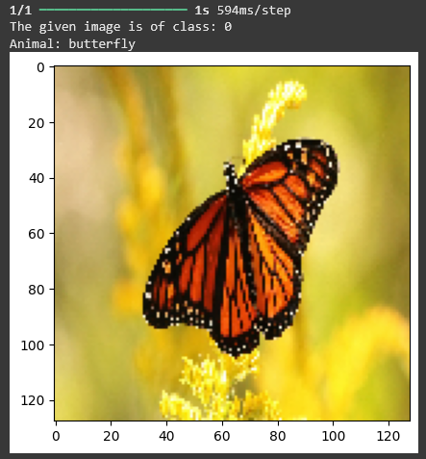
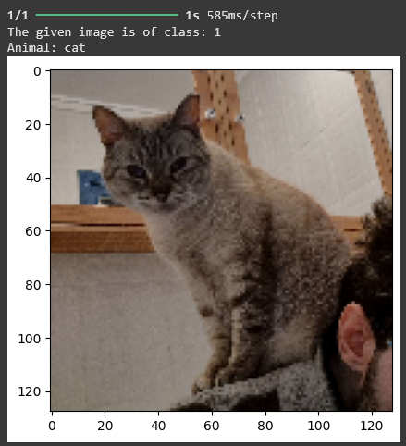
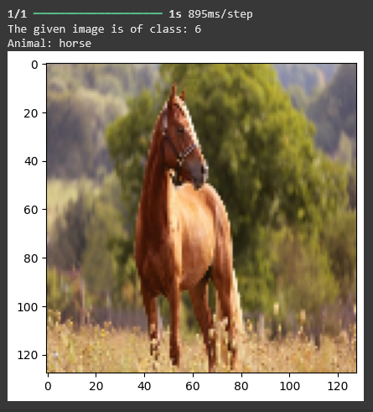
Testing the model locally (Alpha_1)

Slide 15
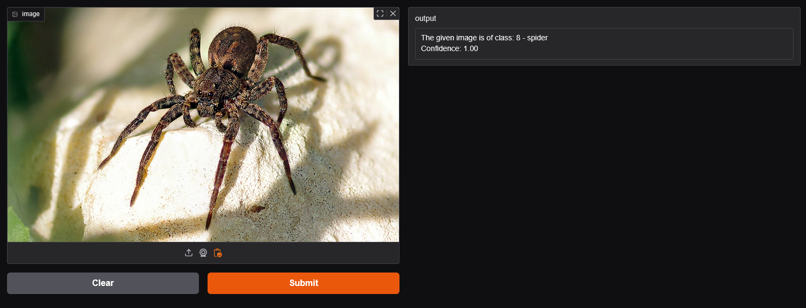
Model Deployment
We attempted HuggingFace and Gradio deployment

Slide 16
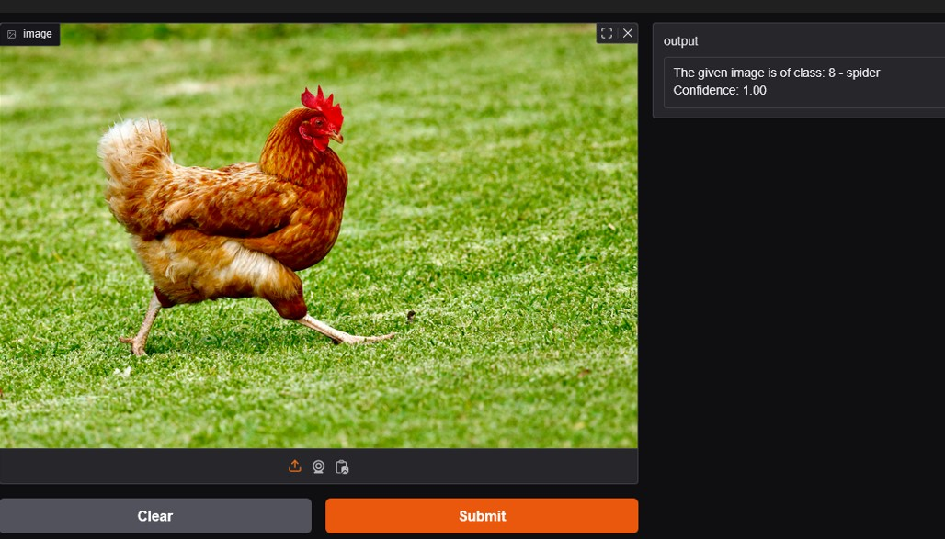
Still a spider...

Slide 17
Overview
What did we learn?
Learned a lot about the process of creating a CNN and how small adjustments like dropout, learning rate adjustments can improve validation accuracy.
We learned through deployment making an app with user interaction.
What could be improved?
Significant overfitting, therefore it would be suggested to look into further data augmentation and maybe change the architecture of the model itself.
Issues and drawbacks.
Had issues with reproducing the model on Huggingface plattform. Not sure if it is utilizing the model correctly.

