Slide 1
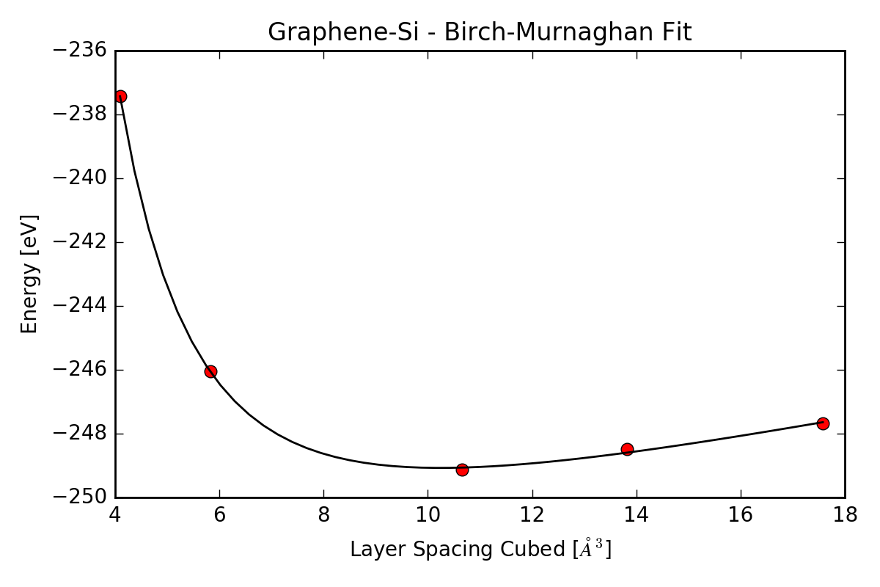
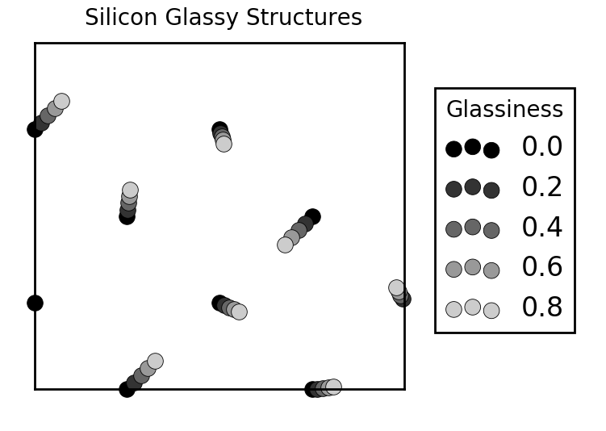
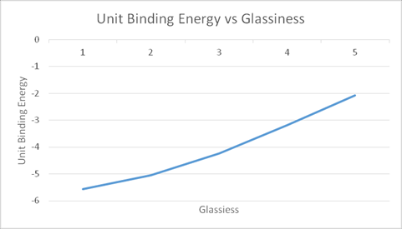
Study of Graphene and Silicon Heterostructures
Sean George, Lucas Bittof
Jefferson County High School
Methods
Get graphite.cif file from ICSD Database
Convert to graphene with text editor
Convert to .vasp file using Vesta
Convert to rectangular unit cell by calculating on paper, using text editor
Generate 4x2 supercell using provided Python script
Get silicon.cif file from ICSD Database
Convert to .vasp file with Vesta
Convert to 2D face-centered layer using text editor
Generate 2x2 supercell using provided Python script
Modify the unit cell lengths of graphene and silicon to be equal, such that the new lengths are in between the initial lengths of the two supercells to minimize strain.
Offset graphene by 1.5 angstroms
Use VASP to calculate energy for both supercells
Generate a series of 4 progressively more glassy silicon supercell using Python script
Combine glassy layers with graphene supercell to form a layered heterostructure, as well as graphene with the crystalline silicon
Calculate energy of combined heterostructures
Take difference in energy between heterostructures and the energy of the graphene supercell alone plus silicon supercell energy alone, the difference = binding energy.
Plot binding energy vs. ‘glassiness’
Results
Energy of Graphene: -235.48285 eV
Energy of Silicon: -8.2747391 eV
Binding Energy of Crystalline Graphene and Silicon: -5.5899956 eV/angstrom^2
Binding Energy of Slightly Glassy Graphene and Silicon: -5.0589389 eV/angstrom^2
Binding Energy of More Glassy Graphene and Silicon: -4.2581974 eV/angstrom^2
Binding Energy of Mostly Glassy Graphene and Silicon: -3.2056997 eV/angstrom^2
Binding Energy of Glassy Graphene and Silicon: -2.0784606 eV/angstrom^2
Fig. 1: Graphene-SI – Birch-Murnaghan Fit
Fig. 2: Silicon Glassy Structures
Fig. 3: Unit Binding Energy vs Glassiness

Slide 2
Introduction
Graphene is a two-dimensional layer of hexagonally bound carbon atoms. Graphene was discovered very recently and has many possible applications. It was discovered when researchers split layers of graphite apart until there was only one layer left. Silicon can be in a crystalline or amorphous structure. Silicon is used in solar panels, some digital displays, and as a semi-conductor in electronics. This study is focusing on the ability of graphene to bind to glassy, amorphous, silicon. Graphene acts as a conductive layer on glassy silicon, this is important for solar panels. Solar panels need both a transparent and a conductive layer. The glassy silicon and graphene heterostructure preforms this better than other options. This study is focused on graphene bonded to silicon. We hypothesized that the graphene that was in a heterostructure with the crystalline silicon would have a lower binding than amorphous silicon, and as the glassiness increases the bonding energy increases.
Conclusion
The energy of the combined system of Graphene and Silicon changes very little
The Glassier the Silicon the lower the energy
The Glassier Silicon is more stable
Only the Single layer of Silicon varies in energy as it gets more Glassy
Graphene binds better to Crystalline Silicon than Glassy Silicon
It would take twice as much energy to separate Graphene from Crystalline Silicon the it would to separate Graphene from Glassy Silicon
References
Chem Soc Rev. (2014). Atlas of 2D Materials. Retrieved from
Florian Banhart, Jani Kaokoski, and Arkady V. Krasheninnikov (2011). Structural Defects in Graphene.
Graphene as a transparent electrode for amorphous silicon-based solar cells. (n.d.). Retrieved July 06, 2016, from http://scitation.aip.org/content/aip/journal/jap/117/24/10.1063/1.4923232
Two-dimensional materials and their prospects in transistor electronics. (n.d.). Retrieved July 06, 2016, from http://pubs.rsc.org/en/content/articlehtml/2015/nr/c5nr01052g
Graphene as a transparent electrode for amorphous silicon-based solar cells. (n.d.). Retrieved July 06, 2016, from http://scitation.aip.org/content/aip/journal/jap/117/24/10.1063/1.4923232\
Neutral-Color Semitransparent Organic Solar Cells with All-Graphene Electrodes. (n.d.). Retrieved July 06, 2016, from http://pubs.acs.org/doi/full/10.1021/acsnano.5b04858
Acknowledgements
We would like to thank the CAPS Outreach Center, the Math and Science Center.
We would also like to thank
Dr. Ernest W. Brewer, Professor and PI/Director of Caps
Ms. Leigh Ann Elkins, Project Director of MSC
Isaac Bredeson, Mentor
Bailee Woodall and Justin Lee, Facilitators of Mentoring Project

