Slide 1

Green Pace
Security Policy Presentation | Developer: Cory Carter

Slide 2
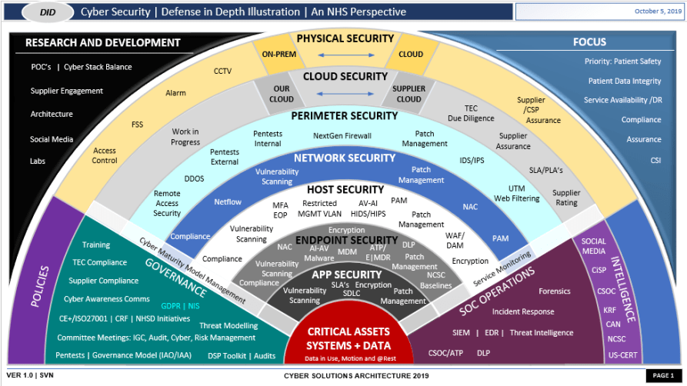
OVERVIEW: DEFENSE IN DEPTH
Goal: standardize the secure-coding habits we already use so every developer applies them the same way.
Why we needed it:
• Team growth means tribal knowledge won’t scale.
• We assume vulnerabilities will happen, so we plan for them.
How it supports defense-in-depth:
• Layers in code, CI/build, and runtime monitoring.
• External testing (SAST, fuzzing, dependency scans) catches issues early.

Slide 3
THREATS MATRIX
This matrix shows how we prioritize our 10 Green Pace coding standards (GP-CS-01 to GP-CS-10) based on likelihood and impact. High-priority items are addressed first (design + implementation + tests).
Automation note: We use CI security gates (compiler warnings, static analysis, unit tests, and dependency scanning) to detect these issues early and consistently.
Likely + Priority GP-CS-01, GP-CS-02, GP-CS-03, GP-CS-04 | Likely + Low priority GP-CS-05, GP-CS-07
Unlikely + Priority GP-CS-06, GP-CS-08 | Unlikely + Low priority GP-CS-09, GP-CS-10

Slide 4
10 PRINCIPLES
10 guiding principles (with related coding standards):
• P1 Assume vulnerability → GP-CS-10, CS-05, CS-08
• P2 Minimize attack surface → GP-CS-09, CS-04
• P3 Defense in depth → GP-CS-10, CS-08, CS-05
• P4 Least privilege → GP-CS-04, CS-09
• P5 Secure by default → GP-CS-09, CS-07
• P6 Validate input / protect boundaries → GP-CS-01, CS-02
• P7 Fail securely → GP-CS-05, CS-01
• P8 Protect secrets & keys → GP-CS-07, CS-06
• P9 Monitor, log, and respond → GP-CS-05, CS-10
• P10 Continuous improvement → GP-CS-08, CS-10

Slide 5
CODING STANDARDS
Priority order (based on likelihood × impact, plus exploitability and cost-to-fix):
1. GP-CS-02 Memory-safe C++ - Bounds checks, avoid unsafe functions, use RAII, enable sanitizers.
2. GP-CS-01 Validate & sanitize input - Central validation helpers, allow-lists, normalize before use.
3. GP-CS-03 Authentication & credential handling - MFA where possible; strong hashing (salted) and lockouts.
4. GP-CS-04 Authorization for every sensitive action - RBAC/ABAC, server-side checks, deny by default.
5. GP-CS-07 Secrets management - No hardcoded secrets; use vault/env; rotate and limit scope.
6. GP-CS-06 Approved crypto & key management - TLS in flight; encrypt at rest; use vetted libraries only.
7. GP-CS-05 Safe errors & secure logging - No sensitive data in errors/logs; consistent messages; audit trails.
8. GP-CS-08 Dependency/build hardening - SCA, pinned versions, compiler warnings as errors, secure flags.
9. GP-CS-09 Secure configuration & resilience - Disable debug in prod, rate limits, safe defaults, minimal ports.
10. GP-CS-10 Testing & reviews as a gate - Code reviews, unit tests, fuzzing, and SAST/DAST in CI.

Slide 6
ENCRYPTION POLICIES
Encryption in flight:
• TLS 1.2+ (prefer TLS 1.3); HSTS for web endpoints; mutual TLS between internal services when feasible.
Encryption at rest:
• Encrypt databases, backups, and file storage (AES-256 via platform-managed encryption). Keys stored in a vault/KMS.
Encryption in use:
• Minimize sensitive data in memory; zeroize buffers after use; avoid logging secrets; protect keys with least privilege.
Policy rules:
• Use approved libraries only (no custom crypto). Rotate keys, set expiration, and log key-access events.

Slide 7
TRIPLE-A POLICIES
Authentication:
• Strong passwords + salted hashing; MFA for admin/high-risk actions; rate limit + lockout for brute force.
Authorization:
• RBAC with least privilege; server-side permission checks on every sensitive endpoint; separation of duties.
Accounting (auditing):
• Central audit logs for auth events, admin actions, and data access. Logs are tamper-resistant and monitored (alerts).
Operational rule:
• If an action changes data or permissions, it must be authenticated, authorized, and logged.

Slide 8
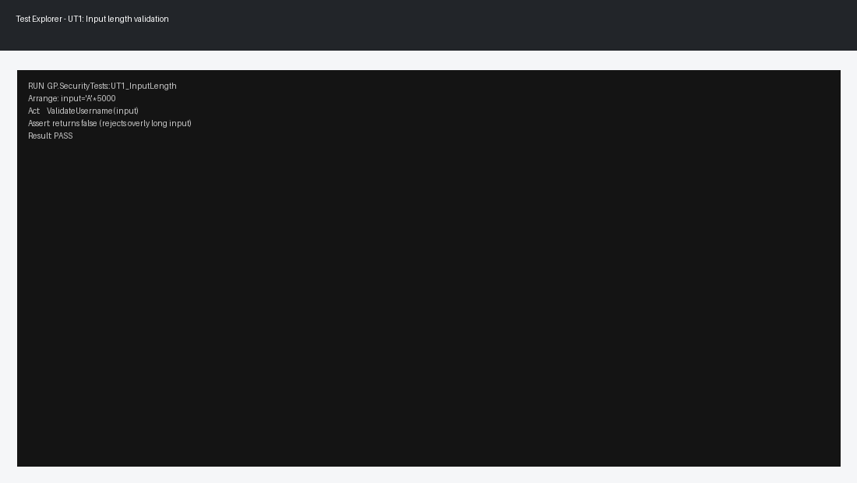
UT1: Does username validation reject overly long input?
Vulnerability: buffer overflow / denial-of-service from unbounded input (GP-CS-02, GP-CS-01)
Positive tests: normal length is accepted
Negative tests: 5,000-char string is rejected
Step further: add fuzz tests + run with AddressSanitizer in CI

Slide 9
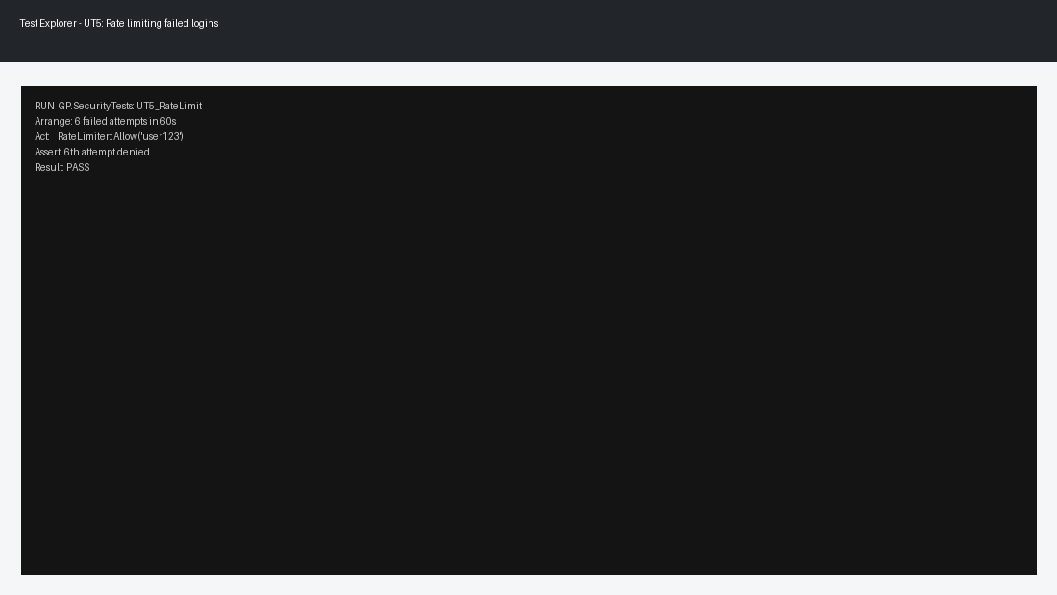
UT5: Does the rate limiter throttle repeated failed logins?
Vulnerability: brute force and account takeover (GP-CS-03, GP-CS-09)
Positive tests: first attempts allowed
Negative tests: after threshold, login attempts are denied
Step further: add IP + user-based limits and alert on spikes

Slide 10
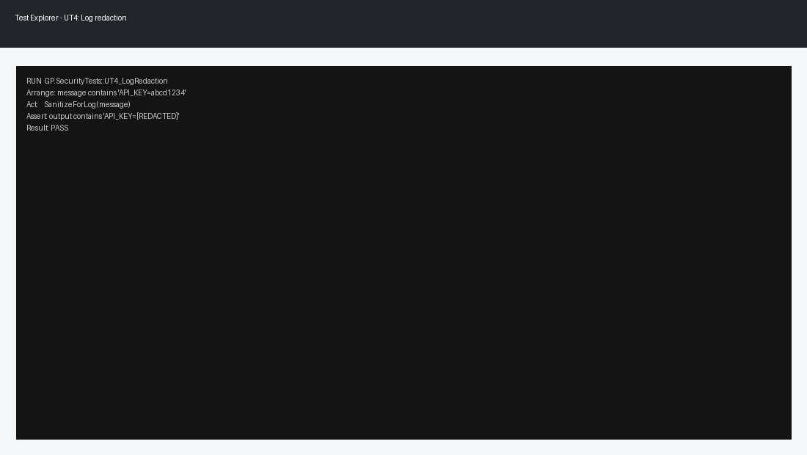
UT4: Are secrets redacted before logging?
Vulnerability: sensitive data exposure (GP-CS-05, GP-CS-07)
Positive tests: normal messages unchanged
Negative tests: API_KEY and tokens are redacted
Step further: add log-scanning automation to fail builds on leaked secrets

Slide 11

UT3: Do non-admin users get blocked from admin actions?
Vulnerability: broken access control (GP-CS-04)
Positive tests: admin role can perform action
Negative tests: standard role is denied
Step further: add tests per endpoint + verify server-side enforcement

Slide 12

UT2: Does path handling block '../' traversal?
Vulnerability: path traversal / unauthorized file access (GP-CS-01, GP-CS-04)
Positive tests: valid relative path accepted
Negative tests: '../../' throws error or returns false
Step further: normalize paths + allow-list base directories

Slide 13
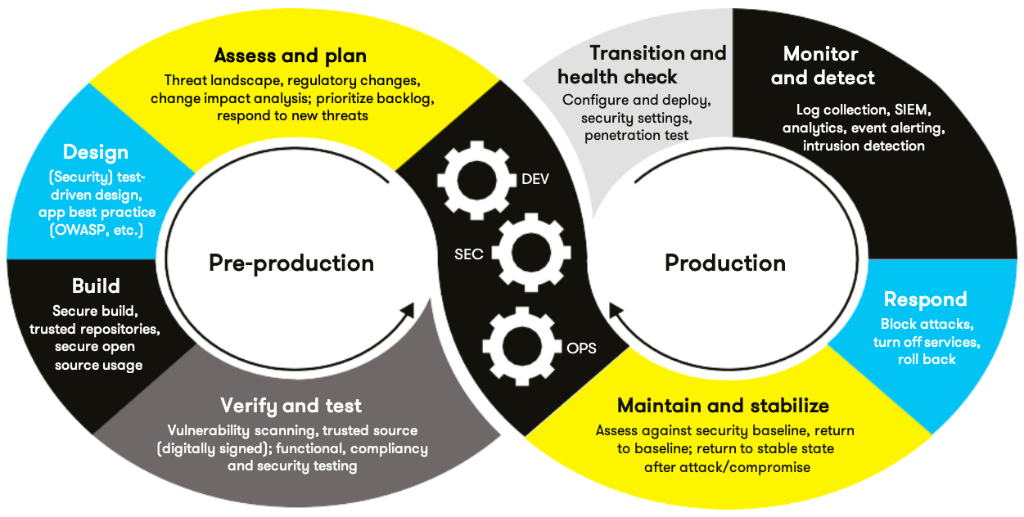
AUTOMATION SUMMARY
Where security automation lives in our DevSecOps flow:
• Code: pre-commit hooks + secret scanning
• Build: compiler warnings-as-errors + static analysis (clang-tidy/cppcheck)
• Test: unit tests + sanitizers + fuzzing
• Package/Deploy: dependency scanning + config checks
• Operate: monitoring + alerting + incident response playbooks
Plan
Code
Build
Test
Package
Release
Deploy
Monitor
→ → → → → → →
Secret scanning
(pre-commit + CI)
GP-CS-07
SAST: clang-tidy/cppcheck
Compiler hardening flags
GP-CS-08
Unit tests + Sanitizers
Fuzzing (libFuzzer)
GP-CS-10
Runtime monitoring
Audit logs + alerts
GP-CS-05

Slide 14
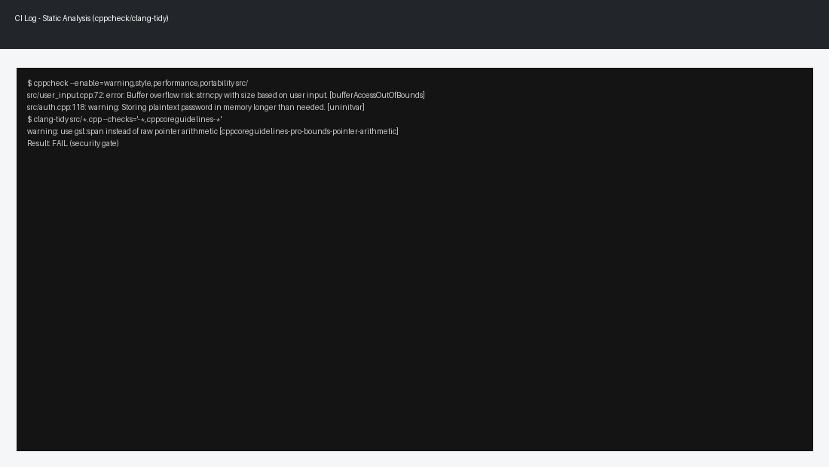
TOOLS
  DevSecOps pipeline (defense-in-depth):
• Code: secure coding checklist + peer review + pre-commit secret scan
• Build: warnings-as-errors; secure flags (/GS, /sdl); SAST (clang-tidy/cppcheck)
• Test: unit tests (CppUnitTestFramework) + sanitizers + fuzzing for input-heavy code
• Package: dependency/SBOM scan + license check
• Deploy: config hardening (no debug, least exposed ports), baseline policies
• Operate: centralized logs, audit trails, alerting, and regular pen testing
External testing methods that catch vulnerabilities:
• SAST finds unsafe patterns (bounds issues, risky APIs, insecure string handling).
• Fuzzing + sanitizers catch crashes, memory corruption, and edge-case bugs.
• Dependency scanning catches vulnerable libraries before release.

Slide 15
RISKS AND BENEFITS
Biggest current problems (and why they matter):
• Memory safety bugs (GP-CS-02): can lead to crashes, data corruption, or remote code execution.
• Broken access control (GP-CS-04): can expose admin actions and sensitive data.
• Secrets + misconfiguration (GP-CS-07/09): easiest way to get breached.
Act now (high return):
• Add validation + safe string/buffer handling everywhere (cheap and prevents many bugs).
• Make authz checks consistent (central helper + tests).
• Turn on security automation gates in CI (SAST + unit tests + dependency scan).
If we wait:
• Risk grows as features and developers increase.
• Bugs become harder and more expensive to fix (and might become incidents).
Tradeoffs:
• More upfront time for tests/review, but fewer production incidents and faster onboarding.

Slide 16
RECOMMENDATIONS
    Current gaps we still need to address:
    • Consistent threat modeling in design reviews (attack surface + assumptions).
    • Stronger dependency/supply-chain controls (SBOMs, pinned versions, review critical libs).
    • Better documentation for secure defaults (what is allowed/denied, logging rules, crypto rules).
    • A clear process for reporting and fixing security findings (SLA + severity).
    Future focus (getting ahead of threats):
    • Add fuzzing to high-risk parsers and input-heavy components.
    • Expand automated checks: secret scanning, IaC scanning, and policy-as-code.
    • Regular external reviews: pen tests / red team exercises + lessons learned.
    Real-world example: SolarWinds (2020) showed how a supply-chain compromise can spread through trusted software updates. That’s why we’re pushing SBOMs, pinned versions, and dependency scannin
    Real-world example: Log4Shell (2021) was a reminder that one common third-party library bug can impact tons of systems fast. That’s why we need inventory (SBOM), rapid patch process, and CI dependency alerts.

Slide 17
CONCLUSIONS
Standards we should adopt (and keep enforcing):
• Security gates in CI (SAST + unit tests + dependency scan) aligned to NIST SSDF.
• OWASP-style requirements for validation, auth, and secure configuration.
• 'No unsafe defaults' rule: deny-by-default permissions, no debug in production, no hardcoded secrets.
• A policy maintenance cycle: quarterly review, metrics (defects found pre-release), and updates after incidents.
Bottom line: we assume vulnerabilities will happen, so we reduce attack surface, add layers, and catch issues early with automation.

Slide 18
REFERENCES
Souppaya, M., Scarfone, K., & Dodson, D. (2022). Secure Software Development Framework (SSDF) Version 1.1 (NIST SP 800-218). National Institute of Standards and Technology. https://csrc.nist.gov/pubs/sp/800/218/final
OWASP Foundation. (2021). OWASP Top 10:2021. https://owasp.org/Top10/2021/
OWASP Foundation. (n.d.). OWASP Application Security Verification Standard (ASVS). https://owasp.org/www-project-application-security-verification-standard/
Microsoft. (2025). Use the Microsoft Unit Testing Framework for C++. Microsoft Learn. https://learn.microsoft.com/en-us/visualstudio/test/how-to-use-microsoft-test-framework-for-cpp?view=visualstudio

