Slide 1
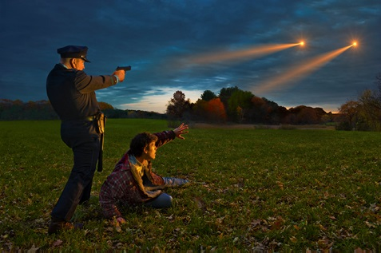
UFO Sightings
Cory Opie
Jessica Covey
James Tabinski
Kendrick Walker
Youssef Boulfrakh

Slide 2
Hypothesis
UFO sightings are correlated to airports, landmarks, and military bases

Slide 3
UFOs: What, When, Where
What areas of the country are most likely to have UFO sightings?
Do clusters of UFO sightings correlate with landmarks, such as airports, military bases, or government research centers?
What are the most common UFO descriptions?
Are certain shapes seen more often in certain locations?
Has there been a change in the number of sightings reported over the years?
Are they seen more often in a particular season?

Slide 4

Data Sources
The National UFO Reporting Center
Website: NUFORC.org
Hotline: 206-722-3000

Slide 5
Data Sources
Primary Data
Supporting Data
UFO Sightings
Source: Kaggle.com
Origin: The National UFO Reporting Center
Website: https://www.kaggle.com/NUFORC/ufo-sightings
Column Headers: datetime, city, state, country, shape, duration, comments, date posted, latitude, and longitude.
Airports
Source: Google Places API
Website: https://maps.googleapis.com/maps/api/place/nearbysearch/json
Military Bases
Source: Open Data Soft
Website: https://public.opendatasoft.com/explore/dataset/military-bases/table

Slide 6
Data Sources
Our initial data pull came from Kaggle: Kaggle - UFO
https://www.kaggle.com/NUFORC/ufo-sightings
This data contained the UFO sightings reported by datetime, city, state, country, shape, duration, comments, date posted, latitude/longitude.
Military Bases: We obtained from open data soft:
https://public.opendatasoft.com/explore/dataset/military-bases/table
Landmarks:
We obtained from xxx:
Airports: We made an API pull from Google APIs – Google Places – Nearby Search function.
https://maps.googleapis.com/maps/api/place/nearbysearch/json
We each began searching various sites to see what type of data could be obtained. Some of the sites we searched, but chose not to use were:
Census Data
Noah.gov
Open Weather
We primarily chose not to use these other sites because data was not complete, finding comparable dates and times was not possible, or the data was not answering our questions and we did not want to have scope creep.

Slide 7
Data Cleanup Process
The clean up of the original Kraggle data was necessary to build the remainder of our code.
The data was scrubbed in Pandas by first reducing the data to United States sightings only. This was done with a loc command.
To use the data for analysis, we had to split the datetime columns to get separate fields. This was done with the str. split command.
We also had to change some of the data types from objects and strings to integers and floats, which we did through the astype function.
Duration had random apostrophes; longitude had an extra space which had to be corrected.
Dropna function to remove incomplete data.

Slide 8
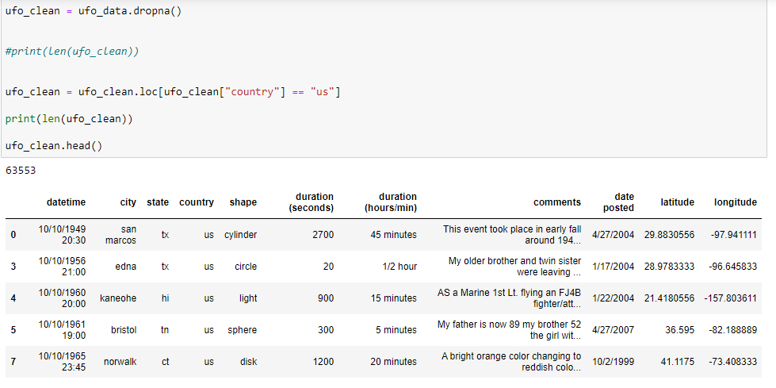
Jupyter Notebook – Clean Up

Slide 9
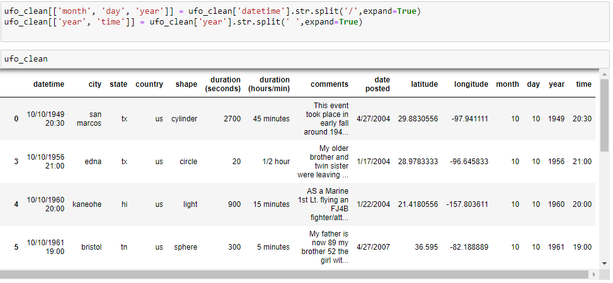
Jupyter Notebook – Clean Up

Slide 10
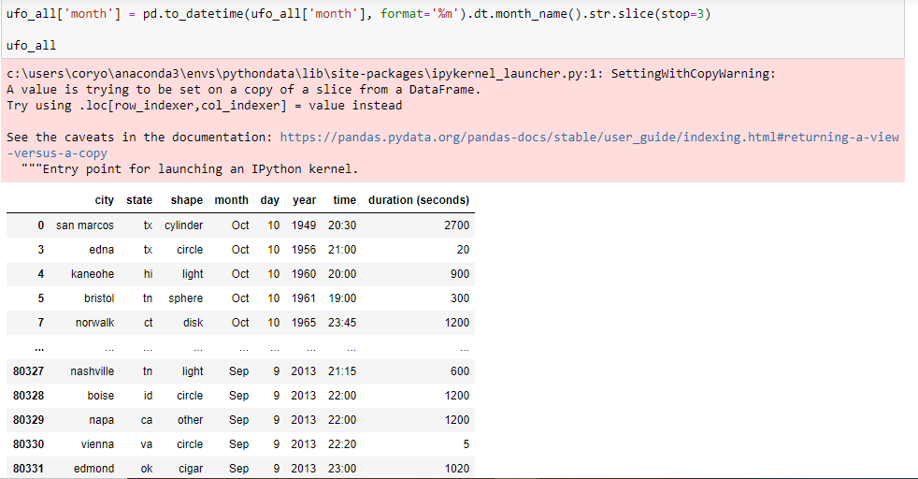
Jupyter Notebook – Clean Up

Slide 11
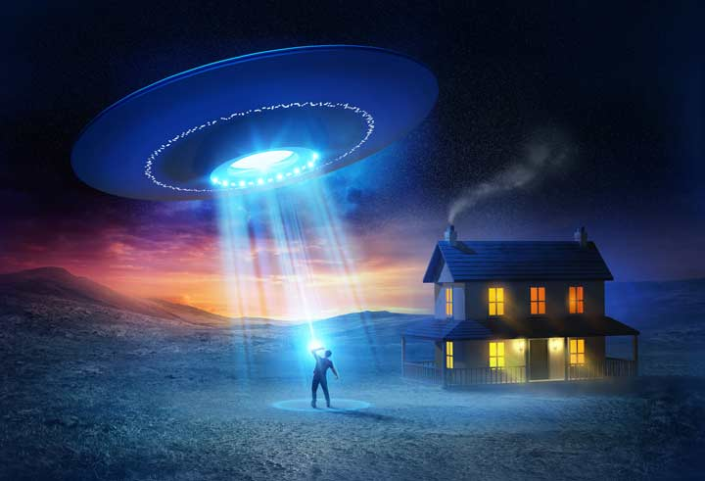
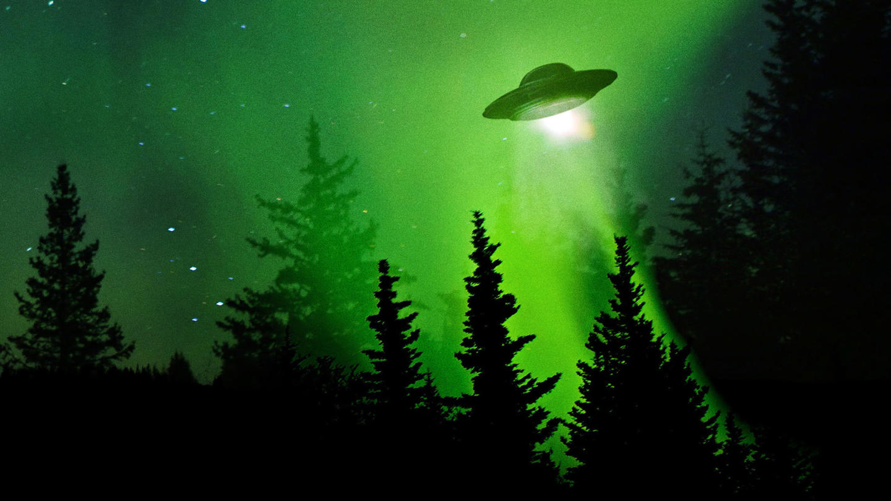
Data Analysis - UFO Sightings
Data Analysis
State
Years
Months
Top City in Top Year
Shapes and Duration
Shapes
Shapes by State

Slide 12
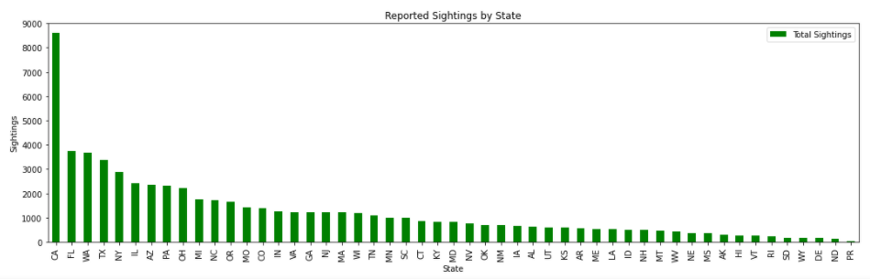
UFO Sightings by State
Str.Upper, Unique, Value.Counts, reset.index,
To determine sightings per state for all data

Slide 13
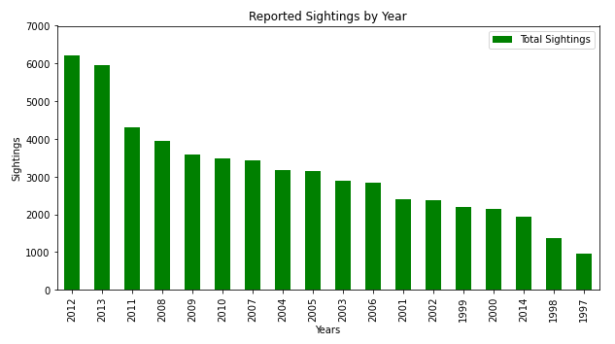
UFO Sightings by Year
Str.Upper, Unique, Value.Counts, reset.index, minimum data points
To determine sightings per year for all data

Slide 14
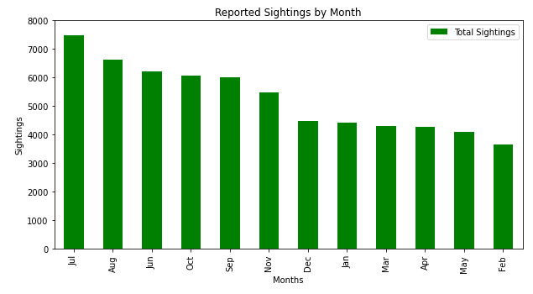
UFO Sightings by Month
Pd.to_datetime to format from month number to actual month name
To determine sightings per month for all data (time of year)

Slide 15
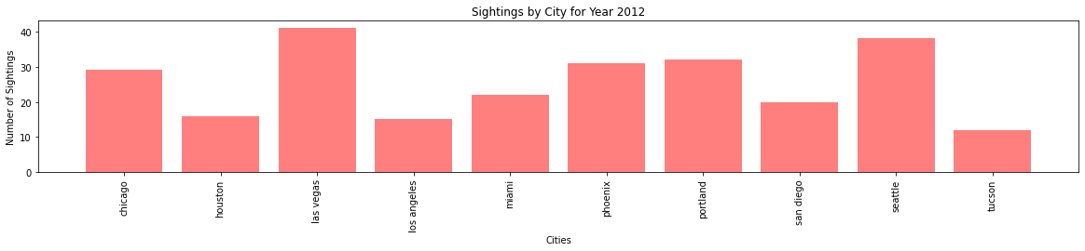
UFO Sightings by City in 2012
Groupby, astype, .loc, .sort_values, .count, plt.bar
To determine most sightings by city for the highest reporting year

Slide 16
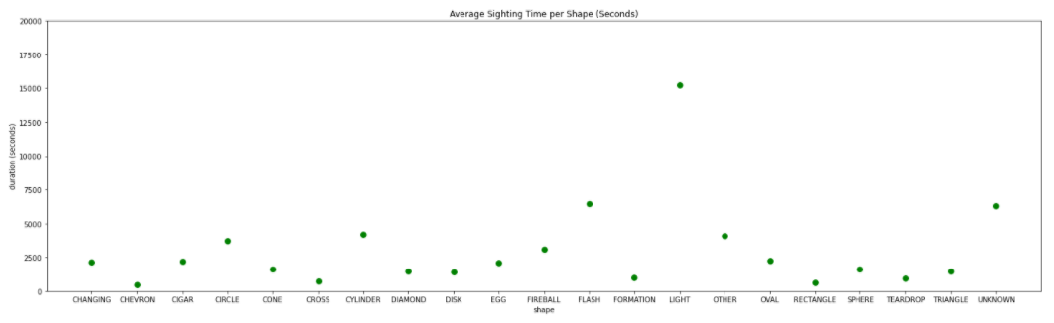
Shapes by Duration
Astype, groupby, .mean, reset.index
Light had longest duration nearly double the other shapes and highest sightings (13,407)
Triangle had high reported sightings, but had one of the lowest durations (6,511)

Slide 17
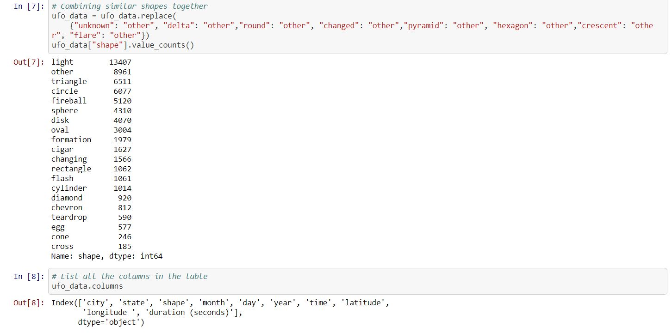
Jupyter Notebook – Shapes Replacement

Slide 18
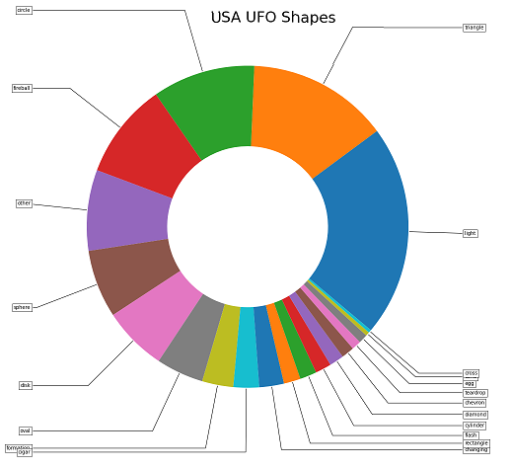
UFO Shapes
Pyplot pie chart
Replace function
Value.Count
Formatting pie chart
Top reported shapes:
Light
Other
Triangle
Circle
Fireball

Slide 19
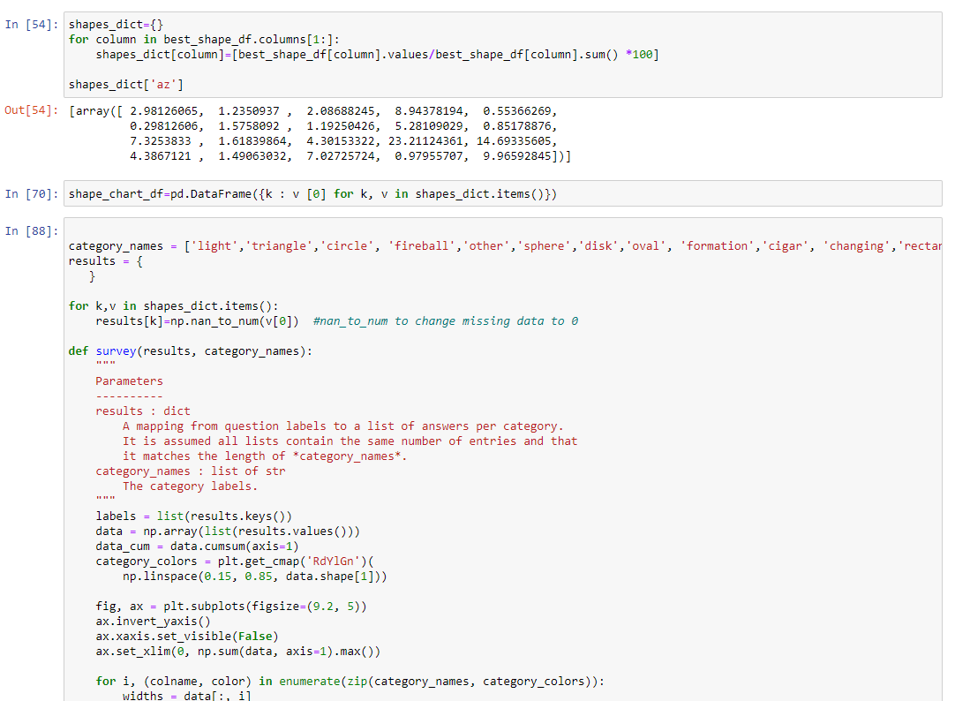
Jupyter Notebook – Shapes Bar Chart

Slide 20
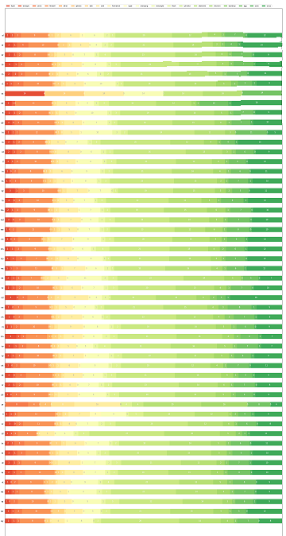
UFO Shapes by State
CSV file
Pivot Table
Index
Sightings by State /
Shape by State
Percentage per shape per state
Dictionary – For Loop on Dict items – nan to num for different lengths –
Format for size
California had most sightings, but only 3% was most often seen shape of light – 20% cylinder

Slide 21
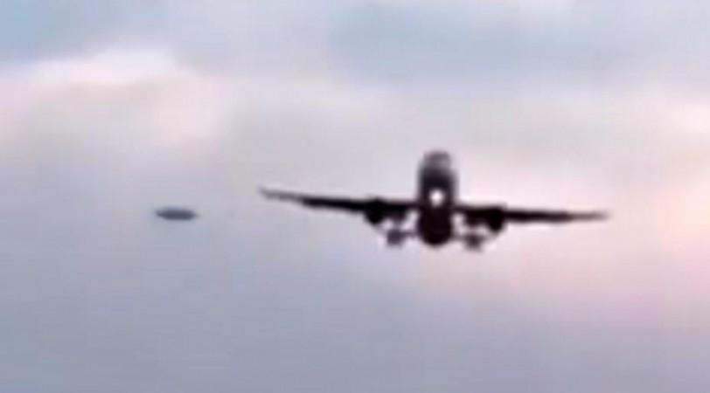
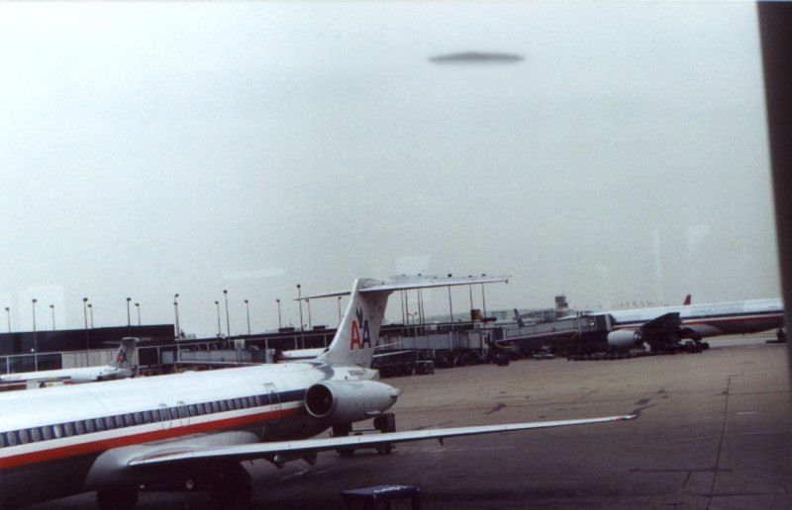
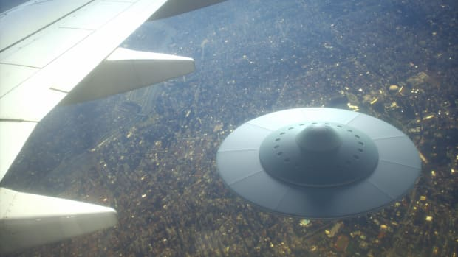
Data Analysis - Airports
Data Analsysis
Airport Heat Map

Slide 22
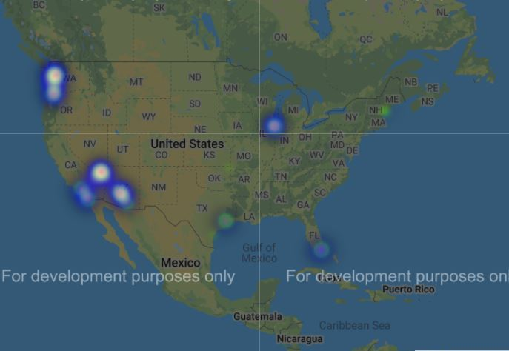
Heatmap: UFO Sightings by Airports
Top cities for sightings in 2012 with airports located within 5000 meters
API Google Places – Nearby Places – Using city lat, lng to find airports. Used json, .loc, index, gmaps.figure – two heatmap layers

Slide 23
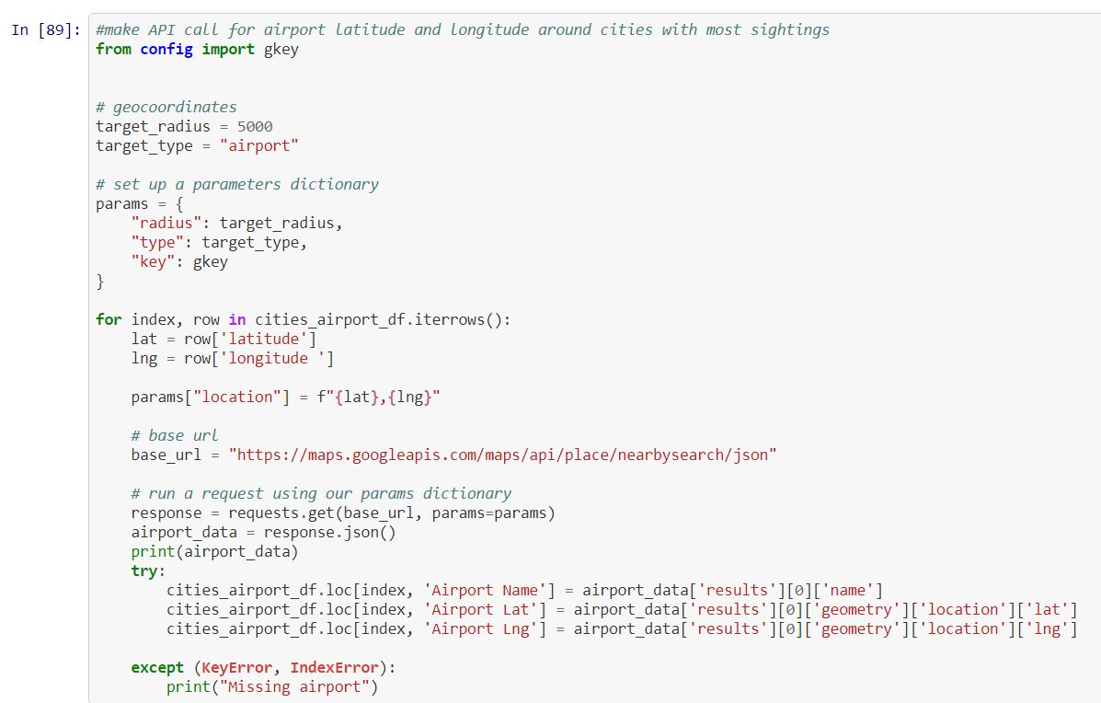
Jupyter Notebook – API Call

Slide 24


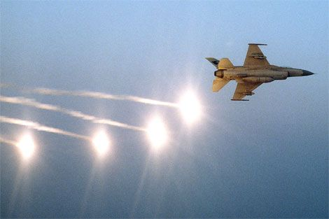
Data Analysis - Military
Data Analysis
UFO Sightings by Military Branch
UFO Sightings by Military Base
State: UFO Sightings by Military Base

Slide 25
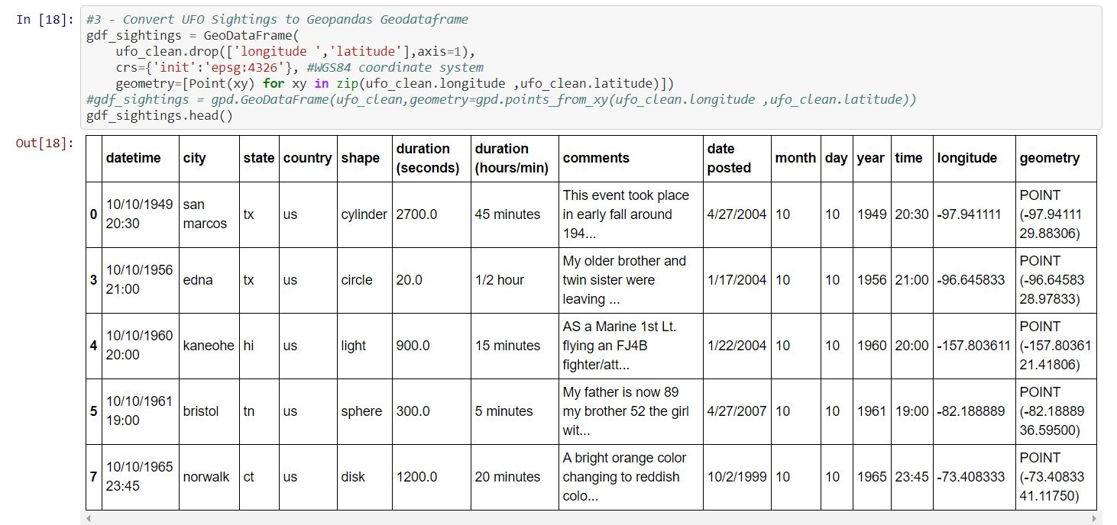
Jupyter Notebook – Geopandas

Slide 26
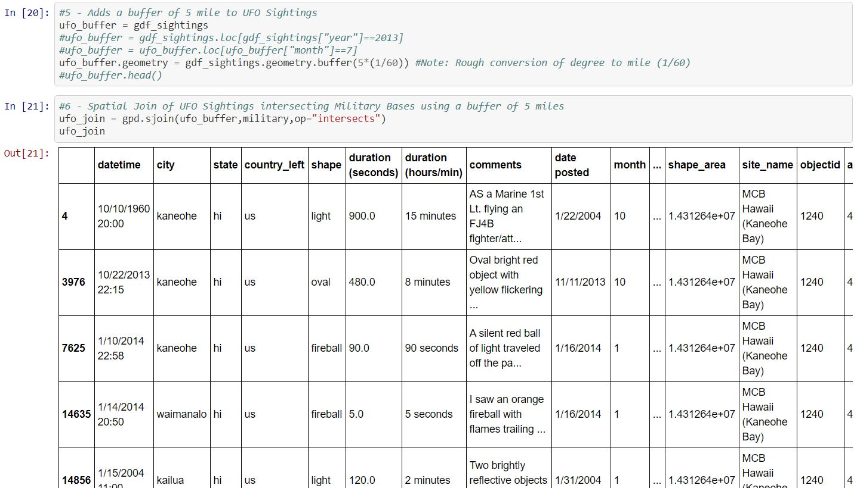
Jupyter Notebook – Buffer/Spatial Join

Slide 27
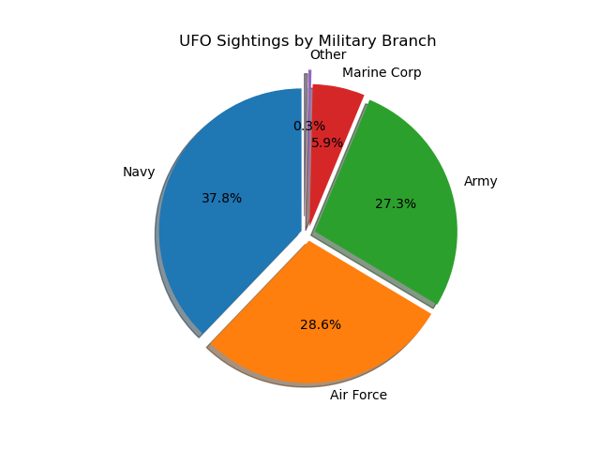
UFO Sightings by Military Branch
Replace to categorize
Group by
Count
Plot Pie Chart
Format Pie Chart
Findings:
Navy has most sightings
Air Force and Army are also quite high
Fairly distributed

Slide 28
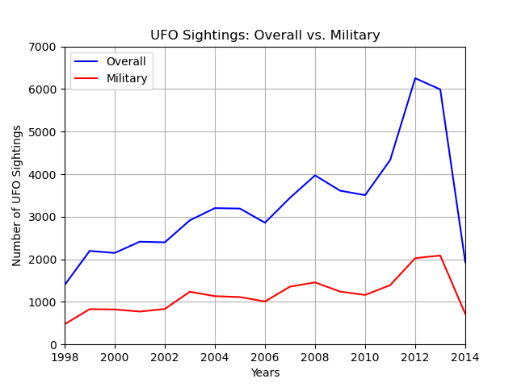
UFO Sightings by Years: Military
Groupby
Count
Plot line graph
Plot formats
X-lim, y-lim
Findings:
2013 had most UFO Sightings near a Military Base
UFO Sightings occur 30-40% within proximity to military bases

Slide 29
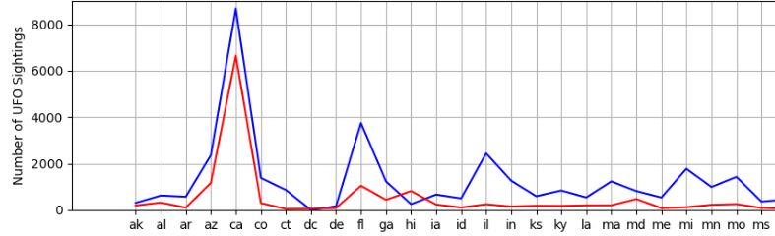
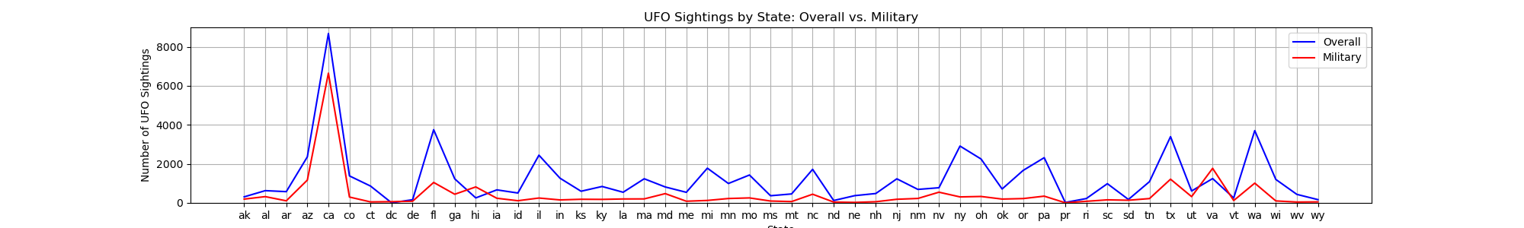
UFO Sightings by State: Military
Grouby
Count
Plot line graph
Plot formats
X-lim, y-lim
Findings:
HI and VA have skewed data
CA and FL correlate to military, some states don’t correlate

Slide 30
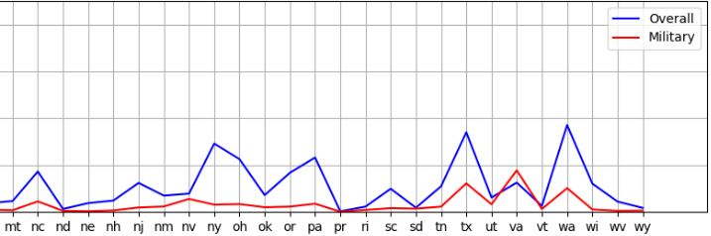
UFO Sightings by State: Military

Slide 31
UFOs: What, When, Where
What areas of the country are most likely to have UFO sightings?
Most sightings are near water/coastal, except for southwest
California, Washington, Florida, Texas almost always in top ten every year
Do clusters of UFO sightings correlate with landmarks, such as airports, military bases, or government research centers?
Often seen near naval bases
Often seen near airports

Slide 32
UFOs: What, When, Where
What are the most common UFO descriptions?
Most frequent seen ‘shape’ over the years is light
Mean duration of light sightings was 15,244 seconds – 4h 14m
Are certain shapes seen more often in certain locations?
California had most sightings, but only 3% was most often seen shape of light – 20% cylinder
Not real correlation between shape and state

Slide 33
UFOs: What, When, Where
Has there been a change in the number of sightings reported over the years?
Sightings reported increases at greater rates after 1997 (was <500 p/yr)
Most reported sightings have been in 2012 (6,216)
Are they seen more often in a particular season?
Mostly seen in warmer, summer months (June, July)

Slide 34
Postmortem
Finding available data in useable form
Can not work in silos – must build off other data
Visualizations provoke new questions
Always takes longer than you think it will
Time available to code and analyze data is limited
Pillows are softer than walls
Would have liked to do something with census or cell phone data – demographics
Surprises:
California as most sightings – thought it would be Nevada , New Mexico
Shape as “light” – thought it would be a “saucer”
Big jump in reported sightings year over year - why?

Slide 35

Questions

