Slide 1
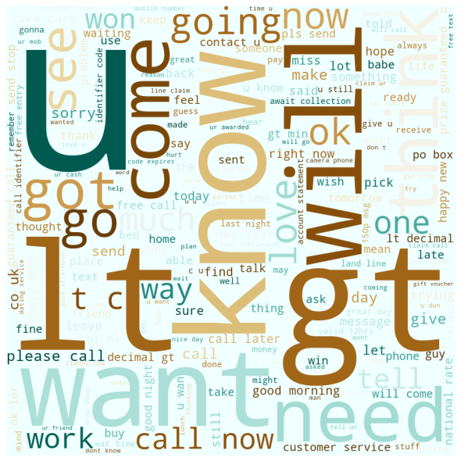

Using Natural Language Processing and Machine Learning to Create an Email Filter
Cory Stanley-Stahr
Final Project
Data Science Certification
ENTITY Academy
This Photo by Unknown Author is licensed under CC BY-SA-NC

Slide 2

About Me

Slide 3


Why the Data Science Certification from ENTITY Academy?

Slide 4
Demonstrate the breadth and depth of skills acquired.
Use Natural Language Processing and Machine Learning Techniques to create an email filter.
Present the process and outcome in a meaningful way.
Project Objectives

Slide 5

Why are
unwanted emails
called Spam?
https://youtube.com/clip/UgkxtfHRVVwehwfQG81HT7nhP2_s9A4VDJ08
This Photo by Unknown Author is licensed under CC BY-SA

Slide 6
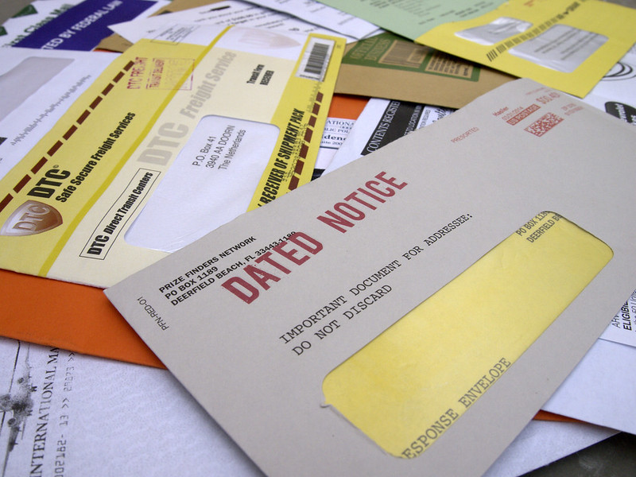
Why do we need to filter spam emails?
Annoying
Time consuming
Privacy issues
Security issues
(viruses, phishing, ransomware, etc.)
Fiscal liability
(distracted employees, server space, security issues)
https://www.flickr.com/photos/jhandbell/

Slide 7
Content: analyzes the body of the email for typical spam content
Content: analyzes the body of the email for typical spam content
Blacklist: blocks emails from senders who appear on a list of known spammers
Can often be personalized by adding senders you designate to the list
Header: examines email headers for particular IP addresses and other flags
Language: removes emails that are not in user’s native language
Rule-based: personalized filter that can search for particular words, phrases, or senders, then process those emails as directed
Bayesian: initially a content filter, but ML enables this filter to adjust based on how you interact with your emails
Blacklist: blocks emails from senders who appear on a list of known spammers
Can often be personalized by adding senders you designate to the list
Types of Email Filters
Header: examines email headers for particular IP addresses and other flags
Language: removes emails that are not in user’s native language
Rule-based: personalized filter that can search for particular words, phrases, or senders, then process those emails as directed
Bayesian: initially a content filter, but ML enables this filter to adjust based on how you interact with your emails
Summarized from What is a Spam Filter & Spam Filtering? (fortinet.com)

Slide 8
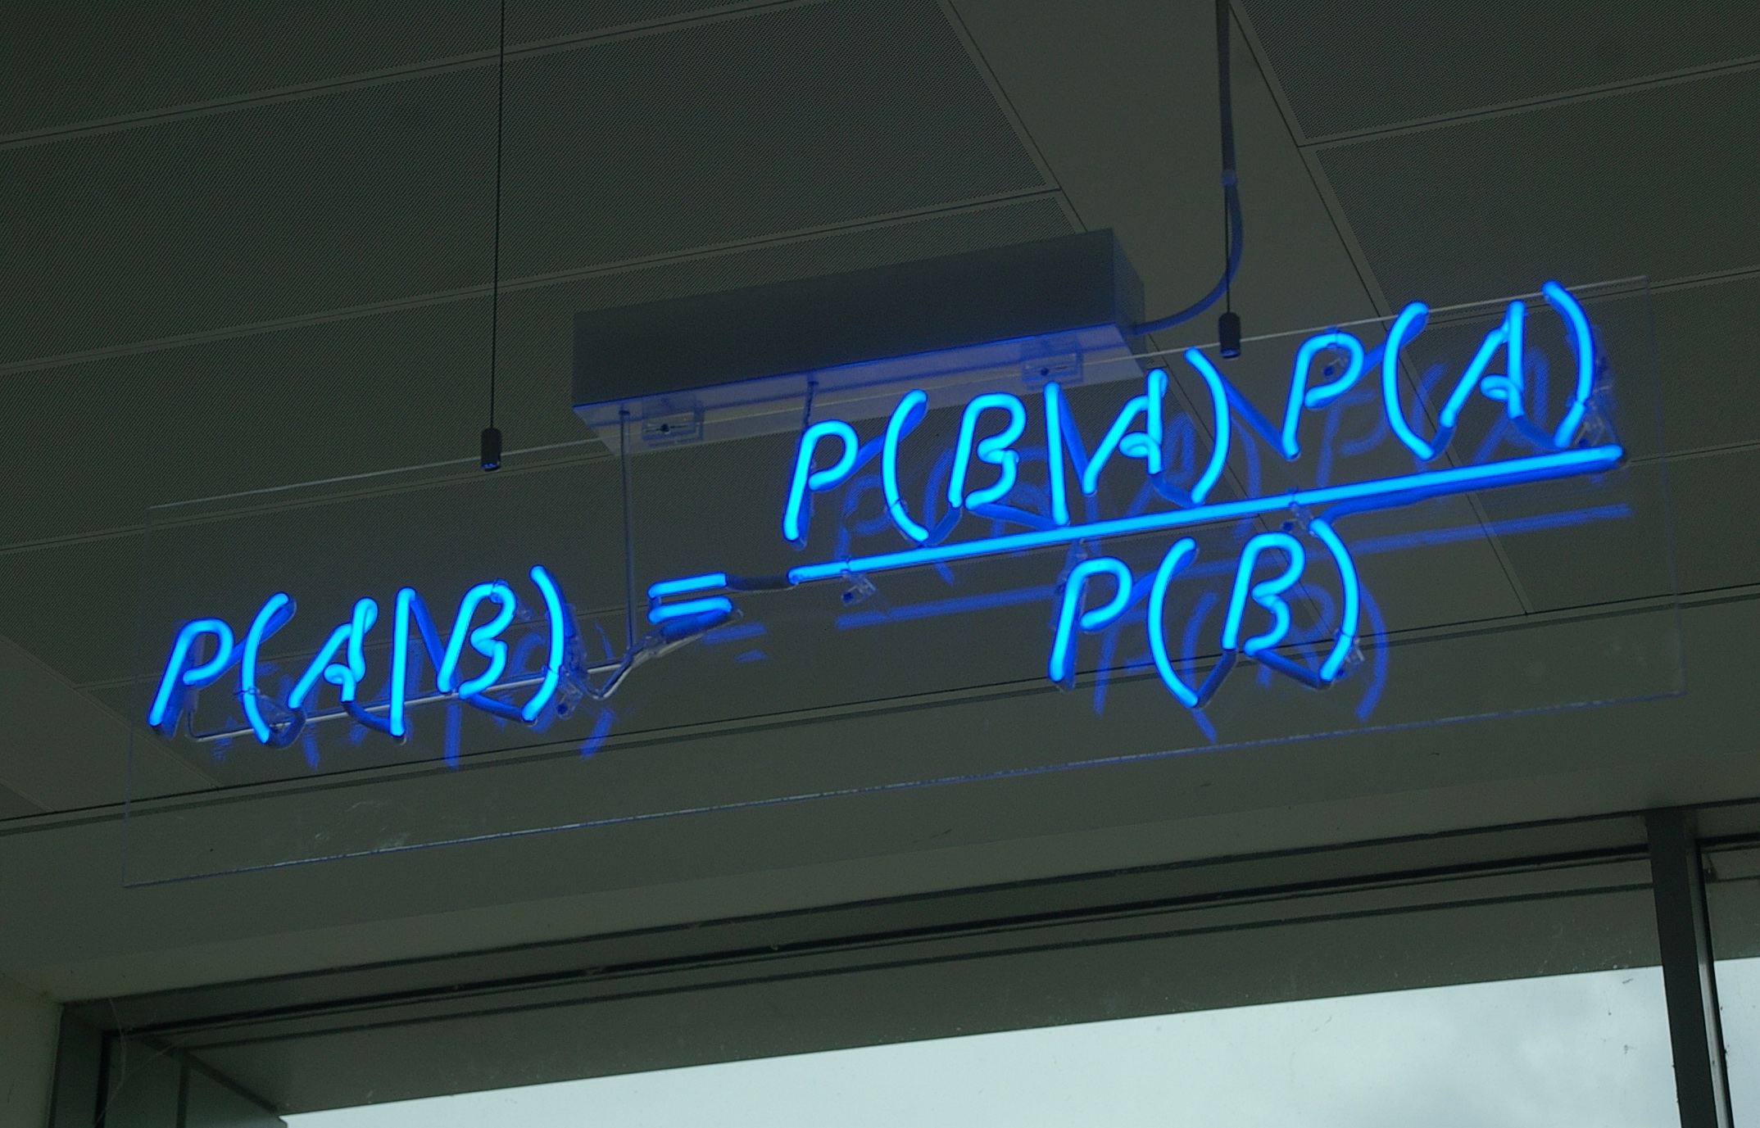
Bayes Theorem
The probability of event A, given the probability of event B, is equal to the probability of event A times the probability of event B given A, divided by the probability of B.
The events are not independent.
$$Posterior Probability=\frac{Likelihood of B|A × Prior Probability (aka Probability of A alone)}{Normalizing Factor (aka Probability of B alone)}$$

Slide 9
Many Approaches to Bayesian Filtering
Each approach includes the same basic steps:
However, the order of the steps and choice of techniques may differ:
Prepare the data
Generate dictionary
Generate features
Generate ML model
Test the ML model
What NLP techniques chosen for preprocessing?
Split then sort, or sort then split?
Some like to divide the data into training and testing datasets first, then divide those into spam and ham.
Some like to start by dividing the data into spam and ham, then divide each of those into training and testing datasets.

Slide 10
Your guide to Natural Language Processing (NLP)
Diego Lopez Yse
https://www.kdnuggets.com/2019/05/guide-natural-language-processing-nlp.html#.Y0MlFjlYsFg.link
recognition and prediction of diseases based on electronic health records and patient’s own speech
determine what customers are saying about a service or product by identifying and extracting information in sources like social media, a process called sentiment analysis
an inventor at IBM developed a cognitive assistant that works like a personalized search engine for your memories
companies like Yahoo and Google develop spam filters to stop unwanted email from arriving in your inbox
to identify fake news, the NLP Group at MIT developed a new system to determine if a source is accurate or politically biased
Amazon’s Alexa and Apple’s Siri are examples of intelligent voice driven interfaces
financial traders use NLP to track news, reports, and comments about possible mergers between companies
both the search and selection phases of talent recruitment
LegalMation developed a platform to automate routine litigation tasks
Uses of Natural Language Processing

Slide 11
Preprocessing (aka cleaning) done with Natural Language Processing (NLP)
What is text preprocessing?
To preprocess your text simply means to bring your text into a form that is predictable and analyzable for your task.

Slide 12
Approach 1 -
Spam Filter in Python: Naive Bayes from Scratch, Alex Olteanu, https://www.kdnuggets.com/2020/07/spam-filter-python-naive-bayes-scratch.html#.YwA2SNperOw.link

