Slide 1

ELEC0447 Analysis of Electric Power and Energy Systems
Programming tools
Based on the slides of Thibaut Théate, Antoine Dubois and Adrien Bolland for ELEC0018-1 – Energy Markets

Slide 2
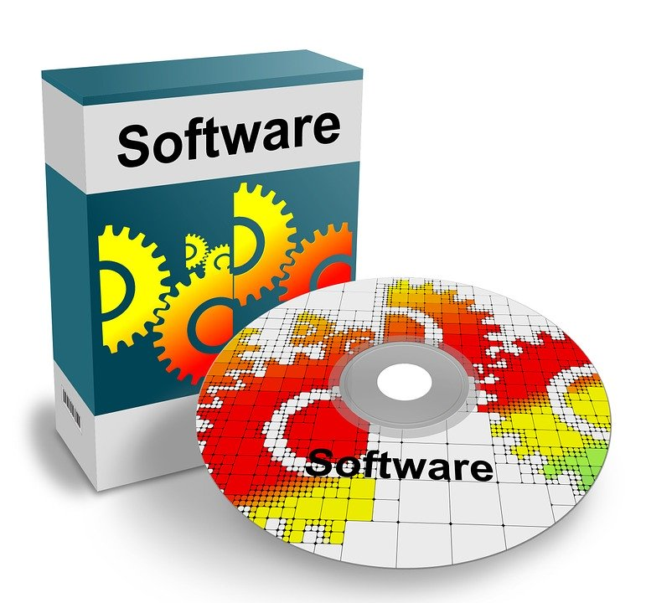
Assignment – Programming tools suggested
Anaconda (or simply conda) for managing your Python environments.
Python 3.7 (please avoid Python 2.7).
Numpy
Pandapower
Choose a text editor or an IDE:
Spyder (IDE installed with Anaconda).
Visual Studio Code (Text editor).
PyCharm (IDE).

Slide 3

Programming tools – Anaconda
Installation of Anaconda:
Windows: https://docs.anaconda.com/anaconda/install/windows
MacOS: https://docs.anaconda.com/anaconda/install/mac-os
Linux: https://docs.anaconda.com/anaconda/install/linux
Verification of the installation: https://docs.anaconda.com/anaconda/install/verify-install
Official Anaconda user guide: https://docs.anaconda.com/anaconda/user-guide
Useful cheat sheets:
https://docs.anaconda.com/anaconda/user-guide/cheatsheet
https://docs.conda.io/projects/conda/en/4.6.0/user-guide/cheatsheet.html

Slide 4


Programming tools – Conda environment
Creation of a new environment named PESanalysis for the assignment:
Open a new terminal (Anaconda Prompt for Windows).
Run the following command: conda create --name PESanalysis python=3.7
Verify the information printed and press “y” to confirm.
Run the following command: conda env list
Check that your new environment named PESanalysis is present in the list.
To activate this environment, run the following command:
Windows: activate PESanalysis
MacOS or Linux: source activate PESanalysis
Do not forget to activate the PESanalysis environment before working on the assignment!

Slide 5
Programming tools – numpy & pandapower
Installation of numpy and pandapower (into the PESanalysis environment):
Open a new terminal (Anaconda Prompt for Windows).
Activate the PESanalysis environment:
Windows: activate PESanalysis
MacOS or Linux: source activate PESanalysis
Run the following command to install numpy: conda install -c anaconda numpy
Run the following command to install pandapower: conda install -c invenia pandapower

Slide 6

Programming tools – Tutorials
Python:
The official Python tutorial: https://docs.python.org/3.7/tutorial
The tutorial from W3School: https://www.w3schools.com/python
The tutorial from learnpython.org: https://www.learnpython.org
The tutorial from Programiz: https://www.programiz.com/python-programming/tutorial
Numpy:
A tutorial from Stanford: https://cs231n.github.io/python-numpy-tutorial/
Pandapower:
The official pandapower documentation: https://pandapower.readthedocs.io/en/v2.4.0/

Slide 7
Any questions?

