Slide 1
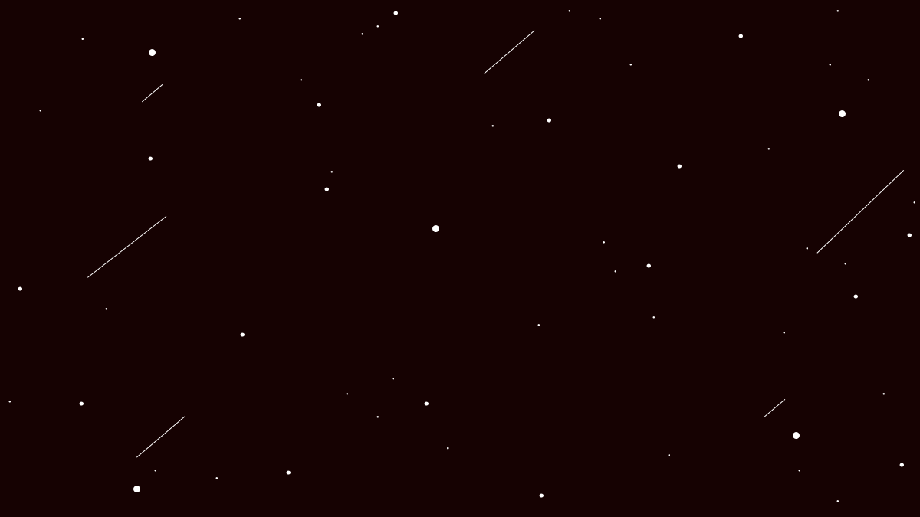


By BrainStew Studios

Slide 2
Team Roles & Features
CORY CLAIRMONT
JILLIAN JABBES
ANDREW SORENSEN
TL1
AUDIO
TL2
PLAYER CHARACTER
TL2+
BOSSES
BIDHI PAUDEL
NIHAT POLAT
ANEESHA SHRESTHA
CHENNY AMADIKE
TL3
WEAPON +
POWERUPS
TL4
LEVEL DESIGN
TL5
ENEMIES
TL6
UI/HUD

Slide 3
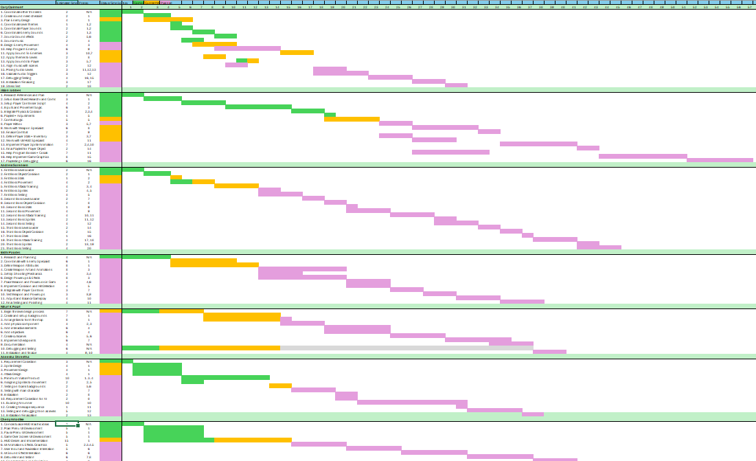
Our Gantt Charts

Slide 4
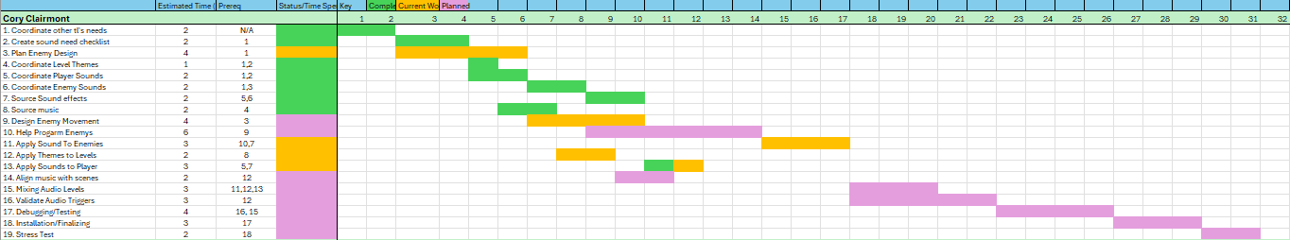
Gantt Chart Breakdown – TL1
Coupling and Cohesion:
High cohesion because the AudioManager only focuses on playing and managing sounds
Moderate coupling because some other managers call the class in their function

Slide 5
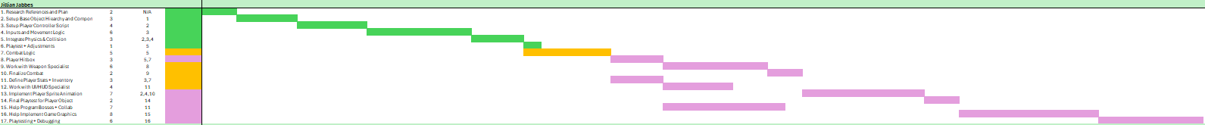
Gantt Chart Breakdown – TL2
Coupling and Cohesion:
High cohesion because the classes do not do anything out of their responsibilities
Moderate coupling because PlayerTakeDamage interacts with AudioManager class

Slide 6
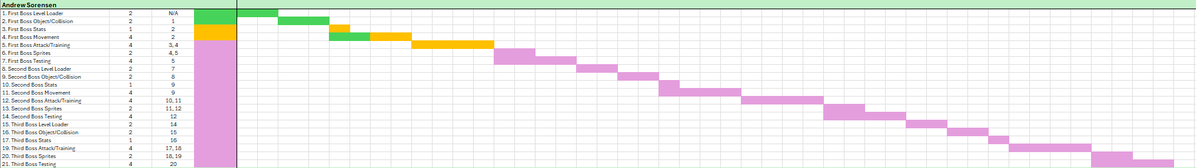
Gantt Chart Breakdown – TL2+
Coupling and Cohesion:
High cohesion
Moderate coupling because there are minor dependencies between classes that creates tight links between classes such as Boss1Move and Boss1

Slide 7
Gantt Chart Breakdown – TL3
Coupling and Cohesion:
High cohesion because each class has clear responsibilities
Moderate coupling because EnemyStats and Shooting scripts depend on each other

Slide 8
Gantt Chart Breakdown – TL4
Coupling and Cohesion:
High cohesion because each scripts have focused responsibilities
Low coupling because no dependencies on other classes

Slide 9
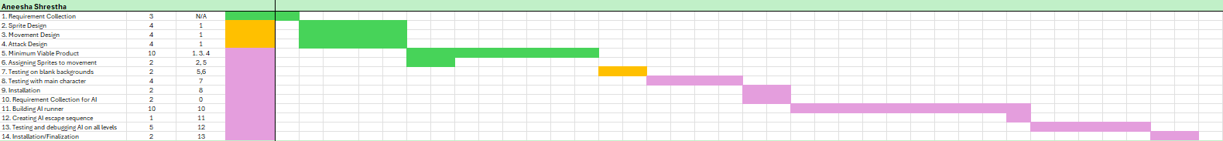
Gantt Chart Breakdown – TL5
Coupling and Cohesion:
High cohesion because the classes do not handle unnecessary functions
Moderate coupling because the classes are dependent on each other. For example, GroundMovement (enemy) class tightly couples with Walkable class.

Slide 10
Gantt Chart Breakdown – TL6
Coupling and Cohesion:
High cohesion
Low coupling because there are no dependencies

Slide 11
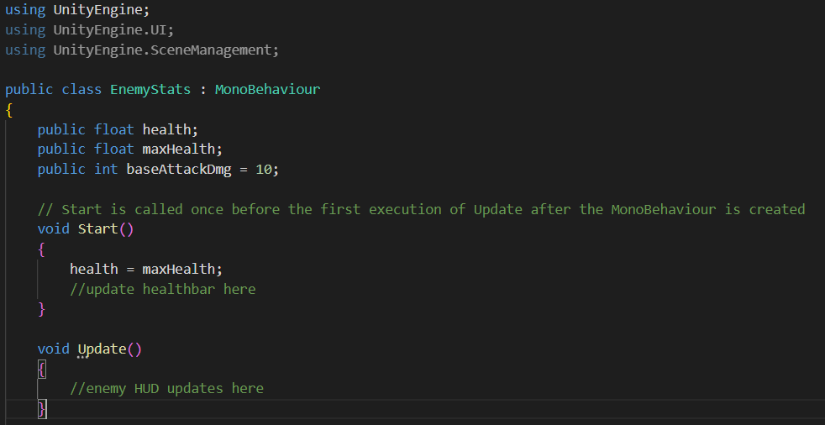
Coding Standards
Variables are using camelCase
Class name uses Pascal Case
Library formats are in alphabetical order as stated in the Coding Standards

Slide 12
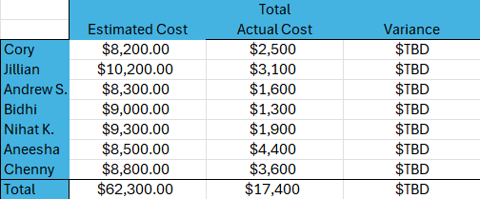
Budget
What is the cost so far?

Slide 13
Progress Update
What are the “road-blocks?”
BrainStew’s roadblocks:
Multiple people working in same scene hierarchy often causes merge conflicts
Lots of errors and bugs
Recovering from scenes being deleted

Slide 14
Thank you for your time!

