Slide 1
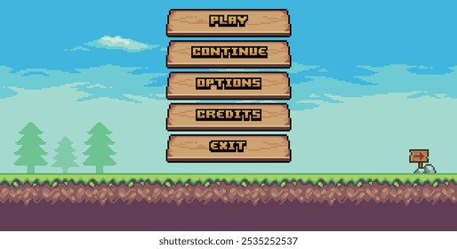
Scene 1: Main Menu
Chenny
Action:
Player launches game first into menu. It has different action buttons to select
Player can press (Play, Options, Quit)
Dialogue:
None
Notes:
Background menu music playing

Slide 2
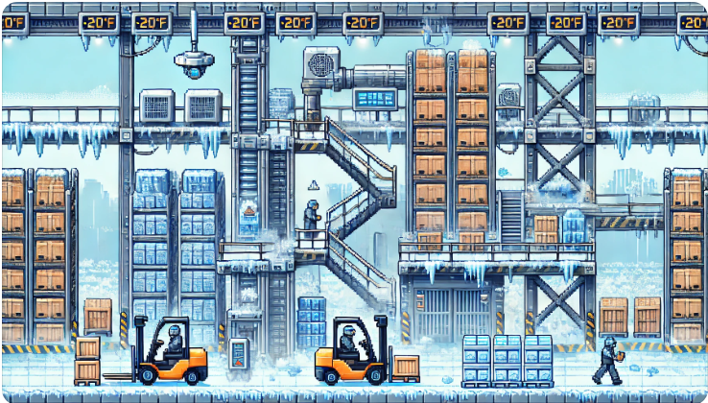
Scene 2: Tutorial
Jillian
Action:
You awaken feeling terribly cold and tired…you spawn in the warehouse freezer. You need to get out
Introduce player to movement controls
Attack basic enemies to learn combat mechanics
Dialogue:
Tutorial Instructions
An old bot’s wise words
Notes:
Easy difficulty

Slide 3




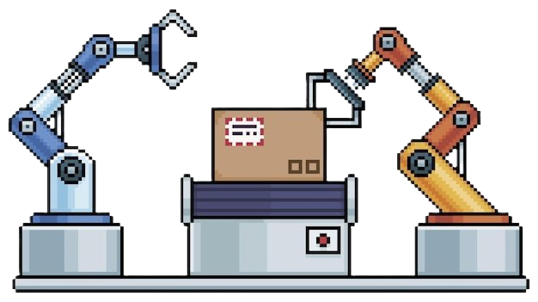

Level 1: Amazöön
Kayra
Action:
Move through warehouse platforming section
Attack enemy swarms
Camera follows MC, horizontal motion
Collect worker notes to locate + get in boss room
Dialogue:
None
Notes:
Easy Level
Ends with Boss Battle Jimmy Beez

Slide 4






Level 2: Circuit Caves
Aneesha
Action:
Move through circuit cave sections
Attack/dodge enemies
Camera follows MC, vertical motion
Dialogue:
None
Notes:
Medium Level
Ends with Marz Suckabörg Boss Battle

Slide 5
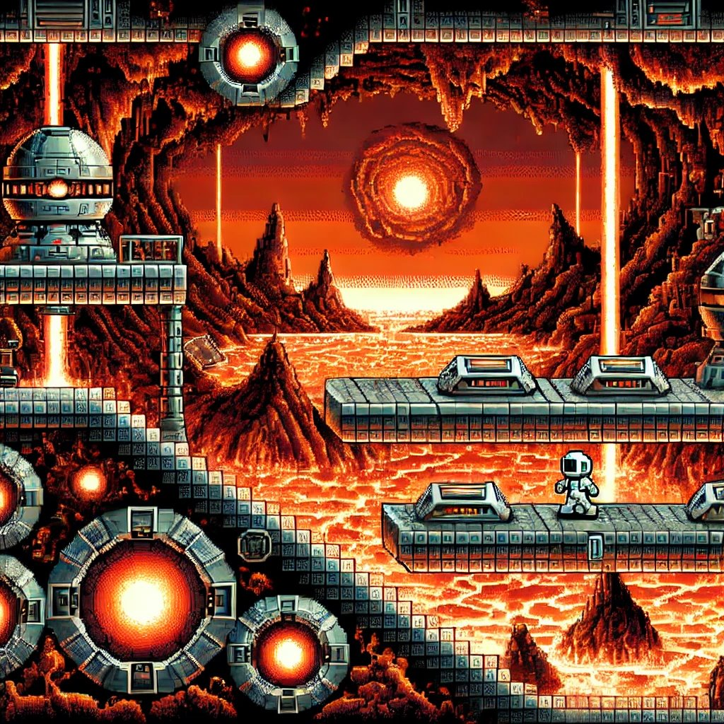
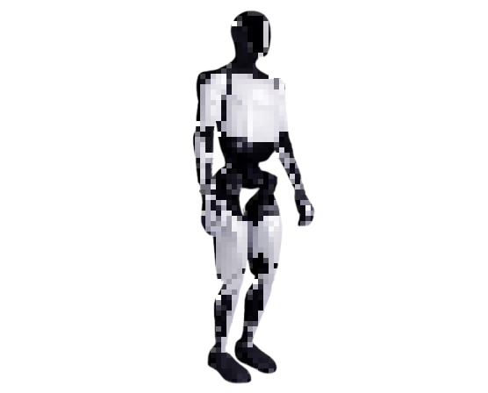




Level 3: The Core of Mars
Cory
Action:
You move through platforms and jump lava
Attack/dodge enemies
Camera follows MC, horizontal motion
Dialogue:
None
Notes:
Hard Level
Ends with Enron Milk Boss Battle

Slide 6
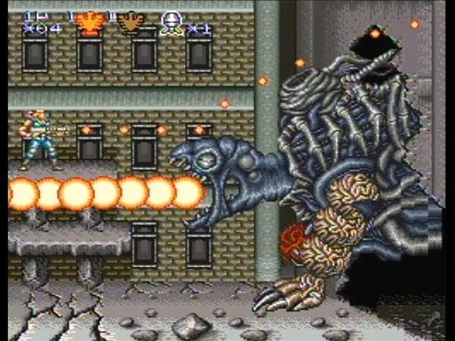
Boss Battle
Andrew
Action:
Boss theme music
Camera changes from moving to fixed
Fights boss until heath depletes
Dialogue:
Boss quotes
Notes:
Involves a set arena

Slide 7
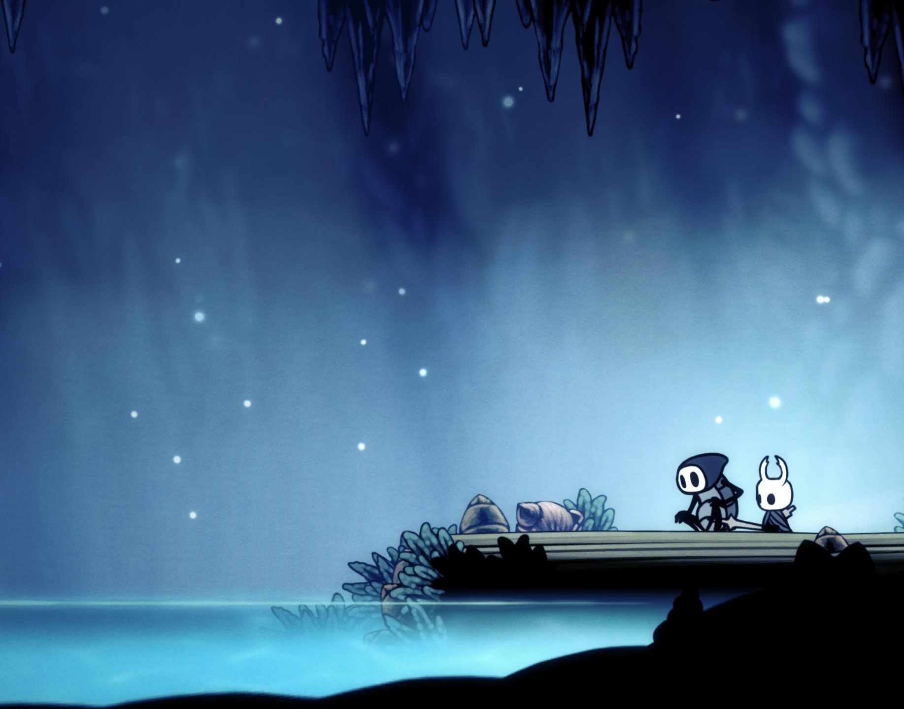
Victory Screen
Bidhi
Action:
Music theme changes
Camera changes from moving to fixed
Dialogue:
Credits roll
Notes:
Involves 1 or 2 atmospheric scene

