Slide 1
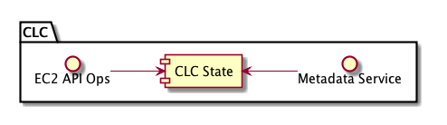
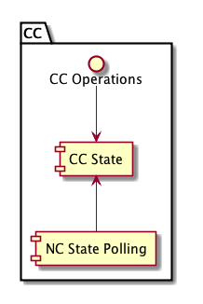
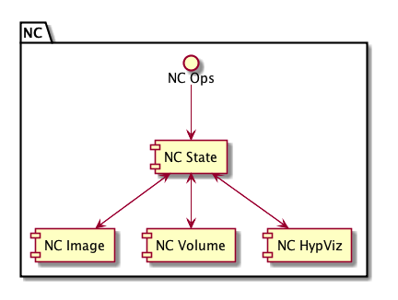
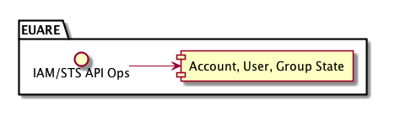

Slide 2
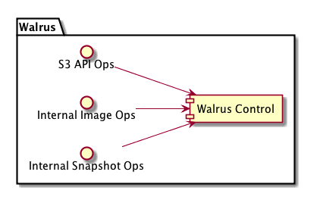
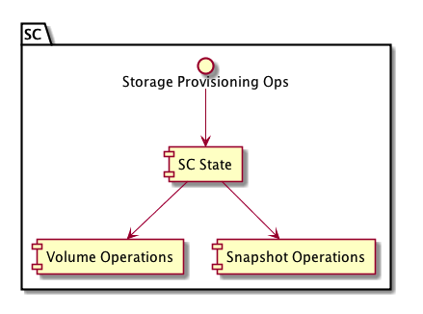
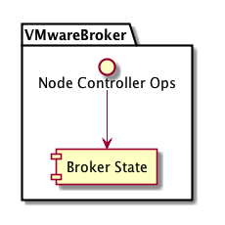

Slide 3
linux
vmware
User/admin requests
linux
xen
kvm
linux
Front End
Middle End
Back End

Slide 4
CLC
Walrus
SC
EUARE
VMWareB
Message and Thread Management (Mule)
message routing
& web services (Netty)
Message Routing
& Transport
Protocol Multiplexing (Netty/JiBX)
Service State
Management
Service Naming &
Registration
Persistence (Hibernate)
& Caching (TreeCache)
Distributed Component Membership (JGroups)

Slide 5
Request
Processing
State
Management
Resource
Control
Authorization
Fulfilled
Resource State Update
Validation
User
Request
Resource
in Progress
Resource Allocation
Reservation

