Slide 1
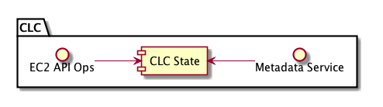
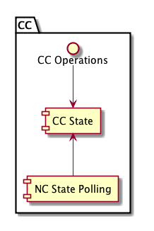
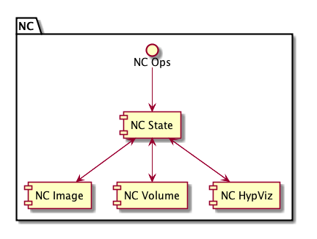
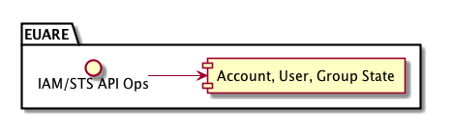

Slide 2
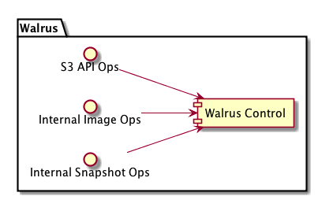
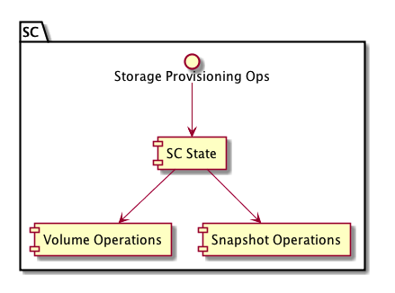
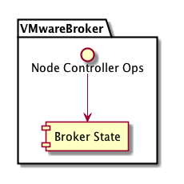

Slide 3
Eucalyptus Service
Architecture
linux
vmware
User/admin requests
linux
xen
kvm
linux
Front End
Middle End
Back End

Slide 4
CLC
Walrus
SC
EUARE
VMWareB
Message and Thread Management (Mule)
message routing
& web services (Netty)
Message Routing
& Transport
Protocol Multiplexing (Netty/JiBX)
Service State
Management
Service Naming &
Registration
Persistence (Hibernate)
& Caching (TreeCache)
Distributed Component Membership (JGroups)
Eucalyptus Web Services
Object Stack

Slide 5
Web Services Communication Stack (SOAP)
Component
Service
Request Routing
Reply Handling
Service Context Dispatch
{
Service State Checks
Binding
Protocol
Multiplicity
WS-Security
SOAP Envelope Processing
SOAP Unmarshalling/Marshalling
Protocol Selection
HTTP Chunking
HTTP Decoding/Encoding
SSL Decoding/Encoding

Slide 6
Request
Processing
State
Management
Resource
Control
Authorization
Fulfilled
Resource State Update
Validation
User
Request
Resource
in Progress
Resource Allocation
Reservation
Eucalyptus Message Processing

