Slide 1
Presentation of the of the judgment of the European Court of Justice of 13 May 2014, Google Spain and Google, C-131/12, EU:C:2014:317.
KnowGraphs Research Colloquium
5 February 2021
Online
ESR 15
Efstratios Koulierakis (University of Groningen)

Slide 2
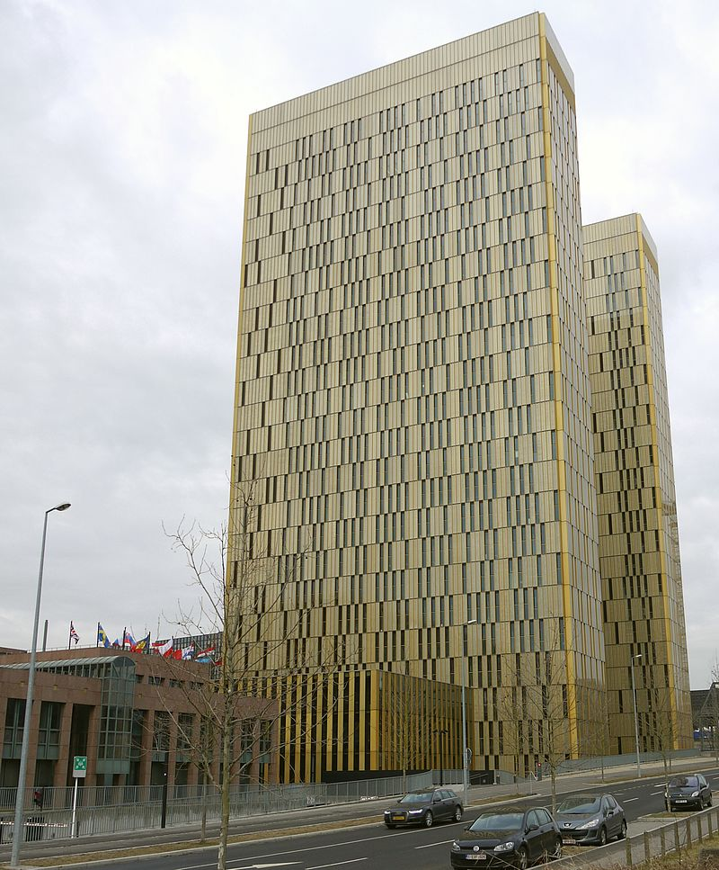
The European Court of Justice
The Supreme Court of the European Union
NOT the European Court of Human Rights
Located in Luxemburg
(Among other tasks) issues preliminary rulings

Slide 3
Preliminary Ruling Procedure
An issue of EU law arises before a court of a Members state
The court may/ should request for a preliminary ruling
The European Court of Justice issues the preliminary ruling
The case is adjudicated by the court of the Member State

Slide 4
The facts of the case
In 1998 La Vangurdia refered to Mr. Costeja González’s car auction
In 2010 the publication was available online
When someone typed the name of Mr. Costeja González in google search, there was a link towards the publication
Mr. Costeja complained to the data protection authorities
The data protection authorities asked google to delink the name from the publication
Google brought the case before the Spanish High Court
The Spanish High Court referred to the ECJ for a preliminary ruling

Slide 5
Is Google a controller? (Answer: Yes)
Article 4(7) ‘controller’ means the natural or legal person, public authority, agency or other body which, alone or jointly with others, determines the purposes and means of the processing of personal data; where the purposes and means of such processing are determined by Union or Member State law, the controller or the specific criteria for its nomination may be provided for by Union or Member State law.
Article 4(2) GDPR ‘processing’ means any operation or set of operations which is performed on personal data or on sets of personal data, whether or not by automated means, such as collection, recording, organisation, structuring, storage, adaptation or alteration, retrieval, consultation, use, disclosure by transmission, dissemination or otherwise making available, alignment or combination, restriction, erasure or destruction.
(1) Indexing through google search qualifies as processing
(2) Google is the one who does the indexing
Conclusion: Google is a controller and data protection law applies in the case

Slide 6
A right to delist?
Google Spain and Google paragraph 89:
‘[The right to erasure and the right to object should be interpreted as] enabling the data subject to require the operator of a search engine to remove from the list of results displayed following a search made on the basis of his name links to web pages published lawfully by third parties and containing true information relating to him, on the ground that that information may be prejudicial to him or that he wishes it to be “forgotten” after a certain time’.

Slide 7
The GDPR
Article 17
1.The data subject shall have the right to obtain from the controller the erasure of personal data concerning him or her without undue delay and the controller shall have the obligation to erase personal data without undue delay where one of the following grounds applies:
(a) the personal data are no longer necessary in relation to the purposes for which they were collected or otherwise processed;
(b) the data subject withdraws consent on which the processing is based according to point (a) of Article 6(1), or point (a) of Article 9(2), and where there is no other legal ground for the processing;
(c) the data subject objects to the processing pursuant to Article 21(1) and there are no overriding legitimate grounds for the processing, or the data subject objects to the processing pursuant to Article 21(2);
(d) the personal data have been unlawfully processed;
(e) the personal data have to be erased for compliance with a legal obligation in Union or Member State law to which the controller is subject;
(f) the personal data have been collected in relation to the offer of information society services referred to in Article 8(1).
2.Where the controller has made the personal data public and is obliged pursuant to paragraph 1 to erase the personal data, the controller, taking account of available technology and the cost of implementation, shall take reasonable steps, including technical measures, to inform controllers which are processing the personal data that the data subject has requested the erasure by such controllers of any links to, or copy or replication of, those personal data.

Slide 8
Specifying abstract legal terms: ‘necessary’, ‘legitimate grounds’
Examining relevant legal texts as:
Case law
The preamble of the Regulation
Opinions of the European Protection Board
The European Court of Justice in this case gives us some parameters to consider:
The passage of time
The interest of the general public to be informed and the importance of a person in public life

Slide 9
Certain remarks
Not necessary to control the data base to be a ‘controller’
The legitimate interest of the public can be a legal basis for the processing of personal data, in knowledge graphs developed by search engines
Even if data processing was initially legitimate, that might not be the case in the future

Slide 10
Thank you for your attention
Looking forward the discussion

