Slide 1

Representing and Reasoing over Legal Policies
Ines Akaichi
Online Biweekly Colloquium
05/02/2020

Slide 2
Outline
Usage Control Policies Overview
Approaches for Policy Specification
Existing Work

Slide 3







Use Case
The policy to use my data ...
Maral
Alice
John
ODRL policy
Data owner
Alex
Data consumers
Usage Control Policies Overview

Slide 4
Example of a policy - ODRL
John can watch Harry Potter –permission
Alice can not watch Harry Potter –prohibition
Alex must pay 5 euros to watch the movie Harry Potter –obligation
Maral can watch the movie Harry Potter without paying if she is an employee–dispensation
Usage Control Policies Overview
Examples inspired from https://www.w3.org/TR/odrl-model/

Slide 5
Data Usage Control: An extension of Access Control
Policies constrain the behaviour of system components:
A set of rules
Related to:
Data storage
Distribution
Aggregation
Processing
Context of:
Intellectual property protection
Privacy protection
Compliance with regulations
Digital rights management
Usage Control Policies Overview
Usage Control Policies Overview

Slide 6
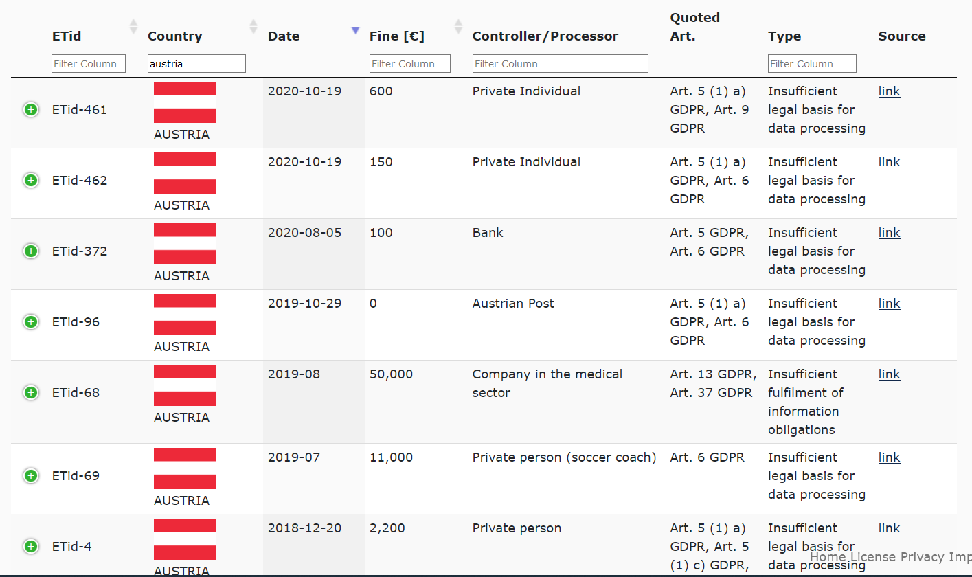
What if no compliance is enforced ?
Costly fines
Loss of reputation
Liability for material and non-material damages
Examples for fines regarding GDPR compliance issues https://www.enforcementtracker.com/
Usage Control Policies Overview

Slide 7
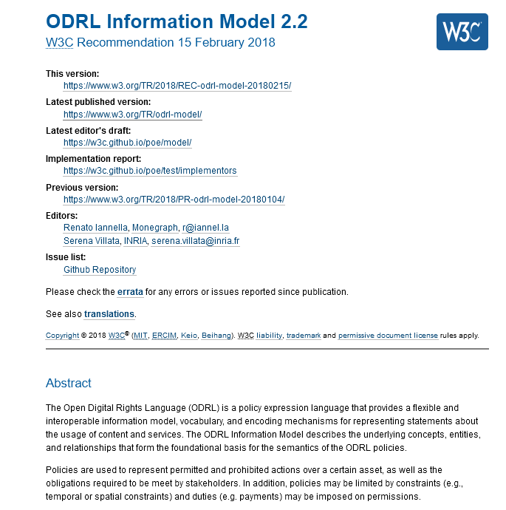
Definitions - ODRL
Policy: One or more rules
Rule: An abstract concept that represents the common characteristics of permissions, prohibitions, obligations and dispensations
Usage Control Policies Overview
Definitions taken from https://www.w3.org/TR/odrl-model/

Slide 8
Adopting policy based approach
The adoption of a policy-based approach for controlling a system requires:
An appropriate policy representation regarding both syntax and semantics
The design and development of a policy management framework to transfer, store and enforce the policy
Clemente, F. J. G., Martínez Pérez, G., Botía Blaya, J. A., & Gómez Skarmeta, A. F. (n.d.). Representing Security Policies in Web Information Systems.
Approaches for policy specification

Slide 9
How to specify a policy?
Approaches:
A formal policy languages that a computer can directly process
Rule-based policy notation using an if-then-else format
The representation of policies based on deontic logic for obligation and permissibility rules
Kagal, L., Finin, T., & Joshi, A. (2003). LNCS 2870 - A Policy Based Approach to Security for the Semantic Web. http://www.w3.org/TR/webont-req/
Approaches for policy specification

Slide 10
Requirements for Policy Specification
Well-defined
Flexibility and extensibility
Interoperability
Clemente, F. J. G., Martínez Pérez, G., Botía Blaya, J. A., & Gómez Skarmeta, A. F. (n.d.). Representing Security Policies in Web Information Systems.
Approaches for policy specification

Slide 11
Semantics and Deontic Logic
Existing work in the area focuses on modelling legal requirements using:
Semantic technologies
Rule/ Deontic based concepts
Example of languages:
KAoS
Rei
Protune
Etc.
The lack of standardised mechanisms for representing policies, such that compliance can be checked automatically
De Vos, M., Kirrane, S., Padget, J., & Satoh, K. (n.d.). ODRL policy modelling and compliance checking.
Approaches for policy specification

Slide 12

Existing Work
How to model and automatically reason over legal text?

Slide 13
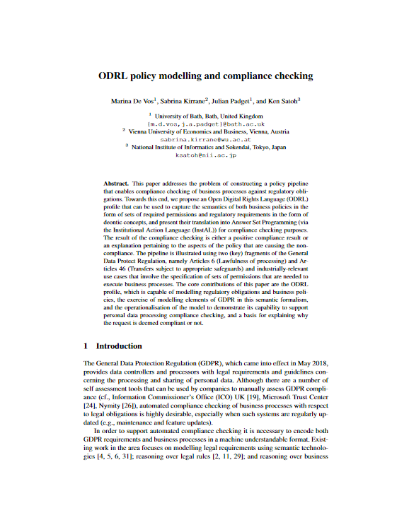
ODRL policy modelling and compliance checking
Modelling:
Create a model and an ontology that woud present regulations (an extension of ODRL¹)
Annotate the GDPR articles based on the model (manually)
Encode the GDPR articles
Encode The company business processes
Compliance checking:
Fedding the model along with the encoded business processes to an answer set solver
Provide evidence in support of the compliance decision
Manually encoding by annotating
Automatic compliance checking
No enforcement/Imposition
Existing Work
¹ The Open Digital Rights Language - https://www.w3.org/TR/odrl-model/

Slide 14
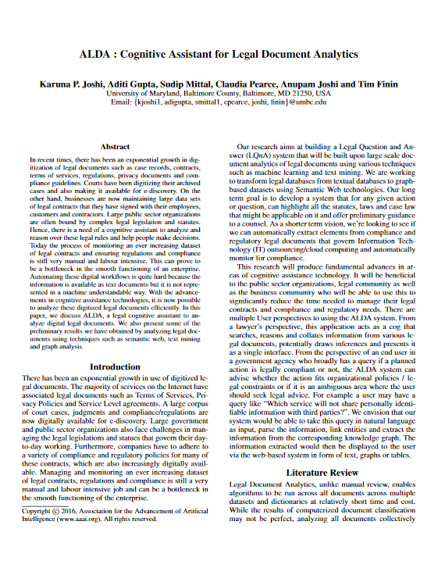
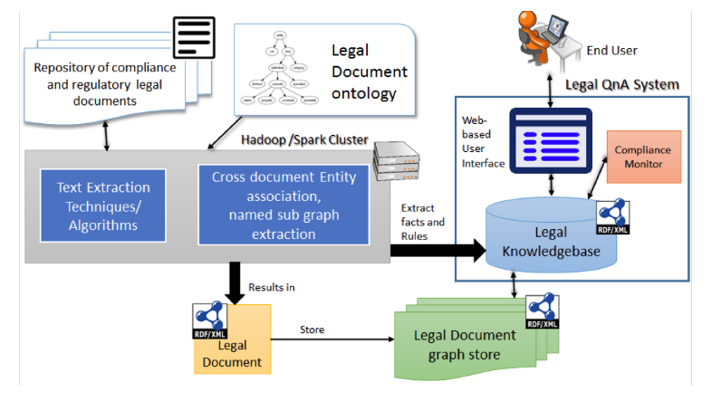
ALDA: Cognitive Assistant for Legal Document Analytics
Automatic Encoding
Automatic compliance checking
System Architecture of the proposed system to analyze legal documents
Existing Work

