Slide 1
Ontology-based Access Control for FAIR Data Christopher Brewster1,2, Barry Nouwt1, Stephan Raaijmakers1 & Jack Verhoosel Data Intelligence 2(2020)
Bi-weekly Colloquium 30/4/2021 Online

Slide 2
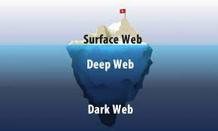

preliminaries
dark Web marketplace:
a commercial website that operates via darknets such as Tor or I2P.
Darknet is a network that can only be accessed with specific software, configurations, or authorization, and often uses a unique customized communication protocol.
FAIR data: are data which meet principles of findability, accessibility, interoperability, and reusability.

Slide 3

Problem?
Defining policy for accessing to FAIR data
Scenario:
Court wants to investigate a dark Web marketplace
Two narcotics police officers
one from the United States and
one from Australia, receive a limited mandate
only for narcotics that both originate from and are shipped to their own country.

Slide 4
About proposed method:
Targets the FAIR principles A1.2 and R1.1
A1. (Meta)data are retrievable by their identifier using a standardised communications protocol
A1.2 The protocol allows for an authentication and authorisation procedure, where necessary
R1. (Meta)data are richly described with a plurality of accurate and relevant attributes
R1.1. (Meta)data are released with a clear and accessible data usage license
R1.2. (Meta)data are associated with detailed provenance
Tripartite approach:
data
associated metadata expressing FAIR information
additional metadata about users

Slide 5



Application
security and intelligence domains need data to be shared under tight controls, with widely varying individual access rights.
legal requirements such GDPR
protection of copyright
health and life science research

Slide 6
Method
Agora dark Web marketplace data set: CSV 100,000 rows 12 columns (Vendor, Category, Item, Item Description, Price, Origin, Destination, Rating and Remarks)
OpenRefine tool:
convert the CSV Agora data set into RDF data
load this RDF data into an Apache Jena triple store AuthzForce XACML description of security policies

Slide 7
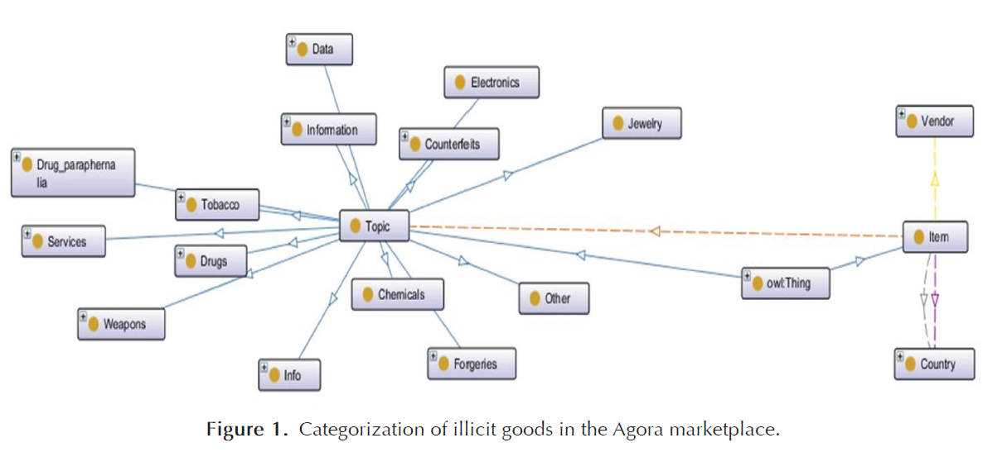
Metadata graph

Slide 8
Scenario:
The limited mandate only allows them to look at the title, origin and destination of items.
The narcotics officers use their mandate to browse the data and collect facts that might be worth further investigation.
If approved, they will be allowed to work with a broader mandate which allows them to hone in on a more specific class of drugs (Steroids) in the data set.

Slide 9
Method:
security policies for this scenario has 4 roles
USA_drugs_officer_limited: the role for a drugs officer from the United States with a limited mandate.
AUS_drugs_officer_limited: the role for a drugs officer from Australia with a limited mandate.
USA_drugs_officer_broad: the role for a drugs officer from the United States with a broad mandate.
AUS_drugs_officer_broad: the role for a drugs officer from Australia with a broad mandate.

Slide 10
Method:
XACML
XACML is a standard under development since 2001 by OASIS for attribute-based access control usually expressed in XML or JSON providing a means among other things for the description of security policies.
AuthzForce
implements the XACML standard and consists of an authorization policy engine

Slide 11
Method:
Graph patterns for the role USA_drugs_officer_limited:
?item dwo:hasTitle ?object .
IF
?item rdf:type dwo:Item .
?item dwo:hasDestination dwd:USA .
?item dwo:hasOrigin dwd:USA .
?item dwo:hasTopic ?topic .
?topic rdf:type ?topicType .
?topicType rdfs:subClassOf+ dwo:Drugs .

Slide 12
Method:
Officer query:
SELECT ?item ?title ?topic
WHERE {
?item a dwo:Item .
?item dwo:hasTitle ?title .
?item dwo:hasTopic ?topic .
}

Slide 13
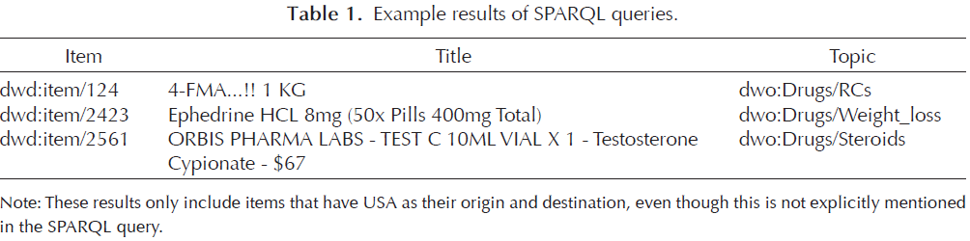
Method:
Result of the query

Slide 14
Method:
graph patterns for the role USA_drugs_officer_broad:
?item ?predicate ?object .
IF
?item rdf:type dwo:Item .
?item dwo:hasDestination dwd:USA .
?item dwo:hasOrigin dwd:USA .
?item dwo:hasTopic ?topic .
?topic rdf:type ?topicType .
?topicType rdfs:subClassOf+ dwo:Steroids .
Officer query:
SELECT ?item ?title ?vendor
WHERE {
?item a dwo:Item .
?item dwo:hasTitle ?title .
?item dwo:hasVendor ?vendor .
}

Slide 15
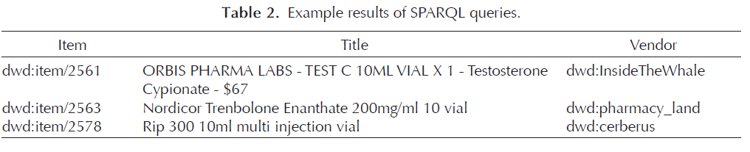
Method:
Result of the query

Slide 16
RELATED WORK:
Ontology-based Access Control :access to a single specific triple
fine-grained level
Traditional method: high level access policies that use “all-or-nothing”
like user name/password mechanisms.
Attribute based access control (ABAC) : providing differential access to data in databases

Slide 17
FUTURE WORK
Apply OBAC to other domains :
Health
GDPR
protection of copyright

Slide 18
Thank you.

