Slide 1
PS swelling
08/03/2019

Slide 2
Information
ID:349
Sva:slowslow2.fps

Slide 3
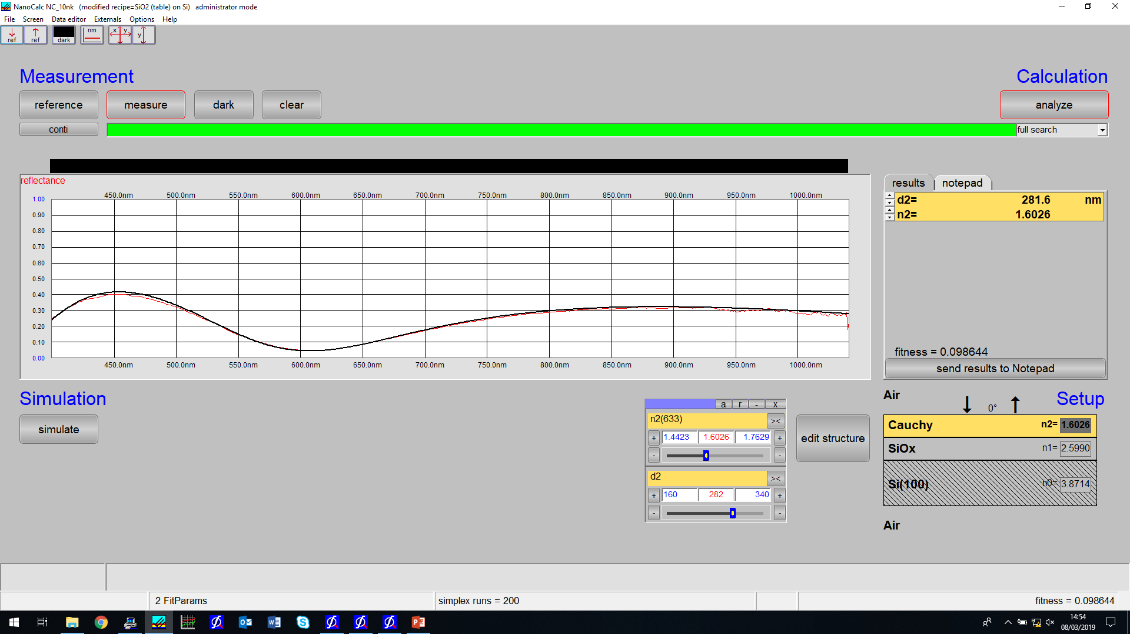
Without_optics.ref
Static1.xy

Slide 4
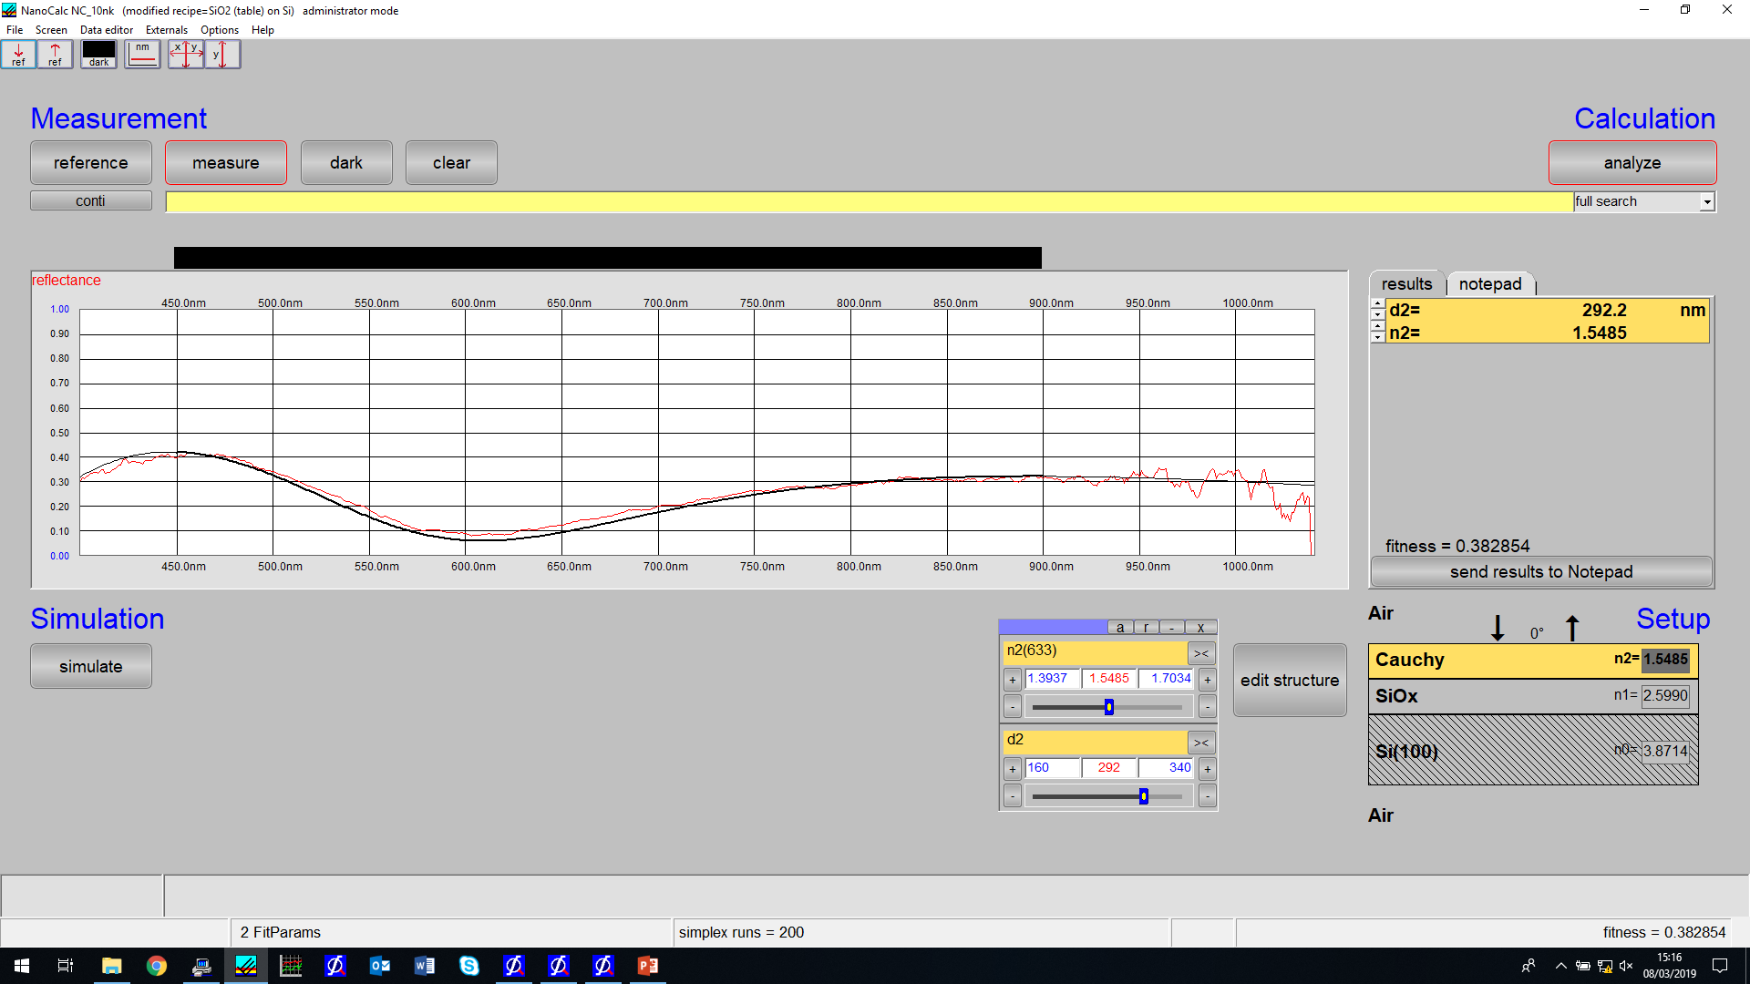
Withoptics.ref
Static2.xy

Slide 5
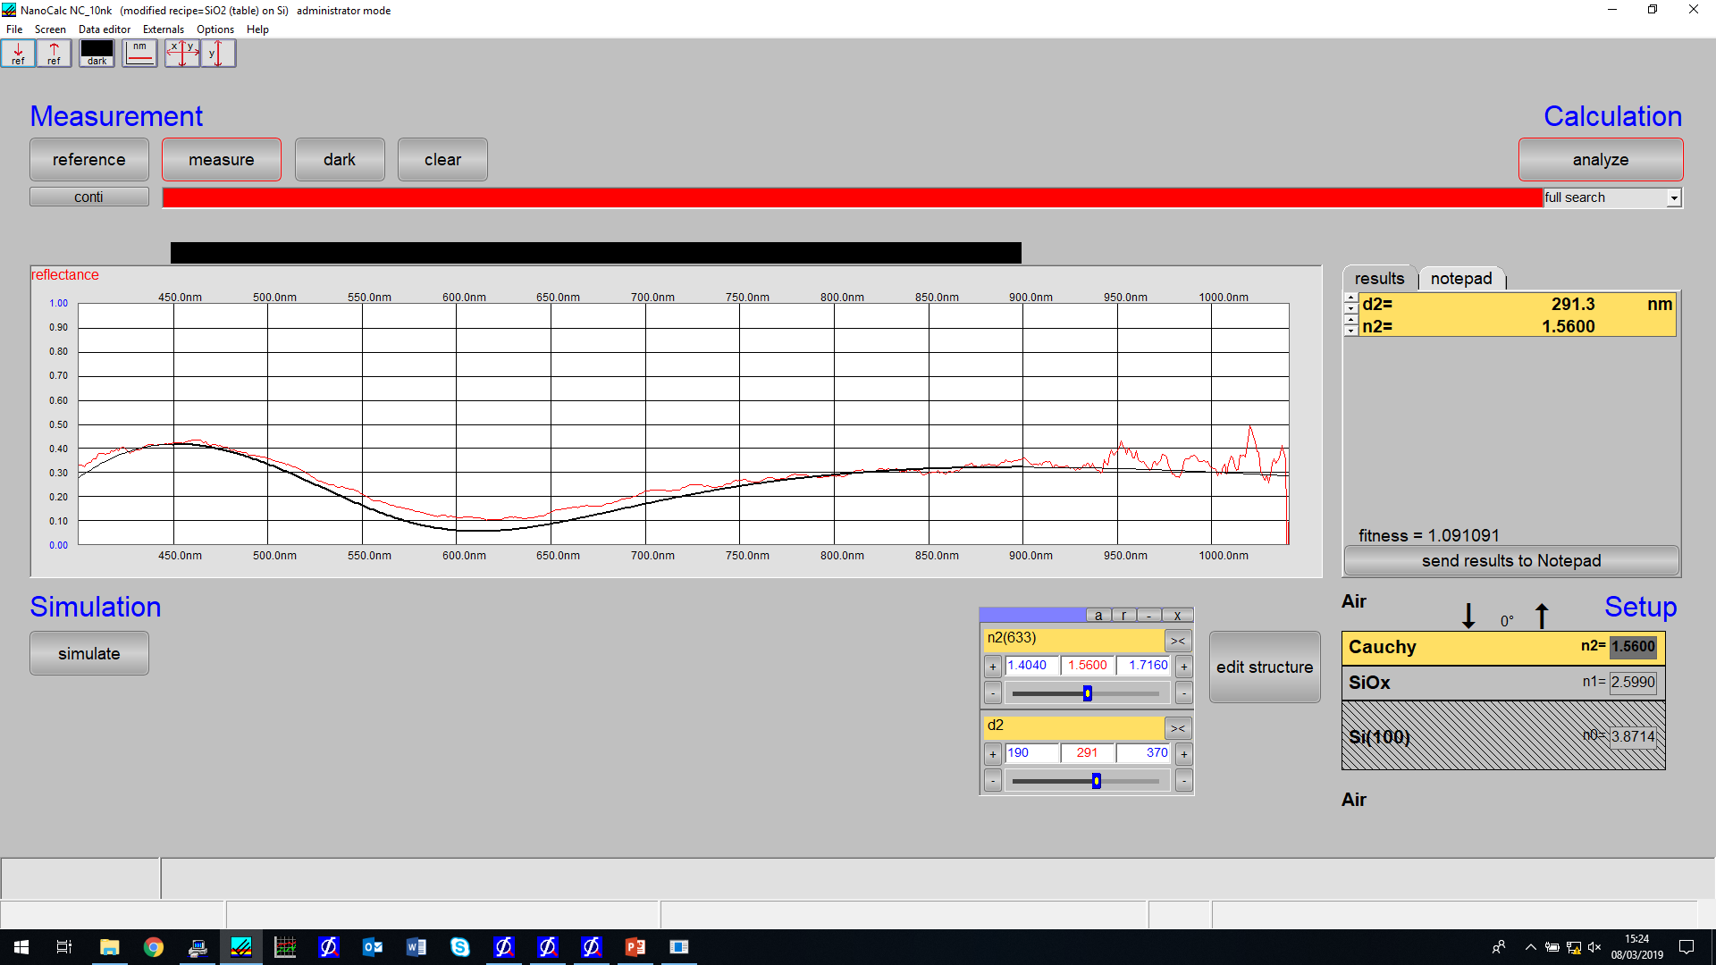
Measurement 2 – a fuctuation

Slide 6

At the end of the run

Slide 7
