Slide 1
Homopolymers
01-02-19

Slide 2
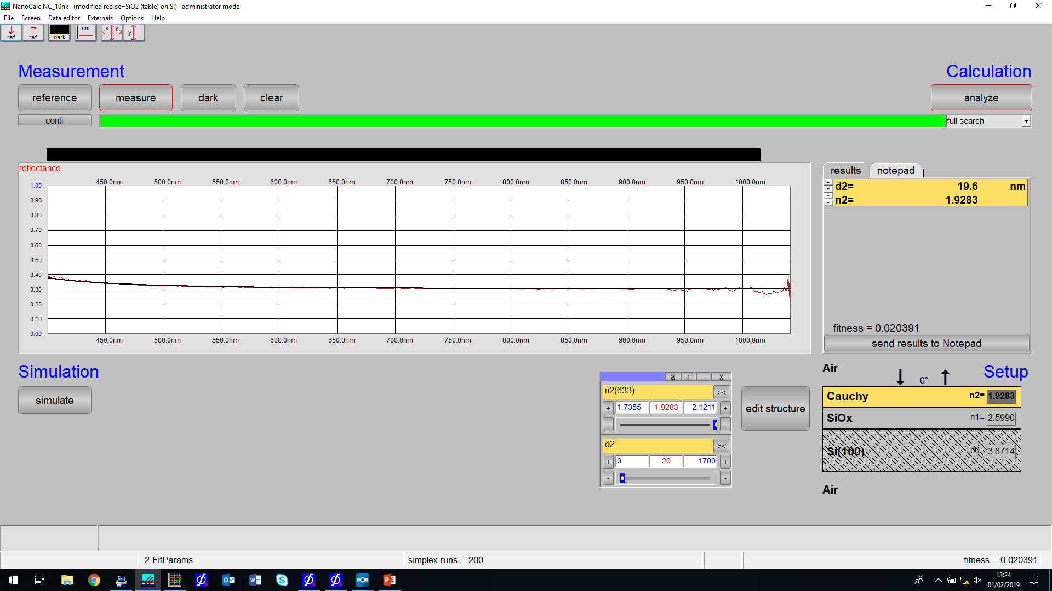
Filename: M-T321_asprep2.xy

Slide 3
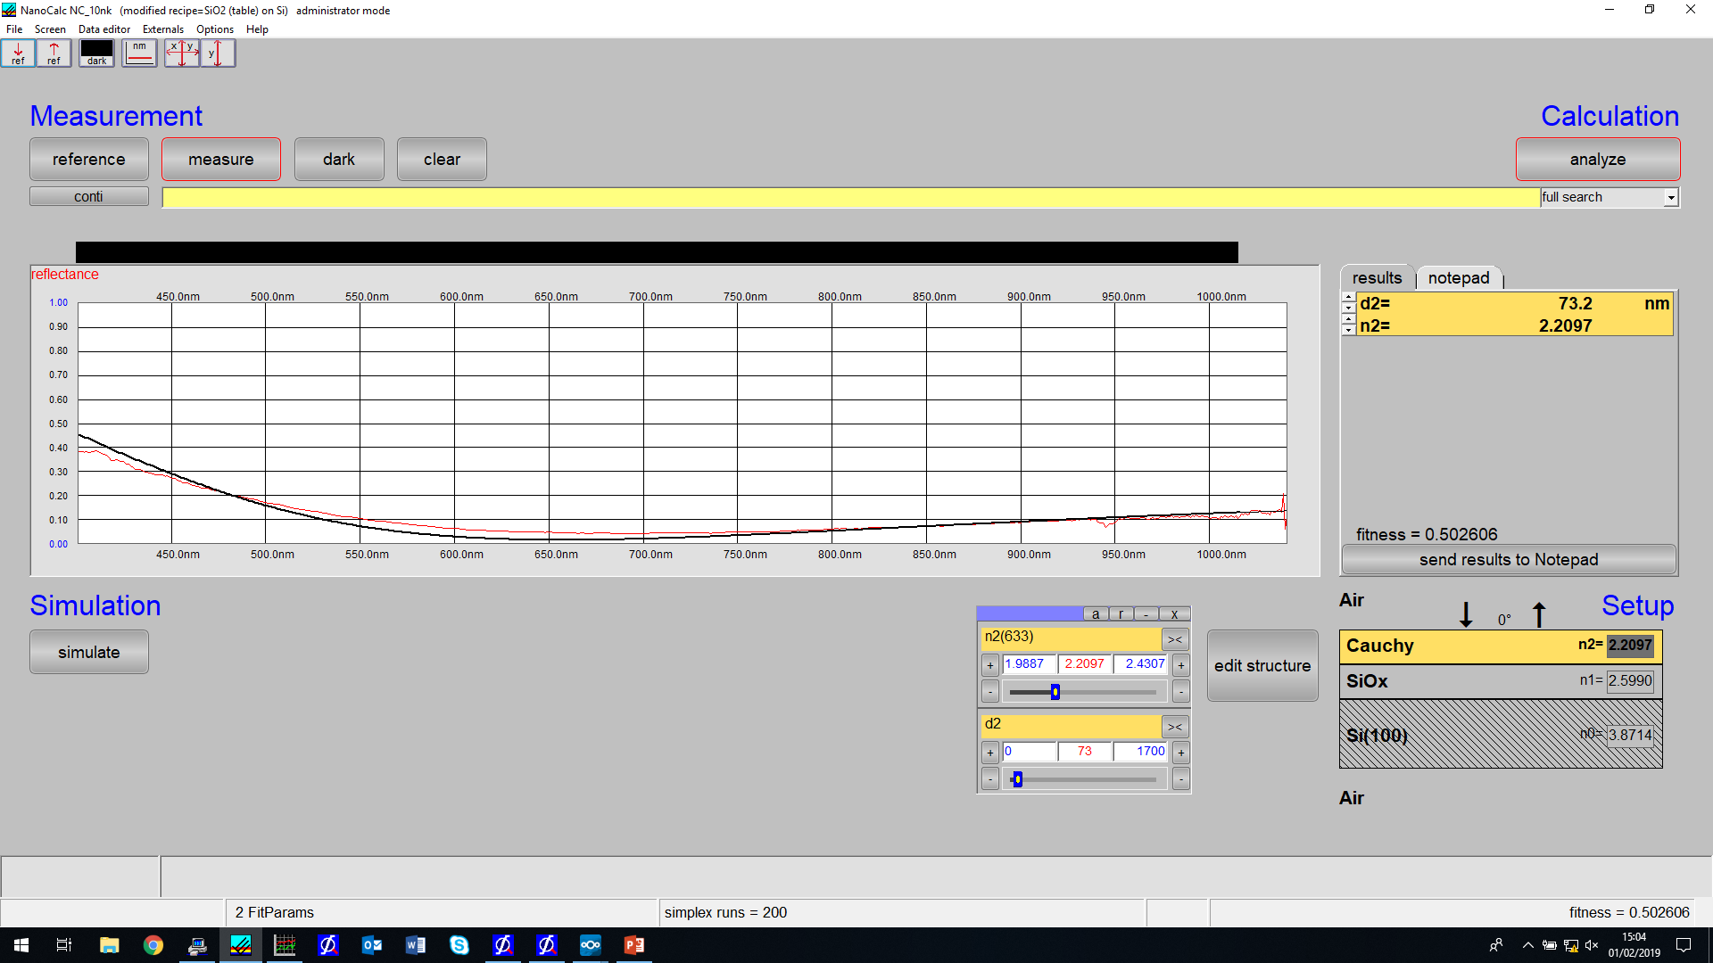
In test chamber using topsilref3.ref
Filename: S-T315_asprep3.xy

Slide 4
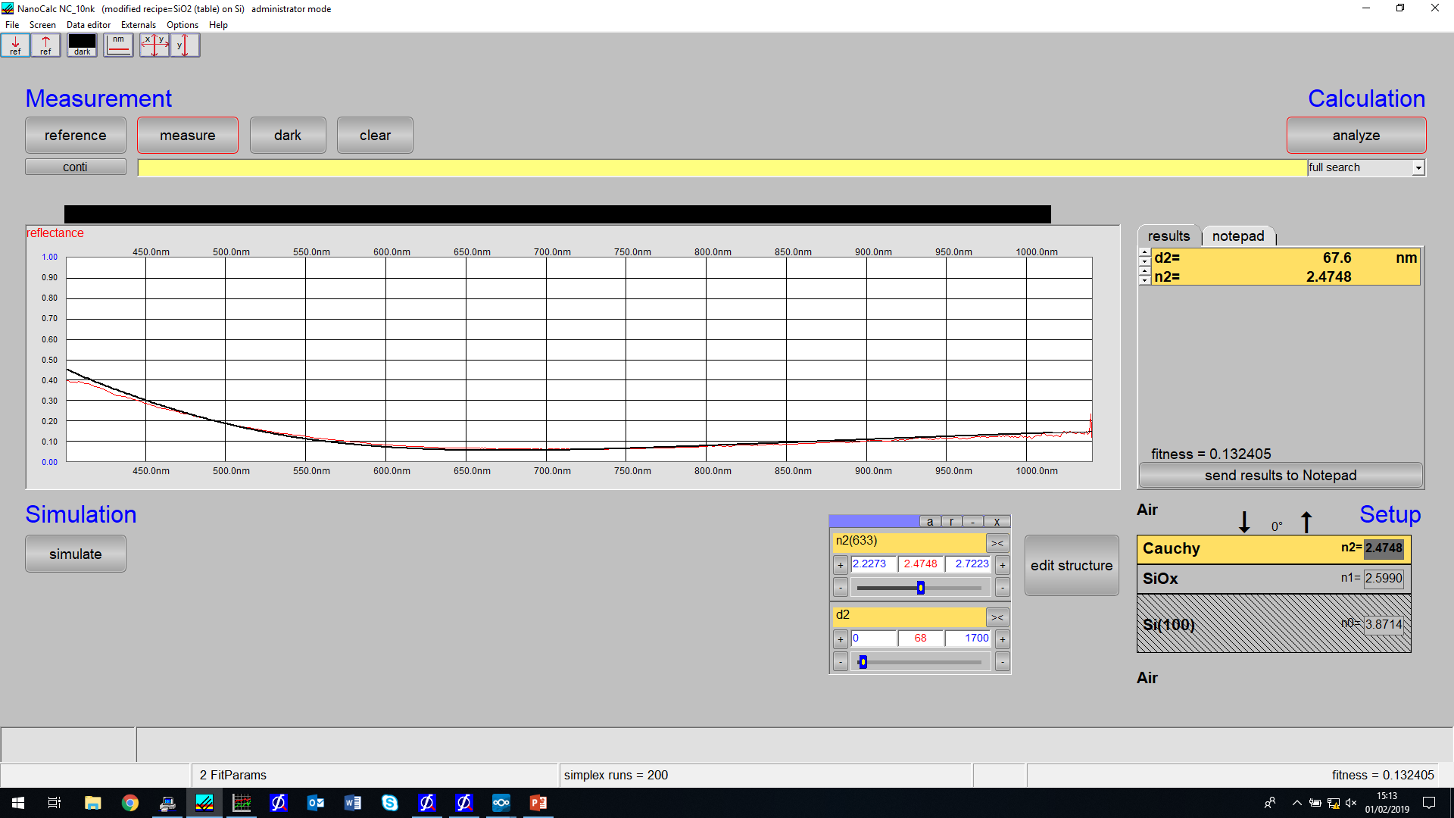
In test chamber using topsilref3.ref
Filename: I-T319_asprep3.xy

Slide 5
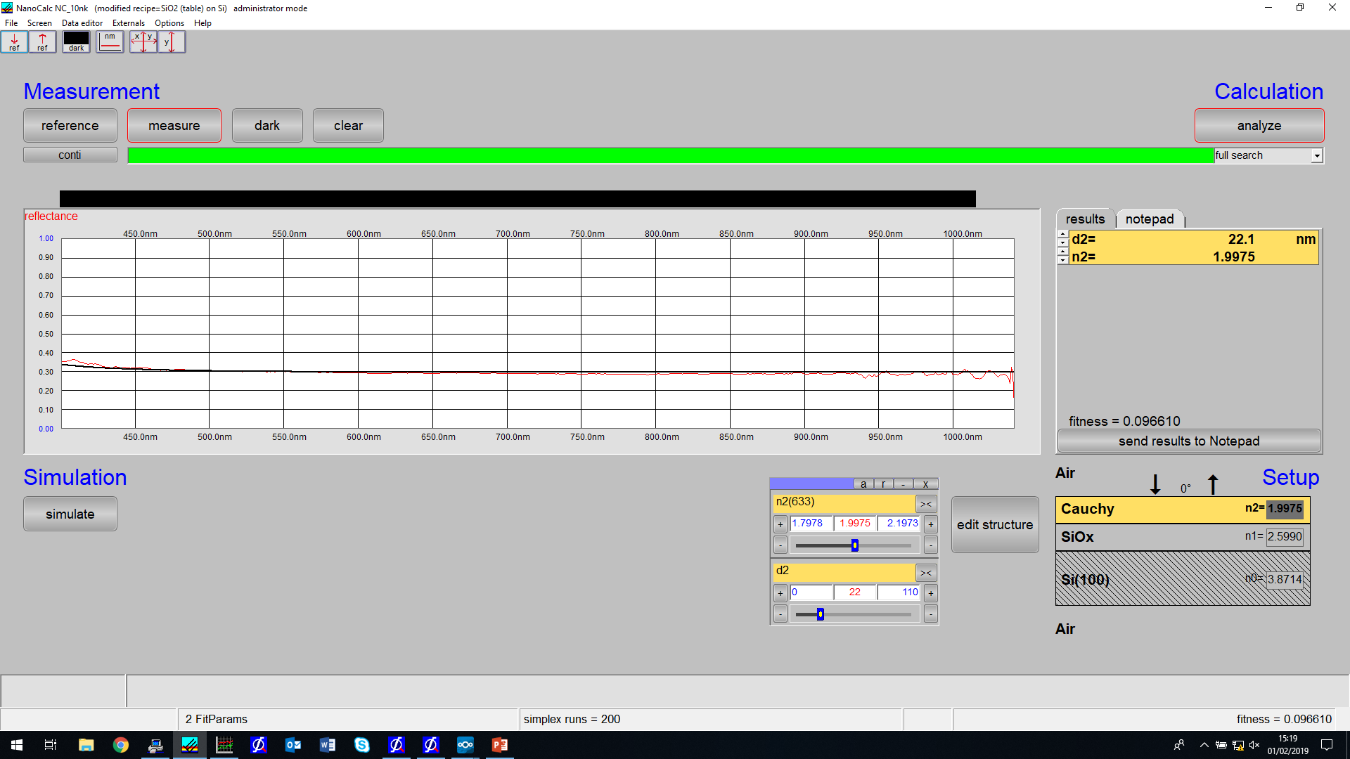
In test chamber using topsilref3.ref
Filename: M-T321_asprep3.xy

Slide 6
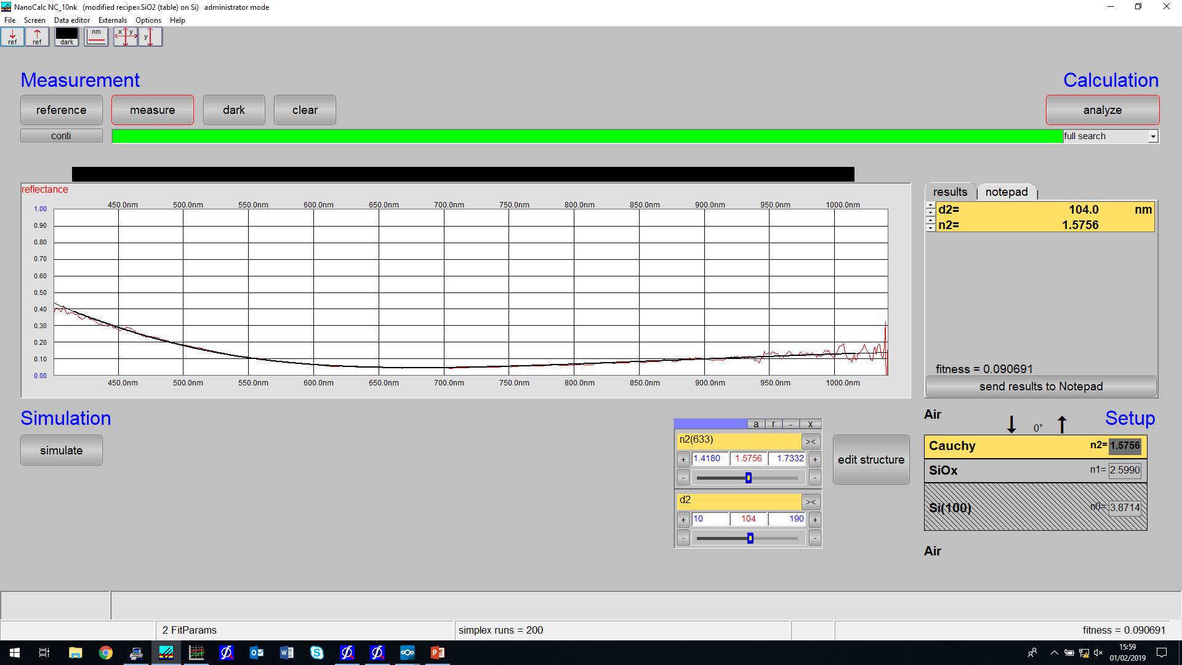
In ocean optics testing stage using topsil_out.ref
Filename: S-T315_asprep_out.xy

Slide 7
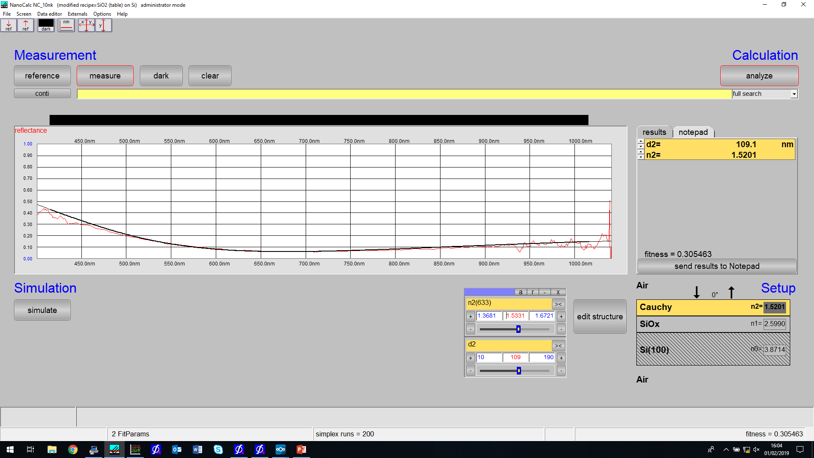
In ocean optics testing stage using topsil_out.ref
Filename: I-T319_asprep_out.xy

Slide 8
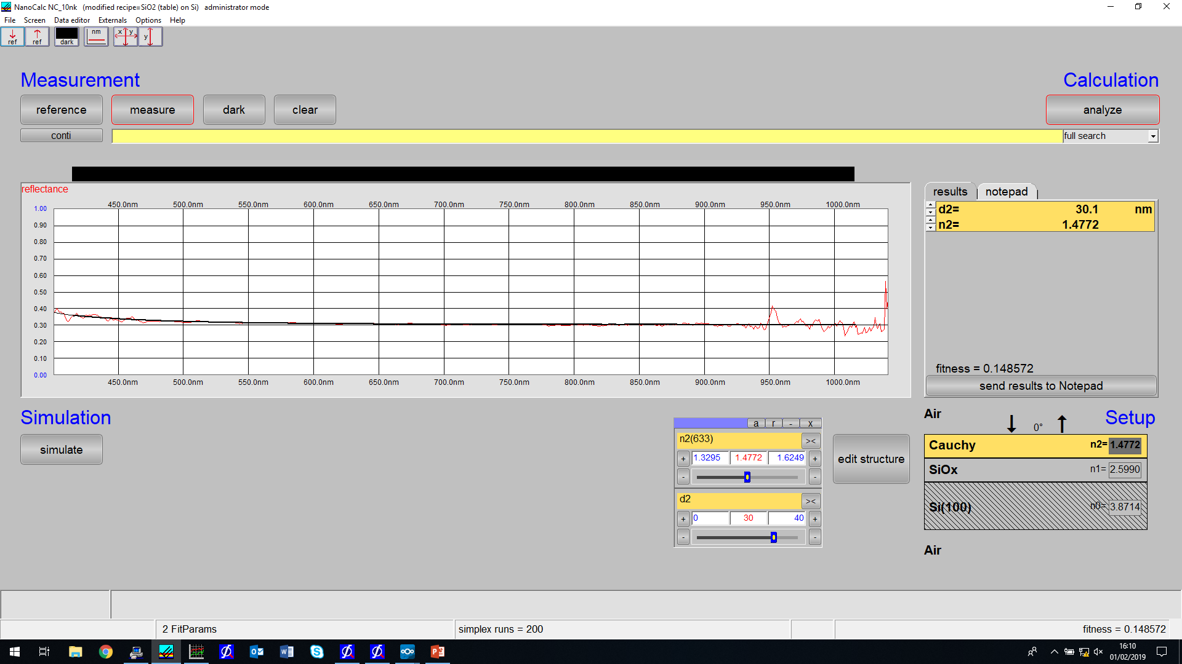
In ocean optics testing stage using topsil_out.ref
Filename: M-T321_asprep_out.xy

