Slide 1
Swelling of PI
Date:06/03/2019

Slide 2
Information
PI id: 353
Swelling protocol – slowslow.fps
Static measurement without optics
Static measurement with optics
Bo’s Frontend screen dump, notice nanocalc cannot model when 100% swelling, same as at Chess
Last measurement.

Slide 3
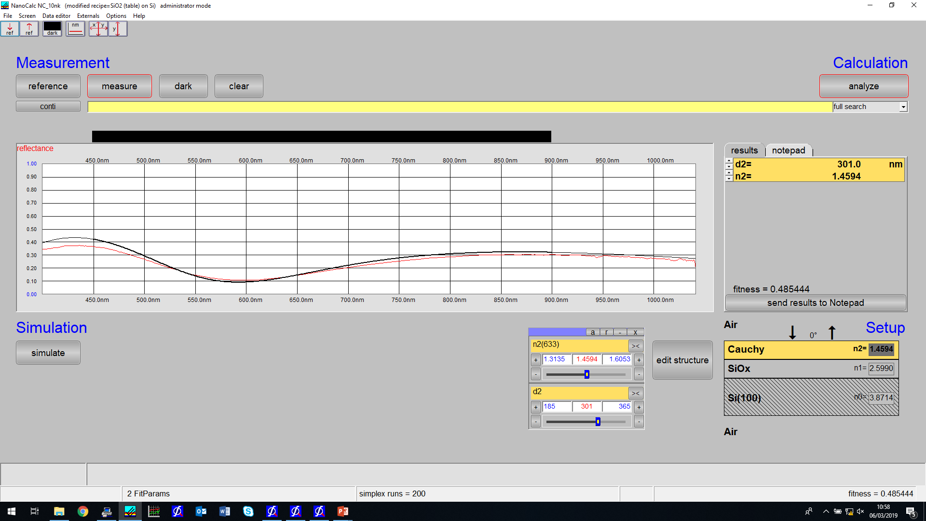
Static – without_optics.ref, file:Pistaticout.xy

Slide 4
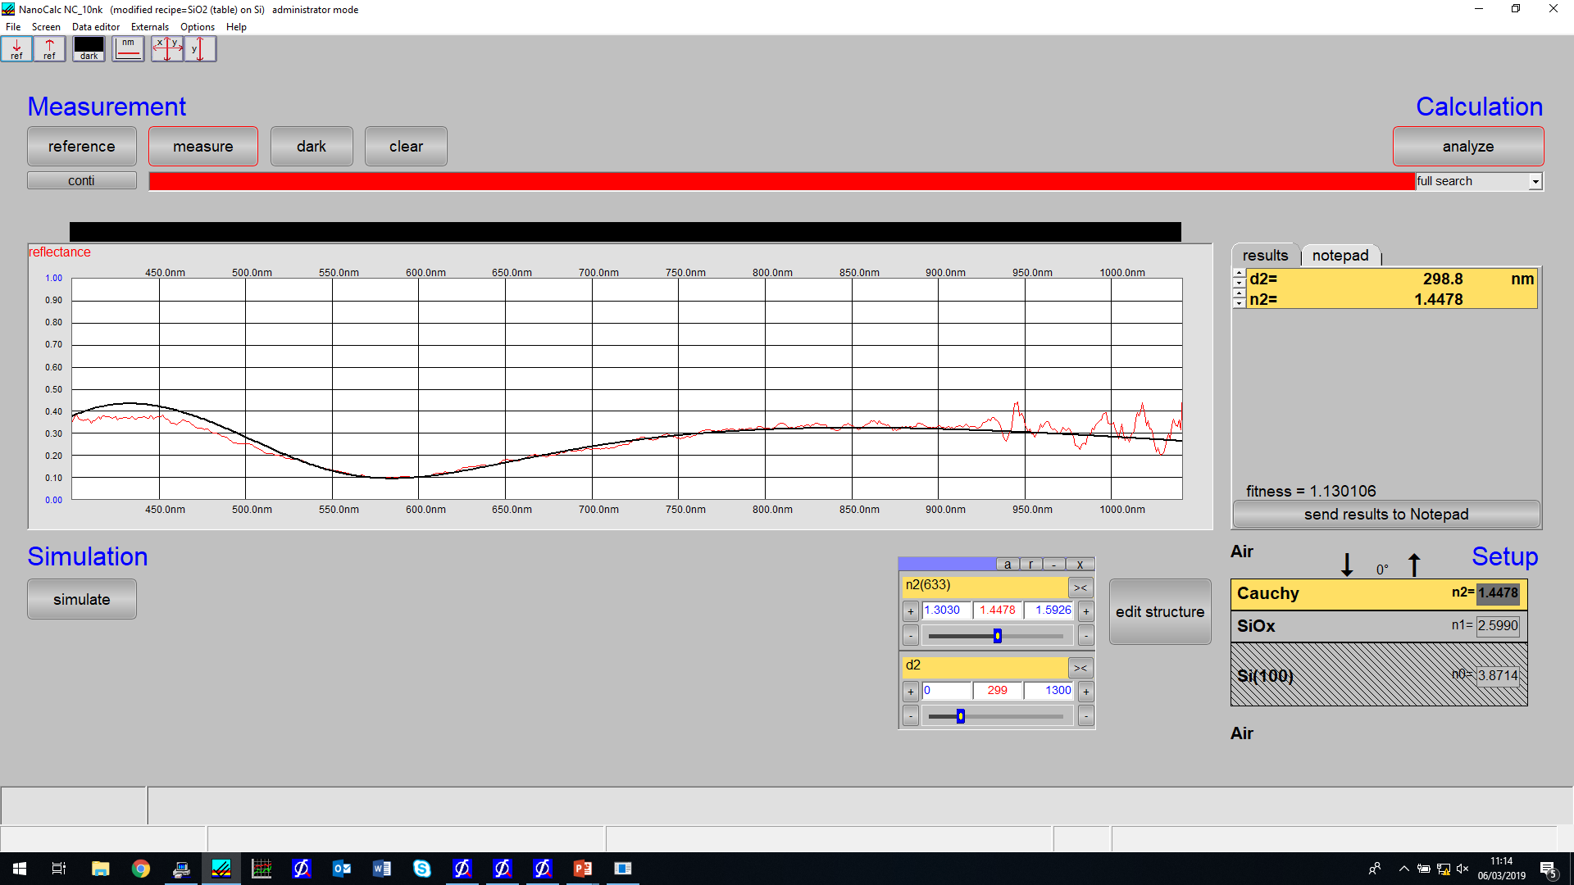
PI static measurement in chamber
Withoptics.ref ; Measurement 3

Slide 5
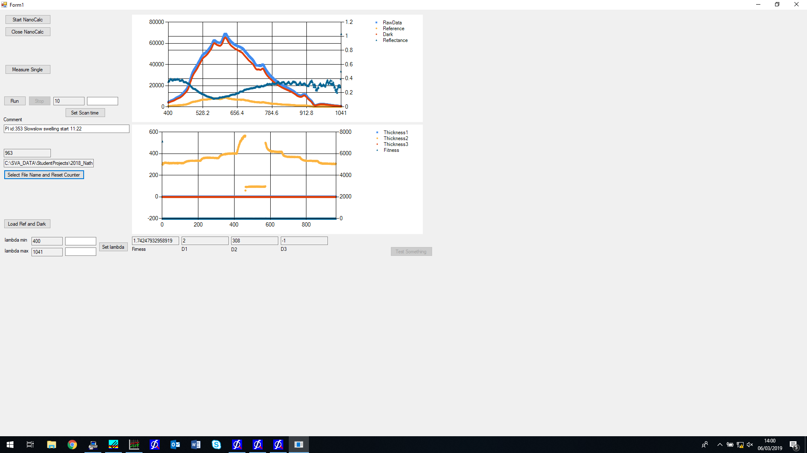

Slide 6


