Slide 1
PS swelling
Date: 16/03/2019

Slide 2
Information
PS id: 348
Sva started at 13:08

Slide 3
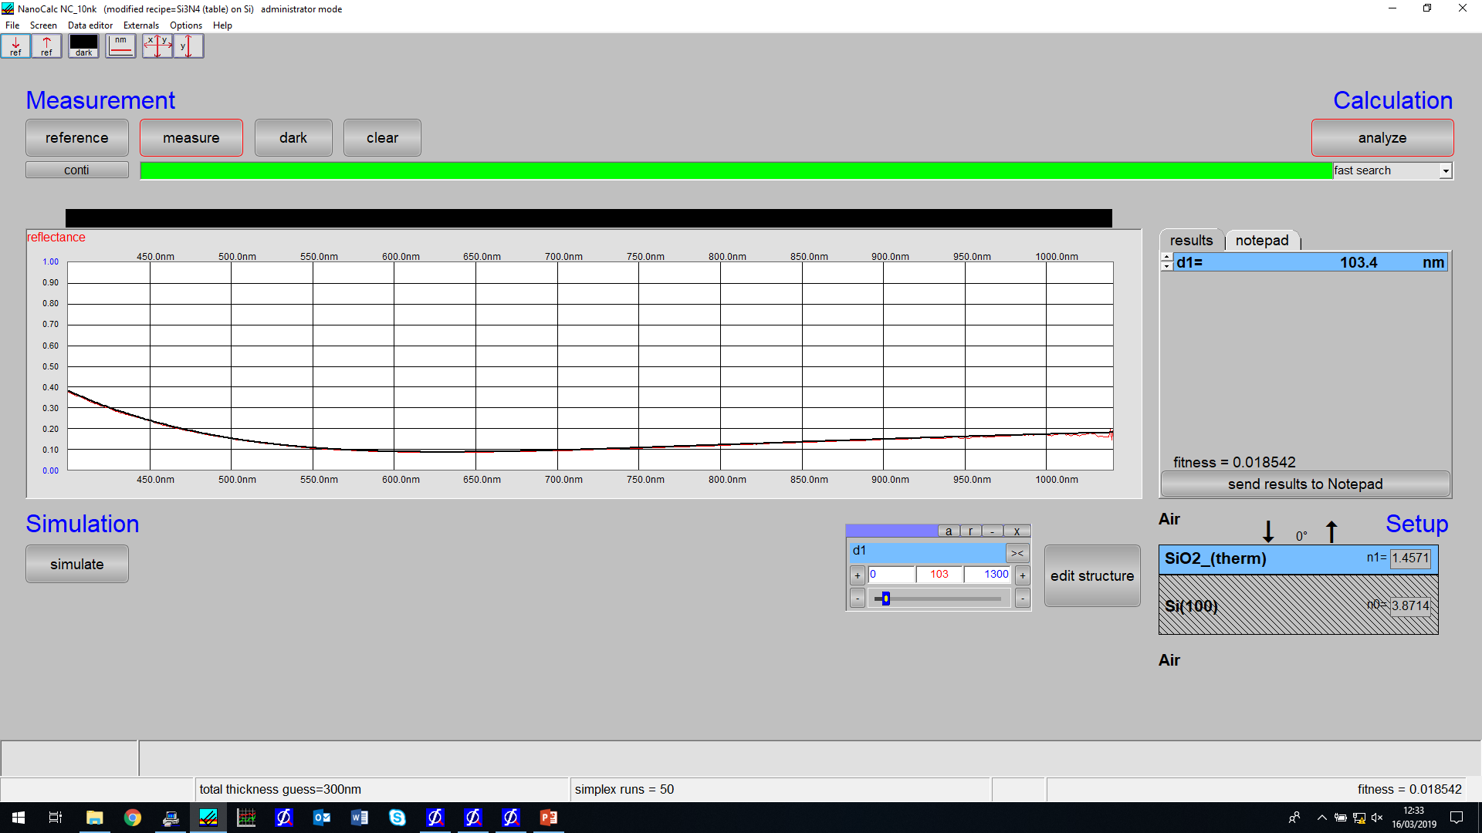
OceanOptics – 101.1nm
Good measurement – single stage is at correct height

Slide 4
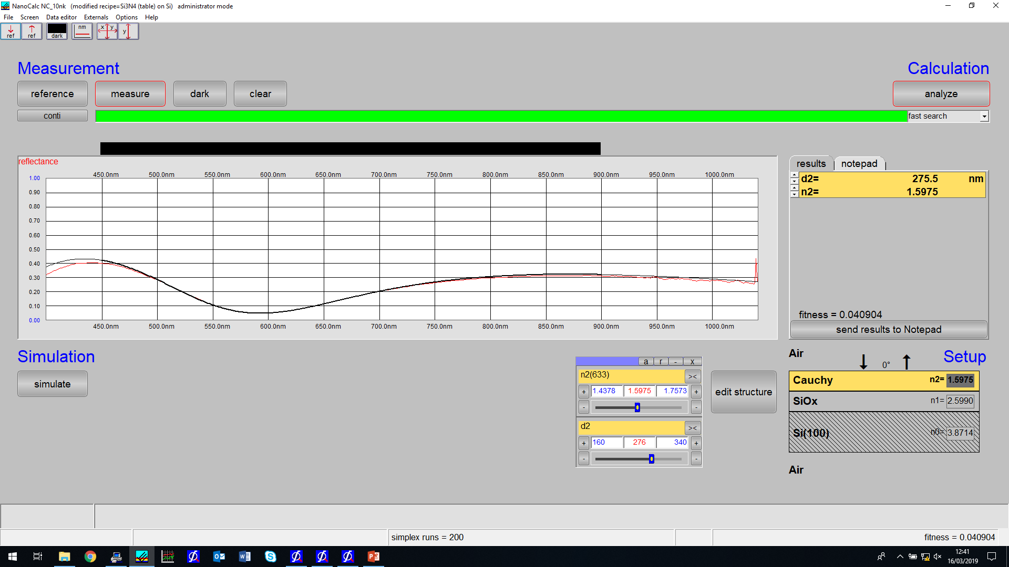
PS id:348 single point stage
Good fit

Slide 5
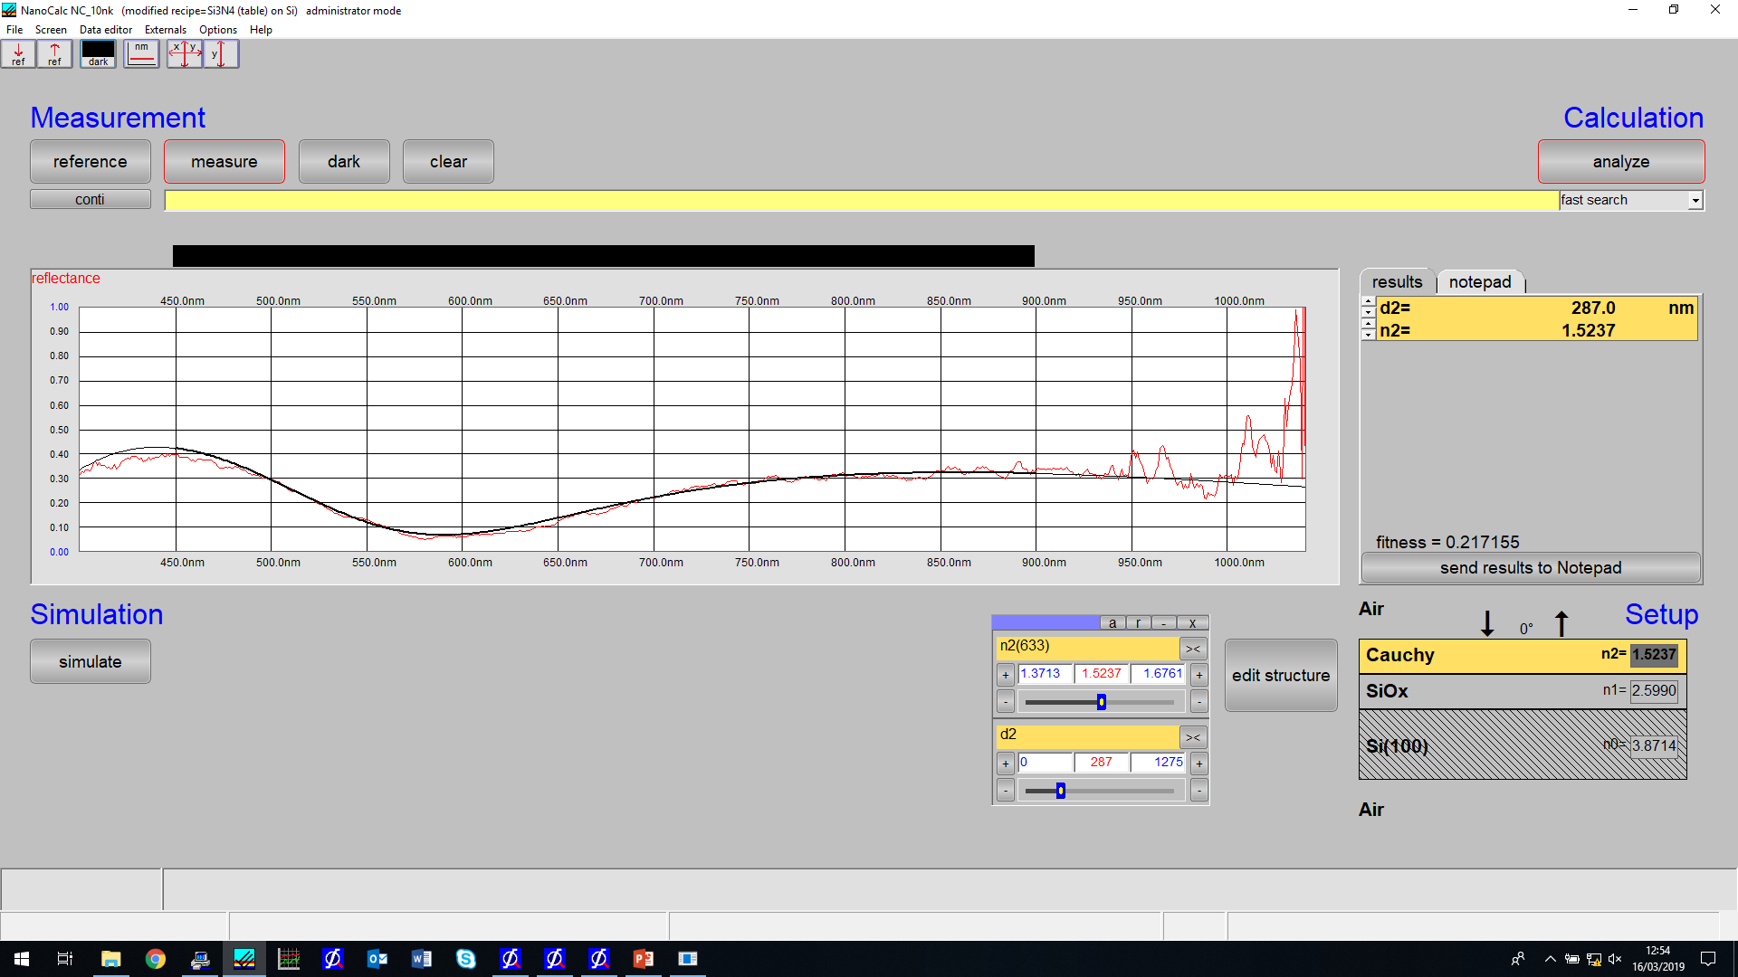
Measurement 2

Slide 6
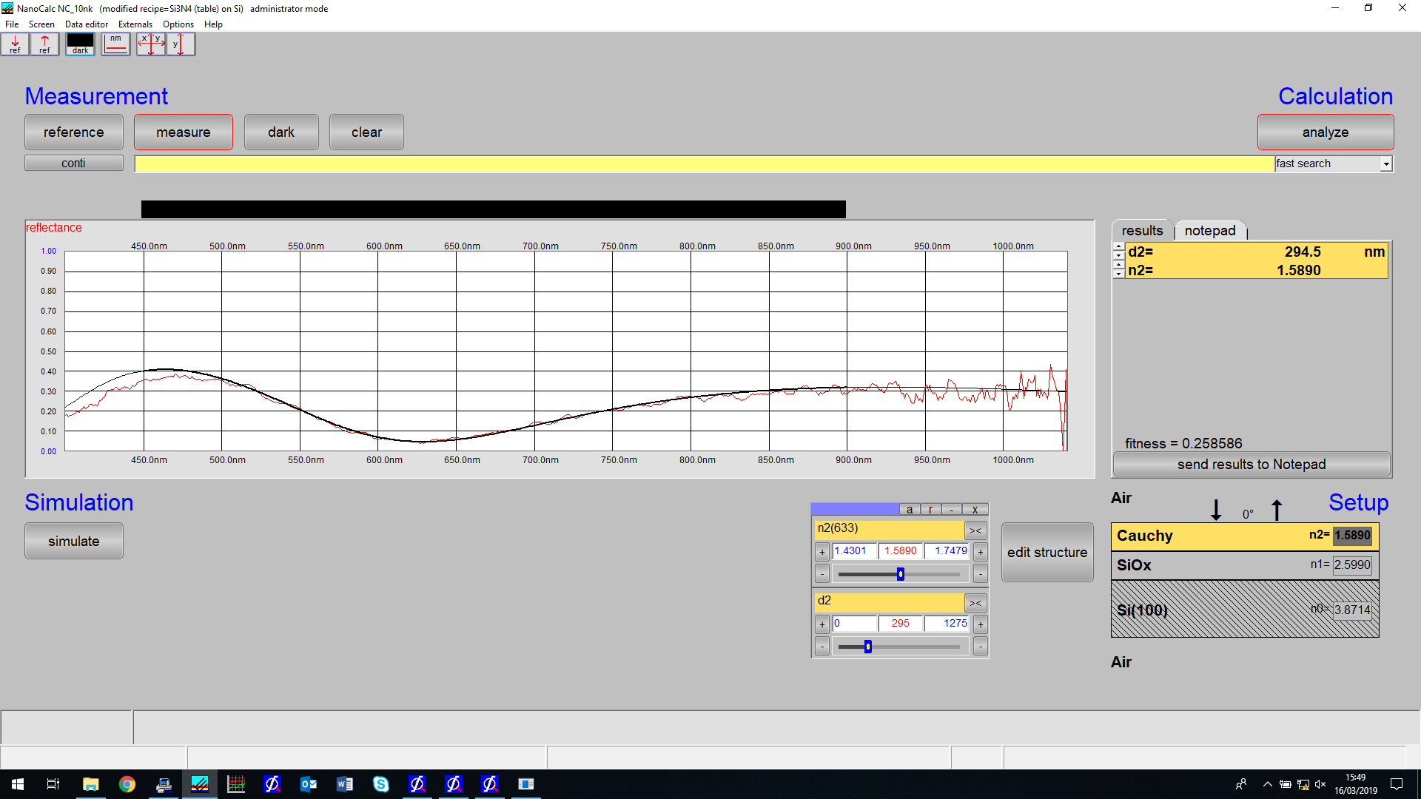

Slide 7
