Slide 1
Homopolymers
Date:19/02/2019
Measurement:Static
Batch: Homopolymers 2019_02_07

Slide 2
Static Information
Using Ocean Optics stage point
Ref and Dark file: topsilminusoptics
Refractive index:
Polystyrene 632.8nm 1.58654
Polyisoprene 632.8nm 1.52
PMMA 589.3nm 1.4905

Slide 3
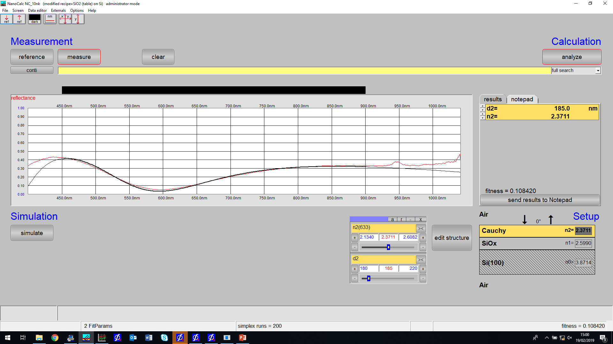
polystyrene id:350 ref:topsilminusoptics

Slide 4

polyisoprene id:354 ref:topsilminusoptics - run3

Slide 5
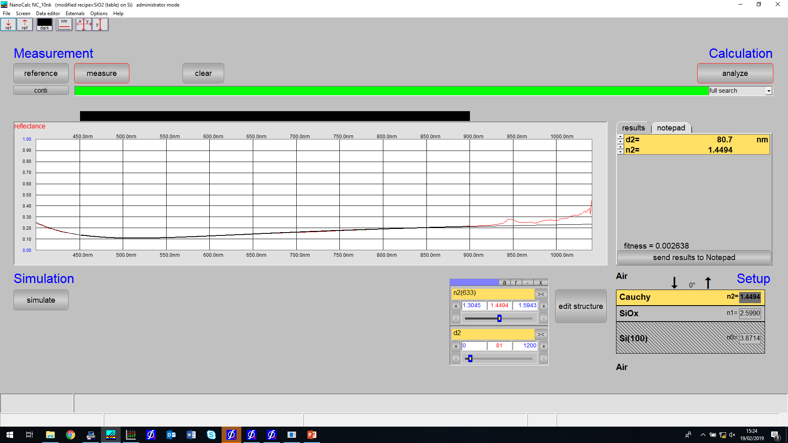
PMMA id:358 ref:topsilminusoptics - run3

Slide 6
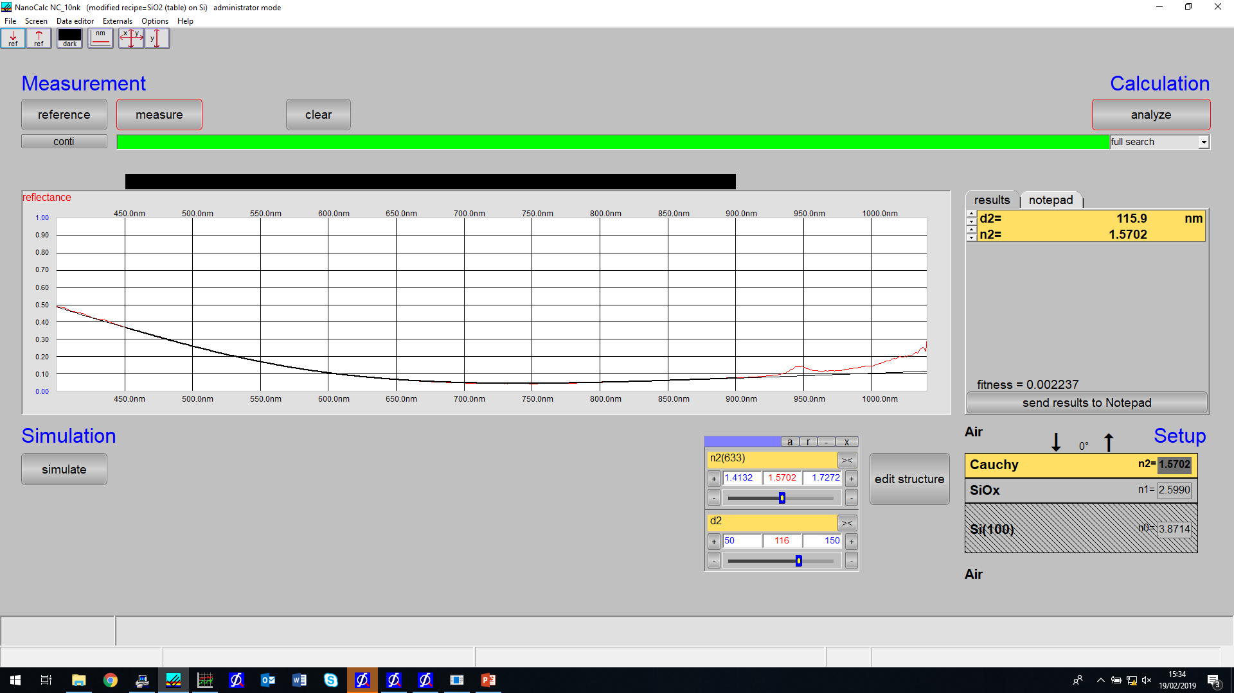
Polystyrene id:338 ref:topsilminusoptics

Slide 7

Polyisoprene id:342 ref:topsilminusoptics

Slide 8

PMMA id:346 ref:topsilminusoptics - run2

Slide 9

Polystyrene id:350 ref:topsilminusoptics - redo - run2

Slide 10

Polyisoprene id:354 ref:topsilminusoptics - redo - run2

Slide 11

PMMA id:358 ref:topsilminusoptics - redo - run 2

Slide 12
Homopolymer
Date:
Measurement: Swelling
Batch: Homopolymer 2019_02_07

Slide 13
Swelling information

