Slide 1
PS-b-PI
06/03/2019

Slide 2
Information
Id:370
PS-b-PI
Swelling started at 16.34

Slide 3
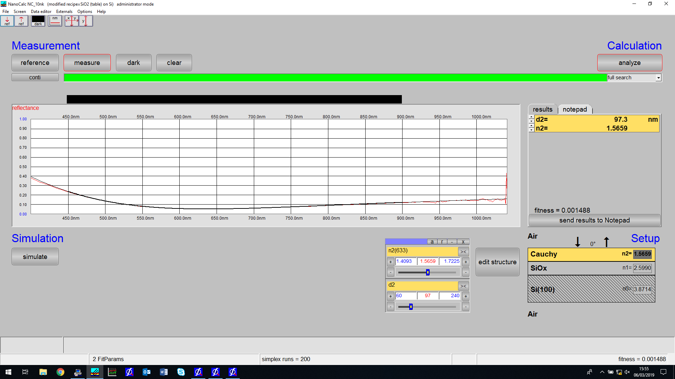
Static measurement
Without_optics.ref
PSbPI.xy

Slide 4
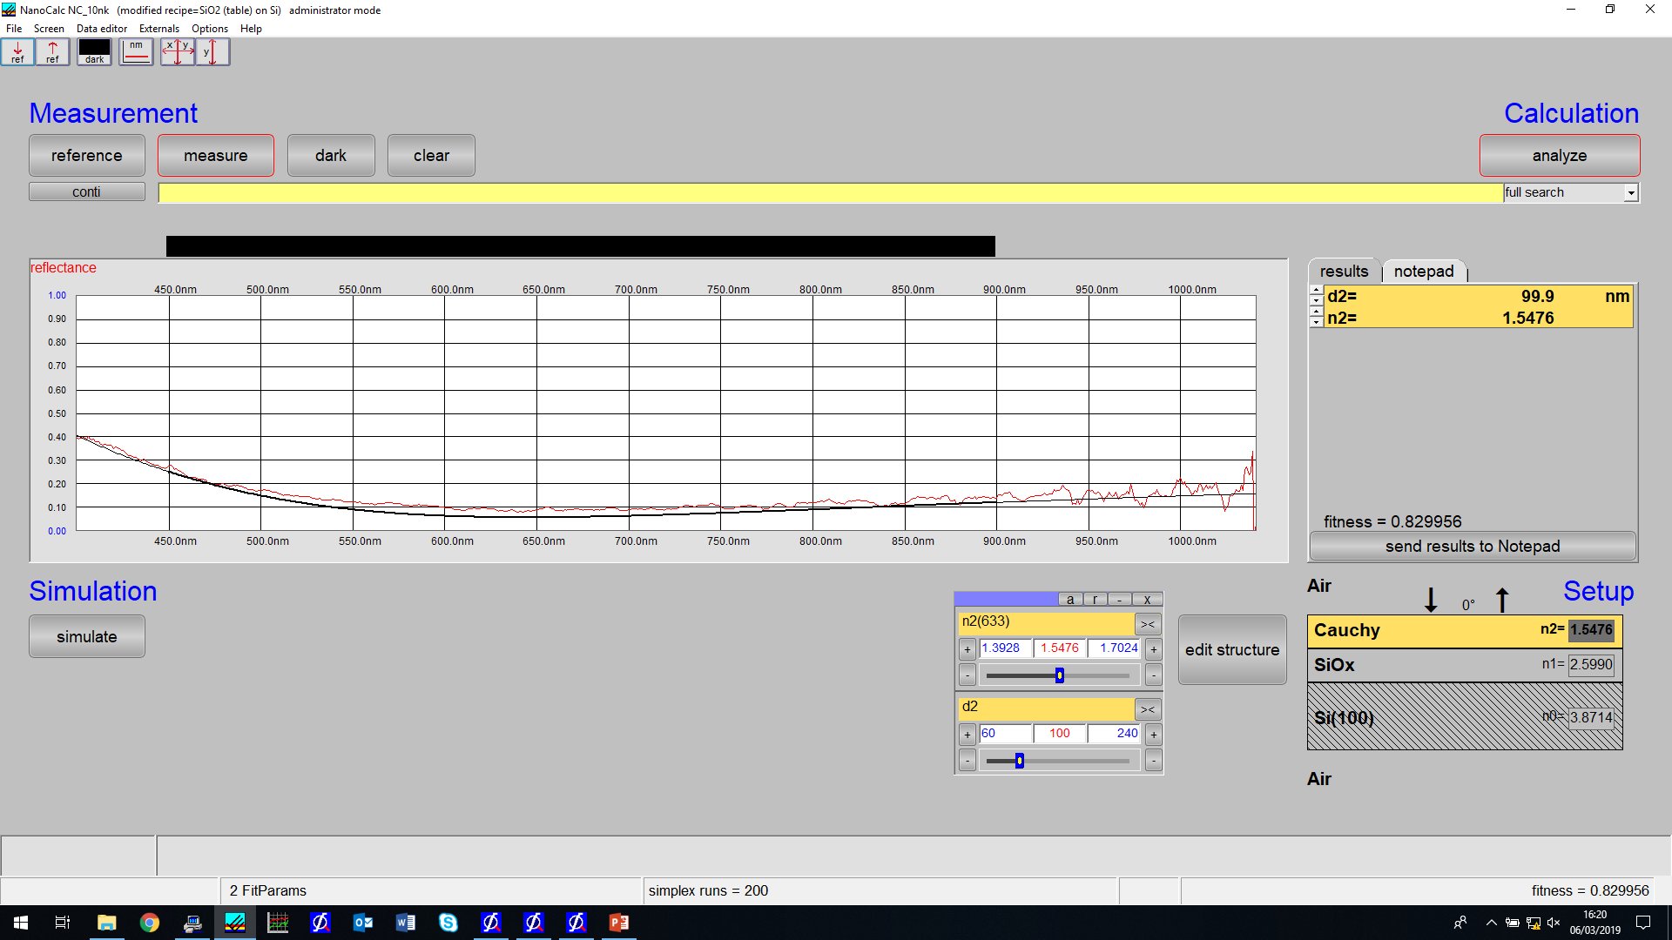
Static measurement
Withoptics.ref
PSbPIwithoptics.xy

Slide 5
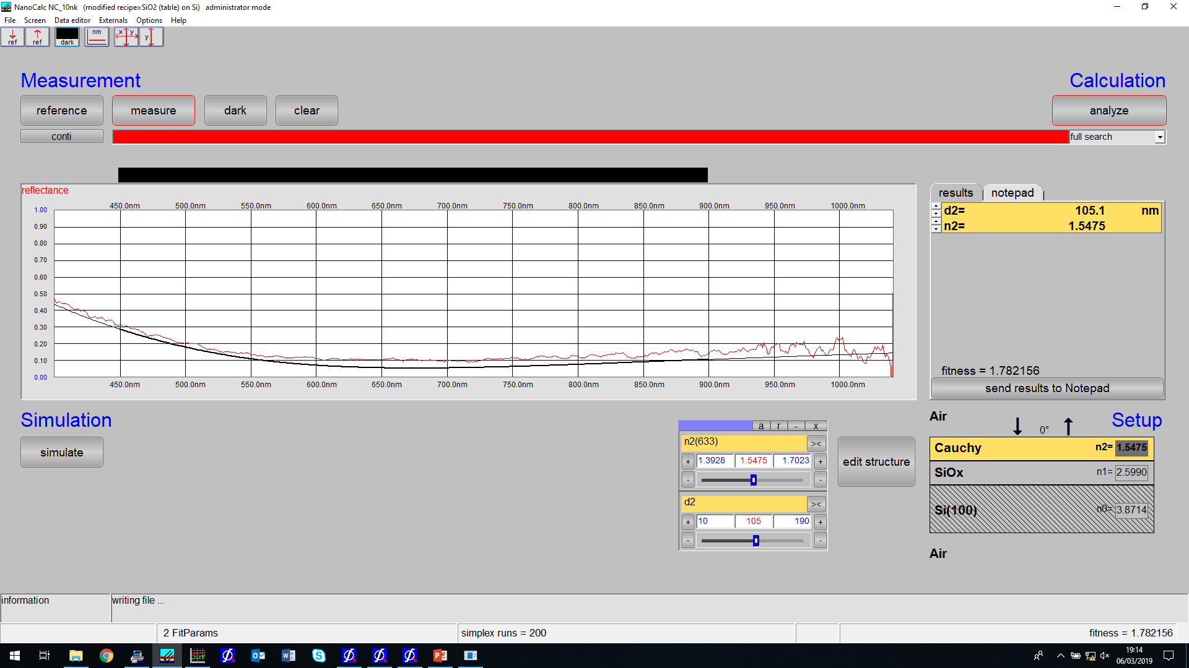
Last swelling measurement

Slide 6
Wafer Pictures
Before
After

Slide 7
