Slide 1
Risk Mitigation for Open SSDP

Slide 2
Agenda
Introduction
About SSDP
Mitigation recommendations for open SSDP
Making the case for implementing mitigations

Slide 3
Introduction
When cyber infrastructure is insecure there is a risk to the global Internet community
Simple Service Discovery Protocol (SSDP) is the standard search protocol for Universal Plug and Play (UPnP)
UPnP is pervasive - it is enabled by default on home gateways, network printers, webcams, network storage servers, and “smart home” devices such as thermostats, automated assistants and wireless home security systems that are part of the Internet of Things (IoT)

Slide 4
About CyberGreen
Global non-profit and collaborative organization focused on helping improve the health of global Cyber Ecosystem
Working to provide reliable metrics and mitigation best practice information to Cyber Security Incident Response Teams (CSIRTs), network operators, and policy makers
Mission: help CSIRTs and others focus remediation efforts on the most important risks
Help understand where improvements can be made
How we can achieve a more sustainable, secure, and resilient cyber ecosystem

Slide 5
Copyright (c) 2016, CyberGreen
These materials are distributed under the following license:
Permission to use, copy, modify, and/or distribute these materials for any purpose with or without fee is hereby granted, provided that the above copyright notice and this permission notice appear in all copies.
THE MATERIAL IS PROVIDED "AS IS" AND THE AUTHOR DISCLAIMS ALL WARRANTIES WITH REGARD TO THIS MATERIAL INCLUDING ALL IMPLIED WARRANTIES OF MERCHANTABILITY AND FITNESS. IN NO EVENT SHALL THE AUTHOR BE LIABLE FOR ANY SPECIAL, DIRECT, INDIRECT, OR CONSEQUENTIAL DAMAGES OR ANY DAMAGES WHATSOEVER RESULTING FROM LOSS OF USE, DATA OR PROFITS, WHETHER IN AN ACTION OF CONTRACT, NEGLIGENCE OR OTHER TORTIOUS ACTION, ARISING OUT OF OR IN CONNECTION WITH THE USE OR PERFORMANCE OF THIS MATERIAL.

Slide 6
About SSDP

Slide 7
Simple Service Discovery Protocol (SSDP)
Simple Service Discovery Protocol (SSDP) is the standard search protocol for Universal Plug and Play (UPnP)
It allows computers and various other network connected devices to communicate with each other
It simplifies the discovery and control of network devices on a local network

Slide 8
Universal Plug and Play (UPnP)
UPnP is enabled by default on many devices: smart TVs, IP cameras, printers, media servers and routers, as well as most operating systems
Common functions provided by UPnP include incoming port mapping on home routers, identification of network printers, and managing media services
UPnP also used in many “smart home” control technologies: programmable thermostats, wireless security systems, home hubs and Internet assistants

Slide 9
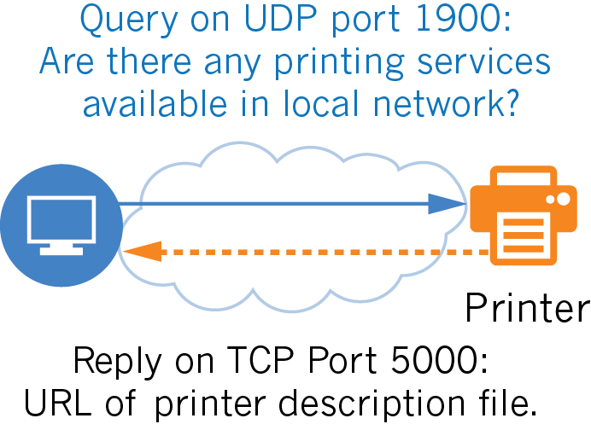
How UPnP uses SSDP to discover services

Slide 10
What is open SSDP?
“Open SSDP” refers to a device that is running SSDP and responds to UPnP discovery requests from the Internet

Slide 11
Risks posed by open SSDP
Devices running open SSDP can be used in reflection attacks, a type of traffic amplification attack
Denial of service (DoS) – attacker tries make a victim’s machine or network unavailable to its intended users
Amplification – when the attacker sends a small packet to a server that will generate a large reply
In amplification distributed denial of service (DDoS) attacks, attackers simultaneous abuse multiple amplifiers such as SSDP servers
Creates highly-distributed DoS attack conducted from a single command and control host

Slide 12
Open SSDP in reflection attacks
Attacker tries to exhaust the victim's bandwidth by abusing the fact that servers using protocols such as SSDP allow spoofing of sender IP addresses
Reflection attacks often exploit User Datagram Protocol (UDP) traffic
UDP responds to requests without any validation of sender identity, i.e. IP address
UDP traffic can be spoofed (i.e. have a misleading apparent source IP address) and attacker is able to hide true identity

Slide 13
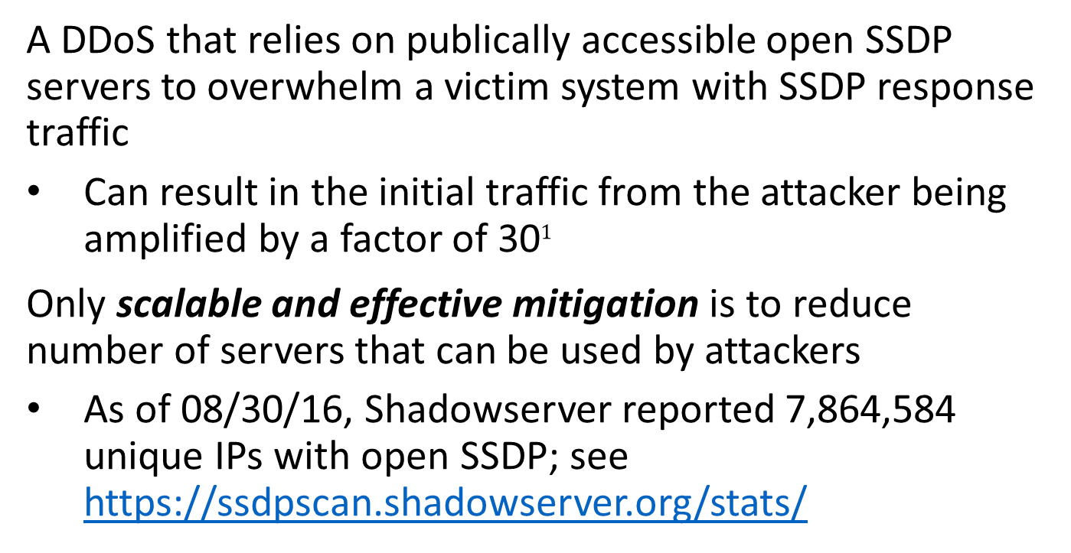
SSDP reflection amplification attack
A DDoS that relies on publically accessible open SSDP servers to overwhelm a victim system with SSDP response traffic
Can result in the initial traffic from the attacker being amplified by a factor of 30$1$
Only scalable and effective mitigation is to reduce number of servers that can be used by attackers
As of 08/30/16, Shadowserver reported 7,864,584 unique IPs with open SSDP; see https://ssdpscan.shadowserver.org/stats/
1 http://www.us-cert.gov/ncas/alerts/TA14-017A

Slide 14
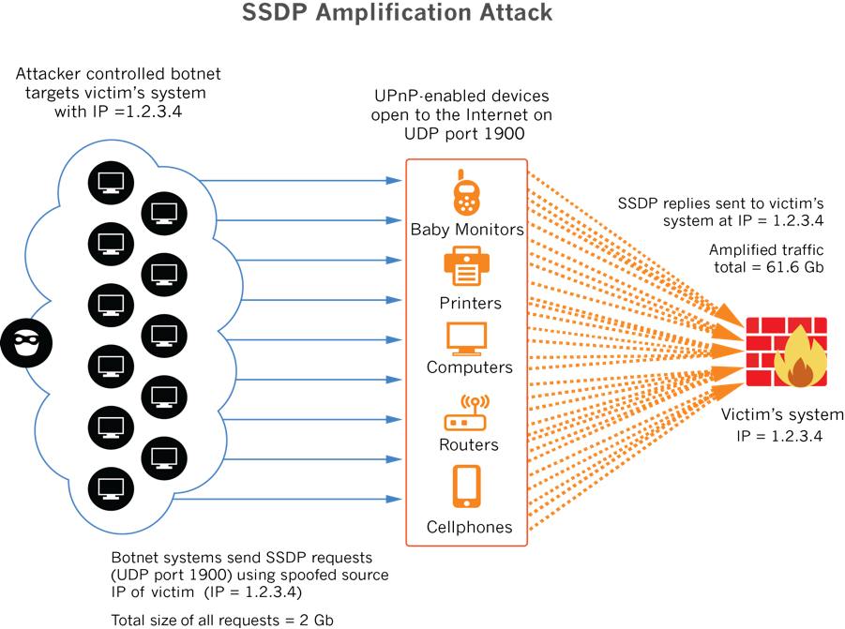

Slide 15
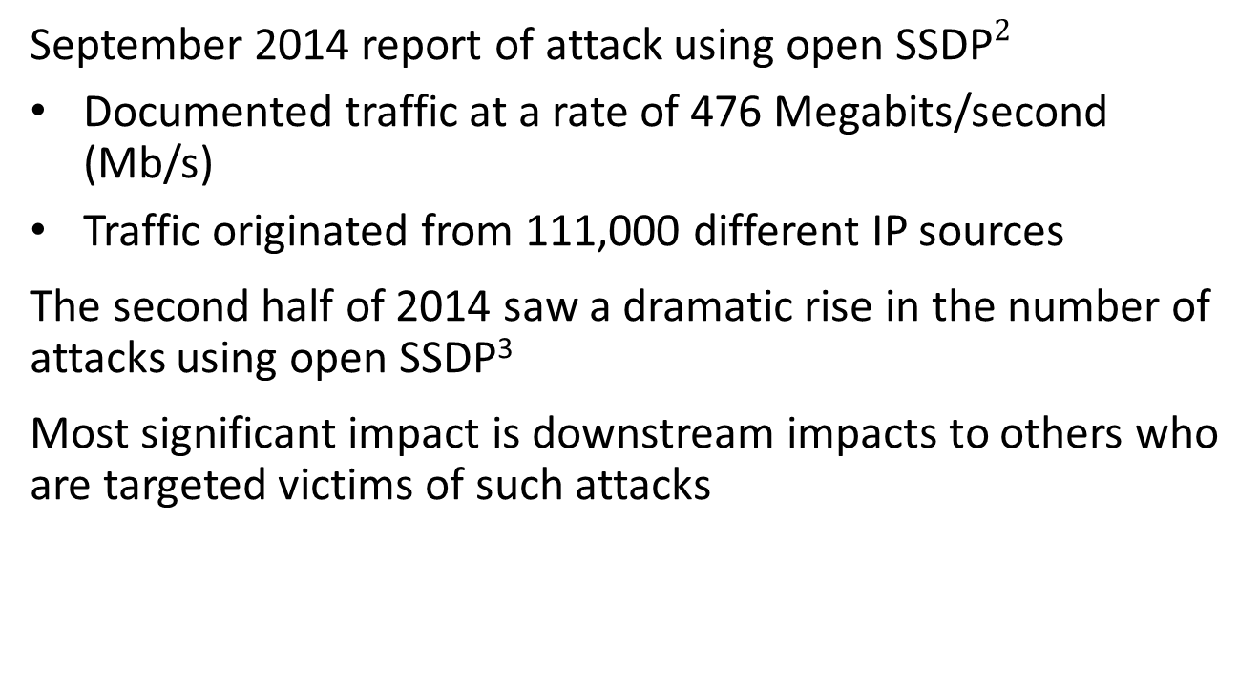
Real life attack using open SSDP
September 2014 report of attack using open SSDP$2$
Documented traffic at a rate of 476 Megabits/second (Mb/s)
Traffic originated from 111,000 different IP sources
The second half of 2014 saw a dramatic rise in the number of attacks using open SSDP³
Most significant impact is downstream impacts to others who are targeted victims of such attacks
2 https://blog.sucuri.net/2014/09/quick-analysis-of-a-ddos-attack-using-ssdp.html 3 https://www.arbornetworks.com/arbor-networks-atlas-data-shows-reflection-ddos-attacks-continue-to-be-significant-in-q3-2014

Slide 16
Potential impacts from SSDP attacks
Productivity
Service interruption or failure of business operations relying on network connectivity, particularly for seasonal operations - e.g. online retailers where a majority of sales happen between Thanksgiving and New Years
Time sensitive operations, e.g. colleges with limited online registration periods or online wagering on upcoming sporting events, etc.
Brand
Loss of reputation with customers and partners
Becoming known as a “DoS magnet” in global community

Slide 17
Other potential SSDP attack impacts
Technical
Network service interrupted
Isolation of victim network by network providers from the rest of Internet to mitigate collateral damage to other customers
Financial
Loss of business resulting from service interruption
Cost of specialized DDoS mitigation services

Slide 18
Indirect impacts from Open SSDP attacks
You may be impacted if a victim organization shares your upstream connectivity
Open SSDP devices on your network may be used to contribute to an attack on another organization
Potential indirect impacts include:
Technical
Network service degraded
Inbound or outbound bandwidth may be reduced
Network providers may isolate your network (or at least your insecure recursive resolver) from the rest of Internet

Slide 19
Other indirect impacts
Brand
Loss of reputation with customers and partners due to slow or unreliable network and systems
Financial
Unexpected network usage costs
Loss of business resulting from service degradation

Slide 20
Mitigate risks from open SSDP

Slide 21
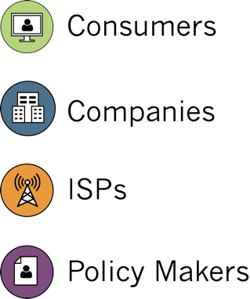
Mitigation options vary by environment
Not all mitigation best practices are appropriate for all environments
CyberGreen provides information relevant to four basic environmental profiles
Look for these icons to find mitigations for your environment
1.
2.
3.
4.

Slide 22
Mitigate risks from open SSDP
The best way to mitigate risks from open SSDP moving forward is to not purchase or deploy devices with UPnP enabled on outside interfaces
Work with your internal acquisition and procurement teams, or vendors about other options

Slide 23
Identify your open SSDP risk
Even if you don’t think your devices currently run SSDP across the Internet, you should check your network
Many devices may be running SSDP without your knowledge
Vulnerabilities in UPnP have been discovered that could pose additional, direct risk to organizations that allow SSDP from the Internet

Slide 24


Find hosts running SSDP
In a shell window, start tcpdump:
tcpdump –n host [IP]
In a second shell window, enter:
perl -e 'print "M-SEARCH * HTTP/1.1\r\nHost:239.255.255.250:1900\r\nST:upnp:rootdevice\r\nMan:\"ssdp:discover\"\r\nMX:3\r\n\r\n"' > /dev/udp/[IP]/1900
If your device has SSDP enabled, you should see a lot of traffic in the first shell window (running tcpdump)

Slide 25
Mitigation: Block SSDP at network edge
SSDP generally not needed across the Internet
Organizations should deploy firewall rules that block inbound port 1900/udp
If you need SSDP or UPnP, restrict access to only allow trusted hosts on that port
If you run applications that depend on UPnP and you block the service, some applications may continue to work with lesser performance
E.g. Microsoft Live Messenger uses UPnP for file transfers; if UPnP is not available, it will use a proxy server from Microsoft that may be more congested

Slide 26
Mitigation: Block SSDP
Use Access Control Lists (ACLs) to restrict SSPD at border routers
Please refer to your specific vendor documentation for instructions on how to implement these changes

Slide 27

Mitigation: Update UPnP devices
Vulnerabilities in UPnP pose additional risk
Two most commonly used UPnP software libraries contain vulnerabilities⁴ that are remotely exploitable through a single UDP packet, which can be forged
Some vulnerabilities would allow remote, unauthenticated attackers to scan internal hosts or proxy Internet traffic through the device
Contact your vendor to find out if a firmware update is available to address these vulnerabilities at https://web.nvd.nist.gov/view/vuln/search-results?query=ssdp
and
https://web.nvd.nist.gov/view/vuln/search-results?query=udp
4 https://community.rapid7.com/community/infosec/blog/2013/01/29/security-flaws-in-universal-plug-and-play-unplug-dont-play

Slide 28
Mitigation: Disable UPnP
If blocking or upgrading UPnP is not an option, disable UPnP, particularly on Internet-accessible devices
UnPlug n’ Pray utility from Gibson Research Company helps consumers shut down and disable UPnP on their Windows devices - available for free at https://www.grc.com/unpnp/unpnp.htm

Slide 29
Spoofed Traffic Mitigation: Implement ingress filtering on networks
Internet Engineering Task Force (IETF) Best Current Practice (BCP) documents
Detail configuration changes to substantially reduce potential for source IP spoofed attacks of all kinds (the most popular types of DDoS attacks)
How to filter network traffic on network to verify the source address of a packet
Reject packets with source addresses that are not reachable via the actual packet’s path

Slide 30
IETF BCPs recommended
All network operators should perform network ingress filtering as described in these BCPs:
BCP-38 Network Ingress Filtering
Defeating Denial of Service Attacks which employ IP Source Address Spoofing: https://tools.ietf.org/html/bcp38
BCP-84 Ingress Filtering for Multihomed Networks
https://tools.ietf.org/html/bcp84

Slide 31
More info on IETF BCPs
Test whether your network currently follows BCP-38 using tools from the Spoofer Project: https://www.caida.org/projects/spoofer/
Additional details about how to implement BCP-38: http://www.bcp38.info/index.php/Main_Page

Slide 32
Additional mitigations for ISPs
ISPs should ensure that they have a DDoS defense that is multi-layered, and designed to deal with:
Attacks that can saturate their connectivity
“Low and slow” sophisticated application layer attacks
Consider rate limited UDP fragments
Note: Blocking UDP fragments negatively affects session initiation protocol (SIP), the protocol for Voice over IP (VoIP), and other text and multimedia sessions like instant messaging, video, online games and other services

Slide 33
Verify your fix
Re-run the command:
tcpdump –n host [IP]
Ensure open SSDP is not enabled again in the future and monitor your infrastructure by subscribing to free reports from Shadowserver:
https://www.shadowserver.org/wiki/pmwiki.php/Involve/GetReportsOnYourNetwork

Slide 34
Additional SSDP resources
https://www.akamai.com/uk/en/multimedia/documents/state-of-the-Internet/ssdp-reflection-ddos-attacks-threat-advisory.pdf
http://www.us-cert.gov/ncas/alerts/TA14-017A
http://www.kb.cert.org/vuls/id/922681
http://www.upnp-hacks.org/faq.html
http://community.rapid7.com/docs/DOC-2150
https://threatpost.com/50-million-potentially-vulnerable-upnp-flaws-012913/77465/
http://www.darkreading.com/attacks-breaches/report-iot-connected-devices-leading-to-rise-in-ssdp-based-reflection-attacks-/d/d-id/1320149
http://www.christian-rossow.de/articles/Amplification_DDoS.php

Slide 35
Making the case for implementing mitigations such as BCP 38

Slide 36

Making the case for mitigations
I Help everyone understand the level of effort needed to improve cyber health in their community
Why should you implement the mitigations in your environment?
It is the right thing to do as a good Internet neighbor
Your organization may be next to be attacked
Let’s join together and stop bad guys from winning!

Slide 37
Changing risk landscape
Increased need to demonstrate “due care”
Obtaining cyber insurance
Complying with risk frameworks to win business with local / national governments and large corporations
If we (you!) don’t do a better job of securing our own infrastructure and reducing cyber risk, government regulation may force additional mandates and/or penalties

Slide 38
Anticipated organizational benefits
Increased productivity
Fewer service interruptions and failures
Improved network performance
Existing network more reliable and resilient, with greater capacity
Improved brand reputation
Technical reliability and security a selling point to customers

Slide 39
More anticipated benefits
Decreased budget uncertainty
Fewer unanticipated usage costs for IT
Budget can be used as planned, e.g. - upgrading technical capability / capacity, additional personnel, etc.
System admins may spend less time spent trying to deal with unexpected problems, which in turn may improve their productivity and reduce unexpected overtime

Slide 40
What do you need to implement these mitigations?
Commands and configuration details for most important mitigations are publically available
No additional software must be purchased
Implementing these mitigations does not require any special knowledge, skills, or abilities
Note: All mitigations should be carefully reviewed in light of your specific business requirements and infrastructure environment before proceeding

Slide 41
How long will mitigations take?
Manually disabling SSDP takes a few minutes per device
System administrators in smaller organizations would need an hour or two per perimeter device to investigate, implement and verify the basic mitigation of using the firewall or ACLs to block access to SSDP
ISPs and large entities can take advantage of configuration management systems with task execution, such as Salt and Ansible, to automate administration of changes

Slide 42
How long to implement BCP-38 network ingress filtering?
Small businesses: from a few minutes to less than an hour
Larger and more complex organizations: days to weeks
Bonus: with no real maintenance, the recurring cost is effectively zero!

Slide 43
Acknowledgement
CyberGreen would like to thank the experts who made the creation of this document possible:
Written by:
Laurin Buchanan, Applied Visions, Inc. – Secure Decisions Division
Contribution and Review by:
Matt Carothers, Cox Communications
Baiba Kaskina, CERT.LV
Moto Kawasaki, JPCERT/CC
Art Manion, CERT/CC
Yoshinobu Matsuzaki, IIJ
Joe St Sauver, Farsight Security
David Watson, ShadowServer Foundation
Disclaimer: CyberGreen believes this guidance and the advice from our experts should be of benefit to anyone mitigating a risk conditions, but it is not advice specific to any reader or network. Ultimately, each reader is responsible for implementing his or her own network remediation strategy and we assume no responsibility or liability therefore.

Slide 44
For more information about
risk mitigation best practices
please contact:
contact@cybergreen.net

