Slide 1





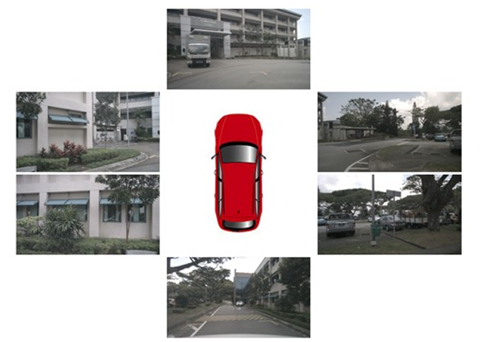
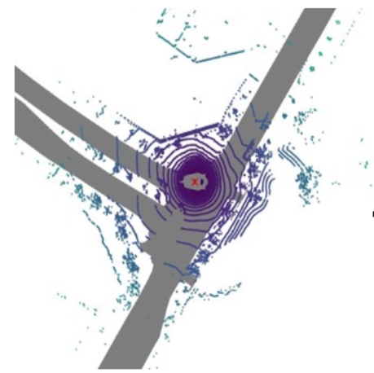
Proposed Model
Answer Labels
CrossEntropy Loss
Answer Logits
DriveVLM T5
Visual Embedding
Text Embedding
Projection Layer
Text Embedding Layer
BEVFusion Encoder
Camera/LiDAR
Aligned BEV Feature
Text Input
Question Texts
Camera Feature
LiDAR Feature
Camera Encoder
LiDAR Encoder
Visual Input
Multi-View RGB Images
LiDAR Point Cloud

