Slide 1
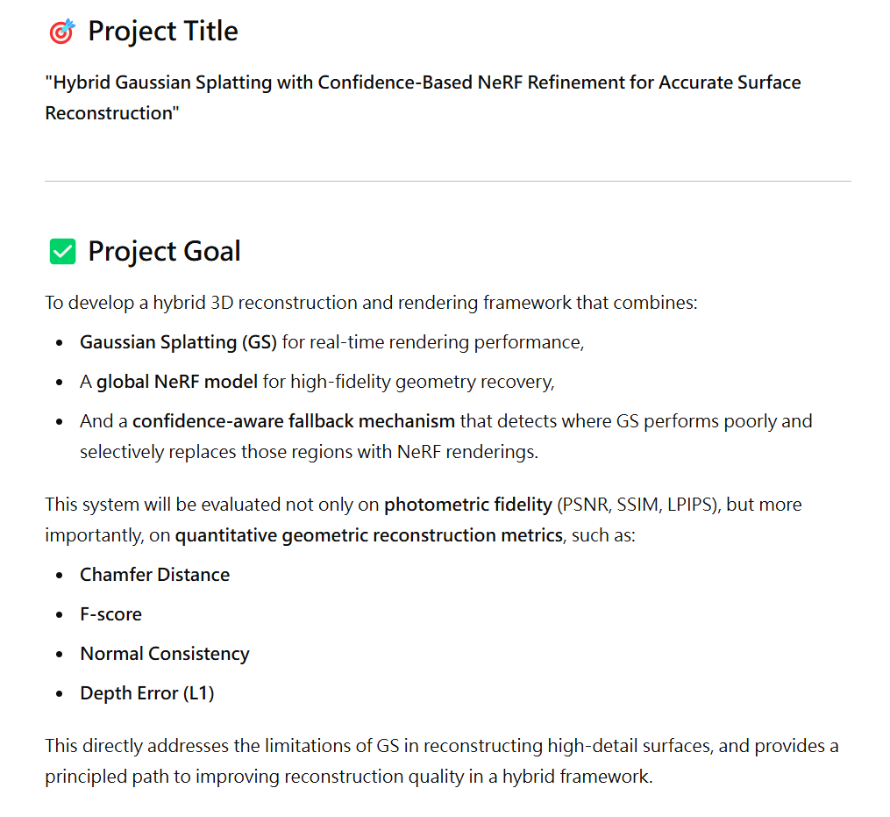
Total Steps

Slide 2
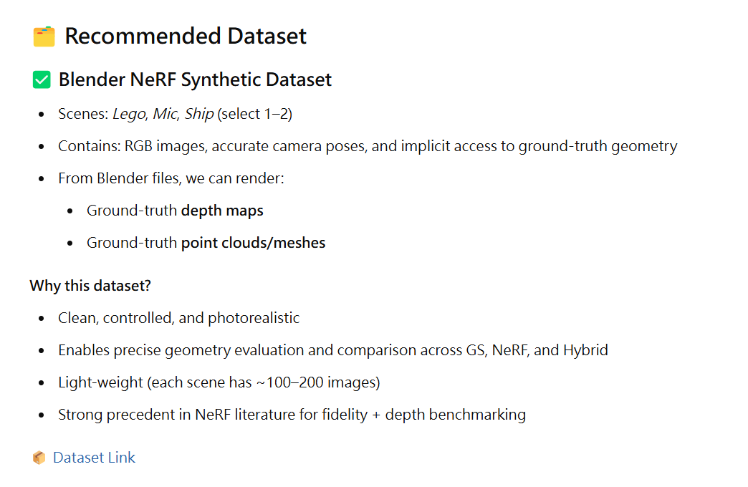
Total Steps

Slide 3
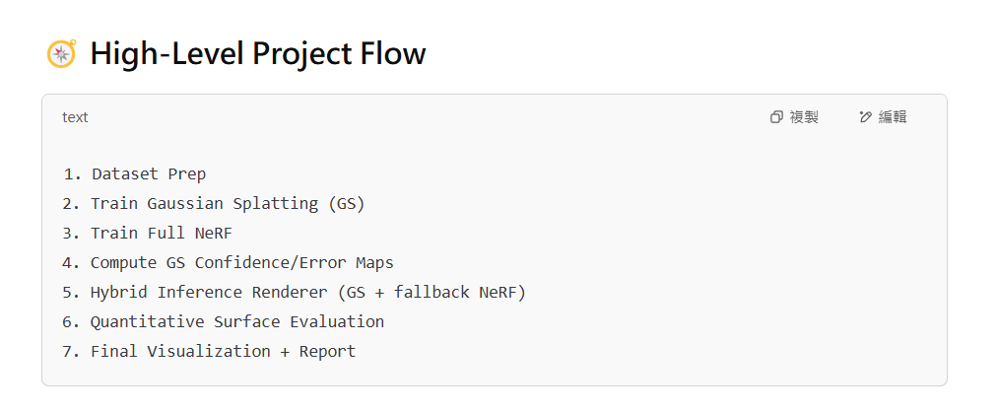
Total Steps

Slide 4
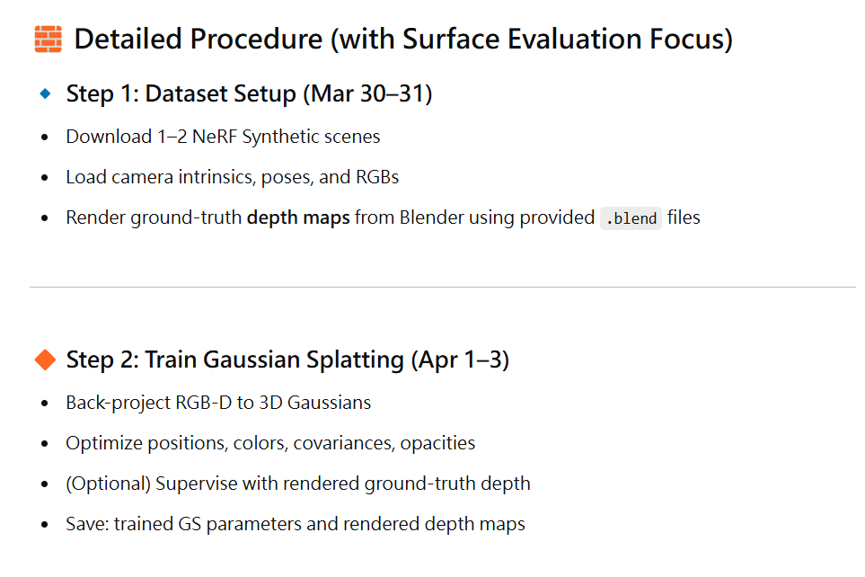
Total Steps

Slide 5
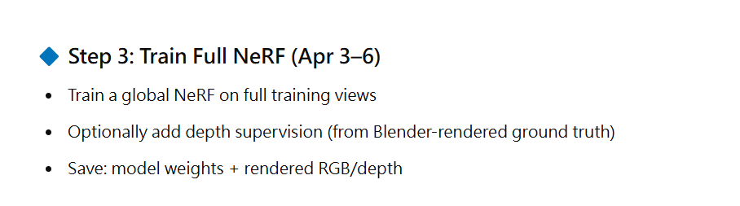
Total Steps

Slide 6
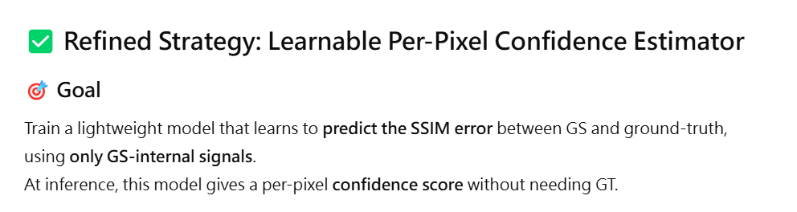
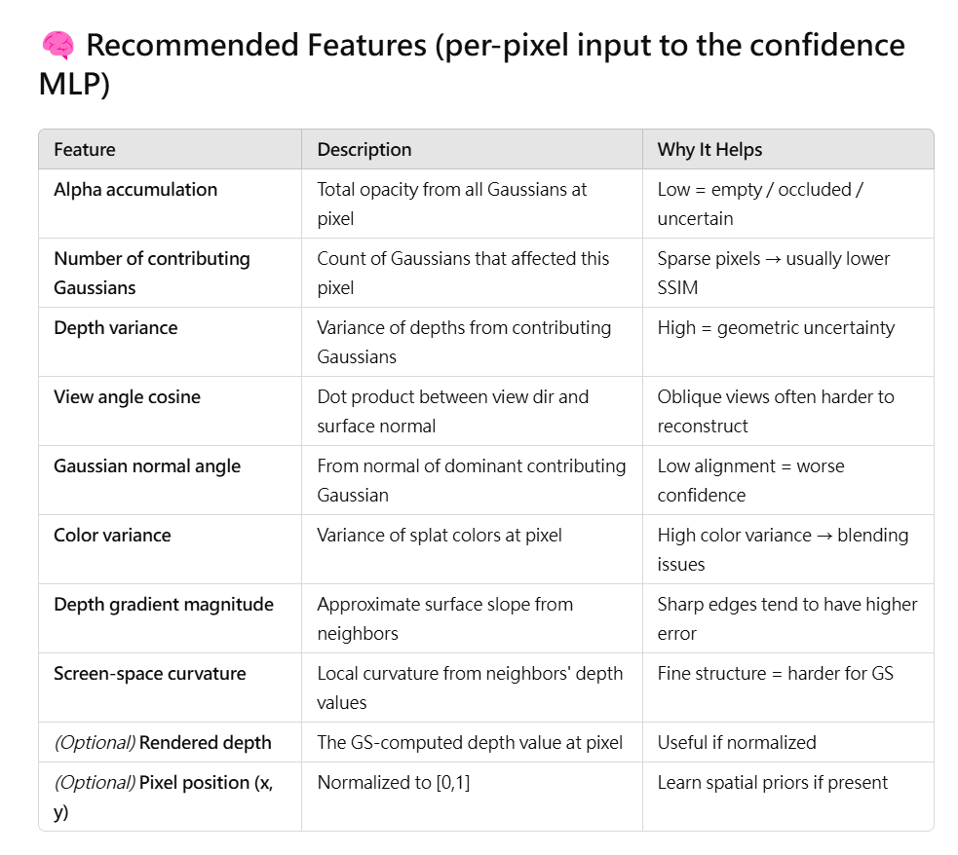
Total Steps

Slide 7
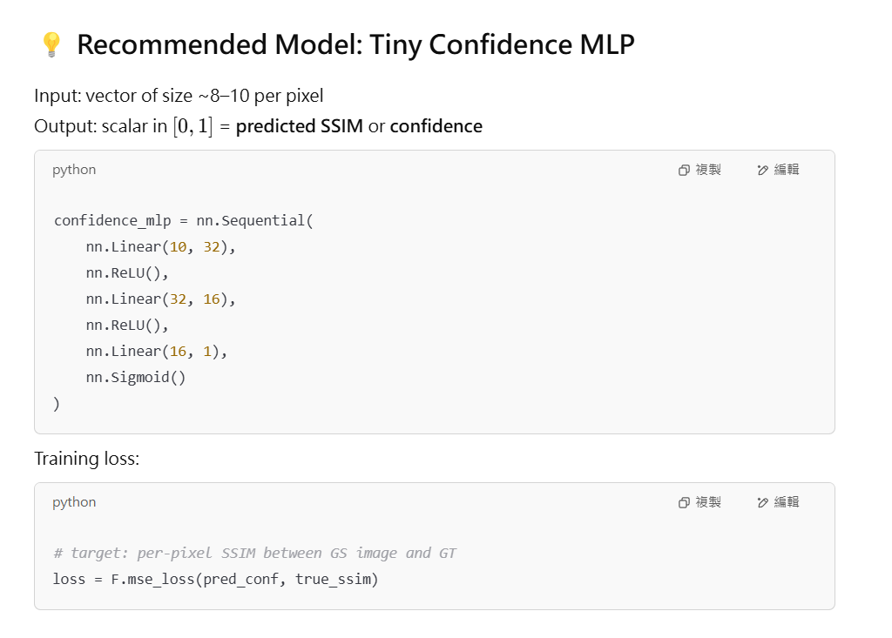
Total Steps

Slide 8
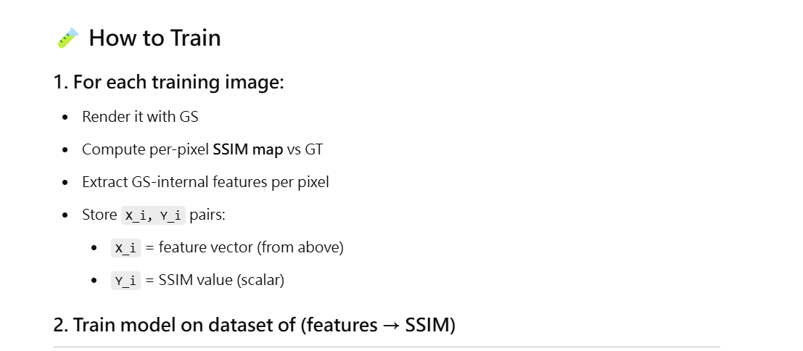
Total Steps

Slide 9
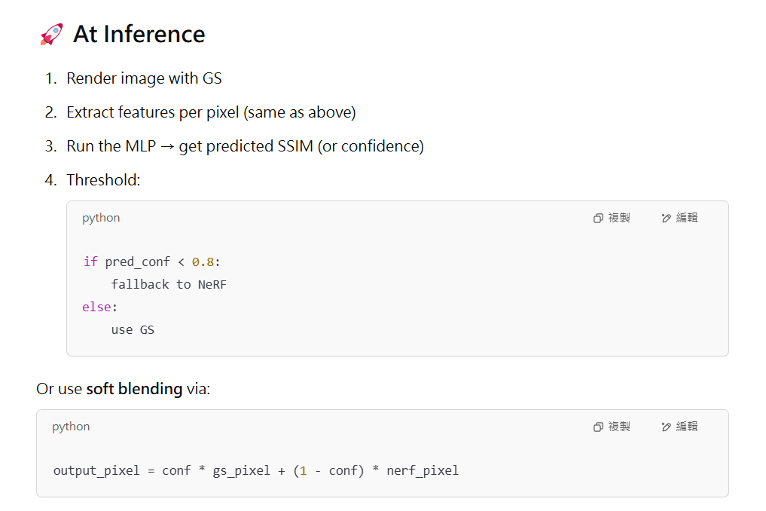
Total Steps

Slide 10
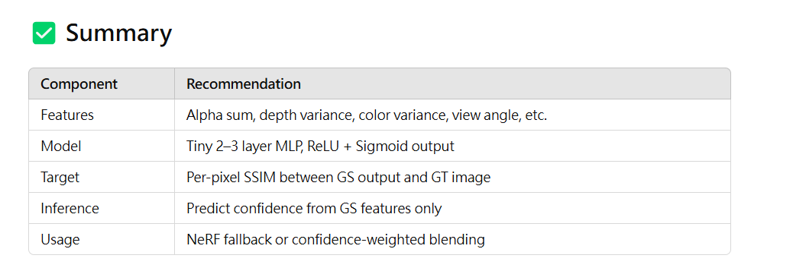
Total Steps

Slide 11
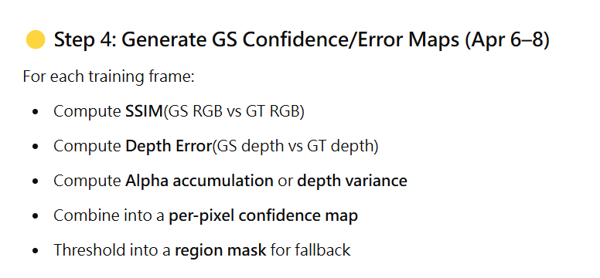
Total Steps

Slide 12
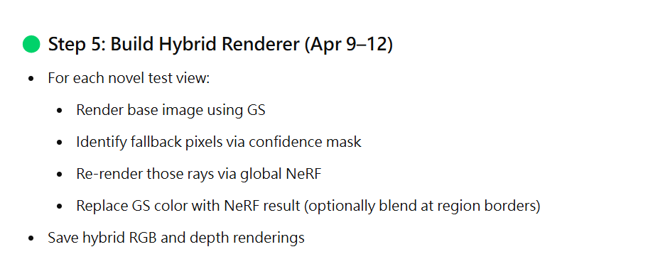
Total Steps

Slide 13
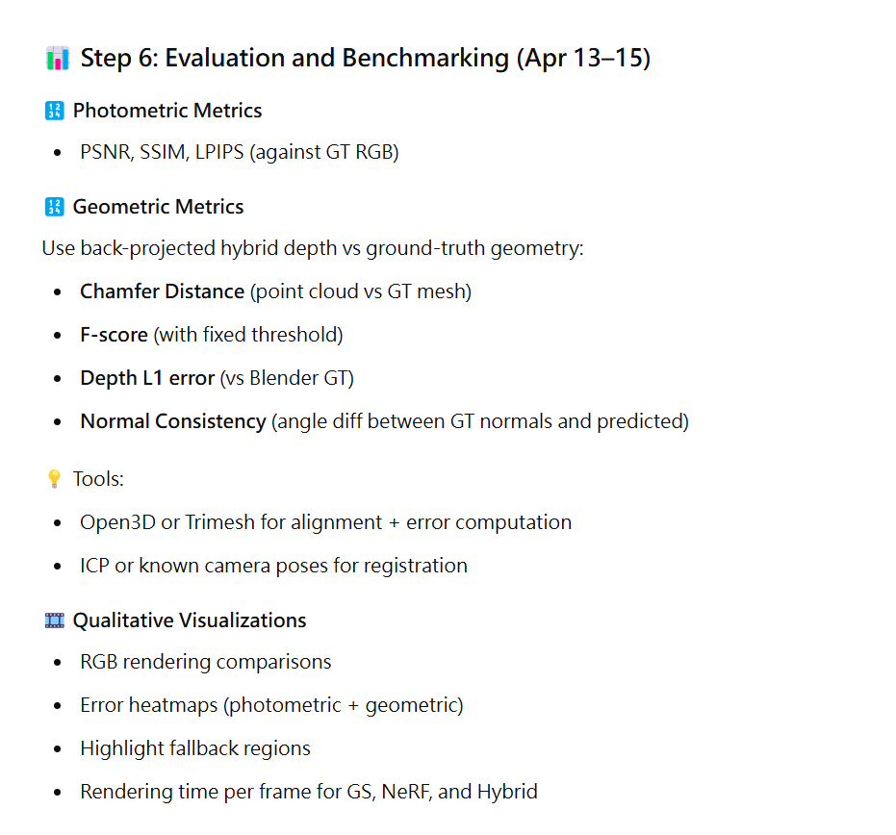
Total Steps

Slide 14
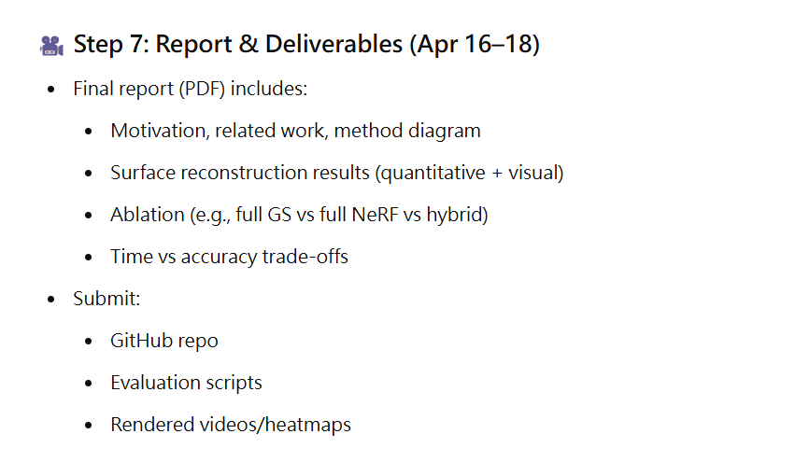
Total Steps

Slide 15
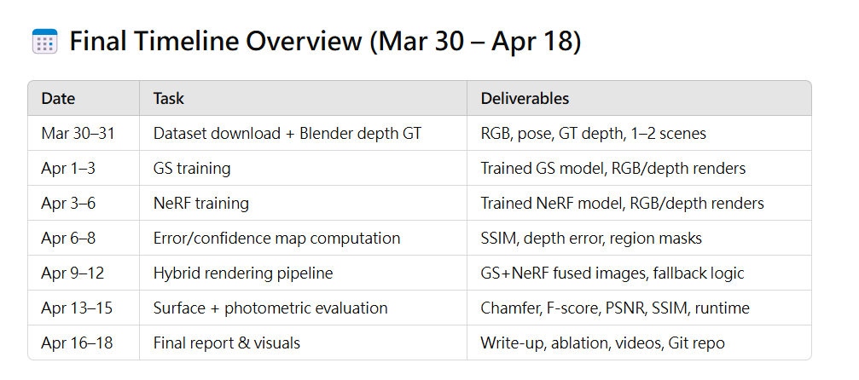
Total Steps

Slide 16
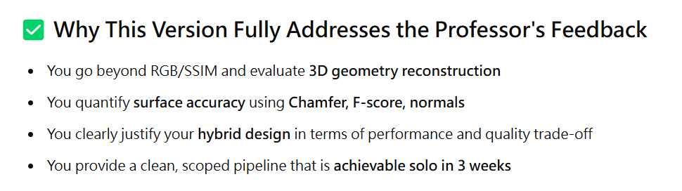
Total Steps

Slide 17










Introduction
$$Ray$$
$$Ray$$
x, y, z, w($d_{x}, d_{y}, d_{z}$)
MLP
$$σ, c$$
$$Splatting$$
(a) NeRF
(b) 3D GS

Slide 18

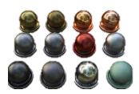
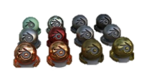





Method
Training
Multi-View RGB
+ Camera Poses
3D GS Training
Neural Uncertainty Training
GS Model
Unet/MLP
Splatting
L1-SSIM
GT
Image
SSIM Error
Feature Extraction
Huber
SSIM
Error
Cam. Pose
Uncertainty
Map
……
Fixed after training
Fixed after training
NeRF Training
$$F_{θ}$$
Volume Rendering
MSE
GT
Image
Fixed after training
$$MLP$$
Hybrid Rendering
GS Model
GS Model
Uncertainty Model
Camera Poses
3D GS Rendering
Neural Uncertainty
Pixel Selection
GS
Rendered
Image
Merging
NeRF Model
Selected Pixels
Rendered
Image
……
Pixel-Wise NeRF Rendering
NeRF
Rendered
Pixels

Slide 19
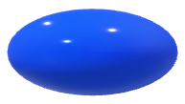
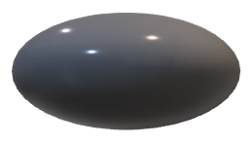

Method
Neural Uncertainty Feature Extraction
alpha
alpha sum map
color variance map
color*transmittance
view direction map
2D covariance area map
view direction
2D covariance
[N, {mean3D, quat, opacity, scales, colors}]
[H, W, 4]

Slide 20
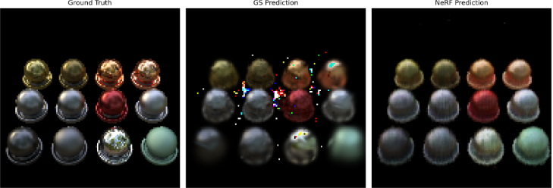
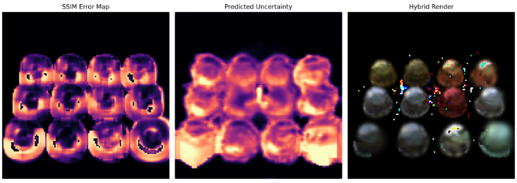
5% Replacement

Slide 21
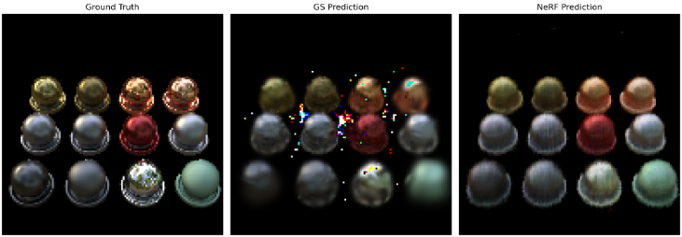
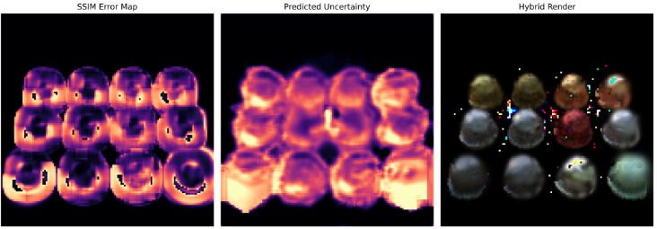
10% Replacement

Slide 22

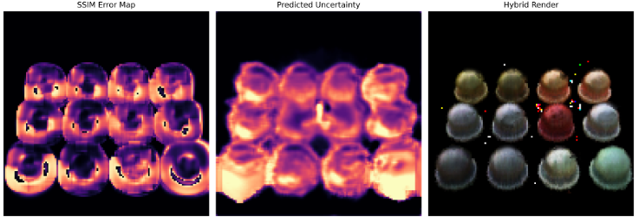
50% Replacement

Slide 23
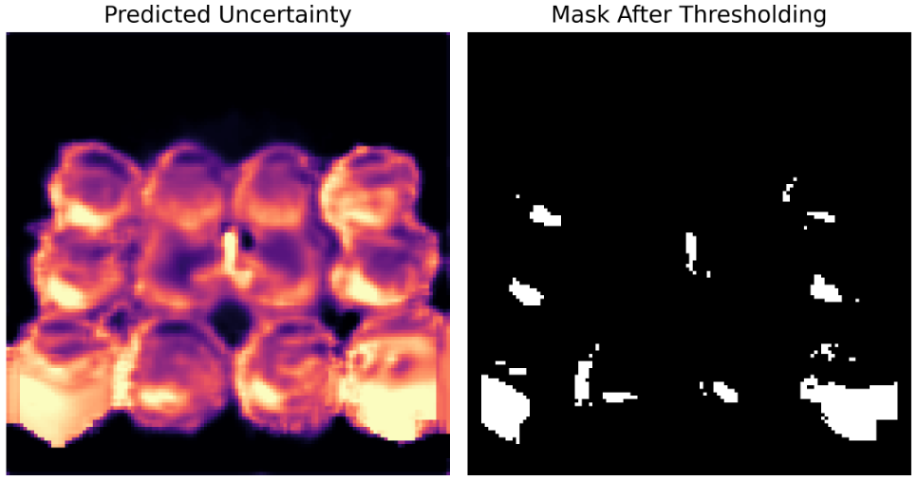
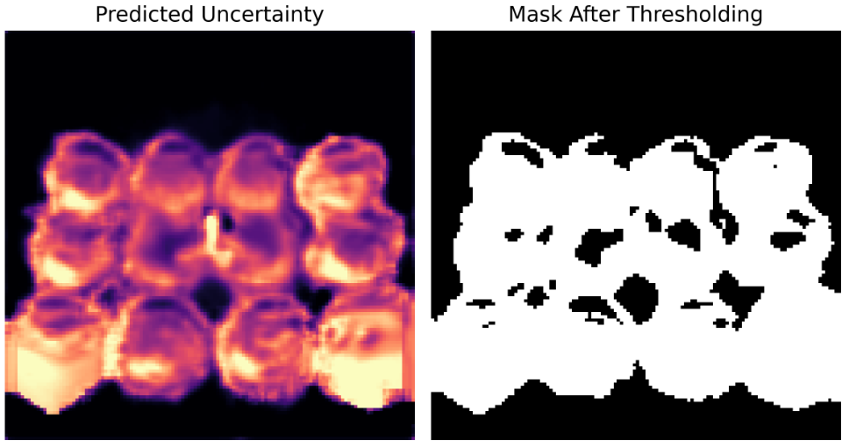
Method
5% Replacement
50% Replacement

Slide 24
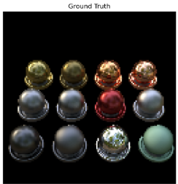
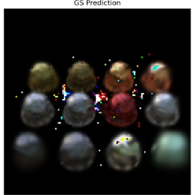
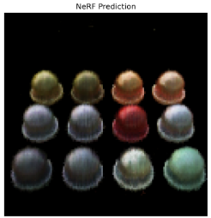
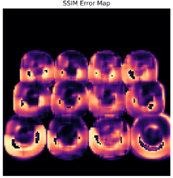
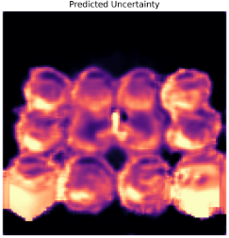
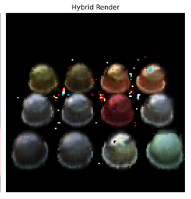

30%

Slide 25
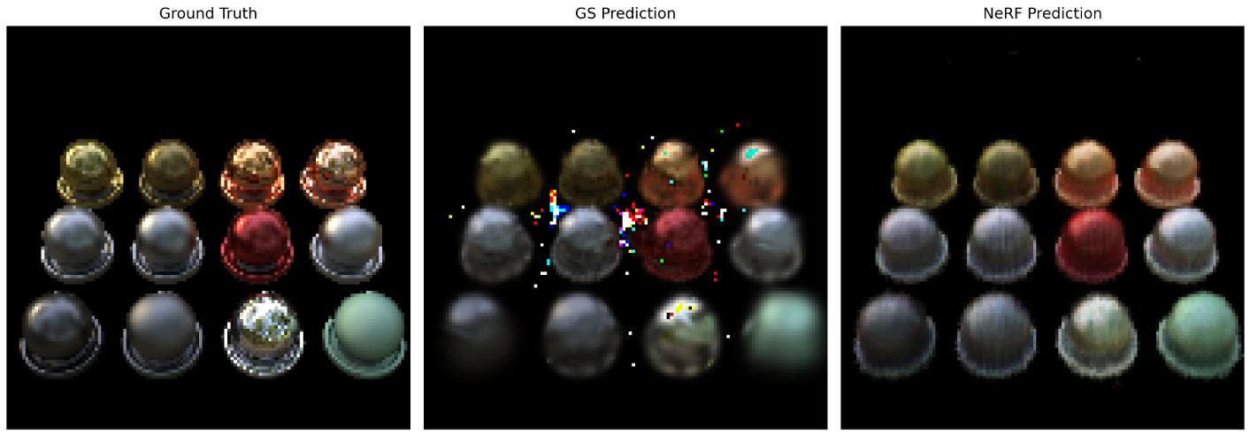
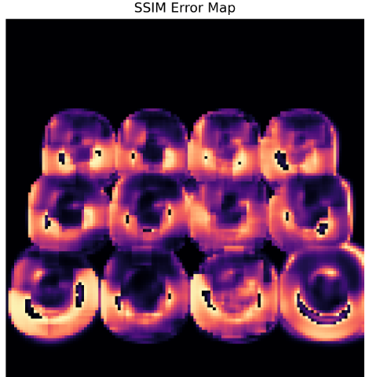
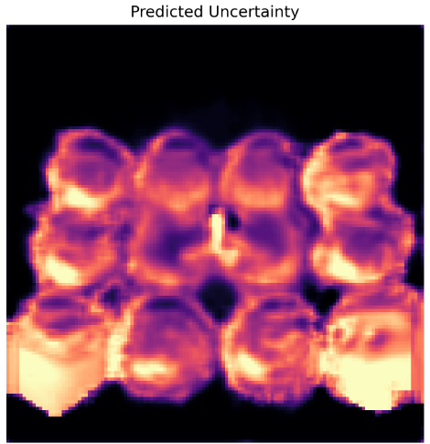

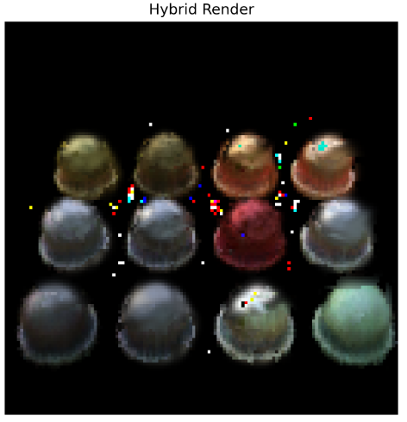
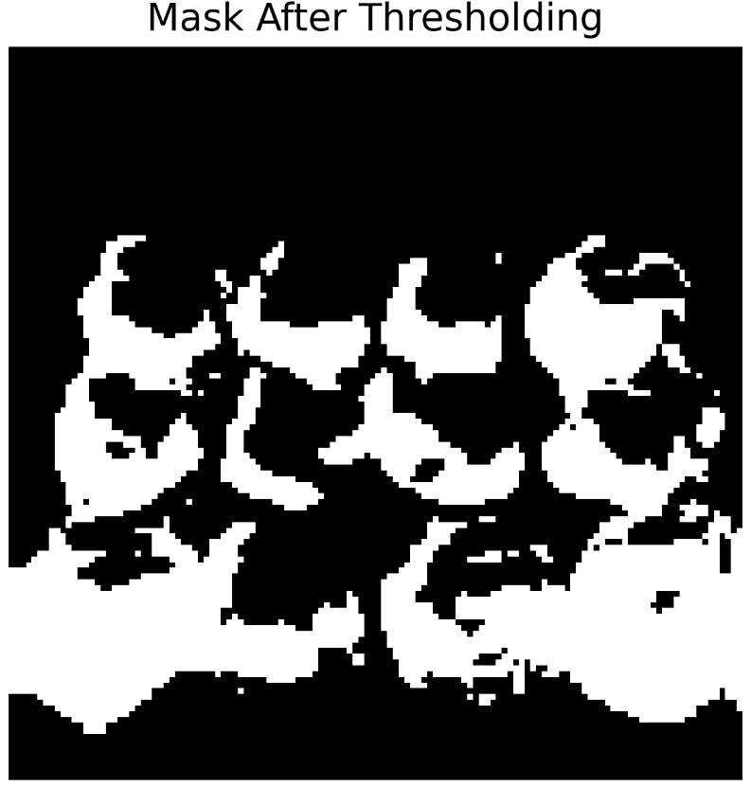
30%

