Slide 1
RBAC / OPA Authorization for Cosmian KMS
Design & Architecture Cosmian KMS Engineering

Slide 2
The Problem

Slide 3
Key Management Without Centralised Access Control
Permission sprawl — ACL grants accumulate per-object over time with no systematic audit or bulk revocation
Algorithm drift — cryptographic allowlists are hardcoded in the server binary; changing them requires a software release
Audit gaps — per-request authorization decisions are implicit; no record of which policy version made each decision
No role model — every user needs individual grants; no concept of “operator” or “auditor” without per-object wiring

Slide 4
Compliance Requirements
NIST SP 800-53 AC-2 / AC-3 — account management and access enforcement must be role-based
ANSSI RGS — cryptographic parameter restrictions must be centrally enforced and auditable
FIPS 140-3 — module security must include role-based authentication and access control
KMIP 2.1 — operations are orthogonal; each requires independent authorization

Slide 5
The Solution

Slide 6
RBAC + Rego Policy via Regorus
Opt-in — legacy ACL behavior is unchanged when RBAC is disabled
Roles from IdP JWT claims — no new identity store; role and tenant claim paths are configurable
Policy in Rego — human-readable, version-controlled, hot-reloadable .rego files
In-process evaluation — Regorus (pure-Rust Rego engine); no sidecar, no network round-trip
Fail-closed — any evaluation error or missing policy → deny
Full audit trail — every allow and deny logged with the SHA-256 hash of the active policy bundle

Slide 7
NIST RBAC Model
Level | Name | Implemented
RC-0 | Core RBAC — users, roles, permissions, sessions | ✅
RC-1 | Hierarchical RBAC — role inheritance graph | ✅
RC-2 | Constrained RBAC — separation of duty | ❌ out of scope

Slide 8
Default hierarchy: admin ⊇ operator ⊇ auditor
Reference: NIST IR 7316 — Assessment of Access Control Systems, ANSI INCITS 359-2004

Slide 9
Architecture

Slide 10
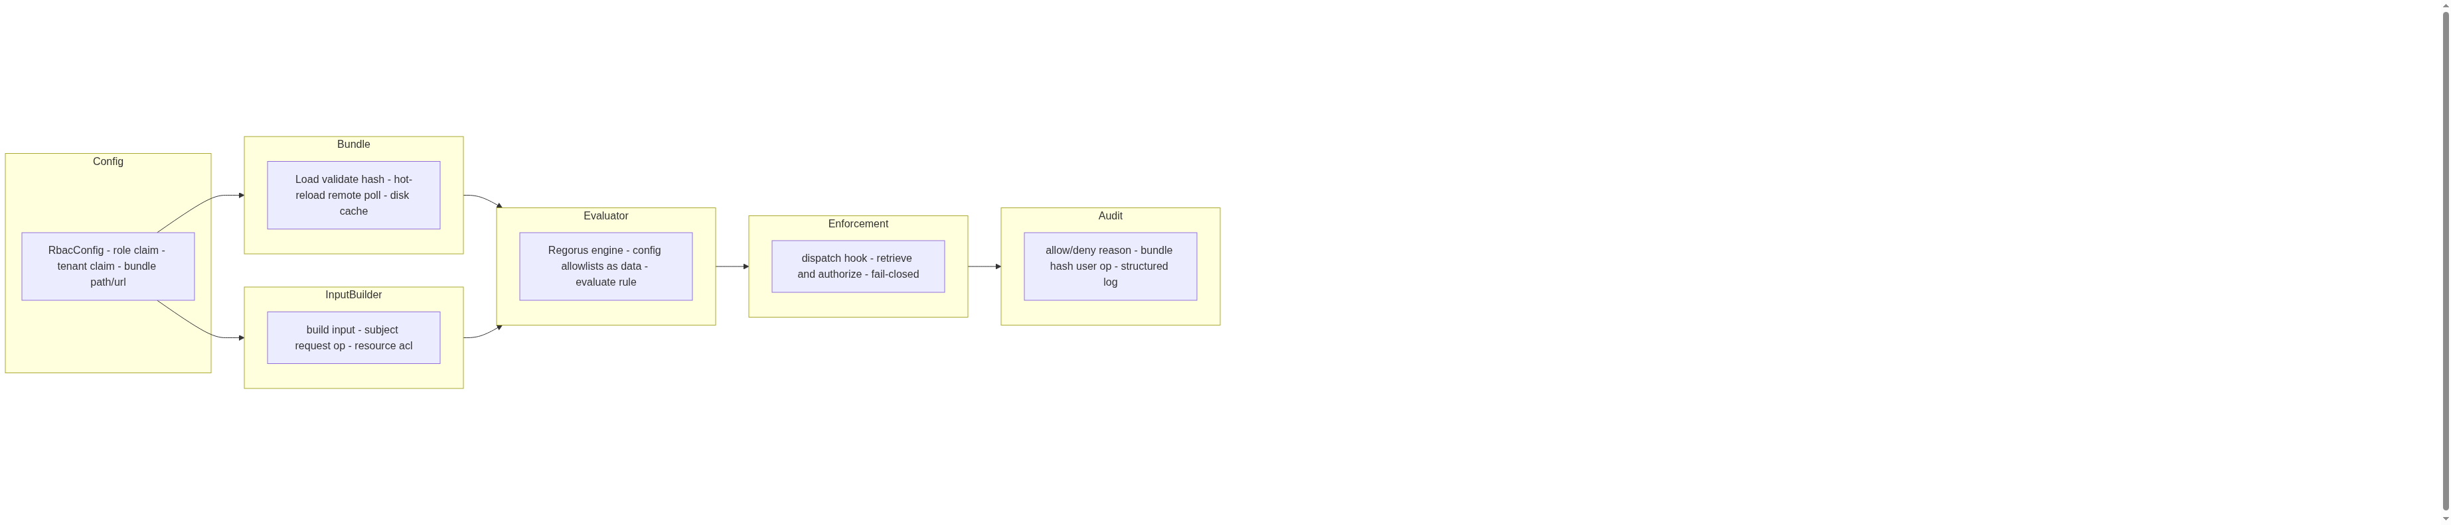
Six Modules
Module Architecture

Slide 11
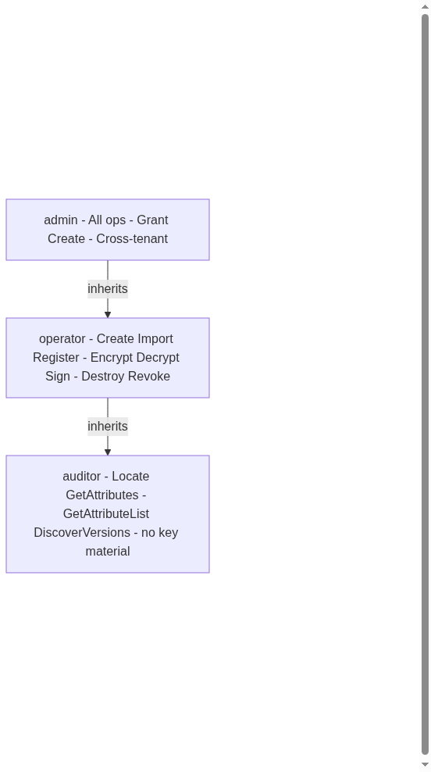
Role Hierarchy
Role Hierarchy

Slide 12
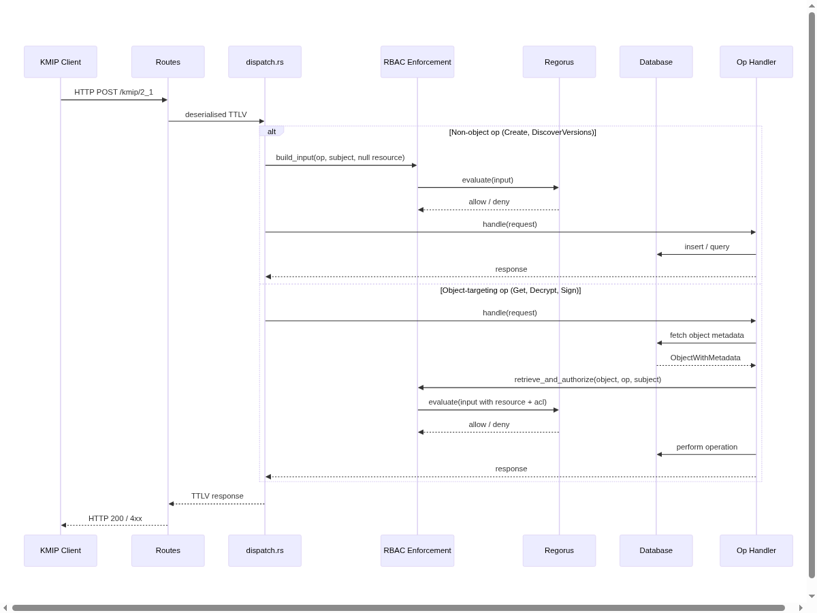
Request Authorization Flow
Request Authorization Flow

Slide 13
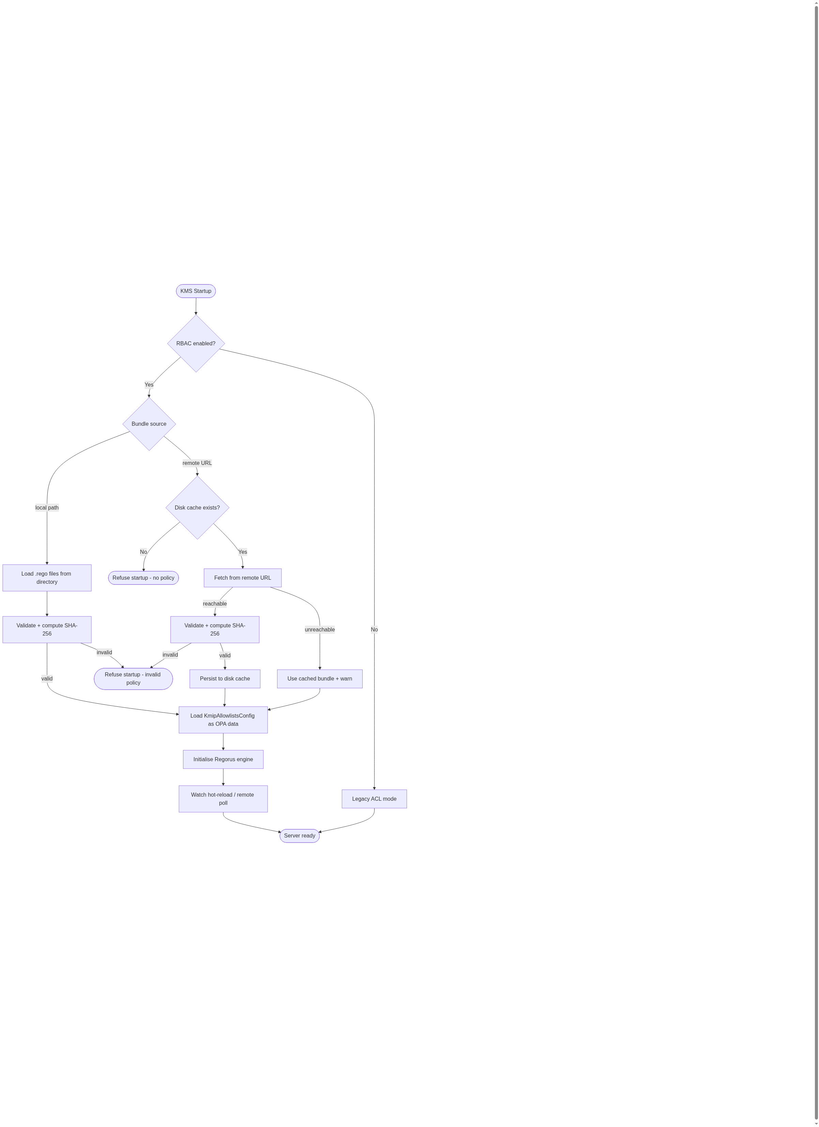
Bundle Loading & Startup
Bundle Loading

Slide 14
Design Decisions

Slide 15
Enforcement Insertion Points
Two-tier strategy — no double DB round-trip:
dispatch.rs — non-object operations (Create, DiscoverVersions, …)
OPA evaluated before any handler runs
resource and acl fields are null
retrieve_and_authorize wrapper — object-targeting operations (Get, Decrypt, Sign, …)
Object metadata already fetched from DB
Owner, state, tags, and ACL grants passed as OPA input

Slide 16
OPA Input Contract (stable API)
{ "subject": { "user_id": "alice@…", "roles": ["operator"], "tenant_id": "acme" }, "request": { "ip": "1.2.3.4", "tls_subject": "CN=alice", "user_agent": "ckms/1.0" }, "operation": { "kmip_op": "Get", "algorithm": "AES", "mode": "GCM" }, "resource": { "id": "uuid", "owner": "bob@…", "type": "SymmetricKey", "state": "Active", "tags": ["env:prod"] }, "acl": { "is_owner": false, "granted_ops": ["Get", "Encrypt"] } }
Decision paths: data.kms.authz.allow (bool) · data.kms.authz.reason (string, audit only)

Slide 17
ACL Semantics in RBAC Mode
Mode | Behavior
RBAC disabled | Legacy DB ACL enforcement unchanged
RBAC enabled | OPA is sole gatekeeper; DB ACL state (owner, grants) passed as input to policy

Slide 18
Per-object grants become additive allows in policy, not enforced by Rust code
Wildcard ACL grants (*) deprecated in RBAC mode
Object owners retain access unless policy explicitly denies

Slide 19
Algorithm Policy
Mode | Behavior
RBAC disabled | algorithm_policy.rs enforces KmipPolicyConfig allowlists
RBAC enabled | algorithm_policy.rs skipped; KmipAllowlistsConfig loaded as OPA data at engine init

Slide 20
Policy authors reference allowlists as data.kms.config.allowlists.algorithms in Rego. Default bundle replicates the current ANSSI/NIST/FIPS conservative allowlists.

Slide 21
Policy Bundle Format
Format: directory of .rego files; entry point must be authz.rego
Hot-reload: inotify watch on local directory
Remote: polling a URL, archive unpacked locally
Startup safety: last-valid bundle persisted to disk cache; refuse startup if no cache and remote unavailable
Bundle hash: SHA-256 over sorted filename:content; included in every audit log entry

Slide 22
Role Definitions (Default Bundle)
Role | Permitted KMIP Operations
admin | All operations · Grant Create to others · Cross-tenant scope
operator | Create · Import · Register · Encrypt · Decrypt · Sign · SignatureVerify · Destroy · Revoke · Activate
auditor | Locate · GetAttributes · GetAttributeList · DiscoverVersions (no key material)

Slide 23
Key invariant: only admin can delegate Create grants — replicated explicitly in default bundle and verified by test vector.

Slide 24
Out of Scope

Slide 25
What Is Not In This Version
Constrained RBAC (RC-2) — separation of duty, mutually exclusive roles
External OPA service — HTTP sidecar mode deferred to follow-on
UI for policy management — no web interface for uploading bundles
Per-object result filtering on Locate/List — query-level authorization only
Enterprise integration routes — AWS XKS, Azure EKM, Google CSE keep existing auth

Slide 26
References

Slide 27
Standards & Specifications
Reference | Title
NIST IR 7316 | Assessment of Access Control Systems (RBAC model)
NIST SP 800-162 Upd2 | Guide to Attribute Based Access Control
NIST SP 800-57 Pt1 Rev 5 | Recommendation for Key Management
NIST SP 800-131A Rev 2 | Transitioning Cryptographic Algorithms
FIPS 140-3 | Security Requirements for Cryptographic Modules
FIPS 197 | Advanced Encryption Standard (AES)
FIPS 203/204/205 | ML-KEM · ML-DSA · SLH-DSA (Post-Quantum)
ANSSI RGS / DAT-NT-028 | Recommandations sur les mécanismes cryptographiques
KMIP 2.1 (OASIS) | Key Management Interoperability Protocol v2.1

