Slide 1

Digit Classifier Using CNN
Kaushal Soundararajan – CB.EN.U4ECE23125 (30)
Nidhil Remila Shivakumaran – CB.EN.U4ECE23129 (31)
Sanjay Subramanyan – CB.EN.U4ECE23147 (32)
Shriyaank S – CB.EN.U4ECE23151 (33)
Vivyn M – CB.EN.U4ECE23157 (34)

Slide 2
Abstract
A Convolutional Neural Network (CNN) - based digit classifier.
Using the MNIST dataset, the model use convolutional layers for feature extraction.
Designing a convolutional neural network model that gives the best results for the classification task.
practical applications : document processing, postal automation, and banking systems.
CNN- provides hides accurate image recognition.

Slide 3
Background and motivation
Due to technological advancements and digitalization handwritten data detection has become a fundamental task.
Traditional machine learning techniques fail to work well across different handwritings.
CNN is effective because of its accurate image recognition because of automatic learning spatial hierarchies of features.

Slide 4
Problem statement
Recognition of handwritten digits across various handwriting and noise in images are major challenge.
Model has to adapt to different styles and learn by itself.
Extensive preprocessing of data is needed for accurate classification of image.
The goal of this project is to develop a robust CNN-based classifier that can efficiently recognize and classify handwritten digits from 0-9 with high accuracy.

Slide 5
LITERATURE REVIEW

Slide 6
Paper 1 – A Robust CNN Model for Handwritten Digits Recognition and Classification
Objective: Develop a reliable CNN model for handwritten digit recognition.
Background:
Early neural networks limited by hardware.
CNNs gained momentum with MNIST and better computing power.
Applications:
Bank check processing, postal address reading, form automation.
CNN Advantages:
High accuracy with minimal preprocessing.
Efficient feature extraction via convolution + pooling layers.
Limitations:
Accuracy drops with complex handwriting styles.
More layers may lead to overfitting and higher computation.

Slide 7
Paper 2 – ML & Deep Learning for Digit Recognition
Objective: Improve HDR accuracy using ML and DL techniques for real-world use cases.
Dataset Used: MNIST (70,000 grayscale digit images).
Methods Compared:
KNN – 96.8% accuracy, slow on large datasets.
SVM – 97.91% accuracy, requires tuning.
CNN – Up to 99.2% accuracy, automatic feature learning.
Key Takeaways:
CNNs outperform traditional methods in accuracy and scalability.
No manual feature extraction needed.
Limitations:
Less effective on cursive/multilingual digits.
Deep CNNs increase computational cost.

Slide 8
Working Of Other ML Models

Slide 9
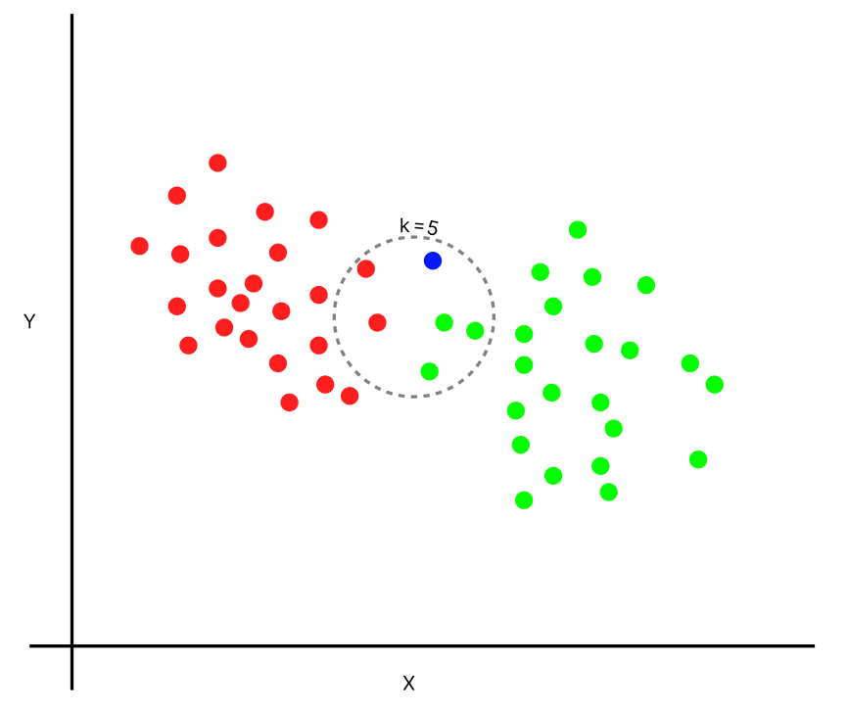
K-Nearest Neighbours (KNN):
Calculate the distance between the target point and all points in the dataset
Identify the K closest points to the target point.
Assign the label or average the values of these neighbors to predict the output.
Disadvantages:
Digit images may contain noise
Each digit image is typically represented as a high-dimensional vector

Slide 10
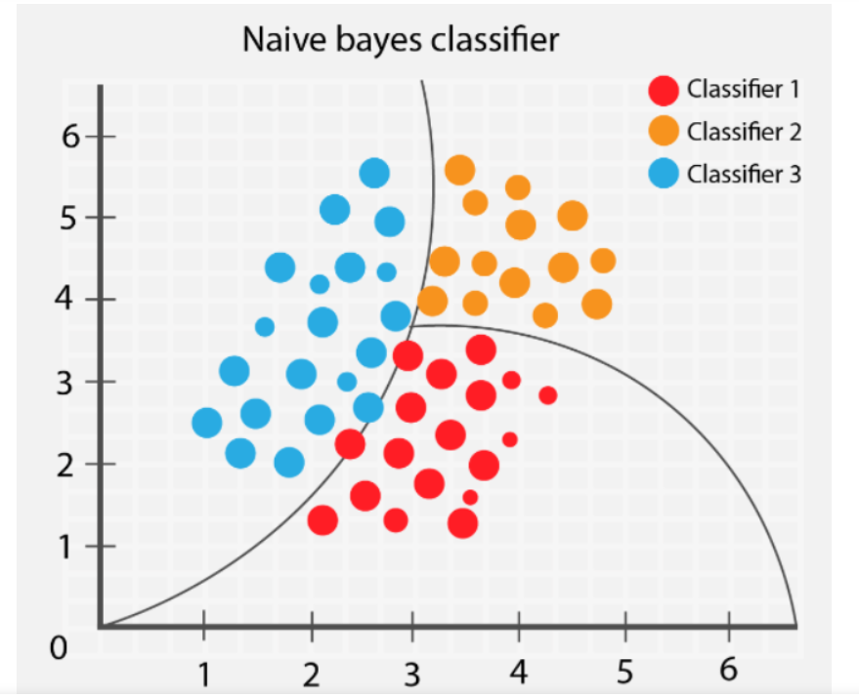
Naive Bayes:
Naive Bayes is based on Bayes' theorem and uses probabilities to classify data points.
For a given data point, calculate P(C∣X) for each class C.
Create Decision Boundaries for classification
Disadvantages:
Assumption of Feature Independence
Sensitivity to High-Dimensional Data

Slide 11

Random Forest:
Uses decision trees which use the concept of the if-else condition.
Random Forest creates multiple decision trees during training and combines their outputs.
The algorithm predicts the class based on majority voting from individual trees.
Disadvantages:
Limited Feature Engineering Capability
Sensitivity to High-Dimensional Data

Slide 12
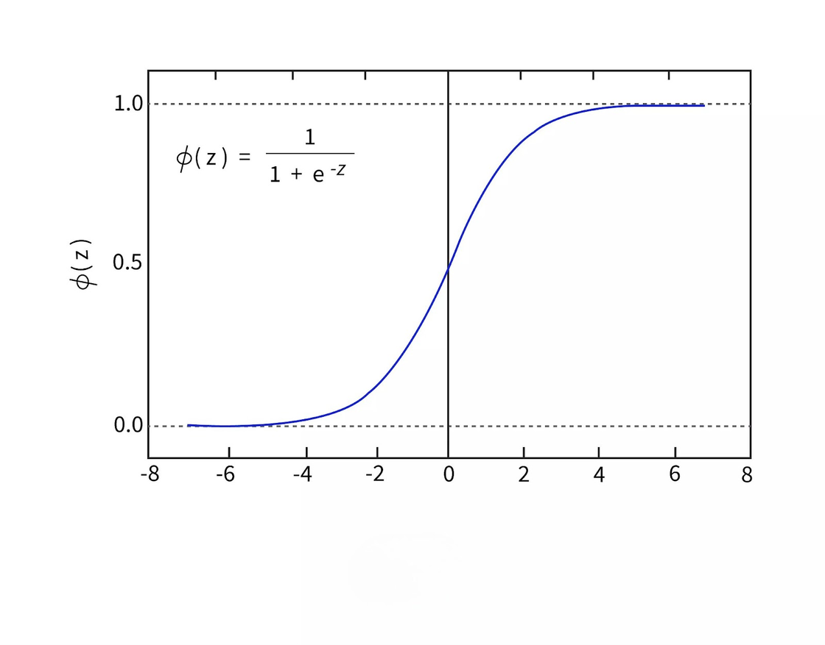
Logistic Regression:
Logistic regression models the probability of a binary outcome using the sigmoid function.
The algorithm predicts the output by applying a threshold to the probability.
Weights and biases used in the sigmoid function can be optimized.
Disadvantages:
Lack of Feature Engineering Capability
Linear Decision Boundaries

Slide 13
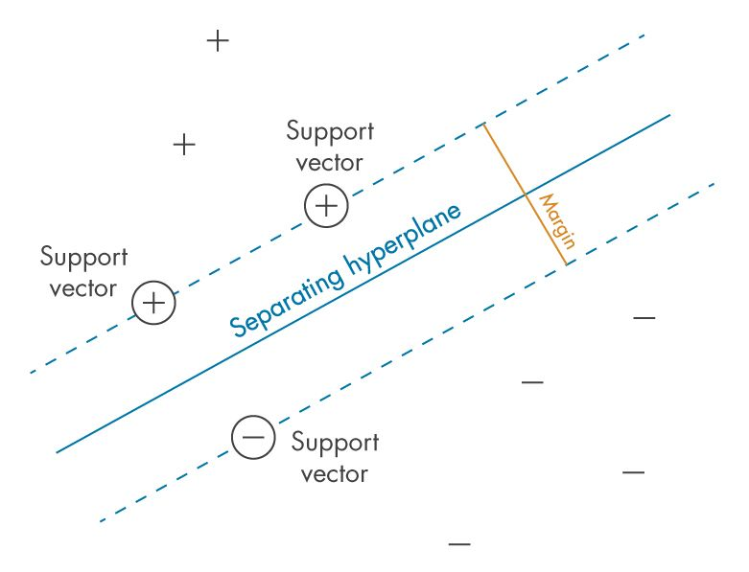
Support Vector Machines (SVM):
SVM finds the hyperplane that best separates data points of different classes while maximizing the margin.
Support Vectors are used to determine the margin.
For non-linear data, SVM uses kernel functions.
Disadvantages:
Need for Feature Engineering
Difficulty Handling Multi-Class Classification

Slide 14
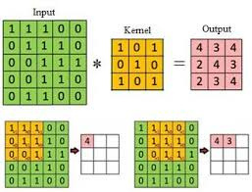
CNN
A Convolutional Neural Network is a type of Neural Network designd to process image.
CNN preserve the spacial structure of an image
Uses convolutional layers to detect local patterns such as edges and corners.
Especially used for recognizing patterns in data .

Slide 15
Convolution
In this process, a small matrix called a filter or kernel systematically moves across the image. At each location, it performs element-wise multiplication with the corresponding image pixels and sums the results.
This produces a feature map, a transformed representation that highlights where specific patterns, such as edges, corners, or curves, are detected.

Slide 16
Kernel
Kernels are small weight matrices that detect specific features by performing element-wise multiplication and summation during convolution.
Stride controls the kernel's step size, while padding ensures the output size matches the input.
Activation functions introduce non-linearity to feature maps, allowing the network to learn complex patterns.
In digit classifiers, kernels detect low-level features like edges and shapes, which are crucial for recognizing digits.
Stacked convolutional layers build hierarchical feature representations, enabling accurate classification by learning progressively complex patterns.

Slide 17
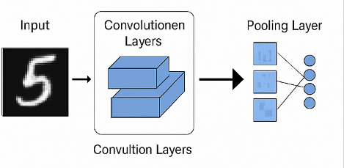
How CNN works ?
CNNs apply filters that move across the image — similar to how neurons in the brain respond to small regions.
Each layer builds up a hierarchy of features:
First layer → detects edges
Next layers → combine edges into shapes
Final layers → recognize digits
Pooling layers make the model more adaptable to variations in the position of the digit

Slide 18
How CNN works in digit classifier ?
A Convolutional Neural Network (CNN) is designed to recognize patterns in images, making it ideal for tasks like identifying handwritten digits.
The image of a digit is passed through filters that scan small parts of it to detect basic shapes, like edges and curves.
As the data moves through the network, it combines these simple features to recognize more complex patterns — like loops, corners, or full digit shapes.
The network then summarizes what it has learned and decides which digit the image most likely represents.
Because CNNs focus on how the pixels are arranged, they can recognize digits even if they're written slightly differently or in different positions.

Slide 19
Objectives and scope
CNNs eliminate the need for manual feature extraction by learning spatial features directly from images.
The model should achieve high accuracy.
Should maintain computational and cost efficiency.
The scope includes data preprocessing, model training, evaluation, and testing.

Slide 20
Data collection
Data preprocessing
Exploratory Data Analysis
Feature Engineering
Model building
Training and evaluation
Scatterplot
Histogram
Two convolutional layers
Max-pooling layers (2x2 pool size)
Dropout layers (0.25-0.5)
Loss Function: Categorical Cross entropy
Optimizer: Adam
Metrics: Accuracy
Hyperparameters:
Epochs:10
Batch Size: 64
Learning Rate Scheduling: ReduceLROnPlateau
Evaluation Metrics:
Accuracy, Loss
Confusion Matrix
Classification Report

Slide 21
CODE

Slide 22
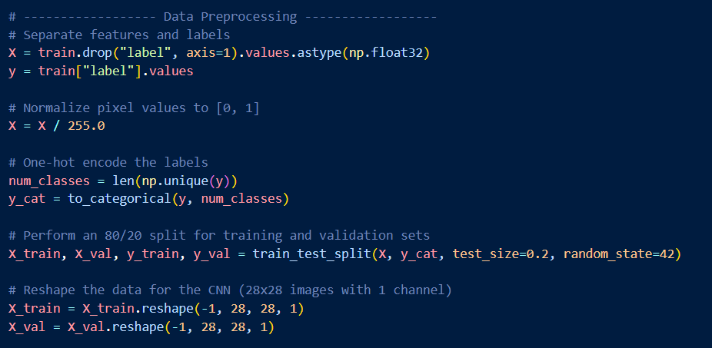
Preprocessing Steps
Loaded and visualized handwritten digit images from MNIST dataset.
Normalized pixel values to range [0, 1] using X / 255.0.
One-hot encoded labels using to_categorical() for multi-class classification.
Reshaped input from (784,) to (28, 28, 1) for CNN compatibility.
Split dataset: 80% training, 20% validation using train_test_split().

Slide 23
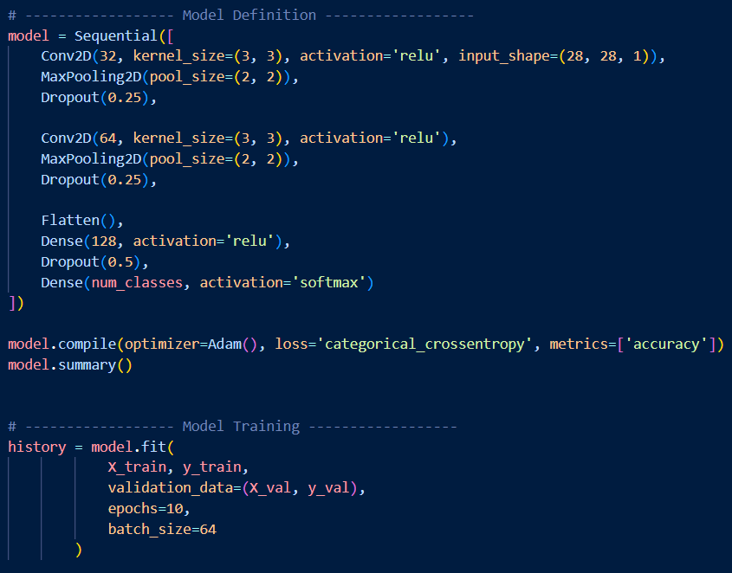
CNN Model Architecture
Conv2D (32 filters, 3x3) + ReLU :
learns basic patterns (edges).
MaxPooling2D (2x2) :
reduces dimensionality, keeps key features.
Dropout (0.25):
prevents overfitting by disabling random neurons.
Conv2D (64 filters, 3x3) :
captures more complex patterns.
Flatten :
converts feature maps to 1D for dense layers.
Dense (128 neurons) + ReLU :
high-level reasoning.
Dropout (0.5) :
regularization in dense layer.
Dense (10 neurons) + Softmax :
outputs class probabilities.

Slide 24
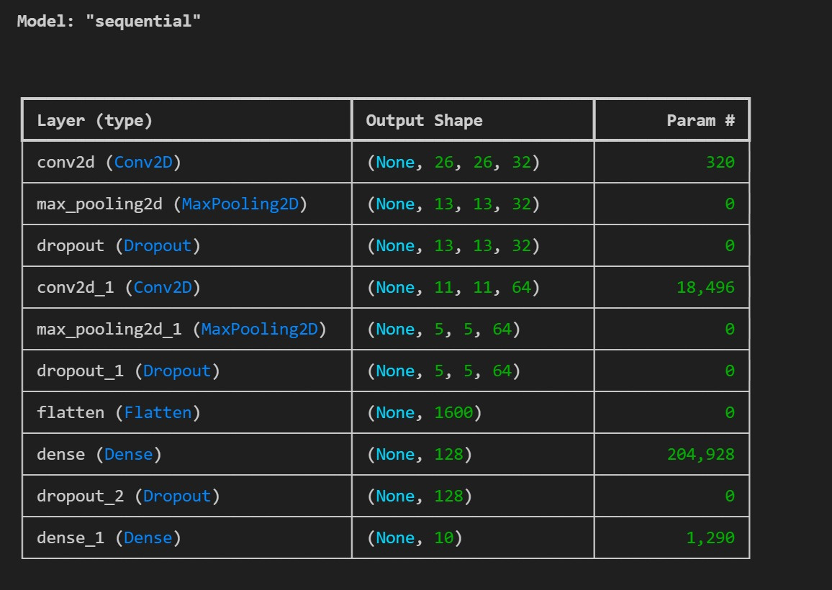
Model parameters

Slide 25
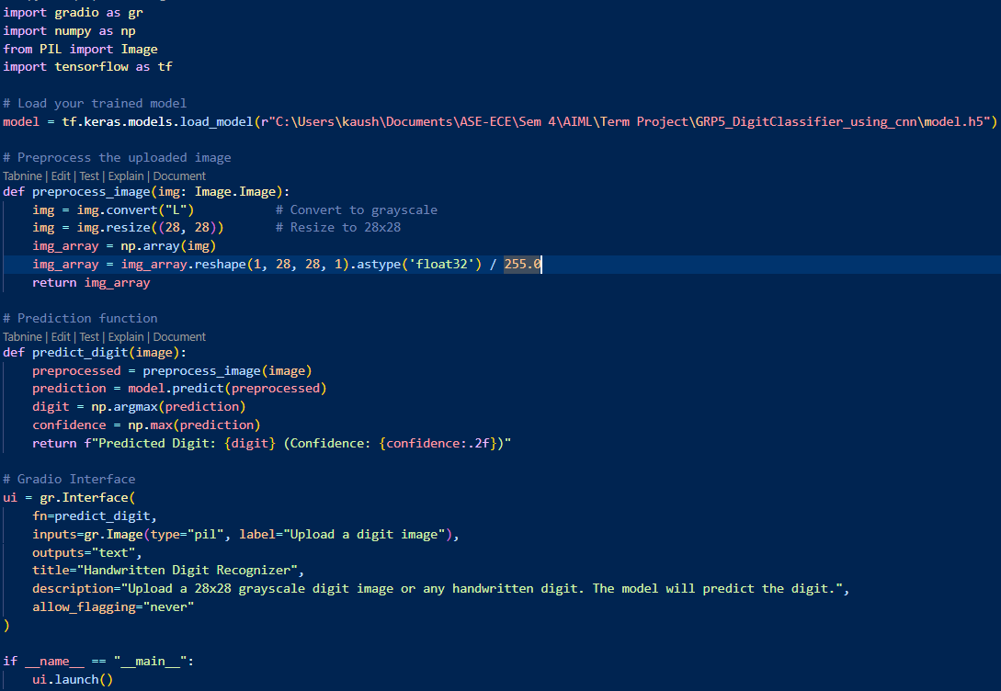
UI Interface
Built using Gradio, a Python library for ML interfaces.
Allows users to upload a digit image and get instant predictions.
Image is converted to grayscale and resized to 28x28 pixels.
Normalized and reshaped to match CNN input format: (28, 28, 1).
Uses the trained CNN model to predict the digit.
Returns the digit with the highest confidence score.
No API required – runs locally and independently.
Adds interactivity and usability to the ML model.
raph text

Slide 26
RESULTS

Slide 27
User Interface
Loads a Trained CNN Model
Creates a FastAPI App
Accepts an image file
Converts the image to grayscale and resizes to 28x28.
Normalizes and reshapes it for the CNN.
Makes a Prediction
Returns the digit as a JSON response.

Slide 28
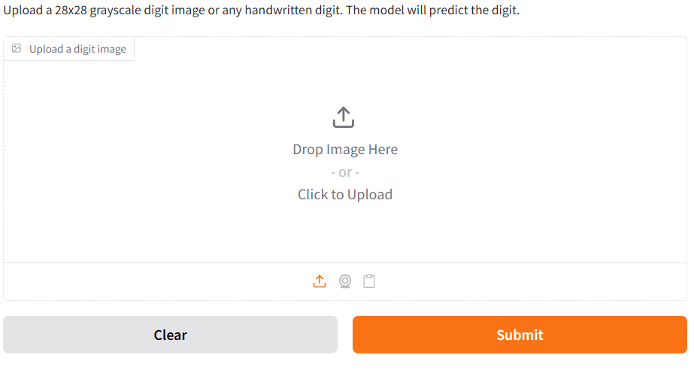
Fast api Interface

Slide 29

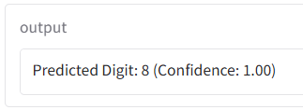

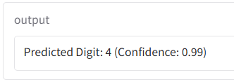
API Input–Output Overview

Slide 30
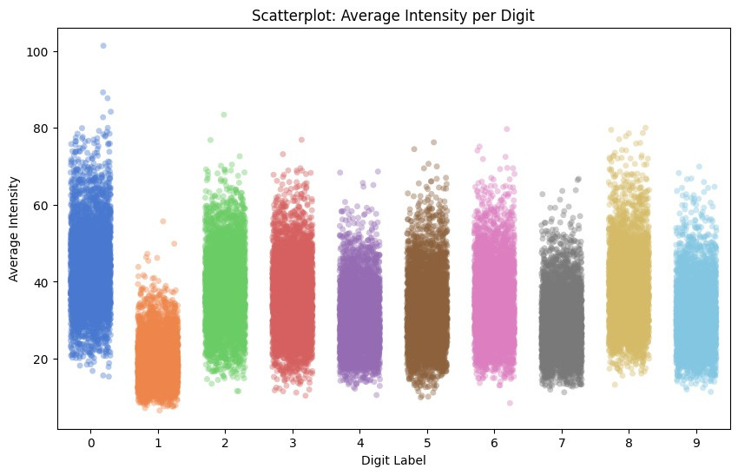
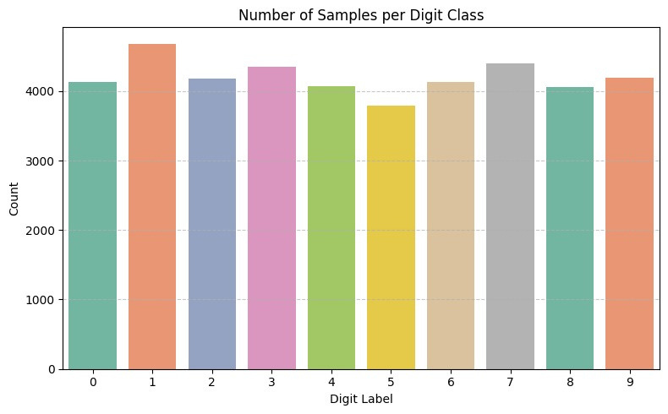
EDA

Slide 31
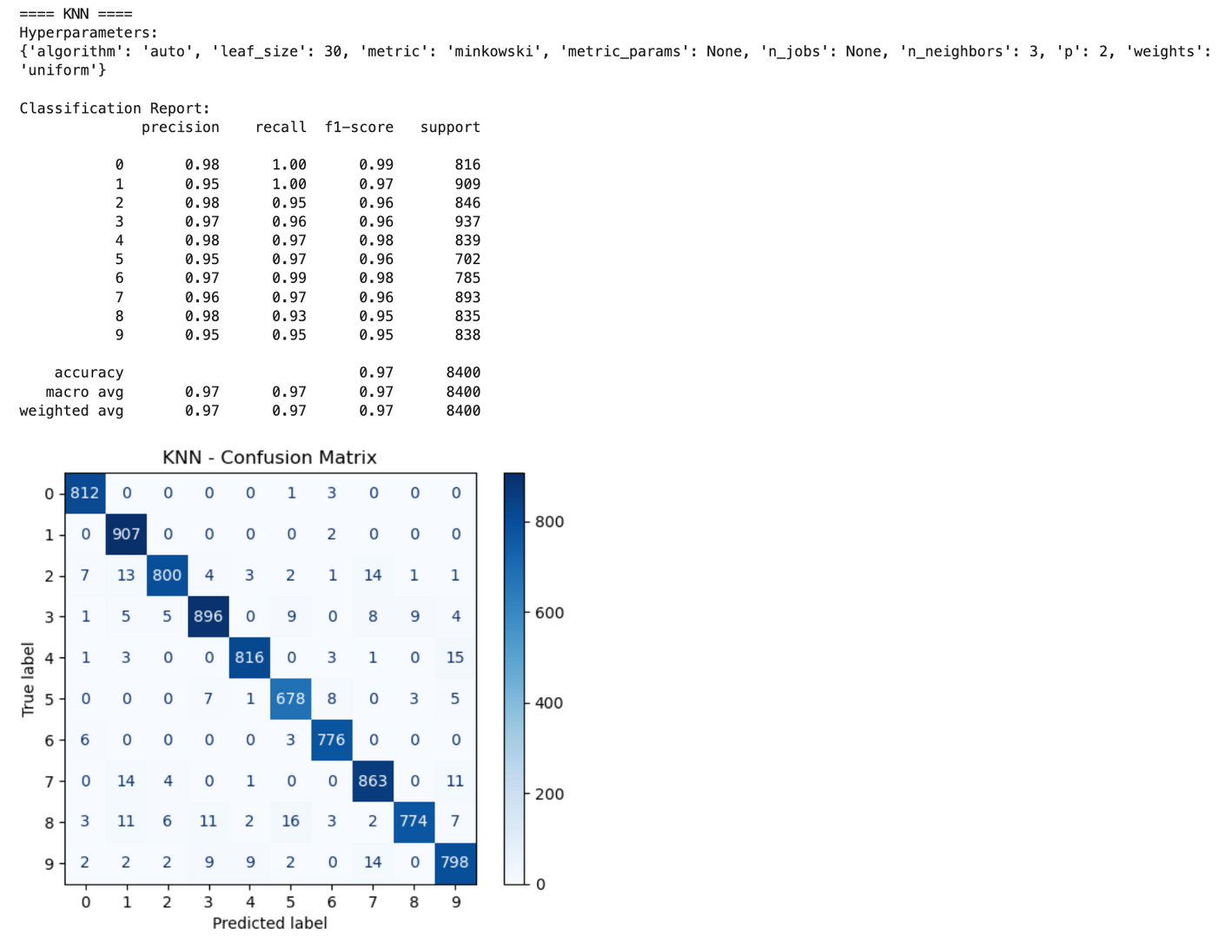
Other models used:

Slide 32
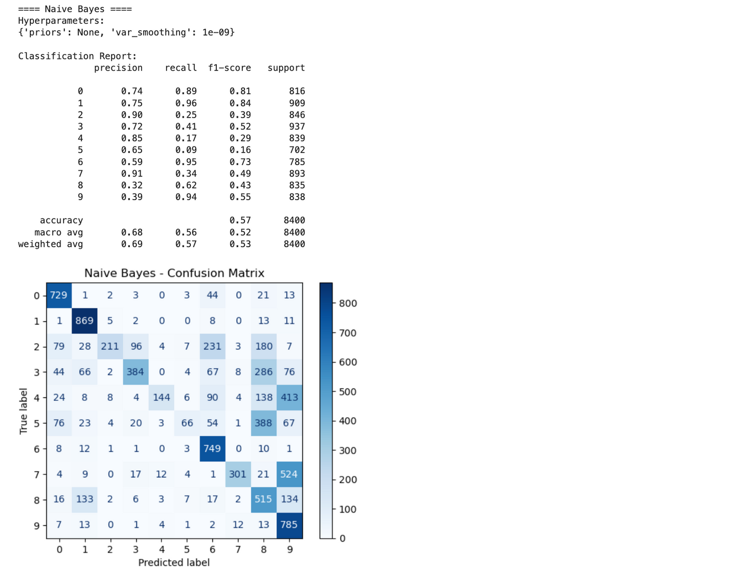
Other models used:

Slide 33
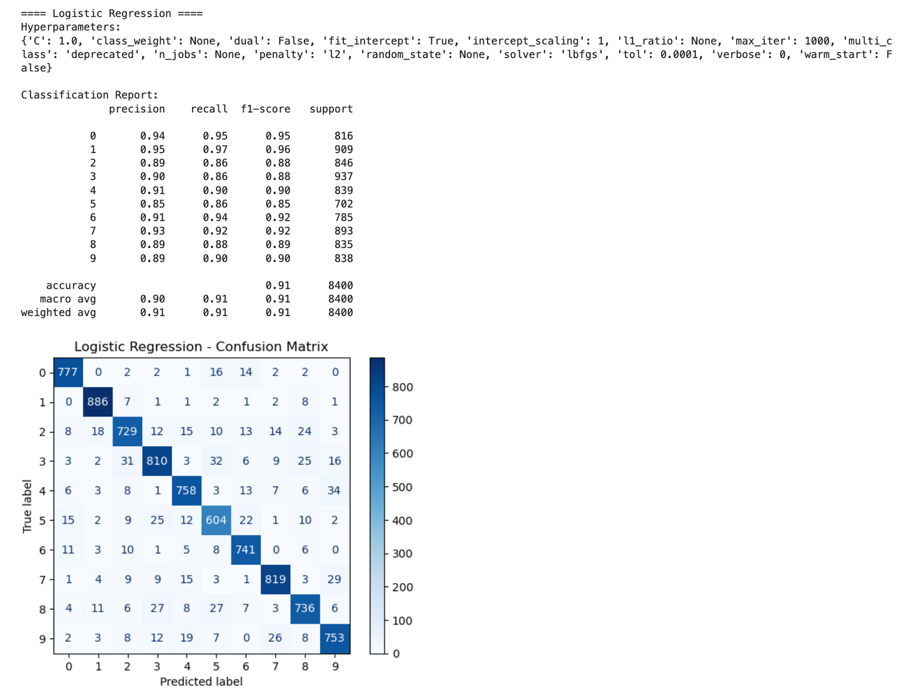
Other models used:

Slide 34
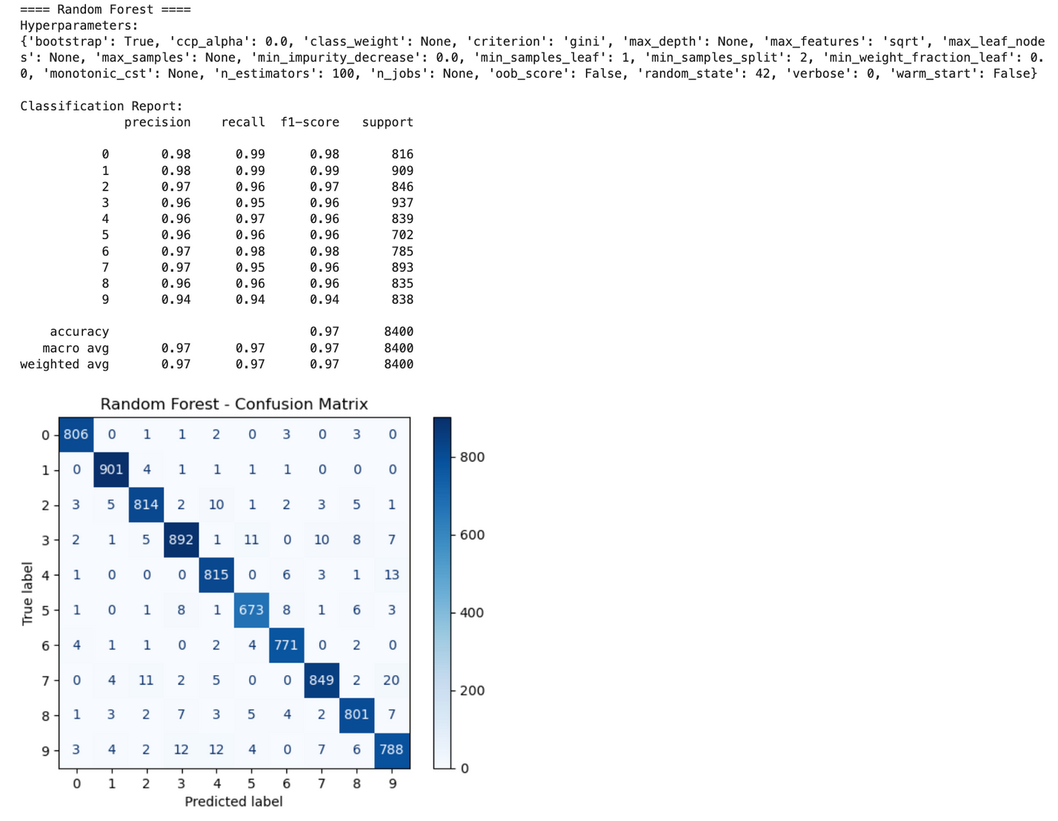
Other models used:

Slide 35
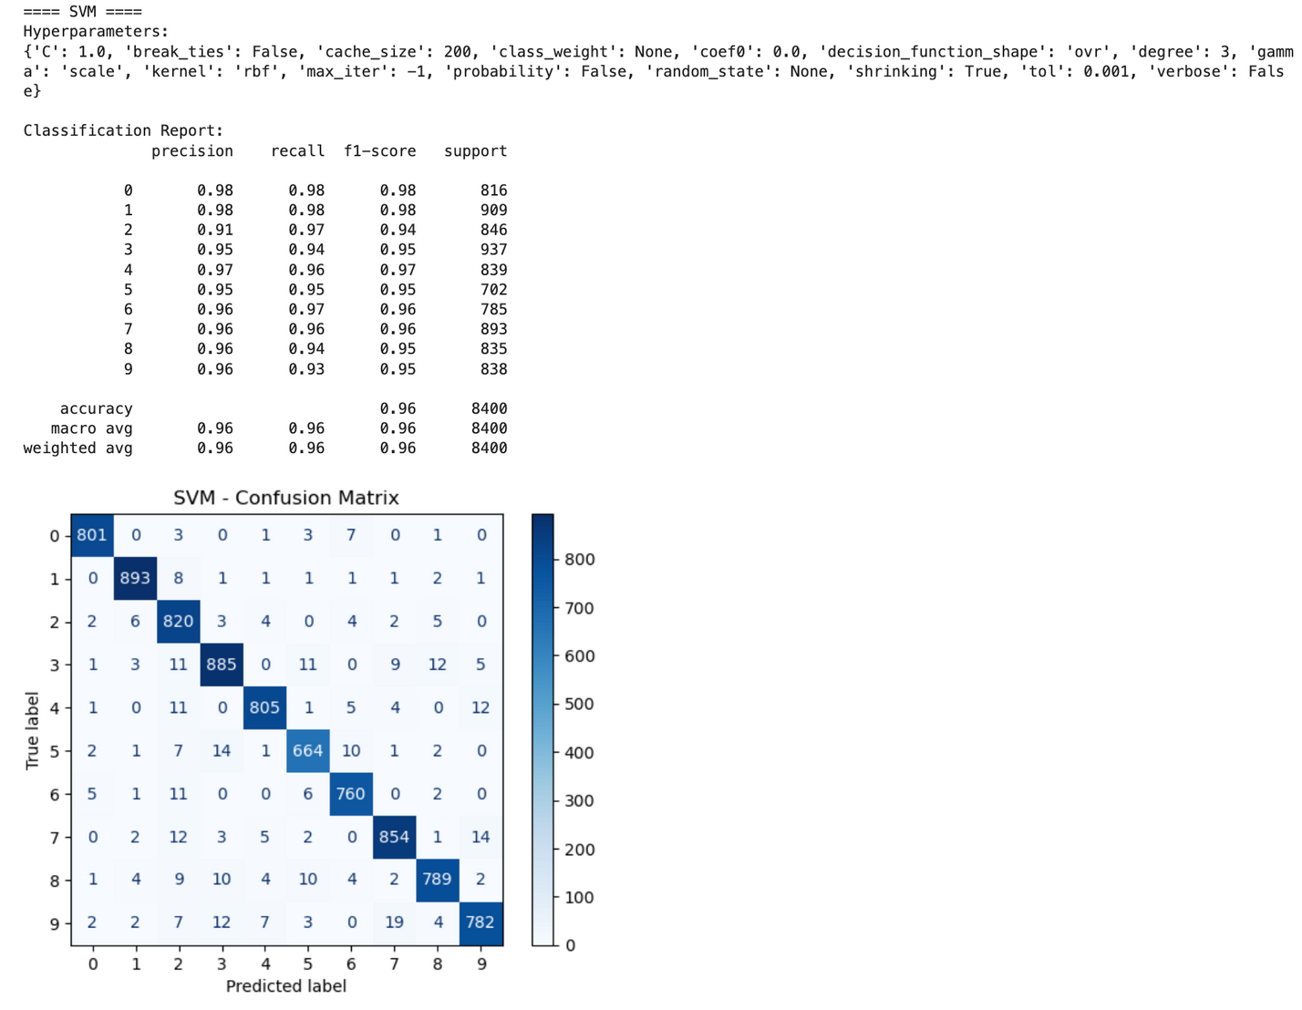
Other models used:

Slide 36
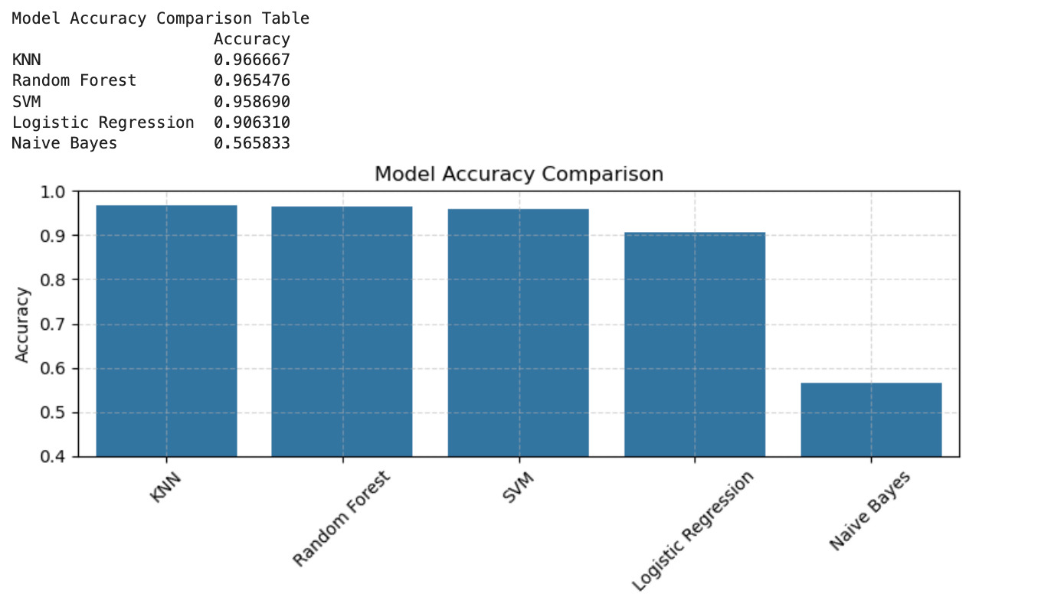
Other models used:

Slide 37
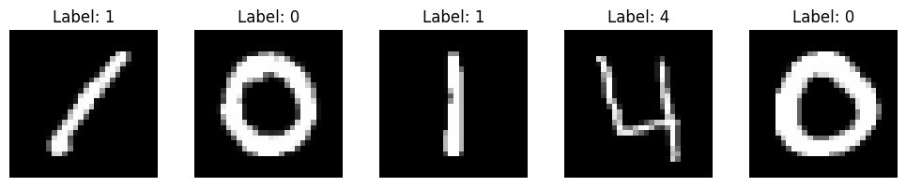
Input visualization

Slide 38
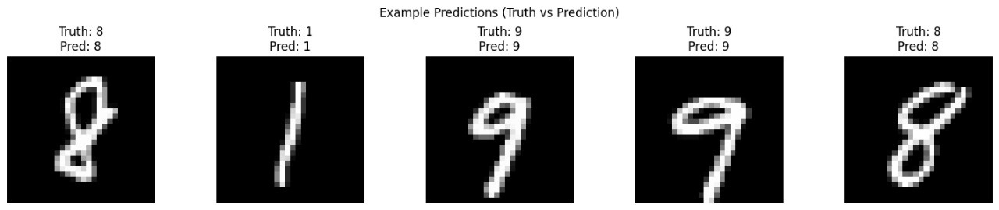
OUTPUT

Slide 39
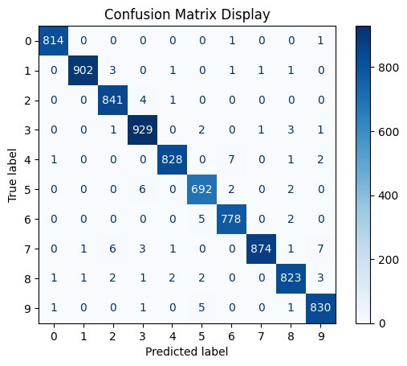
Confusion matrix for CNN

Slide 40
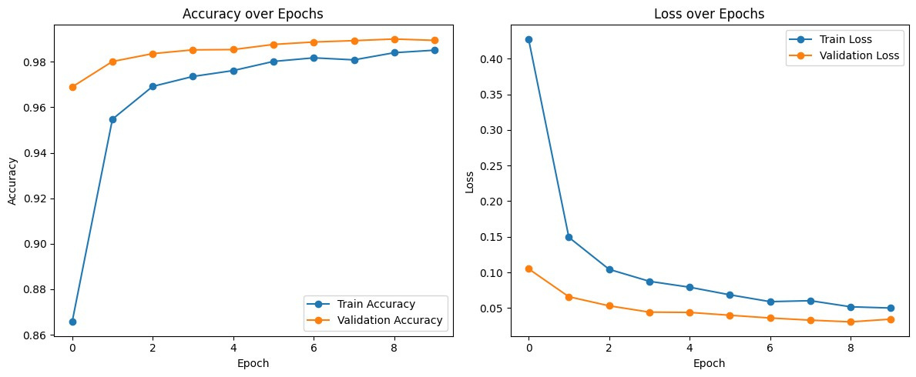
Loss and accuracy curve

Slide 41
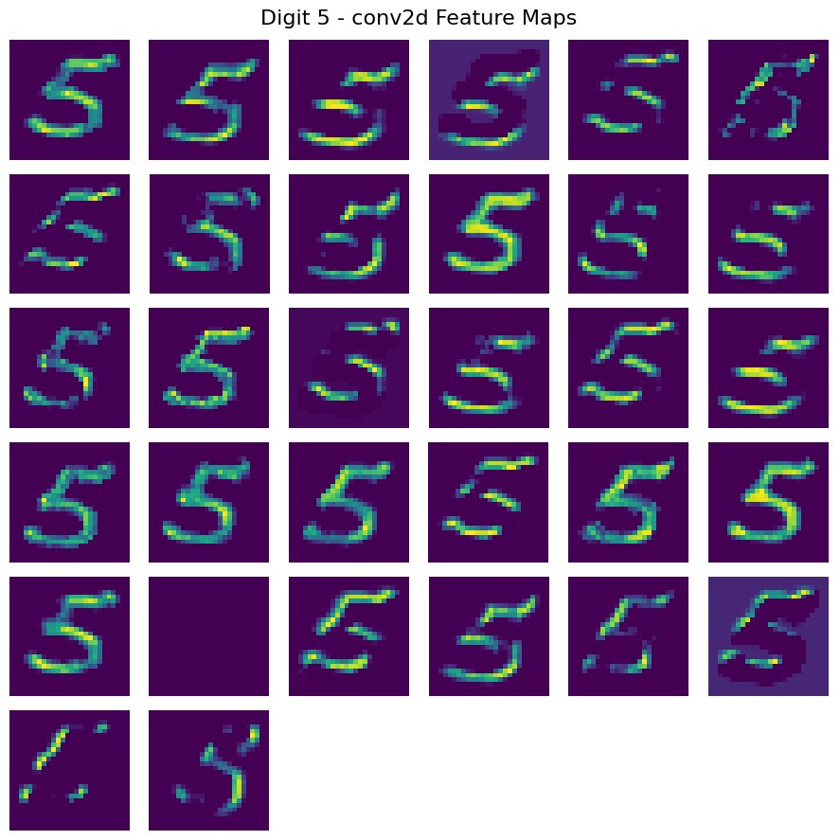
Convolution layer 1- feature map

Slide 42
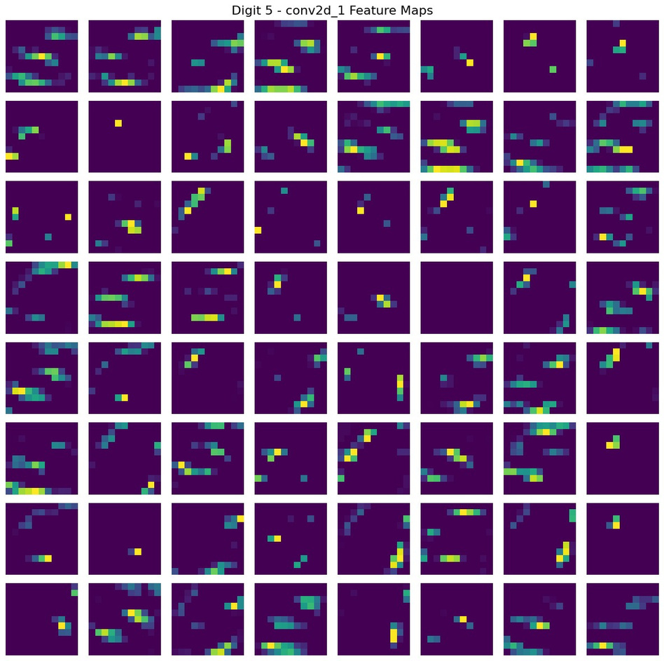
Convolution layer 2- feature map

Slide 43
CONCLUSION
The developed Convolutional Neural Network (CNN) outperforms traditional models like SVMs by automatically learning hierarchical spatial features from raw image data. This enables superior accuracy and scalability on complex datasets like MNIST.
By using convolutional layers tailored for image processing, the model achieved high accuracy in digit classification. CNNs excel in capturing spatial hierarchies and local patterns, which traditional models struggle with
.
Future enhancements include support for multilingual digits, deployment on mobile/web platforms, and optimization for embedded systems.

Slide 44
Future works
To further improve classification accuracy, pretrained CNN models such as ResNet can be utilized. These models consist of deeper architectures with a higher number of filters and kernels, allowing them to capture more complex variations in handwritten digits, including differences in writing styles, scale, shift, and rotation invariance.
Additionally, a hybrid model combining CNN with Support Vector Machine (SVM) instead of the traditional softmax classifier can lead to better performance. In this approach, the CNN acts as a feature extractor, and the SVM serves as the final classifier. SVMs are well-suited for high-dimensional feature spaces and often outperform softmax when dealing with fine-grained class boundaries, especially in complex image datasets like digit recognition.

