Slide 1
Digit Classifier Using CNN
Kaushal Soundararajan – CB.EN.U4ECE23125
Nidhil Remila Shivakumaran – CB.EN.U4ECE23129
Sanjay Subramanyan – CB.EN.U4ECE23147
Shriyaank S – CB.EN.U4ECE23151
Vivyn M – CB.EN.U4ECE23157

Slide 2
Abstract
A Convolutional Neural Network (CNN) - based digit classifier.
Using the MNIST dataset, the model use convolutional layers for feature extraction.
Designing a convolutional neural network model that gives the best results for the classification task.
practical applications : document processing, postal automation, and banking systems.
CNN- provides hides accurate image recognition.

Slide 3
Background and motivation
Due to technological advancements and digitalization handwritten data detection has become a fundamental task.
Traditional machine learning techniques fail to work well across different handwritings.
CNN is effective because of its accurate image recognition because of automatic learning spatial hierarchies of features.

Slide 4
Problem statement
Recognition of handwritten digits across various handwriting and noise in images are major challenge.
Model has to adapt to different styles and learn by itself.
Extensive preprocessing of data is needed for accurate classification of image.
The goal of this project is to develop a robust CNN-based classifier that can efficiently recognize and classify handwritten digits from 0-9 with high accuracy.

Slide 5
LITERATURE REVIEW

Slide 6
Paper 1 – ML & Deep Learning for Digit Recognition
Objective: Improve HDR accuracy using ML and DL techniques for real-world use cases.
Dataset Used: MNIST (70,000 grayscale digit images).
Methods Compared:
KNN – 96.8% accuracy, slow on large datasets.
SVM – 97.91% accuracy, requires tuning.
CNN – Up to 99.2% accuracy, automatic feature learning.
Key Takeaways:
CNNs outperform traditional methods in accuracy and scalability.
No manual feature extraction needed.
Limitations:
Less effective on cursive/multilingual digits.
Deep CNNs increase computational cost.

Slide 7
Paper 2 – A Robust CNN Model for Handwritten Digits Recognition and Classification
Objective: Develop a reliable CNN model for handwritten digit recognition.
Background:
Early neural networks limited by hardware.
CNNs gained momentum with MNIST and better computing power.
Applications:
Bank check processing, postal address reading, form automation.
CNN Advantages:
High accuracy with minimal preprocessing.
Efficient feature extraction via convolution + pooling layers.
Limitations:
Accuracy drops with complex handwriting styles.
More layers may lead to overfitting and higher computation.

Slide 8
Existing works and their limitations
K-Nearest Neighbours (KNN): Simple and effective but computationally expensive for large datasets.
Support Vector Machines (SVM): Performs well but requires careful tuning of kernel functions.
Artificial Neural Networks (ANN): Can learn complex patterns but struggle with high-dimensional image data without feature extraction.

Slide 9
Objectives and scope
CNNs eliminate the need for manual feature extraction by learning spatial features directly from images.
The model should achieve high accuracy.
Should maintain computational and cost efficiency.
The scope includes data preprocessing, model training, evaluation, and testing.

Slide 10
What is cnn?
Input Layer
Convolution Layer- to detect pattenrs
Activation Function
Pooling Layer
Flattening
Fully Connected (Dense) Layer
Output Layer

Slide 11
Why cnn?
Automatic Feature Extraction
Spatial Hierarchies
Parameter Sharing
Translation Invariance
High Accuracy & Generalization

Slide 12
Data collection
Data preprocessing
Exploratory Data Analysis
Feature Engineering
Model building
Training and evaluation
Scatterplot
Histogram
Two convolutional layers
Max-pooling layers (2x2 pool size)
Dropout layers (0.25-0.5)
Loss Function: Categorical Cross entropy
Optimizer: Adam
Metrics: Accuracy
Hyperparameters:
Epochs:10
Batch Size: 64
Learning Rate Scheduling: ReduceLROnPlateau
Evaluation Metrics:
Accuracy, Loss
Confusion Matrix
Classification Report

Slide 13
RESULTS

Slide 14
User Interface
Loads a Trained CNN Model
Creates a FastAPI App
Accepts an image file
Converts the image to grayscale and resizes to 28x28.
Normalizes and reshapes it for the CNN.
Makes a Prediction
Returns the digit as a JSON response.

Slide 15
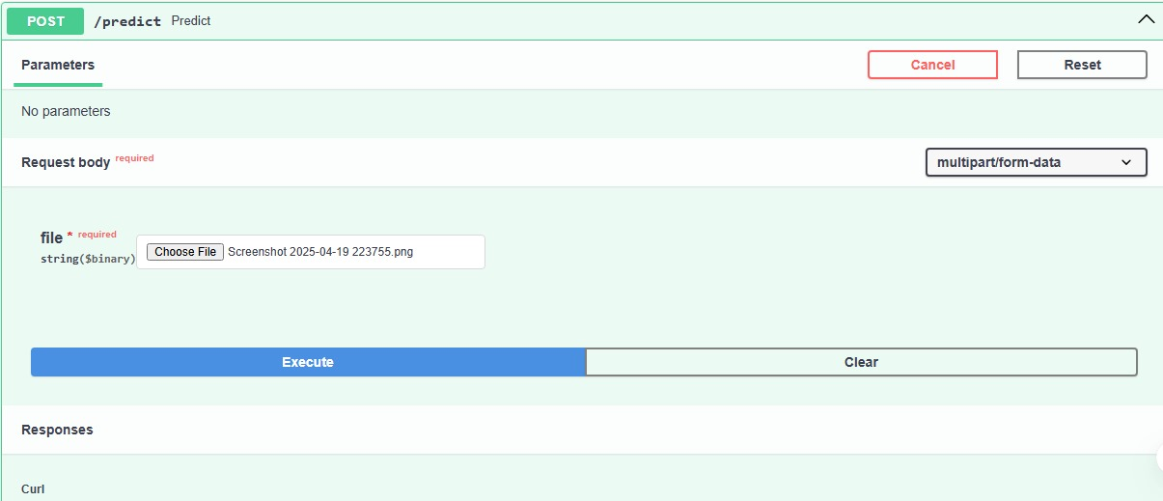
Fast api Interface

Slide 16

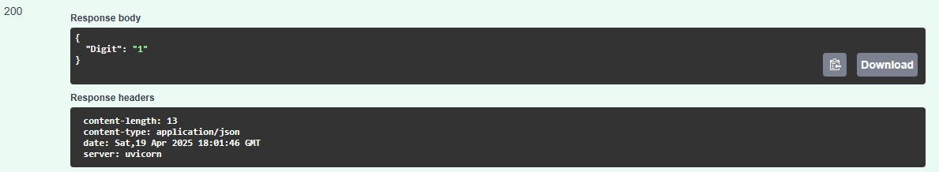
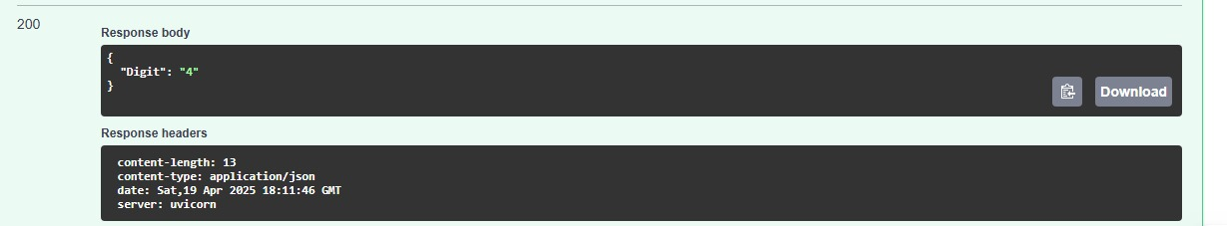

API Input–Output Overview

Slide 17
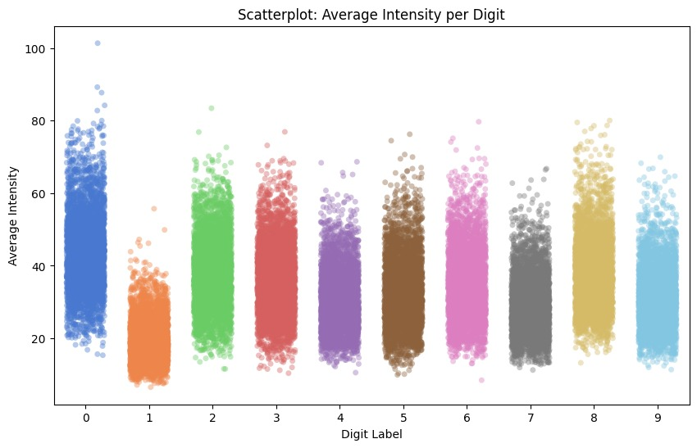
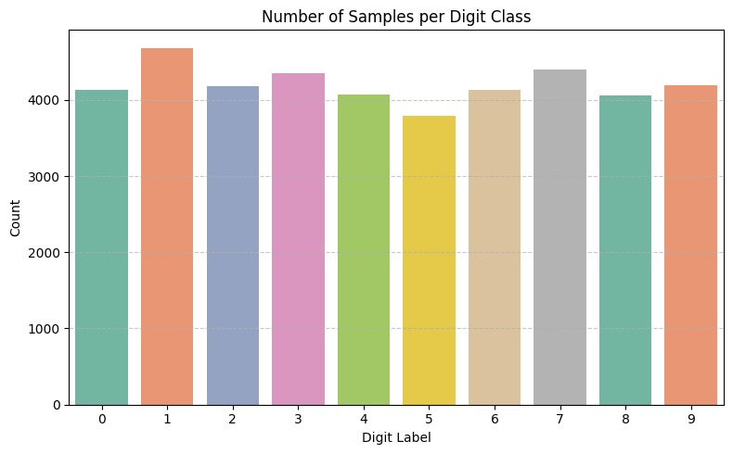
eda

Slide 18
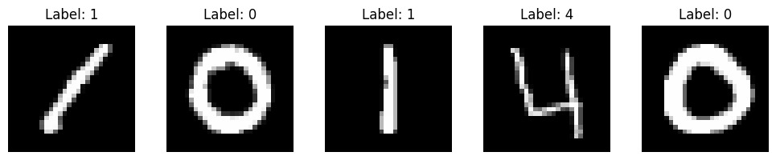
Input visualization

Slide 19
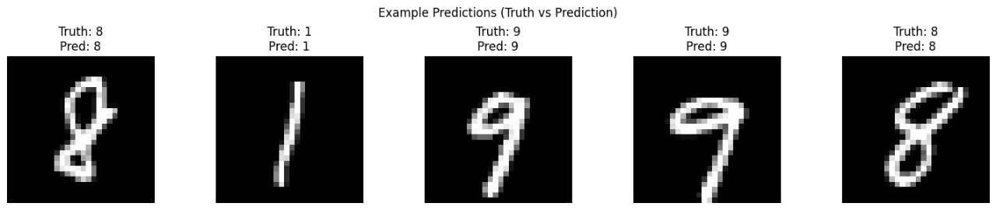
output

Slide 20
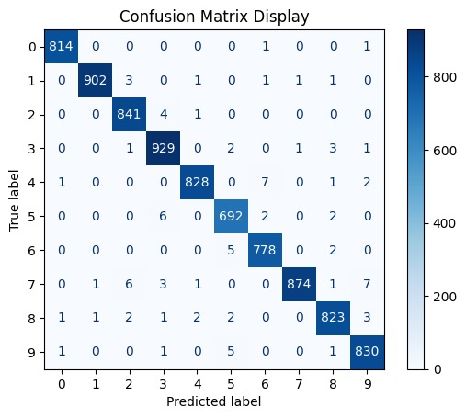
Confusion matrix

Slide 21
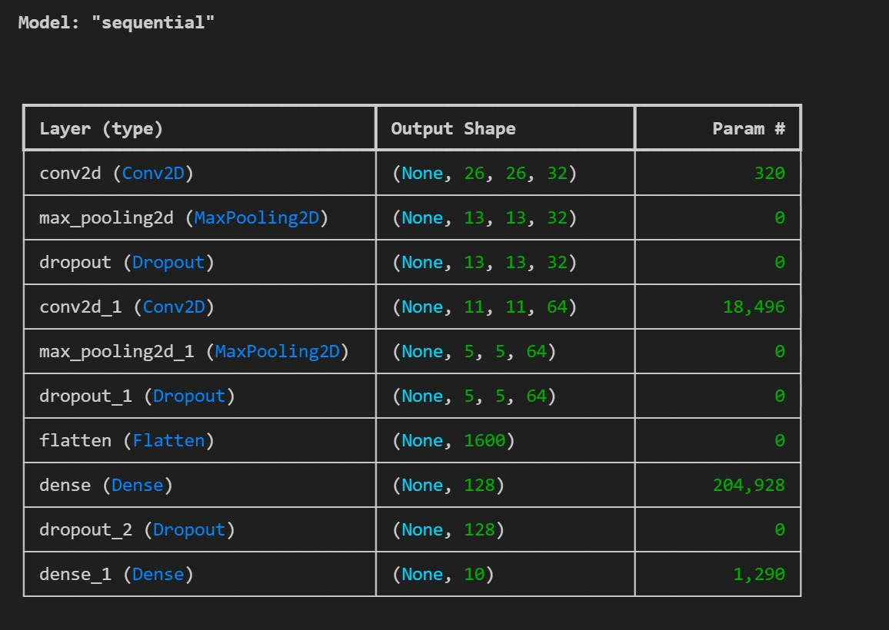
Model parameters

Slide 22
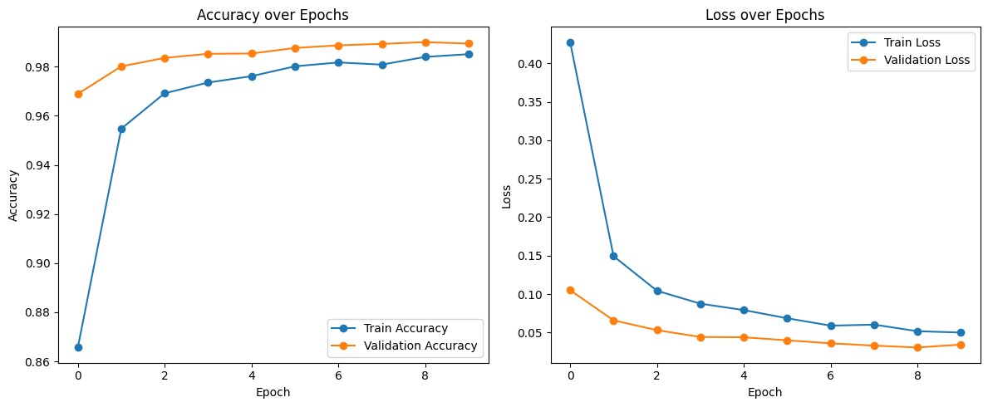
Loss and accuracy curve

Slide 23
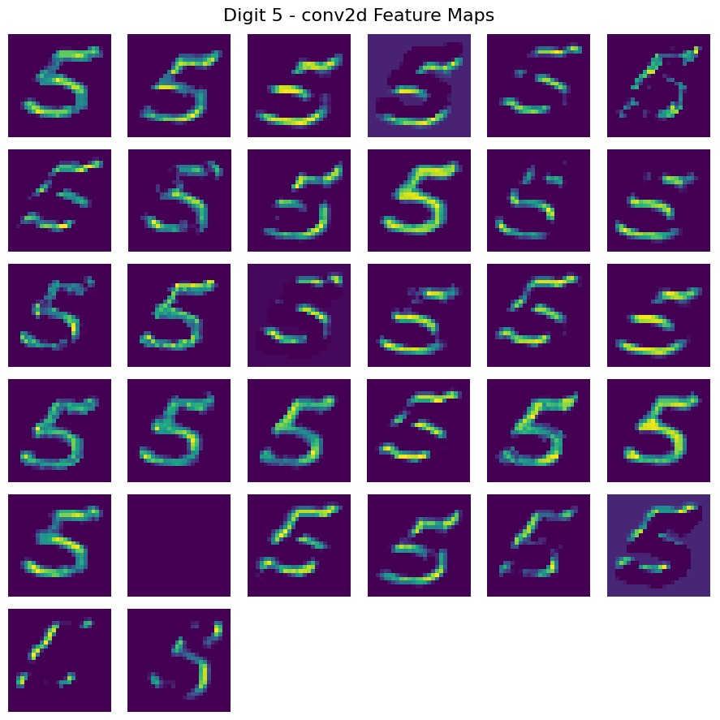
Convolution layer 1- feature map

Slide 24
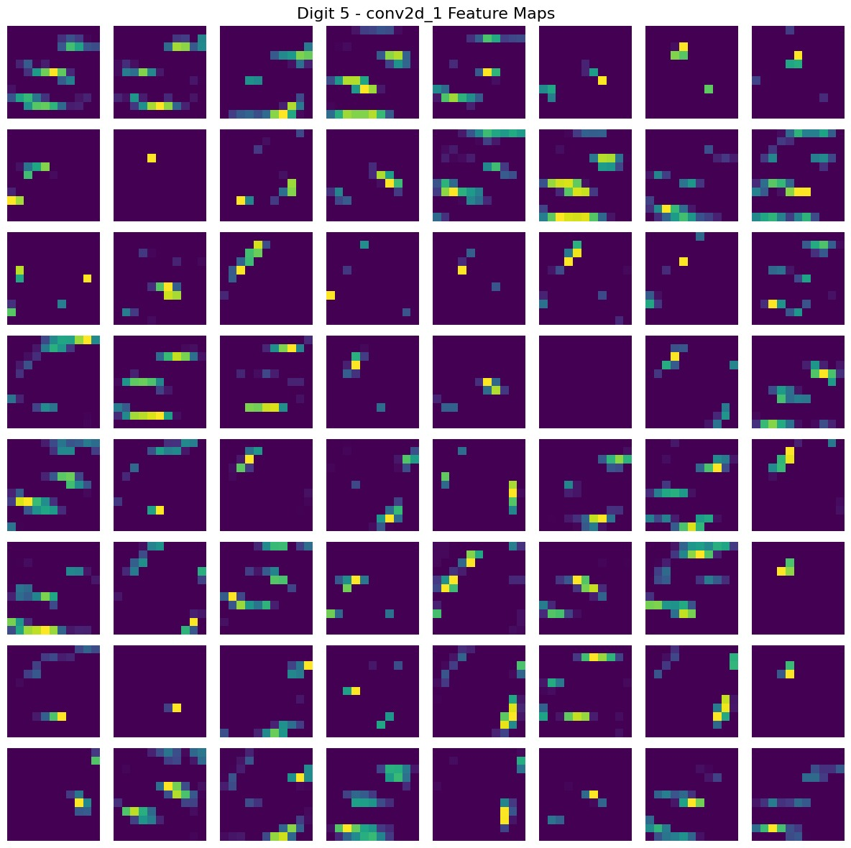
Convolution layer 2- feature map

