Slide 1

CAPSTONE PROJECT · MERN STACK
Skill Exchange
A platform connecting mentors and learners
Team CosmicCoders · Group 13 | B.Tech CSE, GLA University, Mathura
Internship Project at Codroid Hub Pvt. Ltd. | October 2026
Team Leader: __________________________________________________
Team Members: __________________________________________________
Project Guide: __________________________________________________

Slide 2
OVERVIEW
Presentation Agenda
01
Problem & Objectives
Campus peer learning challenges, informal study friction, and core project goals.
02
Architecture & Schemas
Full-stack MERN ecosystem, bi-directional WebSockets, and Mongoose database design.
03
Signature Booking Flow
5-stage deterministic session lifecycle with automatic 4-hour expiration policy.
04
Live System Walkthrough
UI tour across Home, Auth, Profiles, Directory, Dashboards, Chat, and Admin Console.
05
Engineering & Future Scope
Dark theme CSS specificity resolution, technical constraints, and future roadmap.
Skill Exchange · Capstone Project
Slide 2 of 15

Slide 3
CONTEXT & BACKGROUND
Problem Statement: Challenges in Peer Learning
HIGH COST
Commercial 1-on-1 tutoring charges steep hourly rates unaffordable for college students.
FRAGMENTED
Peer coordination is scattered across WhatsApp, Discord, and Google Calendar.
ZERO SAFETY
Informal peer swaps suffer from ghosting, no-shows, and lack of accountability.
1. Expensive Professional Tutoring
Commercial EdTech platforms focus on corporate professionals, charging fees beyond average student budgets.
2. Disconnected Communication Tools
Arranging sessions through chat apps leads to missed links, scheduling clashes, and lost notes without tracking.
3. High Ghosting & No-Show Rates
Free peer-to-peer knowledge sharing lacks formal commitment; learners or mentors cancel last-minute with zero recourse.
4. Awkward Transaction Transparency
Students helping students hesitate to discuss hourly rates informally; lack of a clear fee ledger creates friction.
Skill Exchange · Capstone Project
Slide 3 of 15

Slide 4
SCOPE & ROLES
Project Objectives & Core Modules
Primary Goal: A trusted campus ecosystem for affordable 1-on-1 peer mentoring.
Empower students to monetize their domain expertise while enabling peers to book structured, verified learning sessions.
Learner Module
For Students Seeking Guidance
• Discover verified mentors by skill tags & hourly rate
• 3-step session scheduling with open date/time chips
• Real-time 1-on-1 chat (5 free messages anti-spam)
• Track live learning hours, attended sessions & milestones
Mentor Module
For Student Practitioners & Tutors
• Set custom hourly rates & define availability slots
• Showcase skills with depth ratings (Beginner to Expert)
• Accept, decline, or propose alternate session times
• Teaching Studio analytics & transparent earnings ledger
Admin Governance
For Platform Integrity & Moderation
• Central KPI console: user counts, sessions, pending checks
• Member management: verify accounts, suspend bad actors
• Audit session lifecycle logs & manage dispute reports
• Financial transparency with downloadable CSV ledgers
Skill Exchange · Capstone Project
Slide 4 of 15

Slide 5
ENGINEERING FOUNDATION
Technology Stack & Database Architecture
Frontend: React 19 + Vite
Component architecture, client routing, Lucide icons, responsive CSS variables.
Backend: Node.js + Express
RESTful controllers, modular routes, error handling, and request validation.
Database: MongoDB Atlas
Cloud NoSQL cluster with Mongoose ODM schemas, indexing, and references.
Real-Time: Socket.io
Persistent bi-directional WebSocket channels for instant messaging & read status.
Auth: JWT & Bcrypt
Stateless bearer token authorization with 10-round salted password hashing.
Ledger: Simulated Escrow
0% platform fee, 0% tax, transparent hourly billing & manual admin settlements.
User Model
name, email, password, role ('learner'|'mentor'|'admin'), bio, skillsToTeach, skillsToLearn, hourlyRate, availability, payoutUpiId, profileCompleted, isActive
Booking Model
learner (Ref), mentor (Ref), date, time, duration (30-120m), status ('pending'|'confirmed'|'completed'|'cancelled'), actionExpiresAt (4h), meetingUrl
Chat Models
Conversation: participants, bookingId, lastMessage, lastActivityAt
Message: conversationId, sender, text, isEdited, readBy
Review & Wallet
Review: mentor, learner, rating (1-5), comment
Wallet: balance (simulated top-up), user, transactions ledger
Skill Exchange · Capstone Project
Slide 5 of 15

Slide 6
HIGH-LEVEL DESIGN
System Architecture: End-to-End Data Flow
React Client (Frontend)
• Vite Development & Bundling
• React Router Navigation
• Learner & Mentor Views
• Socket.io Client Listener
• LocalStorage Token Persistence
Node.js / Express API
• JWT Auth & Role Protection
• Booking Lifecycle Controller
• Socket.io Server Event Bus
• Google Meet Link Generator
• Admin Moderation Endpoints
MongoDB Atlas
• Users
• Bookings
• Messages
• Reviews
• Logs
RESTful HTTP
Mongoose ODM
WebSocket (Chat)
Skill Exchange · Capstone Project
Slide 6 of 15

Slide 7
CORE INNOVATION
Signature Feature: 5-Stage Session Booking Lifecycle
STEP 1
Choose
Learner selects duration (30-120m), date chip, and available time slot.
STEP 2
Validate
System checks mentor schedule, prevents self-booking, sets 4h expiry.
STEP 3
Respond
Mentor reviews request to Accept, Propose Alternate Slots, or Decline.
STEP 4
Confirm
Session locked; Google Meet link attached; unlimited chat unlocked.
STEP 5
Complete
Session held; earnings credited to ledger; mutual reviews submitted.
Strict 4-Hour Action Window & Counter-Proposal Protocol
• If a mentor does not respond within 4 hours, the request automatically expires to free the learner's schedule.
• Mentors can counter-propose up to 3 alternative time slots directly without declining the learner.
Skill Exchange · Capstone Project
Slide 7 of 15

Slide 8
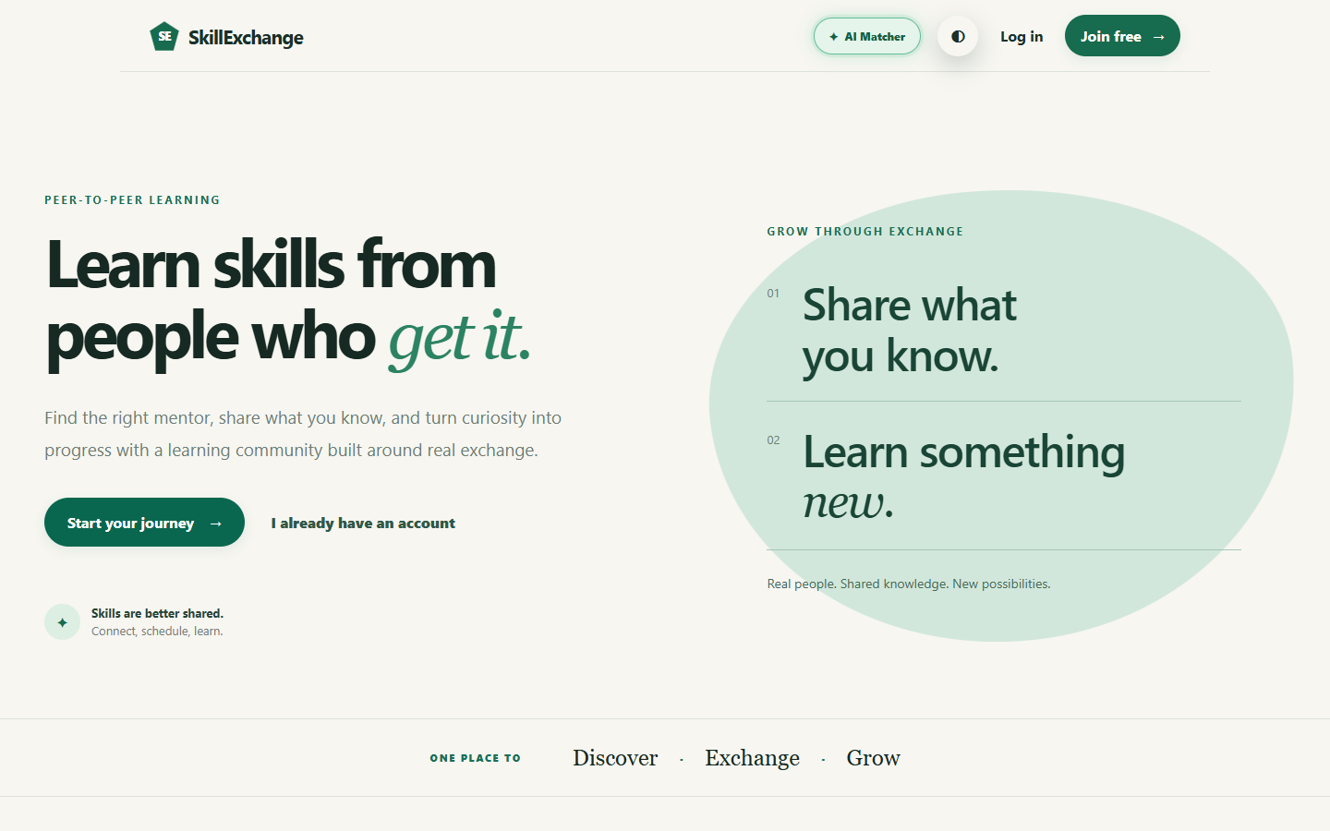
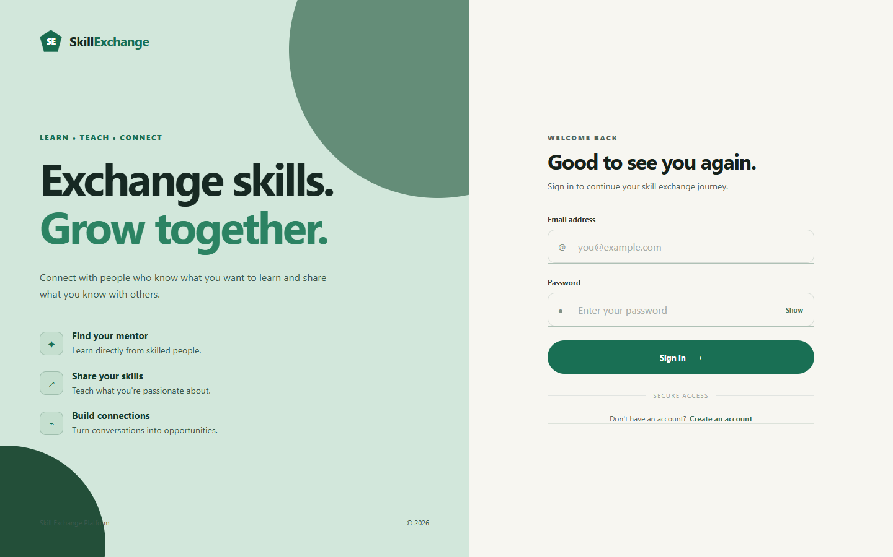
USER ONBOARDING
Live Walkthrough: Landing & Authentication
• Dual-Path Landing: Welcomes users with 'Share what you know' (mentor) and 'Learn something new' (learner).
• Role-Based Registration: Simple choice between 'Learn Skills' and 'Teach & Mentor' with terms validation.
• Secure Access: Bcrypt salted password encryption, JWT local storage, and instant redirection to role dashboards.
Skill Exchange · Capstone Project
Slide 8 of 15

Slide 9
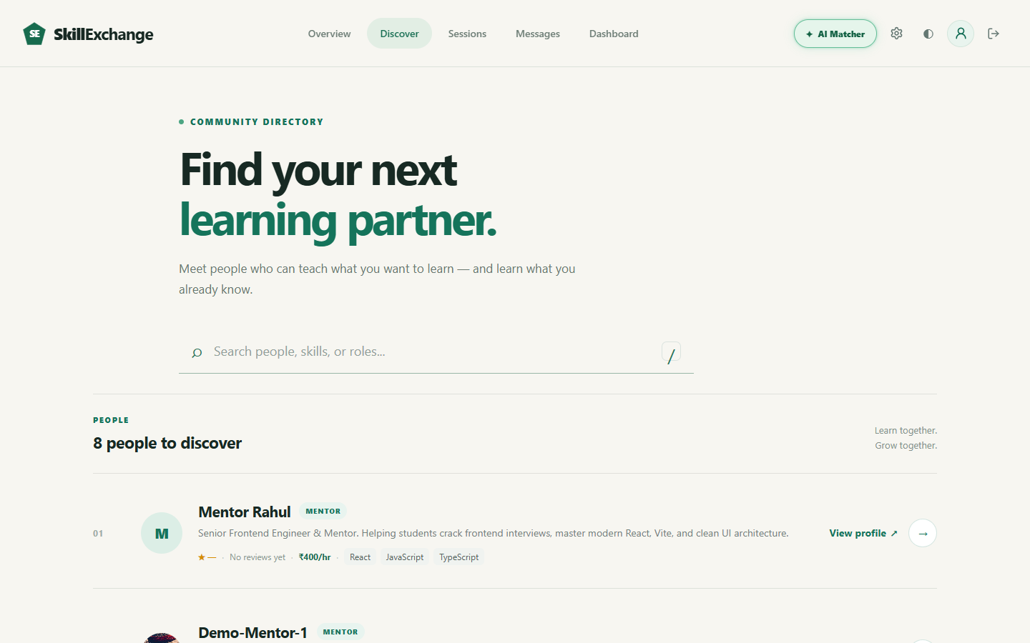
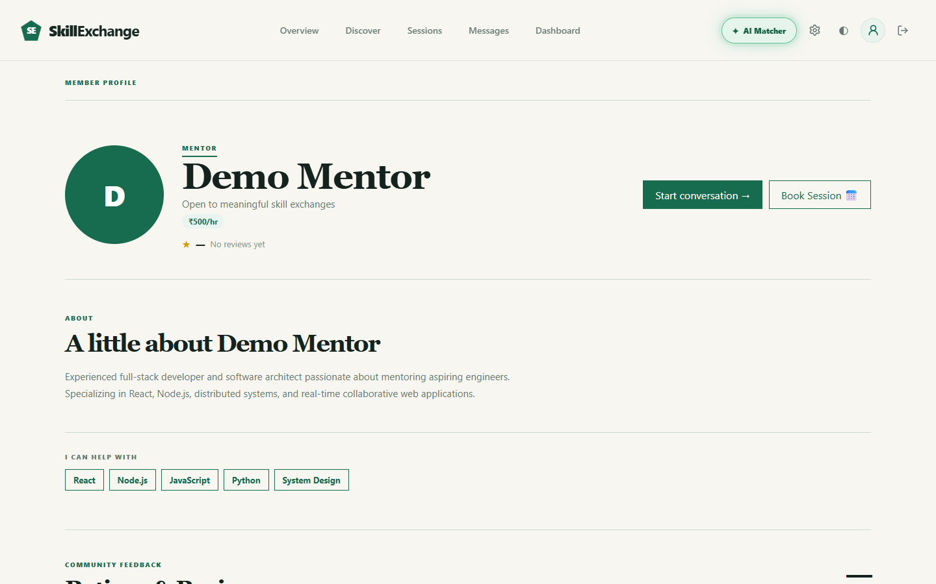
PEER MATCHING
Live Walkthrough: Discovery & Profile Management
• Searchable Directory: Real-time search across peers and mentors by name, role, or technical skill tags.
• Complete Profiles: Showcase bio, skills to teach, skills to learn, and weekly schedule availability.
• Public Mentor Portfolio: Displays verified badge, hourly rates (e.g. ₹400/hr), and direct 'Book Session' action.
Skill Exchange · Capstone Project
Slide 9 of 15

Slide 10
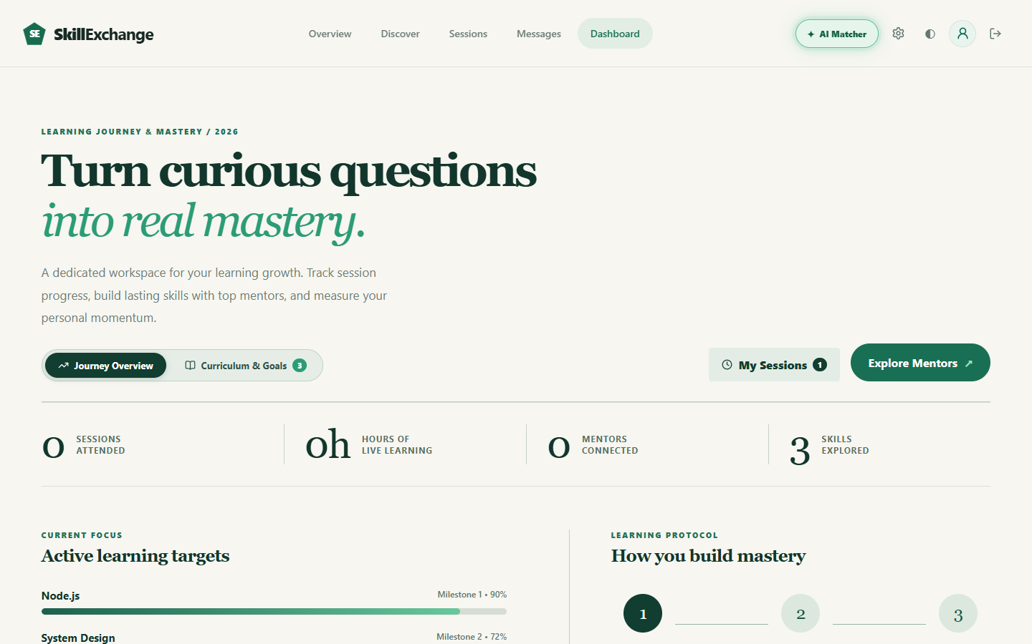
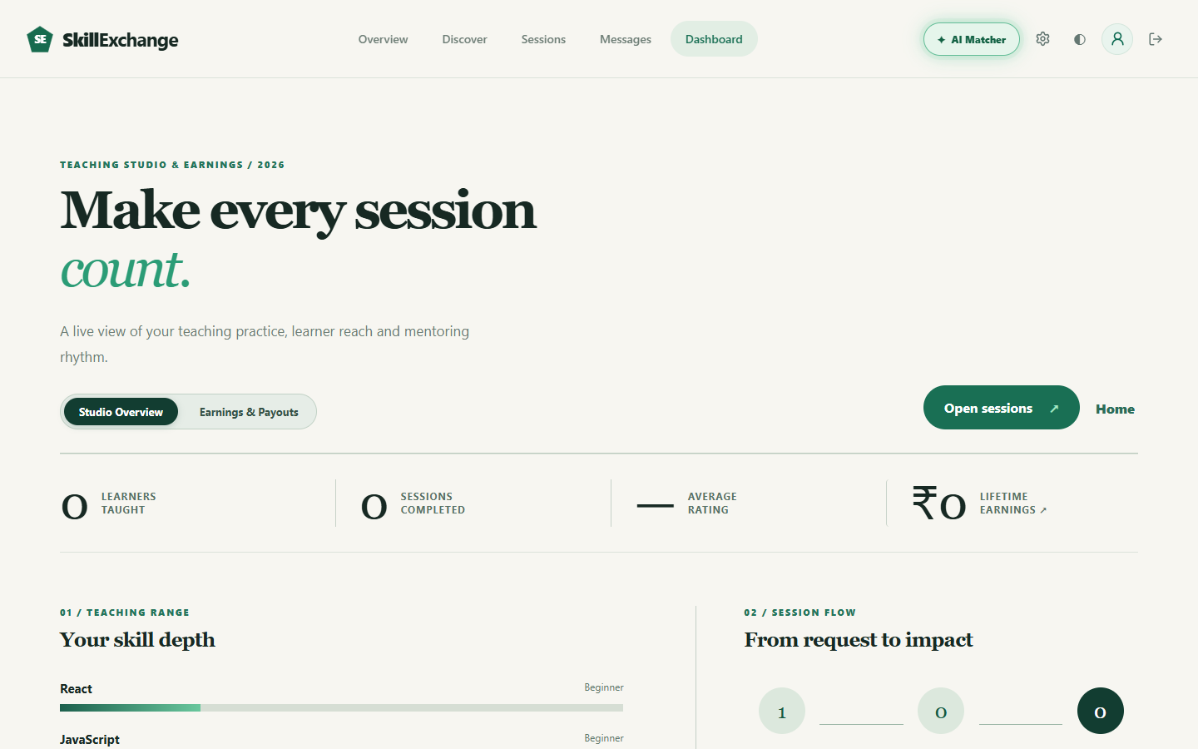
PROGRESS & EARNINGS
Live Walkthrough: Role-Based Dashboards
• Learner Growth Tracker: Monitors live learning hours, attended sessions, mentors connected, and topic milestones.
• Mentor Teaching Studio: Live session request flow, skill depth meters (Beginner-Expert), and student counts.
• Transparent Earnings Ledger: Tracks lifetime revenue, pending disbursements, and inline UPI ID payout setup.
Skill Exchange · Capstone Project
Slide 10 of 15

Slide 11
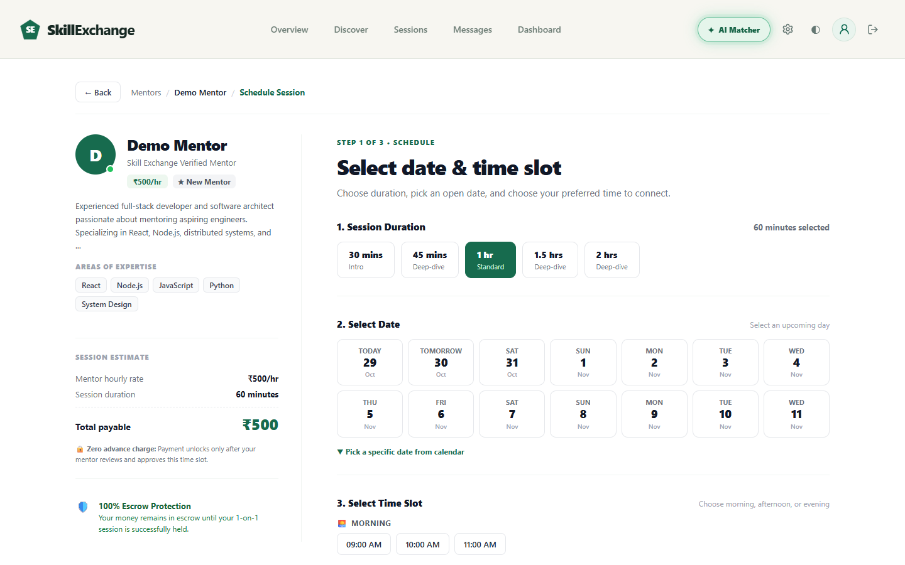
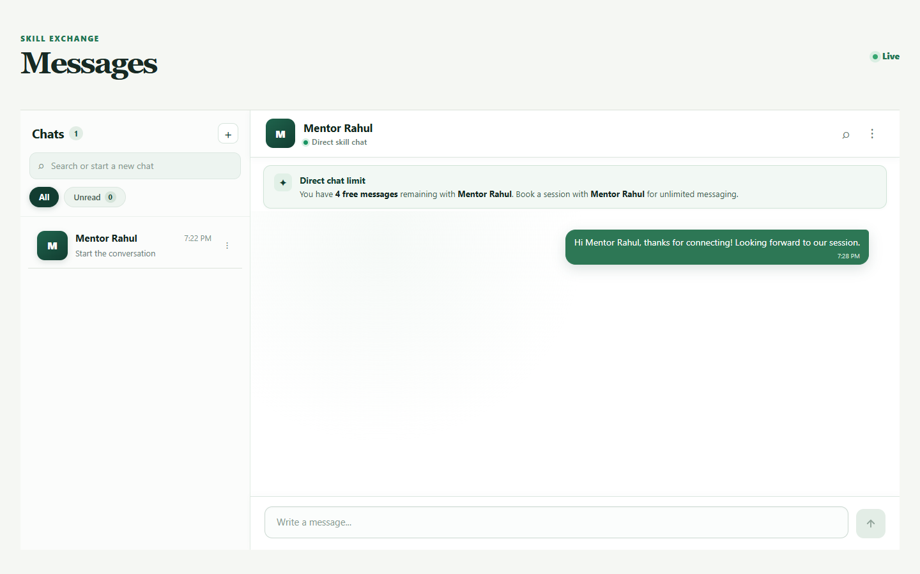
CORE COLLABORATION
Live Walkthrough: Session Booking & Live Chat
• 3-Step Booking Wizard: Select duration (30-120 mins), choose upcoming date chip, and pick morning/evening slots.
• Transparent Fee Model: 0% platform fee, 0% tax, transparent hourly calculation, and escrow protection notice.
• Socket.io Duplex Chat: Real-time messaging with 5-free message anti-spam barrier until session is booked.
Skill Exchange · Capstone Project
Slide 11 of 15

Slide 12
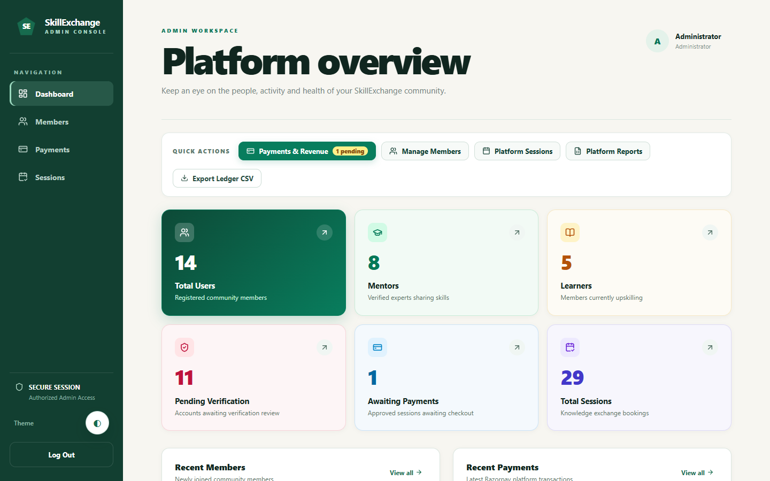
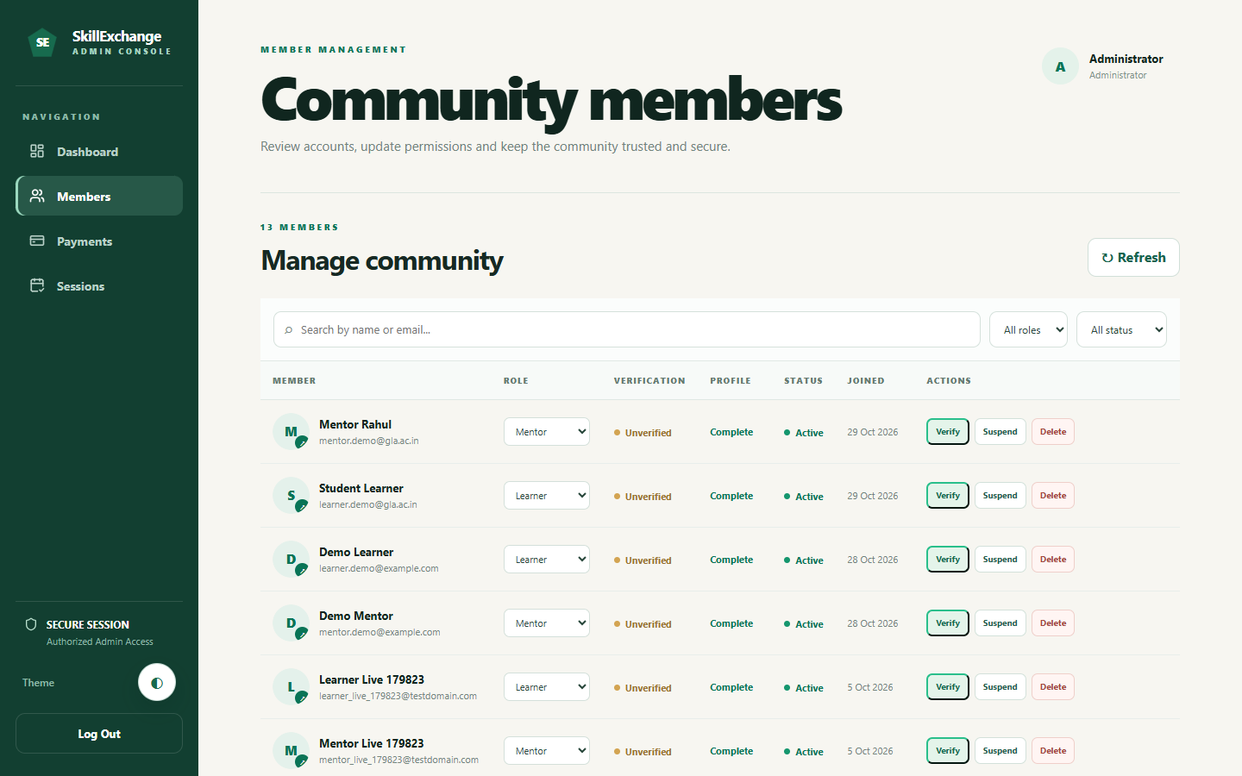
GOVERNANCE
Live Walkthrough: Admin Governance & Quality Control
• Platform Overview KPIs: Live tracking of total members (14), mentors (8), learners (5), and sessions (29).
• Member Management: Administrator controls to verify student credentials, change roles, or suspend bad actors.
• Quality & Audits: Verified post-session 1-5 star reviews, feedback collection, and downloadable financial CSV ledgers.
Skill Exchange · Capstone Project
Slide 12 of 15

Slide 13
TECHNICAL DEEP DIVE
Engineering Challenge: Dark Theme CSS Specificity
The Problem
During the initial dark mode rollout, the global CSS rule inverted app root variables. While public pages rendered well, the Admin Workspace sidebar and data tables broke completely, rendering pale white backgrounds with illegible text.
Root Cause Analysis
Unscoped `!important` declarations in `index.css` collided with admin styling variables, overriding dark slate palettes with inverted root styles.
The Architectural Fix
Refactored administrative styling by strictly scoping them under `html[data-theme='dark'] .admin-page` and `.admin-sidebar`, guaranteeing consistent contrast without breaking public theme toggles.
/* client/src/Pages/Admin Page/admin.css */
/* Preserves intended dark emerald sidebar */
html[data-theme="dark"] .admin-sidebar,
html.dark .admin-sidebar {
background-color: #091712 !important;
border-right: 1px solid #1e3a2f;
}
/* Scoped workspace background & text */
html[data-theme="dark"] .admin-page {
background-color: #0d1f18;
color: #e2f0ea;
}
html[data-theme="dark"] .admin-workspace {
background-color: #0d1f18 !important;
}
Skill Exchange · Capstone Project
Slide 13 of 15

Slide 14
SUMMARY & NEXT STEPS
Project Conclusion & Future Roadmap
Key Project Achievements
• Production-Grade MERN Platform: Solved peer tutoring coordination friction with modern React 19, Express REST APIs, and MongoDB Atlas.
• Zero-Fee Knowledge Economy: Enabled fair knowledge exchange with 0% platform fee and transparent session tracking.
• Deterministic Session Lifecycle: Built-in 4-hour auto-expiration and slot counter-proposals to prevent ghosting.
• Real-Time Collaboration: Integrated persistent Socket.io chat and automatic Google Meet video room attachment.
• Undergraduate Internship Success: Built collaboratively by Team CosmicCoders (Group 13) during internship at Codroid Hub Pvt. Ltd.
Future Technical Scope
• In-Browser WebRTC Video Calling:
Build native peer-to-peer audio/video streaming directly inside the platform without external meeting providers.
• Automated Razorpay Webhooks:
Implement automated bank payout webhooks and automatic refund triggers for dispute arbitration.
• Push & Calendar Synchronization:
Integrate browser Service Worker push alerts and iCal calendar invites 15 minutes before sessions.
• Native Mobile Application:
Develop cross-platform iOS and Android apps using React Native for instant on-the-go chat and bookings.
Skill Exchange · Capstone Project
Slide 14 of 15

Slide 15
Thank You!
Questions & Discussion Welcome
Project Repository: github.com/CosmicCoder06/Skill-Exchange
Live Web Deployment: https://skill-exchange-one-eta.vercel.app/
Built with ❤️ by Team CosmicCoders (Group 13)

