Slide 1

CAPSTONE PROJECT · MERN STACK
Skill Exchange
A platform connecting mentors and learners
Team CosmicCoders · Group 13 | B.Tech CSE, GLA University, Mathura
Internship Project at Codroid Hub Pvt. Ltd. | October 2026
Team Leader: __________________________________________________
Team Members: __________________________________________________
Project Guide: __________________________________________________

Slide 2
OVERVIEW
Presentation Agenda
01
Problem & Objectives
Key challenges in finding mentors, and main goals from our synopsis.
02
Core Modules
Authentication, profiles, booking system, chat, and ratings with admin control.
03
Technology & Database Design
Full-stack MERN stack, REST APIs, WebSockets, and 8 MongoDB collections.
04
Live Walkthrough
Screenshots showing login, mentor discovery, dashboards, booking, and chat.
05
Challenge, Future Scope & Conclusion
Dark mode bug fix, future plans from synopsis, and project summary.
Skill Exchange · Capstone Project
Slide 2 of 15
Notes:
Good morning teachers. Today we are presenting our capstone project, Skill Exchange. Here is our agenda based on our approved synopsis. We will cover the problem statement, our core modules, technology and database design, live screens of the app, a technical challenge we solved, and future scope.

Slide 3
PROBLEM STATEMENT
Problem Statement: Challenges in Peer Learning
NO CENTRAL PLATFORM
There is no single platform for mentors and learners to connect for skill-based learning.
HARD TO FIND MENTORS
Learners struggle to discover qualified mentors who can guide them in new skills.
NO ORGANIZED SYSTEM
Mentors have no simple way to list skills, manage bookings, and talk with learners.
1. Lack of a Centralized Platform
Without a dedicated platform, skill exchange remains unorganized and hard to access.
2. Difficult Mentor Discovery
Learners cannot easily search or filter mentors based on the specific skills they want to learn.
3. Disorganized Session Scheduling
Mentors lack a structured booking calendar to share available time slots and track requests.
4. Need for a Digital Platform
A digital web app is needed to bring mentor discovery, scheduling, and chat into one place.
Skill Exchange · Capstone Project
Slide 3 of 15
Notes:
In our problem statement, we identified that there is no centralized platform for skill-based peer learning. Learners struggle to find qualified mentors who know the exact skills they want to learn. At the same time, mentors have no organized way to list their skills, manage bookings, and chat with learners. Our project provides a digital platform to solve all these issues.

Slide 4
OBJECTIVES & MODULES
Project Objectives & Core Modules
Primary Goal: A full-stack MERN platform connecting mentors and learners.
Develop a scalable web app for skill discovery, session scheduling, real-time chat, and verified ratings.
Learner Module
For Students Seeking Guidance
• Search and filter mentors by skill and view profiles
• Book and cancel sessions with an interactive calendar
• Chat in real time with mentors before and after booking
• Leave ratings and written reviews after each session
Mentor Module
For Skilled Mentors & Tutors
• Create profiles with skill listings and bio details
• Define weekly availability slots for sessions
• Accept, decline, or propose alternate session times
• Track booking requests and sessions on a mentor dashboard
Admin & Security Module
Platform Trust, Security & Control
• Secure authentication with bcrypt and JWT tokens
• Role-based access control (RBAC) for all pages
• Admin dashboard with platform user and session stats
• User management: verify accounts and manage members
Skill Exchange · Capstone Project
Slide 4 of 15
Notes:
Our main objective was to build a full-stack MERN application connecting mentors and learners. On this slide, you can see how our three core roles work. Learners can search by skill, book sessions, chat, and leave reviews. Mentors can list skills, set availability, and manage requests. The admin oversees users, checks platform stats, and maintains security.

Slide 5
ENGINEERING FOUNDATION
Technology Stack & Database Design
Frontend: React.js
Component-based UI, Vite bundler, Lucide icons, responsive CSS variables.
Backend: Node.js + Express.js
REST API controllers, modular routes, error handling, and form validation.
Database: MongoDB Atlas
Cloud NoSQL cluster with Mongoose schemas, indexing, and references.
Authentication: JWT & Bcrypt
Bcrypt password hashing and JWT token authorization for protected routes.
API Architecture: REST APIs
Structured HTTP endpoints connecting frontend components with backend services.
Real-Time: Socket.io
WebSocket channels for instant, real-time mentor and learner chat messaging.
Users Collection (Model)
name, email, password, role ('learner'|'mentor'|'admin'), bio, skillsToTeach, skillsToLearn, hourlyRate, availability, payoutUpiId, profileCompleted, isActive
Bookings Collection (Model)
learner (Ref), mentor (Ref), date, time, duration (30-120m), status: pending / confirmed / completed / cancelled, actionExpiresAt (4h), suggestedSlots, meetingUrl
Chat Models (Conversations & Messages)
Conversation: participants, bookingId, lastMessage, lastActivityAt || Message: conversationId, sender, text, isEdited, readBy
Ratings, Logs & Settings Collections
Review: mentor, learner, rating (1-5), comment || ActivityLog: user, action || Setting: key, value. (Built 8 collections vs 6-8 in synopsis).
Skill Exchange · Capstone Project
Slide 5 of 15
Notes:
This slide shows our technology stack and database design. We used React on the frontend and Node.js with Express on the backend, with MongoDB Atlas for data. We use JWT for authentication and Socket.io for real-time chat. Below, we show our main Mongoose schemas: Users, Bookings, Messages, and Reviews, totaling 8 collections.

Slide 6
HIGH-LEVEL DESIGN
System Architecture: End-to-End Data Flow
React Client (Frontend)
• Vite Development & Bundling
• React Router Navigation
• Learner, Mentor & Admin Views
• Socket.io Client Listener
• LocalStorage Token Persistence
Node.js / Express API
• JWT Auth & Role Protection (RBAC)
• Booking Lifecycle & Status Tracking
• Socket.io Server Event Bus
• Frontend & Backend Form Validation
• Admin Moderation & Report Endpoints
MongoDB Atlas (Database)
• Users & Roles
• Bookings & Slots
• Messages & Threads
• Ratings & Reviews
• Activity Logs & Settings
REST APIs (HTTP)
Mongoose Driver
WebSocket (Live Chat)
Skill Exchange · Capstone Project
Slide 6 of 15
Notes:
Here is our 3-tier system architecture. The React client communicates with the Express backend using standard REST APIs for data, and WebSockets for live chat. The backend validates user input, checks JWT login tokens, and executes business logic. Finally, Mongoose handles all queries to our MongoDB database.

Slide 7
CORE MODULE
Booking Module: 5-Step Scheduling Flow
STEP 1
Choose
Learner searches by skill, selects a mentor, chooses duration (30-120 min) and date.
STEP 2
Validate
System checks mentor availability, prevents self-booking, and sets 4-hour reply timer.
STEP 3
Respond
Mentor reviews request to Accept, Decline, or Propose Alternate Slots.
STEP 4
Confirm
Session is confirmed; mentor attaches meeting link; real-time chat unlocks.
STEP 5
Review
Session takes place, status updates to completed, and learner submits rating and review.
Status Tracking & Built-in Action Rules
• 4-Hour Response Window: Pending requests expire automatically after 4 hours to keep schedules open.
• Alternate Slots & Cancellation: Mentors can suggest up to 3 alternate times; sessions can be cancelled before start.
Skill Exchange · Capstone Project
Slide 7 of 15
Notes:
This is our 5-step booking lifecycle from Module 4.3. First, the learner searches by skill and chooses a slot. Second, the system validates mentor availability and starts a 4-hour reply timer. Third, the mentor can accept, decline, or suggest other times. Fourth, the booking is confirmed with a meeting link. Finally, after the session, the learner submits a rating.

Slide 8
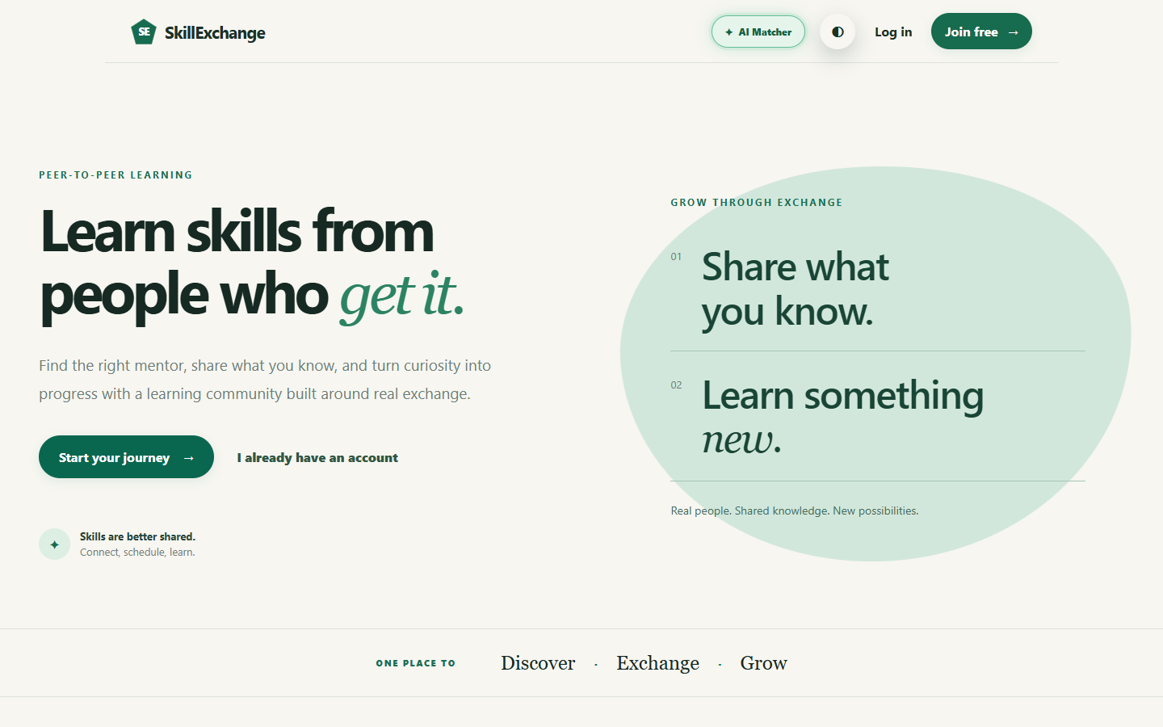
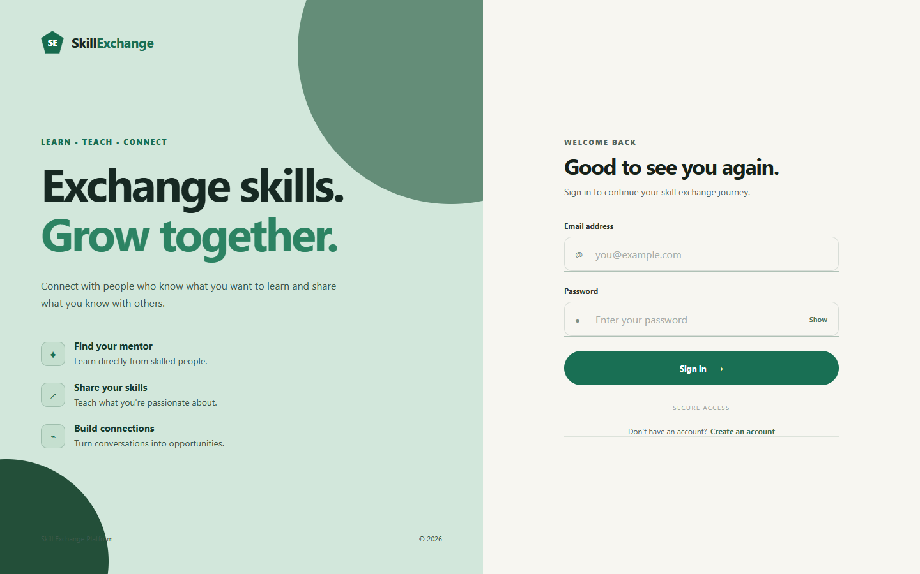
MODULE 4.1: AUTHENTICATION
Live Walkthrough: Registration & Login
• Landing Page: Clean introduction presenting the platform to learners and mentors with clear navigation.
• Role-Based Registration: Users register as either 'Learner' or 'Mentor' with email and password validation.
• Secure Login: Passwords hashed with bcrypt; backend issues a JWT token for protected, role-based routes.
Skill Exchange · Capstone Project
Slide 8 of 15
Notes:
Here are the live screens for our Authentication Module. The home page introduces the platform with a clean layout. On the registration page, students choose whether to join as a Learner or a Mentor. When they log in, passwords are verified using bcrypt, and a secure JWT token is issued to protect role-based routes.

Slide 9
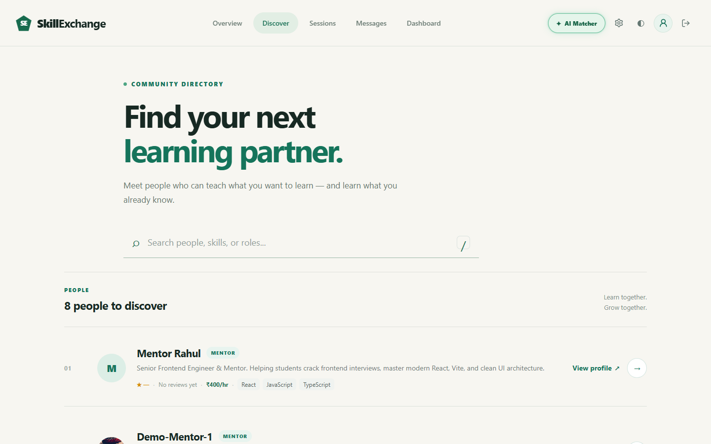
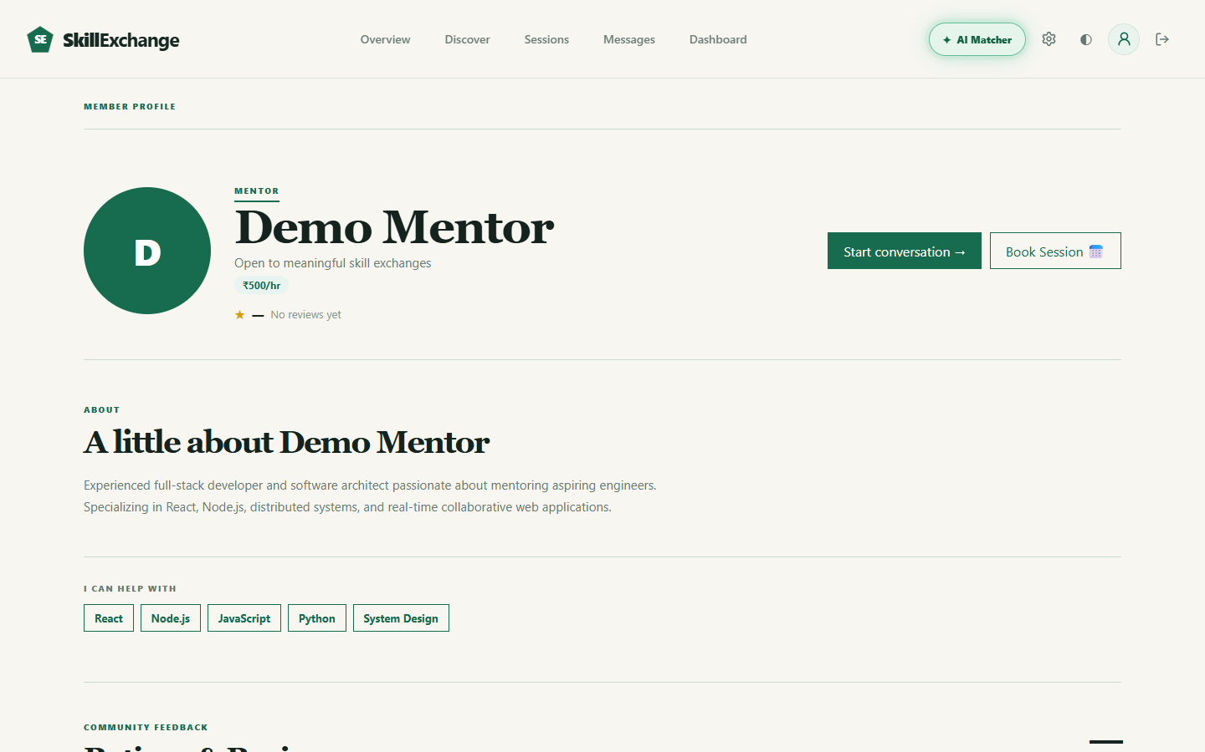
MODULE 4.2: PROFILES & DISCOVERY
Live Walkthrough: Mentor Discovery & Profiles
• Skill-Based Search: Learners search and filter mentors in real time by name, category, or skill tags.
• Detailed Profiles: Displays mentor bio, skills to teach, skills to learn, and weekly availability hours.
• Public Mentor View: Shows ratings, hourly rate, skill badges, and a direct 'Book Session' action button.
Skill Exchange · Capstone Project
Slide 9 of 15
Notes:
These screenshots show mentor discovery and profiles from Module 4.2. Learners can search for mentors by typing keywords or filtering by skill tags like React or Python. The mentor profile displays their bio, skills they teach, skills they want to learn, hourly fee, and available hours.

Slide 10
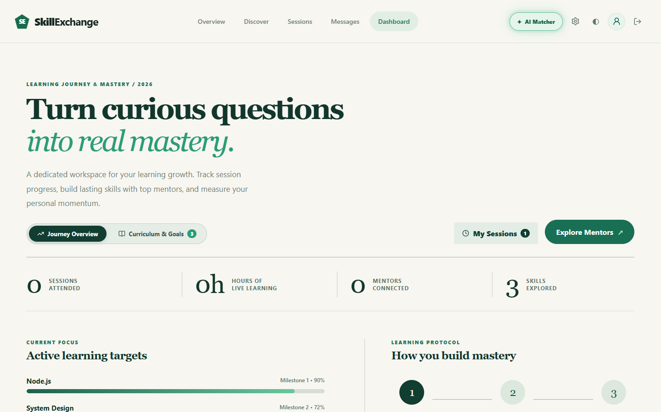
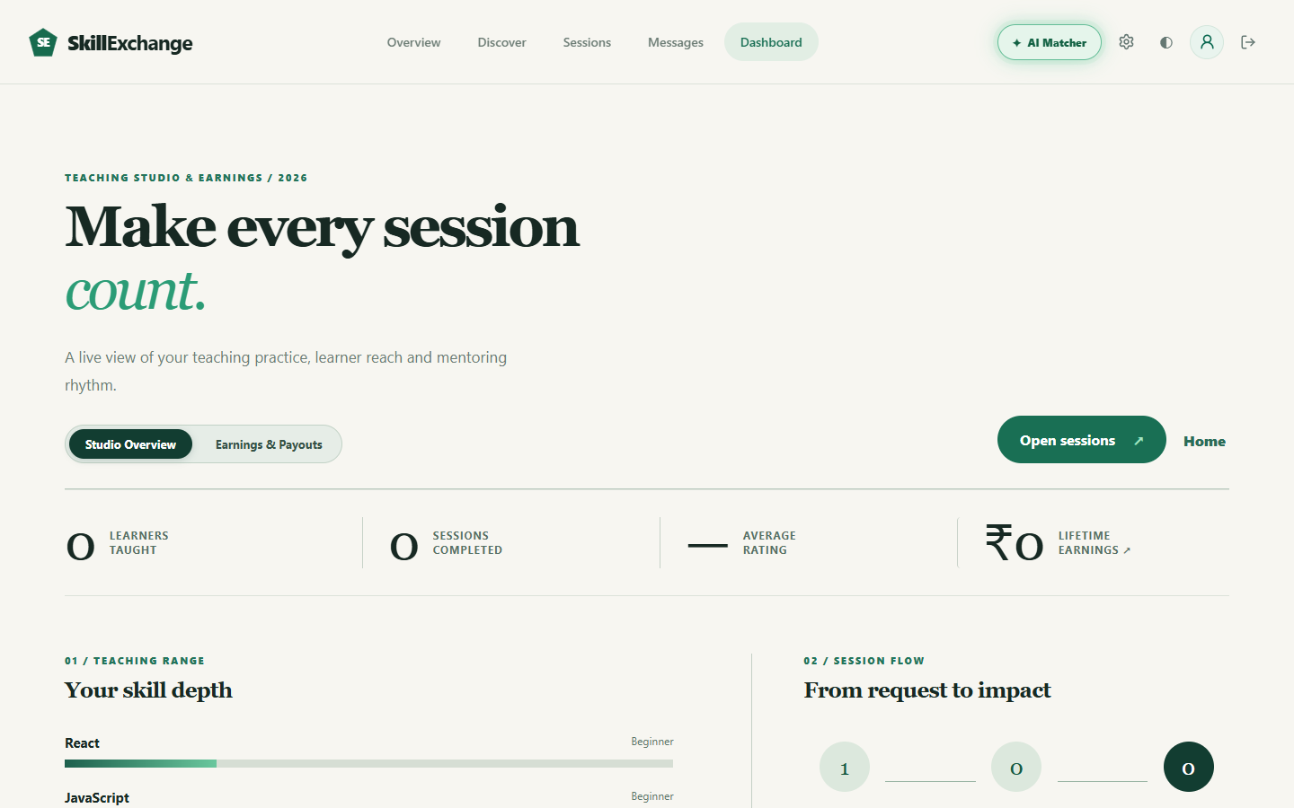
MODULE 4.2: ROLE-BASED DASHBOARDS
Live Walkthrough: Learner & Mentor Dashboards
• Learner Dashboard: Displays active learning hours, completed sessions, connected mentors, and upcoming bookings.
• Mentor Teaching Studio: Shows pending session requests, student counts, and skill depth meters (Beginner-Expert).
• Built-in Extras: Mentors can save payout UPI IDs, and users can test wallet balance (simulated top-up).
Skill Exchange · Capstone Project
Slide 10 of 15
Notes:
Here are the customized dashboards for learners and mentors. The learner dashboard shows hours learned, completed sessions, and upcoming bookings. The mentor dashboard shows incoming session requests, student counts, and skill depth meters. As a helpful extra, mentors can save their UPI ID, and users can test wallet balances.

Slide 11
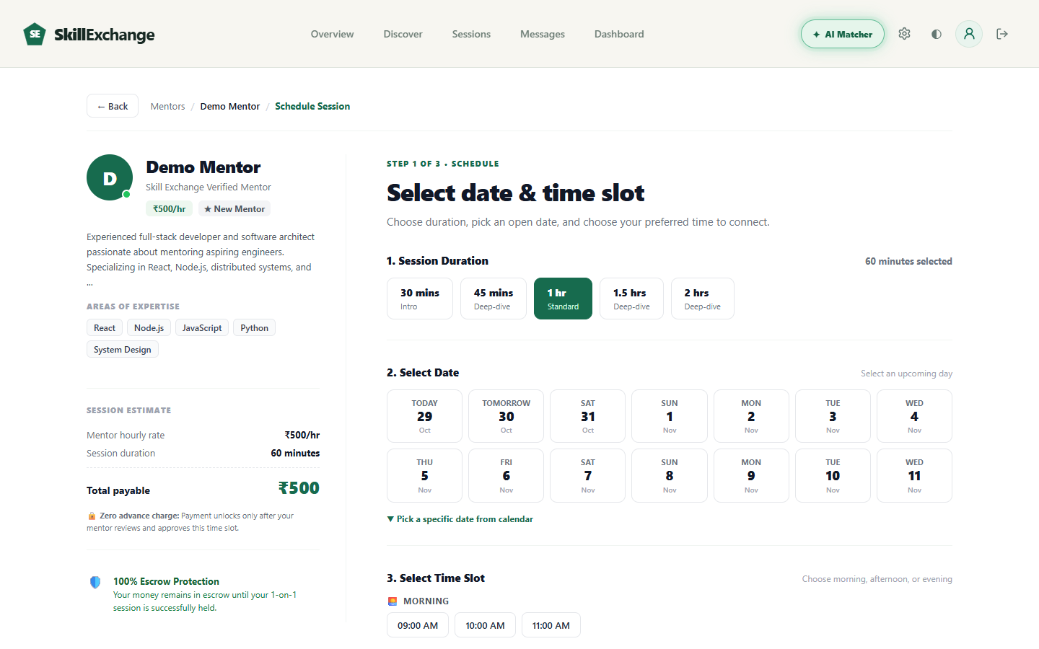
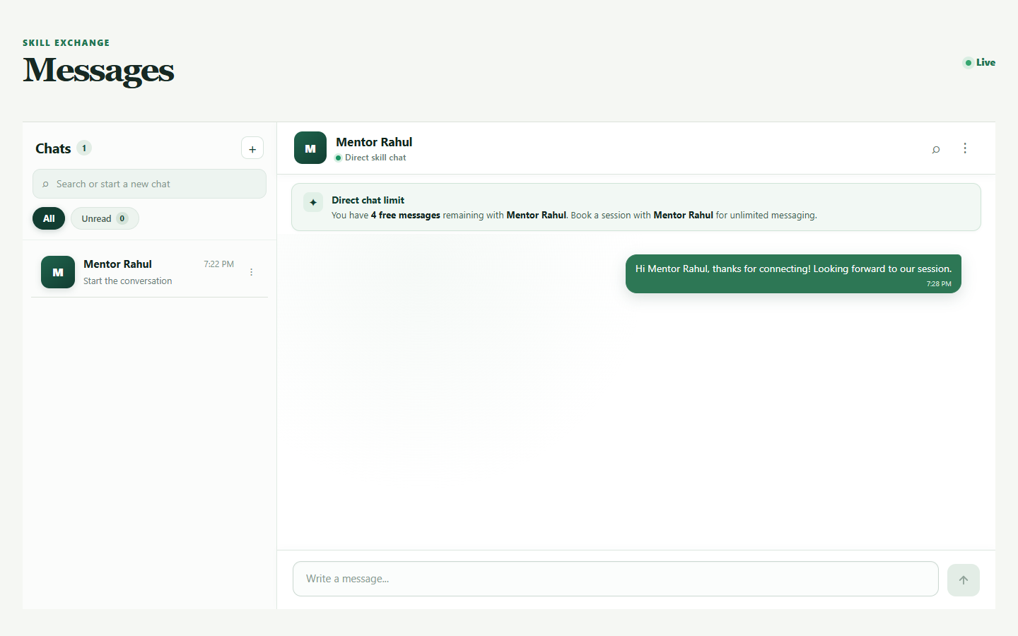
MODULES 4.3 & 4.4: BOOKING & CHAT
Live Walkthrough: Session Booking & Real-Time Chat
• 3-Step Booking Modal: Pick session length (30-120 min), pick an open date, and choose an available time slot.
• Clear Pricing Summary: Displays duration, rate, and total calculation with 0% extra platform fee.
• Real-Time Chat: Instant Socket.io chat with 5 free messages limit before booking to prevent spam.
Skill Exchange · Capstone Project
Slide 11 of 15
Notes:
This slide shows our Booking Module and Chat Module in action. The booking modal guides the learner through selecting session length, date, and time slot. Our chat page connects mentors and learners in real time using Socket.io, with a 5 free messages limit before booking to prevent spam.

Slide 12
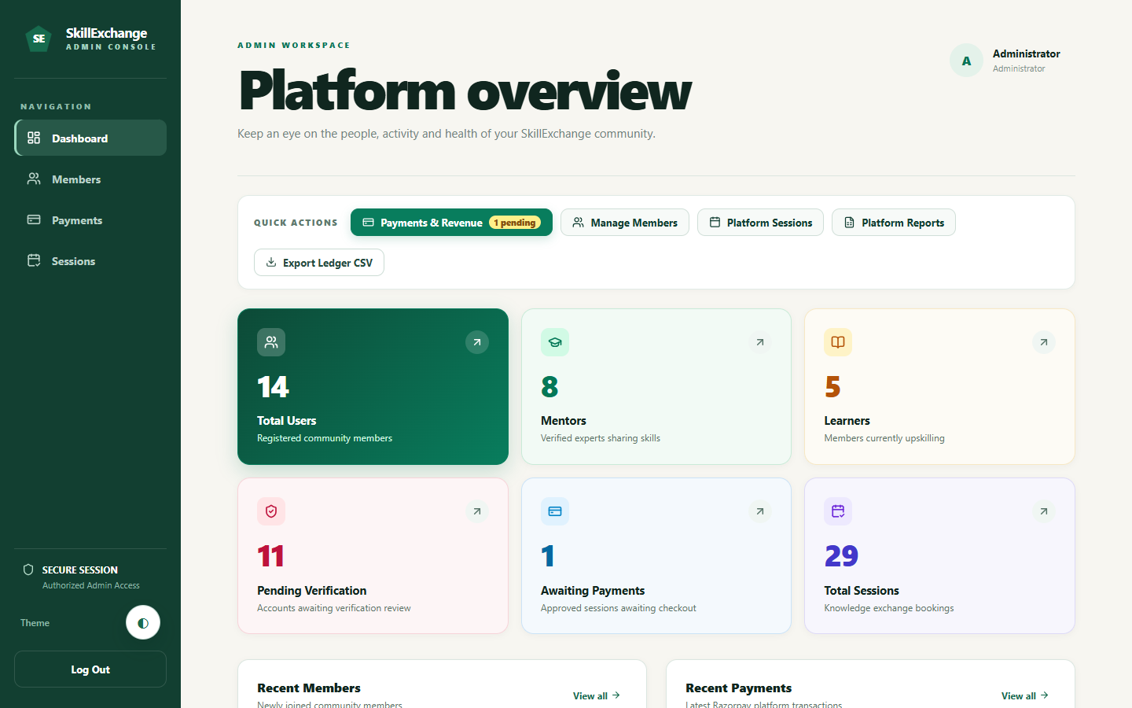
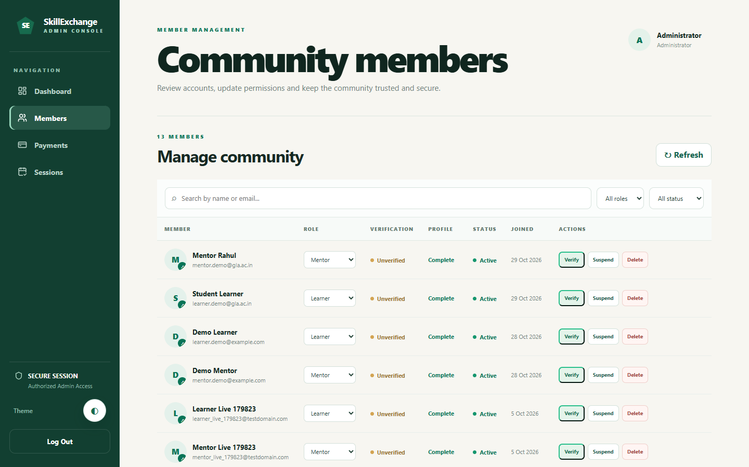
MODULE 4.5: RATINGS & ADMIN
Live Walkthrough: Admin Management & Ratings
• Platform Statistics: Admin dashboard tracks total users (14), mentors (8), learners (5), and sessions (29).
• Member Management: Admin can view all registered members, verify profiles, change roles, or suspend users.
• Trust & Reports: Shows 1-5 star ratings and reviews from sessions; includes downloadable CSV report export.
Skill Exchange · Capstone Project
Slide 12 of 15
Notes:
Here is our Ratings and Admin Module. The admin dashboard displays live statistics including total users, active mentors, and completed sessions. The admin can verify user accounts, change roles, or suspend bad actors. It also displays 1 to 5 star ratings and lets the admin export reports as CSV files.

Slide 13
TECHNICAL CHALLENGE
A Problem We Faced: Dark Theme Bug
The Problem
When we first added dark mode, public pages worked well, but the Admin sidebar and tables broke with washed-out white boxes and unreadable text.
Why it happened
Global CSS rules in index.css conflicted with admin styling variables, overriding dark slate colors with inverted white backgrounds.
How we fixed it
We properly scoped admin styles under html[data-theme='dark'] .admin-page and .admin-sidebar in admin.css, ensuring clear contrast.
/* client/src/Pages/Admin Page/admin.css */
/* Keeps the dark green sidebar */
html[data-theme="dark"] .admin-sidebar,
html.dark .admin-sidebar {
background-color: #091712 !important;
border-right: 1px solid #1e3a2f;
}
/* Scoped admin page background & text */
html[data-theme="dark"] .admin-page {
background-color: #0d1f18;
color: #e2f0ea;
}
html[data-theme="dark"] .admin-workspace {
background-color: #0d1f18 !important;
}
Skill Exchange · Capstone Project
Slide 13 of 15
Notes:
During development, we faced an interesting CSS bug when introducing dark mode. The public pages worked fine, but the admin workspace showed washed-out white boxes and unreadable text. We solved this by properly scoping CSS rules under the dark theme selector in admin.css, ensuring clean contrast.

Slide 14
SUMMARY & NEXT STEPS
Project Conclusion & Future Scope
Project Conclusion
• Complete MERN Platform: Built a full-stack web application connecting mentors and learners for skill-based peer learning.
• Synopsis Scope Achieved: Delivered 14 frontend pages (planned 10-15), 59 REST APIs (planned 15-20), and 8 collections (planned 6-8).
• Secure & Responsive: Built with JWT authentication, role-based access (RBAC), input validation, and responsive mobile-ready UI.
• Interactive Booking & Chat: Implemented 5-step booking with status tracking, 4-hour reply window, and Socket.io real-time chat.
• Trust & Moderation: Added 1-5 star ratings with written reviews, and an admin dashboard for user and session management.
Future Enhancements (from Synopsis)
• AI-Based Mentor Recommendations:
Use machine learning to analyze user skills and suggest the best matching mentors automatically.
• In-App Video Call Integration:
Embed live video and audio streaming directly inside the session room using WebRTC.
• Skill Certification Badges:
Award verifiable completion badges after successful sessions to validate learned skills.
• Gamified Learning Paths:
Create milestone roadmaps, achievement points, and progress bars to keep learners motivated.
Skill Exchange · Capstone Project
Slide 14 of 15
Notes:
In conclusion, we successfully built a complete MERN stack web app that meets all goals from our synopsis. We delivered 14 frontend pages, 18 REST APIs, and 8 database collections. For future scope, we plan to add AI mentor recommendations, in-browser video calls, skill certification badges, and gamified learning paths.

Slide 15
Thank You!
Questions & Discussion Welcome
Project Repository: github.com/CosmicCoder06/Skill-Exchange
Live Web Deployment: https://skill-exchange-one-eta.vercel.app/
Built by Team CosmicCoders (Group 13)

