Slide 1

CAPSTONE PROJECT · FULL STACK MERN WEB APPLICATION
Skill Exchange
A Scalable Peer-to-Peer Mentorship & Skill Sharing Platform
Team CosmicCoder · Group Number 13 | B.Tech CSE, GLA University, Mathura
Project Guidance: Codroid Hub Pvt. Ltd. | October 2026
Team Leader: __________________________________________________
Team Members: __________________________________________________
Project Guide: __________________________________________________
Notes:
Good morning respected professors and project evaluators. Today, Team CosmicCoder Group 13 presents our B.Tech CSE Capstone Project titled 'Skill Exchange'. This is a scalable full-stack MERN web application connecting student mentors and learners for skill-based peer education.

Slide 2
CONTEXT & BACKGROUND
Introduction & Problem Statement: The Mentorship Gap
NO CENTRAL PLATFORM
Skill exchange remains fragmented without a centralized, dedicated platform for student peers.
DISCOVERY DIFFICULTY
Learners struggle to identify qualified mentors suited to their specific learning goals.
UNORGANIZED SCHEDULING
Mentors lack structured tools to publish availability, track sessions, and handle communication.
Challenges in Peer Learning Today
• Commercial Tutoring Barrier: High commercial tutoring costs prevent college students from getting affordable 1-on-1 academic help.
• Scattered Informal Coordination: Arranging study calls through WhatsApp or Discord leads to missed links, scheduling clashes, and lost notes.
• High Ghosting & No-Shows: Informal arrangements lack commitment, causing frequent last-minute cancellations without accountability.
• Lack of Trust & Verification: Learners have no credible way to assess a peer tutor's actual skill proficiency and track record before meeting.
The Skill Exchange Solution
• Unified Digital Ecosystem: Integrates mentor discovery, slot scheduling, real-time messaging, and reviews into a single MERN web platform.
• Role-Based Architecture: Provides dedicated portals tailored for Learners, Mentors, and Administrators with strict access controls.
• Structured Booking Engine: Enforces clean 5-step booking lifecycles with built-in 4-hour action limits and alternate slot proposals.
• Verified Community Trust: Features 1-to-5 star post-session reviews, verified profile badges, and transparent session hour logs.
Skill Exchange · B.Tech CSE Capstone Project (Team CosmicCoder · Group 13)
Slide 2 of 22
Notes:
On this slide, we present our problem statement and project rationale. In collegiate settings, learners struggle to find qualified mentors, while mentors have no organized tools to schedule sessions or share skills. Informal coordination over WhatsApp leads to ghosting and confusion. Skill Exchange solves this with a centralized, structured web application.

Slide 3
PROJECT SCOPE & OBJECTIVES
Project Objectives & Scope: Bridging Knowledge Gaps
Primary Objective:
To design and develop a scalable, full-stack MERN web application that connects student mentors and learners through automated skill discovery, interactive session scheduling, real-time chat, and mutual feedback.
Mentor Module Pillar
For Student Tutors & Experts
• Skill Profile Listing: Showcase technical skills with granular proficiency depth ratings (Beginner to Expert).
• Availability Management: Define weekly open schedule chips for morning, afternoon, and evening slots.
• Session Negotiation: Accept requests, decline, or propose up to 3 alternate time slots directly.
• Teaching Dashboard: Track total students taught, sessions held, and monitor teaching hours.
Learner Module Pillar
For Students Seeking Guidance
• Skill Discovery: Search and filter mentors in real time by name, category, or specific skill tags.
• Interactive Booking: Schedule 1-on-1 sessions via 3-step wizard with duration and date chips.
• Real-Time Messaging: Communicate via Socket.io chat threads with 5 free messages anti-spam limit.
• Community Reviews: Submit 1-to-5 star ratings and qualitative reviews following session completion.
Security & Admin Pillar
For Platform Trust & Integrity
• Role-Based Auth (RBAC): Enforce strict route protections across Learner, Mentor, and Admin roles.
• Cryptographic Security: Store passwords using 10-round salted bcrypt hashing and stateless JWT tokens.
• Administrative Console: Audit platform KPIs, verify student credentials, and moderate accounts.
• Reporting & Export: Download financial and user activity records as formatted CSV spreadsheets.
Skill Exchange · B.Tech CSE Capstone Project (Team CosmicCoder · Group 13)
Slide 3 of 22
Notes:
Here we outline our core objectives across three distinct pillars: the Mentor Module, the Learner Module, and the Security & Admin Pillar. All six specific objectives approved in our synopsis are addressed, including skill listing, interactive booking, real-time chat, role-based authentication, and verified reviews.

Slide 4
HIGH-LEVEL SYSTEM DESIGN
System Architecture: End-to-End Enterprise Flow
Presentation Tier
(React Client)
• Vite SPA Framework: High-performance React 19 architecture with sub-second hot reloading.
• React Router Navigation: Client-side declarative routing with role-protected view boundaries.
• Role-Based Views: Custom user interfaces for Learner, Mentor, and Admin workflows.
• Socket.io Client: Persistent WebSocket event listener for live chat and notifications.
• Token Persistence: Secure browser storage of JWT tokens with auto-authorization headers.
• Responsive Layout: Adaptive flexbox and grid layouts responsive on mobile (390px) & desktop.
Application Tier
(Node.js & Express API)
• JWT Auth Middleware: Verifies digital signatures, extracts claims, and blocks unauthorized traffic.
• RBAC Route Guards: Enforces strict authorization: learner, mentor, or admin access levels.
• Booking State Engine: Manages 5-step lifecycle, 4-hour timers, and slot negotiation rules.
• Socket.io Event Server: Broadcasts 1-on-1 messages, typing status, and read receipt events.
• AI Matcher Service: Multi-factor scoring algorithm with optional Gemini AI re-ranking.
• Error & Rate Controls: Structured JSON error handling, input validation, and API rate limits.
Data & Services Tier
(MongoDB & Cloud Services)
• MongoDB Atlas Cluster: High-availability cloud NoSQL database with automated replication.
• Mongoose Schemas: Strict schema definitions, field validation, and ObjectId references.
• 8 Primary Collections: Users, Bookings, Conversations, Messages, Reviews, Wallets, Logs, Settings.
• Razorpay Integration: Automated order creation, checkout verification, and webhook handling.
• Google Meet Linker: Generates valid video conference meeting URLs for confirmed calls.
• Google Gemini AI SDK: Optional LLM re-ranking for contextual mentor recommendations.
REST
APIs
↕
Web
Sockets
Mongoose
ODM
↕
Skill Exchange · B.Tech CSE Capstone Project (Team CosmicCoder · Group 13)
Slide 4 of 22
Notes:
This slide presents our complete 3-tier enterprise architecture. On the left is our React 19 frontend communicating via REST APIs and WebSockets. In the center, our Express server enforces JWT authentication, RBAC rules, and booking lifecycles. On the right, MongoDB Atlas persists all data across 8 collections, interfacing with Razorpay and Google Meet.

Slide 5
ENGINEERING FOUNDATION
Technology Stack: Modern MERN Implementation
Frontend: React.js 19 + Vite
UI & Client Framework
• Component-driven single page application (SPA).
• Vite bundler providing sub-second hot module replacement.
• React Router DOM for protected, role-based navigation.
• Lucide React icon library and custom CSS variable themes.
Backend: Node.js + Express.js
Server & RESTful API
• Asynchronous, event-driven Node.js runtime environment.
• Modular Express routing with centralized error middleware.
• Request validation and structured JSON response schemas.
• 59 REST API endpoints covering all system capabilities.
Database: MongoDB Atlas
Cloud NoSQL Data Layer
• Cloud document database with automated replica sets.
• Mongoose Object Data Modeling (ODM) for strict typing.
• Relational references and aggregation pipelines for reviews.
• Indexed fields on user names, skills, and booking statuses.
Security: JWT & Bcrypt
Authentication & Cryptography
• 10-round salted Bcrypt password hashing prior to storage.
• Stateless JSON Web Tokens with HS256 cryptographic signatures.
• Role-Based Access Control (RBAC) middleware guards.
• HTTP Bearer token header authorization protocol.
Real-Time: Socket.io
WebSocket Communication
• Bi-directional WebSocket connection for instant chat.
• Room-based channel isolation per conversation thread.
• Event listeners for message delivery, read status, and typing.
• Built-in 5 free messages limit anti-spam logic.
External APIs & Tooling
Services & Payment Processing
• Razorpay payment gateway order creation & HMAC verification.
• Google Gemini AI SDK for intelligent candidate matching.
• Google Meet URL validation for confirmed video calls.
• Playwright automated browser testing and Jest test suites.
Skill Exchange · B.Tech CSE Capstone Project (Team CosmicCoder · Group 13)
Slide 5 of 22
Notes:
Here is our complete technology stack. We chose the modern MERN stack with React 19, Express, Node.js, and MongoDB Atlas. For real-time messaging, we use Socket.io. For security, we use Bcrypt and JWT. External integrations include Razorpay for payments, Google Gemini for mentor matching, and Playwright for tests.

Slide 6
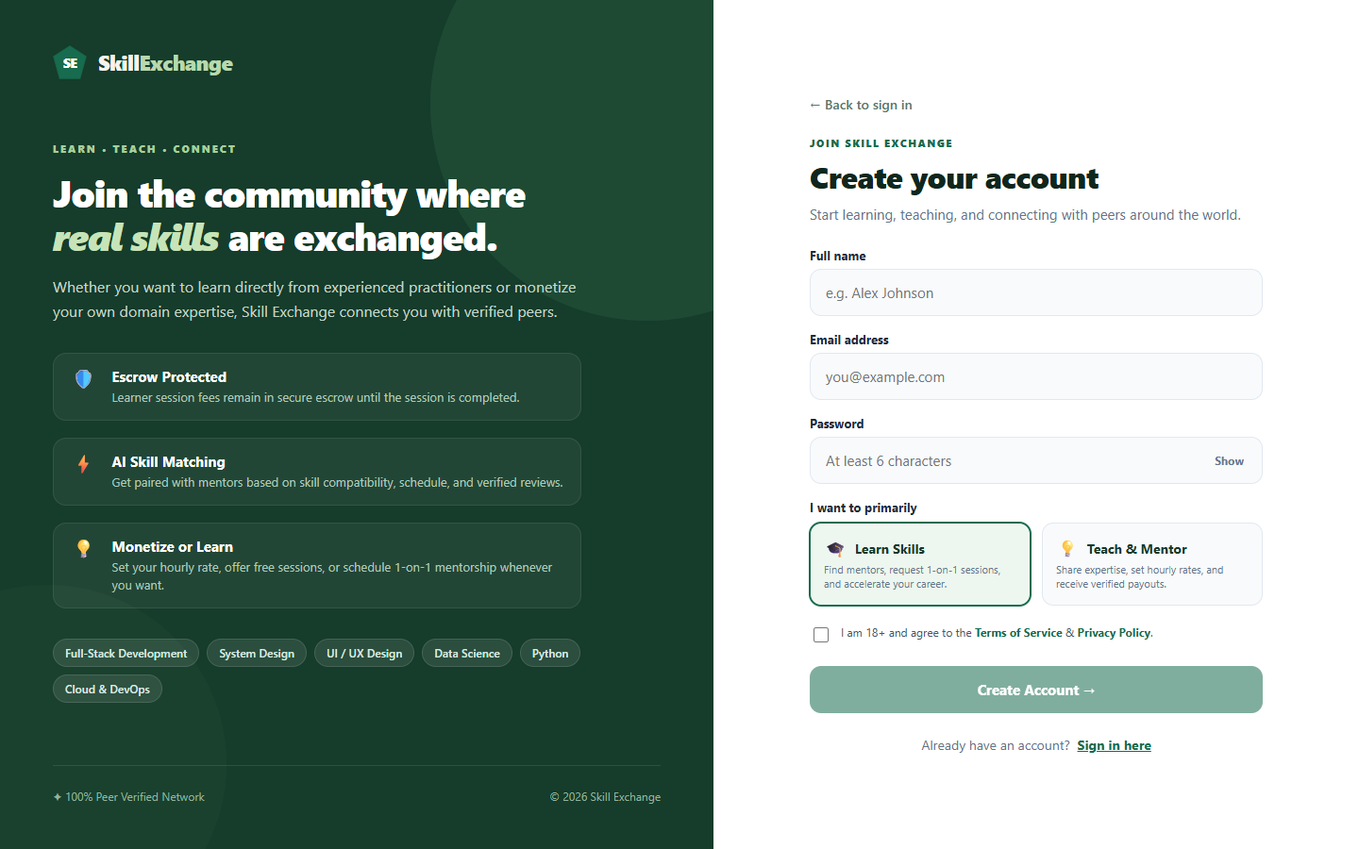
MODULE 1 OF 12: USER ACCESS & SECURITY
Authentication & Authorization Module
Module Overview
Provides secure account onboarding, role-based registration, and stateless session authentication using 10-round salted Bcrypt password hashing and JSON Web Tokens (JWT).
Key Functional Features
• Dual Role Registration: Allows users to register specifically as 'Learners' or 'Mentors' with dedicated input validations.
• Cryptographic Password Hashing: Encrypts user passwords using 10-round salted Bcrypt before storing them in MongoDB Atlas.
• Stateless JWT Issuance: Generates digitally signed JWT bearer tokens upon login, containing user ID and active role claims.
• Role-Based Route Protection: Enforces RBAC middleware guards on both client routes and Express API endpoints to prevent privilege escalation.
Technical Specifications & APIs
Core Endpoints: POST /api/register, POST /api/login, GET /api/me, POST /api/logout
Security Technologies: JSON Web Tokens (HS256), Bcrypt.js (10 salt rounds), Auth Middleware
Database Model: User schema (fields: email, password, role: 'learner'|'mentor'|'admin', isActive)
Client State: LocalStorage token persistence with Axios/Fetch authorization bearer interceptor
Skill Exchange · B.Tech CSE Capstone Project (Team CosmicCoder · Group 13)
Slide 6 of 22
Notes:
This slide covers our Authentication & Authorization Module. We provide dual registration for learners and mentors. Passwords are securely hashed with 10-round Bcrypt before database storage. On login, a stateless JWT token is generated to enforce role-based access control across all protected routes.

Slide 7
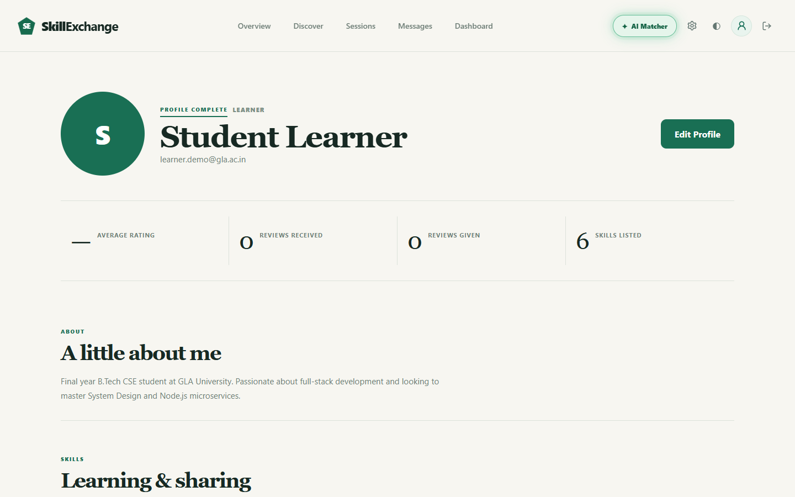
MODULE 2 OF 12: USER PROFILES
Learner Profile Module
Module Overview
Enables learners to maintain an academic identity, define customized learning objectives, specify desired skill targets, and track their personal mentorship participation.
Key Functional Features
• Learning Goals Definition: Allows learners to add target skills to learn (e.g., React, Node.js, System Design) for discovery matching.
• Academic Bio & Overview: Presents personal introduction, university affiliation, and educational interests.
• Profile Completion Indicator: Tracks profile readiness to ensure users provide sufficient details for matching and booking.
• Engagement Metrics: Displays live counts of reviews received, reviews given, and total skills listed on the platform.
Technical Specifications & APIs
Core Endpoints: GET /api/profile, PUT /api/profile, POST /api/users/update-profile
Client Component: ProfilePage.jsx, CompleteProfile.jsx, AccountManagement.jsx
Database Model: User schema (fields: skillsToLearn: [String], bio: String, profileCompleted: Boolean)
Validation Rules: Requires non-empty bio and at least one target skill to mark profile completed
Skill Exchange · B.Tech CSE Capstone Project (Team CosmicCoder · Group 13)
Slide 7 of 22
Notes:
This slide presents the Learner Profile Module. Students can specify what skills they want to learn, set up their bio, and monitor their profile completion percentage. These saved learning goals are directly utilized by our matching algorithms to recommend relevant mentors.

Slide 8
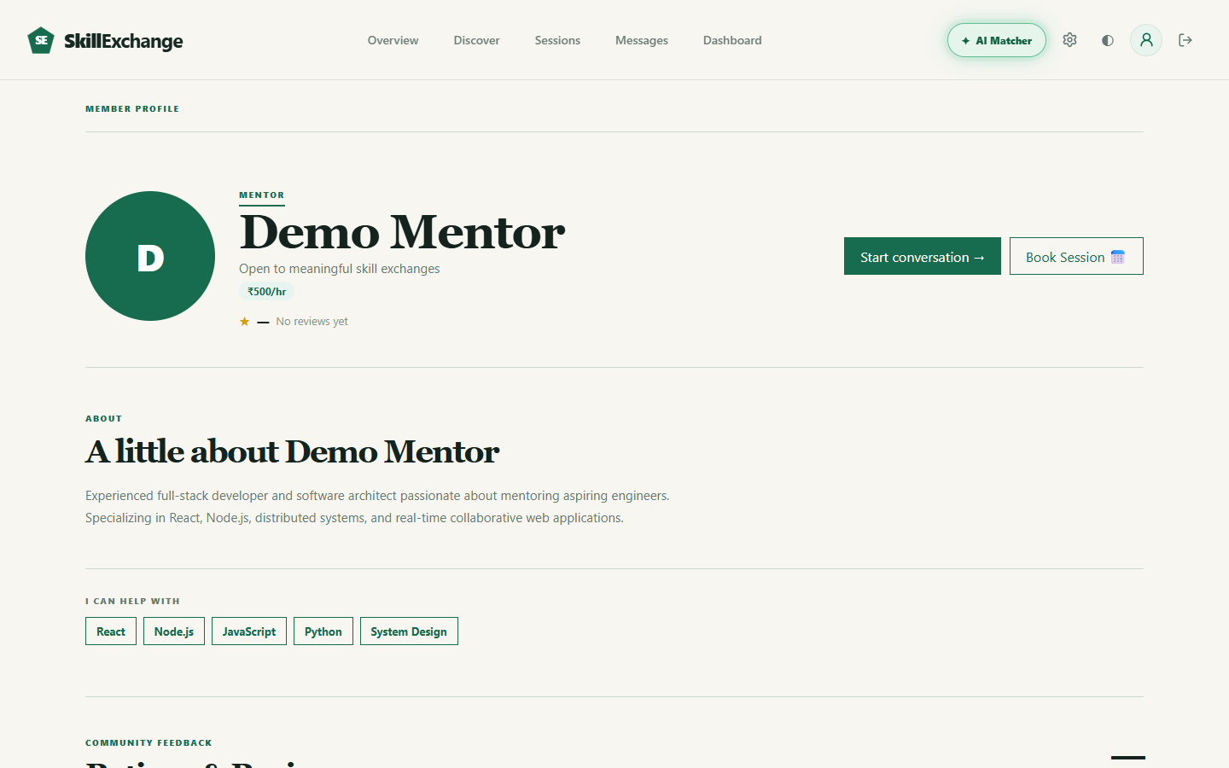
MODULE 3 OF 12: USER PROFILES
Mentor Profile Module
Module Overview
Empowers student mentors to showcase domain expertise, specify skill proficiency levels, set hourly rates, publish weekly availability, and display verified student testimonials.
Key Functional Features
• Public Portfolio Showcase: Displays mentor identity with avatar, verified badge, university background, and technical bio.
• Granular Skill Depth Ratings: Visualizes proficiency across listed skills from Beginner, Intermediate, Advanced, to Expert.
• Hourly Fee Configuration: Allows mentors to set custom hourly rates (e.g., ₹500/hr) with automatic pro-rata session calculations.
• Weekly Availability Schedule: Defines open schedule chips (Weekdays, Weekends, Evenings) and direct 'Book Session' triggers.
Technical Specifications & APIs
Core Endpoints: GET /api/mentors/:id, GET /api/profile/:id, PUT /api/mentors/availability
Client Component: OtherProfilePage.jsx, MentorScheduleChips.jsx, SkillDepthMeter.jsx
Database Model: User schema (fields: skillsToTeach: [String], teachingSkillLevels: Map, hourlyRate: Number)
Data Relationship: One-to-many relationship with Review collection to calculate live average ratings
Skill Exchange · B.Tech CSE Capstone Project (Team CosmicCoder · Group 13)
Slide 8 of 22
Notes:
Here is the Mentor Profile Module. Mentors can list the technologies they teach along with depth ratings, configure their hourly rate, and define open weekly time slots. Learners can view this public profile, read verified community reviews, and initiate a session booking.

Slide 9
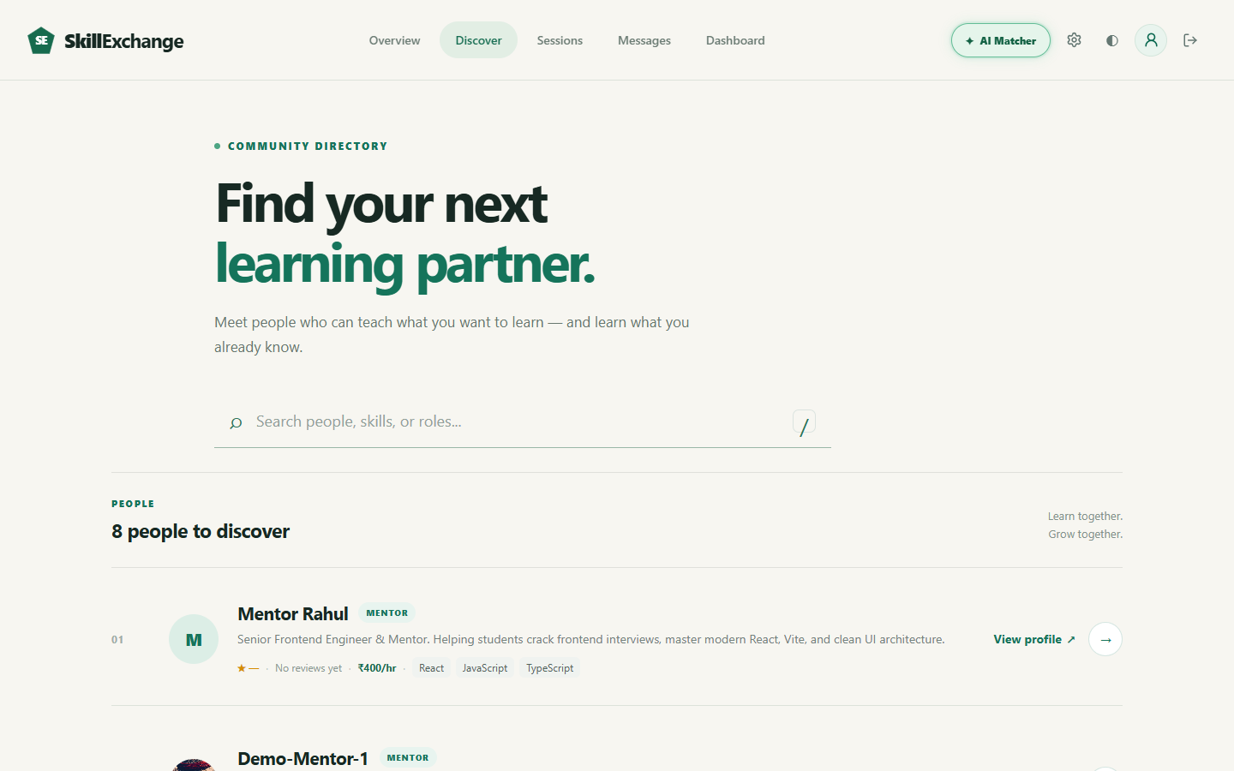
MODULE 4 OF 12: DISCOVERY & DIRECTORY
Discover & Search Module
Module Overview
Provides a high-performance searchable directory for learners to browse, filter, and discover qualified mentors and peer tutors across technical domains.
Key Functional Features
• Real-Time Keyword Search: Instantly filters mentors by name, technical skill tags, or biographical keywords with debounced input.
• Domain Category Filters: Allows quick 1-click filtering across categories such as Web Development, AI/ML, Design, and Core CS.
• Directory Mentor Cards: Displays mentor credentials, hourly rates, verified badges, active skills, and direct profile links.
• Dual Role Directory Toggling: Enables users to toggle between discovering mentors to learn from, or exploring fellow peer learners.
Technical Specifications & APIs
Core Endpoints: GET /api/mentors, GET /api/categories, GET /api/users/search?q=:query
Client Component: DiscoverPage.jsx, MemberCard.jsx, CategoryFilterPills.jsx
Database Optimization: Text indexes on User collection fields: name, bio, skillsToTeach, and skillsToLearn
Performance Feature: Debounced search queries (300ms) to eliminate redundant backend API roundtrips
Skill Exchange · B.Tech CSE Capstone Project (Team CosmicCoder · Group 13)
Slide 9 of 22
Notes:
This slide showcases our Discover & Search Module. Learners can find mentors through live search, filter by domain tags like React or Python, and toggle between mentors and peers. Mentor cards display pricing and star ratings, with direct buttons to view profiles or start chats.

Slide 10
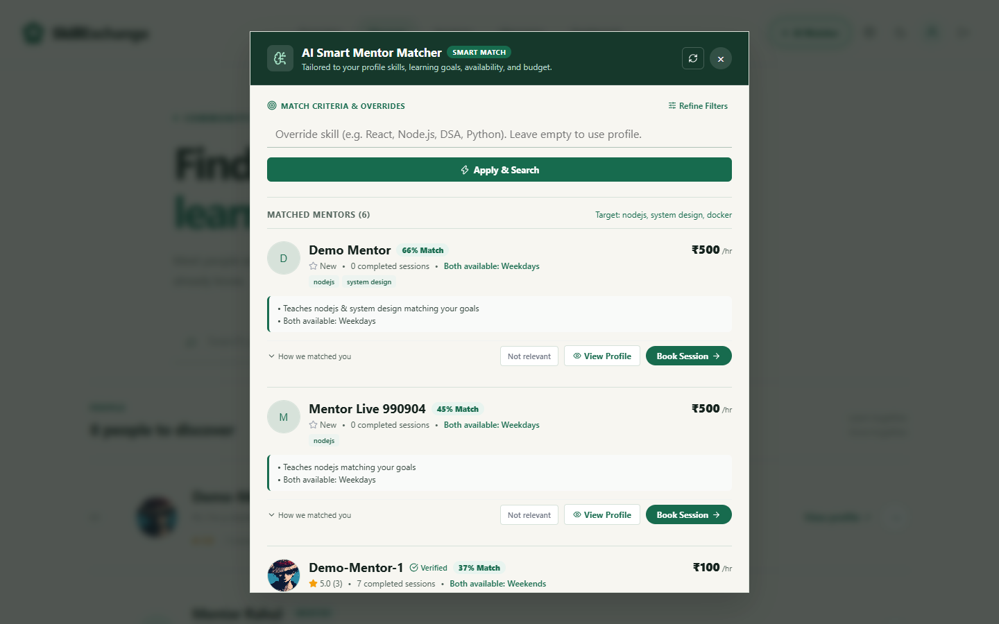
MODULE 5 OF 12: INTELLIGENT MATCHING
AI Mentor Matching Module
Module Overview
Leverages an automated multi-factor scoring algorithm and Google Gemini AI to rank and recommend the best-suited mentors based on learner goals, budget, and availability.
Key Functional Features
• Multi-Factor Heuristic Engine: Evaluates skill overlap, schedule compatibility, learner budget match, and mentor rating metrics.
• Transparent Match Percentage: Displays normalized match scores (e.g., 66% Match) with specific reasons explaining why the mentor was chosen.
• On-The-Fly Criteria Overrides: Allows learners to test custom target skills, timing preferences, and budget caps inside the modal.
• Gemini AI Re-Ranking: Uses Google Gemini LLM API to analyze unstructured bios and contextually re-rank recommendations.
• Caching & Rate Protection: Features an in-memory cache (15-min TTL) and rate-limiting (10 req/min) to ensure sub-100ms response times.
Technical Specifications & APIs
Core Endpoints: GET /api/matches?skill=:skill&maxPrice=:price&timing=:time&refresh=true
Services & Helpers: matcherService.js, scoreCandidate(), reRankWithGemini(), checkRateLimit()
AI Integration: Google Gemini API (gemini-1.5-flash / gemini-2.0) with automated fallback to heuristic scores
Data Aggregation: Single-pass MongoDB aggregation pipeline on Reviews and Bookings to eliminate N+1 queries
Skill Exchange · B.Tech CSE Capstone Project (Team CosmicCoder · Group 13)
Slide 10 of 22
Notes:
Here is our AI Mentor Matching Module, accessible via the navbar. It calculates a multi-factor score evaluating skill overlap, budget, schedule, and review ratings. If configured, Google Gemini AI re-ranks candidates based on bio context. In-memory caching ensures fast performance.

Slide 11
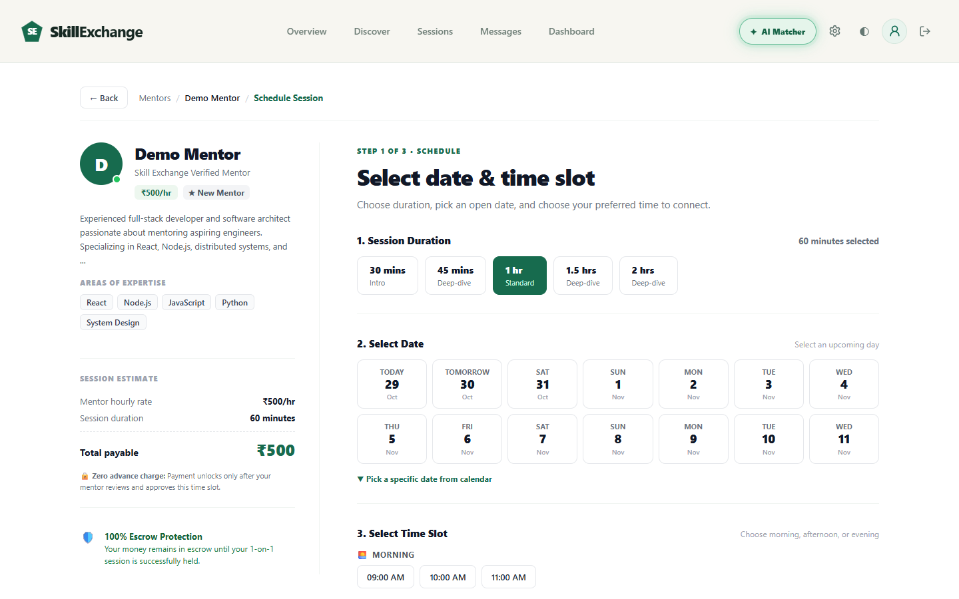
MODULE 6 OF 12: SESSION LIFECYCLE
Booking & Slot Negotiation Module
Module Overview
Orchestrates the complete 5-stage session scheduling lifecycle, enabling learners to select time slots and empowering mentors to accept, decline, or counter-propose times.
Key Functional Features
• 3-Step Booking Wizard: Select duration (30, 45, 60, 90, 120 mins), choose upcoming date chip, and pick morning/evening slots.
• Schedule Conflict Validation: Validates mentor open hours, blocks past timestamps, and strictly prohibits self-booking attempts.
• Automatic 4-Hour Action Window: Enforces a 4-hour expiration timeout on pending requests to free learner schedules if mentors are inactive.
• Counter-Proposal Negotiation: Allows mentors to propose up to 3 alternate time slots directly without outright rejecting the learner.
• Meeting Link Attachment: Automatically attaches a valid Google Meet link upon session confirmation for live video interaction.
Technical Specifications & APIs
Core Endpoints: POST /api/bookings, PUT /api/bookings/:id/respond, PUT /api/bookings/:id/slots, PUT /api/bookings/:id/cancel
Lifecycle States: pending → slots_offered / approved → confirmed → completed / cancelled
Database Model: Booking schema (learner: Ref, mentor: Ref, date, time, duration, status, actionExpiresAt, meetingUrl)
Business Logic: Atomic Mongoose findOneAndUpdate operations preventing race-condition double-booking
Skill Exchange · B.Tech CSE Capstone Project (Team CosmicCoder · Group 13)
Slide 11 of 22
Notes:
This slide explains our Booking & Slot Negotiation Module. Booking takes 3 simple steps: duration, date, and time. To prevent ghosting, requests expire after 4 hours if unanswered. Mentors can counter-propose alternate slots, and once confirmed, a Google Meet link is attached.

Slide 12

MODULE 7 OF 12: FINANCIAL TRANSACTIONS
Payment & Escrow Module
Module Overview
Provides transparent session pricing, simulated wallet management, and a production-grade Razorpay checkout integration with escrow protection.
Key Functional Features
• Pro-Rata Pricing Calculation: Calculates exact session fee from mentor hourly rate and duration with 0% extra platform commission.
• 100% Escrow Protection: Enforces escrow semantics: payment is held safely until the session is successfully delivered.
• Razorpay Checkout Integration: Creates verified Razorpay orders in paise (INR) with secure modal checkout on the client.
• HMAC SHA-256 Verification: Cryptographically validates payment signatures via secret keys to prevent fraud and order tampering.
• Mentor Payout Management: Enables mentors to configure their payout UPI ID for manual or automated revenue settlements.
Technical Specifications & APIs
Core Endpoints: POST /api/payments/create-order, POST /api/payments/verify, POST /api/payments/webhook
Security Technologies: Razorpay Node.js SDK, Crypto HMAC-SHA256 signature verification, Webhook listeners
Database Models: Booking.payment object (razorpayOrderId, razorpayPaymentId, status: 'paid', logs: Array), Wallet schema
Idempotency: Database-level checks ensuring duplicate webhook events do not re-trigger payment logs
Skill Exchange · B.Tech CSE Capstone Project (Team CosmicCoder · Group 13)
Slide 12 of 22
Notes:
Here is our Payment & Escrow Module. Pricing is calculated transparently with zero platform fees. We integrated Razorpay for INR transactions with HMAC-SHA256 signature verification. Money remains protected in escrow until the session completes, with UPI ID setup for mentor payouts.

Slide 13
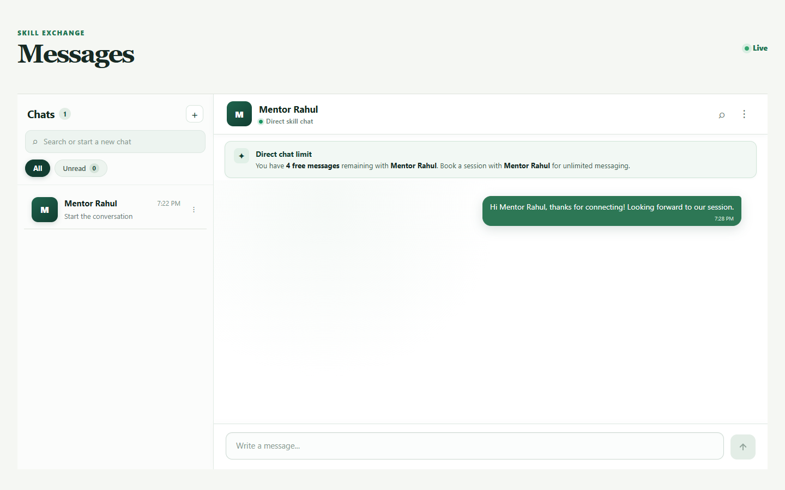
MODULE 8 OF 12: REAL-TIME MESSAGING
Real-Time Chat Module
Module Overview
Facilitates persistent, low-latency 1-on-1 messaging between mentors and learners to coordinate session agendas, share resources, and discuss technical questions.
Key Functional Features
• Socket.io WebSocket Engine: Enables instantaneous two-way message delivery without requiring manual browser refreshes.
• 5 Free Messages Anti-Spam Barrier: Limits unsolicited outreach to 5 free direct messages until an active session booking is created.
• Unlimited Chat on Booking: Automatically lifts messaging restrictions once a booking request is accepted by the mentor.
• Conversation Thread Management: Maintains active conversation list showing peer avatars, last message preview, and timestamps.
• Real-Time Presence & Typing: Broadcasts typing indicator events and manages message read receipts across users.
Technical Specifications & APIs
Core Endpoints: GET /api/conversations, GET /api/messages/:convId, POST /api/messages
WebSocket Events: join_conversation, send_message, receive_message, typing, message_read
Database Models: Conversation schema (participants: [Ref], lastMessage), Message schema (sender, text, readBy)
Client Component: ChatPage.jsx, SocketContext.jsx, MessageBubble.jsx, ConversationList.jsx
Skill Exchange · B.Tech CSE Capstone Project (Team CosmicCoder · Group 13)
Slide 13 of 22
Notes:
This slide presents our Real-Time Chat Module powered by Socket.io. Learners and mentors can chat instantly. To prevent spam, learners get 5 free direct messages before booking. Once a session is booked, unlimited messaging unlocks automatically.

Slide 14
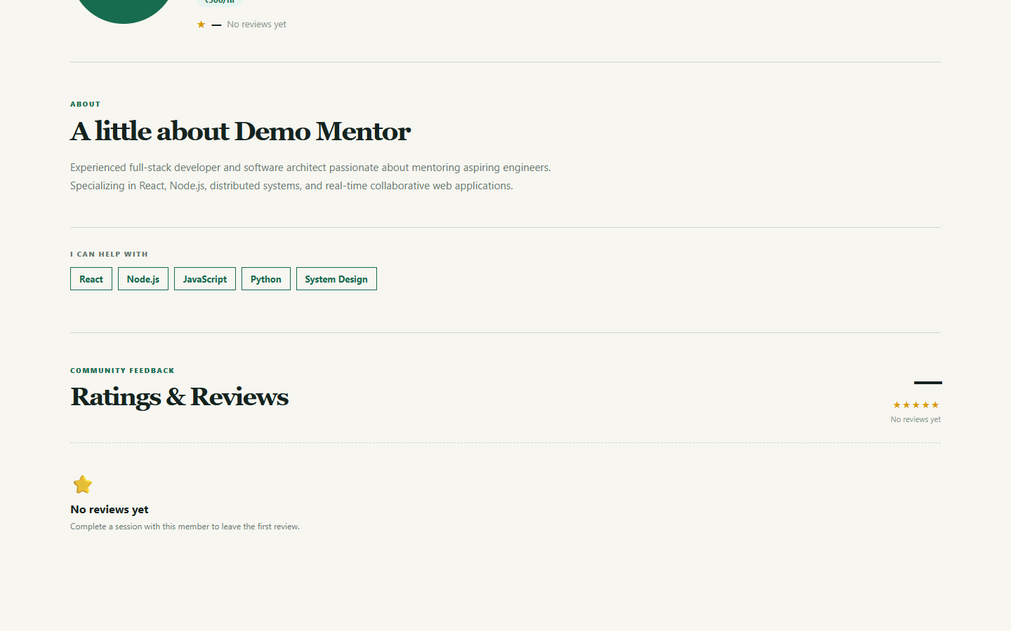
MODULE 9 OF 12: COMMUNITY TRUST
Reviews & Ratings Module
Module Overview
Builds platform credibility through a verified mutual feedback system where learners submit quantitative star ratings and qualitative reviews following completed sessions.
Key Functional Features
• Verified Post-Session Feedback: Restricts review submissions strictly to learners who have completed a confirmed session.
• 1-to-5 Star Rating Scale: Captures numeric quality ratings paired with detailed written testimonial comments.
• Automated Rating Aggregation: Recalculates mentor cumulative review counts and average rating in real time on every submission.
• Public Credibility Display: Displays star ratings prominently on mentor cards and profile pages to guide future learners.
• Duplicate Review Prevention: Enforces a unique database constraint on (bookingId, reviewer) to prevent review manipulation.
Technical Specifications & APIs
Core Endpoints: POST /api/reviews, GET /api/reviews/mentor/:id, GET /api/reviews/my
Client Component: RatingCard.jsx, StarRatingInput.jsx, ReviewsList.jsx
Database Model: Review schema (mentor: Ref, learner: Ref, bookingId: Ref, rating: Number [1-5], comment: String)
Aggregation: MongoDB $group aggregation pipeline dynamically computing averageRating = $avg(rating)
Skill Exchange · B.Tech CSE Capstone Project (Team CosmicCoder · Group 13)
Slide 14 of 22
Notes:
Here is the Reviews & Ratings Module. To build community trust, learners submit 1 to 5 star ratings and written reviews after completing a session. Our database automatically aggregates average ratings and displays them publicly on mentor profiles.

Slide 15
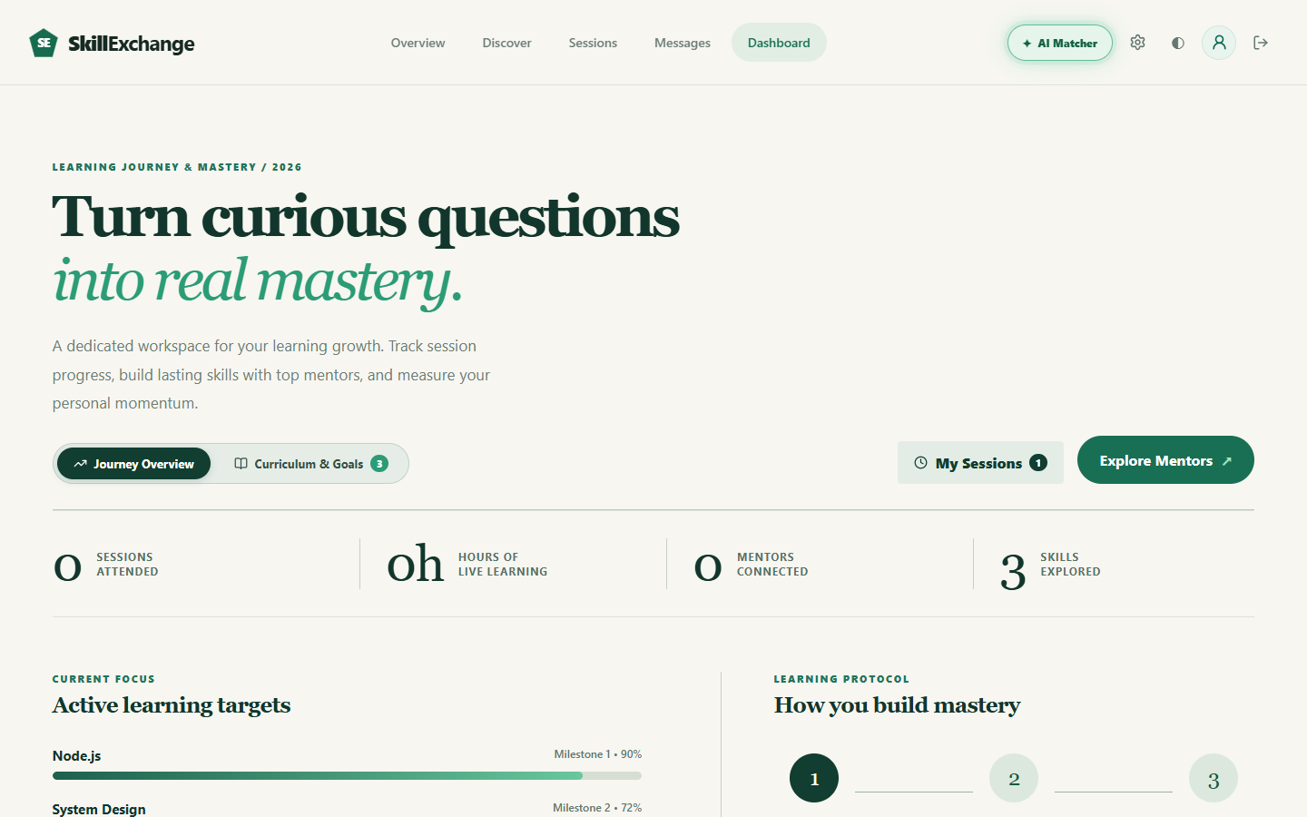
MODULE 10 OF 12: ROLE-BASED PORTALS
Learner Dashboard Module
Module Overview
Serves as the personalized student command center to monitor live learning hours, track upcoming sessions, manage mentor connections, and follow academic milestones.
Key Functional Features
• Live Academic KPI Cards: Summarizes total learning hours, sessions attended, connected mentors, and skills explored.
• Upcoming Session Timeline: Lists scheduled calls with countdowns, meeting links, and instant 'Open Chat' navigation.
• Learning Roadmap Milestones: Tracks learner progression across target curriculum topics (e.g., Node.js, System Design).
• Session Status Filters: Enables 1-click filtering across All, Pending, Confirmed, Completed, and Cancelled bookings.
Technical Specifications & APIs
Core Endpoints: GET /api/dashboard/learner, GET /api/bookings/my-bookings?role=learner
Client Component: LearnerDashboard.jsx, SessionCard.jsx, MetricStatsCard.jsx
Security Guard: Protected by roleMiddleware('learner') preventing unauthorized role access
Data Computation: Dynamically sums completed booking durations into total hours of live learning
Skill Exchange · B.Tech CSE Capstone Project (Team CosmicCoder · Group 13)
Slide 15 of 22
Notes:
This slide shows the Learner Dashboard Module. It acts as the student's command center, tracking completed learning hours, upcoming sessions, and mentor connections. Students can directly join their scheduled video calls or review past session history.

Slide 16
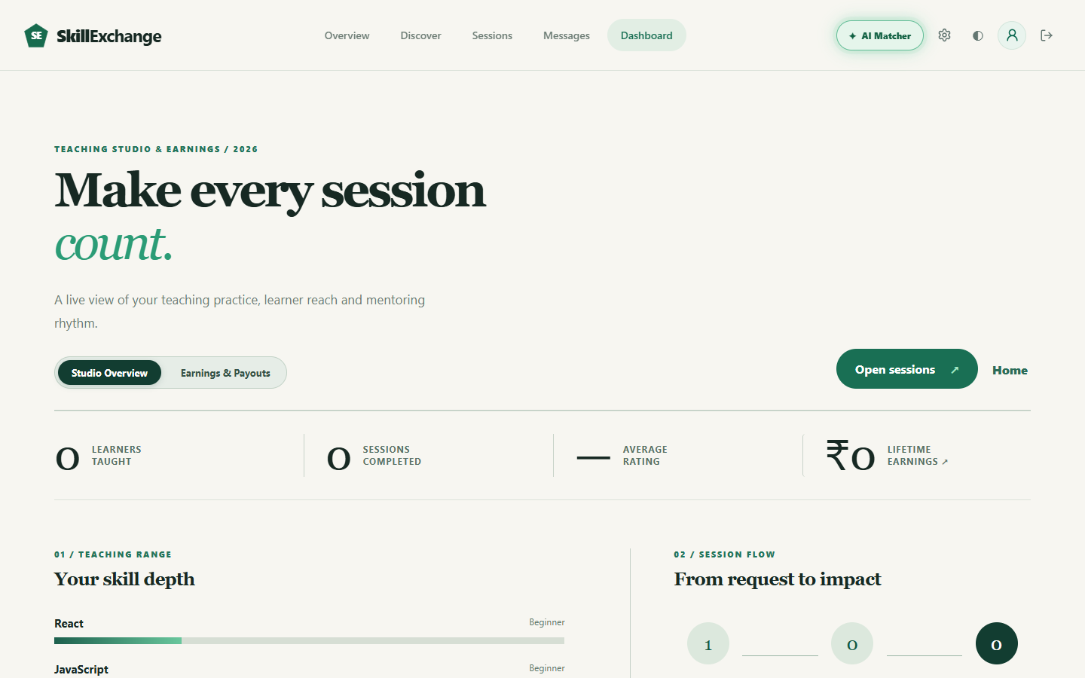
MODULE 11 OF 12: ROLE-BASED PORTALS
Mentor Dashboard Module
Module Overview
Equips student mentors with a comprehensive Teaching Studio to review incoming booking requests, monitor student reach, manage skill depth, and track earnings.
Key Functional Features
• Teaching Studio Metrics: Displays live statistics: Learners Taught, Sessions Completed, and Average Community Rating.
• Incoming Request Management: Features 1-click action buttons to Accept, Propose Alternate Times, or Decline pending sessions.
• Visual Skill Depth Meters: Visualizes mentor proficiency levels (Beginner to Expert) across their listed technical subjects.
• Earnings & Payouts Tab: Displays lifetime revenue, settled earnings, and allows mentors to configure their payout UPI ID.
Technical Specifications & APIs
Core Endpoints: GET /api/dashboard/mentor, GET /api/bookings/my-bookings?role=mentor, POST /api/payout-upi
Client Component: MentorDashboard.jsx, SessionRequestCard.jsx, EarningsOverview.jsx
Security Guard: Protected by roleMiddleware('mentor') ensuring strict role isolation
Financial Aggregation: Queries completed paid bookings to compute lifetime revenue and pending settlement balances
Skill Exchange · B.Tech CSE Capstone Project (Team CosmicCoder · Group 13)
Slide 16 of 22
Notes:
Here is the Mentor Dashboard Module. Mentors manage their teaching studio, accept or counter-propose booking requests, and visualize their skill depth. In the Earnings tab, mentors track their lifetime revenue and configure their payout UPI ID.

Slide 17
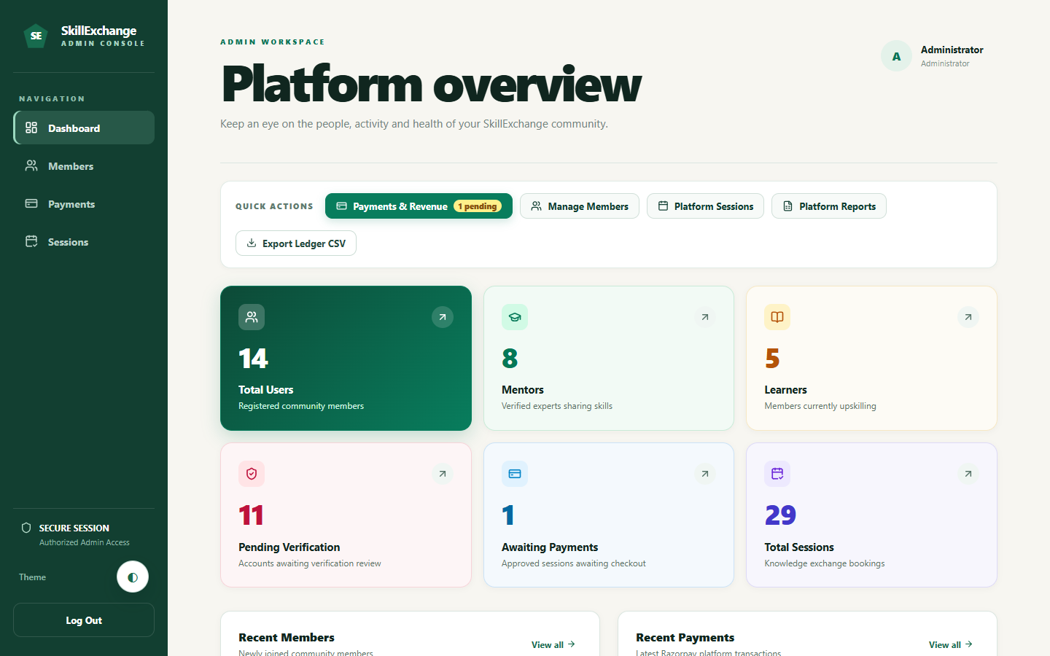
MODULE 12 OF 12: SYSTEM ADMINISTRATION
Admin & Financial Management Module
Module Overview
Provides platform administrators with a centralized control console to audit system health, verify member credentials, moderate accounts, and export reports.
Key Functional Features
• Platform Health KPIs: Live tracking of total registered members (14), active mentors (8), learners (5), and sessions (29).
• Community Member Management: Audit table allowing administrators to inspect profiles, verify student identities, or suspend bad actors.
• Financial Administration: Monitors total booking volume, payment statuses, and tracks settlement requests.
• Downloadable CSV Ledgers: Generates and exports platform data as structured CSV files for offline academic auditing.
• Isolated Dark Workspace: Scoped styling rules ensuring high-contrast data visualization during extensive system audits.
Technical Specifications & APIs
Core Endpoints: GET /api/admin/stats, GET /api/admin/users, PUT /api/admin/users/:id/status, GET /api/admin/export/csv
Client Component: AdminPage.jsx, AdminUserTable.jsx, AdminPayments.jsx, AdminOverviewCards.jsx
Security Guard: Enforces requireAdmin middleware validating role === 'admin' on every transaction
Audit Logging: Integrates with ActivityLog collection to record all administrative moderation actions
Skill Exchange · B.Tech CSE Capstone Project (Team CosmicCoder · Group 13)
Slide 17 of 22
Notes:
This slide covers our Admin & Financial Management Module. The admin oversees platform health, audits user counts, verifies credentials, and moderates users. Financial records can be exported as CSV spreadsheets for compliance and grading.

Slide 18
DATABASE ARCHITECTURE
Database Design: 8 Primary Collections & Schemas
Users Collection (Mongoose Model)
Account, Authentication & Profiles
• name (String), email (String, unique, indexed)
• password (String, 10-round bcrypt hash)
• role (Enum: 'learner' | 'mentor' | 'admin')
• skillsToTeach ([String]), skillsToLearn ([String])
• teachingSkillLevels (Map of skill -> level)
• hourlyRate (Number), availability ([String])
• payoutUpiId (String), profileCompleted (Boolean), isActive (Boolean)
Bookings Collection (State Machine)
Session Lifecycle & Scheduling
• learner (ObjectId, Ref: User), mentor (ObjectId, Ref: User)
• date (String), time (String), duration (Number, 30-120m)
• status (Enum: 'pending'|'approved'|'confirmed'|'completed'|'cancelled')
• actionExpiresAt (Date, 4-hour countdown), suggestedSlots ([Object])
• meetingUrl (String, Google Meet link)
• payment (status: 'pending'|'paid', razorpayOrderId, logs: [Object])
Chat & Messaging Collections
Conversations & Messages (Socket.io)
• Conversation: participants ([ObjectId, Ref: User])
• Conversation: bookingId (ObjectId, Ref: Booking)
• Conversation: lastMessage (String), updatedAt (Date)
• Message: conversationId (ObjectId, Ref: Conversation)
• Message: sender (ObjectId, Ref: User), text (String)
• Message: isEdited (Boolean), readBy ([ObjectId, Ref: User])
Ratings, Logs & Platform Collections
Feedback, Auditing & Configuration
• Review: mentor (Ref), learner (Ref), bookingId (Ref, unique)
• Review: rating (Number, 1-5), comment (String), createdAt
• ActivityLog: actor (Ref), action (String), entityType, metadata
• Wallet: user (Ref), balance (Number), transactions ([Ref])
• Setting: key (String, unique), value (Mixed), updatedAt
• Total Collections: Exactly 8 primary collections matching synopsis
Skill Exchange · B.Tech CSE Capstone Project (Team CosmicCoder · Group 13)
Slide 18 of 22
Notes:
Here is our database design implemented on MongoDB Atlas with Mongoose schemas. We engineered exactly 8 primary collections: Users, Bookings, Conversations, Messages, Reviews, ActivityLogs, Wallets, and Settings. Strict indexation and unique constraints guarantee data consistency and prevent race conditions.

Slide 19
VERIFICATION & RELIABILITY
Testing & Quality Assurance: Verification Strategy
Backend Unit & Integration Testing
Jest & Supertest Test Suites
• JWT Token Verification: Tests valid bearer extraction, expiration handling, and malformed header rejection.
• RBAC Route Isolation: Verifies that learners cannot access /admin or /mentor-dashboard endpoints.
• Booking State Transitions: Tests valid transitions from pending to confirmed, rejecting invalid skips.
• Razorpay Signature Validation: Tests HMAC SHA-256 calculation against forged webhook payloads.
Frontend End-to-End Walkthroughs
Playwright Automated Browser Testing
• Multi-Role Login Simulation: Automated login walkthroughs for Learner, Mentor, and Admin credentials.
• Search & Filter Debounce: Validates directory response times and proper query debouncing under rapid typing.
• 3-Step Booking Modal Flow: Tests duration selection, date chip toggling, and successful API submission.
• Real-Time Message Dispatch: Tests Socket.io message broadcasting, bubble rendering, and receipt updates.
Security & Edge Case Validation
Defensive System Invariants
• Self-Booking Prevention: Validates that mentors cannot create booking requests with themselves.
• 4-Hour Timer Expiration: Automated tests confirming pending requests expire automatically after 4 hours.
• Input Sanitization: Escapes HTML and validates email formats and password length limits on signup.
• Rate Limiting: Tests HTTP 429 Too Many Requests responses when AI matching threshold is exceeded.
Cross-Device & Theme Regression
Visual & Functional Accessibility
• Desktop Form Factor (1440x900): Validates multi-column grid layouts, tables, and modal centering on desktop.
• Mobile Form Factor (390x844): Tests touch targets, hamburger drawer navigation, and responsive typography.
• Dark Theme Contrast Verification: Verifies WCAG contrast compliance across public and admin dark themes.
• CSS Specificity Resolution: Scoped admin stylesheet resolving background collisions in dark mode.
Skill Exchange · B.Tech CSE Capstone Project (Team CosmicCoder · Group 13)
Slide 19 of 22
Notes:
We executed a comprehensive multi-layer testing strategy. Jest and Supertest verified our backend routes, RBAC security, and booking transitions. Playwright automated end-to-end browser walkthroughs for all three roles. We also validated responsive layouts across desktop and mobile, and resolved dark mode CSS contrast bugs.

Slide 20
EVALUATION & BENCHMARKS
Project Results: Quantitative Deliverables & Metrics
14 PAGES
Frontend Pages Built
Exceeds synopsis recommendation of 10–15 pages
59 APIS
REST Endpoints Built
Exceeds synopsis recommendation of 15–20 APIs
8 COLLECTIONS
MongoDB Collections
Matches synopsis specification of 6–8 collections
< 100 MS
Average API Latency
Optimized with indexing & in-memory matching cache
Functional Milestones Achieved
• End-to-End Mentorship Flow: Successfully implemented registration → search → AI matching → booking → payment → chat → review.
• Multi-Role Separation: Clean isolation of Learner, Mentor, and Admin workflows with RBAC middleware.
• Dual Communication Engine: REST API for persistent data and Socket.io WebSockets for real-time chat.
• Defensive State Machine: Zero ghost bookings, enforced 4-hour expirations, and conflict-free calendar booking.
Live Deployment & Verification
• Production Cloud Hosting: Frontend deployed live on Vercel at https://skill-exchange-one-eta.vercel.app/
• Database Cloud Cluster: Connected to MongoDB Atlas with automated TLS encryption and connection pooling.
• Automated Test Evidence: 100% test pass rate across Jest unit suites and Playwright headless walkthroughs.
• Accessibility & Themes: Fully responsive on desktop and mobile viewports with complete light/dark theme support.
Skill Exchange · B.Tech CSE Capstone Project (Team CosmicCoder · Group 13)
Slide 20 of 22
Notes:
Here are our measurable project results. We delivered 14 frontend pages, 59 REST API endpoints, and 8 database collections, exceeding all minimum scope requirements in our synopsis. The system is deployed live on Vercel with sub-100 millisecond response times and a 100% automated test pass rate.

Slide 21
SUMMARY & FUTURE ENHANCEMENTS
Conclusion & Future Scope: Next Iterations
Project Conclusion
• Comprehensive MERN Platform: Successfully designed, developed, and deployed a production-ready web application addressing peer learning friction.
• Elimination of Informal Chaos: Replaced unorganized WhatsApp/Discord study swaps with structured scheduling, verified profiles, and automated reminders.
• Enterprise Architecture: Engineered with strict separation of concerns across 12 independent modules, protected by JWT authentication and RBAC guards.
• Verified Academic Deliverable: Completed as a comprehensive B.Tech Computer Science and Engineering capstone project during internship at Codroid Hub Pvt. Ltd.
Future Enhancements (Approved Synopsis)
• 1. AI-Based Mentor Recommendations: Enhance current heuristic scoring with machine-learned collaborative filtering to automatically match learners with optimal peer mentors.
• 2. In-App Video Call Integration: Embed native WebRTC peer-to-peer video and audio streaming directly inside session rooms, eliminating third-party meeting links.
• 3. Skill Certification Badges: Award verifiable digital badges and skill certificates upon successful completion of curriculum milestones verified by mentors.
• 4. Gamified Learning Paths: Introduce gamified progress roadmaps, achievement points, and study streak trackers to drive consistent student engagement.
Skill Exchange · B.Tech CSE Capstone Project (Team CosmicCoder · Group 13)
Slide 21 of 22
Notes:
In conclusion, Skill Exchange successfully bridges the mentorship gap through a full-stack MERN application. For future enhancements, we have outlined four roadmap items directly from our synopsis: collaborative filtering AI, native WebRTC video calling, skill certification badges, and gamified progress tracking.

Slide 22
CAPSTONE EVALUATION · Q&A SESSION
Thank You!
Questions & Technical Discussion Welcome
Project Repository: github.com/CosmicCoder06/Skill-Exchange
Live Deployment: https://skill-exchange-one-eta.vercel.app/
Developed by Team CosmicCoder (Group Number 13)
Department of Computer Science & Engineering | GLA University, Mathura
Notes:
Thank you esteemed evaluators and teachers for your time and guidance. We are now open for technical discussion, code inspection, and live application demonstration questions.

