Slide 1
Skill Exchange
A platform connecting mentors and learners
MERN Stack Project | B.Tech CSE, GLA University, Mathura | Internship at Codroid Hub Pvt Ltd
Team Members: __________________________________________________
Guide / Mentor: __________________________________________________

Slide 2
Problem & Objective
Problem Statement
• Expensive Coaching: Commercial 1-on-1 tutoring platforms charge high hourly rates that college students cannot afford.
• Fragmented Channels: Students currently arrange peer help across WhatsApp, Discord, and Google Calendar without proper coordination.
• Ghosting & No-Shows: Informal peer sessions often fail due to lack of scheduling commitment and zero accountability.
• No Secure Escrow: Free swapping lacks reliability, while informal payments lack safety and dispute resolution.
Project Objectives
• Centralized Peer Platform: Build a single web app connecting campus learners and mentors for verified 1-on-1 sessions.
• Flexible Scheduling: Provide date chips, duration picker, and slot negotiation with automated expiry windows.
• Real-Time Messaging: Integrate WebSocket-based chat for instant communication before and during sessions.
• Transparent Governance: Give administrators oversight over community members, session disputes, and payout ledgers.

Slide 3
Technology Stack
Frontend: React 19 & Vite
• Modern component-driven UI with Vite bundling for fast loading
• Client-side routing with React Router
• Lucide React iconography & custom clean CSS themes
Backend: Node.js & Express.js
• RESTful API architecture handling auth, bookings, and profiles
• Modular controllers, routes, and middleware pipeline
• Input validation and CORS configuration
Database: MongoDB Atlas
• NoSQL document database hosted on cloud Atlas
• Mongoose ODM for robust schema validation and indexing
• Stores users, bookings, messages, reviews, and logs
Real-Time: Socket.io
• Bi-directional WebSocket connection for instant 1-on-1 chat
• Unread message tracking and active session gating
• Real-time presence and connection resilience
Auth & Security: JWT Authentication
• Stateless token-based auth with accessToken stored securely
• Role-based authorization for Learner, Mentor, and Admin
• Bcrypt password hashing with salt rounds
Integrations: Razorpay & Google Meet
• Escrow payment integration with Razorpay order API
• 18% GST calculation and 3% platform commission logic
• Automatic Google Meet URL provisioning for confirmed calls

Slide 4
System Architecture
React Client (Frontend)
• Vite + React 19 UI
• Role Dashboards
• Booking Calendar
• Socket.io Client
• Local Storage Token
REST / HTTP
Express / Node.js API
• JWT Auth Middleware
• Booking Lifecycle Engine
• Socket.io Chat Server
• Escrow & Fees Calculator
• Admin Governance API
MongoDB Atlas
• Users & Profiles
• Bookings & Slots
• Chat Messages
• Reviews & Ratings
• Activity Logs
Mongoose ODM
WebSocket (Chat)

Slide 5
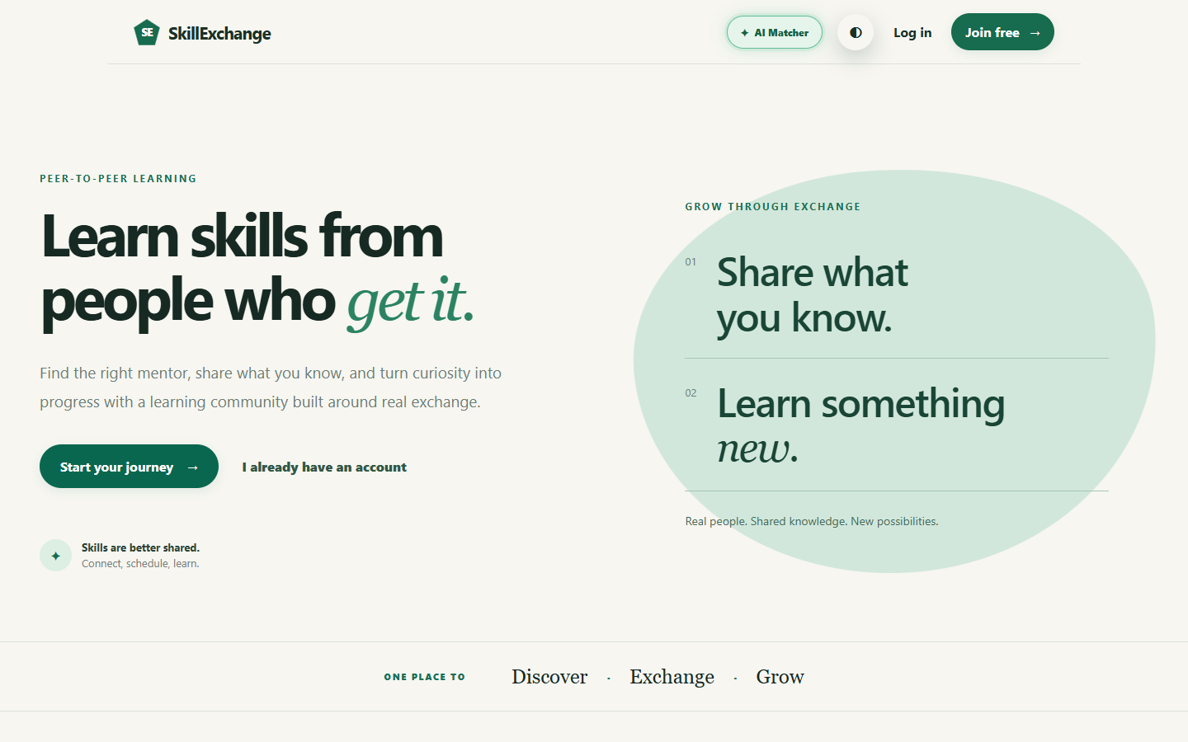
Home & Landing Page
• Modern First Impression: Introduces students to the peer-to-peer knowledge sharing model with clear call-to-actions.
• Clear Exchange Proposition: Emphasizes two primary paths — 'Share what you know' as a mentor and 'Learn something new' as a student.
• Interactive Navigation: Fast access to Sign in, Register free, Theme mode toggle, and the experimental AI Matcher modal.

Slide 6
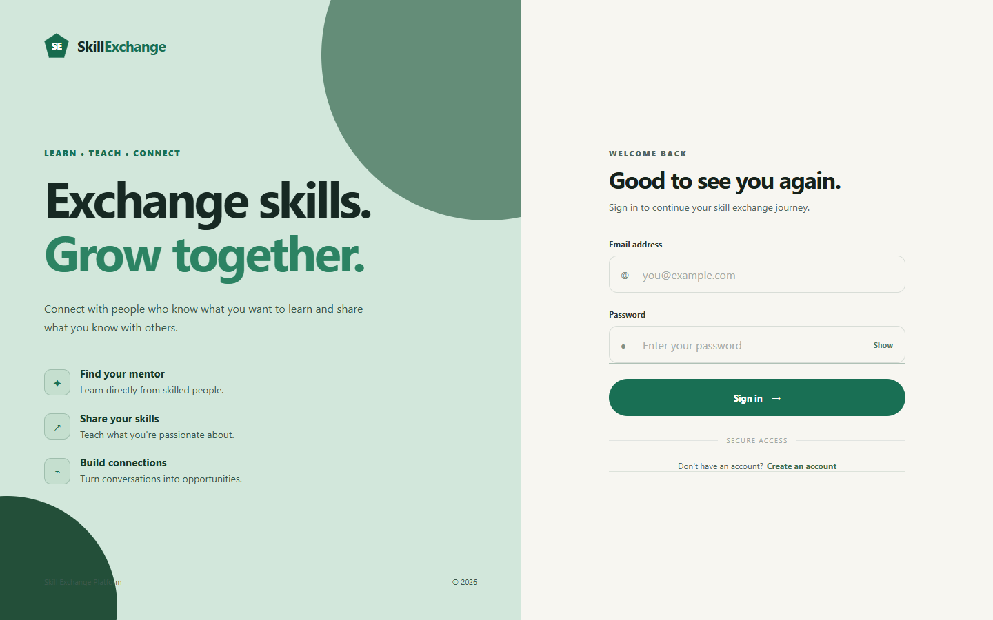
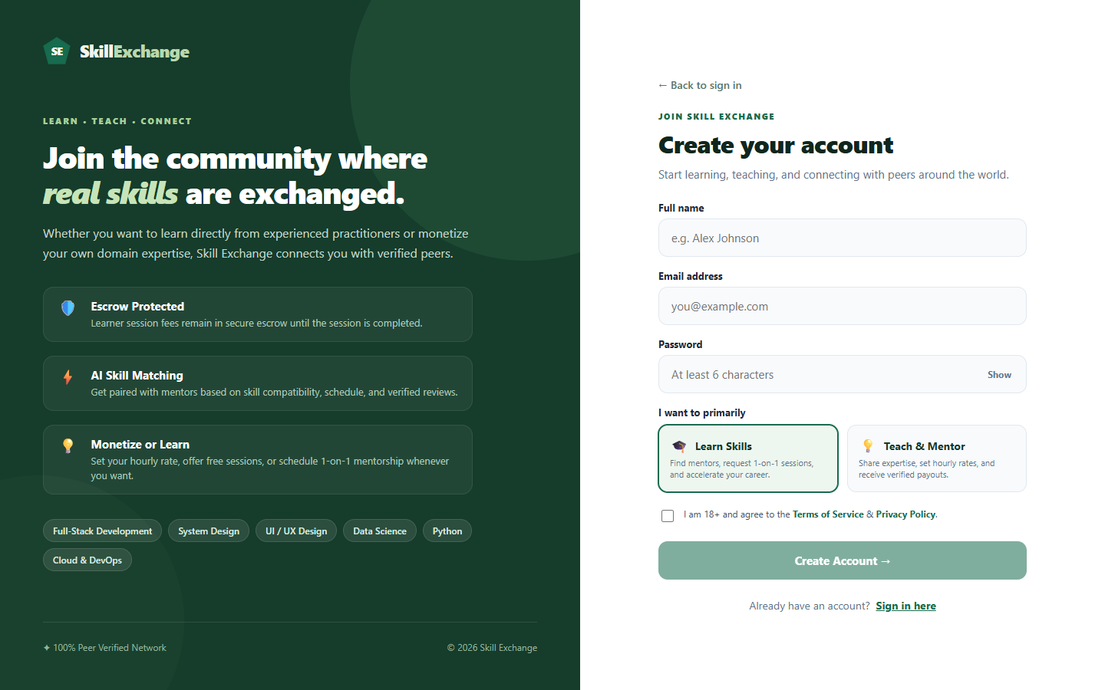
Authentication (Signup & Login)
• Role Selection: New users can easily choose between 'Learn Skills' and 'Teach & Mentor' during registration.
• Secure JWT Flow: Passwords are encrypted with bcrypt, and verified logins return JWT tokens saved in local storage.
• Direct Redirection: Directs authenticated users immediately to their respective learner or mentor dashboard.

Slide 7
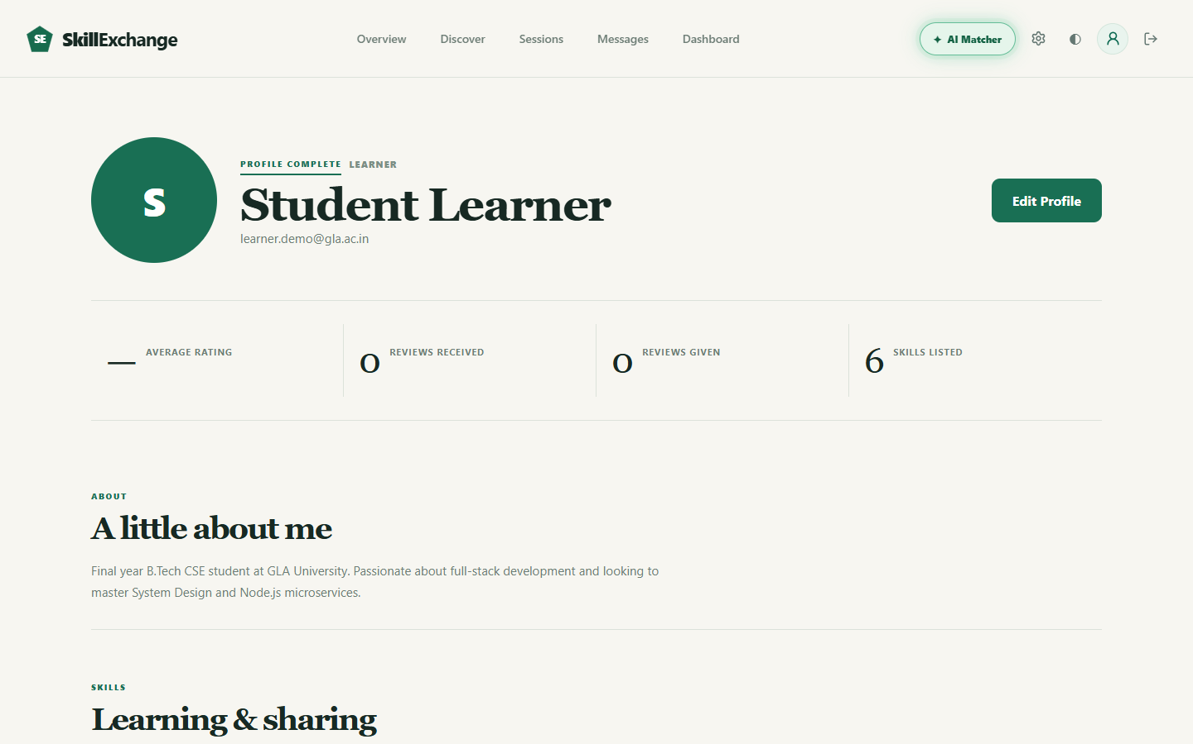
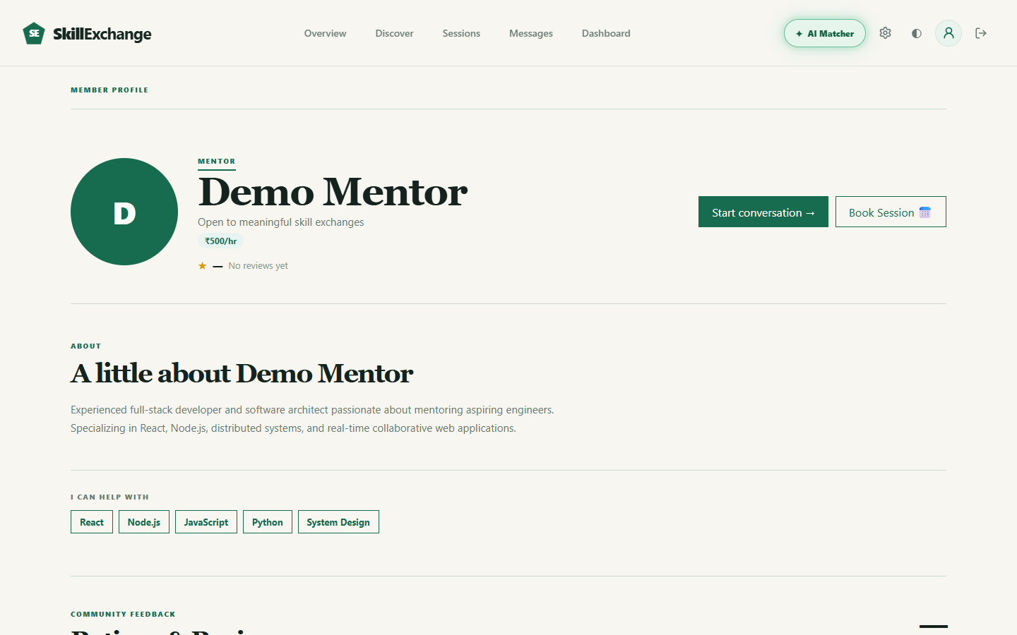
Profile Management (My Profile & Mentor Profile)
• Comprehensive Profile: Allows users to showcase bio, skills to teach, skills to learn, and available weekly time slots.
• Public Mentor Page: Displays verified mentor badges, hourly consultation rates, skill tags, and rating averages.
• Direct Action Triggers: Other students can start a 1-on-1 chat or jump directly into the session booking calendar.

Slide 8
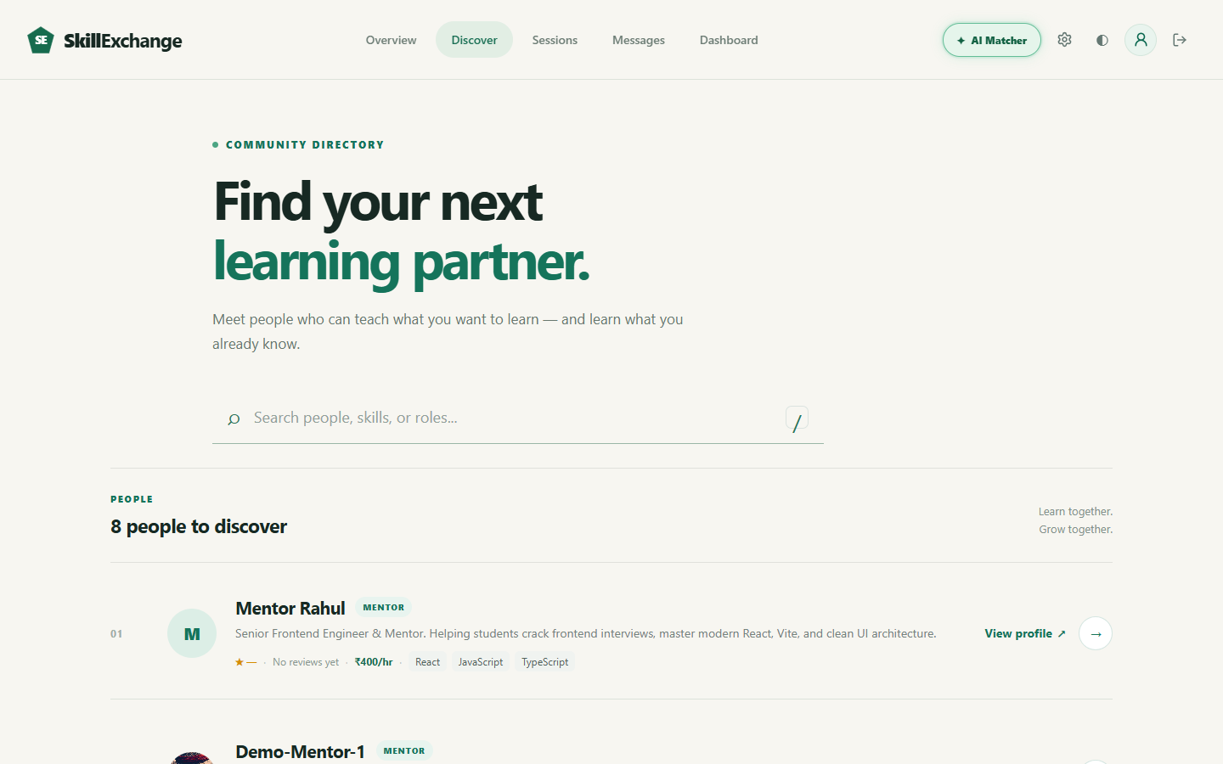
Discover Mentors & Peers
• Searchable Directory: Lists verified mentors across various domains including React, Node.js, Python, and System Design.
• Skill & Rate Transparency: Each mentor card highlights key teaching skills, hourly fees, and average community star ratings.
• Fast Filtering: Instant live search lets students filter peers by name, specific technology tags, or availability.

Slide 9
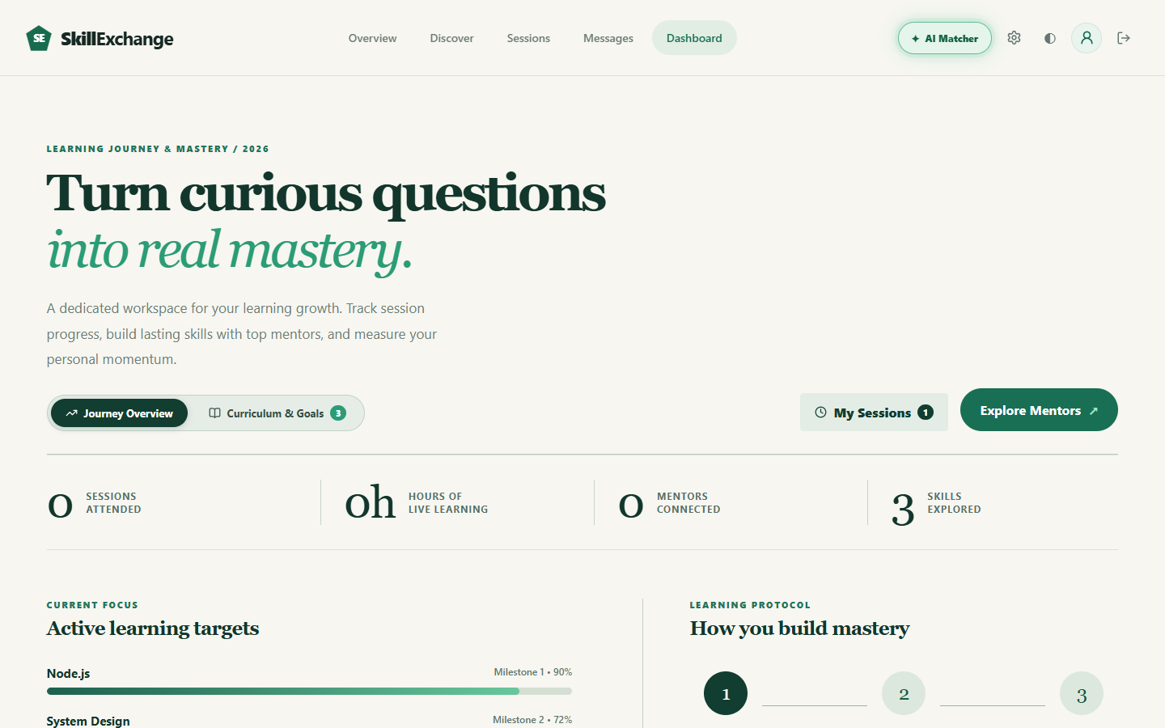
Learner Dashboard
• Learning Growth Workspace: Dedicated dashboard helping students keep track of their learning momentum and progress.
• Key Progress Metrics: Displays sessions attended, hours of live learning, mentors connected, and skills explored.
• Active Targets & Milestones: Visual tracking of topics like Node.js and System Design with milestone percentages.

Slide 10
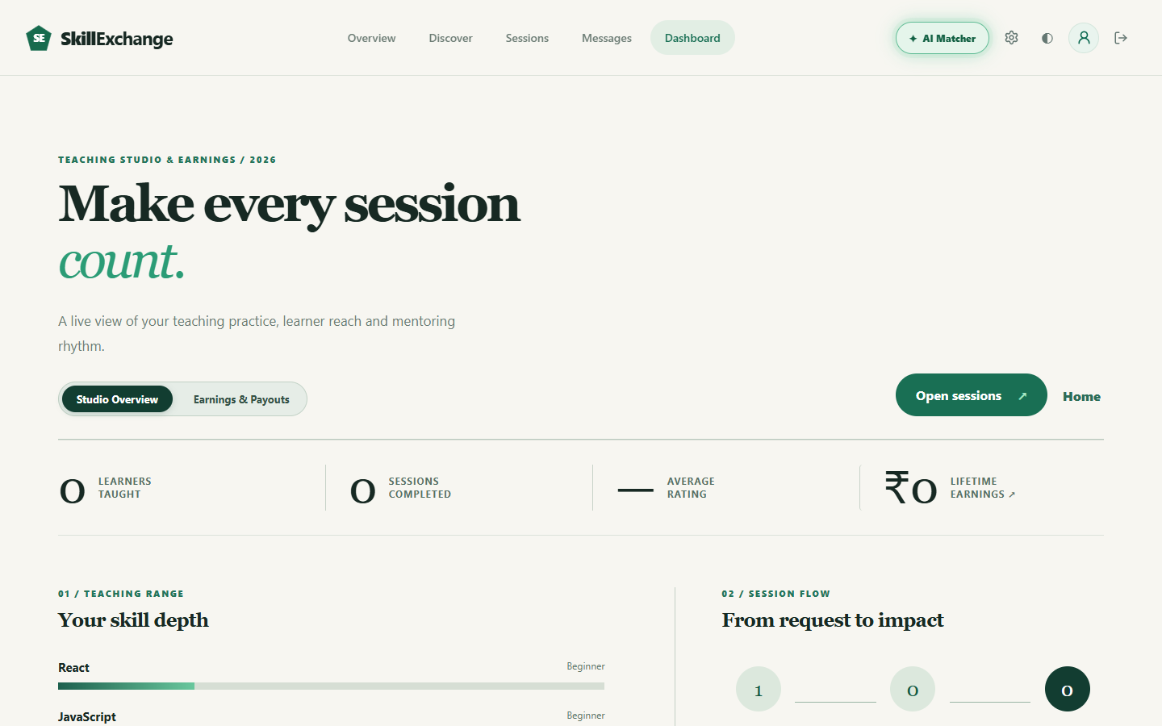
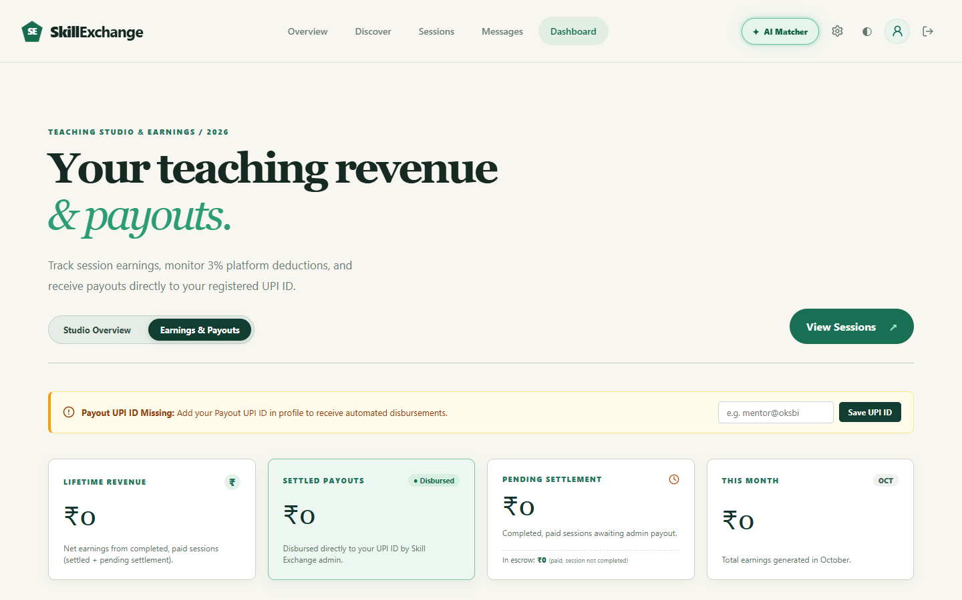
Mentor Dashboard & Earnings
• Teaching Studio: Live overview of teaching practice, learners taught, completed sessions, and skill level depth.
• Earnings & Settlement: Detailed ledger tracking lifetime revenue, settled payments, in-escrow funds, and pending payouts.
• UPI Payout Setup: Mentors can update and save their personal UPI ID directly for fast administrative settlements.

Slide 11
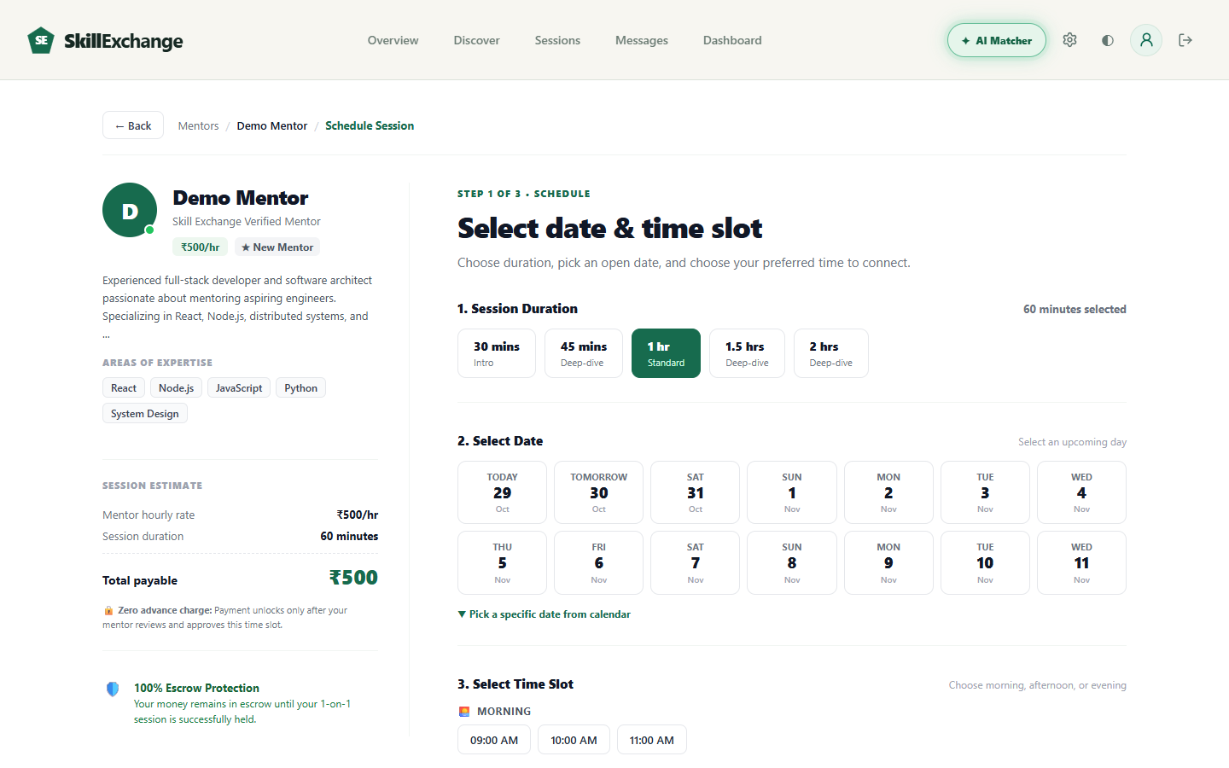
Session Booking Flow
• 3-Step Scheduling: Clean wizard to pick session duration (30m, 45m, 1h, 1.5h, 2h) and an upcoming open calendar date.
• Morning/Evening Slots: Offers convenient time chips or custom time entry based on mentor availability.
• 100% Escrow Protection: Clear fee calculation breakdown including base hourly rate, 18% GST, and secure escrow guarantee.

Slide 12
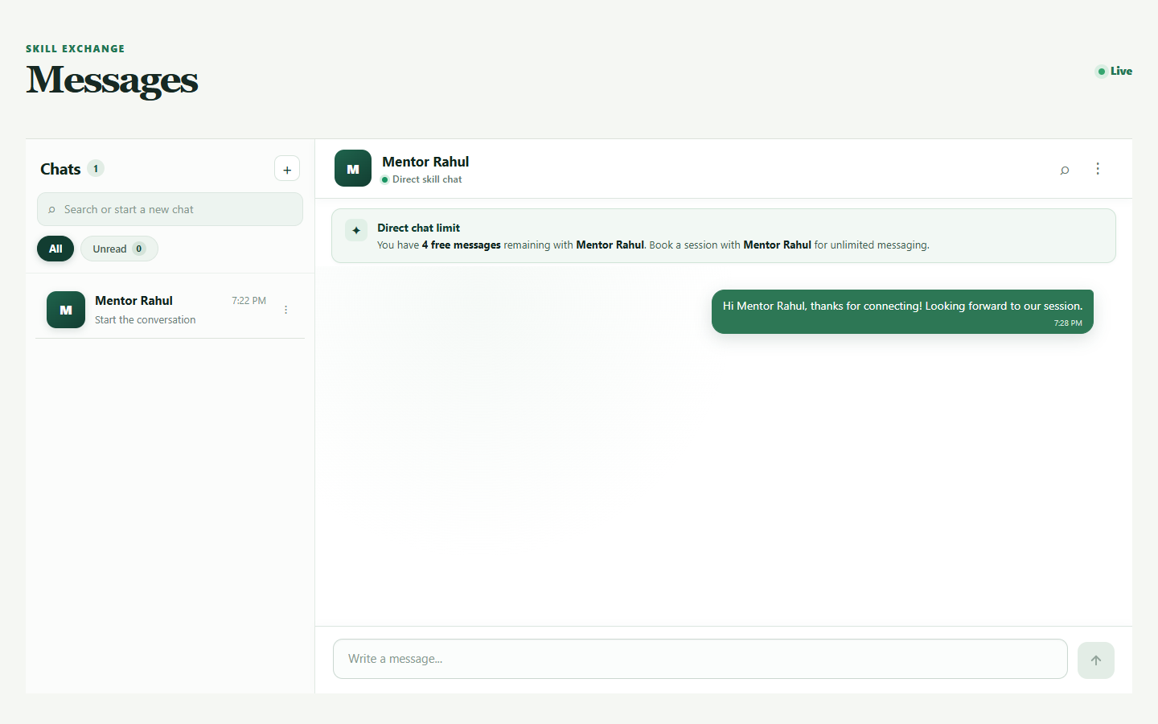
Real-Time Chat Messaging
• Socket.io Powered: Direct bi-directional messaging with instant delivery and live connectivity indicators.
• Conversation Management: Active chat list showing contact name, last message time, and unread counts.
• Spam Prevention: Enforces a 5-free direct message limit to prevent spam until a 1-on-1 mentorship session is scheduled.

Slide 13
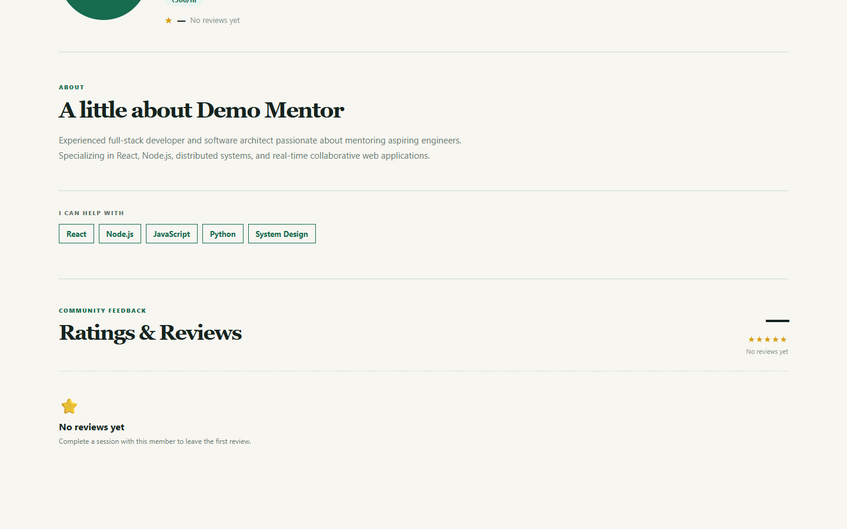
Ratings & Reviews System
• Verified Community Feedback: Learners can leave honest 1-5 star ratings and written reviews after completed sessions.
• Average Score Calculation: Real-time calculation of overall rating averages and review counts displayed on mentor cards.
• Trust & Quality Assurance: Motivates mentors to provide high-quality sessions and helps new learners pick trusted guides.

Slide 14
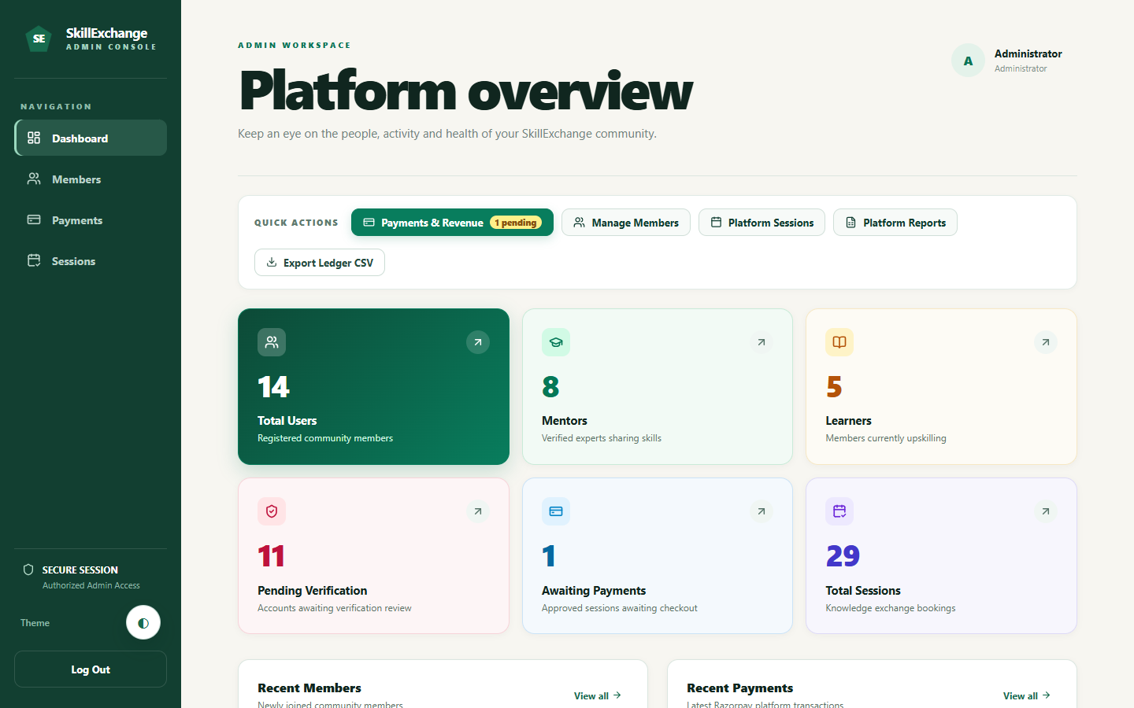
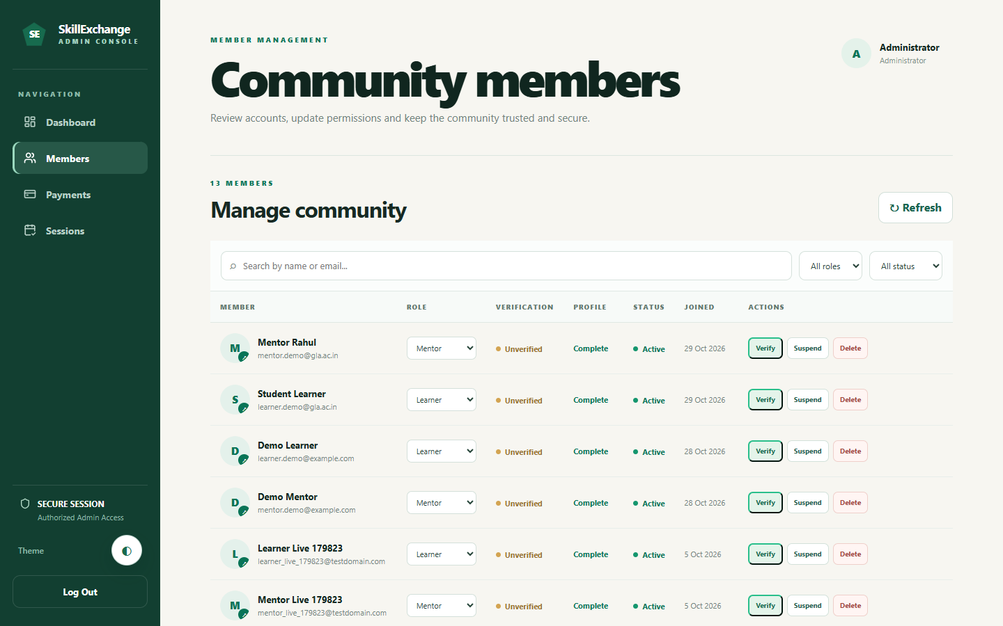
Admin Governance Dashboard
• Platform Overview KPIs: Live counts of total registered users, verified mentors, learners, and total completed sessions.
• Community Member Controls: Table allowing administrators to verify new accounts, suspend bad actors, or remove profiles.
• Financial & Session Audit: Tracks awaiting payments, escrow settlements, and generates full CSV ledger reports for audits.

Slide 15
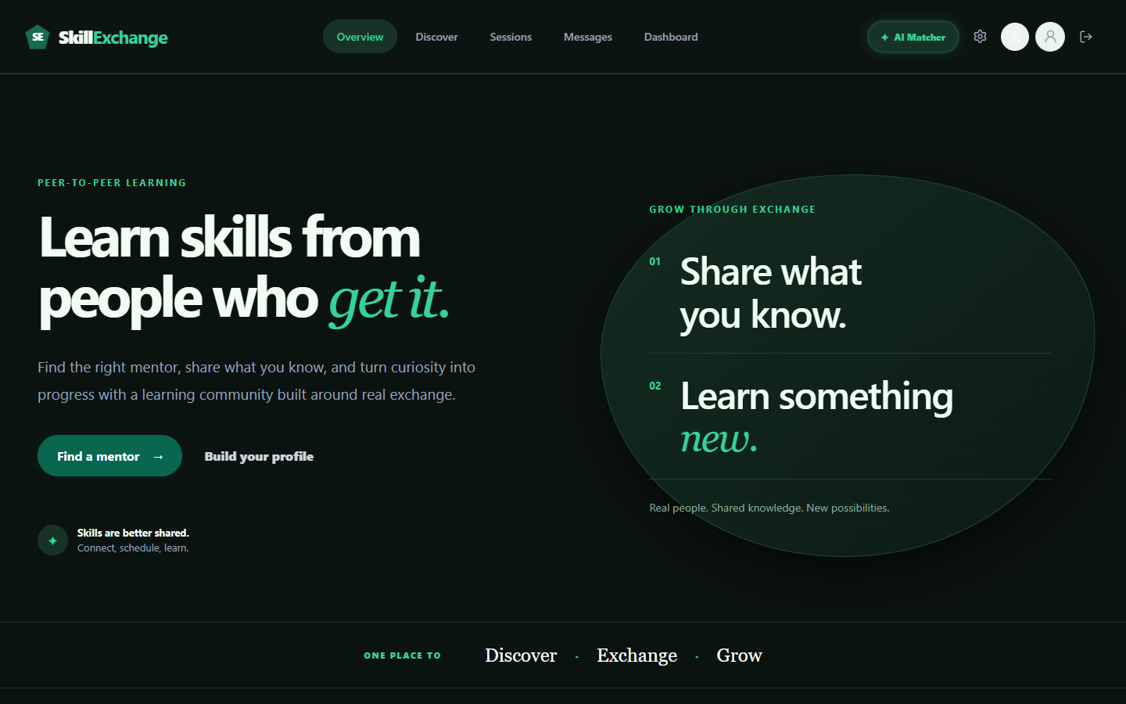
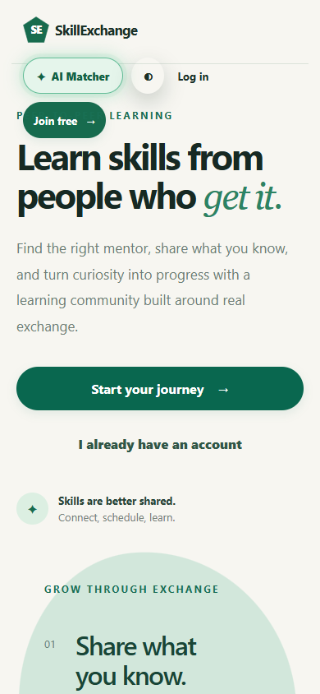
Dark Theme & Responsive Design
• Built-in Dark Mode: User-friendly theme toggle switching the interface to an elegant dark emerald palette for night use.
• Mobile-First Experience: Fully responsive layout tested at 390x844 mobile resolution with compact navigation and cards.
• Adaptive Typography & Touch: Buttons, chips, and cards automatically adapt for smooth interaction across phones and laptops.

Slide 16
Conclusion & Future Scope
Conclusion
• Working MERN Solution: Successfully implemented a full-stack platform solving peer tutoring and knowledge exchange.
• Real-Time Collaboration: Integrated seamless Socket.io chat and calendar scheduling to eliminate coordination friction.
• Production Tested: Deployed live on Vercel and Render with live MongoDB Atlas database and role-based permissions.
• Undergraduate Team Work: Built cooperatively during our internship at Codroid Hub Pvt Ltd by GLA University students.
Future Scope
• In-Browser Video Calling: Native WebRTC peer video calling directly inside the website without external Google Meet links.
• Automated Payment Webhooks: Live Razorpay automated webhooks for instant escrow fund releases and automated refunds.
• Push & Email Notifications: Instant browser push alerts and email reminders 15 minutes before scheduled sessions.
• Mobile App: Build native cross-platform iOS and Android apps using React Native or Flutter for quick on-the-go chat.

Slide 17
Thank You!
Questions & Discussion
Project Repository: github.com/CosmicCoder06/Skill-Exchange
Live Demo: https://skill-exchange-one-eta.vercel.app/

