Slide 1
CAPSTONE PROJECT PRESENTATION • B.TECH CSE
Skill Exchange Platform
A Collaborative Peer-to-Peer Mentorship & Skill Sharing Ecosystem
COURSE / PROGRAMME | Bachelor of Technology (B.Tech) in Computer Science & Engineering
ACADEMIC SESSION | 2025–2026 (Final Year Capstone Project)
PROJECT SUPERVISOR / GUIDE | [Faculty Mentor Name & Designation / Dr. Shashi Bhusan]
PROJECT GROUP / TEAM NAME | GROUP 13 (Full Stack MERN Engineering Track)
TEAM MEMBERS | 1. [Student 1 Name] (Roll No: [Roll 1]) 2. [Student 2 Name] (Roll No: [Roll 2]) 3. [Student 3 Name] (Roll No: [Roll 3]) 4. [Student 4 Name] (Roll No: [Roll 4])
LIVE DEPLOYED URLS | Frontend: https://skill-exchange-one-eta.vercel.app/ Backend API: https://skill-exchange-o19g.onrender.com/
Prepared by Group 13 • Department of Computer Science & Engineering • GLA University

Slide 2
PRESENTATION AGENDA
Table of Contents
A structured walkthrough of the project, architecture, core modules, implementation and test results.
01
Project Overview & Motivation
09
Module 4: Ratings & Reviews Quality System
02
Problem Statement & Objectives
10
Database Design & Entity Invariants
03
Methodology & Agile Sprint Lifecycle
11
Live System Walkthrough & UI Output
04
System Architecture & Request Pipeline
12
Testing, Quality Assurance & Verification
05
Technology Stack & Engineering Rationale
13
Synopsis vs. Implementation Benchmark
06
Module 1: Authentication & Session Bookings
14
Limitations & Future Roadmap
07
Module 2: Profile & AI Discovery Matcher
15
Project Conclusion & Summary
08
Module 3: Real-Time Chat & Admin Governance
Skill Exchange Platform • College Capstone Project Presentation • 2025–2026
Slide 2 of 15

Slide 3
CONTEXT & MOTIVATION
01 Project Overview
Platform Concept & Vision
Deployment & Project Stats
• Peer-to-Peer Learning Paradigm: Undergraduate engineers possess complementary strengths (e.g. React vs. System Design). Skill Exchange creates an institutionalized marketplace to monetize and trade technical expertise.
• Structured Scheduling & Safety: Replaces disorganized WhatsApp groups with interactive calendar booking (15–480 mins), collision detection, and 4-hour automatic request expiration timers.
• AI-Assisted Mentor Matching: Employs Google Gemini 1.5 Flash to evaluate learner goals against mentor profiles, returning ranked recommendations with compatibility percentage scores.
• Secure Transaction Verification: Integrates Razorpay in test mode with server-side HMAC-SHA256 signature verification to prevent payment disputes.
Frontend Hosting | Vercel (React 19 SPA)
Backend API | Render (Node.js & Express 5)
Database Cloud | MongoDB Atlas (Replica Set)
REST Endpoints | 71 Registered API Endpoints
Pages & Routes | 12 Core Pages (18 Component Files)
Automated Tests | 58 Passed Tests (100% Pass Rate)
Target Audience | GLA University Engineering Students
Skill Exchange Platform • College Capstone Project Presentation • 2025–2026
Slide 3 of 15

Slide 4
FOUNDATION & PURPOSE
02 Problem Statement & 03 Objectives
Critical Operational Challenges (Existing)
Proposed Platform Objectives (Achieved)
1. Discovery Fragmentation: No central peer directory; finding classmates skilled in Docker or React requires asking across disconnected social groups.
2. Scheduling Conflicts & Ghosting: Manual coordination results in missed sessions, double-booked slots, and learners waiting indefinitely without response.
3. Payment Friction & Uncertainty: Informal advance payments risk non-delivery; conversely, post-session payments risk unpaid mentor hours.
4. Quality & Accountability Vacuum: Informal tutoring offers zero historical ratings, verified reviews, or administrative moderation to penalize bad actors.
✓ Mentors List Skills & Availability: Dedicated studio setting hourly rates in INR (or ₹0 volunteer) with weekly slot tags.
✓ Search & Book Sessions: Interactive calendar engine supporting 15–480 min sessions with calendar collision rejection.
✓ Real-Time Chat Messaging: Persistent WebSocket messaging via Socket.io with typing indicators and read receipts.
✓ Secure Role-Based Auth: Bcrypt password hashing (10 rounds) + 15m JWT access tokens with 7d HttpOnly refresh cookies.
✓ Tamper-Resistant Ratings: 1-to-5 star feedback with compound unique index {booking, reviewer} preventing duplicates.
✓ Responsive Academic UI: React 19 SPA with fluid flex/grid layouts, dark/light theme toggle, and mobile navigation.
Skill Exchange Platform • College Capstone Project Presentation • 2025–2026
Slide 4 of 15

Slide 5
DEVELOPMENT LIFECYCLE
04 Methodology & Agile Sprints
The platform was engineered following an Agile / Iterative Development Lifecycle across 6 two-week sprint cycles:
Sprint 1
Domain Modeling
Sprint 2
Auth & Security
Sprint 3
Profile & Matching
Requirements analysis, user personas (learner/mentor/admin), and Mongoose database schemas.
Bcrypt 10-round password hashing, dual-token JWT lifecycle, cookie rotation, and RBAC guards.
Dual profile setup, discover catalog, search indexing, and Google Gemini 1.5 Flash AI matcher.
Sprint 4
Booking Engine
Sprint 5
Payment & Sockets
Sprint 6
Admin & Verification
Interactive calendar, collision check algorithms, 4-hour countdown timer, and slot negotiation.
Razorpay order creation, HMAC signature verification, and Socket.io real-time chat rooms.
Admin governance portal, user moderation, 58 automated unit tests, and Vercel/Render deploy.
Skill Exchange Platform • College Capstone Project Presentation • 2025–2026
Slide 5 of 15

Slide 6
HIGH-LEVEL DESIGN
05 System Architecture & Request Pipeline
3-Tier Client-Server Architecture
6-Step Express Request Lifecycle
Tier 1: Presentation Tier (Client)
React 19 Single Page Application scaffolded with Vite 8. Utilizes React Router for client-side routing, Context API for global state, and Socket.io-client for real-time WebSockets.
Tier 2: Application Tier (API Server)
Node.js v22 LTS & Express 5 running on Render. Enforces compression, 400kb body ceilings, cookie authentication, route controllers, and Socket.io room multiplexing.
Tier 3: Data Tier & External Services
MongoDB Atlas (Replica Set M0) persistent storage via Mongoose ODM. Integrated with Razorpay Gateway API (test payments) and Google Gemini 1.5 Flash API.
1. compression(): Gzip/deflate response compression reducing payload sizes.
2. express.json({ limit: "400kb" }): Body parser defending against memory exhaustion.
3. cookieParser(): Extracts secure, HttpOnly session refresh tokens from cookies.
4. cors({ origin: CLIENT_URL, credentials: true }): Validates cross-origin access.
5. verifyToken & authorize(roles): Decodes Bearer JWT & checks role privileges.
6. Entity Ownership Check: Controllers confirm req.user.id owns target record.
Skill Exchange Platform • College Capstone Project Presentation • 2025–2026
Slide 6 of 15

Slide 7
ENGINEERING FOUNDATION
05 Technology Stack & Justification
Technology / Library | Category | Engineering Justification for Selection
React 19.2.7 | Frontend SPA | Component-driven declarative UI, virtual DOM diffing for rapid re-rendering, hook-based state.
Vite 8.1.1 | Build Tool | Ultra-fast dev server with Hot Module Replacement (HMR) and optimized Rollup asset bundling.
Node.js v22 LTS | Backend Runtime | Non-blocking, event-driven asynchronous I/O optimal for concurrent WebSocket & HTTP traffic.
Express.js 5.2.1 | Web Framework | Minimalist routing, composable middleware pipeline, and standardized REST controllers.
MongoDB Atlas 6.0+ | NoSQL Database | Flexible schema document model supporting nested skills arrays and audit activity logs.
Mongoose 9.9.1 | ODM Library | Strict schema validation, compound collision indexes, and pre-save password hashing hooks.
Socket.io 4.8.3 | WebSocket Library | Full-duplex bidirectional event transport with dynamic room multiplexing & auto-reconnect.
Razorpay SDK 2.9.8 | Payment Gateway | Test mode order creation and server-side cryptographic HMAC-SHA256 signature verification.
Bcryptjs 3.0.3 | Password Security | Adaptive cryptographic hashing with work factor salting (10 rounds) to resist offline brute force.
Skill Exchange Platform • College Capstone Project Presentation • 2025–2026
Slide 7 of 15

Slide 8
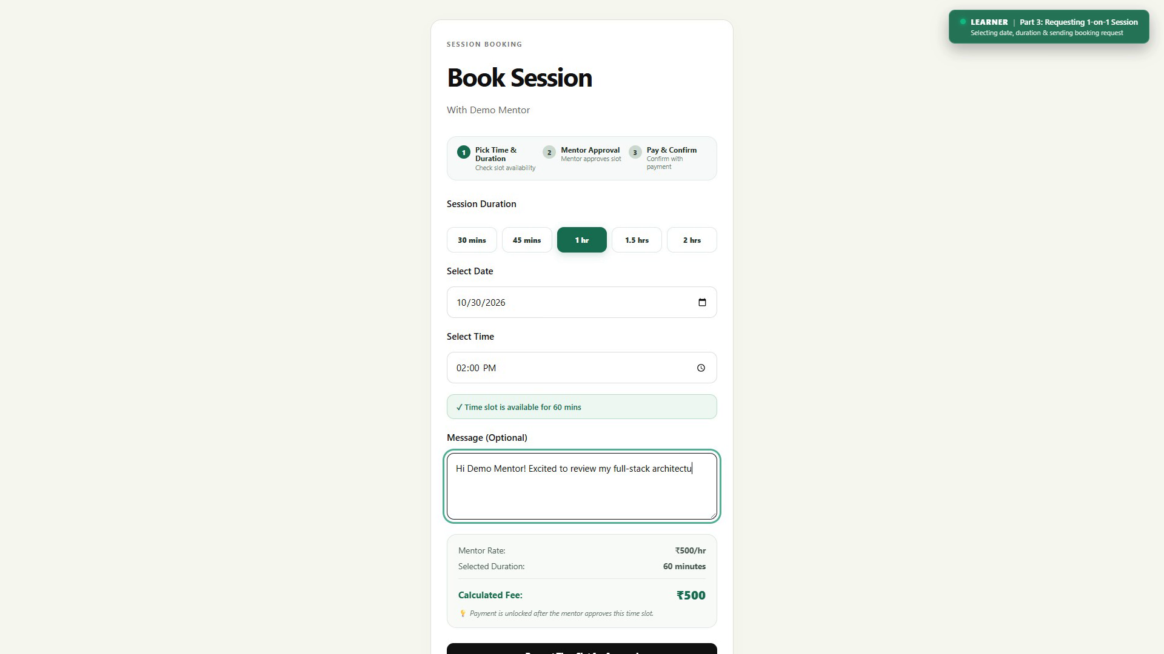
CORE SUBSYSTEMS
06 Module 1: Authentication & Session Bookings
Key Capabilities & Implementation
Verified Live User Interface
• Secure User Onboarding: Registration with Bcrypt password hashing (10 salt rounds) and role assignment (Learner vs. Mentor).
• Dual-Token JWT Lifecycle: Stateless 15-minute access tokens paired with 7-day HttpOnly refresh cookies with rotation on renewal.
• Interactive Session Booking: Duration selector (15–480 mins) with automated collision check (rejects overlapping bookings).
• 4-Hour Auto-Expiration Timer: actionExpiresAt set on booking creation; prevents unattended pending requests from hanging indefinitely.
• Mentor Slot Negotiation: Mentors can propose up to 3 alternate time slots (suggestedSlots) instead of flat rejection.
• Cryptographic Razorpay Verification: In-app checkout in test mode; backend verifies HMAC-SHA256 signature before confirming session.
• Format-Validated Google Meet Links: Stores verified Google Meet links (https://meet.google.com/...) for session delivery.
Figure 6.1: Interactive Session Scheduling Interface with date/time picker, duration slider, fee calculation, and collision check verification.
Key APIs: POST /api/bookings • PUT /api/bookings/:id/suggest-slots • POST /api/payments/verify
Skill Exchange Platform • College Capstone Project Presentation • 2025–2026
Slide 8 of 15

Slide 9
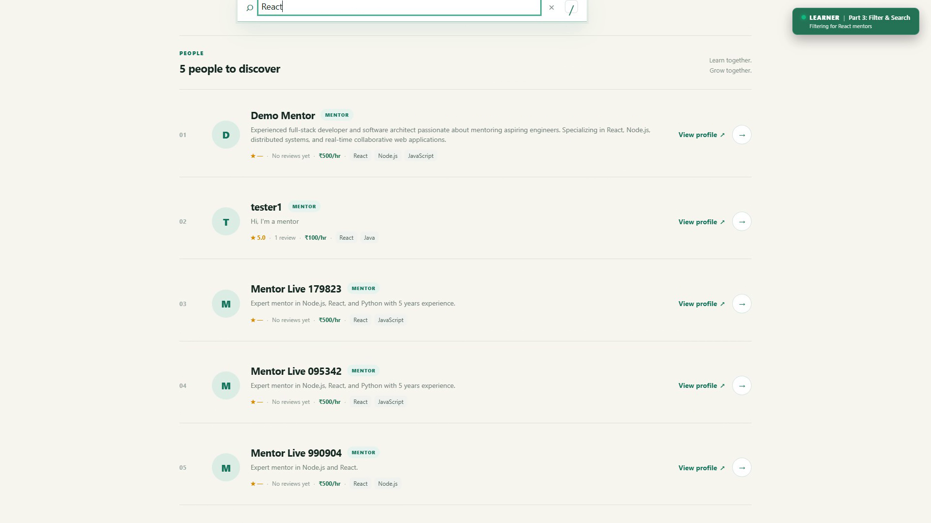
CORE SUBSYSTEMS
06 Module 2: Profile & AI Discovery Matcher
Key Capabilities & Implementation
Verified Live User Interface
• Dual Profile Customization: Users configure technical biographies, skills to teach/learn, proficiency tags, social links, and avatars.
• Flexible Mentoring Rates: Mentors specify hourly rates in INR (or ₹0 for volunteer mentoring) stored as integer paise to prevent rounding errors.
• Debounced Catalog Search: 300ms debounced text input in /discover reduces server query frequency during live search.
• Multi-Faceted Filter Criteria: Interactive skill chips, category filtering, hourly price range slider, and minimum rating thresholds.
• Google Gemini 1.5 Flash Matcher: Evaluates learner goals and budget constraints against the mentor pool to compute 0–100% compatibility scores.
• Public Mentor Portfolios: Showcases aggregate ratings, student review history, active skills, and direct "Book Session" trigger.
Figure 6.2: Mentor Discovery Catalog with real-time keyword search ("React"), interactive skill tags, and mentor cards.
Key APIs: GET /api/mentors • GET /api/matches • GET /api/profile/:id • PUT /api/profile/update
Skill Exchange Platform • College Capstone Project Presentation • 2025–2026
Slide 9 of 15

Slide 10
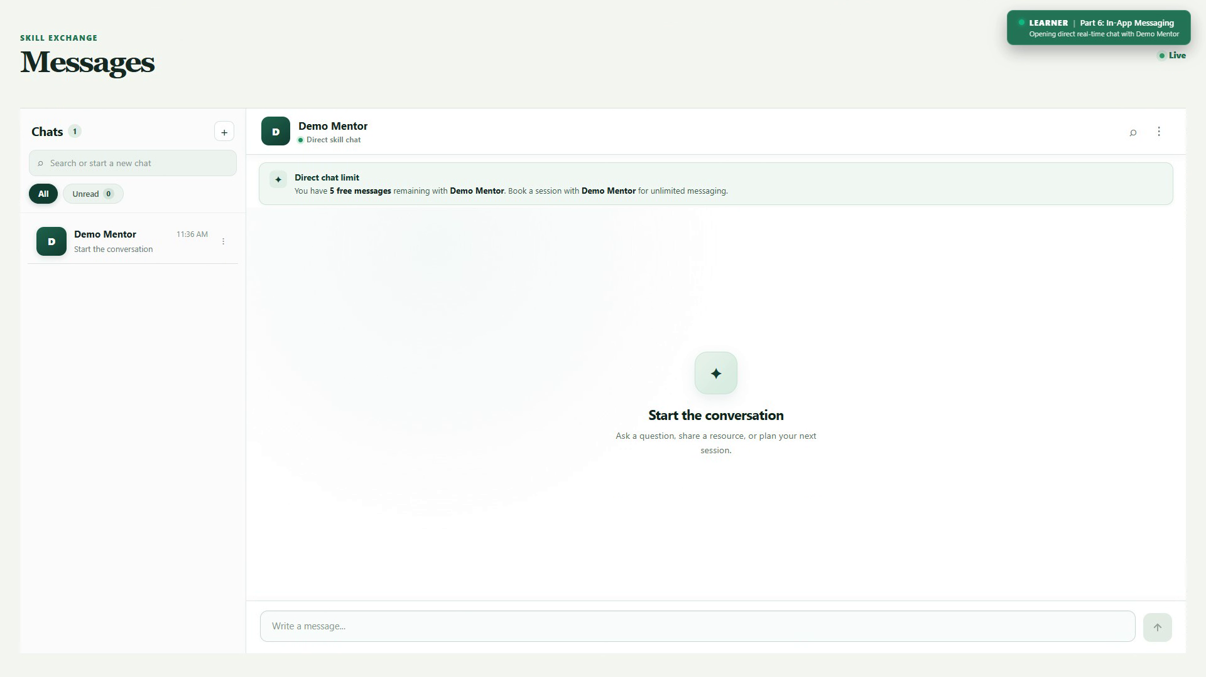
CORE SUBSYSTEMS
06 Module 3: Real-Time Chat & Admin Governance
Key Capabilities & Implementation
Verified Live User Interface
• Persistent WebSocket Communication: Socket.io event bus supporting join_room, send_message, typing, and message_read events.
• Two-Column Messaging Experience: Active conversation threads, chronological message loading, live typing indicators, and read checkmarks.
• Fair-Use Anti-Spam Limitation: Caps unconfirmed bookings at 5 free messages to eliminate unsolicited marketing spam.
• Soft-Delete Message Model: Flags messages as deleted while preserving database records for administrative auditability.
• Admin Executive Cockpit: Real-time platform analytics: total users, active mentors, booking volume, and gross platform metrics.
• User Moderation & Status Control: Account suspension (isSuspended toggle), profile audits, and mentor credential verification.
• Activity Logging (ActivityLog): Immutable audit trail capturing administrative actions with timestamps and IP addresses.
Figure 6.3: Two-Column Real-Time Chat Window powered by Socket.io, showing active threads, message bubbles, and live typing indicators.
Key APIs: GET /api/conversations • PATCH /api/conversations/:id/read • GET /api/admin/overview
Skill Exchange Platform • College Capstone Project Presentation • 2025–2026
Slide 10 of 15

Slide 11
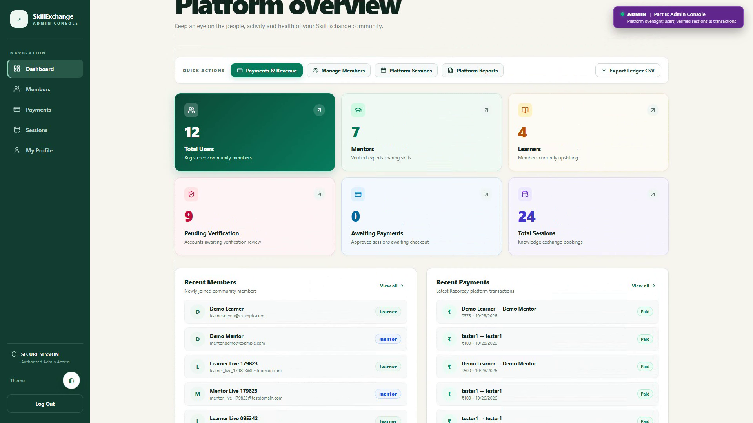
CORE SUBSYSTEMS
06 Module 4: Ratings & Reviews Quality System
Key Capabilities & Implementation
Verified Live User Interface
• Quantitative 1-to-5 Star Ratings: Learners evaluate completed sessions on a 1-to-5 scale paired with descriptive textual feedback.
• Verified Review Guard: Reviews can strictly only be submitted after a booking transitions to completed status.
• Anti-Duplicate Review Check: Database compound unique index on { booking: 1, reviewer: 1 } guarantees exactly one review per session.
• Dynamic Mentor Credibility Score: Mentor average rating dynamically aggregates and updates across public profile and discover cards.
• Public Trust & Accountability: Eliminates fake reviews and transparently highlights high-performing student mentors.
• Interactive Review Modal: Dedicated feedback submission dialogue in MyBookings.jsx following session conclusion.
Figure 6.4: Centralized Admin Governance Cockpit displaying platform KPIs, user moderation grid, and transaction audit records.
Key APIs: POST /api/reviews • GET /api/reviews • GET /api/reviews/my-reviewed-bookings
Skill Exchange Platform • College Capstone Project Presentation • 2025–2026
Slide 11 of 15

Slide 12
DATA ARCHITECTURE
07 Database Design & Entity Invariants
Model Entity | Key Schema Fields & References | Cryptographic & Business Invariants
1. User | name, email, password, role, skillsToTeach[], hourlyRate, availability[], isSuspended | email unique; password Bcrypt salted (10 rounds); role enum strictly constrained.
2. Booking | learner, mentor, date, time, duration, status, sessionFee, actionExpiresAt, meetingLink | Compound index (mentor, date, time) collision rejection; 4-hour countdown expiry.
3. Conversation | participants[], participantKey, booking, lastMessage, lastActivityAt | Unique participantKey (user1_user2) guarantees exactly one thread between two users.
4. Message | conversation, sender, text, isRead, isEdited, isDeletedForEveryone | Soft-delete preserving audit trails; compound index (conversation, createdAt).
5. Review | booking, reviewer, reviewee, rating, comment | Compound unique index {booking: 1, reviewer: 1}; rating integer bounded 1–5.
6. Wallet | user, balance, currency, isActive | user reference unique (1:1); monetary values stored in integer subunits (paise).
7. WalletTransaction | wallet, user, booking, amount, type, reference, status | Immutable insert-only ledger; type enum: credit, debit, payout, refund.
8. SkillCategory | name, slug, description, icon, isActive | name and slug unique and indexed for fast category filtering in mentor discovery.
9. ActivityLog | actor, action, entityType, entityId, metadata, ipAddress | Chronological administrative audit trail for compliance and moderation tracking.
Skill Exchange Platform • College Capstone Project Presentation • 2025–2026
Slide 12 of 15

Slide 13
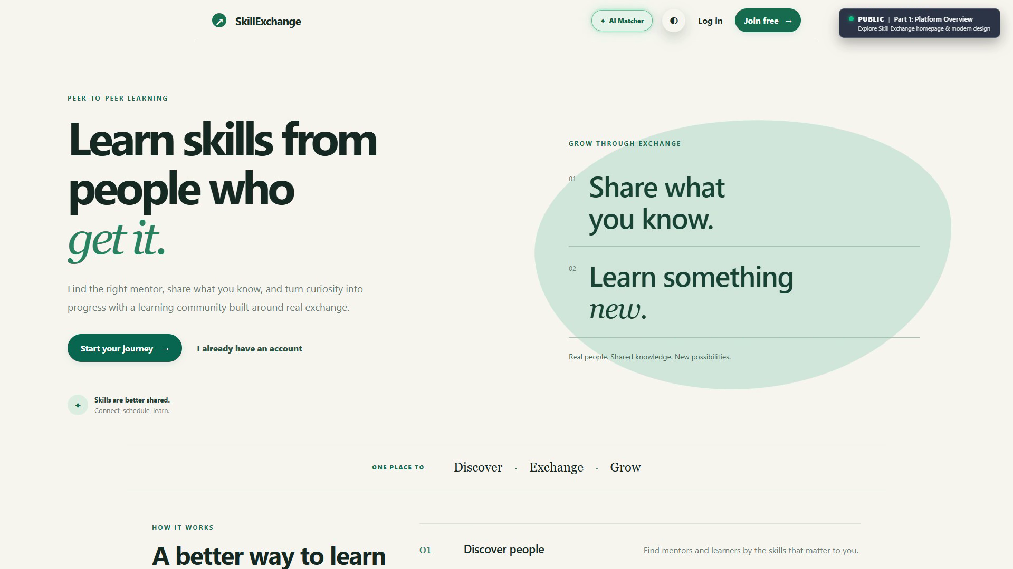
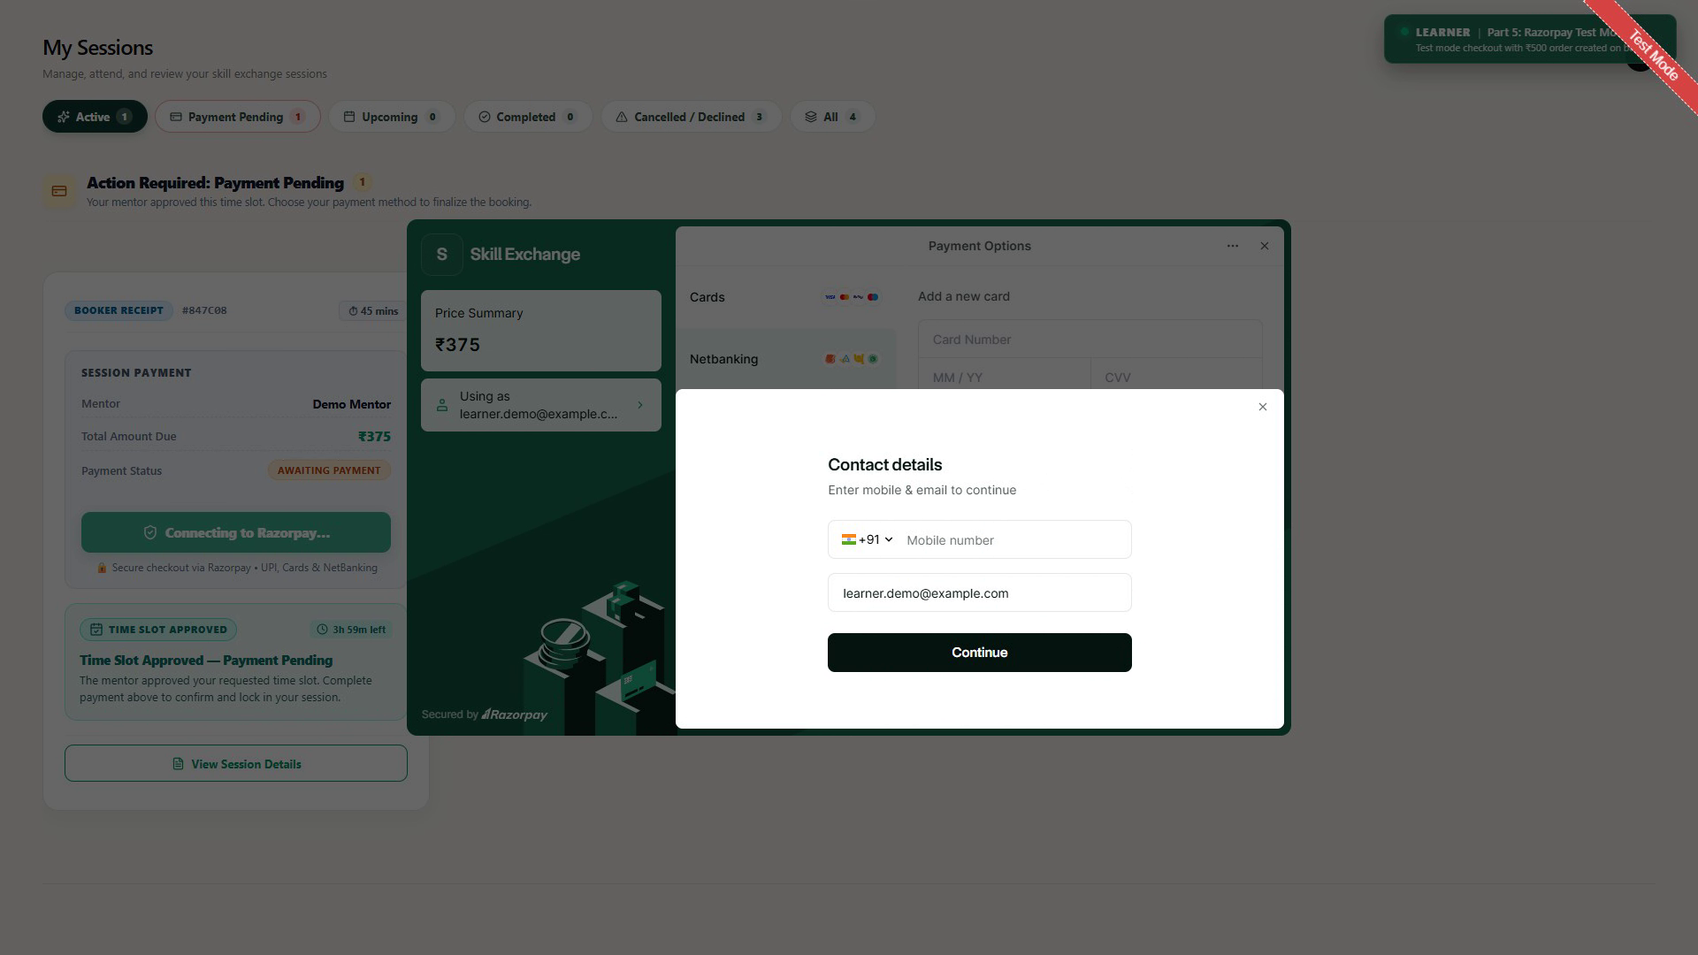
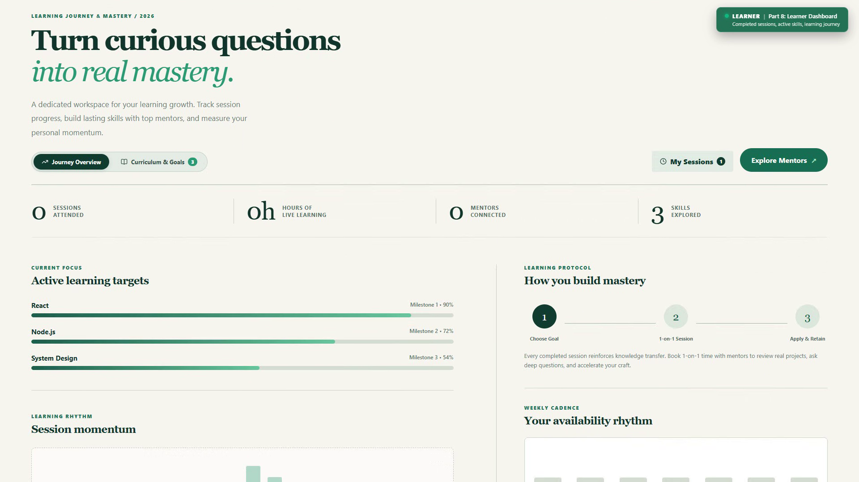
PRODUCTION ARTIFACTS
08 Live System Walkthrough & UI Output
Home Page Hero Section
Payment Checkout Modal
Learner Mastery Dashboard
Hero value proposition, dark/light toggle, and AI Matcher trigger.
In-app Razorpay modal in official Test Mode (UPI, Cards, NetBanking).
Active learning targets, confirmed upcoming sessions, and mentor recommendations.
Skill Exchange Platform • College Capstone Project Presentation • 2025–2026
Slide 13 of 15

Slide 14
QUALITY ASSURANCE
09 Testing, Quality Assurance & Live Verification
58 Automated Unit Tests (100% Passed)
Security & Deployment Verification
• 52 Server-Side Automated Tests:
Executed via Node.js native test runner (node --test). Verifies auth middleware, token refresh rotation, booking collisions, slot suggestions, meeting links, and payouts.
• 6 Client-Side Integration Tests:
Executed via Vitest. Validates API service abstraction, token persistence in localStorage, and request error interception.
• 10 Manual System Test Cases (TC-01 to TC-10):
Full-pass execution covering user signup, collision rejection, 4-hour countdown expiration, Razorpay test payment, Socket.io chat, and duplicate review guards.
• Execution Proof:
Total suites: 58 • Passed: 58 • Failed: 0 • Cancelled: 0 • Concurrency: 1 • Exit code: 0.
• Zero Secrets Exposed:
All environment variables (.env) use safe dummy placeholders in documentation, protecting live production credentials.
• XSS & Injection Defense:
HttpOnly cookies prevent JavaScript reading of refresh tokens; Mongoose ODM enforces strict schema-level parameter sanitization.
• Denial-of-Service Safeguards:
express.json({ limit: "400kb" }) caps request body size, protecting memory and event loops.
• Production Deployments:
Frontend deployed on Vercel Edge Network with client rewrite rules; Backend deployed on Render with containerized Linux web service.
Skill Exchange Platform • College Capstone Project Presentation • 2025–2026
Slide 14 of 15

Slide 15
PROJECT WRAP-UP
10 Future Scope & Project Conclusion
Future Development Roadmap
Project Conclusion & Acknowledgments
1. Embedded In-Browser WebRTC Video Calling: Native peer-to-peer audio/video calling and screen sharing directly inside the browser, eliminating reliance on external Google Meet links.
2. Automated RazorpayX Bank Payouts: Direct IMPS/NEFT fund transfers to mentor bank accounts upon verified session completion.
3. Skill Certification & Quizzes: Automated technical coding quizzes to award verified skill badges on mentor profiles.
4. Mobile Native Apps: Packaging React client with React Native / Flutter for native iOS and Android store deployment.
Summary of Achievements:
• Built a complete, production-grade MERN web platform with 71 REST API endpoints and 12 core responsive pages.
• Successfully replaced unstructured informal tutoring with synchronized calendar scheduling and automated collision detection.
• Validated through 58 passed automated tests with zero failures.
Thank you for your guidance and evaluation!
Questions & Answers (Q&A)
We invite the evaluation committee and faculty mentors to share their questions and feedback.
Skill Exchange Platform • College Capstone Project Presentation • 2025–2026
Slide 15 of 15

