Slide 1

TEAM COSMICCODERS | GROUP 13
SkillExchange
TEAM COSMICCODERS • GROUP 13
Team Leader:
________________________________________
Team Members:
1. ______________________
2. ______________________
3. ______________________
4. ______________________
Project Guide / Mentor:
________________________________________
A platform connecting mentors and learners
MERN STACK PROJECT • B.TECH CSE
GLA University, Mathura | Internship at Codroid Hub Pvt. Ltd.
A centralized, full-stack peer mentorship web application built with React 19, Node.js, Express, MongoDB Atlas, and Socket.io for frictionless peer tutoring and verifiable skill exchange.
Learn together. Share knowledge. Grow together.
01
Notes:
Good morning respected professors and project evaluators. Today, Team CosmicCoders (Group 13) presents our college capstone project: 'SkillExchange' — A centralized, full-stack peer mentorship and skill-sharing web platform developed using the modern MERN stack. This project bridges the gap between students seeking targeted academic/technical guidance and skilled senior peers willing to mentor.

Slide 2
CONTEXT & MOTIVATION
Problem Statement & Project Objectives
The Campus Peer Learning Gap
• Expensive Commercial Tutoring: Existing 1-on-1 coaching platforms (Preply, Chegg) charge commercial rates (₹500–₹2500/hr) unaffordable for college students.
• Fragmented Informal Channels: Students arrange peer help across WhatsApp, Discord, and Google Calendar without proper coordination or centralized history.
• Ghosting & Zero Accountability: Informal peer sessions suffer frequent no-shows, delayed cancellations, and lack of scheduling commitment.
• Lack of Financial Transparency: Students lack transparent pricing, receipts, and a secure way to track peer honorariums and mentor payouts.
Project Objectives & Solutions
✓ Unified Peer Platform: Build a dedicated web portal where campus learners and mentors connect through verified university profiles.
✓ Deterministic 5-Step Scheduling: Provide intuitive duration chips, date selectors, slot validation, and a strict 4-hour automatic request expiration.
✓ Real-Time WebSocket Communication: Integrate Socket.io messaging for instant chat with a 5-free message anti-spam quota unlocked upon session booking.
✓ Transparent Wallet & Receipts: Implement dual-balance wallet architecture (Top-Up vs Earned), simulated escrow, and 0% platform fee receipts.
✓ Institutional Governance: Provide administrators with platform KPIs, member verification/suspension controls, and auditable activity logs.
Learn together. Share knowledge. Grow together. • Team CosmicCoders (Group 13)
02 / 10
Notes:
Here we discuss the core problem statement. College students often struggle to find timely academic help. Commercial tutoring platforms are far too expensive, while informal WhatsApp arrangements lead to high ghosting rates. SkillExchange addresses this through a centralized MERN web application offering verified mentor profiles, deterministic scheduling, real-time messaging with anti-spam limits, and a transparent simulated escrow wallet.

Slide 3
TECHNICAL FOUNDATION
System Architecture & MERN Technology Stack
1. Client Frontend
React 19 & Vite
• Component-driven SPA architecture
• Tailwind & custom CSS with Light/Dark mode
• Role-based routing & Socket.io client
2. Application API
Node.js & Express.js
• RESTful JSON controllers & routes
• JWT bearer auth & RBAC middleware
• Booking lifecycle engine & fee calculators
3. Real-Time Engine
Socket.io WebSockets
• Bi-directional event-driven messaging
• Room-based chat sessions & typing events
• Unread badge counters & online status
4. Database Cloud
MongoDB Atlas
• Mongoose ODM for robust schema indexing
• Collections: Users, Bookings, Messages,
• Reviews, Wallets, and Audit Logs
End-to-End Data Flow Pipeline
→ Client Request: React client dispatches REST HTTP requests via Axios interceptor with Bearer JWT.
→ Auth Validation: Express authMiddleware intercepts request, verifies JWT signature, and attaches req.user.
→ Business Logic: Dedicated controllers (booking, user, payment) execute slot checking, state changes, or calculations.
→ Persistence Layer: Mongoose models validate constraints, timestamps, and save documents into MongoDB Atlas.
Security Standards & Integrations
🔒 Cryptographic Hashing: Passwords hashed using 10-round salted Bcrypt prior to database insertion.
🔒 Stateless JWT Authorization: HS256 tokens carrying role claims (Learner, Mentor, Admin) preventing privilege escalation.
🔒 Payment Checkout Gateway: Razorpay integration supporting test card/UPI checkout, combined with wallet balances.
🔒 Simulated Escrow Protection: Transparent fee model: 0% platform fee, 0% tax, ₹0 extra convenience fees credited on completion.
Learn together. Share knowledge. Grow together. • Team CosmicCoders (Group 13)
03 / 10
Notes:
This slide illustrates our full-stack architecture. We selected the MERN stack for high developer productivity and performance. The frontend is built with React 19 and Vite. The backend utilizes Express.js and Node.js with strict JWT authentication middleware. Data is persisted in MongoDB Atlas via Mongoose ODM, and real-time messaging is powered by Socket.io.

Slide 4
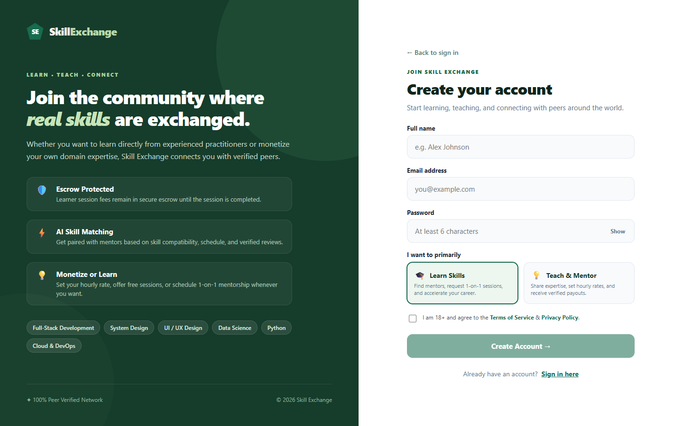
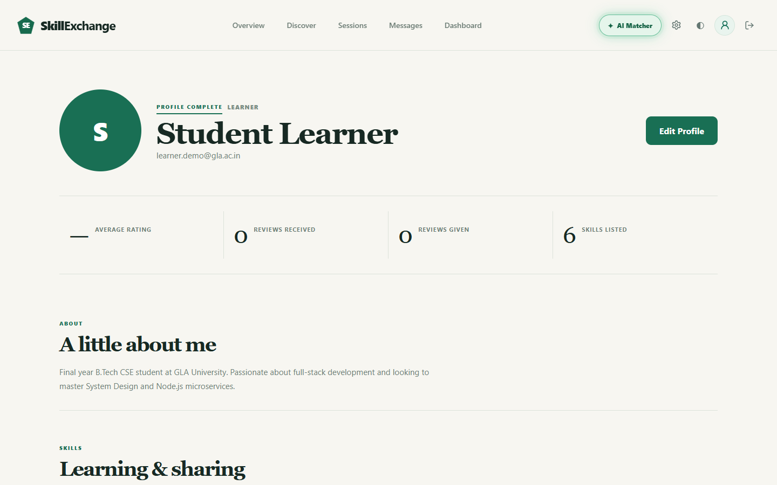
CORE FUNCTIONAL MODULE
Module 01: Authentication, Profiles & Skill Management
Identity, Access & Profile Capabilities
• Dual-Role Registration: Users choose between 'Learn Skills' and 'Teach & Mentor' during signup with specific validation schemas.
• Cryptographic Security: Passwords hashed with Bcrypt (10 salt rounds); validated sessions return signed JWT bearer tokens stored in localStorage.
• Learner Profile & Goals: Learners maintain academic bios, learning goals (React, Node.js, System Design), and track profile completion percentages.
• Mentor Skill Depth & Rates: Mentors showcase domain expertise, granular skill proficiency ratings (Beginner to Expert), and set hourly rates (₹/hr).
• Public Profile & Trust Badges: Public profile showcase allows peers to inspect bios, verified university badges, average star ratings, and community reviews.
APIs: POST /api/register, POST /api/login, GET/PUT /api/profile | Model: UserSchema
Learn together. Share knowledge. Grow together. • Team CosmicCoders (Group 13)
04 / 10
Notes:
Module 1 covers User Onboarding, Authentication, and Profiles. We offer dual registration for learners and mentors. Authentication is secured via 10-round salted Bcrypt password encryption and JWT stateless tokens. Learners specify skills they wish to learn, while mentors configure their hourly rates and proficiency levels.

Slide 5
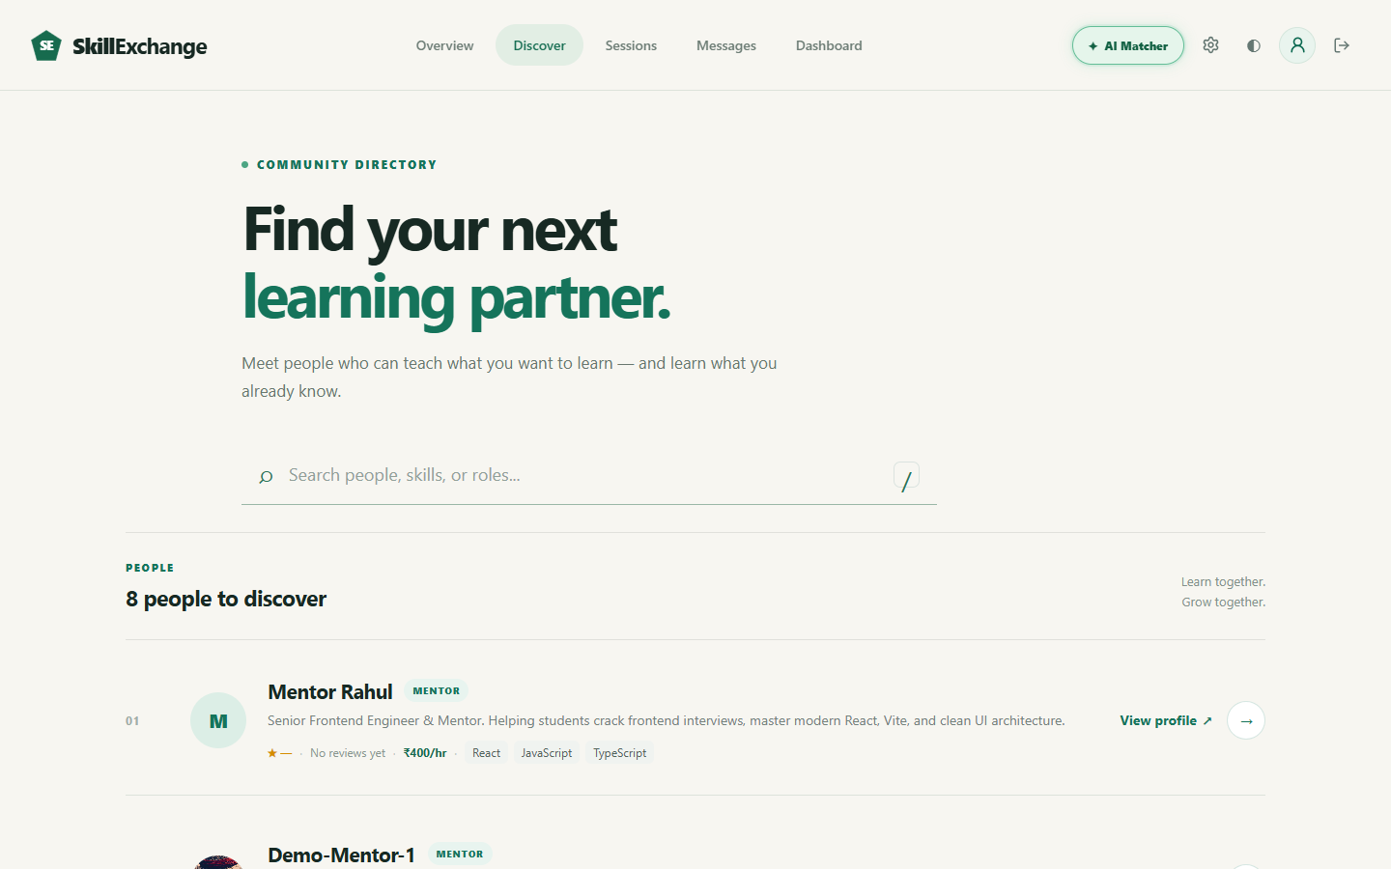
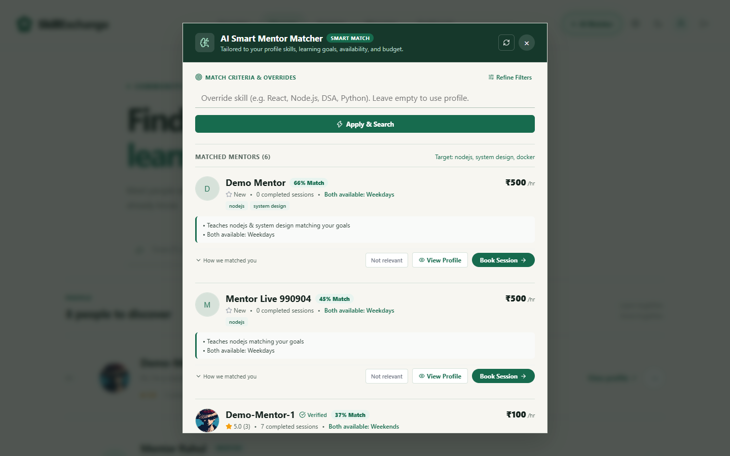
CORE FUNCTIONAL MODULE
Module 02: Peer Discovery & Intelligent AI Matcher
Search, Filtering & AI Compatibility Engine
• Searchable Community Catalog: Fast indexed directory listing verified mentors across modern technical stacks (React, Node.js, Python, System Design).
• Live Multi-Parametric Filters: Instant client-side filtering by mentor name, skill tags, availability days, and fee ranges without page reloads.
• Card Transparency: Each mentor card highlights teaching skills, verified university badge, hourly rate (e.g. ₹500/hr), and star reviews.
• Gemini-Powered AI Matcher: Dedicated 'AI Matcher' modal analyzes learner's desired skills, learning rhythm, and mentor schedule compatibility to recommend optimal peers.
• One-Click Profile Inspection: Learners can seamlessly navigate from discovery to detailed mentor profiles to review student testimonials and initiate booking.
APIs: GET /api/users/mentors, POST /api/ai/match | Components: DiscoverPage.jsx, AIMatcherModal.jsx
Learn together. Share knowledge. Grow together. • Team CosmicCoders (Group 13)
05 / 10
Notes:
Module 2 is Peer Discovery & the AI Matcher. Learners can browse mentors by technology tags or search by name. A key innovation is the Gemini-powered AI Matcher, which allows students to describe what they want to learn and automatically pairs them with the best suited mentor based on skill overlap, schedule compatibility, and community ratings.

Slide 6
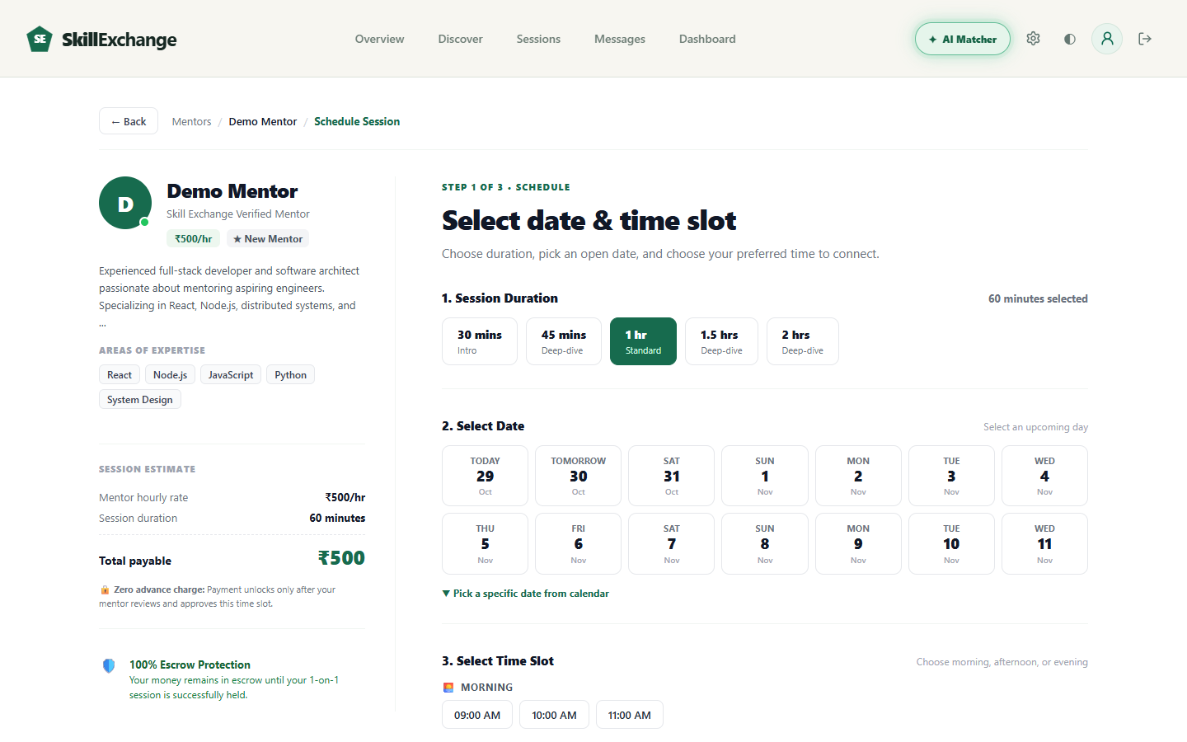
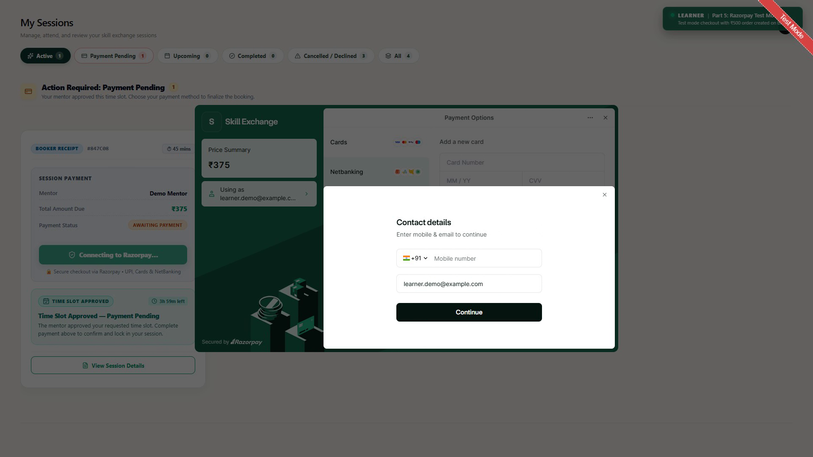
SIGNATURE FEATURE
Module 03: 5-Stage Session Booking & Slot Negotiation
Deterministic 5-Step Scheduling Lifecycle
• Step 1: Duration & Date Selection: Learner selects session duration (30m, 45m, 1h, 1.5h, 2h) and upcoming date chips with automatic cost calculation.
• Step 2: Real-Time Slot Validation: System checks mentor's active calendar availability to eliminate double-booking conflicts before submission.
• Step 3: Mentor Response Window: Mentor receives the request and can Approve, Propose Alternate Slots, or Decline with custom feedback.
• Step 4: Automatic 4-Hour Expiration: Unanswered pending requests automatically expire after 4 hours, preventing stale bookings and scheduling deadlock.
• Step 5: Escrow Payment & Confirmation: Payment is authorized via wallet or checkout and held securely in escrow until the session is successfully conducted.
APIs: POST /api/bookings, PUT /api/bookings/:id/status | Model: BookingSchema (Enum status)
Learn together. Share knowledge. Grow together. • Team CosmicCoders (Group 13)
06 / 10
Notes:
Module 3 is our signature Session Booking Flow. Unlike informal messaging, our platform implements a 5-step deterministic lifecycle. The learner picks duration and date chips, the system validates mentor slots, and the mentor can approve or suggest counter-slots. Crucially, any request left unaddressed for 4 hours automatically expires to avoid stale scheduling. Funds are held in escrow.

Slide 7
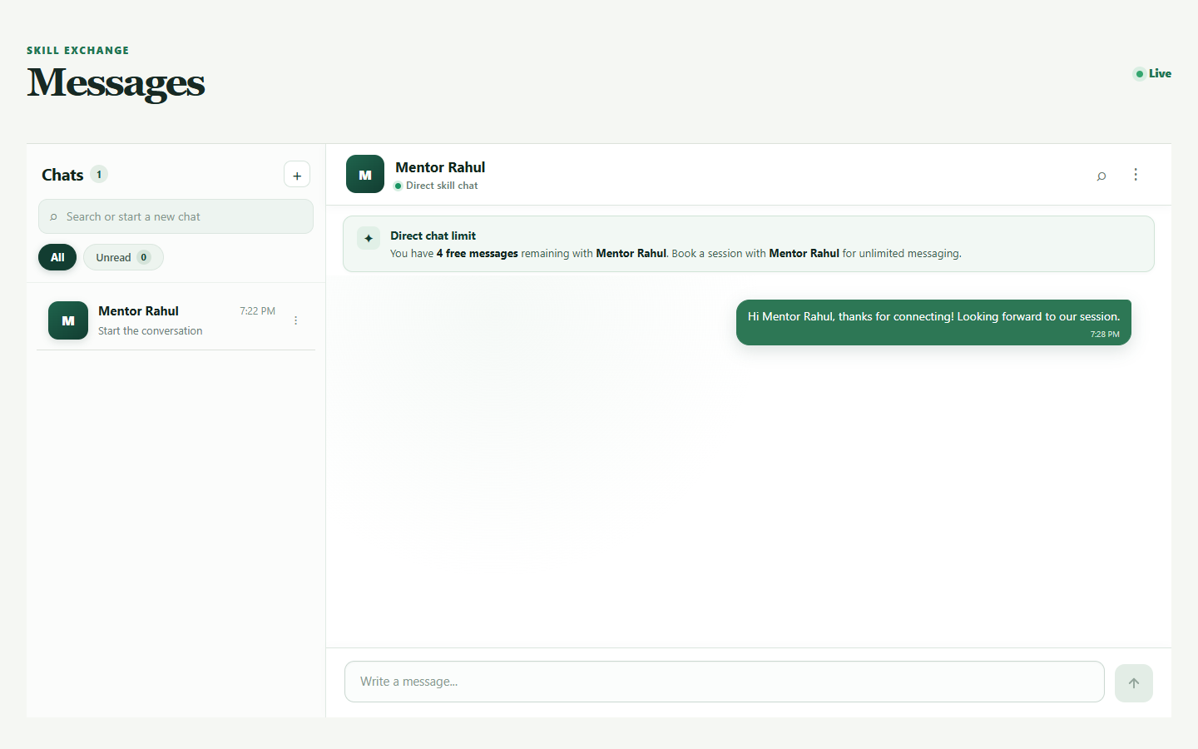
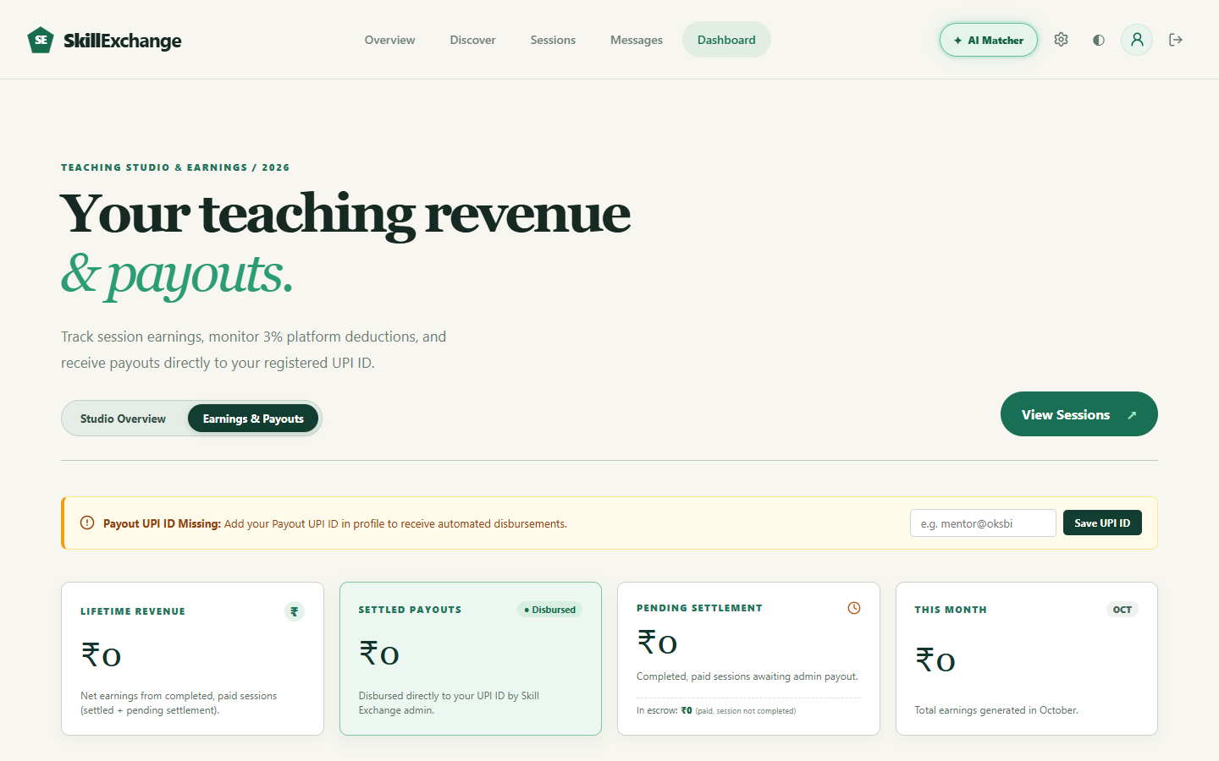
CORE FUNCTIONAL MODULE
Module 04: Real-Time Chat & Wallet / Payment Engine
WebSocket Messaging & Dual-Balance Wallet
• Socket.io Bi-Directional Messaging: Sub-100ms instant message delivery with live connection indicators, typing events, and unread counters.
• Anti-Spam 5-Message Quota: To prevent mentor harassment, free direct chat is strictly capped at 5 messages until a 1-on-1 session is booked; booking unlocks unlimited messaging.
• Dual-Balance Wallet Architecture: Separates spendable 'Top-Up Balance' (for purchasing sessions) from 'Earned Balance' (mentor revenue credited upon session completion).
• Transparent Pricing & 0% Fees: Clear session receipts with 0% platform deductions, 0% convenience fees, and 0% taxes; 100% of agreed fees credit to the mentor.
• Manual Settlement & Payout Tracking: Mentors configure registered UPI IDs to receive disbursed earnings tracked through life-time revenue and pending settlement cards.
Sockets: send_message, receive_message, typing | APIs: GET /api/wallet, POST /api/wallet/topup
Learn together. Share knowledge. Grow together. • Team CosmicCoders (Group 13)
07 / 10
Notes:
Module 4 integrates Real-Time Messaging and the Payment Wallet. Our chat is powered by Socket.io for instantaneous delivery. To stop spam, non-paying users have a 5-message free limit, which converts to unlimited chat once a session is confirmed. Our wallet features a dual-balance system separating top-up funds from earned teaching revenue, with transparent 0% platform fees.

Slide 8
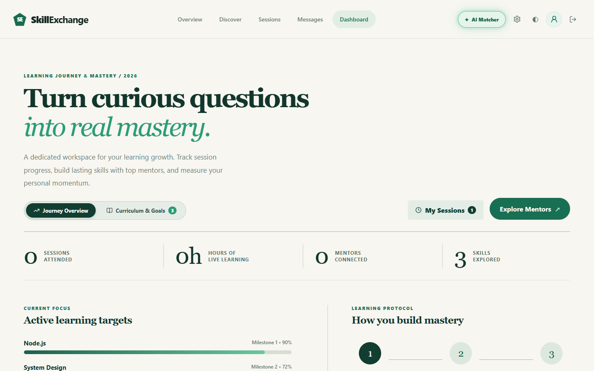
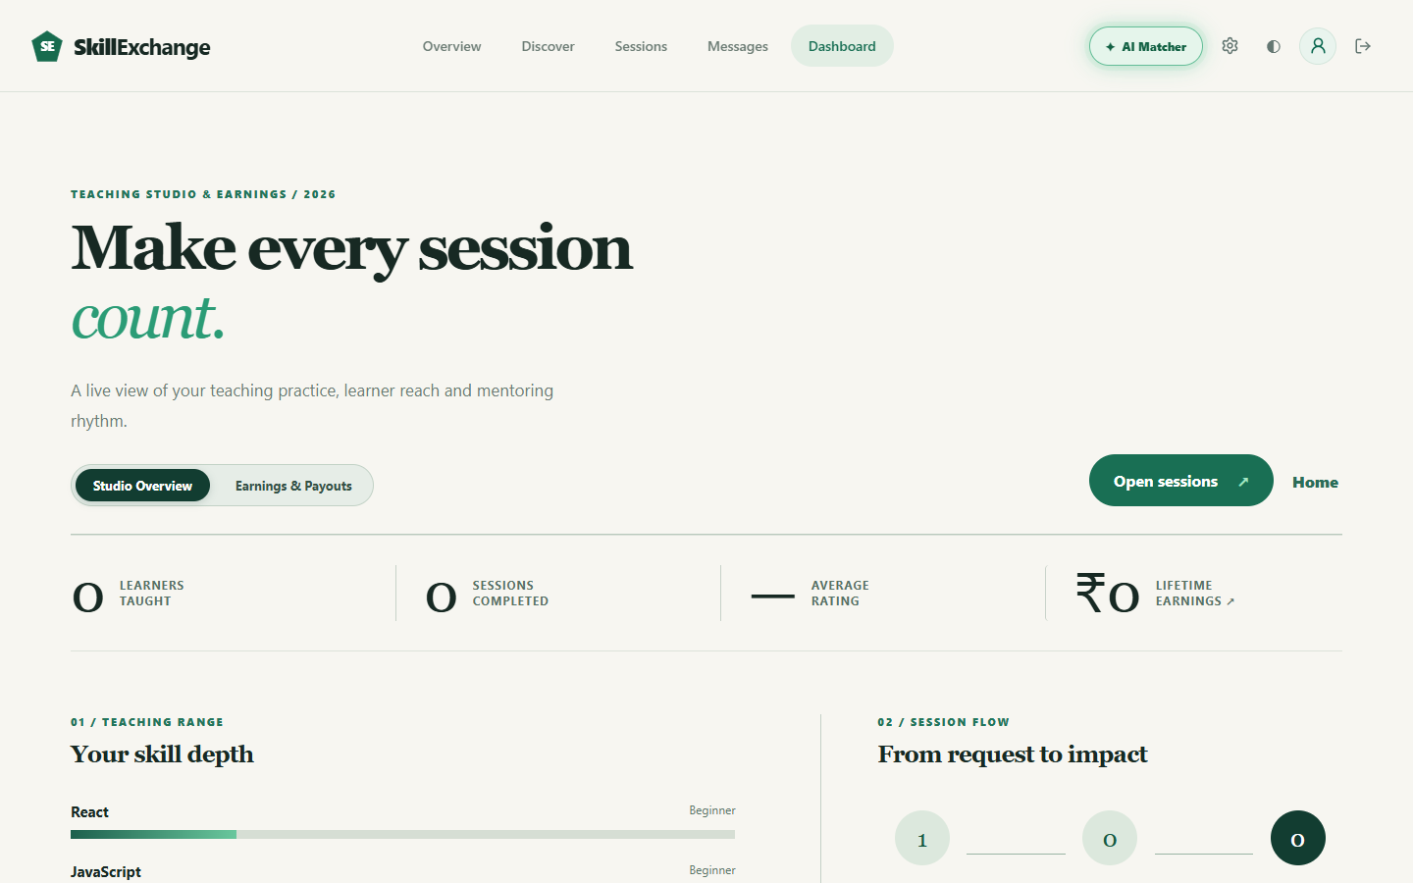
CORE FUNCTIONAL MODULE
Module 05: Role Dashboards, Analytics & Community Trust
Role-Tailored Dashboards & Feedback
• Learner Mastery Workspace: Visualizes learning momentum with key metrics: Sessions Attended, Hours of Live Learning, Mentors Connected, and Skills Explored.
• Milestone Progress Bars: Tracks active curriculum targets (e.g. Node.js 90%, System Design 72%) to keep students motivated toward their academic goals.
• Mentor Teaching Studio: Comprehensive overview of learners taught, sessions completed, average star rating, and granular skill depth across listed technologies.
• Community Star Ratings & Reviews: One-review-per-completed-session policy ensures 100% verified student testimonials and eliminates fake feedback.
• Trust & Reputation Cycle: Positive student reviews boost mentor rankings in the search directory, driving a self-sustaining cycle of quality education.
APIs: GET /api/dashboard/learner, GET /api/dashboard/mentor, POST /api/reviews | Model: ReviewSchema
Learn together. Share knowledge. Grow together. • Team CosmicCoders (Group 13)
08 / 10
Notes:
Module 5 covers Role-Based Dashboards and Reviews. Learners have a dedicated workspace showing session hours and milestone bars. Mentors have a Teaching Studio summarizing learners reached and revenue earned. After each completed session, verified 1-5 star reviews can be submitted, building long-term academic reputation.

Slide 9
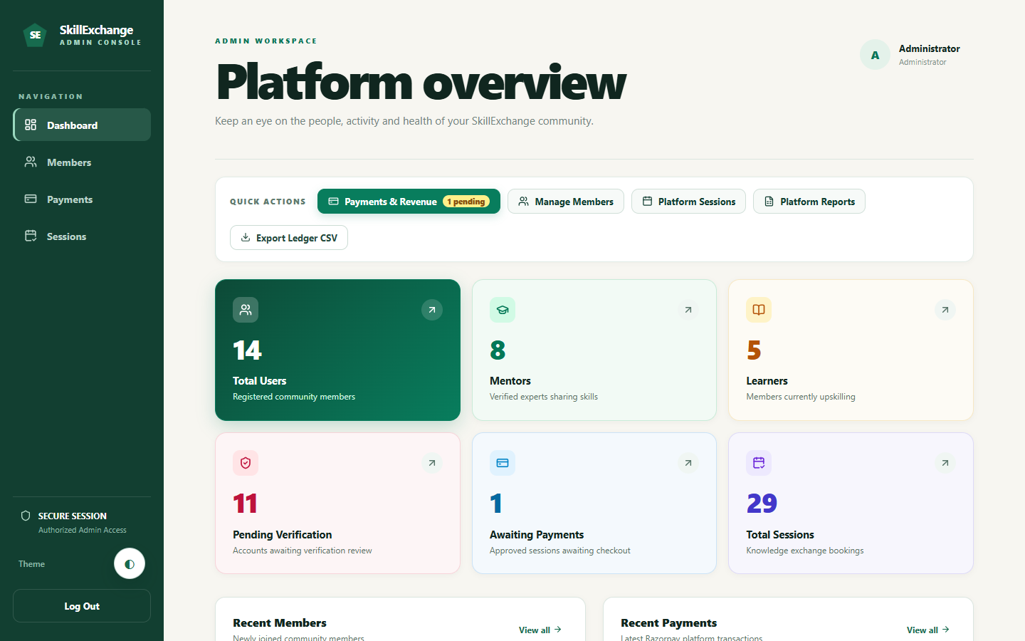
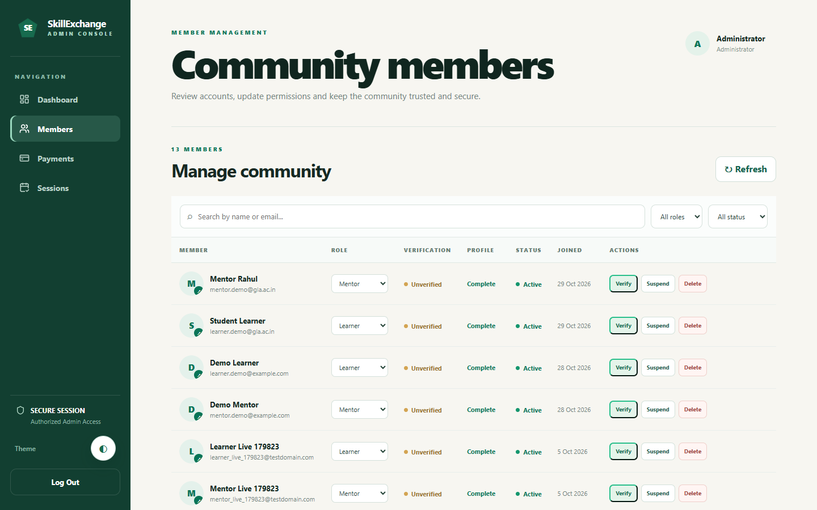
GOVERNANCE & TESTING
Module 06: Admin Governance & System Verification
Platform Oversight & Quality Assurance
• Institutional Overview KPIs: Live executive counters tracking Total Users, Verified Mentors, Active Learners, Pending Verifications, and Total Sessions.
• Member Moderation Controls: Administrators can review profiles, approve unverified accounts, suspend bad actors, or delete fraudulent accounts.
• Auditable Activity Logs: All critical actions (role updates, booking cancellations, financial settlements) are stored in immutable MongoDB activity logs.
• Comprehensive Testing Suite: End-to-end user flows validated with automated Playwright browser tests; backend endpoints verified via Postman test collections.
• Responsive & Dark Mode UI: Seamless CSS theming tested across light/dark contrast standards and fully responsive down to 390px mobile viewports.
APIs: GET /api/admin/stats, PUT /api/admin/users/:id/status | Security: AdminRBACGuard
Learn together. Share knowledge. Grow together. • Team CosmicCoders (Group 13)
09 / 10
Notes:
Module 6 covers Admin Governance and System Testing. Administrators have high-level oversight through live KPIs and can verify, suspend, or moderate community accounts. The entire platform has been thoroughly verified using Playwright automated browser tests and API validation suites to guarantee zero double-booking and resilient connection handling.

Slide 10
SkillExchange
TEAM COSMICCODERS • GROUP 13
Thank You!
Questions & Technical Discussion
• Working Full-Stack Solution: Engineered and deployed a functional MERN platform solving campus peer tutoring friction.
• Zero Scheduling Friction: Integrated Socket.io chat and deterministic 5-stage calendar scheduling with 4-hour auto-expiration.
• In-Browser WebRTC Calling: Future enhancement: Native peer-to-peer audio/video calling without external Google Meet links.
• Automated Payouts & Alerts: Future roadmap: Razorpay Route automated disbursements and browser push reminders 15 mins prior to sessions.
PROJECT REPOSITORY & DEMO
GitHub Source Code:
github.com/CosmicCoder06/Skill-Exchange
Live Cloud Deployment:
skill-exchange-one-eta.vercel.app
GLA University, Mathura • B.Tech CSE Capstone Project
Internship Project at Codroid Hub Pvt. Ltd. (October 2026)
Learn together. Share knowledge. Grow together.
10
Notes:
In conclusion, SkillExchange delivers an accessible, robust MERN solution for student mentorship. We have solved coordination ghosting and provided transparency in scheduling and peer honorariums. Our live demo is hosted on Vercel and the code is open on GitHub. We are now open for questions and feedback.

