Slide 1
LegalSangam
Team BitBenders:
Eklavya Verma
Suryakant Dwivedi
Prashant Gupta
Prakhar Kumar
Project Title:
Incentives-Based Design for Onboarding Legal Service Providers on e-Marketplaces for Extending Legal Services to Citizens in India

Slide 2
INTRODUCTION
Context
E-marketplaces for legal services are transforming access to legal professionals.
Problem Statement
Citizens face challenges in finding reliable legal assistance, and legal professionals struggle with visibility and client acquisition.
Objective
Develop an incentive-based system that attracts legal professionals while ensuring accessibility, transparency, and efficiency for users.

Slide 3




PROBLEM STATEMENT
“Legal help shouldn't be a maze; it should be a clear path to resolution”
Cost & Clarity
Professional Reach
Digital Divide
Access Barriers
Offering affordable legal options, with transparent pricing and clear explanations of legal processes.
Creating efficient connections between clients and legal professionals, expanding the reach of legal services.
Bridging the digital gap through accessible online resources and support for those with limited digital literacy.
Ensuring trustworthy legal help is available for all, regardless of income or location, by removing barriers to access.

Slide 4


PROPOSED SOLUTION
E-MARKETPLACE INTEGRATION
ONE-TO-ONE MEETINGS
ASKCOUNSEL CHATBOT
Enables better case understanding before assigning advocates based on location, ratings, and pricing.
AI-powered legal chatbot for preliminary legal guidance.
A platform where advocates, mediators, notaries, and document writers can offer legal services.

Slide 5
INCENTIVE MODEL FOR LEGAL PROFESSIONALS
ONBOARDING INCENTIVES
LONG-TERM ENGAGEMENT INCENTIVES
Sign-up bonus and free listing for early adopters.
Referral rewards for bringing in other legal professionals.
Discounted platform fees for initial months.
Performance-based ranking system for higher visibility.
Exclusive tools for top-rated professionals.
Continuous professional development through training programs.

Slide 6



INCENTIVE MODEL FOR CITIZENS
Discounted Initial Consultations to attract users
Subscription Models for affordable access to legal services
Loyalty Programs & Gamification to encourage referrals and engagement

Slide 7
FEATURES OF THE PLATFORM
1
SERVICE LISTINGS
2
SECURE PAYMENT GATEWAY
Detailed advocate profiles with ratings and reviews.
Transparent transaction processing.
3
BOOKING SYSTEM
Search and filter by location, specialty, and cost.
4
AI-POWERED CHATBOT
VIRTUAL CONSULTATION
Provides instant legal guidance.
(AskCounsel)
5
Video/audio consultations for remote accessibility.

Slide 8
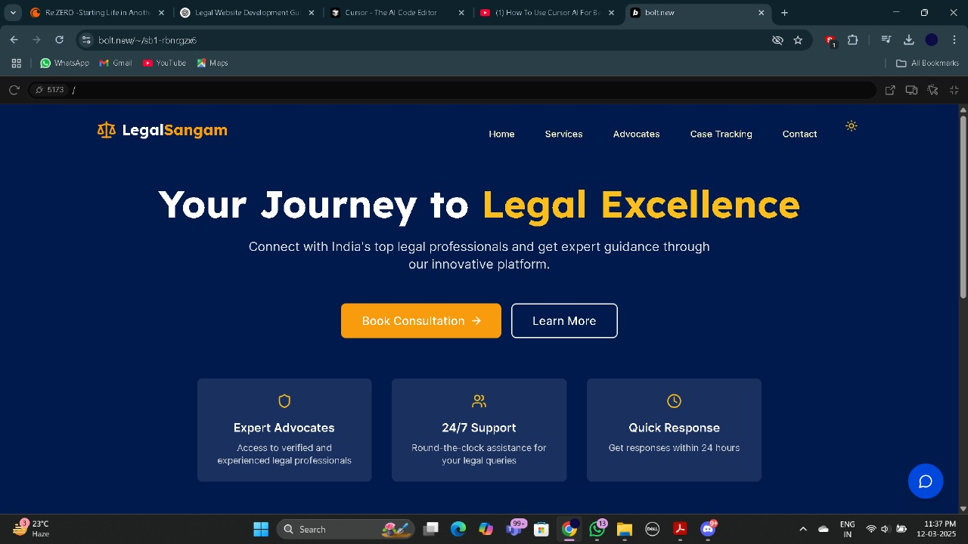
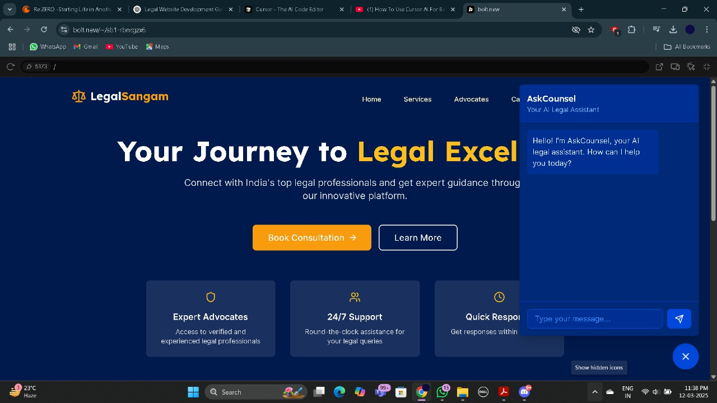
WHAT WOULD OUR UI/UX LOOK LIKE?

Slide 9
CONCLUSION
SUMMARY
FUTURE-SCOPE
This platform connects lawyers and citizens through organized, transparent legal access. Incentives drive lawyer participation, ensuring expertise. Features like meetings, AI chatbots, and ratings build trust. Ultimately, this marketplace aims to revolutionize law by increasing affordability and fostering a competitive, high-quality legal environment.
Expansion into document review, property legal advice, and AI-driven legal assistance.

Slide 10




THANKS!
Do you have any questions?
suryakantdwivedi8493@gmail.com
+91 956-9816-443

