Slide 1

Identify cancer driver genes through shared Mendelian disease pathogenic variants and cancer somatic mutations
Meng Ma, Ph.D.

Slide 2
Identify cancer driver genes through shared Mendelian disease pathogenic variants and cancer somatic mutations
Along with wide application of deep sequencing in cancer research field, more and more tumor sequencing databases were released.
Catalogue Of Somatic Mutation In Cancer (COSMIC)
The world’s largest and most comprehensive resource for exploring the impact of somatic mutations in human cancer
Genome or exome sequencing for over 28,000 tumor samples covering more than 35 tumor types
~2 million somatic mutations identified
How to interpret tumor sequencing data and identify cancer driver remains a big challenge.

Slide 3
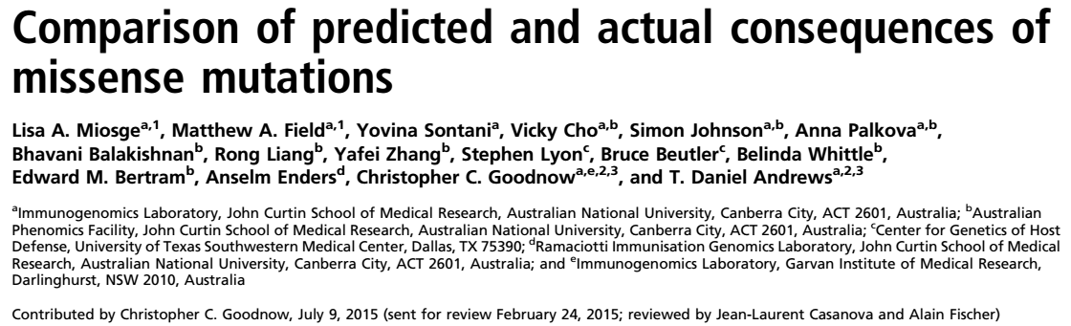
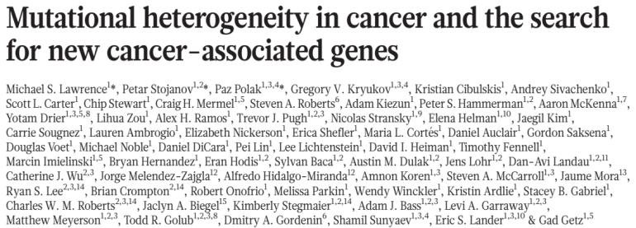
Identify cancer driver genes through shared Mendelian disease pathogenic variants and cancer somatic mutations
Cancer driver identification
Many computational methods have been developed to predict the functional consequences of mutations, like SIFT, CADD, Panther, Condel et al.
The utility of many computational methods is limited
Most commonly used approach is to identify significantly mutated genes in a cohort study
Requires a large number of samples

Slide 4
Identify cancer driver genes through shared Mendelian disease pathogenic variants and cancer somatic mutations
Cancer driver identification
Cancer genes identified through Mendelian disease study
The first tumor suppressor RB1 was discovered by studying the familial form of retinoblastoma
TP53 in Li-Fraumeni syndrome
VHL in Von Hippel-Lindau syndrome
MLH1, MSH2, MSH6 in Lynch syndrome
TSC1, TSC2 in Tuberous sclerosis
ATM in ataxia-telangiectasia
Mendelian disease pathogenic variants can be helpful for identifying cancer genes?

Slide 5
Identify cancer driver genes through shared Mendelian disease pathogenic variants and cancer somatic mutations
Mendelian disease pathogenic variants
Germline pathogenic variants impact functions of key proteins involved in the developmental process and consequently cause inheritable diseases.
Hypothesis: If the same germline pathogenic variants occur as somatic mutations in cancer, these mutations would also alter protein functions and may play a role in tumor initiation and progression.

Slide 6
Identify cancer driver genes through shared Mendelian disease pathogenic variants and cancer somatic mutations
Oncogene and Tumor suppressor
Oncogenes are often mutated recurrently at certain positions (referred as hotspots)
Tumor suppressors usually are mutated at many positions across the gene sequences.

Slide 7
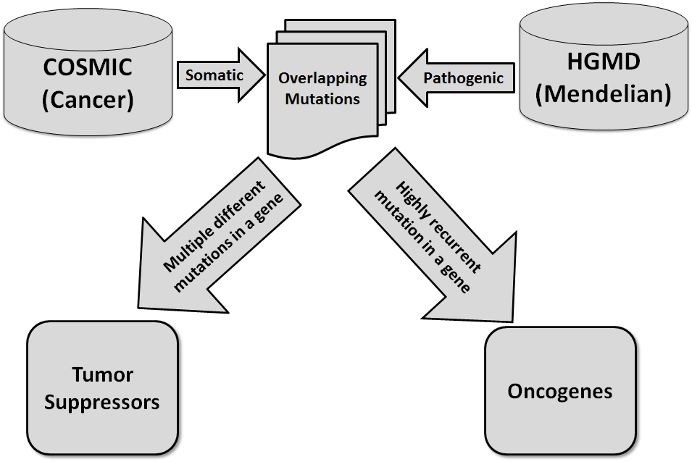
Identify cancer driver genes through shared Mendelian disease pathogenic variants and cancer somatic mutations

Slide 8
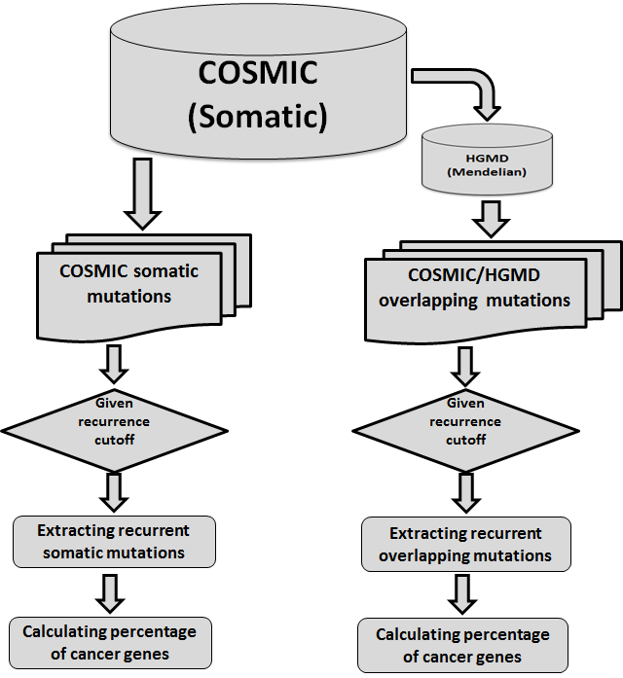
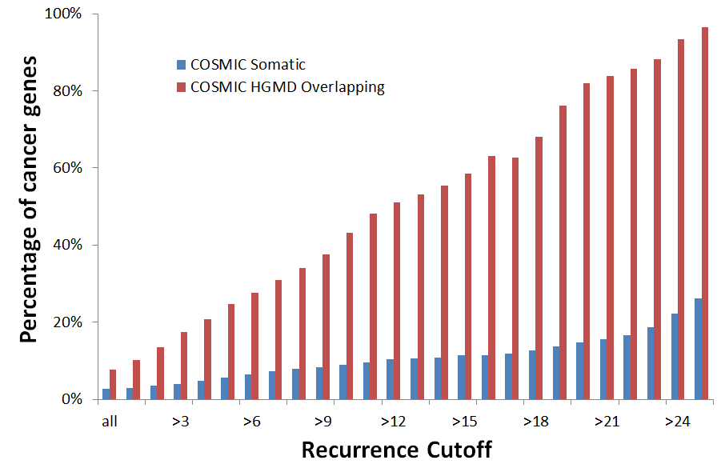
Identify cancer driver genes through shared Mendelian disease pathogenic variants and cancer somatic mutations
COSMIC/HGMD overlapping mutations are more likely to be in cancer genes than common somatic mutations.
A somatic mutation is more likely to be in a cancer gene as its recurrence increases.
The probability that the mutation-harboring genes are cancer-related increases if there are COSMIC/HGMD overlapping variants in this gene.

Slide 9
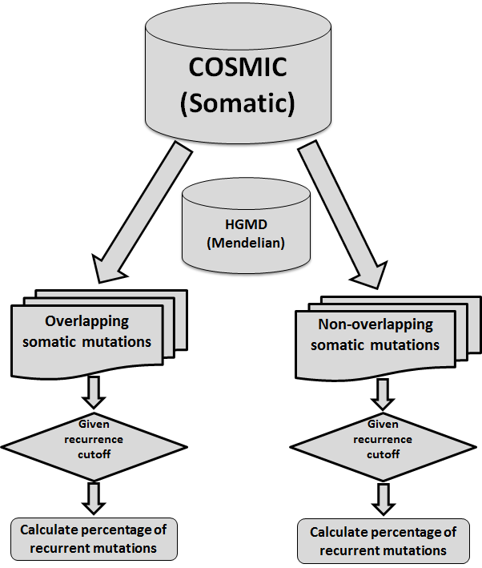
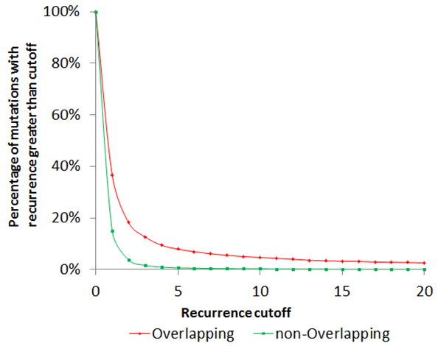
Identify cancer driver genes through shared Mendelian disease pathogenic variants and cancer somatic mutations
COSMIC/HGMD overlapping mutations are more recurrent than non-overlapping somatic mutations.
Mean of recurrence in Overlapping group is 8.03
Mean of recurrence in non-Overlapping group is 1.33
T-test, one-tail, pvalue = 1.46E-5
COSMIC/HGMD overlapping mutations are more likely to be oncogenic.

Slide 10
Identify cancer driver genes through shared Mendelian disease pathogenic variants and cancer somatic mutations
Rank genes according to the recurrence of the most recurrent COSMIC/HGMD overlapping mutation in each gene
46 genes where the most recurrent mutation with recurrence > 15
41% (19/46) of genes are annotated as oncogene or tumor suppressor.
Among 19 annotated genes, 53% (10/19) are oncogenes. 47% are tumor suppressor.
Mutational hotspots (typically dominant negative mutations) can also be observed in some tumor suppressors such as TP53.
The unannotated genes provide possible candidate oncogenes due to the presence of mutational hotspots.
Gene | Mutation | Recurrence | Vogelstein Oncogene/TSG |  | Gene | Mutation | Recurrence | Vogelstein Oncogene/TSG
KRAS | p.G12D | 524 | Oncogene |  | TMEM106B | p.T185S | 19
IDH1 | p.R132H | 293 | Oncogene |  | TAS2R43 | p.H212R | 19
PIK3CA | p.H1047R | 274 | Oncogene |  | ROCK2 | p.T431N | 18
TP53 | p.R175H | 226 | TSG |  | PRNP | p.M129V | 18
APC | p.R1450* | 66 | TSG |  | GZMB | p.P94A | 18
PTEN | p.R130Q | 42 | TSG |  | PON2 | p.S311C | 17
CDKN2A | p.R80* | 40 | TSG |  | KRT14 | p.A94T | 17
CHEK2 | p.Y390C | 37 |  |  | HNF1A | p.I27L | 17 | TSG
SMAD4 | p.R361H | 31 | TSG |  | FGFR2 | p.S252W | 17 | Oncogene
ABCD1 | p.S606P | 29 |  |  | NRAS | p.G13D | 16 | Oncogene
KMT2C | p.T316S | 26 |  |  | IL1A | p.A114S | 16
OPRD1 | p.C27F | 25 |  |  | HLA-DPB1 | p.M105V | 16
PRDM9 | p.T681S | 24 |  |  | EME1 | p.I350T | 16
IDH2 | p.R140Q | 24 | Oncogene |  | ALK | p.R1275Q | 16 | Oncogene
ARID1A | p.R1989* | 24 | TSG |  | ABCA1 | p.R219K | 16
AR | p.Q58L | 24 | Oncogene |  | POU5F1B | p.E238Q | 15
UGT2A1 | p.R75K | 23 |  |  | LTF | p.K47R | 15
PRSS1 | p.K170E | 23 |  |  | IFIH1 | p.A946T | 15
UGT1A7 | p.N129K | 22 |  |  | HLA-A | p.L180* | 15
USH2A | p.C3416G | 21 |  |  | GRIN3B | p.T577M | 15
TGFB1 | p.P10L | 20 |  |  | FGFR3 | p.Y373C | 15 | Oncogene
RAD21L1 | p.C90R | 20 |  |  | BRCA2 | p.N372H | 15 | TSG
HRG | p.P204S | 20 | Oncogene |  | ATM | p.R337C | 15 | TSG

Slide 11


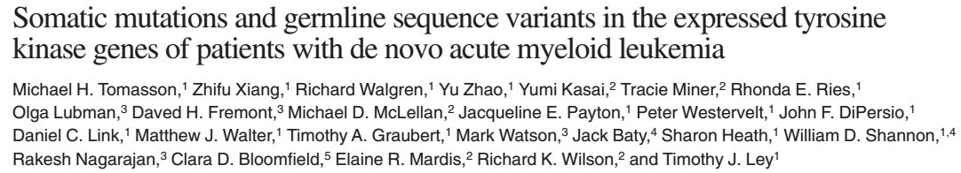
Identify cancer driver genes through shared Mendelian disease pathogenic variants and cancer somatic mutations
Rank genes according to the most recurrent COSMIC/HGMD overlapping mutation in each gene
Three unannotated protein kinase genes that had a recurrent somatic mutation detected in more than 10 but less than 15 tumor samples
It has been shown that these mutations are activating and/or oncogenic, strongly suggesting RAF1, FGFR4 and TYK2 are novel oncogenes.
Gene | Mutation | Recurrence | Vogelstein Oncogene/TSG
RAF1 | p.S257L | 13
FGFR4 | p.G388R | 12
TYK2 | p.V362F | 12
COSMIC/HGMD overlapping mutations can be helpful for oncogene identification

Slide 12
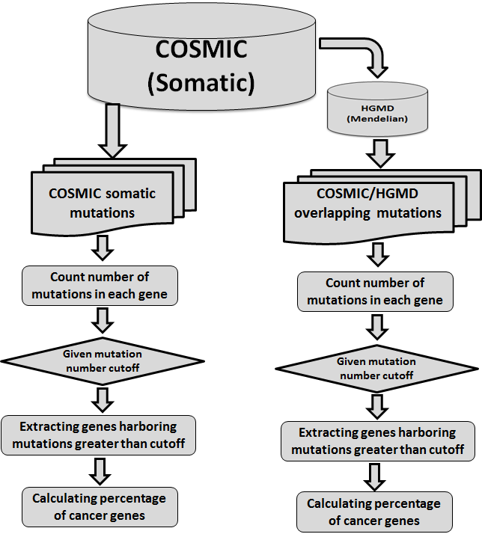
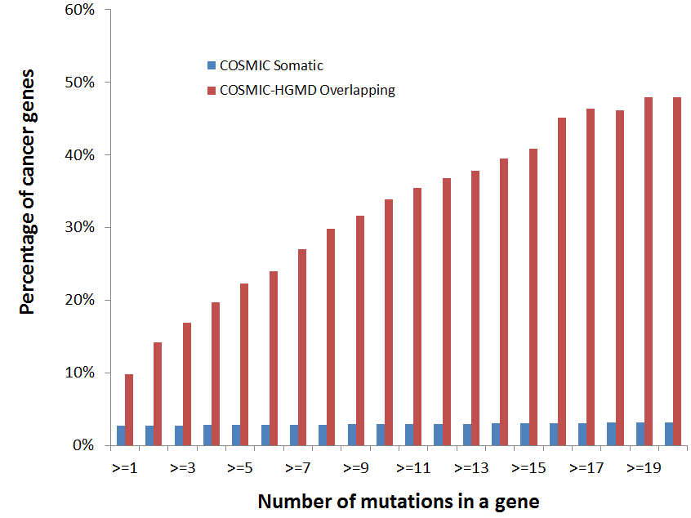
Identify cancer driver genes through shared Mendelian disease pathogenic variants and cancer somatic mutations
More COSMIC/HGMD overlapping mutations in a gene, more possible for this gene as cancer gene (tumor suppressor)
Common somatic mutations do little contribution for tumor suppressor identification.
The number of distinct overlapping COSMIC/HGMD mutations in a given gene increases, the percentage of cancer genes increases as well

Slide 13
Identify cancer driver genes through shared Mendelian disease pathogenic variants and cancer somatic mutations
Emerging evidences support the predicted tumor suppressors.
Genes harboring over 20 COSMIC/HGMD overlapping mutations
Gene | #Mutations | Cancer Gene Census | Vogelstein Oncogene/TSG |  | Gene | #Mutations | Cancer Gene Census | Vogelstein Oncogene/TSG
TP53 | 198 | Yes | TSG |  | F9 | 33
APC | 192 | Yes | TSG |  | DMD | 33
VHL | 173 | Yes | TSG |  | PKHD1 | 31
NF1 | 148 | Yes | TSG |  | SMAD4 | 31 | Yes | TSG
PTEN | 145 | Yes | TSG |  | PTPN11 | 31 | Yes | Oncogene
RB1 | 91 | Yes | TSG |  | RYR2 | 30
SCN5A | 67 |  |  |  | COL3A1 | 29
CDKN2A | 66 | Yes | TSG |  | MLH1 | 29 | Yes | TSG
NF2 | 65 | Yes | TSG |  | BRCA1 | 29 | Yes | TSG
KMT2D | 56 | Yes |  |  | MSH2 | 28 | Yes | TSG
F8 | 56 |  |  |  | VWF | 27
MYH7 | 54 |  |  |  | TSC2 | 27 | Yes
SCN1A | 52 |  |  |  | STK11 | 27 | Yes | TSG
USH2A | 50 |  |  |  | PTCH1 | 27 | Yes | TSG
ATM | 50 | Yes | TSG |  | ATP7B | 25
MEN1 | 49 | Yes | TSG |  | WT1 | 24 | Yes | TSG
CFTR | 48 |  |  |  | TGFBR2 | 22
FBN1 | 43 |  |  |  | PAH | 22
HNF1A | 39 | Yes | TSG |  | IRF6 | 22
RET | 39 | Yes | Oncogene |  | COL7A1 | 22
ABCA4 | 37 |  |  |  | CASR | 22
RYR1 | 36 |  |  |  | APOB | 22
BRCA2 | 36 | Yes | TSG |  | GCK | 21
LDLR | 35 |  |  |  | MYBPC3 | 20
About half of genes (21/48 )are TSG or oncogene.
Over 90% (19/21) of annotated genes are TSG.

Slide 14
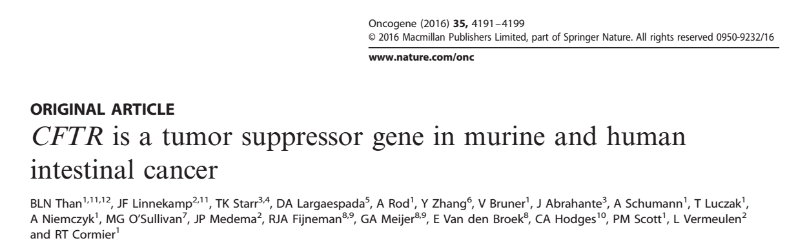
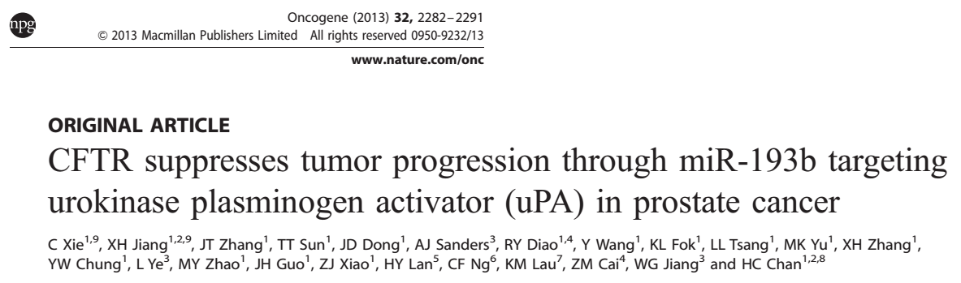
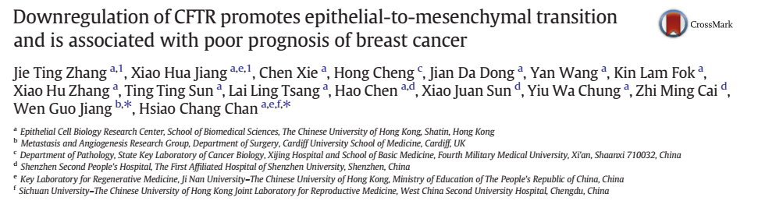
Identify cancer driver genes through shared Mendelian disease pathogenic variants and cancer somatic mutations
Emerging evidences support the predicted tumor suppressors.
Genes harboring over 20 COSMIC-HGMD overlapping mutations
Gene | #Mutations | Cancer Gene Census | Vogelstein Oncogene/TSG |  | Gene | #Mutations | Cancer Gene Census | Vogelstein Oncogene/TSG
TP53 | 198 | Yes | TSG |  | F9 | 33
APC | 192 | Yes | TSG |  | DMD | 33
VHL | 173 | Yes | TSG |  | PKHD1 | 31
NF1 | 148 | Yes | TSG |  | SMAD4 | 31 | Yes | TSG
PTEN | 145 | Yes | TSG |  | PTPN11 | 31 | Yes | Oncogene
RB1 | 91 | Yes | TSG |  | RYR2 | 30
SCN5A | 67 |  |  |  | COL3A1 | 29
CDKN2A | 66 | Yes | TSG |  | MLH1 | 29 | Yes | TSG
NF2 | 65 | Yes | TSG |  | BRCA1 | 29 | Yes | TSG
KMT2D | 56 | Yes |  |  | MSH2 | 28 | Yes | TSG
F8 | 56 |  |  |  | VWF | 27
MYH7 | 54 |  |  |  | TSC2 | 27 | Yes
SCN1A | 52 |  |  |  | STK11 | 27 | Yes | TSG
USH2A | 50 |  |  |  | PTCH1 | 27 | Yes | TSG
ATM | 50 | Yes | TSG |  | ATP7B | 25
MEN1 | 49 | Yes | TSG |  | WT1 | 24 | Yes | TSG
CFTR | 48 |  |  |  | TGFBR2 | 22
FBN1 | 43 |  |  |  | PAH | 22
HNF1A | 39 | Yes | TSG |  | IRF6 | 22
RET | 39 | Yes | Oncogene |  | COL7A1 | 22
ABCA4 | 37 |  |  |  | CASR | 22
RYR1 | 36 |  |  |  | APOB | 22
BRCA2 | 36 | Yes | TSG |  | GCK | 21
LDLR | 35 |  |  |  | MYBPC3 | 20
Some unannotated genes, like SCN1A, CFTR, RYR1, RYR2, encode ion channels.
Many published studies suggest at least some ion channels are involved in promoting malignancy.

Slide 15
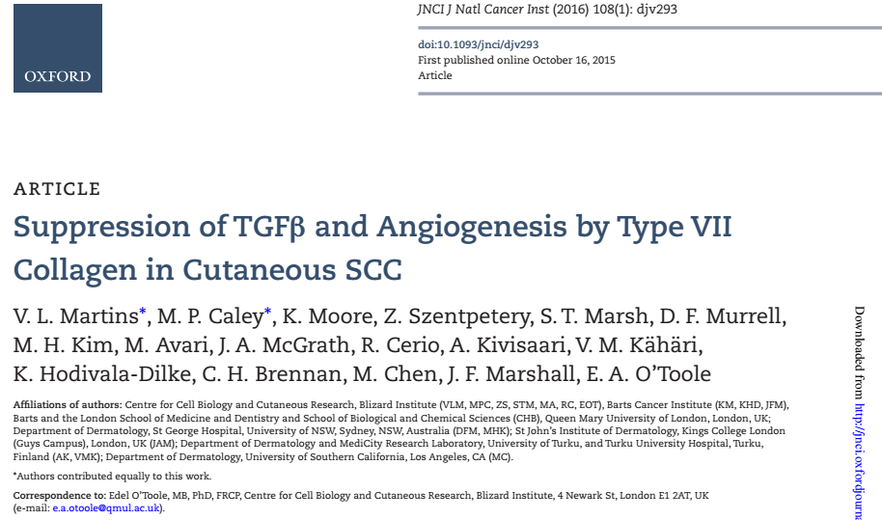
Identify cancer driver genes through shared Mendelian disease pathogenic variants and cancer somatic mutations
Emerging evidences support the predicted tumor suppressors.
Genes harboring over 20 COSMIC-HGMD overlapping mutations
Gene | #Mutations | Cancer Gene Census | Vogelstein Oncogene/TSG |  | Gene | #Mutations | Cancer Gene Census | Vogelstein Oncogene/TSG
TP53 | 198 | Yes | TSG |  | F9 | 33
APC | 192 | Yes | TSG |  | DMD | 33
VHL | 173 | Yes | TSG |  | PKHD1 | 31
NF1 | 148 | Yes | TSG |  | SMAD4 | 31 | Yes | TSG
PTEN | 145 | Yes | TSG |  | PTPN11 | 31 | Yes | Oncogene
RB1 | 91 | Yes | TSG |  | RYR2 | 30
SCN5A | 67 |  |  |  | COL3A1 | 29
CDKN2A | 66 | Yes | TSG |  | MLH1 | 29 | Yes | TSG
NF2 | 65 | Yes | TSG |  | BRCA1 | 29 | Yes | TSG
KMT2D | 56 | Yes |  |  | MSH2 | 28 | Yes | TSG
F8 | 56 |  |  |  | VWF | 27
MYH7 | 54 |  |  |  | TSC2 | 27 | Yes
SCN1A | 52 |  |  |  | STK11 | 27 | Yes | TSG
USH2A | 50 |  |  |  | PTCH1 | 27 | Yes | TSG
ATM | 50 | Yes | TSG |  | ATP7B | 25
MEN1 | 49 | Yes | TSG |  | WT1 | 24 | Yes | TSG
CFTR | 48 |  |  |  | TGFBR2 | 22
FBN1 | 43 |  |  |  | PAH | 22
HNF1A | 39 | Yes | TSG |  | IRF6 | 22
RET | 39 | Yes | Oncogene |  | COL7A1 | 22
ABCA4 | 37 |  |  |  | CASR | 22
RYR1 | 36 |  |  |  | APOB | 22
BRCA2 | 36 | Yes | TSG |  | GCK | 21
LDLR | 35 |  |  |  | MYBPC3 | 20
Multiple collagen family genes with significant overlap between COSMIC and HGMD mutations.
A causal relationship between loss of collagens and tumor progression, suggesting collagen family genes as tumor suppressor.
COL1A2 | 19
COL4A5 | 18
COL2A1 | 14
COL6A3 | 13
COL1A1 | 13
COL4A4 | 11

Slide 16
Identify cancer driver genes through shared Mendelian disease pathogenic variants and cancer somatic mutations
Emerging evidences support the predicted tumor suppressors.
Genes harboring over 20 COSMIC-HGMD overlapping mutations
Gene | #Mutations | Cancer Gene Census | Vogelstein Oncogene/TSG |  | Gene | #Mutations | Cancer Gene Census | Vogelstein Oncogene/TSG
TP53 | 198 | Yes | TSG |  | F9 | 33
APC | 192 | Yes | TSG |  | DMD | 33
VHL | 173 | Yes | TSG |  | PKHD1 | 31
NF1 | 148 | Yes | TSG |  | SMAD4 | 31 | Yes | TSG
PTEN | 145 | Yes | TSG |  | PTPN11 | 31 | Yes | Oncogene
RB1 | 91 | Yes | TSG |  | RYR2 | 30
SCN5A | 67 |  |  |  | COL3A1 | 29
CDKN2A | 66 | Yes | TSG |  | MLH1 | 29 | Yes | TSG
NF2 | 65 | Yes | TSG |  | BRCA1 | 29 | Yes | TSG
KMT2D | 56 | Yes |  |  | MSH2 | 28 | Yes | TSG
F8 | 56 |  |  |  | VWF | 27
MYH7 | 54 |  |  |  | TSC2 | 27 | Yes
SCN1A | 52 |  |  |  | STK11 | 27 | Yes | TSG
USH2A | 50 |  |  |  | PTCH1 | 27 | Yes | TSG
ATM | 50 | Yes | TSG |  | ATP7B | 25
MEN1 | 49 | Yes | TSG |  | WT1 | 24 | Yes | TSG
CFTR | 48 |  |  |  | TGFBR2 | 22
FBN1 | 43 |  |  |  | PAH | 22
HNF1A | 39 | Yes | TSG |  | IRF6 | 22
RET | 39 | Yes | Oncogene |  | COL7A1 | 22
ABCA4 | 37 |  |  |  | CASR | 22
RYR1 | 36 |  |  |  | APOB | 22
BRCA2 | 36 | Yes | TSG |  | GCK | 21
LDLR | 35 |  |  |  | MYBPC3 | 20
FBN1 and TGFBR2 are associated with Marfan syndrome, and the two genes are mutated frequently in lung squamous cell carcinomas with a mutation frequency 10% in the TCGA cohort.

Slide 17
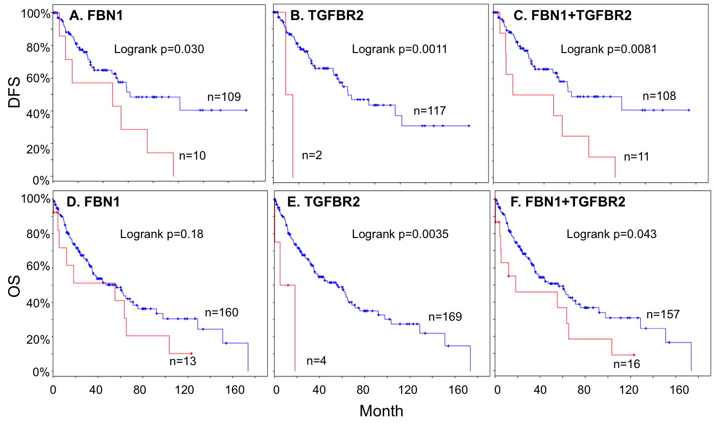
Identify cancer driver genes through shared Mendelian disease pathogenic variants and cancer somatic mutations
Emerging evidences support the predicted tumor suppressors.
Disease progression free survival
Overall survival
FBN1 and TGFBR2 mutations are associated with poor survival, suggesting their role as tumor suppressor.
FBN1 mutation-harboring lung SCCs had poor disease progression free survival (A) and poor overall survival (D)
TGFBR2 mutation-harboring lung SCCs had poor disease progression free survival (B) and poor overall survival (E)
The combined FBN1 and TGFBR2 mutations are associated with both poor DFS and OS (C, F)
COSMIC/HGMD overlapping mutations can be helpful for tumor suppressor identification

Slide 18
Identify cancer driver genes through shared Mendelian disease pathogenic variants and cancer somatic mutations
Summary
Applied Mendelian disease pathogenic mutations to predict novel cancer genes (oncogene and tumor suppressor)
Rediscovered many known cancer genes.
Protein kinase gene RAF1, FGFR4, TYK2 may represent novel oncogenes.
Ion channels, collagens and Marfan syndrome associated genes may represent new classes of tumor suppressors.

